Slide 1
Introduction

Slide 2
Textbook
A Data Centric Introduction to Computing
  Kathi Fisler, Shriram Krishnamurthi, Benjamin S. Lerner, Joe Gibbs Politz
  Freely available at: http://dcic-world.org
CMPU 101: Problem Solving and Abstraction

Slide 3
What is Computer Science?
According to Wikipedia (so it must be true!) it is…
The study of computation, i.e., using computers, algorithms and data-structures to solve computational problems.
Do we know what these terms mean?

Slide 4
What is Computer Science?
According to Wikipedia (so it must be true!) it is…
The study of computation, i.e., using computers, algorithms and data-structures to solve computational problems.
Do we know what these terms mean?
  Algorithm: A step-by-step procedure for solving a problem or performing a task.
  Data-Structure: A collection of data organized to facilitate solution of a computational problem
  What about computation?

Slide 5
Procedure for computationally solving a problem
Define the problem:
  What data do we have? (our input)
  What data or end result do we want? (our output)
  What is the relationship between the input and output?
  This last question leads us to step 2…
Design an algorithm (and a runnable program) that…
  Creates a way to structure the data and
  Manipulates the data structure to get the end result we want.

Slide 6
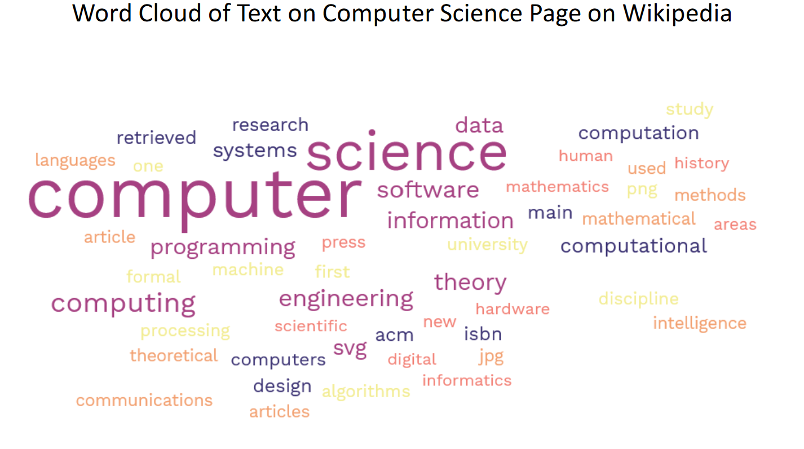
Let’s see an example…

Slide 7
Our Example
Define the problem:
  We have the text of the computer science Wikipedia page
    i.e. our input
  We want a luxurious word cloud picture of the most used terms
    i.e. our output
  We want the font size to represent the relative frequency of the words
    i.e. relationship between I/O

Slide 8
Our Example, step 2
Design an algorithm (and a runnable program) to…
  Create a table of the (important) words & also includes the number of occurrences of each word and
  Displays each word in the table at a random position with a font size proportional to number of occurrences.

Slide 9
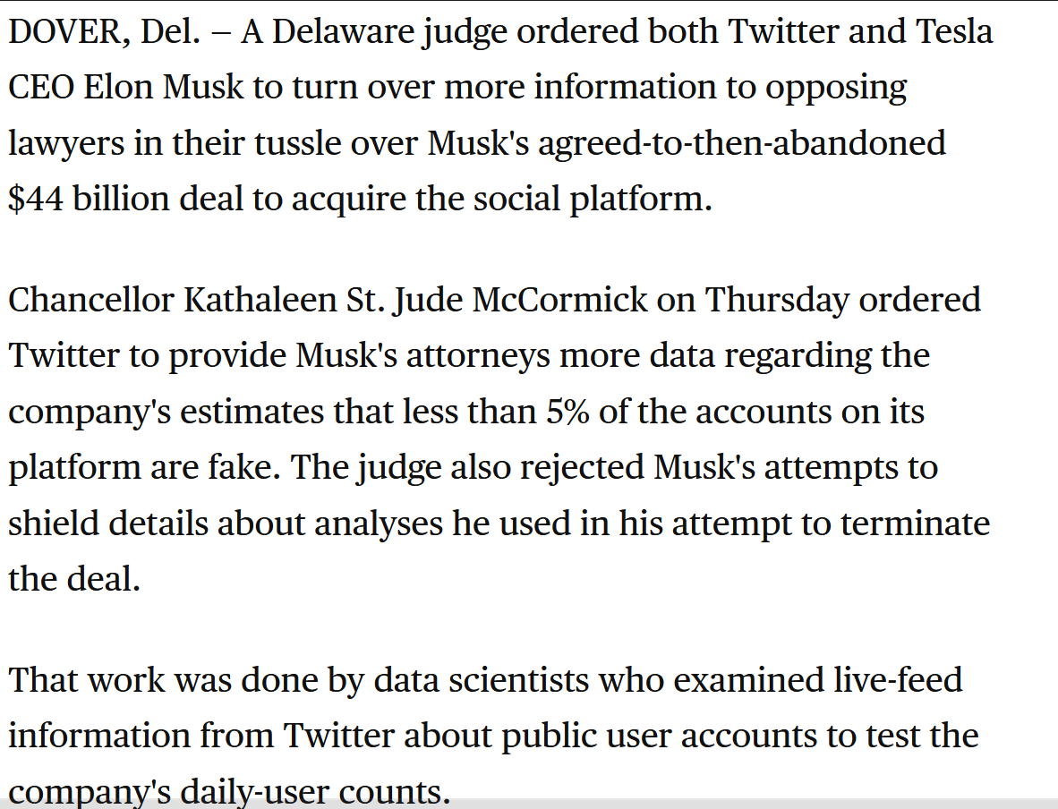
Let’s try one together!
Reference:
https://www.cbsnews.com/sanfrancisco/news/elon-musk-twitter-trial-judge-orders-both-sides-turn-over-more-documents/

Slide 10
Let’s try one together, ripped from the headlines!
Reference:
https://www.cbsnews.com/sanfrancisco/news/elon-musk-twitter-trial-judge-orders-both-sides-turn-over-more-documents/
output?
input?

Slide 11
More Computer Science Terms
Computability
  What class of problems can even be solved by a computer?
  What class of problems can NOT be solved by a computer?
  Example: The Halting Problem… If we supply data to a program will the program eventually stop or run forever? Can we write a program to solve this?

Slide 12
More Computer Science Terms
Computability
  What class of problems can even be solved by a computer?
  What class of problems can NOT be solved by a computer?
  Example: The Halting Problem… If we supply data to a program will the program eventually stop or run forever? Can we write a program to solve?
  We cannot solve this problem with a program for every combination of data & program
X

Slide 13
More Computer Science Terms
Complexity
  How does program runtime grow as problem sets grow? Proportionally? Asymptotically? Etc.
  What kinds of problems are intractable (hard)?
    Example: The “traveling salesman problem… Given some number of cities, can we find the optimal path (i.e. shortest distance travelled) of cities to visit?

Slide 14
More Computer Science Terms
Complexity
  How does program runtime grow as problem sets grow? Proportionally? Asymptotically? Etc.
  What kinds of problems are intractable (hard)?
    Example: The “traveling salesman problem… Given some number of cities, can we find the optimal path (i.e. shortest distance travelled) of cities to visit?
Intractable! We have to check every possible route! Is there any other way?

Slide 15
Addressing The Title of Our Textbook
What does it mean to be Data-Centric?
  First, we focus on data!
    Data types
    Organization of data (data structures)
  Only later will we emphasize algorithms
    We’ll design our algorithms based on data structures and
    We’ll design our data structures based on the algorithms we develop

