Slide 1
Expressions, Values, & Names

Slide 2
Programs
A program (or script) instructs a computer to do
something.
These instructions must be very specific for the computer to
carry them out.
  Recall my National Engineers week comments
But programs also need to be understood by people, i.e. they
must be readable!
CMPU 101: Problem Solving and Abstraction

Slide 3
More Basics
To write a program, we need to use a programming language
  We could write the 1’s and 0’s (apologies to Elle King) in a way that the computer can understand the input stream… that’s what assembly language is for, btw
and programming environment. Also known as an Interactive Development Environment, IDE
We write our computation in the (specified) programming language.
We run the program in the environment.
  There’s more to the story, but this will suffice for now.

Slide 4
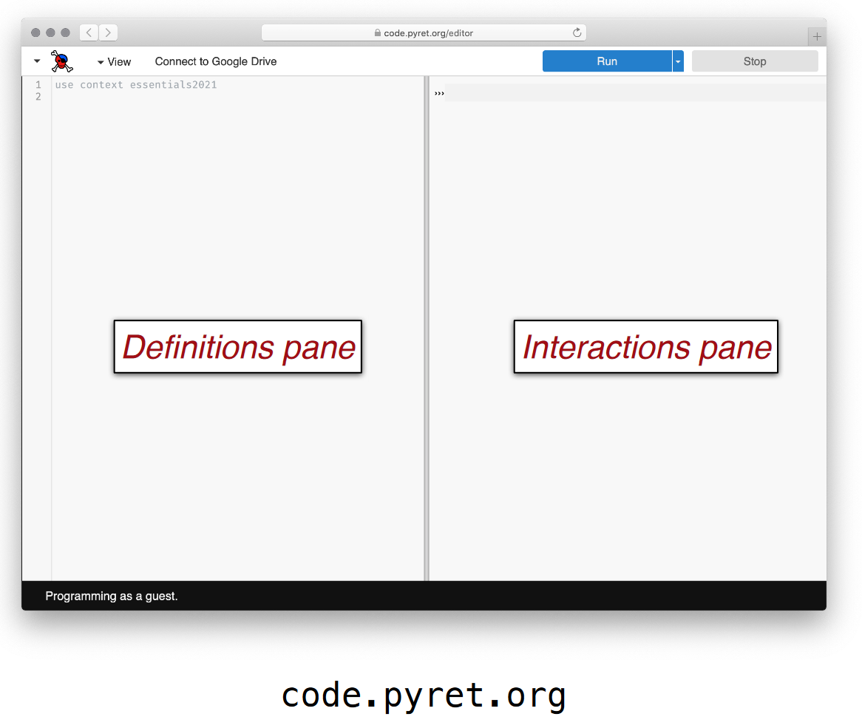
Introducing our IDE
…Both sides now

Slide 5
Introducing our IDE
From up and down
On RHS is: The Prompt! (>>>)

Slide 6
Things you can do LHS/RHS
And still somehow
Write expressions
Name expressions
Use previously defined expressions
Try out expressions
Check syntax
Save your code!

Slide 7
Pop Quiz!
Which pane would I use if...
I want to see if I can make a blue circle?
I want to define my-shape as a blue circle and use it later in my
code?
I want to see if Pyret will accept this: print "5"?
I want to start my assignment now and finish it later?

Slide 8
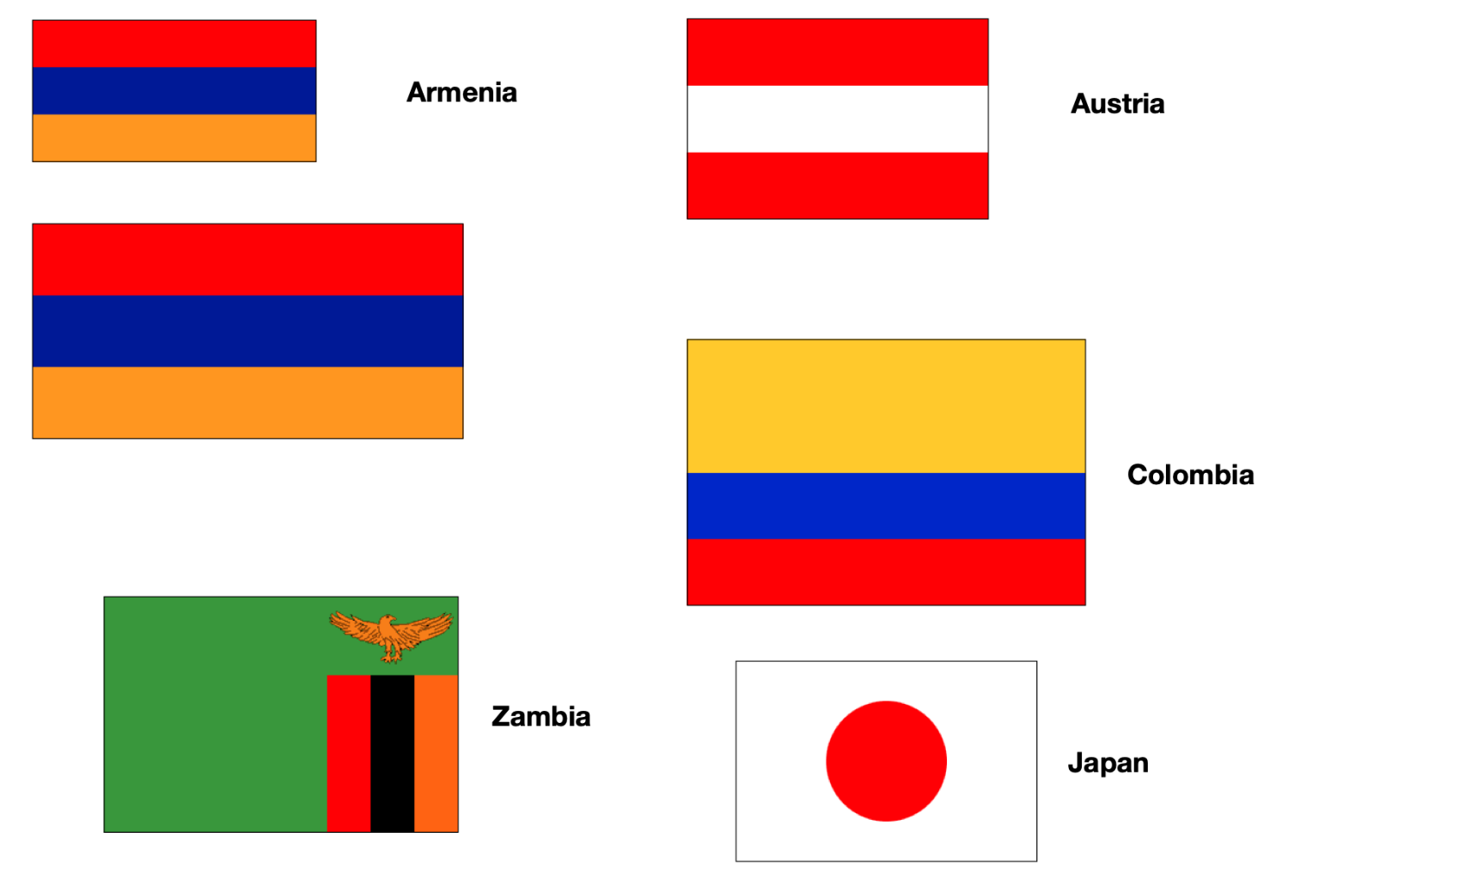
Let’s start to program by considering… Flags ?

Slide 9
OK, we want to print some flags…
Let’s start with the data – consider flags here - before we dive in and write code.
  Dimensions, shapes, juxtapositions, etc.
For instance, we might want to compute
  heights of the stripes given: overall flag dimensions,
  Which means we need to write programs over [the set of] numbers.
We also need a way to describe colors to our program.
More generally, we need a way to create images
  based on simple shapes of different colors.

Slide 10
Numbers
Consider
  An individual number like 5 is a value – it can’t be computed any further.
  An expression like(3 + 4) * (5 + 1) is a computation that produces an answer.
  A program – any program - consists of one or more
  computations
  Question: what about 3 + 4 * 5 + 1 ?
    WWJD?

Slide 11
Numbers
Consider
  An individual number like 5 is a value – it can’t be computed any further.
  An expression like(3 + 4) * (5 + 1) is a computation that produces an answer.
  A program – any program - consists of one or more
  computations
  Question: what about 3 + 4 * 5 + 1 ?
    WWJD? See… https://introcs.cs.princeton.edu/java/11precedence/

Slide 12
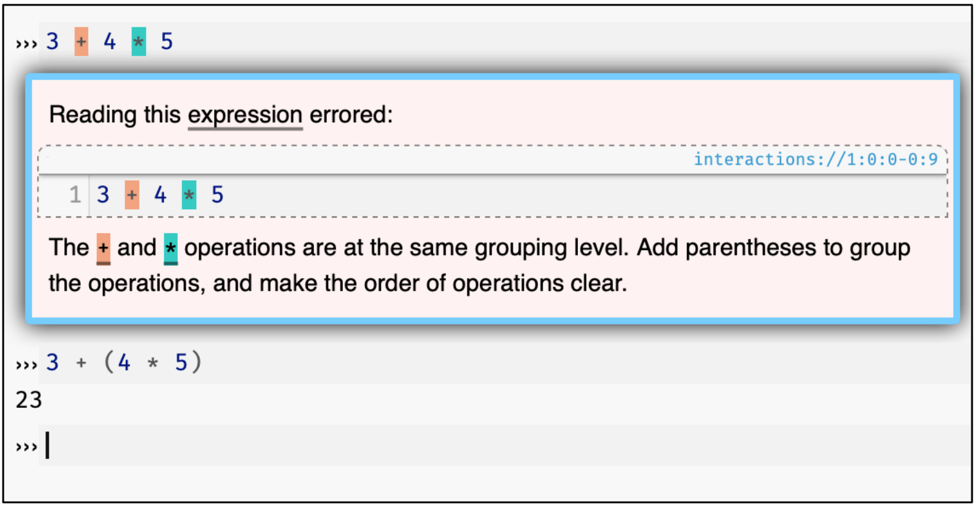
In pyret…

Slide 13
Colors
Consider
  Names can be given as text strings, e.g.,
  “purple"
  Pyret will understand what “purple“ means in the context of a color, i.e. if pyret is expecting a text string that represents a color. Let’s clarify…

Slide 14
Shapes
Consider
  ››› include image
  ››› circle(50, "solid", “purple")
  We’re asking pyret to create an image, specifically a solid purple circle with some dimension of 50.

Slide 15
Shapes
Like numbers, we can manipulate images…
  Numbers can be added, subtracted, etc.
  Similarly, Images can overlaid, rotated, flipped, etc.

Slide 16
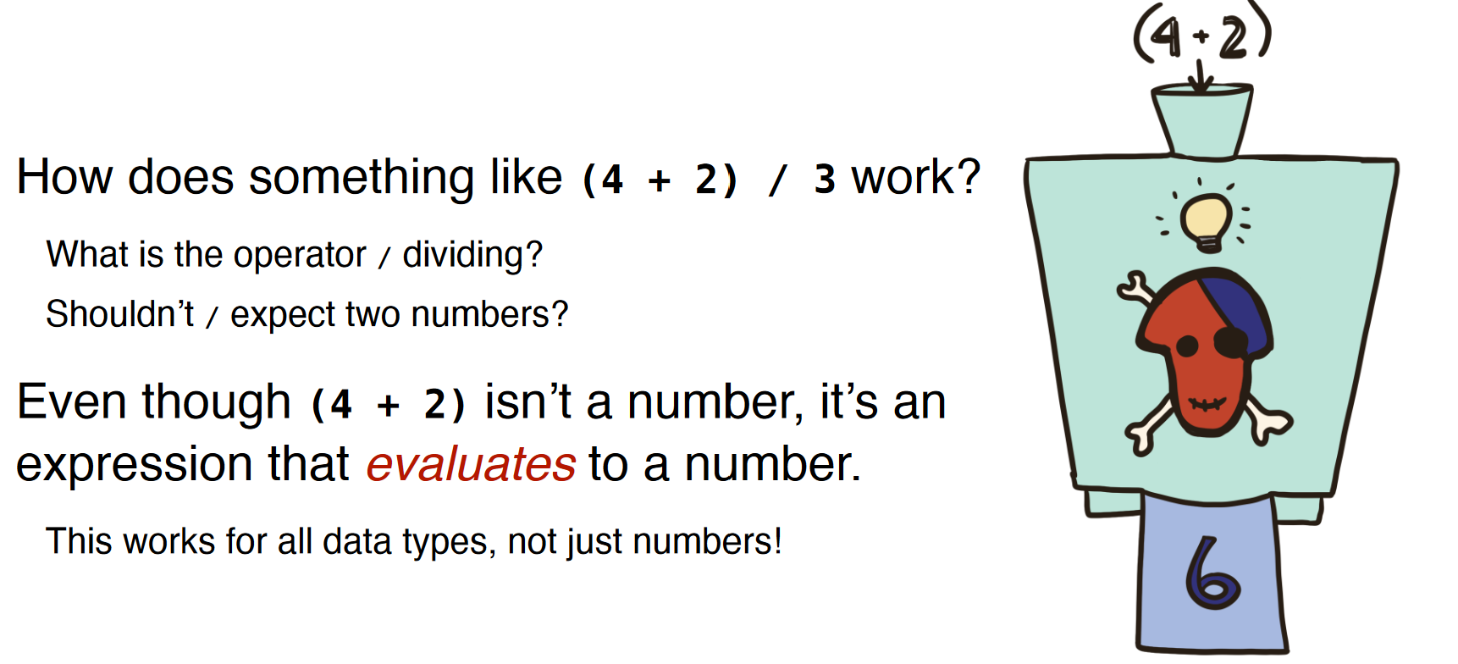
Moving On To Evaluations

Slide 17
Moving On To Evaluations
Consider this thingy on the right to be a “black box”
Have you heard the term before?

Slide 18
More On Evaluations
An expression of the form
⟨name⟩ = ⟨expression⟩
tells Pyret to associate the value of
⟨expression⟩ with ⟨name⟩.
Every time you type ⟨name⟩, Pyret will substitute the value for you:
x = 5
x + 4
will evaluate to 9.

Slide 19
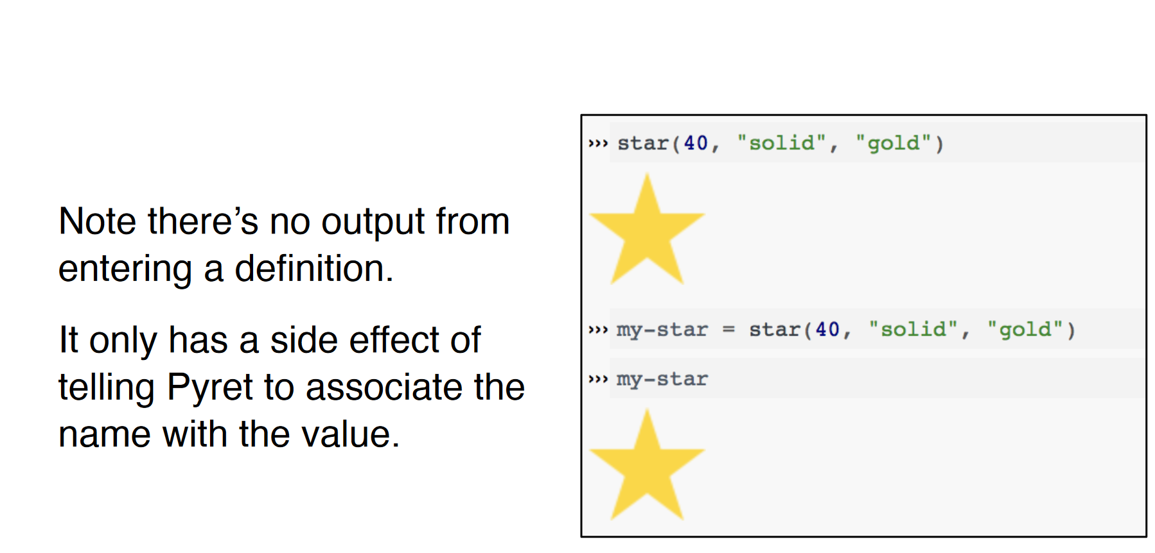
Creating a definition…

Slide 20
Naming Conventions
Every programming language has its own
conventions for names.
In Pyret, names are lowercase with words joined by hyphens, e.g.,
this-is-a-good-name
this_makes_bonny_cry
thisIsACrimeAgainstPyret

Slide 21
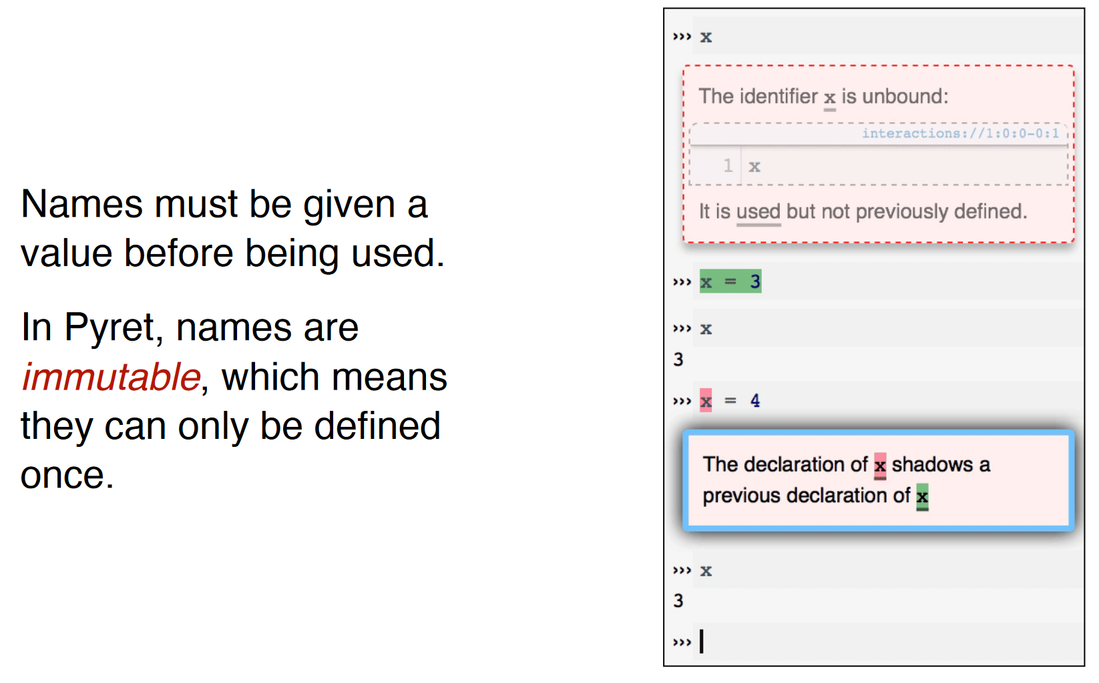
Naming Conventions (2)

Slide 22
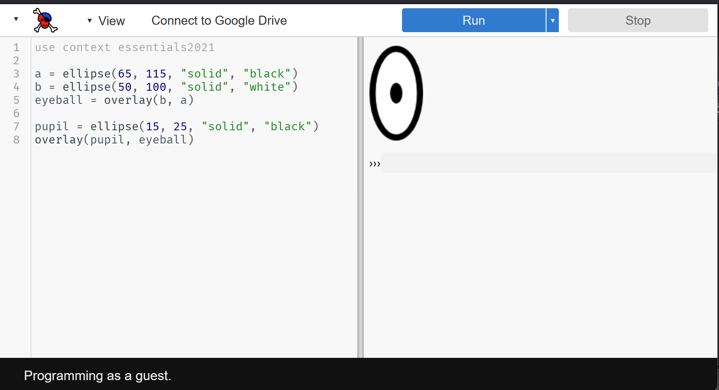
Let’s try drawing something an eyeball

Slide 23
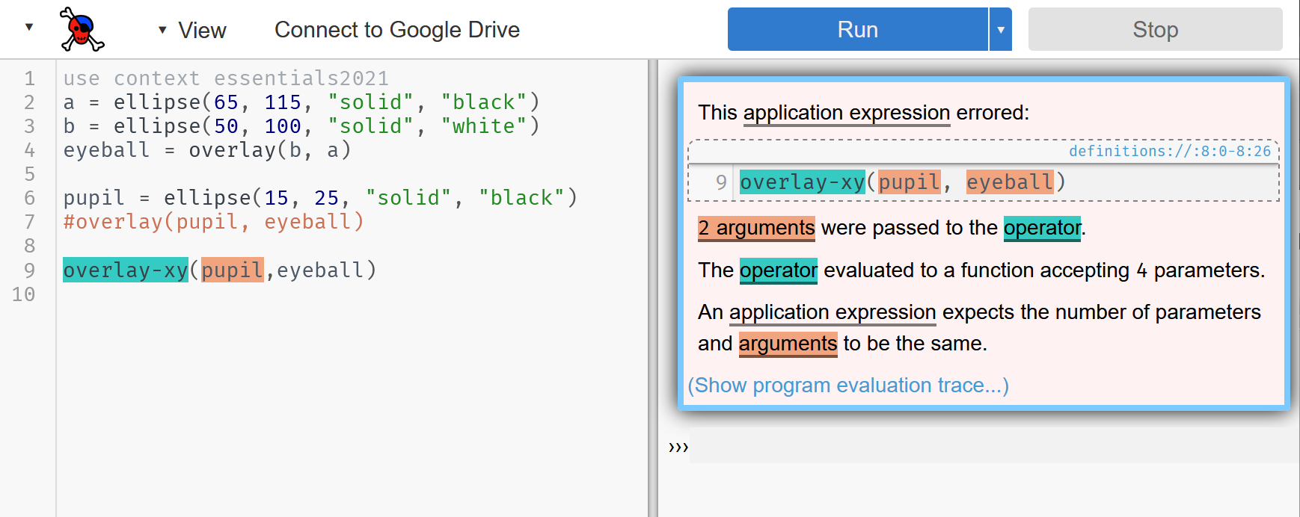
Let’s try drawing something an eyeball 2 eyeballs!

Slide 24
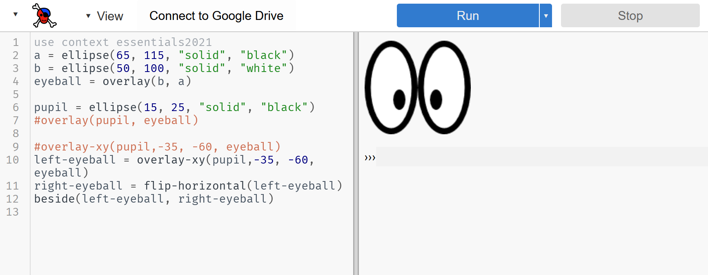
Whoops! Whoopsie! Don’t forget documentation!

Slide 25
Final Thoughts on the eyeballs
As you build up more complex images from simpler ones, you’re following a core idea called:
composition.
Programs are always built of smaller programs that do parts of
the larger task you want to perform.
We’ll use composition throughout this course

Slide 26
Next: What does this code do?
# Create the head: a yellow circle with black border
base = circle(50, "solid", "yellow")
base-border = circle(53, "solid", "black")
head = overlay(base, base-border)
# Create pair of eyes, using a square as a spacer
eye = circle(9, "solid", "blue")
eye-spacer = square(12, "solid", "yellow")
one-eye-with-space = beside(eye, eye-spacer)
eyes = beside(one-eye-with-space, eye)
# Add a mouth to the eyes to make a face
mouth = ellipse(30, 15, "solid", "red")
mouth-spacer = rectangle(30, 15, "solid", "yellow")
eyes-with-mouth-space = above(eyes, mouth-spacer)
face = above(eyes-with-mouth-space, mouth)
# Put the face on the head
emoji = overlay-align("center", "center", face, head)
emoji

Slide 27
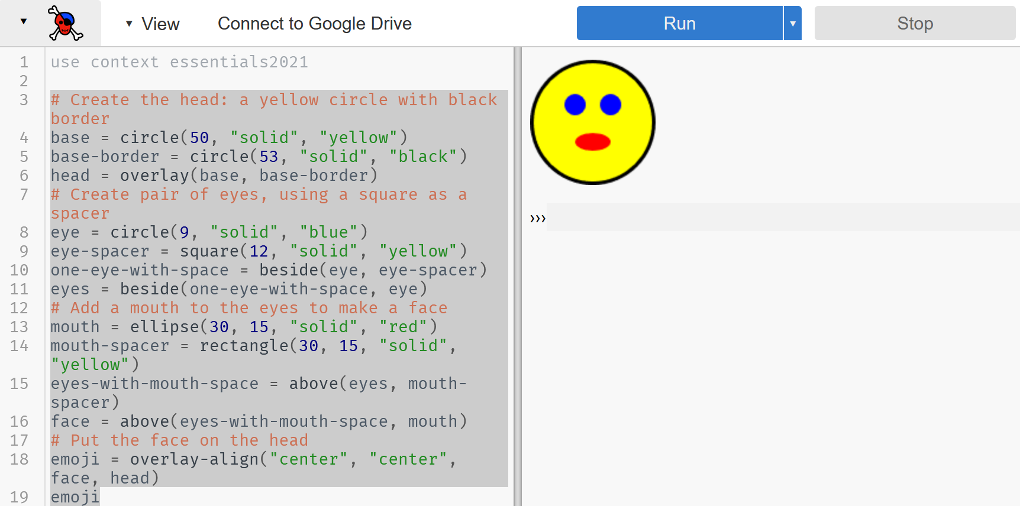
Too slow: This code makes a smiley emojii

Slide 28
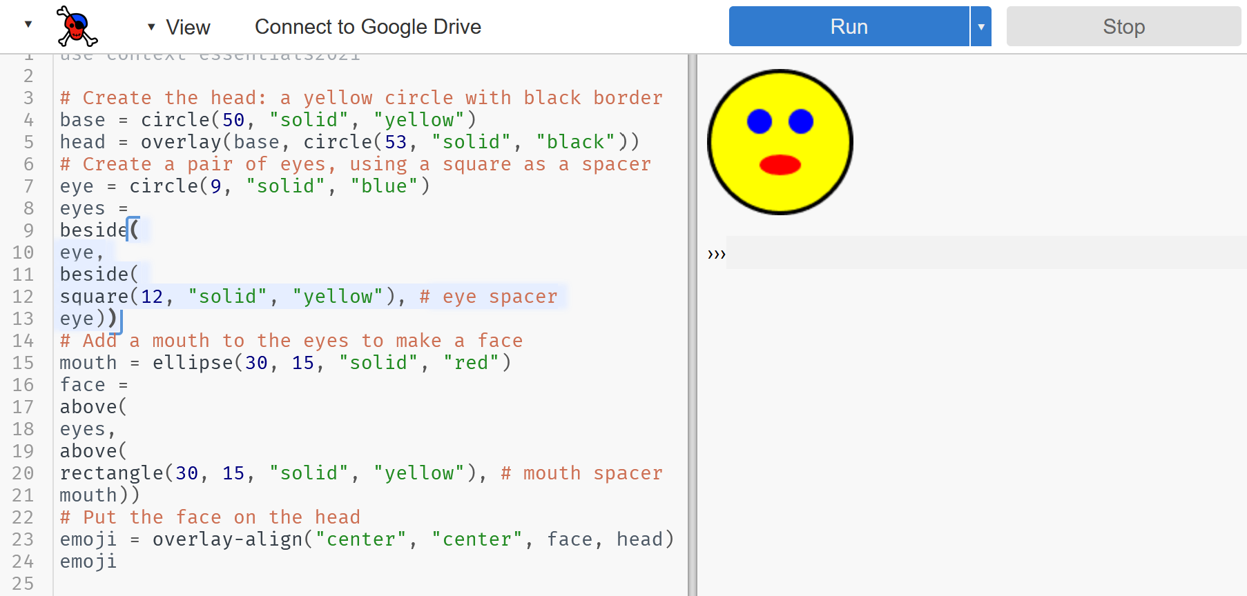
This also makes a smiley emojii

Slide 29
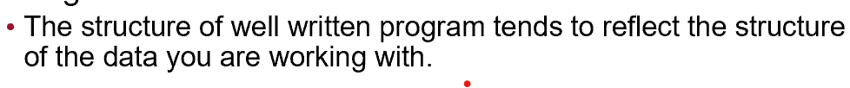
Which version is “better?”
The first set of code may seem easier to understand. At first.
As we get more involved working with structured data, writing code like the second slide will be more useful:
  The structure of well written program tends to reflect the structure of the data you are working with.

Slide 30
Eyeball code: Copy From
a = ellipse(65, 115, "solid", "black")
b = ellipse(50, 100, "solid", "white")
eyeball = overlay(b, a)
pupil = ellipse(15, 25, "solid", "black")
#overlay(pupil, eyeball)
#overlay-xy(pupil,-35, -60, eyeball)
left-eyeball = overlay-xy(pupil,-35, -60, eyeball)
right-eyeball = flip-horizontal(left-eyeball)
beside(left-eyeball, right-eyeball)

Slide 31
2nd set of emoji code: Copy From
# Create the head: a yellow circle with black border
base = circle(50, "solid", "yellow")
head = overlay(base, circle(53, "solid", "black"))
# Create a pair of eyes, using a square as a spacer
eye = circle(9, "solid", "blue")
eyes =
beside(
eye,
beside(
square(12, "solid", "yellow"), # eye spacer
eye))
# Add a mouth to the eyes to make a face
mouth = ellipse(30, 15, "solid", "red")
face =
above(
eyes,
above(
rectangle(30, 15, "solid", "yellow"), # mouth spacer
mouth))
# Put the face on the head
emoji = overlay-align("center", "center", face, head)
emoji

