Slide 1
Functions… kinda like f(x)

Slide 2
A quick review of last week’s concepts
We’ve been using Pyret to write expressions that use:
Data, including numbers (0, -10, 0.4),
strings ("" , "hi", "111"),
images (circle(2, "solid", "red")).
Which we modify or combine using operators or functions
+
string-append
overlay
CMPU 101: Problem Solving and Abstraction

Slide 3
A quick review of last week’s concepts
We’ve been using Pyret to write expressions that use:
Data, including numbers (0, -10, 0.4),
strings ("" , "hi", "111"),
images (circle(2, "solid", "red")).
Which we modify or combine using operators or functions
+
string-append
overlay
Operator
Function
Function
CMPU 101: Problem Solving and Abstraction

Slide 4
Errrors
IRL Software Problems are expensive when found by customers
In terms of cost of lost revenue, fixing the problem, brand satisfaction
Typically called “run time errors”
Less expensive if found before released to customers
The cost of a problem is lower… the earlier a problem is discovered
Lowest cost: finding a problem immediately after we write it!
This is what pyret does as you type code
This is also what happens when you click on
In Agile programming terms: Fail Fast

Slide 5
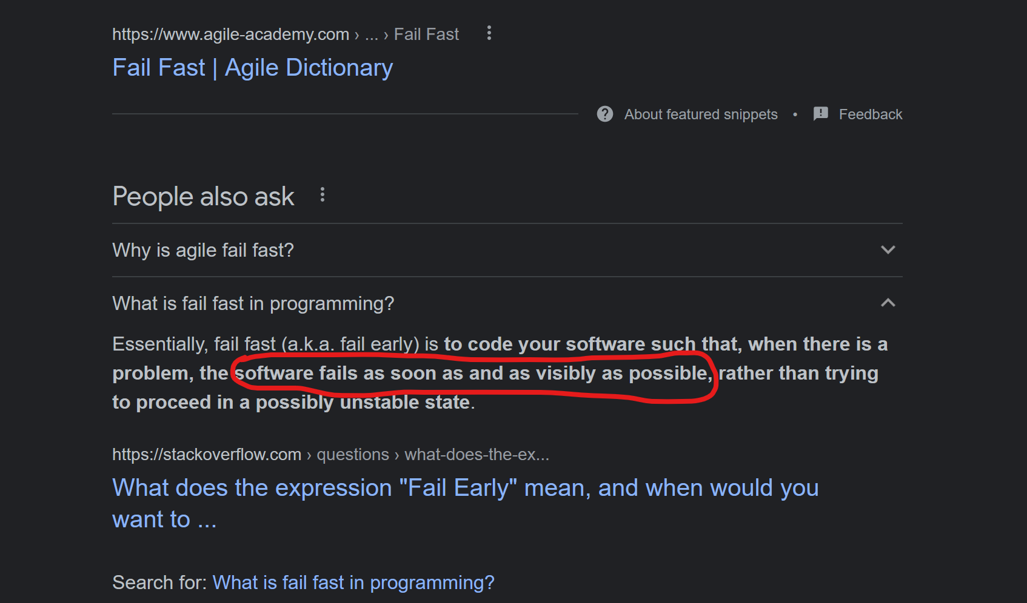
Fail Fast
…google search:

Slide 6
What else did we observe last week?
We can create (more) sophisticated code by combining functions and operators
…essentially creating expressions
1 + (7 / 8)
string-append(“Computer”, “Science”)
We can name our expressions too
…more precisely, the results of our expressions
my-major = string-append(“Computer”, “Science”)

Slide 7
Today’s Topic: Functions
In mathematics:
f(x) = x³ + 2x + 1
In Pyret Programming:
We need a way to tell Pyret we have a function:
fun
f(x): = (x * x * x) + (2 * x) + 1
end

Slide 8
Pyret Function Syntax
Angle brackets < > refer to something that is optional
Technically, the ellipse should have angle brackets too!
Another name for arg-name is parameter

Slide 9
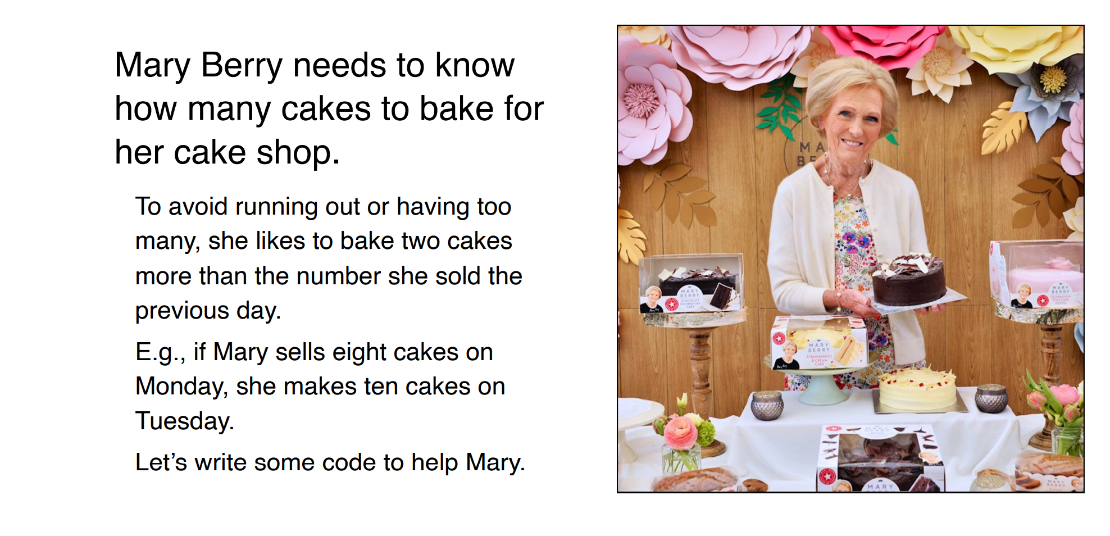
SSE: Super Simple Example

Slide 10
SSE: Pyret function elements 1/5

Slide 11
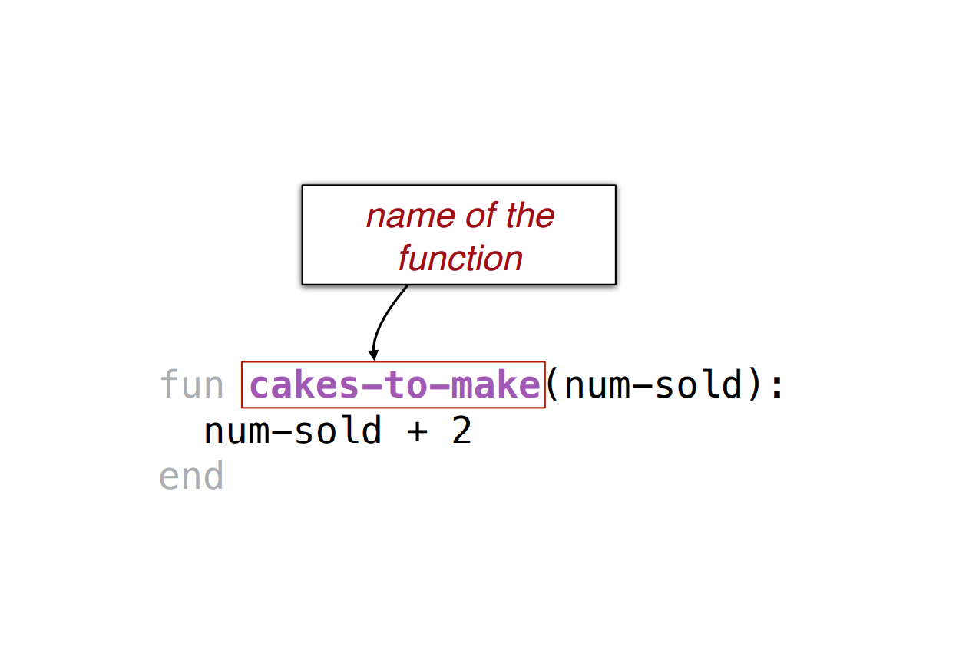
SSE: Pyret function elements 2/5

Slide 12
SSE: Pyret function elements 3/5

Slide 13
SSE: Pyret function elements 4/5
Transmogrify data

Slide 14
SSE: Pyret function elements 5/5

Slide 15
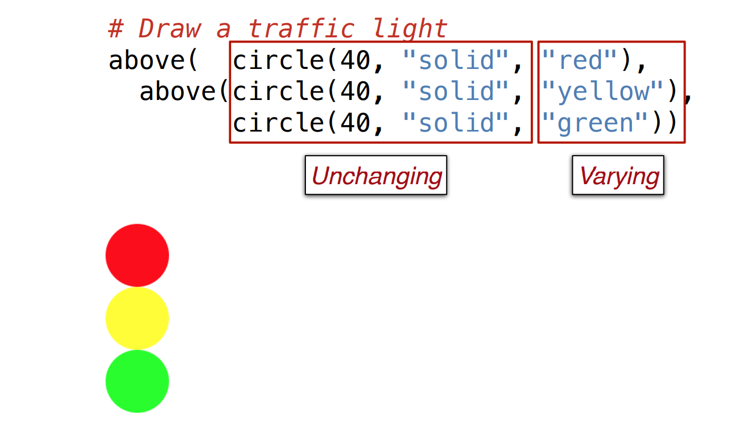
Functional Abstraction 1/3

Slide 16
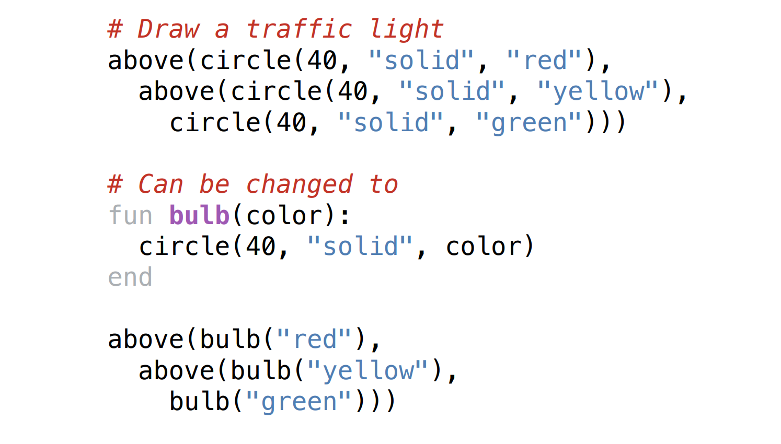
Functional Abstraction 2/3

Slide 17
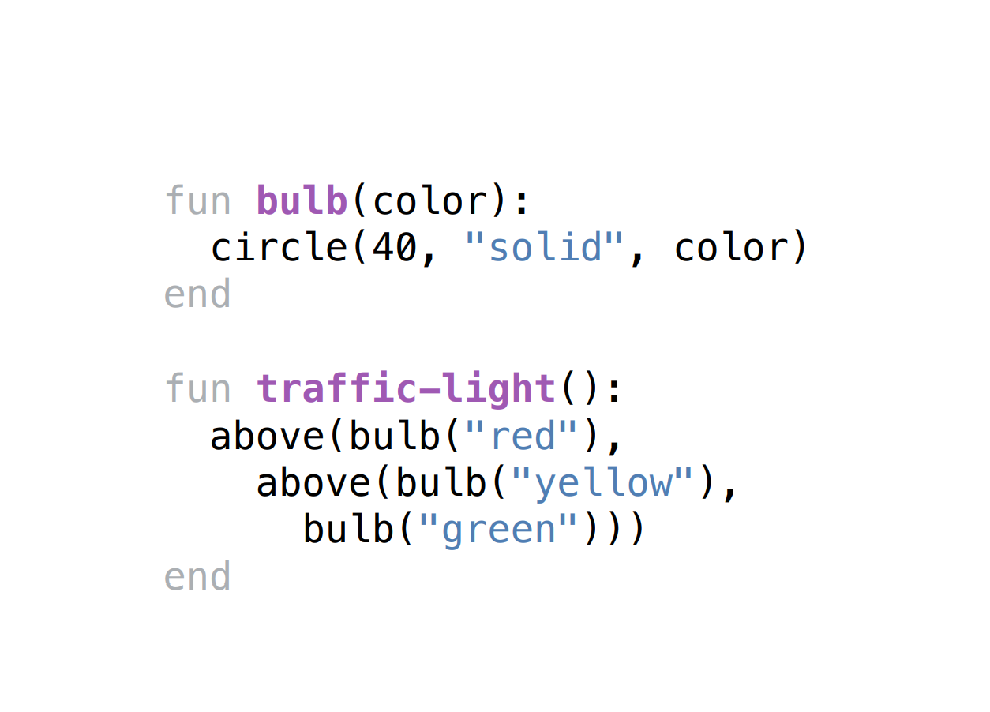
Functional Abstraction: 3/3 (kicking it up a notch)

Slide 18
Functional Abstraction: Back To Baking
Consider Mary’s cake shop (again)
We want to determine the price of each cake based on the cost of the ingredients and the time to prepare it.
The price is twice the cost of the ingredients plus 1/4 of the preparation time in minutes.
One approach: consider each cake, separately

Slide 19
Functional Abstraction: Ace of Cakes Functions
Looking more closely…
The price is twice the cost of the ingredients plus 1/4 of the preparation time in minutes.
Use functions to avoid repetitive code when performing the same operations with different values.
Purple font/arrows: different values? Hmm… should be a parameter!
Cost of the ingredients
Preparation time

Slide 20
Informal Definition
Parameters: generic names representing values that are passed into a function & are required/needed for creating a result.
fun
cake-price(ingredients-cost, prep-time):
(2 * ingredients-cost) + (0.25 * prep-time)
end
Using our cake example, we can now calculate cost of any kind of cake by calling the cake-price function.
# Price of chocolate cake
cake-price(10, 20)
# Price of cheesecake
cake-price(15, 36)

Slide 21
Making bitter batter better with butter functions better
Improved definition: Parameters: generic names representing values of a particular type that are passed into a function & are required/needed for creating a result.
fun
cake-price(ingredients-cost :: Number, prep-time :: Number):
(2 * ingredients-cost) + (0.25 * prep-time)
end
We specify the type of each parameter so that Pyret will check that the right type of values are actually being passed. Why does this matter?

Slide 22
Making bitter batter better with butter functions better
Improved definition: Parameters: generic names representing values of a particular type that are passed into a function & are required/needed for creating a result.
fun
cake-price(ingredients-cost :: Number, prep-time :: Number):
(2 * ingredients-cost) + (0.25 * prep-time)
end
We specify the type of each parameter so that Pyret will check that the right type of values are actually being passed. Why does this matter?
Answer: so that we can fail fast and discover problems faster than if we didn’t check

Slide 23
Making functions better (returning a result)
We can do this for the function result (i.e. return type) too!
fun
cake-price(ingredients-cost :: Number, prep-time :: Number) -> Number:
(2 * ingredients-cost) + (0.25 * prep-time)
end
We specify the type of the return value to maintain data consistency
i.e. so that we can fail fast when calling a function and naming the result!

Slide 24
Using pyret

Slide 25
Making functions better (epilogue)
It’s a good idea to let the instructor other programmers know what a function does!
fun
cake-price(ingredients-cost :: Number, prep-time :: Number) -> Number:
doc: "Calculate price of cake based on ingredient cost and prep time"
(2 * ingredients-cost) + (0.25 * prep-time)
end
We document the function so that a user of the function, or one who maintains it, can understand and use it properly.
i.e. so that we don’t have to fail at all!

Slide 26
More On Failing Fast (i.e. testing)
Consider the following function which includes some test information
fun cakes-to-make(num-sold :: Number) -> Number: doc: "Compute the number of cakes to make based on the previous number sold"
num-sold + 2
where:
cakes-to-make(0) is 2
cakes-to-make(107) is 109
End
But what if we happens to make a typo in pyret…

Slide 27
More On Failing Fast (i.e. testing)

Slide 28
Another Testing Example
Consider the following function which uses an image!
fun rectangle-area(r :: Image) -> Number:
doc: "Return the rectangular area of the image" image-height(r) * image-width(r)
where: rectangle-area(rectangle(0, 0, "solid", "black")) is 0
rectangle-area(rectangle(2, 3, "outline", "blue")) is 6
end

Slide 29
Another Testing Example: epilogue

Slide 30
Another Testing Example: epilogue
Achievement unlocked: pyret talks like a pirate!

Slide 31
Acknowledgements
This lecture incorporates material from:
Kathi Fisler, Brown University,
Gregor Kiczales, University of British Columbia,
And, Jonathan Gordon

