Slide 1
Conditionals and Booleans

Slide 2
Boolean Values
Are:
true or false
They can, in older programming languages, be represented by {1, 0}
Or even {nonzero value, 0}
i.e. they are relatively new data type
They can also be created by evaluating expressions i.e. 5 > (2 + 2)
CMPU 101: Problem Solving and Abstraction

Slide 3
Combining Boolean Values
To combine Boolean values, we can use and:
⟨expression 1⟩ and ⟨expression 2⟩
To combine Boolean values we can use or:
⟨expression 1⟩ or ⟨expression 2⟩
Evaluation of an expression stops, or is “short-circuited” when:
For and: as soon as one of the expressions being combined evaluates to false. (why?)
For or: as soon as one of the expressions evaluates to true. (why?)
Short Circuiting (vb)
CMPU 101: Problem Solving and Abstraction

Slide 4
Combining Boolean Values
To combine Boolean values, we can use and:
⟨expression 1⟩ and ⟨expression 2⟩
To combine Boolean values we can use or:
⟨expression 1⟩ or ⟨expression 2⟩
Evaluation of an expression stops, or is “short-circuited” when:
For and: as soon as one of the expressions being combined evaluates to false.
(it’s pointless to proceed… if false, further evaluation can never become true)
For or: as soon as one of the expressions evaluates to true.
(it’s pointless to proceed if true, further evaluation can never become false)
What if there was no short circuiting?
Short Circuiting (vb)
CMPU 101: Problem Solving and Abstraction

Slide 5
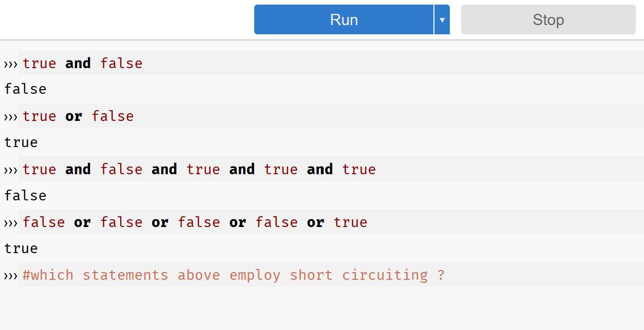
Boolean Examples
Answer: ?

Slide 6
Boolean Examples
Answer: true and false and true and true and true

Slide 7
Boolean Examples
Answer: ?

Slide 8
Boolean Examples
Answer: no, but how can we change the second expression such that:
there is short circuiting?

Slide 9
We can change expression evaluation… not!
To change an expression that evaluates to true to be false or vice versa,
use not:
››› not(1 == 0)
true

Slide 10
Another example

Slide 11
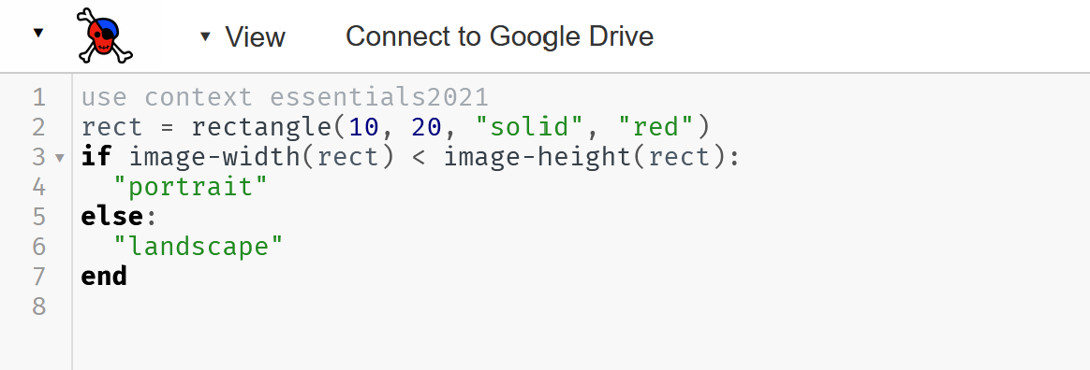
Introducing: If
What is the result of this expression?
Poem by Rudyard Kipling. Excerpt from https://en.wikipedia.org/wiki/If%E2%80%94

Slide 12
Introducing: If
What is the result of this expression?
Poem by Rudyard Kipling. Excerpt from https://en.wikipedia.org/wiki/If%E2%80%94

Slide 13
If/else expressions

Slide 14
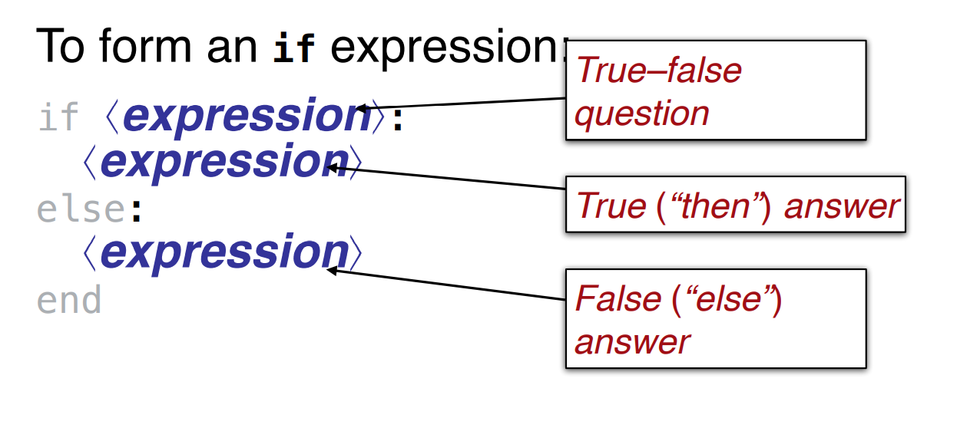
If/else expressions
Evaluation steps for if expressions
If the question expression is not a value, evaluate it, and replace with value.
If the question expression is true, replace entire if expression with true answer expression.
If the question is false, replace entire if expression with false answer expression.
If the question is a value other than true or false, ➔ error

Slide 15
Portrait/Landscape Mode (Revisited)
Let’s convert this code snippet to classify rectangles. We need a third classification though…
Portrait
Landscape
square

Slide 16
Portrait/Landscape/Square
We need to “nest” or embed if statements for this third category
rect = rectangle(10, 20, "solid", "red")
if image-width(rect) < image-height(rect):
"portrait"
else if image-width(rect) == image-height(rect): "square"
else:
"landscape"
end
Note: The “==“ operator means
“is equivalent”. It is not the assignment operator “=“
Don’t use assignment operators in if/else statements!

Slide 17
Function: Portrait/Landscape/Square
rect = rectangle(10, 20, "solid", "red") #used for testing in where:
fun image-type(img :: Image) -> String:
doc: "Classify an image as portrait, square, or landscape"
if image-width(img) < image-height(img):
"portrait"
else if image-width(img) == image-height(img):
"square"
else:
"landscape"
end
where:
image-type(rect) is “portrait"
image-type(rectangle(10, 10, "solid", "blue")) is "square"
image-type(rectangle(20, 10, "solid", "blue")) is "landscape"
end
Another note: You don’t need to use == to compare a value to true or false: you can just write the value or expression on its own!

Slide 18
Acknowledgements
This lecture incorporates material from:
Kathi Fisler, Brown University,
Gregor Kiczales, University of British Columbia,
And, Jonathan Gordon

