Slide 1
Working With Tables

Slide 2
Data Types
Here are some data that can be represented with what we’ve seen so far:
  A picture of a dog Image
  The population of Azerbaijan Number
  The complete text of the Baghavad Gita String
  Whether or not I ate breakfast this morning Boolean
CMPU 101: Problem Solving and Abstraction

Slide 3
A more complex example
What if we wanted to write a program to look up the population of any town in New York?
  We can consider the last two census years – 2010 and 2020.
  Next slide has a way to get us started…

Slide 4
The Population Function (plain text)
fun population(municipality :: String, year :: Number) -> Number:
doc: "Return population of the municipality for the given year"
if municipality == "New York":
if year == 2010:
8175133
else if year == 2020:
8804190
else:
raise("Bad year")
end
else if municipality == "Poughkeepsie":
if year == 2010:
43341
else if year == 2020:
45471
else:
raise("Bad year")
end
else:
raise("Bad municipality")
end
end
Data from: Local Government 2020 Census Interactive Dashboard
wwe1.osc.state.ny.us/localgov/2020-census-interactive-dashboard.htm

Slide 5
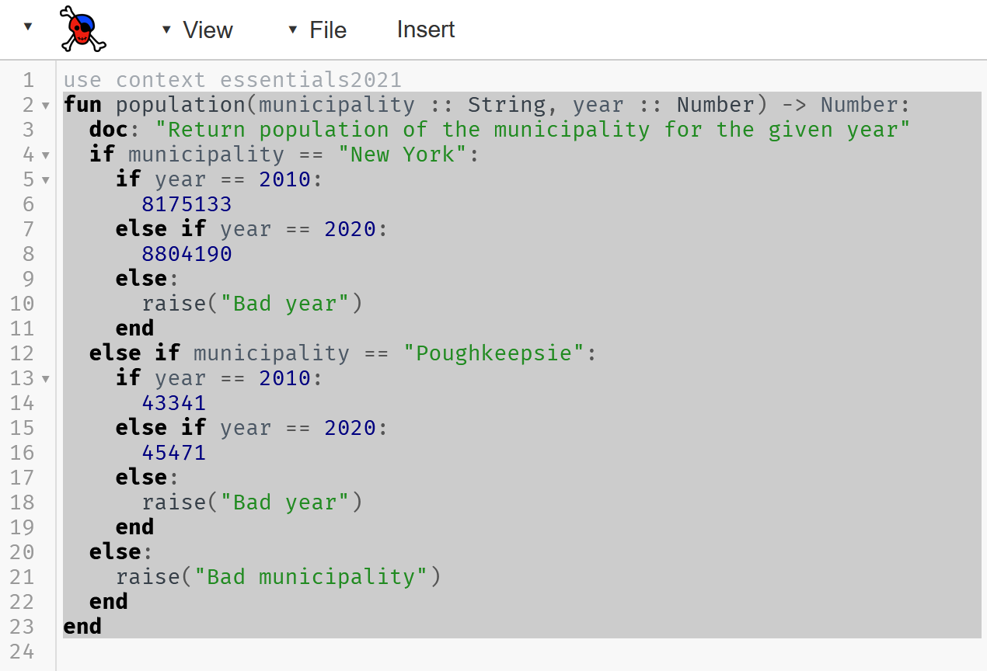
The Population Function (pyret)

Slide 6
The Population Function (pyret – nested if)
Just pointing out nested if stmts here!

Slide 7
What’s all this then? (pyret: new lang. feature)

Slide 8
What’s all this then? (pyret: raise)
raise…
stops Pyret from evaluating the program and displays an error message to the user.
This is different than returning a value, which lets Pyret continue as normal. Our "population" function returns numbers, but if it can't return a number, it will display one of these error messages.
This is a convenient thing to do when dealing with unexpected inputs.
  Data is not always “pure!”

Slide 9
A more complex example revisited
What if we wanted to write a program to look up the population of any town in New York?
  The approach used is not the best approach
    Not at all!
    But why?
    Let’s take another look at the code

Slide 10
The Population Function (pyret)

Slide 11
The Population Function (pyret)
We have New York City…
We have Poughkeepsie…
We have… none of the other 1528 municipalities!

Slide 12
How to consider functions
Key idea: Separate data from code computations.
Then, we can reuse the data in as many functions as we want.
Another KEY IDEA: Table-Driven Programming (my term!)
i.e. Organize data into tables and we can tailor functions based on tables

Slide 13
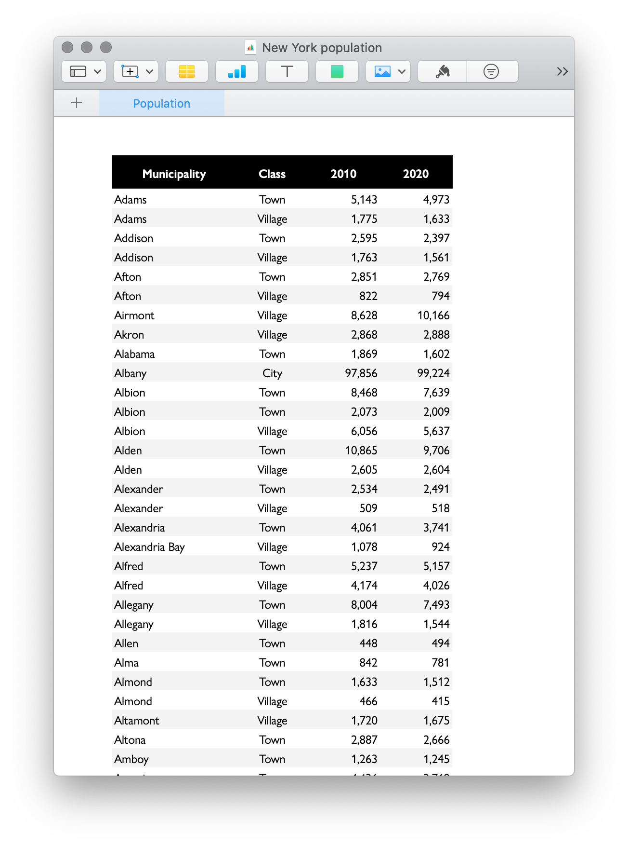
What’s a Table?
It is tabular data made up of rows/columns
  similar to what you would see in a spreadsheet

Slide 14
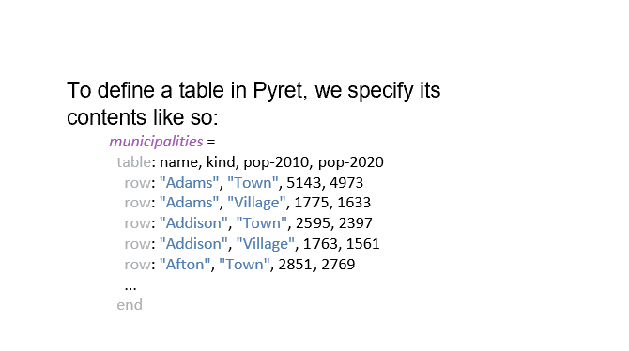
Defining a Table in pyret
Dileneate data using commas
Name of the table
Column Headings are named here
Notes:
Some municipalities are technically villages, while others are towns or cities. It's important to include these types because municipalities of different kinds can have the same name, e.g., there's both the city of Poughkeepsie (where the train station is) and the more populous town of Poughkeepsie, where you are right now.
(Actually there are some names that are used for multiple municipalities of the same class, so we'd need more information to distinguish them, such as the county name.)

Slide 15
Defining a Table in pyret
Dileneate data using commas
Name of the table
Column Headings are named here
Q: What type of data makes up a single row?
Notes:
Some municipalities are technically villages, while others are towns or cities. It's important to include these types because municipalities of different kinds can have the same name, e.g., there's both the city of Poughkeepsie (where the train station is) and the more populous town of Poughkeepsie, where you are right now.
(Actually there are some names that are used for multiple municipalities of the same class, so we'd need more information to distinguish them, such as the county name.)

Slide 16
Defining a Table in pyret – adding data types
municipalities =
table: name :: String, kind :: String,
pop-2010 :: Number, pop-2020 :: Number
row: "Adams", "Town", 5143, 4973
row: "Adams", "Village", 1775, 1633
row: "Addison", "Town", 2595, 2397
row: "Addison", "Village", 1763, 1561
row: "Afton", "Town", 2851, 2769
#careful if you copy/paste from here,
#all whitespace is not the same!
end

Slide 17
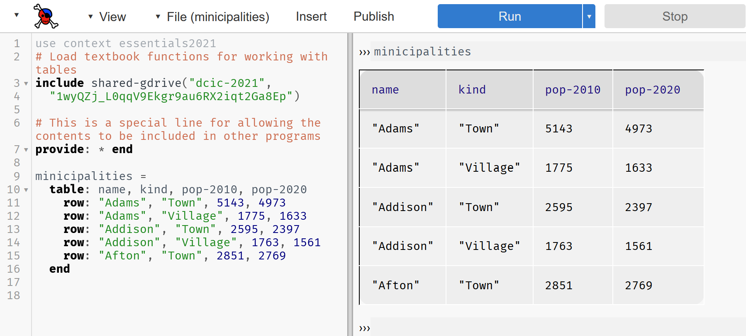
Steps to Create the table
Name the table (minicipalities here) & click Run (“mi” and not “mu” here) -> table is created
Type in “minicipalities” & press enter key -> table is displayed
Good idea to simply include lines 2-7 in your programs, even if they aren’t necessary right now
(again) be careful when doing copy/paste, tab keys and space characters have different behavior

Slide 18
Publish or Perish
So much data, so little time!
  We can share tables using the “Publish” menu button rather than typing/copying/pasting/whatever
    Important for sharing ginormous tables instead of gathering data yourself

Slide 19
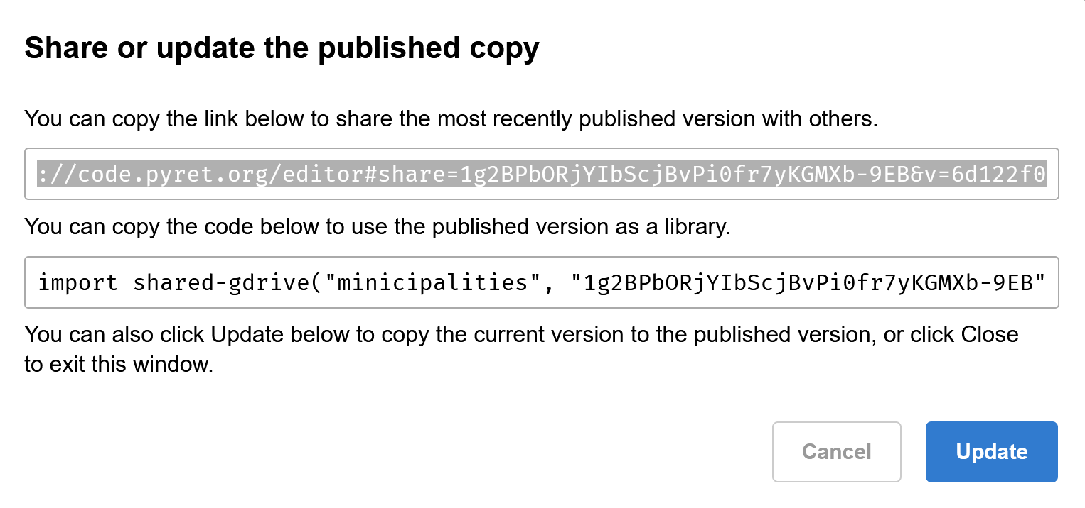
Publish or Perish (2)
End result is a sharable “link!”
  That we can, umm, type/copy/paste/whatever.

Slide 20
Publish or Perish (3)
End result is a sharable “link!”
  That we can, umm, type/copy/paste/whatever.
The juicy bits are enclosed in quotes (google identifier)
we can use “include” or “import”
as with textbook data in dcic-2021

Slide 21
Publish or Perish (4)
End result is a sharable “link!”
  That we can, umm, type/copy/paste/whatever.
The name of the file being shared is also used.
Good idea to avoid name collisions: create unique names by including (parts of) your name
(unlike what I did here!)

Slide 22
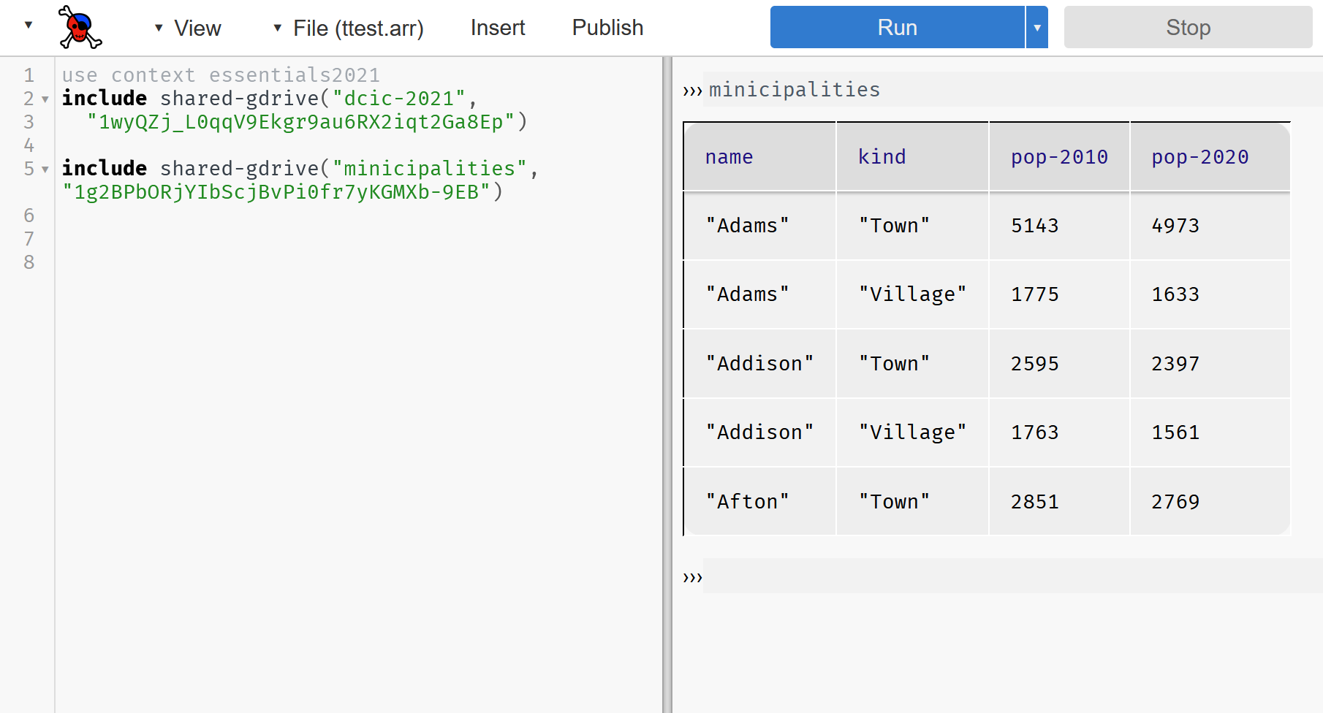
Publish or Perish (5)
Here we use the table called minicipalities (as if we compiled the data ourselves)

Slide 23
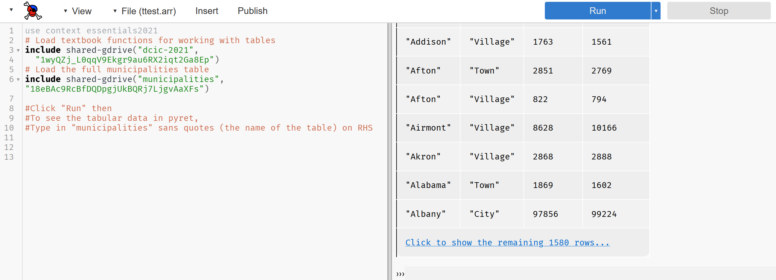
Turning the Tables
Let’s use the complete set of data from the NY State website!

Slide 24
Turning the Tables (2)
You should be able to copy/paste these lines into pyret to get the same results:
  (It worked on my machine at home!)
# Load textbook functions for working with tables
include shared-gdrive("dcic-2021",
"1wyQZj_L0qqV9Ekgr9au6RX2iqt2Ga8Ep")
# Load the full municipalities table
include shared-gdrive("municipalities", "18eBAc9RcBfDQDpgjUkBQRj7LjgvAaXFs")
#Click "Run" then
#To see the tabular data in pyret,
#Type in "municipalities" sans quotes (the name of the table) on RHS

Slide 25
Ok, I’ve got a table. Now what?
Now that we have the data in Pyret, we can write programs to “crunch the numbers” i.e. analyze the data!
We’ll need to learn some basic table manipulation functions first…

Slide 26
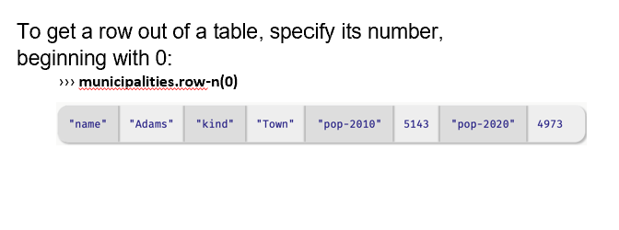
Extracting Rows

Slide 27
Row Data
The data type returned by .row-n is a Row.
We can access a value in the row by specifying the name of a column:
››› municipalities.row-n(0)["name"]
"Adams"
A note about the format of the above statement
  The parentheses ( ) are saying that row-n is a function
  The square brackets [ ] are saying to look up or extract the value of a particular column (the column named “name” here)

Slide 28
Row Data as input to a function
We can write a function that takes a row as input:
fun population-decreased(r :: Row) -> Boolean:
doc: "Return true if the municipality's population went down between 2010 and 2020"
r["pop-2020"] < r["pop-2010"]
end
If you remember Friday’s lab, we can safely omit the explicit checks using if statements when returning a Boolean.
  if r["pop-2020"] < r["pop-2010"]:
  true
  else:
  false
  end

Slide 29
Defining a Table in pyret – adding data types
municipalities =
table: name :: String, kind :: String,
pop-2010 :: Number, pop-2020 :: Number
row: "Adams", "Town", 5143, 4973
row: "Adams", "Village", 1775, 1633
row: "Addison", "Town", 2595, 2397
row: "Addison", "Village", 1763, 1561
row: "Afton", "Town", 2851, 2769
#careful if you copy/paste from here,
#all whitespace is not the same!
end

Slide 30
Filtering data and (re)Ordering Tables
From this point on, we will need to include the textbook functions via:
# Load textbook functions for working with tables
include shared-gdrive("dcic-2021", "1wyQZj_L0qqV9Ekgr9au6RX2iqt2Ga8Ep")
(I’ll provide it with sample code; you’ll just need to remember to copy/paste into your programs)

Slide 31
Filtering data and (re)Ordering Tables
From this point on, we will need to include the textbook functions via:
# Load textbook functions for working with tables
include shared-gdrive("dcic-2021", "1wyQZj_L0qqV9Ekgr9au6RX2iqt2Ga8Ep")
(I’ll provide it with sample code; you’ll just need to remember to copy/paste into your programs)

Slide 32
Filtering data and (re)Ordering Tables
Can we synthesize the data in municipalities to create a new table showing only cities where the population decreased between 2010 and 2020?

Slide 33
Filtering data and (re)Ordering Tables
Can we synthesize the data in municipalities to create a new table showing only cities where the population decreased between 2010 and 2020?
Spoiler Alert: YES, we can do that!

Slide 34
Brainstorming ways to do this: Table as parameter
# Create function that accepts a table and finds all municipalities with pop. decrease
fun filter-population-decreased(t :: Table) -> Table:
if population-decreased(t.row-n(0)):
... # Keep row 0
if population-decreased(t.row-n(1):
... # Keep row 1
else:
... # Don't keep row 1
end
else:
... # Don't keep row 0
end
end

Slide 35
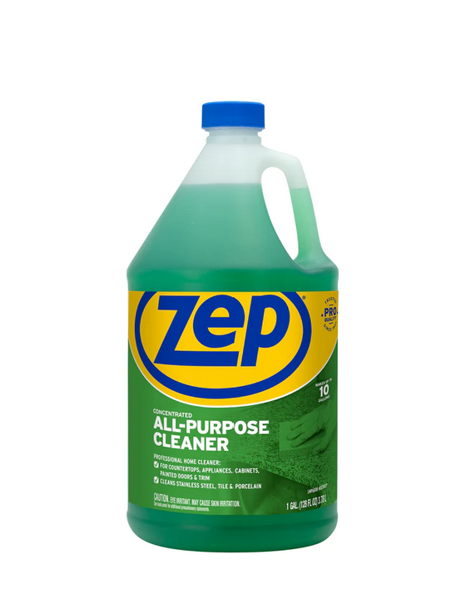
Brainstorming ways to do this (2)
fun filter-population-decreased(t :: Table) -> Table:
if population-decreased(t.row-n(0)):
... # Keep row 0
if population-decreased(t.row-n(1):
... # Keep row 1
else:
... # Don't keep row 1
end
else:
... # Don't keep row 0
end
end
We would need 1500+ if statements? Noooooooo…
Good idea, but awful implementation. We don’t really need to write code like this!
We can write general, all-purpose code to handle this.

Slide 36
This is the way…
filter-with can be used as a function to create a table with the desired set of rows…
filter-with(municipalities, population-decreased)
Two parameters
  Our (municipalities) table
  A function that filter-with uses. It will accept a row as a parameter and return a Boolean
In other words, filter-with will iterate through the rows in our table, keeping what fits its criterion
  A place with a decrease in population!

Slide 37
This is the way… more generally
filter-with(t :: Table, keep :: (Row -> Boolean))
-> Table
Read this as: Given a table and a predicate on rows, returns a table with only the rows for which the predicate returns true.
Again, two parameters
  A data type of table
  A keep function (the predicate) that filter-with uses. It will accept a row as a parameter and return a Boolean

Slide 38
A similar example with municipalities
We can also use filter-with to get a table made up of just the towns:
fun is-town(r :: Row) -> Boolean:
doc: "Check if a row is for a town"
r["kind"] == "Town"
end
filter-with(municipalities, is-town)

Slide 39
Expanding our options
order-by(t :: Table, colname :: String, sort-up :: Boolean)
-> Table
Given a table and the name of a column in that table, return a table with the same rows but ordered based on the named column.
If sort-up is true, the table will be sorted in ascending order, otherwise (false) it will be in descending order.
We can also order the data by the values in one column:
order-by(municipalities, "pop-2020", false)

Slide 40
We can combine all of these too!
How do we create a function that gives us the town with the smallest population?
?

Slide 41
We can combine all of these too!
How do we use the order-by function to give us the town with the smallest population?
order-by(
filter-with(municipalities, is-town),
"pop-2020",
true).row-n(0)

Slide 42
Using what we have seen
Problem: We want to know the fastest-growing towns in New York.

Slide 43
Using what we have seen (2)
Problem: We want to know the fastest-growing towns in New York.
i.e. we want a table containing only towns, sorted by the percent change in population.
Let’s break the problem statement into manageable parts

Slide 44
Using what we have seen (3)
Problem: We want to know the fastest-growing towns in New York.
i.e. we want a table containing only towns, sorted by the percent change in population.
Let’s break the problem statement into manageable parts
  Make a new table and…
  Filter out the cities, etc. (i.e. only towns)
  Calculate percentage change in population
  Build a (new) column for percentage change
  Sort the table based on that new column in descending order

Slide 45
Building a solution (1)
Problem: We want to know the fastest-growing towns in New York.
i.e. we want a table containing only towns, sorted by the percent change in population.
Let’s break the problem statement into manageable parts
  Make a new table and…
  Filter out the cities, etc. (i.e. only towns)
    towns = filter-with(municipalities, is-town)
  Calculate percentage change in population
  Build a (new) column for percentage change
  Sort the table based on that new column in descending order

Slide 46
Building a solution (2)
Problem: We want to know the fastest-growing towns in New York.
i.e. we want a table containing only towns, sorted by the percent change in population.
Let’s break the problem statement into manageable parts
  Make a new table and…
  Filter out the cities, etc. (i.e. only towns)
    towns = filter-with(municipalities, is-town)
  Calculate percentage change in population
      fun percent-change(r :: Row) -> Number:
      doc: "Compute the percentage change for the population of the given municipality between 2010 and 2020"
      (r["pop-2020"] - r["pop-2010"]) / r["pop-2010"]
      end
  Build a (new) column for percentage change
  Sort the table based on that new column in descending order

Slide 47
Building a solution (3)
Problem: We want to know the fastest-growing towns in New York.
i.e. we want a table containing only towns, sorted by the percent change in population.
Let’s break the problem statement into manageable parts
  Make a new table and…
  Filter out the cities, etc. (i.e. only towns)
    towns = filter-with(municipalities, is-town)
  Calculate percentage change in population
      fun percent-change(r :: Row) -> Number:
      doc: "Compute the percentage change for the population of the given municipality between 2010 and 2020"
      (r["pop-2020"] - r["pop-2010"]) / r["pop-2010"]
      end
  Build a (new) column for percentage change
      towns-with-percent-change =
      build-column(towns, "percent-change", percent-change)
  Sort the table based on that new column in descending order

Slide 48
Building a solution (4)
Problem: We want to know the fastest-growing towns in New York.
i.e. we want a table containing only towns, sorted by the percent change in population.
Let’s break the problem statement into manageable parts
  Make a new table and…
  Filter out the cities, etc. (i.e. only towns)
    towns = filter-with(municipalities, is-town)
  Calculate percentage change in population
      fun percent-change(r :: Row) -> Number:
      doc: "Compute the percentage change for the population of the given municipality between 2010 and 2020"
      (r["pop-2020"] - r["pop-2010"]) / r["pop-2010"]
      end
  Build a (new) column for percentage change
      towns-with-percent-change =
      build-column(towns, "percent-change", percent-change)
  Sort the table based on that new column in descending order
      fastest-growing-towns =
      order-by(towns-with-percent-change,
      "percent-change", false)

Slide 49
Full solution… almost(!)
Problem: We want to know the fastest-growing towns in New York.
fun percent-change(r :: Row) -> Number:
doc: "Compute the percentage change for the population of the given municipality between 2010 and 2020"
(r["pop-2020"] - r["pop-2010"]) /
r["pop-2010"]
end
Fun is-town(r :: Row) -> Boolean:
doc: "Check if a row is for a town"
r["kind"] == "Town"
end
towns = filter-with(municipalities, is-town)
towns-with-percent-change =
build-column(towns, "percent-change", percent-change)
fastest-growing-towns =
order-by(towns-with-percent-change,
"percent-change", false)
fastest-growing-towns

Slide 50
Second look at filter-with parameter
filter-with(t :: Table, keep :: (Row -> Boolean))
-> Table
Read this as: Given a table and a predicate (the keep function) on rows, returns a table with only the rows for which the predicate returns true.
Think of the keep function as a helper function for filter-with
This pattern (helper function as input parameter to a function) will show up quite often, as in…

Slide 51
… build-column
From step 3 in slide titled, “Building a solution (3)”
      towns-with-percent-change =
      build-column(towns, "percent-change", percent-change)
  Here, percent-change() is the function that helps build-column build a column!
fun percent-change(r :: Row) -> Number:
doc: "Compute the percentage change for the population of the given municipality between 2010 and 2020"
(r["pop-2020"] - r["pop-2010"]) /
r["pop-2010"]
end

Slide 52
Second look at building a mystery new column
Let’s write a new function, builder, that will help us build a new column for our table
fun builder(r :: Row) -> Number:
string-length(row["a"]) + row["b"]
end
  string-length(): a function that gives us the number of printable characters in a string
  We’ll return the sum of two numbers in this function.
  Return values from builder will (at run time) be an input parameter to build-column
    As it builds the new column, for each row
  Here’s what it does, pictorially, on some random table “t”…

Slide 53
builder
  Table t
  Start:
  string-length(“dog”) is 3, string-length(kangaroo) is 8
  Table t after we build a new column with builder function in previous slide
  (The values returned from the builder function make up the elements in the new column we’re adding to each row.)
Pet | Number Owned
Dog | 2
Kangaroo | 3
Pet | Number Owned | Secret-number
Dog | 2 | 5
Kangaroo | 3 | 11

Slide 54
Questions (for everyone to ponder)…
What happened to the original table t?
And, didn’t table t just change?

Slide 55
Short answers…
What happened to the original table t?
  A: nothing, it still exists in its original form
And, didn’t table t just change?
  A: No, we created a new table

Slide 56
Longer answers…
What happened to the original table t?
  A: nothing, it still exists in its original form
And, didn’t table t just change?
  A: No, we created a new table
Just as the mathematical function f(x,y) = x + y, doesn’t change x and y…
  And, the expression 2 + 3 doesn’t change the value of 2 or of 3,
functions that take a table as input don’t change the original table.
Instead, they return a new table.

Slide 57
Functional Programming
This is a paradigm called functional programming.
If you have experience working in other languages,
  this may seem strange,
but it can be extremely useful!
Scheduling note… we’ll further explore functional programming in the weeks to come.

Slide 58
Acknowledgements
This lecture incorporates material from:
Kathi Fisler, Brown University,
Gregor Kiczales, University of British Columbia,
And, Jonathan Gordon

