Slide 1
Visualization of Tabular Data

Slide 2
A few items I want to emphasize (1)
To combine Boolean values, we can use and:
⟨expression 1⟩ and ⟨expression 2⟩
To combine Boolean values we can use or:
⟨expression 1⟩ or ⟨expression 2⟩
Evaluating an expression or is “short-circuited” when:
For and: as soon as one of the expressions evaluates to false.
(it’s pointless to proceed… if false, further evaluation can never become true)
For or: as soon as one of the expressions evaluates to true.
(it’s pointless to proceed if true, further evaluation can never become false)
Q: What if there was no short circuiting?
Short Circuiting (vb)
STOPS
CMPU 101: Problem Solving and Abstraction

Slide 3
A few items A few items I want to emphasize (2)
To change an expression that evaluates to true to be false or vice versa,
use not: note not is a function
Not a keyword reserved by the pyret programming language
A keyword recognized by the pyret programming language is highlighted in bold in our IDE
As you have seen with fun, end, etc. (but not etc.)
One important example is from Lab 3.
x and y and not(z) equivalent to:
X and y and (z == false)

Slide 4
A few items I want to emphasize (2.5)
To change an expression that evaluates to true to be false or vice versa,
use not: note not is a function
Not a keyword reserved by the pyret programming language
A keyword recognized by the pyret programming language is highlighted in bold in our IDE
As you have seen with fun, end, etc. (but not etc.)
One important example is from Lab 3.
x and y and not(z) equivalent to:
X and y and (z == false)

Slide 5
A few items I want to emphasize (3)
Golly Gee Willakers, these tables (municipalities & candy-data) are big!
When developing functions that will be used to filter tables,
We want to test them, of course!
Try things out with small tables you create yourself!
… to be sure the functions your write are correct
… before combining them into meaningful functions!
The tests from Lab 3 used candy-data and it was a cumbersome task!

Slide 6
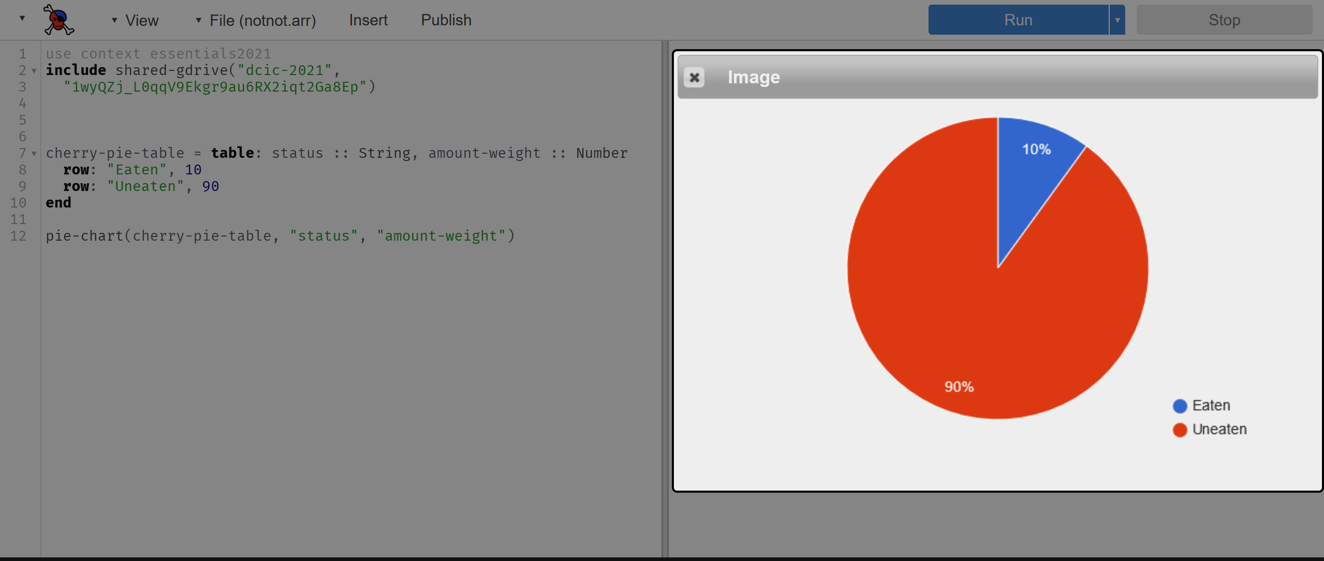
Visualization
Pie Chart that explains: How much Cherry Pie did I eat?
CMPU 101: Problem Solving and Abstraction

Slide 7
Visual Representation of Data
Data scientists use plots for both exploratory and explanatory purposes.
They are useful for understanding data…
Sometimes necessitating further analysis
And, in presenting data to a general audience…
With a concomitant impact
An example:
Florence Nightingale's most famous graphics illustrated the "loss of an army"
The British army sent to Crimea.

Slide 8
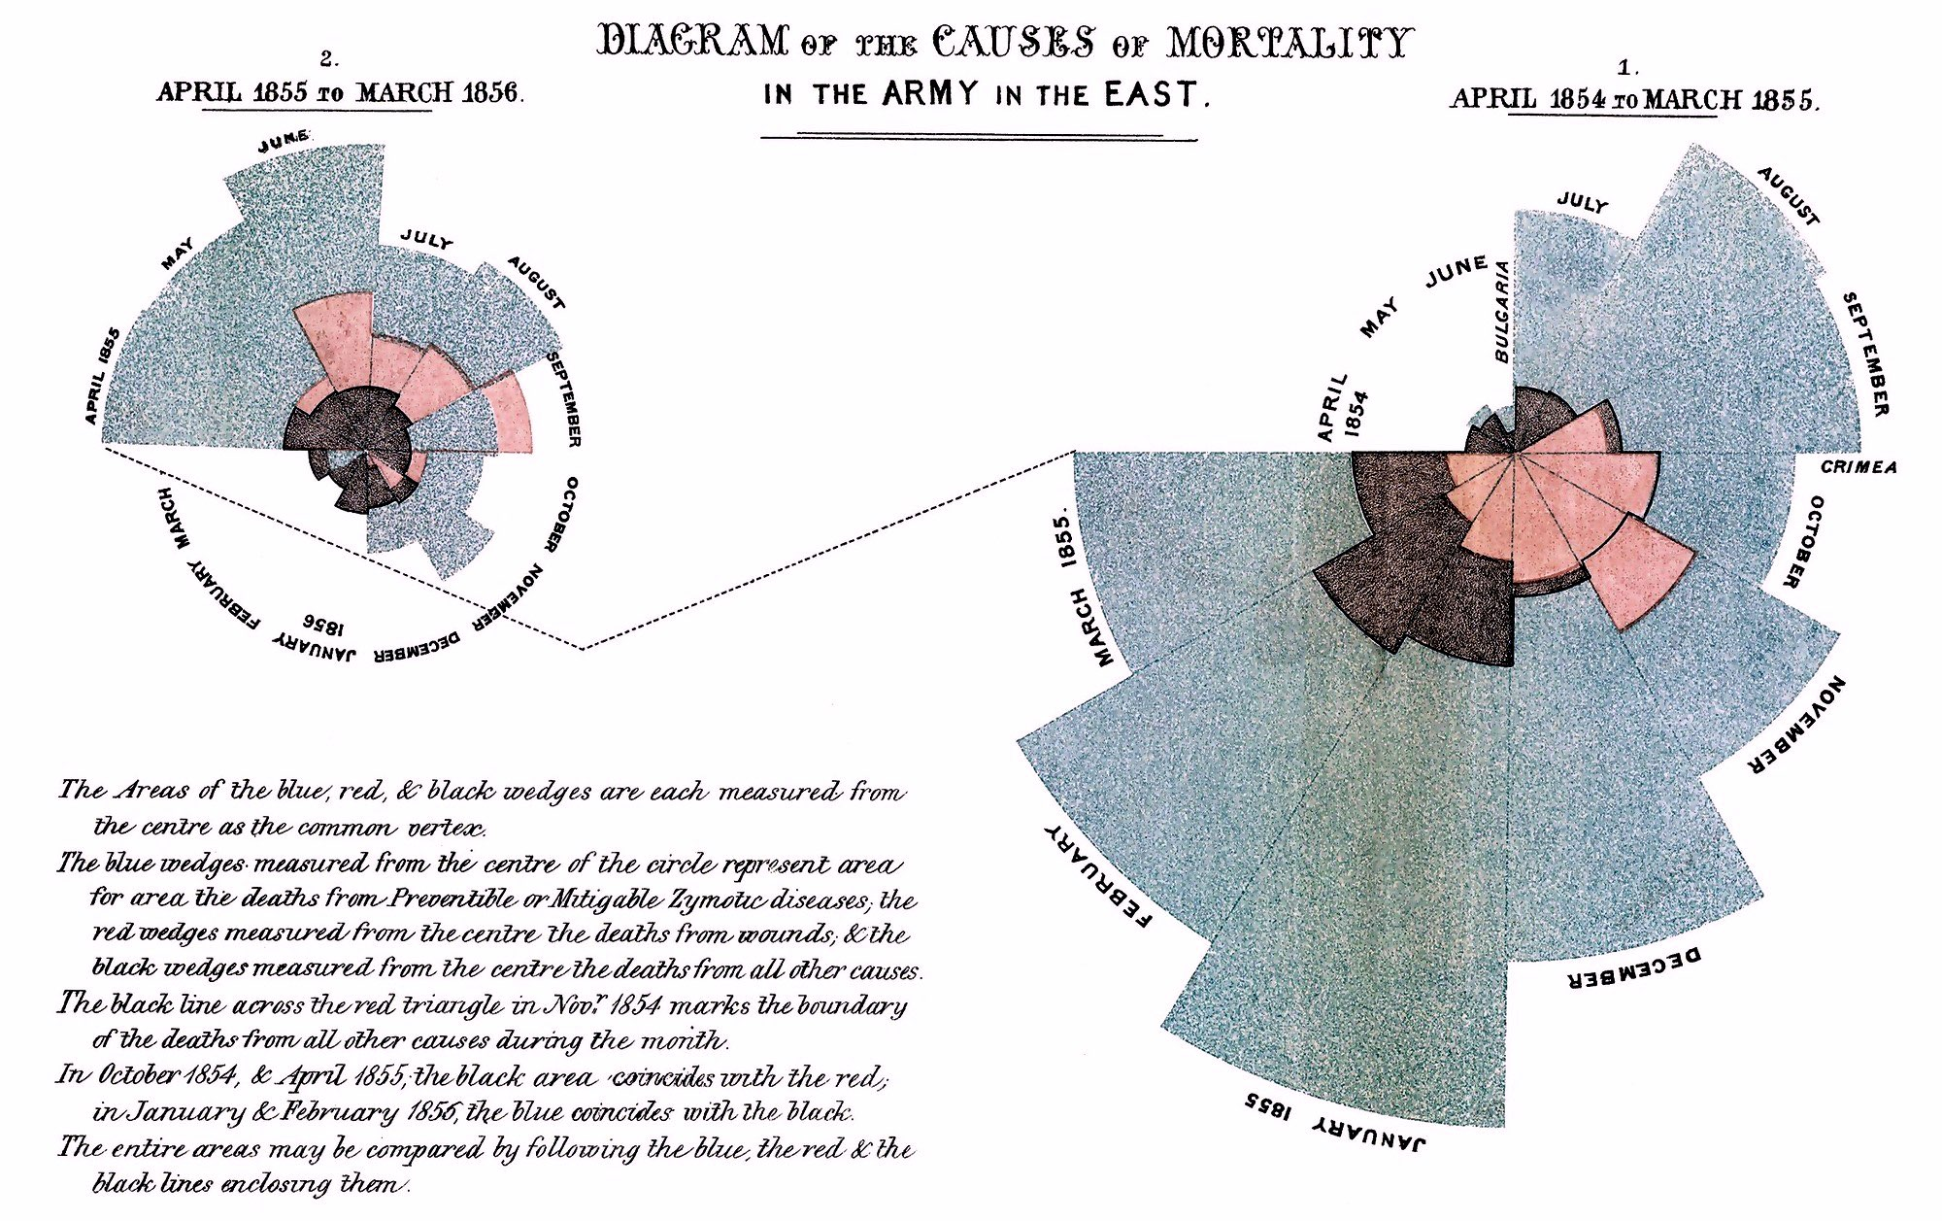
Visual Representation of Data (2)

Slide 9
Florence Nightingale’s Charts
The wedges are the total mortality. The red (pink) regions are deaths from being wounded in combat.
It's quick and easy to tell that something else was going on here, and on a large scale.
Nightingale’s medical expertise and hospital visits gave her insight to identify the bad medical conditions as the surprising and preventable cause of so much death.
The research was part of a Royal Commission looking into the causes of mortality of soldiers in the Crimean War.
Nightingale worked with William Farr, a Victorian pioneer in statistics who did not support the idea of including visualizations, but Nightingale stood firm and advocated for this now-famed visualization.
Her diagrams conveyed a call to action - by using recent data to persuade the Government to improve army hygiene.

Slide 10
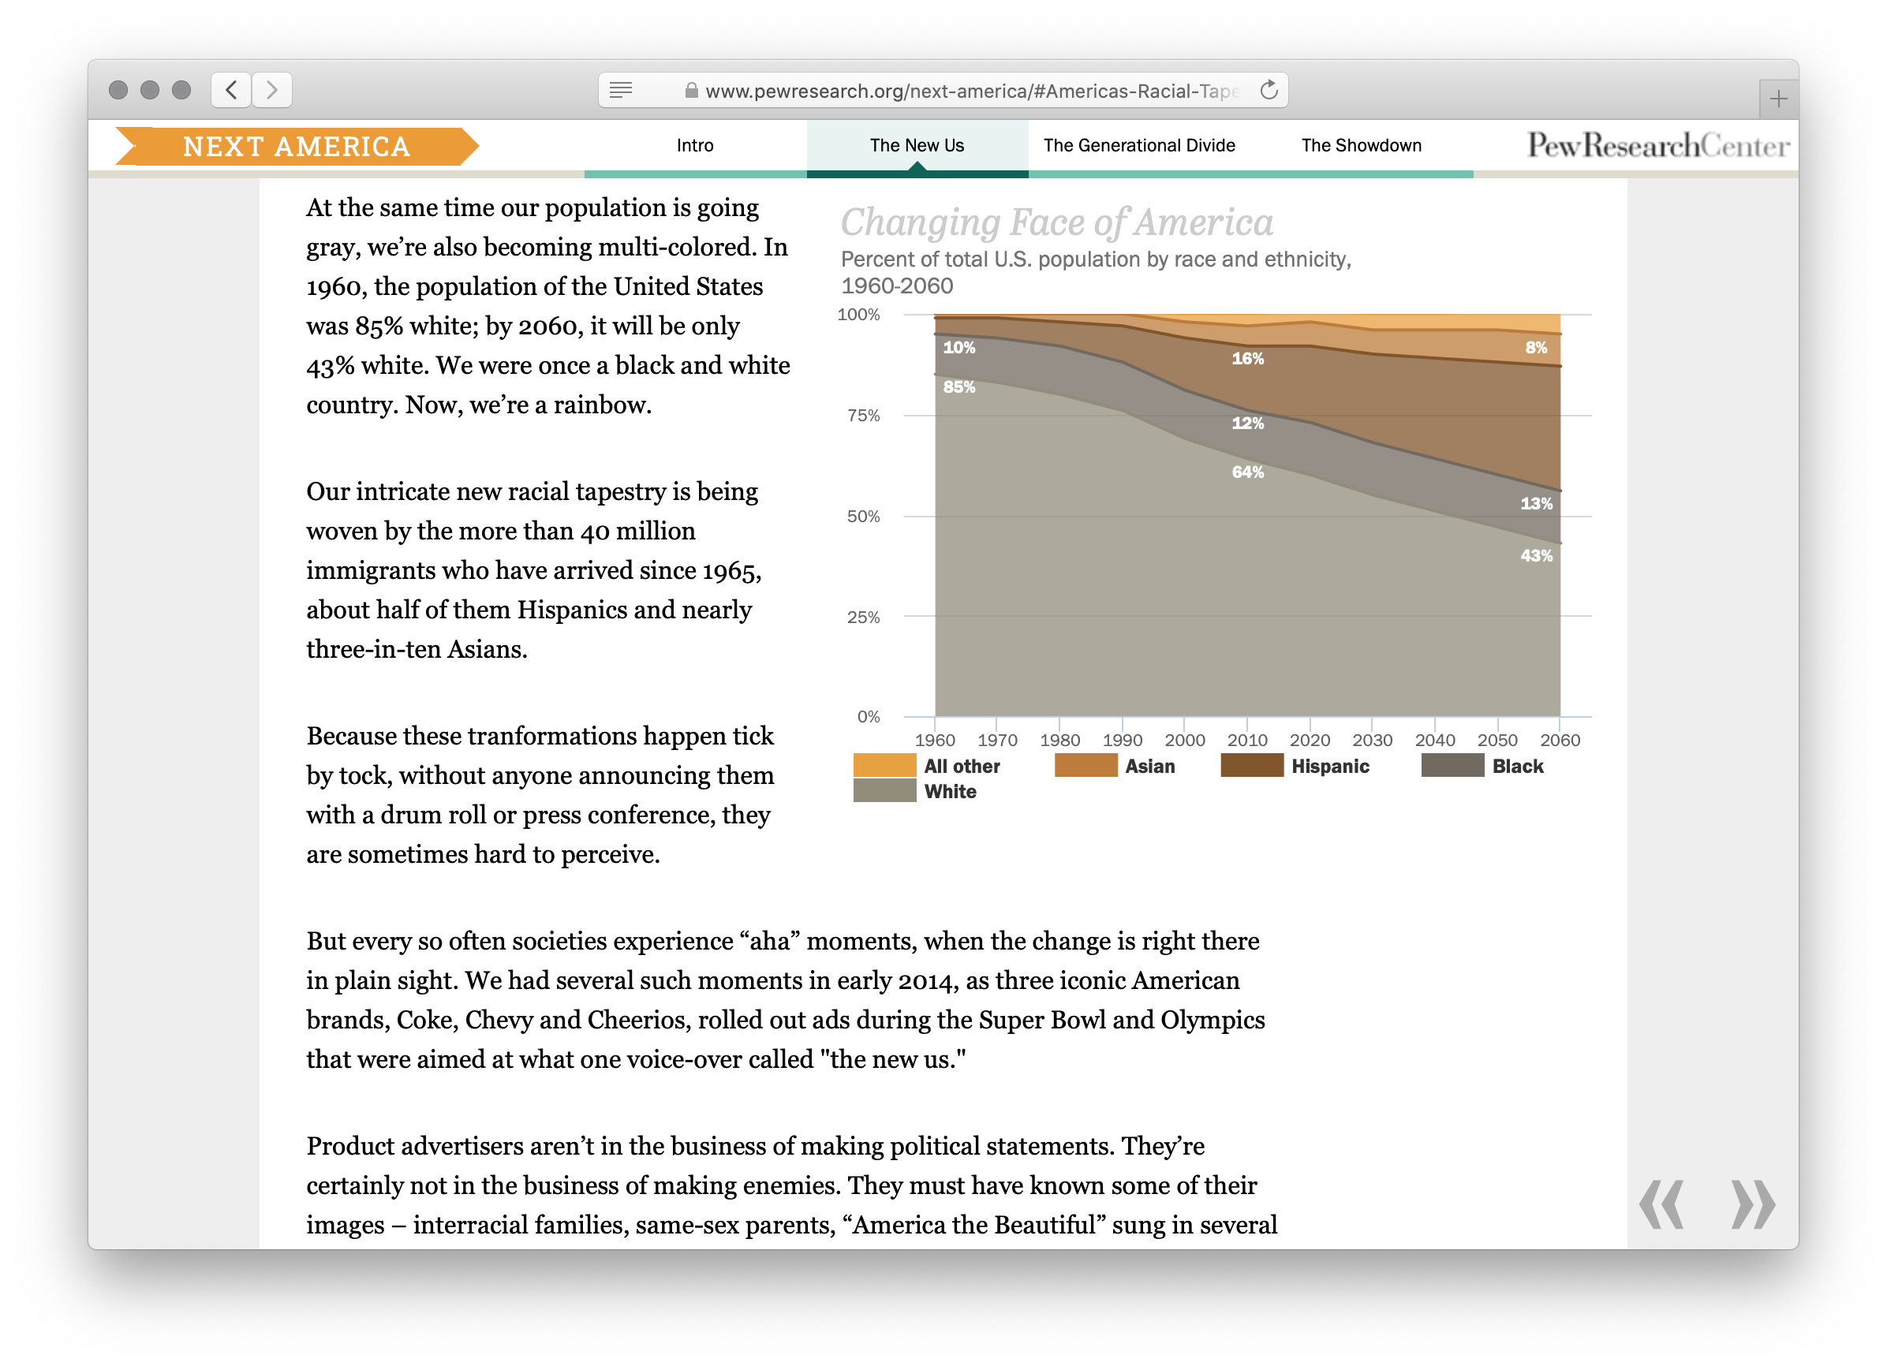
Visual Impact of Data

Slide 11
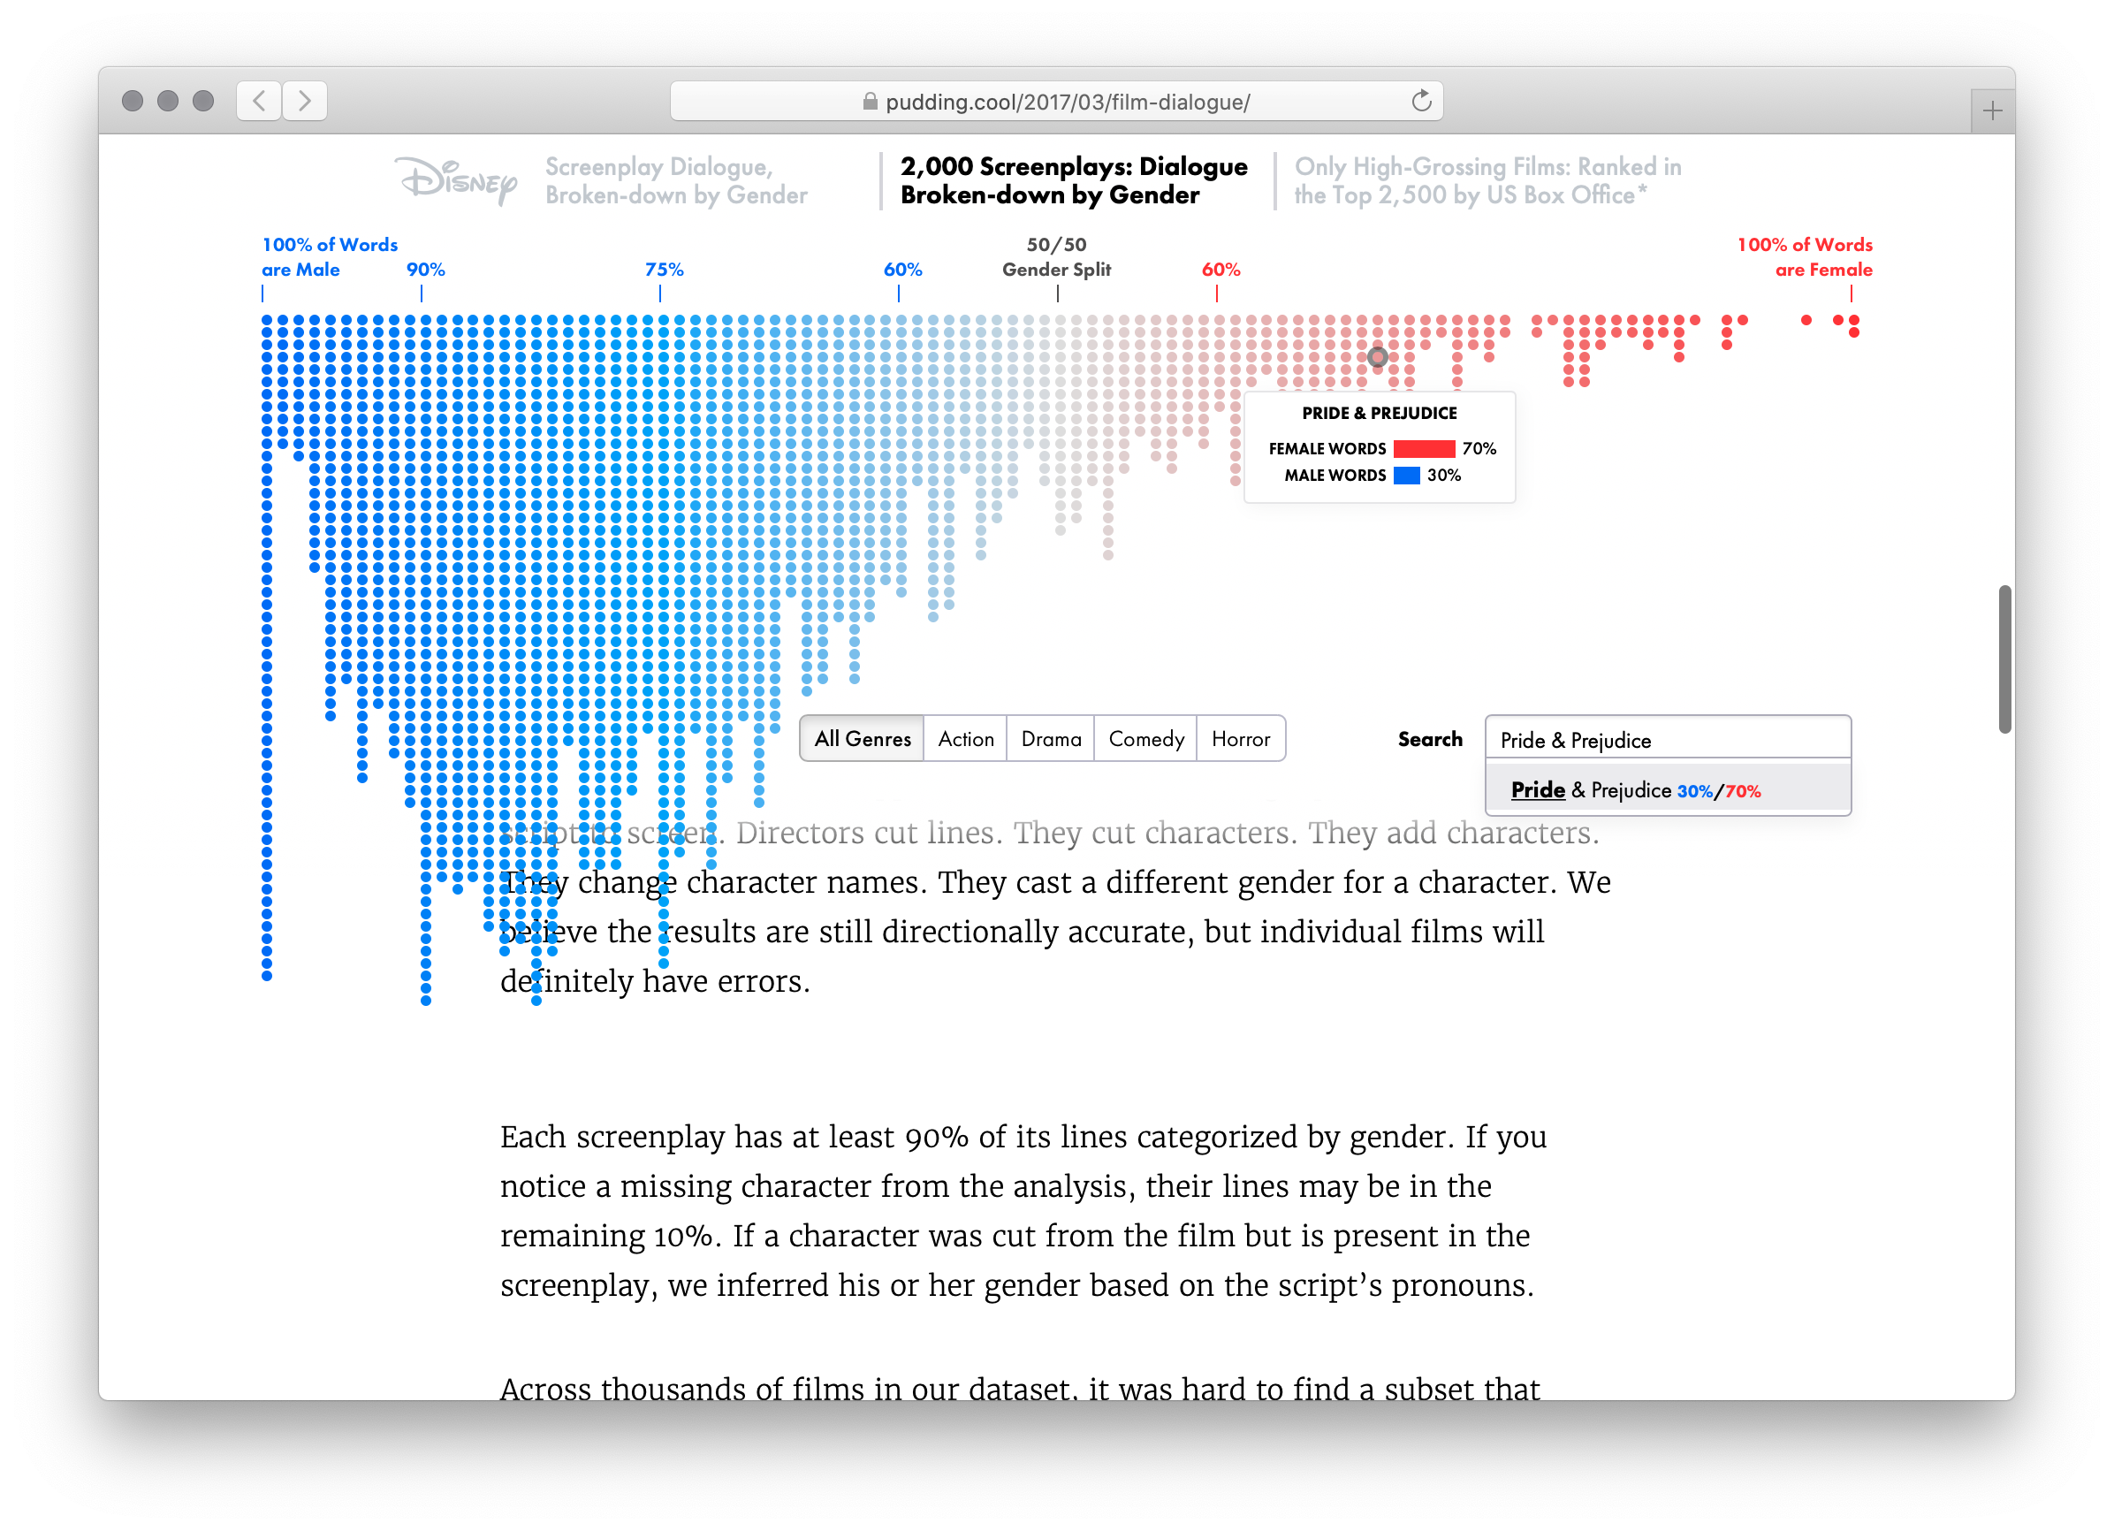
Visual Impact of Data

Slide 12
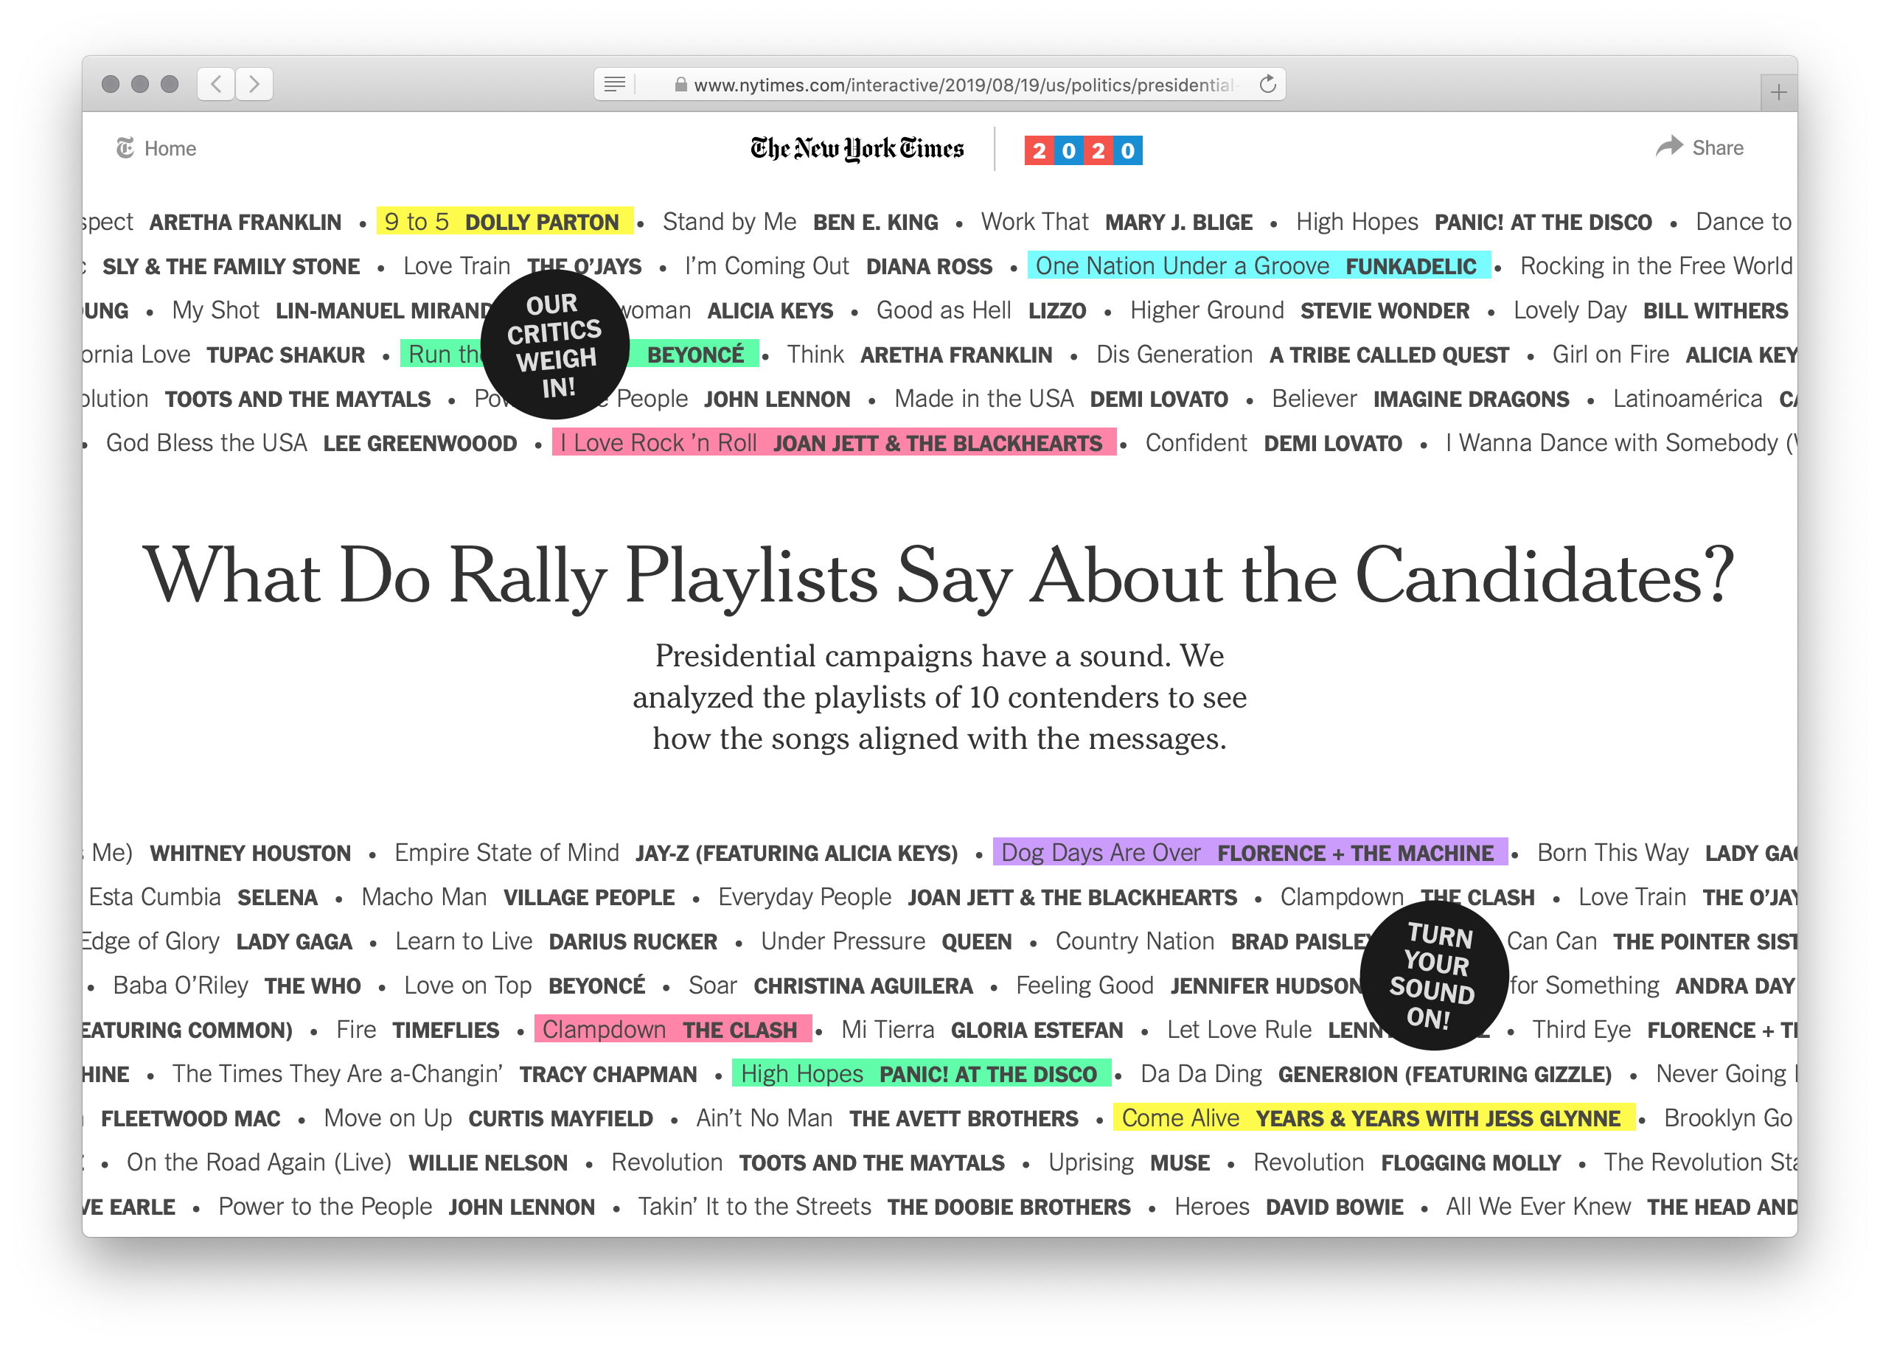
Visual Impact of Data

Slide 13
We can do visualization too!
Be sure to include dcic-2021 !
Be sure to grab municipalities again too… then we can visualize New York State census data. For example…
# How is population distributed in the state?
pie-chart(municipalities, "name", "pop-2020")
Notes:
The pie-chart should be referenced via the concise table documentation introduced during Lab 3.

Slide 14
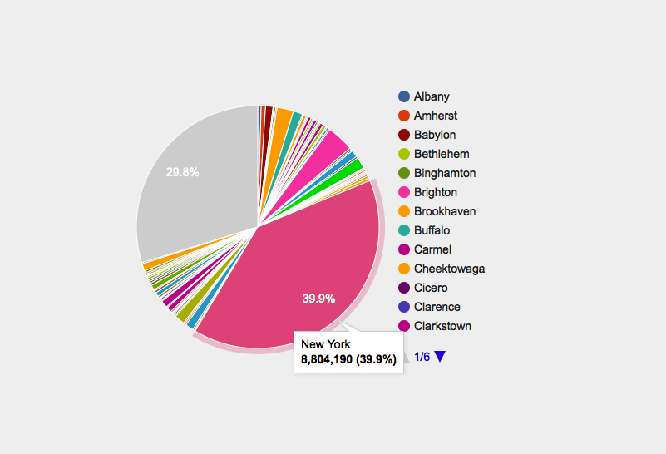
We can do visualization too!
pie-chart(municipalities, "name", "pop-2020")

Slide 15
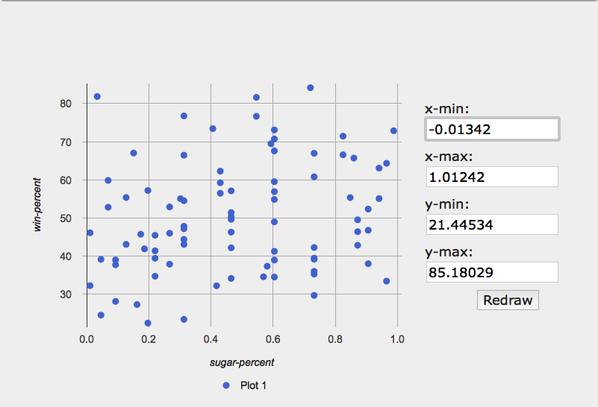
scatter-plot(candy-data, "sugar-percent", "win-percent")
Notes:
[Open Lab 2 solutions]
At the end of lab, we asked you to use a scatterplot to graph the percent of times a candy won in a face-off vs how sugary it was. There was a very weak correlation with lots of outliers.

Slide 16
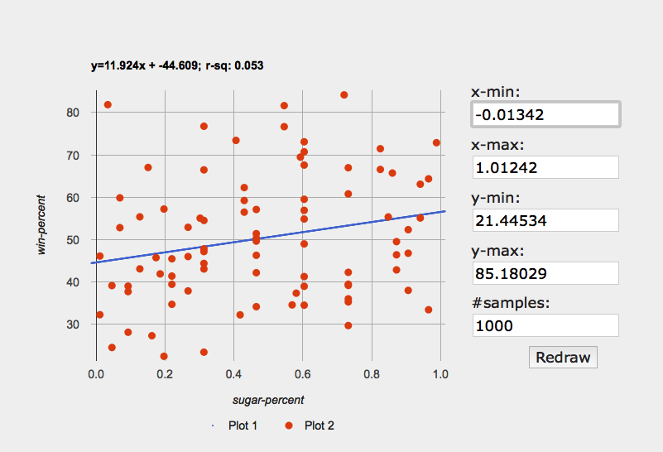
lr-plot(candy-data, "sugar-percent", "win-percent")
#lr stands for linear regression!
Notes:
We can see this relation more clearly if we fit a linear regression to it.

Slide 17
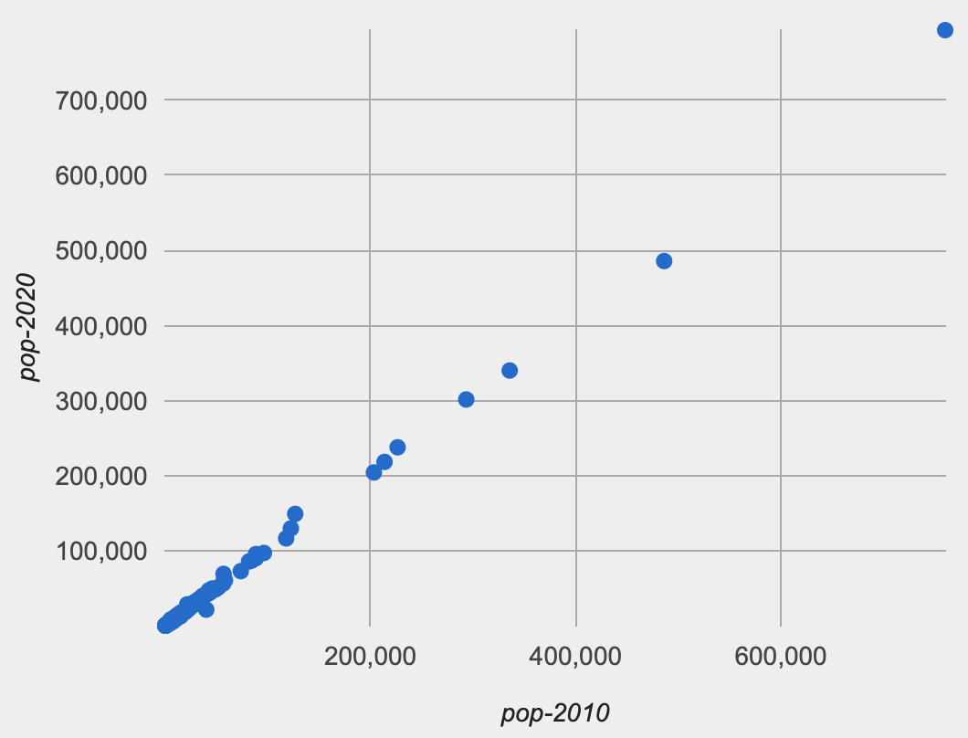
# Is a town's population in 2010 correlated with its population in 2020?
scatter-plot(ft, "pop-2010", "pop-2020")
Notes:
[Switch back to population data.]
We can see a much stronger correlation if we plot the 2010 and 2020 populations. No need to do a linear regression here to see the trend…
This makes sense, right? The population in 2010 is a *very* strong predictor of what the population will be in 2020.
That's like saying how tall a person is in 2022 is a strong predictor of how tall they'll be in 2023. Even if they grow or shrink, they're doing so relative to their current height.

Slide 18
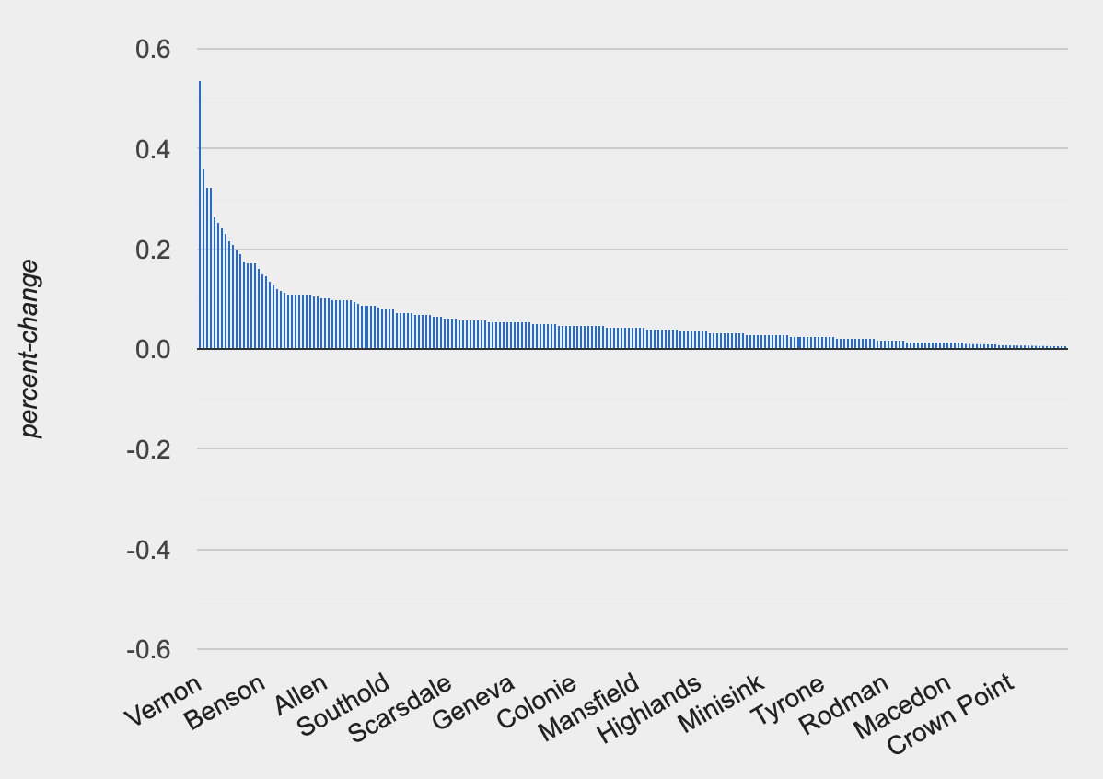
ft = fastest-growing-towns(municipalities)
# Visually present the growth data
bar-chart(ft, "name", "percent-change")
…didn’t any towns shrink?
Notes:
Finally, on Assignment 3, you're asked to use bar charts to visualize changes in the hours of sunlight and moonlight.
You'll see those charts when you finish the assignment, but we can try a different bar chart just to see what one looks like.
Last class, we wrote a function to make a table of towns in NY, ordered by how fast they were growing — the change in population relative to their starting population.
A bar chart shows us the distribution of growth percents we computed.
[advance]
Why aren't we seeing negative values? Didn't any towns shrink? [Check ft table] They did! But there are too many towns and they get cut off!
Don't trust a plot without thinking about it. Always ask if what you're seeing makes sense given what you know about the data.

Slide 19
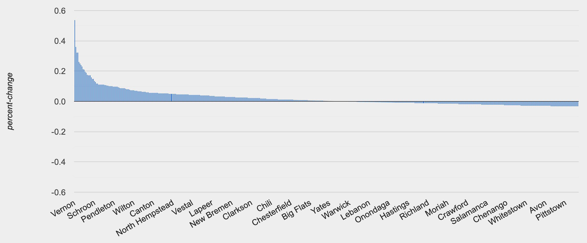
ft = fastest-growing-towns(municipalities)
# Visually present the growth data
bar-chart(ft, "name", "percent-change")
Notes:
If we drag the window to make it wider, it shows us more data.

Slide 20
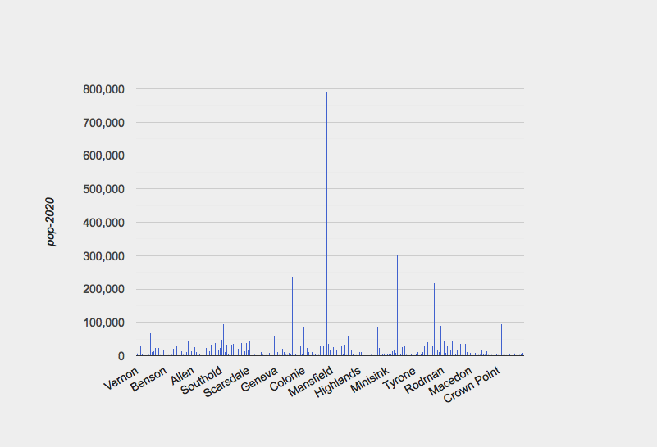
ft = fastest-growing-towns(municipalities)
# Visually present the growth data
bar-chart(ft, "name", "pop-2020")
Notes:
Now if we make the bars show the actual populations, we see there's a lot of variation without a clear pattern like the fastest growing towns were the biggest or the smallest ones.

Slide 21
Side note:
There are a staggering number of publicly available data sets that we can load from a spreadsheet.
Take a look at the archives of the Data is Plural newsletter: data-is-plural.com
This site kept me up half the night on Saturday:
https://pudding.cool/

Slide 22
Acknowledgements
This lecture incorporates material from:
Kathi Fisler, Brown University,
Gregor Kiczales, University of British Columbia,
And, Jonathan Gordon

