Slide 1
Consistently Inconsistent Data

Slide 2
“Dirty” Data:
Real data sets can be significantly harder to work with than contrived examples:
Missing values
Inconsistent entry of data
Differing levels of precision (1987 vs 7 July 1987)
Consider the town of Palm Tree in our municipalities table
Incorporated in 2019, how should pop-2020 be represented?
“---” (original, google sheet not imported if Number is expected)
0 - We saw divide by zero result though (Always protect against division-by-zero in code!)
1 – not(correct)
Something else?
Well, a little bit pyret coding can help.

Slide 3
Submitted for your approval: LFB
(Clickable link)
(download link)
Notes:
Another clickable link! Easier to find the right website this way

Slide 4
Submitted for your approval: LFB
As with municipalities and candy-data, the simplest use case:
Download csv file,
Import csv file as google (spread)sheet
Share with people and groups/get link (choose anyone with link)
Use pyret to download and create a table
Notes:
Downloadable log of animal rescue incidents starting from January, 2009. In the form of a csv!

Slide 5
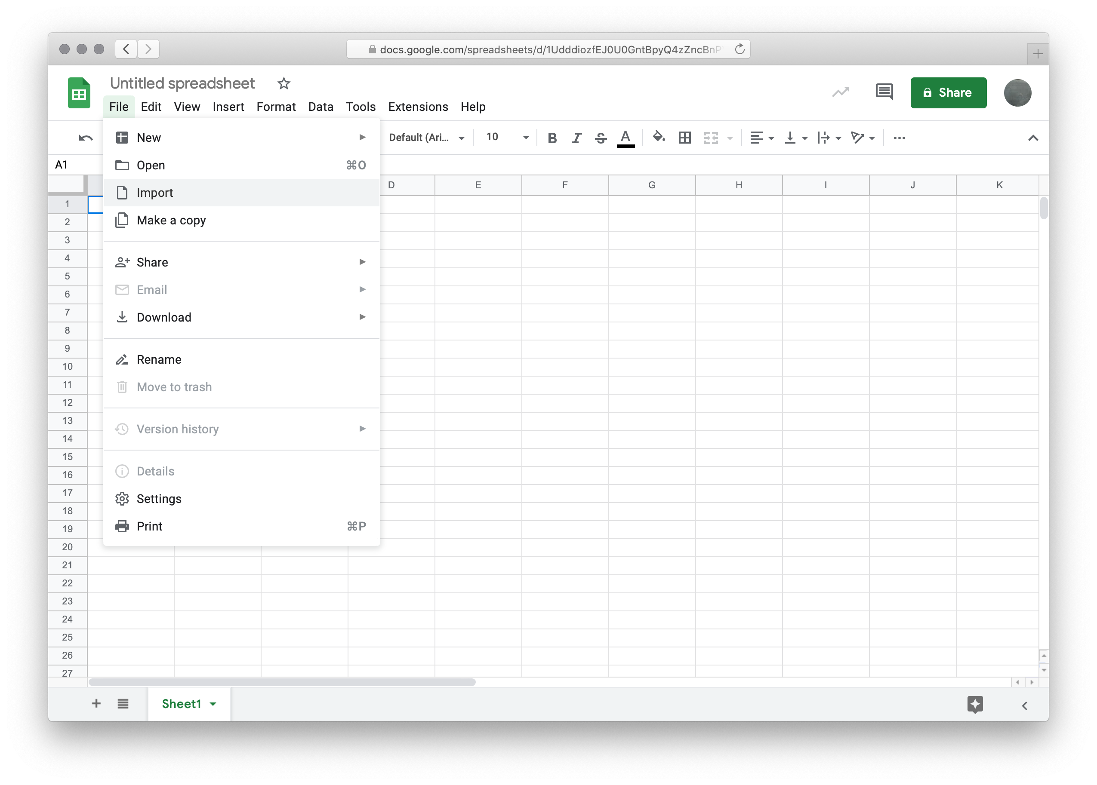
Step 1 already completed, open google sheets

Slide 6
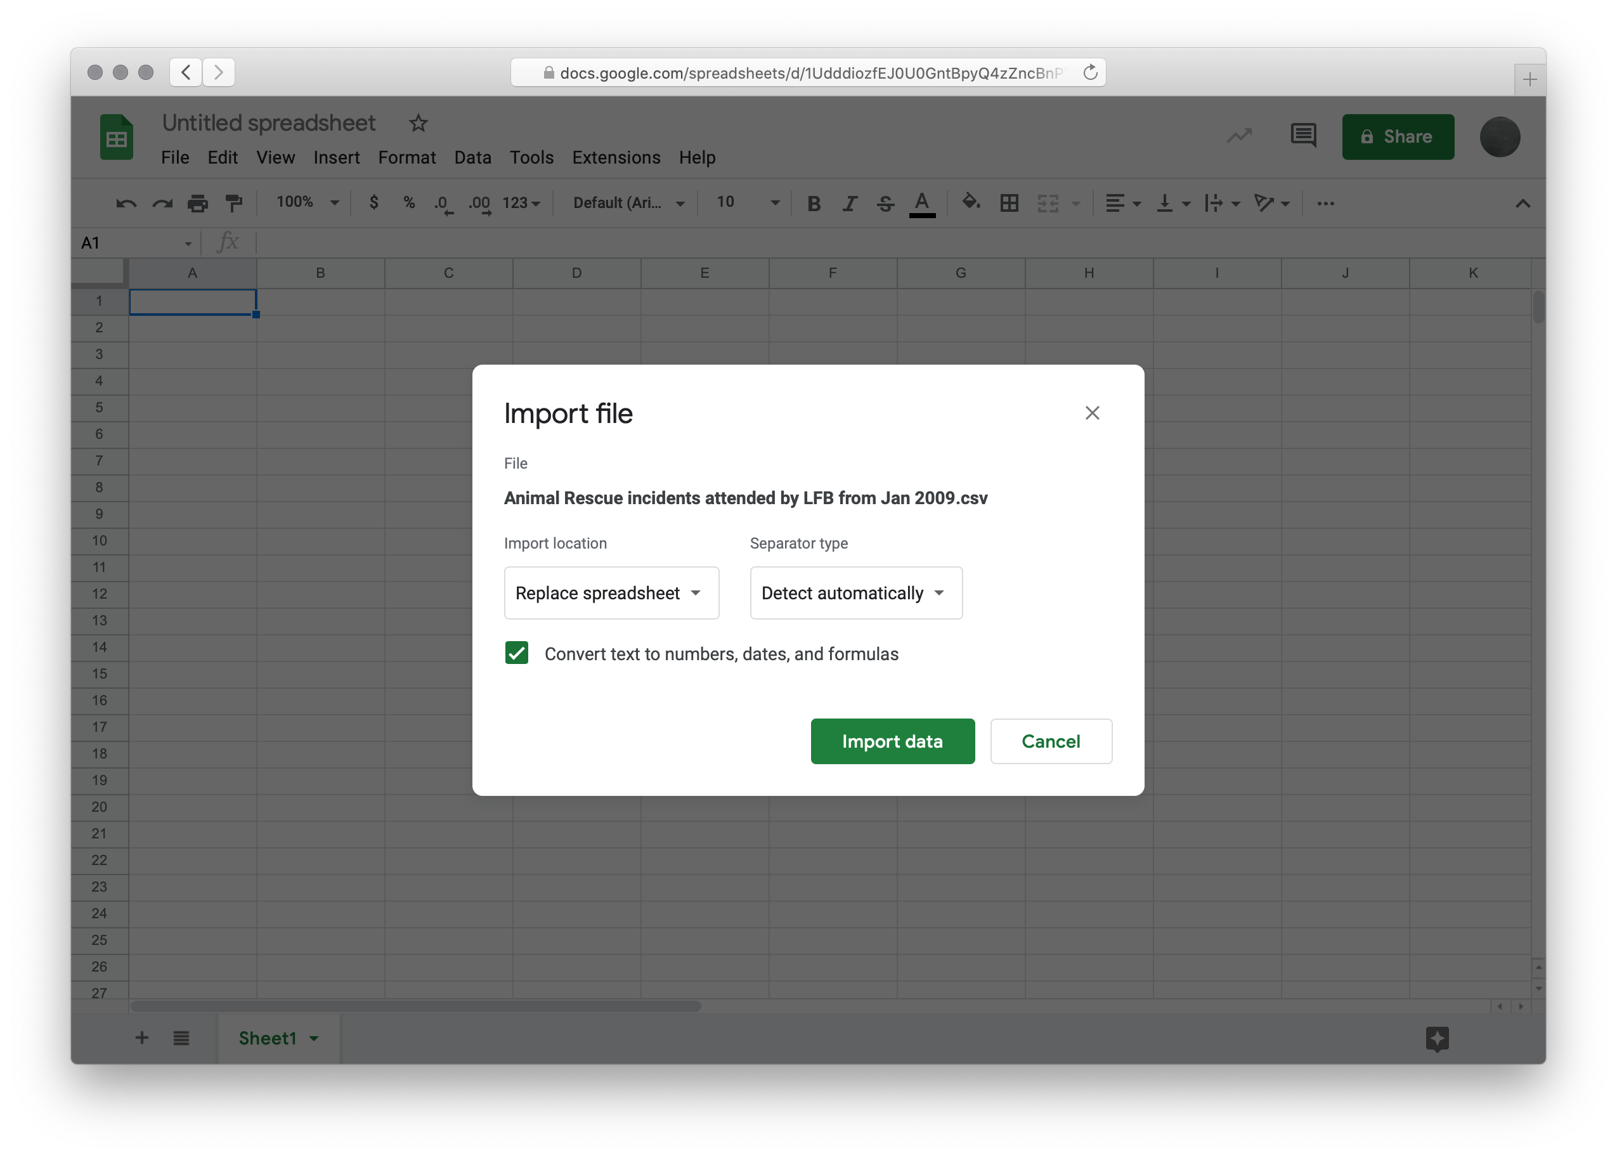
Step 2

Slide 7
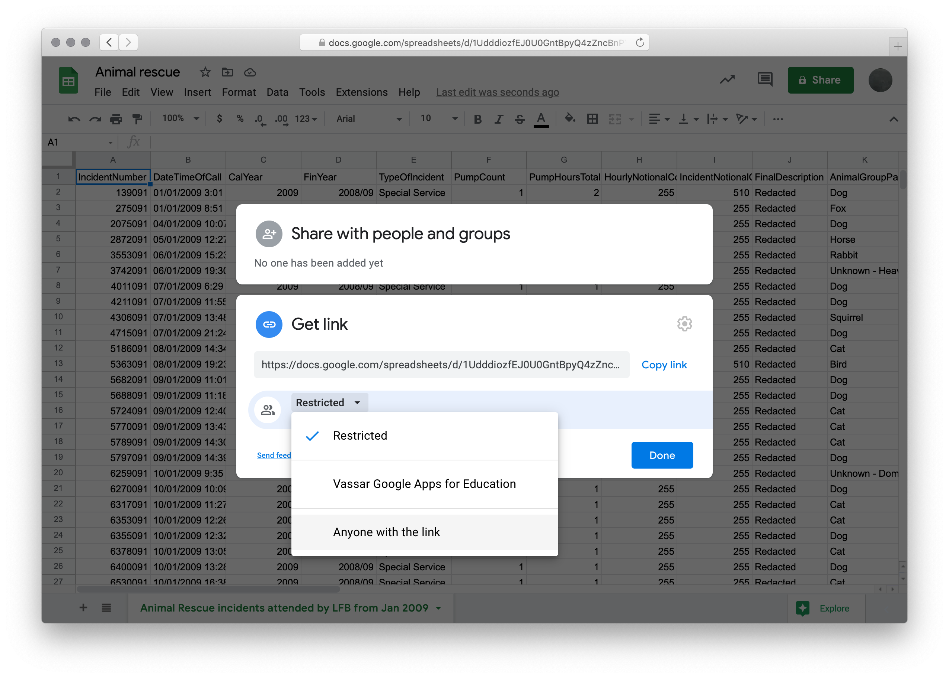
Step 3

Slide 8
Step 4
include gdrive-sheets
include shared-gdrive("dcic-2021", "1wyQZj_L0qqV9Ekgr9au6RX2iqt2Ga8Ep")
# The ID of the Google Sheets file, which appears in the URL
ssid = "1mXW5k7OGFKJvv4nK3AeGMSZzrdpjzJYLUnKWh_3jROw"
spreadsheet = load-spreadsheet(ssid)
rescue-data =
load-table:
#... Please stand by …
source: spreadsheet.sheet-by-name("ari-from-lfb", true)
end

Slide 9
Oh Nooo…
We don’t need all 33 columns, I manually removed unneeded colums

Slide 10
Step 4: You can (not) redo
include gdrive-sheets
include shared-gdrive("dcic-2021", "1wyQZj_L0qqV9Ekgr9au6RX2iqt2Ga8Ep")
# The ID of the Google Sheets file, which appears in the URL
ssid = "1mXW5k7OGFKJvv4nK3AeGMSZzrdpjzJYLUnKWh_3jROw"
spreadsheet = load-spreadsheet(ssid)
rescue-data = #note – I kept 14 separate data columns
load-table:
time, year, description, animal-group-parent, origin-of-call,
property-type, property-category, special-service-type-category,
special-service-type, ward, borough, stn-name, street, postcode
source: spreadsheet.sheet-by-name("ari-from-lfb", true)
end

Slide 11
Step 4: You can (not) redo
include gdrive-sheets
include shared-gdrive("dcic-2021", "1wyQZj_L0qqV9Ekgr9au6RX2iqt2Ga8Ep")
# The ID of the Google Sheets file, which appears in the URL
ssid = "1mXW5k7OGFKJvv4nK3AeGMSZzrdpjzJYLUnKWh_3jROw"
spreadsheet = load-spreadsheet(ssid)
rescue-data = #note – I kept 14 separate data columns
load-table:
time, year, description, animal-group-parent, origin-of-call,
property-type, property-category, special-service-type-category,
special-service-type, ward, borough, stn-name, street, postcode
source: spreadsheet.sheet-by-name("ari-from-lfb", true)
end

Slide 12
Success!

Slide 13
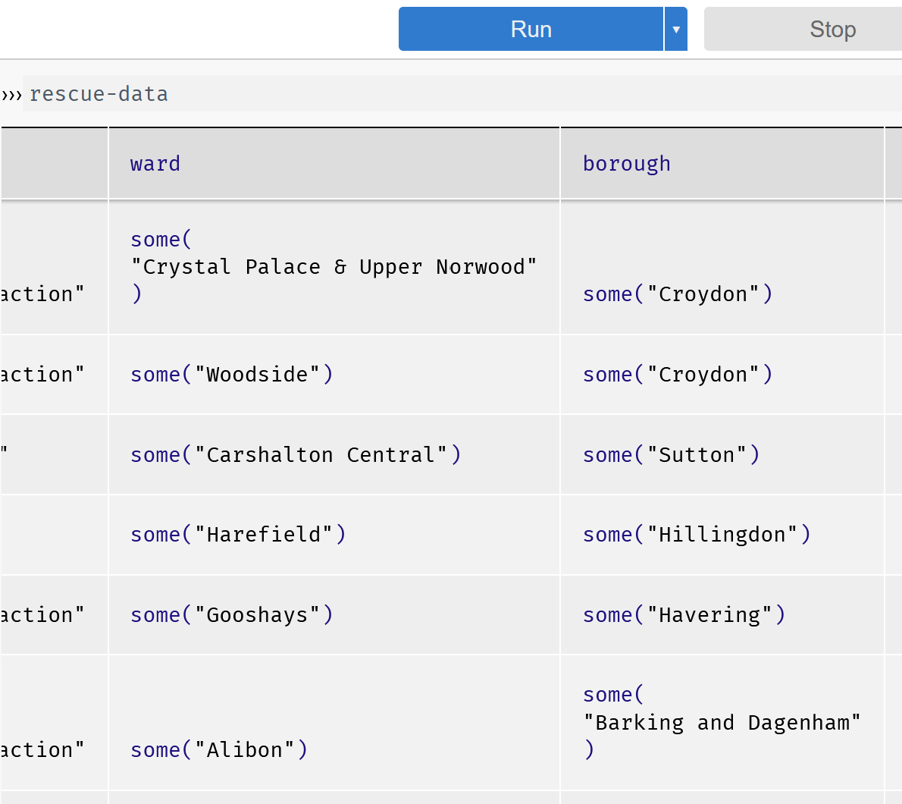
We now return to… Dirty Data
We have some in our
animal rescue table!

Slide 14
This is the endemic phase of Covid-19, after all…
To make the data end up in the format we want,
we’ll use sanitizers, which convert data from an external source into a specific Pyret data type.
Sanitizers are functions
There are some built-in ones
We can also create our own

Slide 15
The Built-in Sanitizers
These are applied to your table at load time,
i.e. a component of the load-table statement!
string-sanitizer
Replaces missing values with ""
Converts non-string data to strings, e.g., 3 to "3"
num-sanitizer
Replaces missing values with 0
Converts numeric strings to numbers, e.g., "3" to 3
Format:
sanitize column-name using string-sanitizer
sanitize column-name using num-sanitizer
Notes:
When a function name like num-sanitizer is created instead of number-sanitizer, that tells you something about the designer/developer!

Slide 16
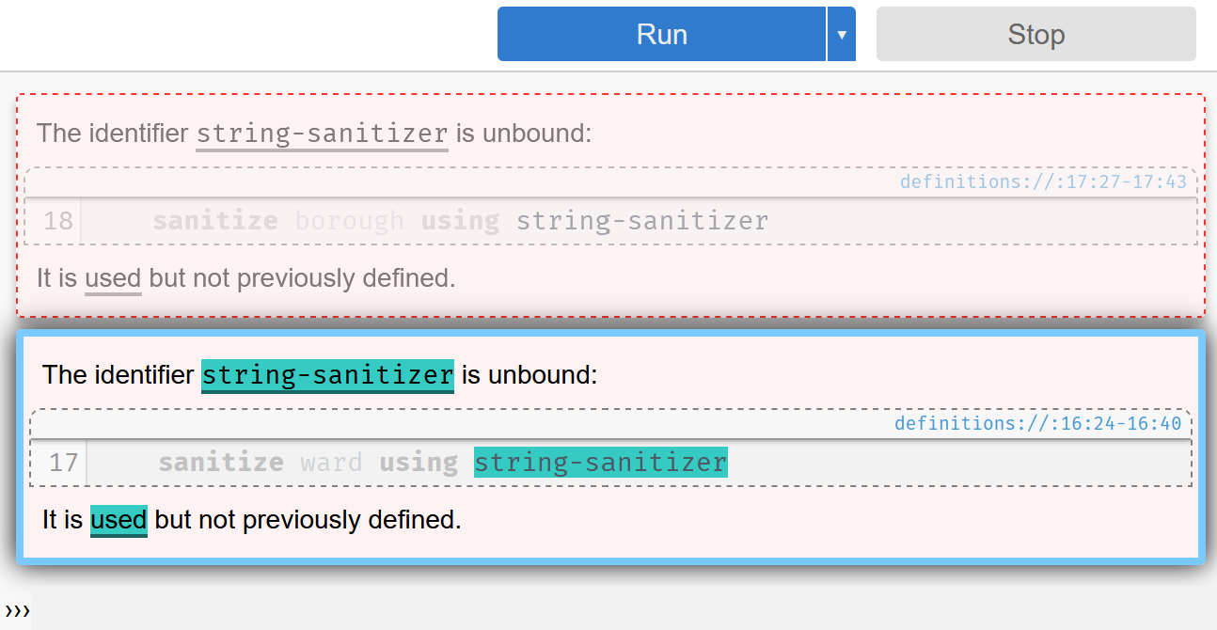
We need to tell pyret about the built-in sanitizers!
Simply adding the following to your program will accomplish this:
include data-source
If you forget to add it…

Slide 17
Add the sanitizers like so:

Slide 18
And Voila!

Slide 19
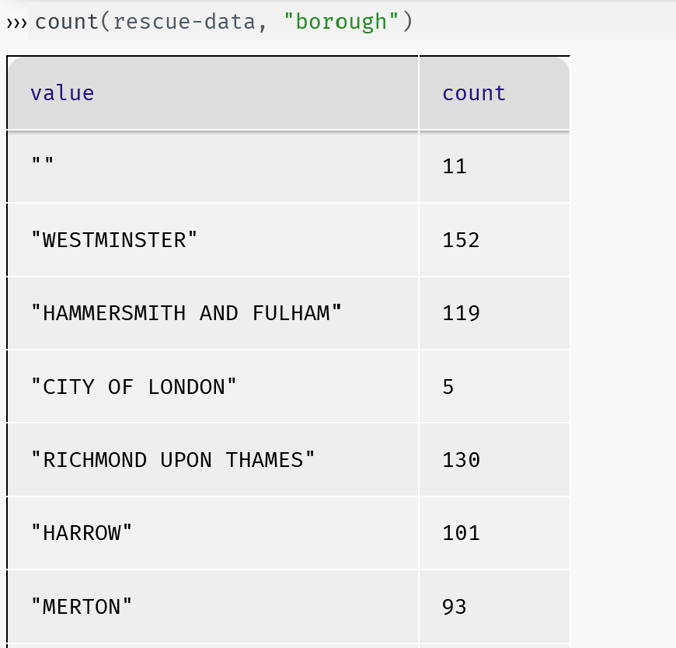
“The absence of evidence is not evidence of absence”
What should we do with null data?
Options?

Slide 20
“The absence of evidence is not evidence of absence”
What should we do with null data?
Options?
Ignore
Modify data
Remove
idk

Slide 21
“The absence of evidence is not evidence of absence”
What should we do with null data?
Options?
Ignore
Modify data
Remove
Let’s examine the data more closely!

Slide 22
Let’s look a little bit further into the null data (1)
First, let’s find them!
fun no-borough(r :: Row) -> Boolean:
doc: "Return true if the borough column is empty for a given row"
r["borough"] == ""
end

Slide 23
Let’s look a little bit further into the null data (2)
fun no-borough(r :: Row) -> Boolean:
doc: "Return true if the borough column is empty for a given row"
r["borough"] == ""
end
Then let’s filter them…
filter-with(rescue-data, no-borough)

Slide 24
Let’s look a little bit further into the null data (3)

Slide 25
Let’s look a little bit further into the null data (3)
Look like places outside of London itself? Thus no borough or word to list!

Slide 26
Let’s look a little bit further into the null data (3)
Ok so what to do?

Slide 27
Introducing transform-column
fun empty-to-other(s :: String) -> String:
doc: "Return the string or 'Other' if the string is empty."
if s == "":
"Other"
else:
s
end
end
rescue-data-clean =
transform-column(
transform-column(rescue-data,
"borough", empty-to-other),
"ward", empty-to-other)

Slide 28
transform-column
fun empty-to-other(s :: String) -> String:
doc: "Return the string or 'Other' if the string is empty."
if s == "":
"Other"
else:
s
end
end
rescue-data-transformed = #transform-column returns a new table!
transform-column(
transform-column(rescue-data,
"borough", empty-to-other),
"ward", empty-to-other)

Slide 29
Pyret: “Is that all you got, rescue-data?”
rescue-data: heh. No.
pyret: …
Rescue-data: checkout the following
order-by(
count(rescue-data-clean, "borough"),
"value", true)

Slide 30
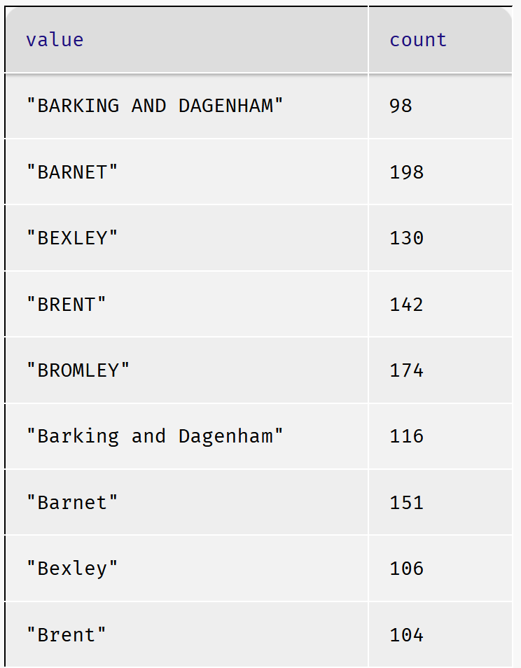
What’s all this, then?

Slide 31
Yes, a mixed-case mix-up case!

Slide 32
string-to-upper-to-the-rescue (string-to-lower too)
rescued-rescue-data = # cleanup data in one fell-swoop
transform-column(
transform-column(
transform-column(
transform-column(rescue-data,
"borough", empty-to-other),
"ward", empty-to-other),
"borough", string-to-upper),
"ward", string-to-upper

Slide 33
Maybe a better way to write the code…
fun clean-table(t :: Table) -> Table:
doc: "Fix various columns from the animal rescue spreadsheet"
# Change the blank strings to "Other"
t1 =
transform-column(
transform-column(t,
"borough", empty-to-other),
"ward", empty-to-other)
# Change strings to all uppercase
t2 =
transform-column(
transform-column(t1,
"borough", string-to-upper),
"ward", string-to-upper)
t2
end
rescue-data-clean = clean-table(rescue-data)

Slide 34
Consistently Consistent Data ==> data analysis
order-by(
count(rescue-data-clean, "borough"),
"value", true)

Slide 35
Consistently Consistent Data ==> data analysis
order-by(
count(rescue-data-clean, "borough"),
"value", true)

Slide 36
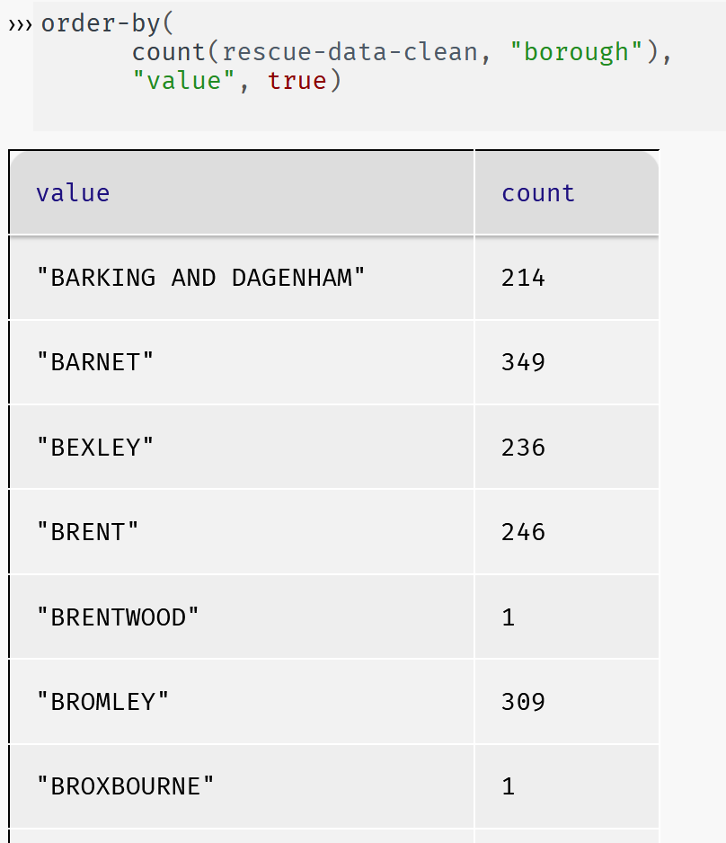
Data analysis on number of incidents by borough

Slide 37
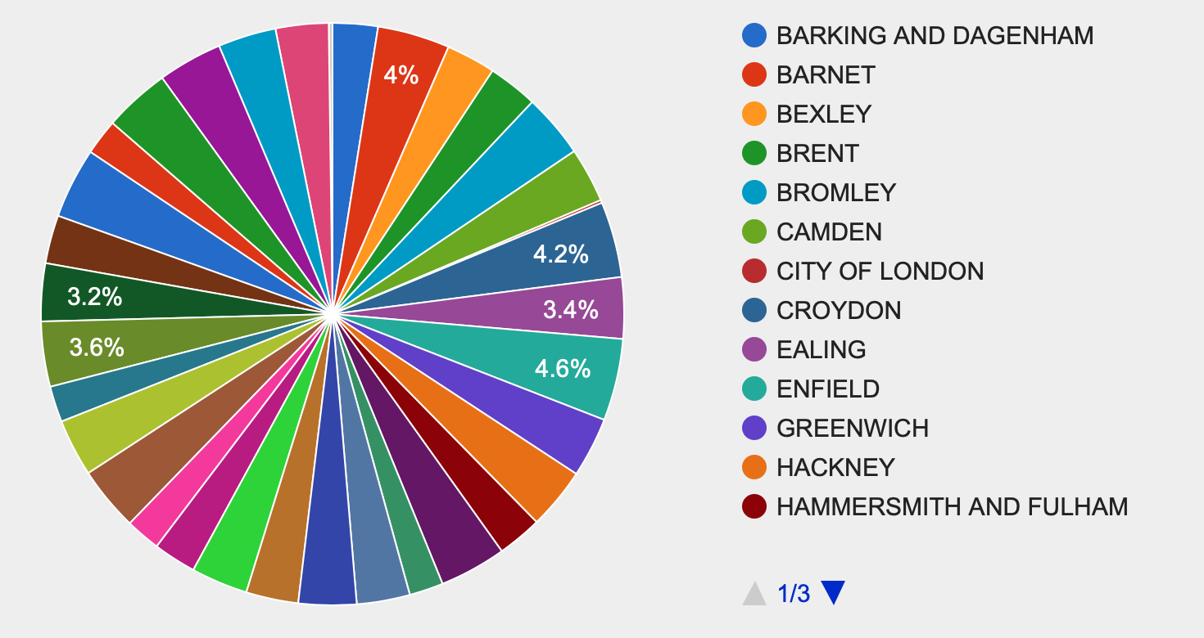
Now Visually:
borough-counts =
order-by(
count(rescue-data-clean, "borough"),
"value", true)
››› pie-chart(borough-counts, "value", "count")
Notes:
Some variation, but mostly even. No one borough that's animal-up-a-tree central.

Slide 38
How can we generalize our code?
borough-counts =
order-by(
count(rescue-data-clean, "borough"),
"value", true)
››› pie-chart(borough-counts, "value", "count")
We should want to generalize our code in order to visualize different data
Vs. copy/paste to get counts by ward, copy/paste to get counts by animal, copy/paste to…
The copy/paste actions should make you think of ?
Notes:
Some variation, but mostly even. No one borough that's animal-up-a-tree central.

Slide 39
How can we generalize our code?
borough-counts =
order-by(
count(rescue-data-clean, "borough"),
"value", true)
››› pie-chart(borough-counts, "value", "count")
We should want to generalize our code in order to visualize different data
Vs. copy/paste to get counts by ward, copy/paste to get counts by animal, copy/paste to…
The copy/paste actions should make you think of ? Answer: functions
And, what should we generalize to create our function?
Notes:
Some variation, but mostly even. No one borough that's animal-up-a-tree central.

Slide 40
How can we generalize our code?
borough-counts =
order-by(
count(rescue-data-clean, "borough"),
"value", true)
››› pie-chart(borough-counts, "value", "count")
We should want to generalize our code in order to visualize different data
Vs. copy/paste to get counts by ward, copy/paste to get counts by animal, copy/paste to…
The copy/paste actions should make you think of ? Answer: functions
And, what should we generalize to create our function? Answer: columns
Notes:
Some variation, but mostly even. No one borough that's animal-up-a-tree central.

Slide 41
How can we generalize our code?
borough-counts =
order-by(
count(rescue-data-clean, "borough"),
"value", true)
››› pie-chart(borough-counts, "value", "count")
We should want to generalize our code in order to visualize different data
Vs. copy/paste to get counts by ward, copy/paste to get counts by animal, copy/paste to…
The copy/paste actions should make you think of ? Answer: functions
And, what should we generalize to create our function? Answer: columns
But, that isn’t “general” enough!
We don’t have to limit our coding ideas to the animal rescue table!

Slide 42
Create a pie chart for any column you want to count
fun pie-chart-counts(t :: Table, col :: String) -> Image:
doc: "Make a pie chart of the number of times each value occurs in the specified table column"
counts = order-by(count(t, col), "value", true)
pie-chart(counts, "value", "count")
end
Use case: pie-chart-counts(rescue-data-clean, "animal-group-parent")
Let’s visualize this in pyret

Slide 43
Sanitize early and often
But if we scroll through the pie chart, we see a familiar problem!
We have a count for "Cat" and for "cat".
Back to cleaning data!
Where?

Slide 44
Maybe a better way to write the code… version 2
fun clean-table-v2(t :: Table) -> Table:
doc: "Fix various columns from the animal rescue spreadsheet"
# Note: the number of transform-column function
# calls must match the number of columns being transformed.
# Change the blank strings to "Other"
t1 =
transform-column(
transform-column(t,
"borough", empty-to-other),
"ward", empty-to-other)
# Change strings to all uppercase
t2 =
transform-column(
transform-column(
transform-column(t1,
"borough", string-to-upper),
"ward", string-to-upper),
"animal-group-parent", string-to-upper)
t2
end
rescue-data-clean-v2 = clean-table-v2(rescue-data)

Slide 45
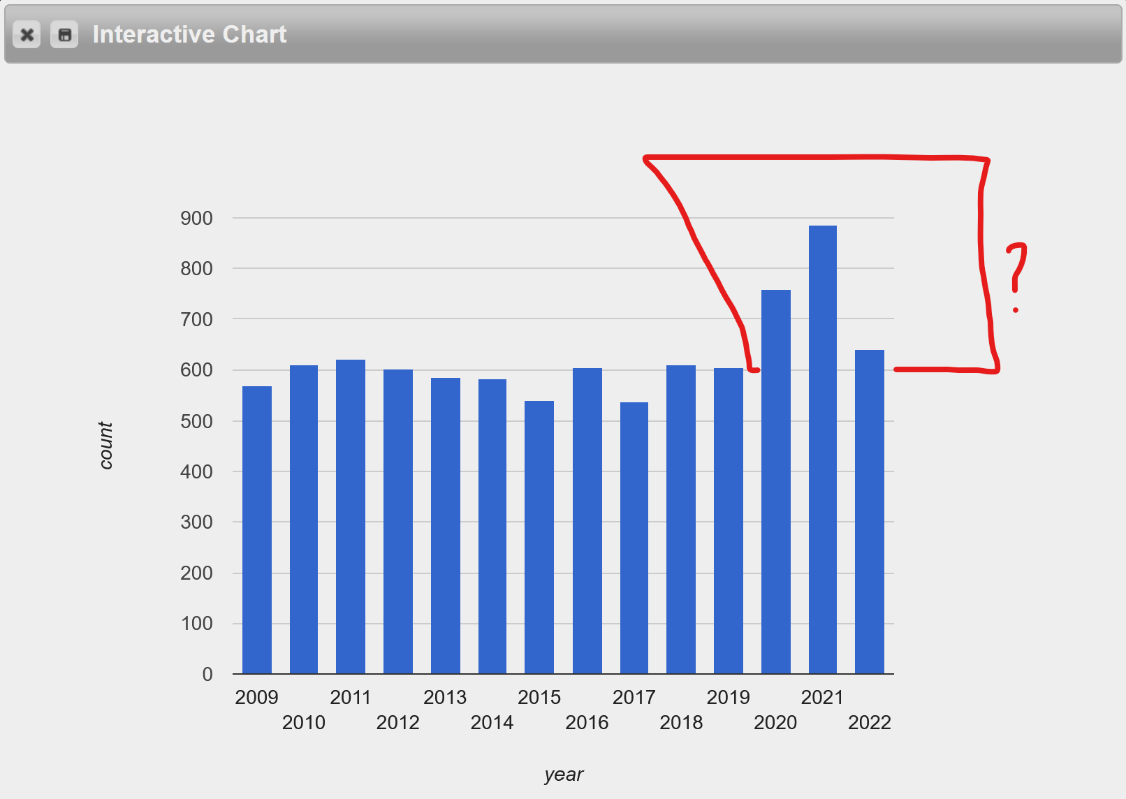
Visualizing year-to-year data
Via bar charts
freq-bar-chart(rescue-data-clean-v2, "year”)
Pandemic related?

Slide 46
Let’s find out by splitting the data
We can split the data into pre-2020 and 2020–2022 to explore this "surge". (Where should early 2022 data be included?)
fun plague-year(r :: Row) -> Boolean:
doc: "Return true if the row takes place during the COVID pandemic (rounding up to full years)"
(r["year"] == 2020) or (r["year"] == 2021) or (r["year"] == 2022)
end
rescue-data-plague = filter-with(rescue-data-clean-v2, plague-year)
fun not-plague(r :: Row) -> Boolean:
doc: "Return true if the row is from a year entirely before or after the COVID pandemic"
not(plague-year(r))
end
rescue-data-not-plague = filter-with(rescue-data-clean-v2, not-plague)

Slide 47
Side-by-side: BC (Before Covid) vs DC (During Covid)
pie-chart-counts(rescue-data-not-plague, "property-category")
pie-chart-counts(rescue-data-plague, "property-category")
Notes:
Basically, people were home more often! Note that outdoor and non residential and boat all went down, comparatively, as well.

Slide 48
Access to the code from this lecture
https://code.pyret.org/editor#share=1vSgZiuKMo9WJWcx174T_xAMiIYdTA2X5&v=31c9aaf

Slide 49
Acknowledgements
This lecture incorporates material from:
Kathi Fisler, Brown University,
Gregor Kiczales, University of British Columbia,
And, Jonathan Gordon

