Slide 1
Coming Attractions Lambdas &Lists

Slide 2
Function Call vs. Inline Function
A function call is, essentially, a “break in the action” for a CPU
Such that it might take a moment to find out where that function actually is:
They could be built-in or user written, like the textbook functions we have to include
An inline function is code that the CPU can execute line-by-line
Similar to how one would read a book (no skipping around!)

Slide 3
Introducing: λ
fun percent-true(t :: Table, col :: String) -> Number:
doc: "Return the percentage of rows that are true in column 'col'"
fun true-filter(r :: Row) -> Boolean:
r[col]
end
filter-with(t, true-filter).length() / t.length()
end
# The nested function true-filter is only used (called) in one location
Do we have to name it and call it if we’re only going to do this once?
Spoiler alert: No, we don’t!

Slide 4
Introducing: λ
fun percent-true(t :: Table, col :: String) -> Number:
doc: "Return the percentage of rows that are true in column 'col'"
filter-with(t, lam(r): r[col] end).length()
/ t.length()
filter-with(t, true-filter).length() / t.length()
end
# We can instruct pyret to use an unnamed function!
It will only ever be executed in-line (and from within filter-with)

Slide 5
Definition: λ
A lambda expression defines an anonymous function
i.e. a function that can be passed as an argument but doesn’t have an associated name.
A lambda expression is executed as an in-line function
And can improve application performance (why?)
They are a common feature in modern programming languages
Recognize them, but use them as you become comfortable using them.
Useful as “helper functions”
Nothing wrong with named functions!

Slide 6
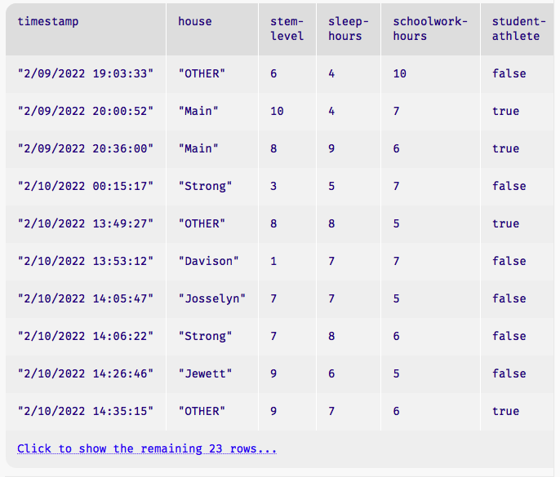
Rows are easy to access.
.row-n gives us a row in a table…

Slide 7
Rows are easy to access. But what about columns?
.row-n gives us a row in a table…
How can we access all the elements in one column?

Slide 8
Introducing: lists
.row-n gives us a row in a table…
How can we access all the elements in one column?
A: get-column
Example:
student-data-cleaned.get-column("house")
[list: "OTHER", "Main", "Main", "Strong", ...]

Slide 9
Introducing: lists
The concept is similar to Zeyu Zheng’s solution from earlier in the lecture!
in that solution, there was one big string with all the house names. (a kind-of list!)
string-contains was used to find the desired string in “list” of house names
What if we want to use the “substrings” independently.
It is messy to separate each house name!
What if we wanted to do something similar with numbers or Booleans or…
a general all-purpose solution for all data types besides strings is needed

Slide 10
Introducing: lists for student data
houses = [list: "Main", "Strong", "Raymond",
"Davison", "Lathrop", "Jewett", "Josselyn",
"Cushing", "Noyes"]
fun normalize-house(house :: String) -> String:
doc: "Return one of the nine Vassar houses or 'Other'"
if member(houses, house):
house
else:
"Other"
end
where:
normalize-house("Main") is "Main"
normalize-house("Offcampus") is "Other"
end
houses, pictorally
Notes:
I’ve highlighted how we define a list, and an example of how we might use a list consisting of student housing on campus.

Slide 11
Link to code
https://code.pyret.org/editor#share=1WXx7yJvtOKJtXjza0CdCi8gdtozF8ZnR&v=31c9aaf

Slide 12
Acknowledgements
This lecture incorporates material from:
Kathi Fisler, Brown University,
Jason Waterman, Vassar College
And, Jonathan Gordon, Vassar College

