Slide 1
Lists

Slide 2
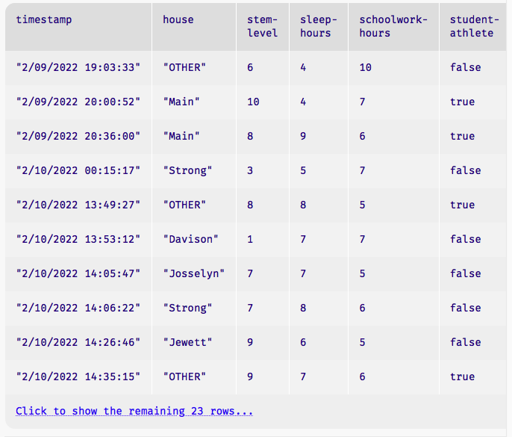
Introducing: lists
.row-n gives us a row in a table…
How can we access all the elements in one column?
A: get-column
Example:
student-data-cleaned.get-column("house")
[list: "OTHER", "Main", "Main", "Strong", ...]

Slide 3
Introducing: lists for student data
houses = [list: "Main", "Strong", "Raymond",
"Davison", "Lathrop", "Jewett", "Josselyn",
"Cushing", "Noyes"]
fun normalize-house(house :: String) -> String:
doc: "Return one of the nine Vassar houses or 'Other'"
if L.member(houses, house):
house
else:
"Other"
end
where:
normalize-house("Main") is "Main"
normalize-house("Offcampus") is "Other"
end
houses, pictorally
Notes:
I’ve highlighted how we define a list, and an example of how we might use a list consisting of student housing on campus.

Slide 4
Using Lists
To work with lists, the statement:
use context essentials2021
Will provide list capabilities.

Slide 5
Let’s play a game!
Mad Libs
Given a part of speech (noun, verb, etc.) create a random word that fits
Then, a sentence requiring that part of speech is shown, with that word!
In doing so we create a hilarious sentence!
An example: Plural-Noun
Answer: Rocks

Slide 6
Let’s play a game!
Mad Libs
Given a part of speech (noun, verb, etc.) create a random word that fits
Then, a sentence requiring that part of speech is shown, with that word!
In doing so we create a hilarious sentence!
An example: Plural-Noun
Answer: Rocks
The sentence:
We saw many Plural-Noun on vacation this summer!
Becomes:
We saw many Rocks on vacation this summer!

Slide 7
Thousands of Plural-Noun ago, there were calendars that enabled the ancient Plural-Noun to divide a year into twelve Plural-Noun, each month into Number weeks, and each week into seven Plural-Noun. At first, people told time by a sun clock, sometimes known as the Noun dial. Ultimately, they invented the great timekeeping devices of today, such as the grandfather Noun, the pocket Noun, the alarm Noun, and, of course, the Body-Part watch. Children learn about clocks and time almost before they learn their A-B- Alphabet-Letter s. They are taught that a day consists of 24 Plural-Noun, an hour has 60 Plural-Noun, and a minute has 60 Plural-Noun. By the time they are in Kindergarten, they know if the big Body-Part is at twelve and the little Body-Part is at three, that it is Number o’clock. I wish we could continue this Adjective lesson, but we’ve run out of Noun.
Notes:
[Write each answer on the text so it appears correctly when I advance]

Slide 8
Thousands of Plural-Noun ago, there were calendars that enabled the ancient Plural-Noun to divide a year into twelve Plural-Noun, each month into Number weeks, and each week into seven Plural-Noun. At first, people told time by a sun clock, sometimes known as the Noun dial. Ultimately, they invented the great timekeeping devices of today, such as the grandfather Noun, the pocket Noun, the alarm Noun, and, of course, the Body-Part watch. Children learn about clocks and time almost before they learn their A-B- Alphabet-Letter s. They are taught that a day consists of 24 Plural-Noun, an hour has 60 Plural-Noun, and a minute has 60 Plural-Noun. By the time they are in Kindergarten, they know if the big Body-Part is at twelve and the little Body-Part is at three, that it is Number o’clock. I wish we could continue this Adjective lesson, but we’ve run out of Noun.
Notes:
[read]
Endless amusement, but too much work! Let's automate it. Make the game play itself.

Slide 9
Q: How can we represent text?
template = "Thousands of Plural-Noun ago, there were calendars that enabled the ancient Plural-Noun to divide a year into twelve Plural-Noun , each month into Number weeks, and each week into seven Plural-Noun . At first, people told time by a sun clock, sometimes known as the Noun dial. Ultimately, they invented the great timekeeping devices of today, such as the grandfather Noun , the pocket Noun , the alarm Noun , and, of course, the Body-Part watch. Children learn about clocks and time almost before they learn their A-B- Alphabet-Letter s. They are taught that a day consists of 24 Plural-Noun , an hour has 60 Plural-Noun , and a minute has 60 Plural-Noun . By the time they are in Kindergarten, they know if the big Body-Part is at twelve and the little Body-Part is at three, that it is Number o'clock. I wish we could continue this Adjective lesson, but we’ve run out of Noun ."

Slide 10
A: As a list of words!
template = "Thousands of Plural-Noun ago, …"
template-words = string-split-all(template, " ")
››› template-words
[list: "Thousands", "of", "Plural-Noun", "ago", ...]

Slide 11
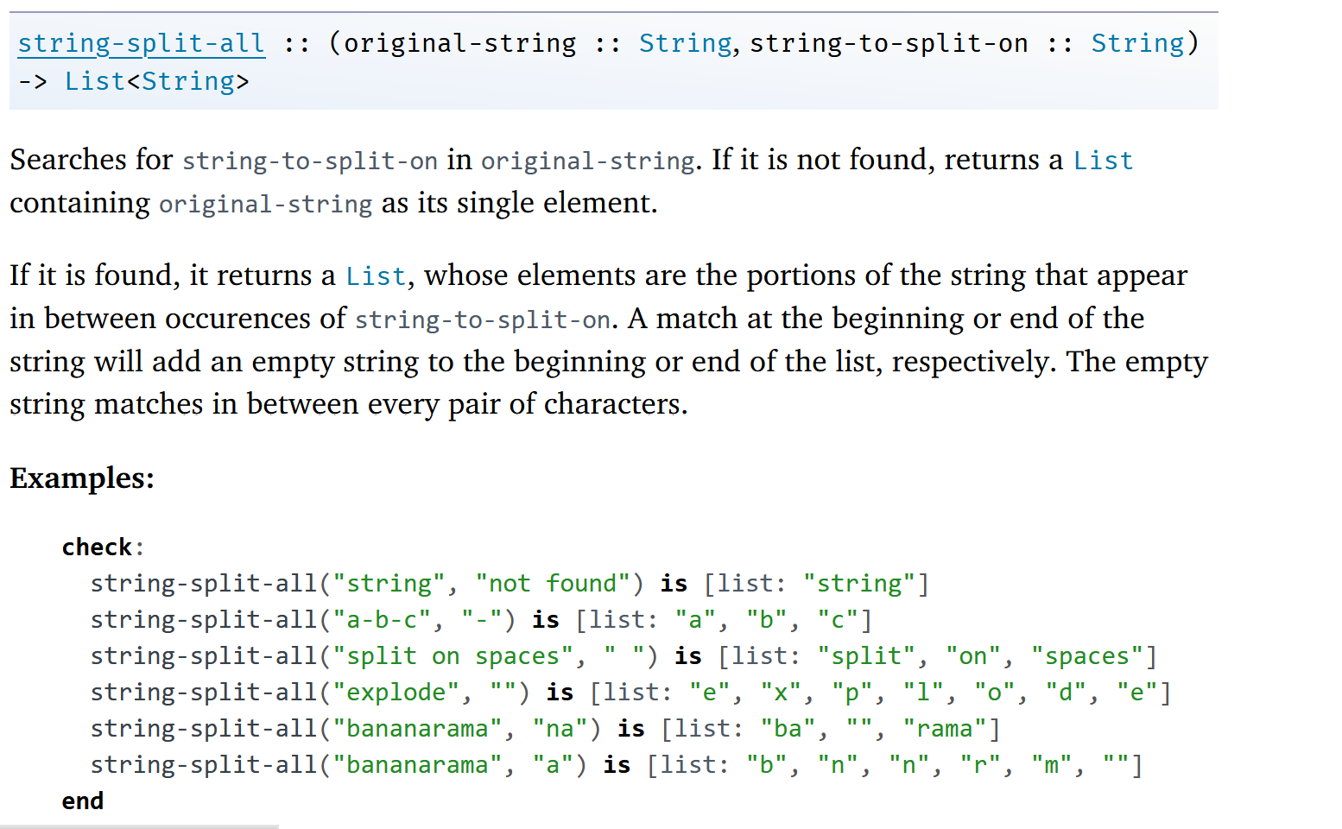
From the documentation
<String> refers to a specific data type
Notes:
List<Boolean> List<Numbers> etc.

Slide 12
From the documentation

Slide 13
We now return you to our list of words
template = "Thousands of Plural-Noun ago, …"
template-words = string-split-all(template, " ")
#shout out to “Plural-Noun”
››› template-words
[list: "Thousands", "of", "Plural-Noun", "ago", ...]

Slide 14
We now return you to our list of words
template = "Thousands of Plural-Noun ago, …"
template-words = string-split-all(template, " ")
#shout out to “Plural-Noun”
››› template-words
[list: "Thousands", "of", "Plural-Noun", "ago", ...]

Slide 15
Let’s diagram what we want to do
"Thousands of Plural-Noun ago, ..."
string-split-all
[list: "Thousands", "of", "Plural-Noun", "ago", ...]

Slide 16
From “Plural-Noun” to “gazebos”
"Thousands of Plural-Noun ago, ..."
string-split-all
[list: "Thousands", "of", "Plural-Noun", "ago", ...]
[list: "Thousands", "of", "gazebos", "ago", ...]
Something like transform-column but for lists

Slide 17
From “Plural-Noun” to “gazebos”
"Thousands of Plural-Noun ago, ..."
string-split-all
[list: "Thousands", "of", "Plural-Noun", "ago", ...]
[list: "Thousands", "of", "gazebos", "ago", ...]
Needs a helper function!
Something like transform-column but for lists

Slide 18
substitute-word does what we want
"Thousands of Plural-Noun ago, ..."
string-split-all
[list: "Thousands", "of", "Plural-Noun", "ago", ...]
substitute-word
"Thousands" -> "Thousands"
"Plural-Noun" -> "gazebos"
[list: "Thousands", "of", "gazebos", "ago", ...]
Something like transform-column but for lists

Slide 19
How can we represent a text?

Slide 20
Let’s write the helper function substitute-word
fun substitute-word(w :: String) -> String:
doc: "Substitute a random word if w is a category"
...
where:
substitute-word("Thousands") is "Thousands"
substitute-word("Plural-Noun") is ...
end

Slide 21
Just one question – what word should we use?
fun substitute-word(w :: String) -> String:
doc: "Substitute a random word if w is a category"
...
where:
substitute-word("Thousands") is "Thousands"
substitute-word("Plural-Noun") is ...
end

Slide 22
Well, we know what word it isn’t (is-not)!
fun substitute-word(w :: String) -> String:
doc: "Substitute a random word if w is a category"
...
where:
substitute-word("Thousands") is "Thousands"
substitute-word("Plural-Noun") is-not "Plural-Noun"
end

Slide 23
Getting closer…
plural-nouns = [list: "gazebos", "avocados", "pandas"]
fun substitute-word(w :: String) -> String:
doc: "Substitute a random word if w is a category"
...
where:
substitute-word("Thousands") is "Thousands"
substitute-word("Plural-Noun") is-not "Plural-Noun“
member(
plural-nouns,
substitute-word("Plural-Noun"))
is true
end

Slide 24
Getting closer… but we want some randomness!
plural-nouns = [list: "gazebos", "avocados", "pandas"]
fun substitute-word(w :: String) -> String:
doc: "Substitute a random word if w is a category"
if w == "Plural-Noun":
...
else:
w
end
where:
...
end

Slide 25
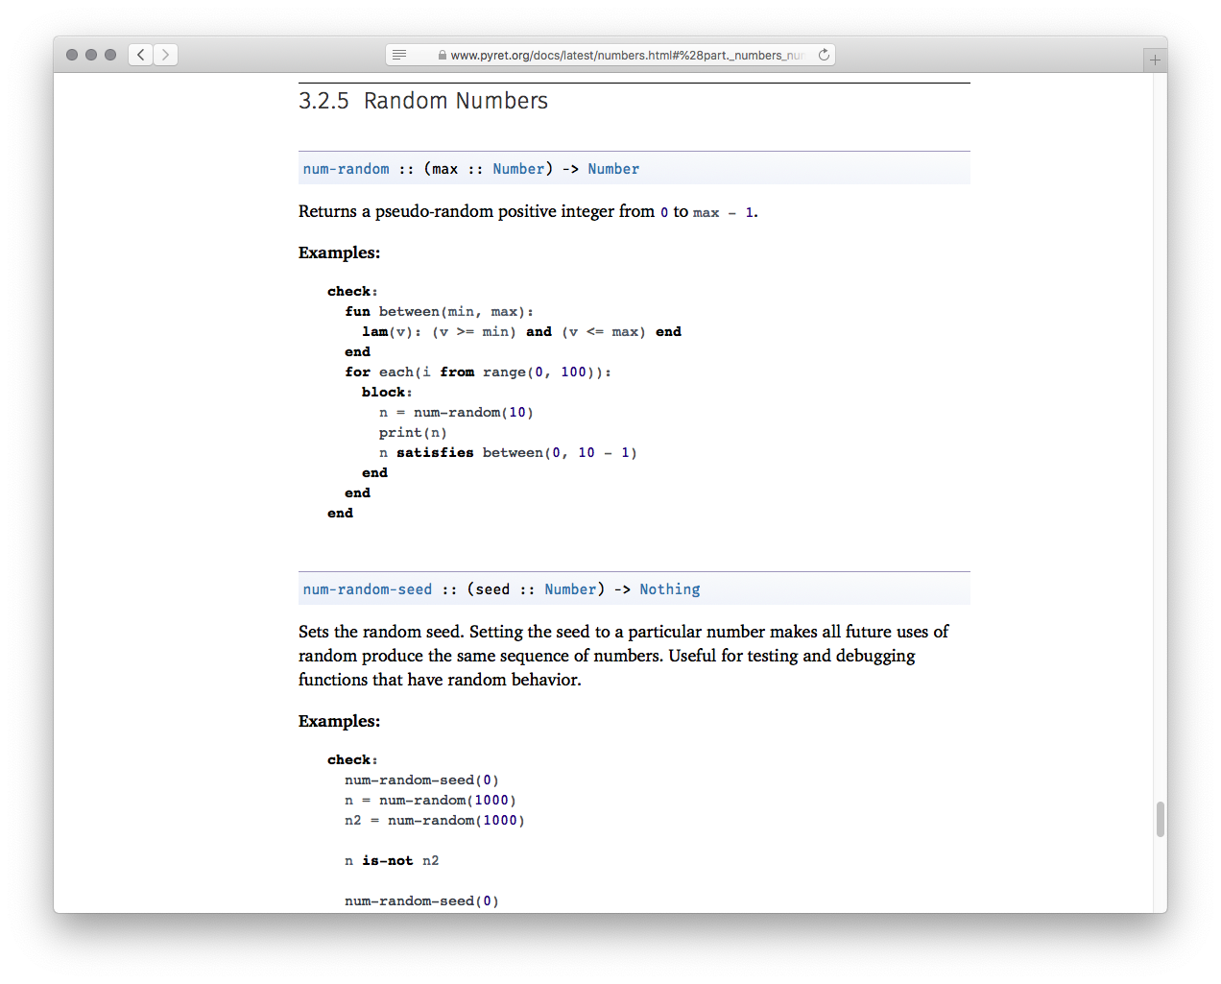
Ripped from the documentation

Slide 26
Ok… how do we get from random number to…

Slide 27
…a random list item?
With a table, we use .row-n to get a specific row by its index number.
With a list, we can use get to get an item.

Slide 28
…a random list item?
With a table, we use .row-n to get a specific row by its index number.
With a list, we can use get to get an item.
So…
Get a random number. Then,
Get list element(item) positioned at that number

Slide 29
Adding randomness to our code
plural-nouns = [list: "gazebos", "avocados", "pandas"]
fun substitute-word(w :: String) -> String:
doc: "Substitute a random word if w is a category"
if w == “Plural-Noun": #we want a Plural Noun!
...
else:
w
end
where:
...
end

Slide 30
Adding randomness to our code
plural-nouns = [list: "gazebos", "avocados", "pandas"]
fun substitute-word(w :: String) -> String:
doc: "Substitute a random word if w is a category"
if w == “Plural-Noun":
rand = num-random(3) #we have 3 items in our plural-nouns list
get(plural-nouns, rand)
else:
w
end
where:
else:
w
end
where:
...
end

Slide 31
Q:Do we have to know how many plural-nouns we have?
plural-nouns = [list: "gazebos", "avocados", "umiaks", "pandas"]
fun substitute-word(w :: String) -> String:
doc: "Substitute a random word if w is a category"
if w == “Plural-Noun":
rand = num-random(3) #we have 3 items in our plural-nouns list… oops, no we don’t
get(plural-nouns, rand)
else:
w
end
where:
else:
w
end
where:
...
end

Slide 32
A: No, we don’t!
plural-nouns = [list: "gazebos", "avocados", "umiaks", "pandas"]
fun substitute-word(w :: String) -> String:
doc: "Substitute a random word if w is a category"
if w == “Plural-Noun":
rand = num-random(length(plural-nouns))
get(plural-nouns, rand)
else:
w
end
where:
else:
w
end
where:
...
end

Slide 33
The other parts of speech (data) for our madlib
plural-nouns =
[list: "gazebos", "avocados", “umiaks", “pandas"]
numbers =
[list: "-1", "42", "a billion"]
nouns =
[list: "apple", "computer", "borscht"]
body-parts =
[list: "elbow", "head", "spleen"]
alphabet-letters =
[list: "A", "C", "Z"]
adjectives =
[list: "funky", "boring"]

Slide 34
Getting the rest of the random words
plural-nouns = [list: "gazebos", "avocados", "umiaks", "pandas"]
fun substitute-word(w :: String) -> String:
doc: "Substitute a random word if w is a category"
if w == “Plural-Noun":
rand = num-random(length(plural-nouns))
get(plural-nouns, rand)
else if w == “Numbers":
rand = etc. etc. etc.
else if w == “Nouns":
rand = etc. etc. etc.
end
where:
else:
w
end
where:
...
end

Slide 35
Getting the rest of the random words
plural-nouns = [list: "gazebos", "avocados", "umiaks", "pandas"]
fun substitute-word(w :: String) -> String:
doc: "Substitute a random word if w is a category"
if w == “Plural-Noun":
rand = num-random(length(plural-nouns))
get(plural-nouns, rand)
else if w == “numbers":
rand = etc. etc. etc.
else if w == “nouns":
rand = etc. etc. etc.
end
where:
else:
w
end
where:
...
end
Can we generalize this code even further? Speficially those calls to num-random?
Yes we can!
Notes:
2 tangents to add here…

Slide 36
Generalizing the call to num-random
#address need for general utility that gives us a random word.
fun rand-word(l :: List<String>) -> String:
doc: "Return a random word in the given list"
rand = num-random(length(l))
get(l, rand)
where:
member(plural-nouns, rand-word(plural-nouns))
is true
end

Slide 37
Completing the helper function…
fun substitute-word(w :: String) -> String:
doc: "Substitute a random word if w is a category"
if w == "Plural-Noun":
rand-word(plural-nouns)
else if w == "Number":
rand-word(numbers)
else if w == "Noun":
rand-word(nouns)
else if w == "Body-Part":
rand-word(body-parts)
else if w == "Alphabet-Letter":
rand-word(alphabet-letters)
else if w == "Adjective":
rand-word(adjectives)
else:
w
end
end

Slide 38
Back to our task plan
We’ve completed our helper,
Now we need to run it on every word in the list, the same way
transform-column
runs a function on every row of a table.

Slide 39
Back to our task plan
We’ve completed our helper, substitute-word!
Now we need to run it on every word in the list, the same way
transform-column
runs a function on every row of a table.
This is the way: map

Slide 40
Mad-libs so far…
fun mad-libs(t :: List<String>) -> String:
doc: "Randomly fill in the blanks in the mad libs template"
map(substitute-word, t) #like transform-column
end

Slide 41
Mad-libs so far… actually…
fun mad-libs(t :: List<String>) -> String:
doc: “Actually… This only returns a list of strings "
map(substitute-word, t) #like transform-column
end

Slide 42
… to the string documentation!
Notes:
We can still consult the official pyret documentation for strings!

Slide 43
Mad-libs: final version
fun mad-libs(t :: List<String>) -> String:
doc: "Randomly fill in the blanks in the mad libs template"
# map(substitute-word, t) used on next line.
with-subs = map(substitute-word, t)
join-str(with-subs, " ")
end

Slide 44
Link to code
https://code.pyret.org/editor#share=1gNCCr9cAxOFqewY3Wx221gSqV-JQho5n&v=31c9aaf

Slide 45
Acknowledgements
This lecture incorporates material from:
Kathi Fisler, Brown University,
Jason Waterman, Vassar College
And, Jonathan Gordon, Vassar College

