Slide 1
Lists and Recursion

Slide 2
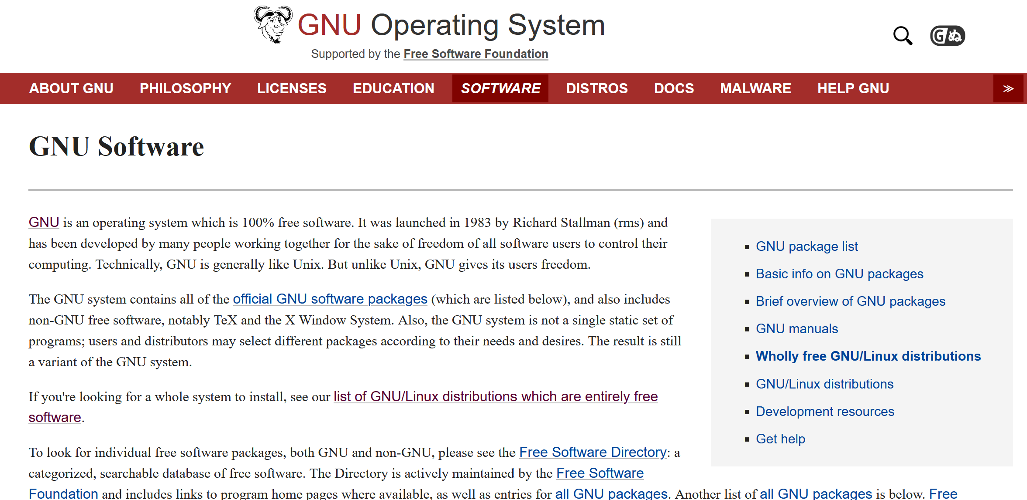
One take on recursion: GNU (www.gnu.org)

Slide 3
But what does GNU mean?

Slide 4
But what does recursion mean?
Recursion is a programming technique that involves defining a solution or structure using itself as part of the definition.
We will revisit recursion again!

Slide 5
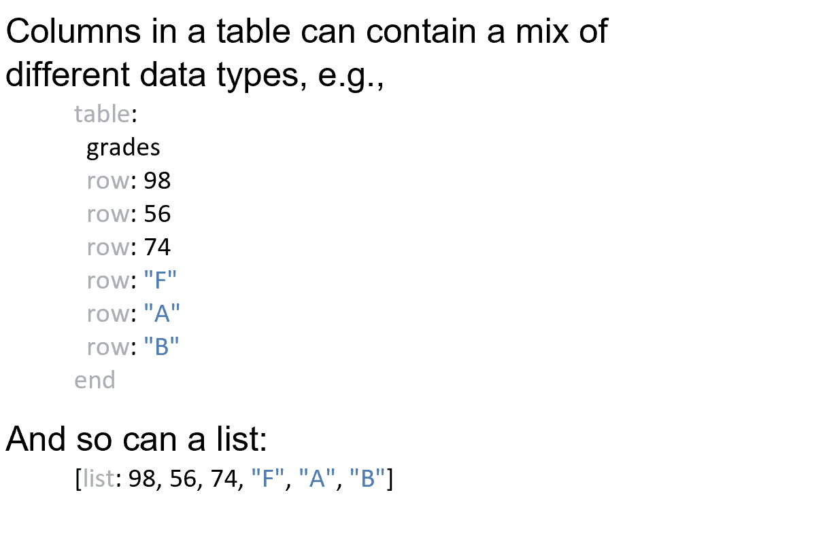
Back to lists columns

Slide 6
Back to lists columns

Slide 7
Back to lists

Slide 8
In pyret… we can use get…
Much like the rows in a table, the items in a list have (zero based) numeric indices and be accessed via get:

Slide 9
In pyret… we can use get… uh oh.
Much like the rows in a table, the items in a list have (zero based) numeric indices and be accessed via get:

Slide 10
In pyret… we can use get… click run first though
Much like the rows in a table, the items in a list have numeric (zero based) indices and be accessed via get as long as we use context essentials2021:
Notes:
Context essentials2021 is an update to pyret and changes were made for list access.

Slide 11
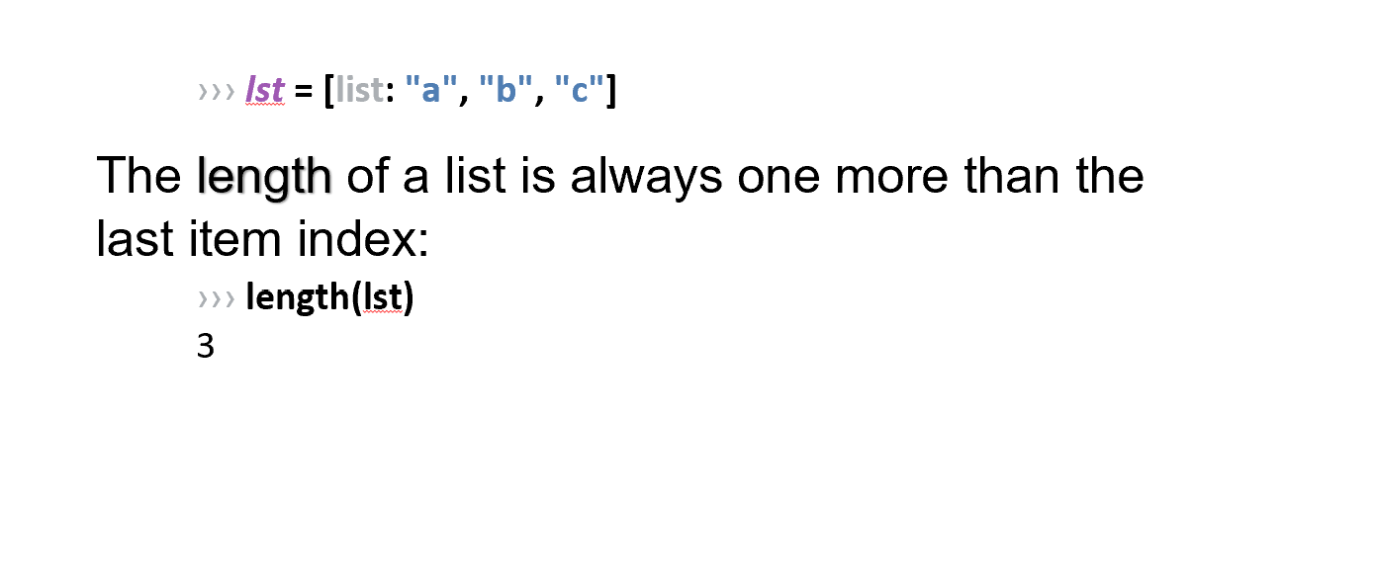
List length

Slide 12
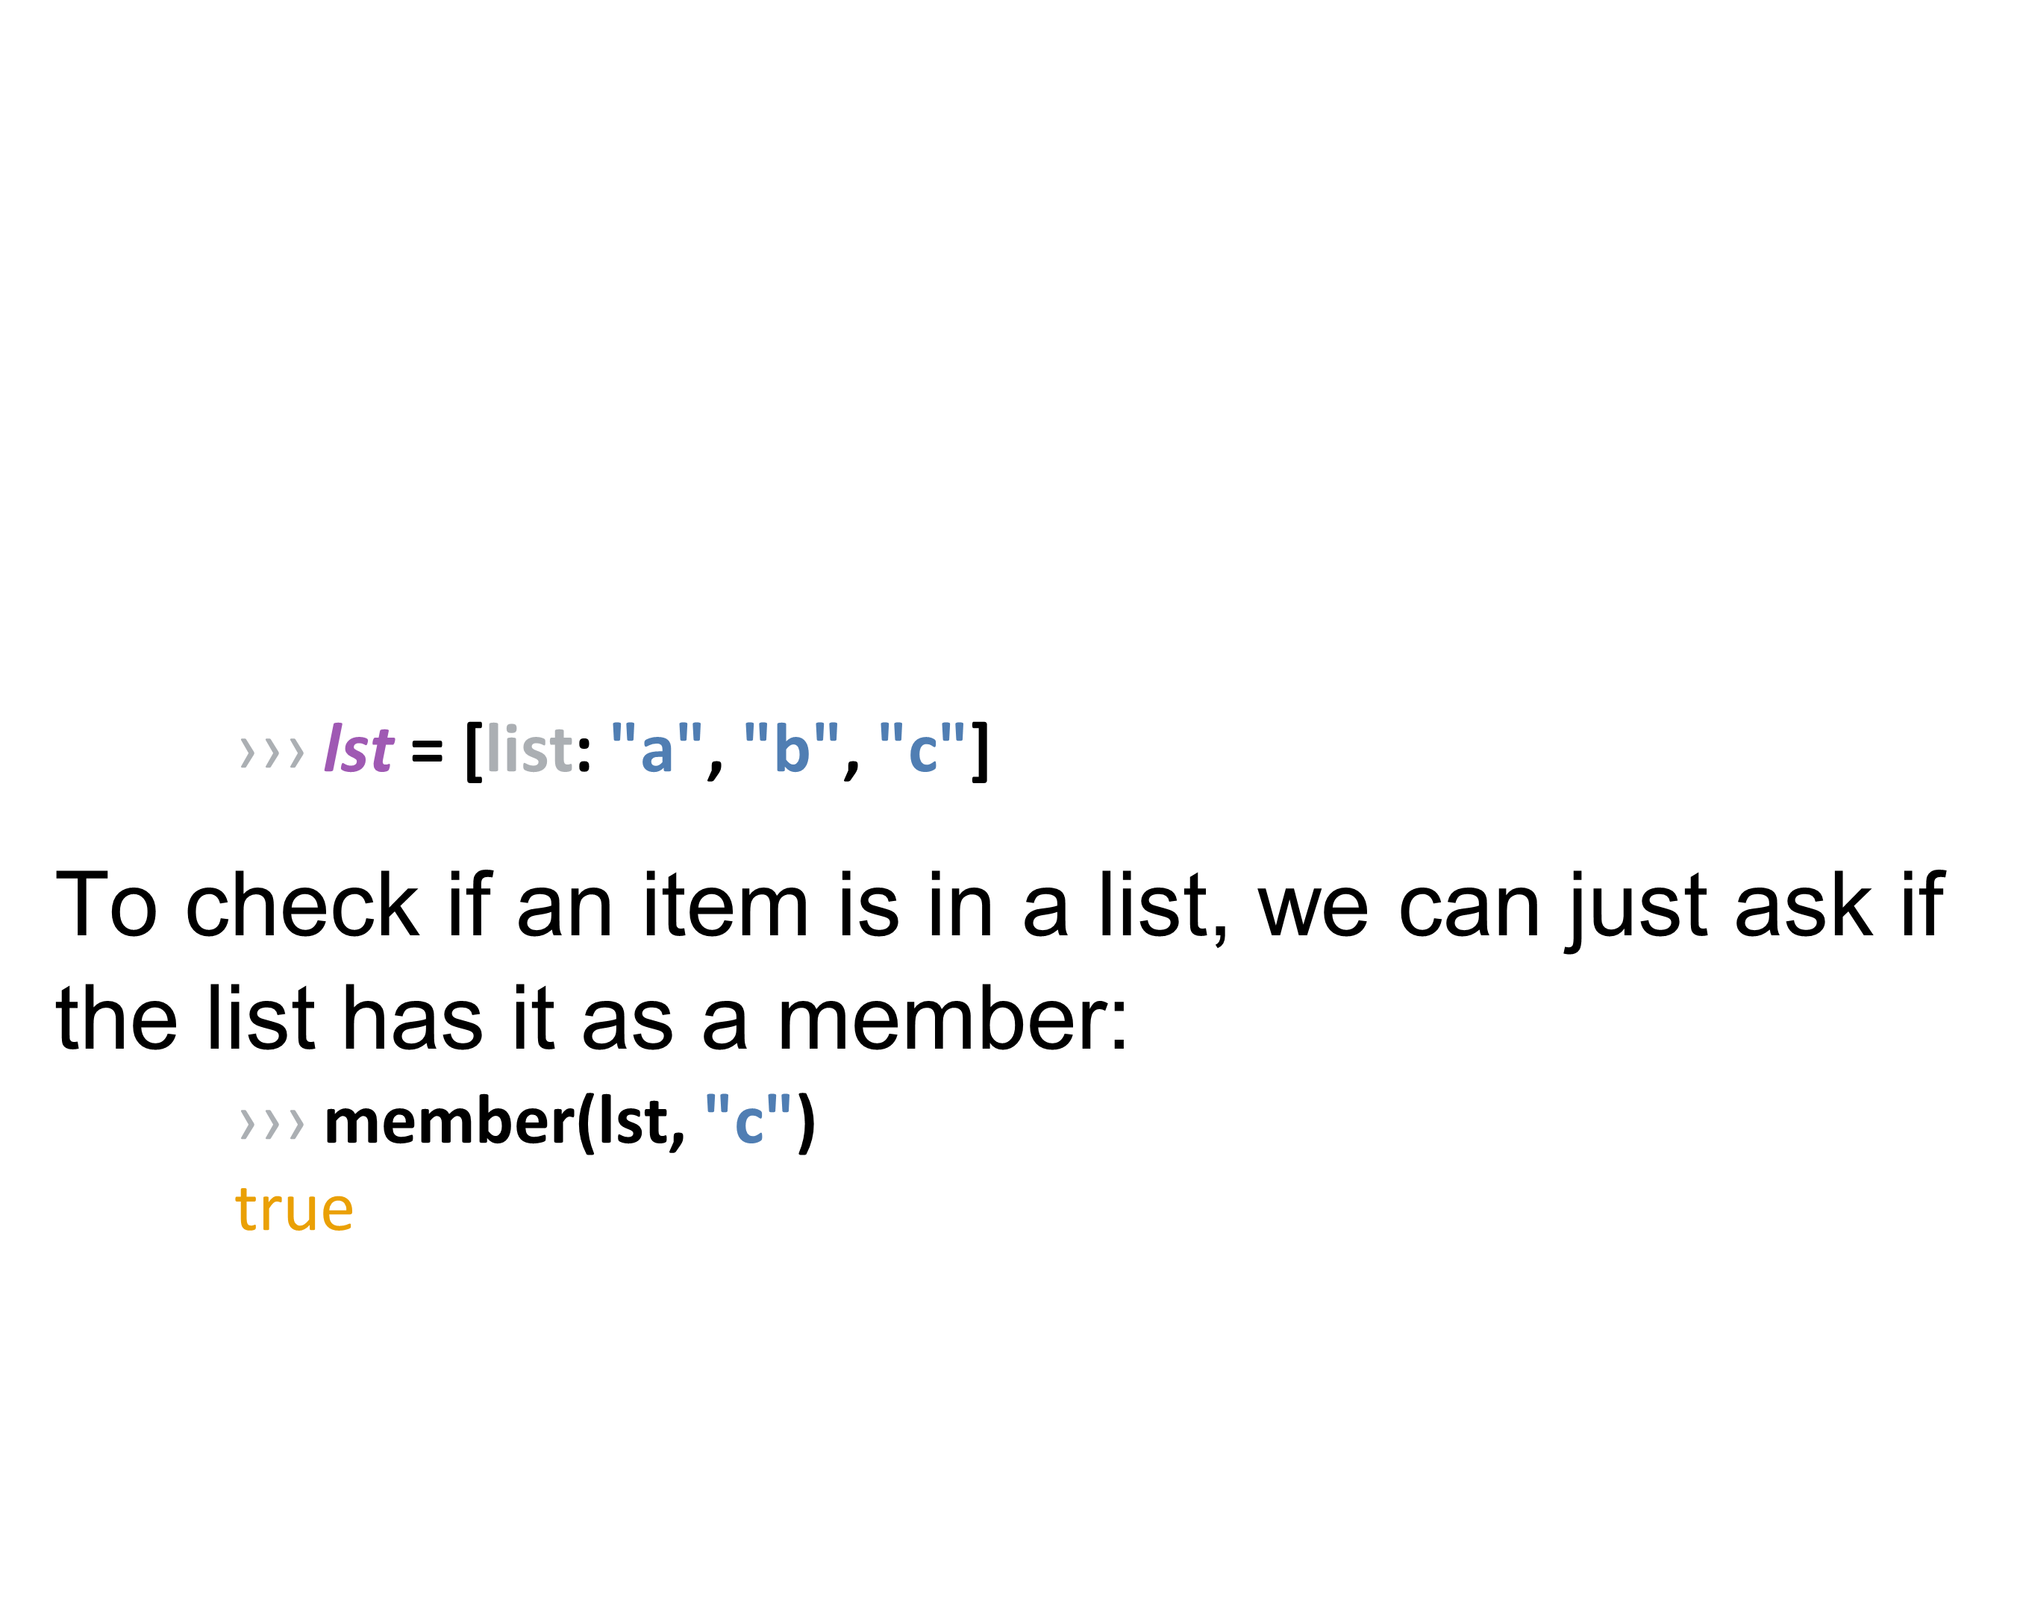
List member

Slide 13
Table functions analogous to List functions

Slide 14
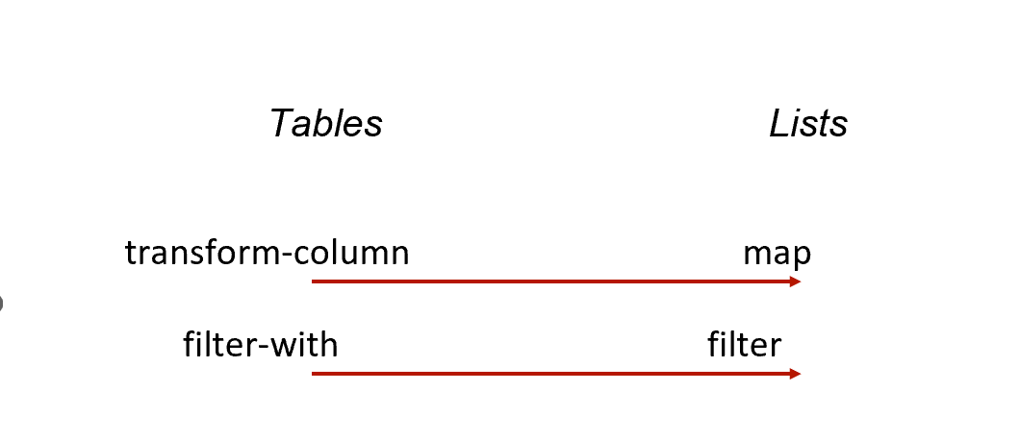
Table functions analogous to List functions
Notes:
When we wanted just certain rows in a table, we used filter-with, giving it the table and a function that returned true for the rows we want to keep.
To do the same thing for items in a list, use L.filter.

Slide 15
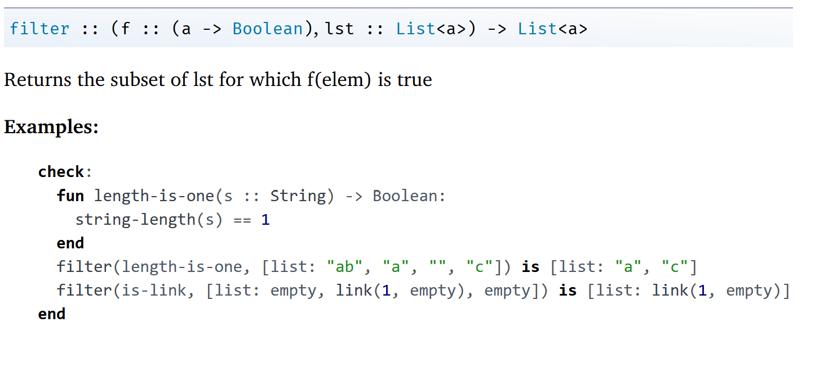
Filter documentation

Slide 16
List filter example + lambda
Notes:
Mise en place

Slide 17
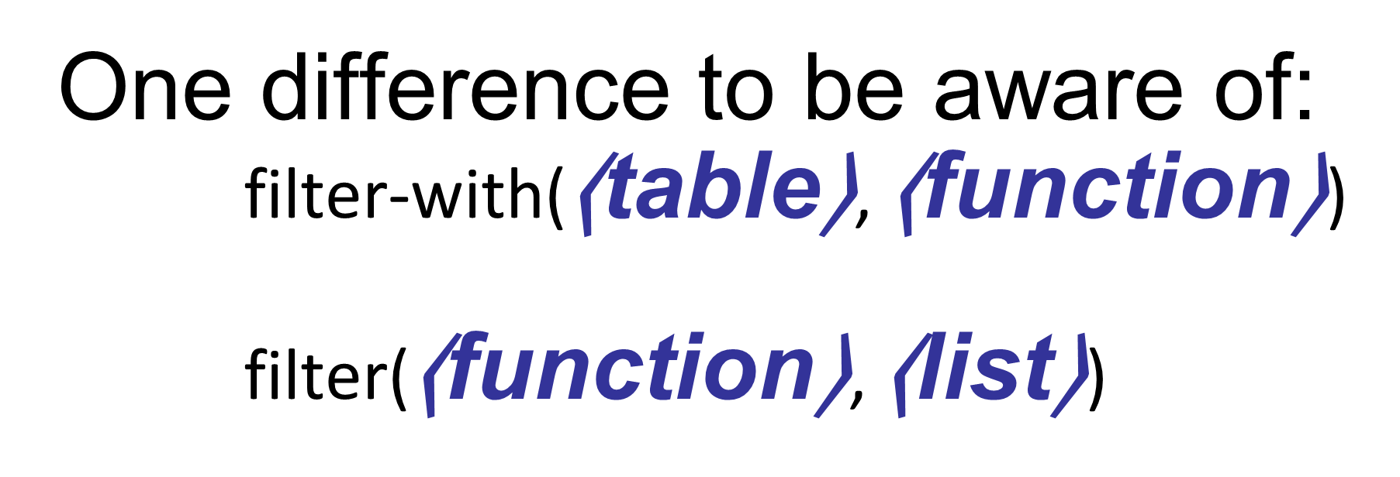
Consistently inconsistent pyret functions
Notes:
Mise en place

Slide 18
DIY List functions
Consider: a list of numbers
What do we want: the sum of these numbers
How do we approach this problem?

Slide 19
DIY List functions
Consider: a list of numbers
What do we want: the sum of these numbers
How do we approach this problem?
Similar to how you (hopefully) approached exam problems:
Start with a name and write the function shell!
fun my-sum(lst :: List<Number>) -> Number:
doc: "Return the sum of the numbers in the list"
...
end

Slide 20
DIY List functions
Next up: consider testing examples (where…)
Btw, function “sum” already exists in pyret
fun my-sum(lst :: List<Number>) -> Number:
doc: "Return the sum of the numbers in the list"
...
where:
my-sum([list: ]) is ...
end

Slide 21
DIY List functions: developing test cases before code
Simplest case: an empty list!
Similar to an empty string: “”
Corresponds to [list: ]
fun my-sum(lst :: List<Number>) -> Number:
doc: "Return the sum of the numbers in the list"
...
where:
my-sum([list: ]) is 0 # we could name our empty list and use its name here instead
end

Slide 22
DIY List functions: developing test cases before code
Next simplest case: one item in list
Corresponds to [list: 7]
fun my-sum(lst :: List<Number>) -> Number:
doc: "Return the sum of the numbers in the list"
...
where:
my-sum([list: ]) is 0 # we could name our empty list and use its name here instead
my-sum([list: 7]) is 7
end

Slide 23
DIY List functions: developing test cases before code
Next simplest cases: etc.
Corresponds to [list: 7]
fun my-sum(lst :: List<Number>) -> Number:
doc: "Return the sum of the numbers in the list"
...
where:
my-sum([list: ]) is 0 # we could name our empty list and use its name here instead
my-sum([list: 7]) is 7
my-sum([list: 2, 7]) is 9
my-sum([list: 4, 2, 7]) is 4 + 2 + 7 # math is hard at 3am!
end
Notes:
Think about developing code as if you need to read that code at 3am!

Slide 24
DIY List functions: establishing a pattern
Let’s rewrite all of our test case results
In terms of previous results
fun my-sum(lst :: List<Number>) -> Number:
doc: "Return the sum of the numbers in the list"
...
where:
my-sum([list: ]) is 0
my-sum([list: 7]) is 7
my-sum([list: 2, 7]) is 2 +7
my-sum([list: 4, 2, 7]) is 4 + 2 + 7
end

Slide 25
DIY List functions: establishing a pattern
Let’s rewrite all of our test case results
fun my-sum(lst :: List<Number>) -> Number:
doc: "Return the sum of the numbers in the list"
...
where:
my-sum([list: ]) is 0
my-sum([list: 7]) is 7 + 0
my-sum([list: 2, 7]) is 2 + 7 + 0
my-sum([list: 4, 2, 7]) is 4 + 2 + 7 + 0
end

Slide 26
DIY List functions: establishing a pattern
Let’s rewrite all of our test case results
fun my-sum(lst :: List<Number>) -> Number:
doc: "Return the sum of the numbers in the list"
...
where:
my-sum([list: ]) is 0
my-sum([list: 7]) is 7 + my-sum([list: ])
my-sum([list: 2, 7]) is 2 + my-sum([list: 7])
my-sum([list: 4, 2, 7]) is 4 + my-sum([list: 2, 7])
end

Slide 27
Before we continue,
We should take a look at:
The Secret Nature of Lists!:

Slide 28
Shorthand list notation
[list: 3, 1, 4] is a lie

Slide 29
List notation in pyret
Pyret’s a priori assumption about lists:
There are two ways of making a list.
A list is one of either:
empty
link(⟨item⟩, ⟨list⟩) # link() will join an item & existing list into a new list.

Slide 30
Implementation of a list
A list of one item, e.g.,
[list: "A"],
is really a link between an item and the empty list:
link("A", empty)

Slide 31
Implementation of a list
And so on…
[list: "Z", "A"],
is really a link between an item and the list with one item which itself is a link with one item and the empty list:
link("Z", (link("A", empty)))

Slide 32
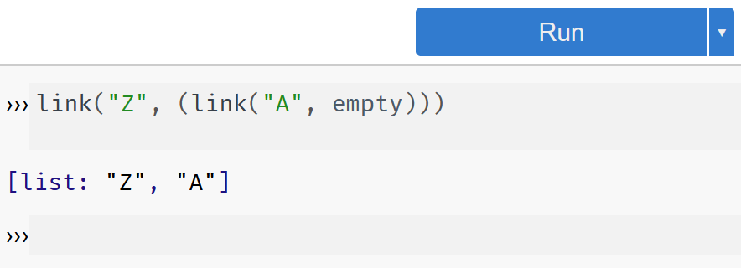
Implementation of a list
And so on…
[list: "Z", "A"],
is really a link between an item and the list with one item which itself is a link with one item and the empty list:
link("Z", (link("A", empty)))

Slide 33
We now return to our regularly scheduled lecture

Slide 34
From earlier… without the garish colors
Let’s rewrite all of our test case results
fun my-sum(lst :: List<Number>) -> Number:
doc: "Return the sum of the numbers in the list"
...
where:
my-sum([list: ]) is 0
my-sum([list: 7]) is 7 + my-sum([list: ])
my-sum([list: 2, 7]) is 2 + my-sum([list: 7])
my-sum([list: 4, 2, 7]) is 4 + my-sum([list: 2, 7])
end

Slide 35
Writing the my-sum function
fun my-sum(lst :: List<Number>) -> Number:
doc: "Return the sum of the numbers in the list"
#thinking recursively…
where:
my-sum([list: ]) is 0
my-sum([list: 7]) is 7 + my-sum([list: ])
my-sum([list: 2, 7]) is 2 + my-sum([list: 7])
my-sum([list: 4, 2, 7]) is 4 + my-sum([list: 2, 7])
end
To write our function, we need to use the true form of a list and think recursively.

Slide 36
Writing the my-sum function, recursively (1)
fun my-sum(lst :: List<Number>) -> Number:
doc: "Return the sum of the numbers in the list"
# our base “case” is when our list is empty: ([list: ]) is 0
# the next case is when our list is NOT empty
where:
my-sum([list: ]) is 0
my-sum([list: 7]) is 7 + my-sum([list: ])
my-sum([list: 2, 7]) is 2 + my-sum([list: 7])
my-sum([list: 4, 2, 7]) is 4 + my-sum([list: 2, 7])
end

Slide 37
We’ll refer to this as The Base Case
fun my-sum(lst :: List<Number>) -> Number:
doc: "Return the sum of the numbers in the list"
cases (List) lst: | empty => # the answer when list is empty! 0
# the next case
where:
my-sum([list: ]) is 0
my-sum([list: 7]) is 7 + my-sum([list: ])
my-sum([list: 2, 7]) is 2 + my-sum([list: 7])
my-sum([list: 4, 2, 7]) is 4 + my-sum([list: 2, 7])
end

Slide 38
We’ll refer to this as The Recursive Case
fun my-sum(lst :: List<Number>) -> Number:
doc: "Return the sum of the numbers in the list"
cases (List) lst: | empty => 0
| link(f, r) => f + my-sum(r) # covers all the other tests in where
end
where:
my-sum([list: ]) is 0
my-sum([list: 7]) is 7 + my-sum([list: ])
my-sum([list: 2, 7]) is 2 + my-sum([list: 7])
my-sum([list: 4, 2, 7]) is 4 + my-sum([list: 2, 7])
end
Notes:
The code is actually based on what we wrote as the test case!

Slide 39
How does this function get evaluated?

Slide 40
When is a recursive solution appropriate?
Any time a problem is structured such that
the solution on larger inputs can be built from
the solution on smaller inputs, then
recursion is appropriate.

Slide 41
The two cases we need to solve
All recursive functions have these two parts:
Base case(s):
What’s the simplest case to solve?
Recursive case(s):
What’s the relationship between the current case and the answer to a slightly smaller case?
You should be calling the function you’re defining here; this is referred to as a recursive call.
Each time you make a recursive call, you must make the input smaller.
Otherwise, we would have a “GNU” case (i.e. endless recursion)!
If your input is a list, you do this by passing the rest of the list to the recursive call.

Slide 42
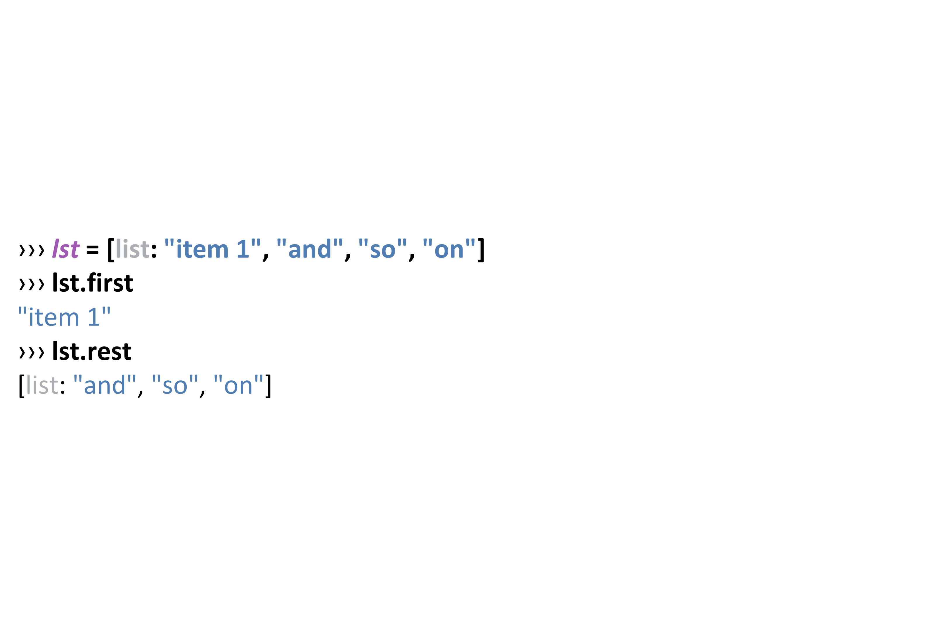
Splitting up a list recursively: First and Rest

Slide 43
First/Rest in my-sum
link(f, r) => f + my-sum(r)
first of the list is… f
rest of the list is… my-sum(r)

Slide 44
What if…
… we made a recursive call on the original input list?
link(f, r) => f + my-sum(lst)
first of the list is… f
rest of the list is… my-sum(lst)

Slide 45
Let’s try writing another recursive function
Given: a list of numbers…
The function any-below-10 should return true if any member of the list is less than 10 and false otherwise.

Slide 46
Writing any-below-10
#Start with the test cases first!
fun any-below-10(lst :: List<Number>) -> Boolean:
doc: "Return true if any number in the list is less than 10"
...
where:
any-below-10([list: 3, 1, 4]) is (3 < 10) or (1 < 10) or (4 < 10)
any-below-10([list: 1, 4]) is (1 < 10) or (4 < 10)
any-below-10([list: 4]) is (4 < 10)
any-below-10([list: ]) is ...
end
Notes:
Base case in “orange” Recursive case in “light blue”
What should the base case return? Are there any values below 10 in an empty list of numbers?

Slide 47
Writing any-below-10: base case test case
fun any-below-10(lst :: List<Number>) -> Boolean:
doc: "Return true if any number in the list is less than 10"
...
where:
any-below-10([list: 3, 1, 4]) is (3 < 10) or (1 < 10) or (4 < 10)
any-below-10([list: 1, 4]) is (1 < 10) or (4 < 10)
any-below-10([list: 4]) is (4 < 10)
any-below-10([list: ]) is false
end
Notes:
Base case in “orange” Recursive case in “light blue”
What should the base case return? Are there any values below 10 in an empty list of numbers?

Slide 48
Writing any-below-10: rewrite the recursive tests
fun any-below-10(lst :: List<Number>) -> Boolean:
doc: "Return true if any number in the list is less than 10"
...
where:
any-below-10([list: 3, 1, 4]) is (3 < 10) or any-below-10([list: 1, 4])
any-below-10([list: 1, 4]) is (1 < 10) or any-below-10([list: 4])
any-below-10([list: 4]) is (4 < 10) or any-below-10([list: ])
any-below-10([list: ]) is false
end
Notes:
Base case in “orange” Recursive case in “light blue”
What should the base case return? Are there any values below 10 in an empty list of numbers?

Slide 49
Writing any-below-10: lastly, the function itself
fun any-below-10(lst :: List<Number>) -> Boolean:
doc: "Return true if any number in the list is less than 10"
cases (List) lst:
| empty => false
| link(f, r) => (f < 10) or any-below-10(r)
where:
any-below-10([list: 3, 1, 4]) is (3 < 10) or any-below-10([list: 1, 4])
any-below-10([list: 1, 4]) is (1 < 10) or any-below-10([list: 4])
any-below-10([list: 4]) is (4 < 10) or any-below-10([list: ])
any-below-10([list: ]) is false
end
Notes:
Base case in “orange” Recursive case in “light blue”
What should the base case return? Are there any values below 10 in an empty list of numbers?

Slide 50
Writing a Recursive Predicate
Now that we’ve seen how to write any-below-10, we can use the same pattern to implement a higher-order function where we can ask if any item in a list satisfies some predicate.
“Some predicate”: meaning some kind of “generalized or, helper, function”

Slide 51
Writing my-any
fun my-any(fn :: Function, lst :: List) -> Boolean:
doc: "Return true if the function fn is true for any item in the given list."
cases (List) lst:
| empty => false
| link(f, r) => fn(f) or my-any(fn, r)
end
end

Slide 52
Writing my-all
fun my-all(fn :: Function, lst :: List) -> Boolean:
doc: "Return true if the function fn is true for every item in the given list."
cases (List) lst:
| empty => true
| link(f, r) => fn(f) and my-all(fn, rst)
end
end

Slide 53
Let’s try some practice examples together
BTW This stuff can be adjective!
adjectives =
[list: “difficult", “funky"]

Slide 54
fun list-len(lst :: List) -> Number:
doc: "Compute the length of a list"
cases (List) lst:
| empty => 0
| link(f, r) => 1 + list-len(____)
end
end
Practice Makes _____
Notes:
Fill in the blank

Slide 55
fun list-len(lst :: List) -> Number:
doc: "Compute the length of a list"
cases (List) lst:
| empty => 0
| link(f, r) => 1 + list-len(r)
end
end
Practice Makes Perfect

Slide 56
fun list-product(lst :: List<Number>) -> Number:
doc: "Compute the product of all the numbers in lst"
cases (List) lst:
| empty => 1
| link(f, r) => ____ * list-product(r)
end
end
Practice Makes _____
Notes:
Fill in the blank

Slide 57
fun list-product(lst :: List<Number>) -> Number:
doc: "Compute the product of all the numbers in lst"
cases (List) lst:
| empty => 1
| link(f, r) => f * list-product(r)
end
end
Practice Makes Perfect

Slide 58
fun is-member(lst :: List, item) -> Boolean:
doc: "Return true if item is a member of lst"
cases (List) lst:
| empty => ______
| link(f, r) =>
(f == ______) or (is-member(______, ______)
end
end
Practice Makes ______
Notes:
Fill in the blank

Slide 59
fun is-member(lst :: List, item) -> Boolean:
doc: "Return true if item is a member of lst"
cases (List) lst:
| empty => false
| link(f, r) =>
(f == item) or (is-member(r, item)
end
end
Practice Makes Perfect
Notes:
If lst is empty, then the function has finished going though the entire list and returns false. Otherwise, the functions checks if first is equal to item. If it is, the function returns true, otherwise it makes a recursive call on the rest of the list.

Slide 60
Link to code
https://code.pyret.org/editor#share=11g-ulsJlopYJlZUctfv9wIpDN9rTIVFW&v=31c9aaf

Slide 61
Acknowledgements
This lecture incorporates material from:
Kathi Fisler, Brown University,
Marc Smith, Vassar College
And, Jonathan Gordon, Vassar College

