Slide 1
Recursion (continued)

Slide 2
Picking up from last week: When is a recursive solution appropriate?
Any time a problem is structured such that
the solution on larger inputs can be built from
the solution on smaller inputs, then
recursion is appropriate.

Slide 3
The two cases we need to solve
All recursive functions have these two parts:
Base case(s):
What’s the simplest case to solve?
(Usually, the “empty” or “null” or “zero” case)
Recursive case(s):
What’s the relationship between the current case and the answer to a slightly smaller case?
You should be calling the function you’re defining here; this is referred to as a recursive call.
Each time you make a recursive call, you must make the input smaller.
Otherwise, we would have a “GNU” case (i.e. endless recursion)!
If your input is a list, you do this by passing the rest of the list to the recursive call.

Slide 4
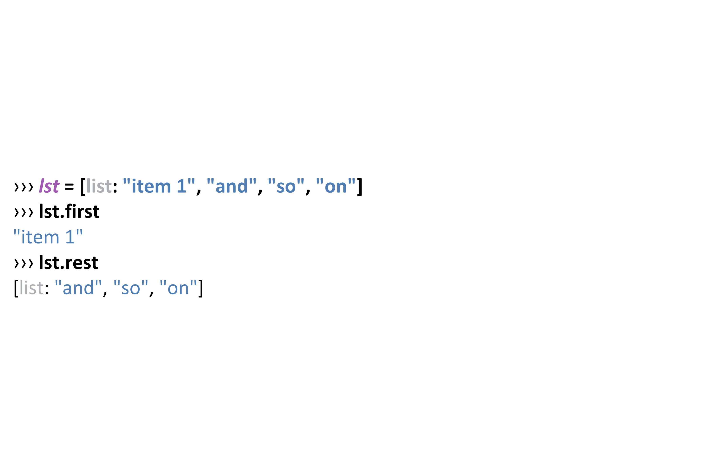
Splitting up a list recursively: First and Rest

Slide 5
First/Rest in my-sum
link(f, r) => f + my-sum(r)
first of the list is… f
rest of the list is… my-sum(r)

Slide 6
What if…
… we made a recursive call on the original input list?
link(f, r) => f + my-sum(lst)
first of the list is… f
rest of the list is… my-sum(lst)

Slide 7
Let’s try writing another recursive function
Given: a list of numbers…
The function any-below-10 should return true if any member of the list is less than 10 and false otherwise.

Slide 8
Writing any-below-10
#Start with the test cases first!
fun any-below-10(lst :: List<Number>) -> Boolean:
doc: "Return true if any number in the list is less than 10"
...
where:
any-below-10([list: 3, 1, 4]) is (3 < 10) or (1 < 10) or (4 < 10)
any-below-10([list: 1, 4]) is (1 < 10) or (4 < 10)
any-below-10([list: 4]) is (4 < 10)
any-below-10([list: ]) is ...
end
Notes:
Base case in “orange” Recursive case in “light blue”
What should the base case return? Are there any values below 10 in an empty list of numbers?

Slide 9
Writing any-below-10: base case test case
fun any-below-10(lst :: List<Number>) -> Boolean:
doc: "Return true if any number in the list is less than 10"
...
where:
any-below-10([list: 3, 1, 4]) is (3 < 10) or (1 < 10) or (4 < 10)
any-below-10([list: 1, 4]) is (1 < 10) or (4 < 10)
any-below-10([list: 4]) is (4 < 10)
any-below-10([list: ]) is false
end
Notes:
Base case in “orange” Recursive case in “light blue”
What should the base case return? Are there any values below 10 in an empty list of numbers?

Slide 10
Writing any-below-10: rewrite the recursive tests
fun any-below-10(lst :: List<Number>) -> Boolean:
doc: "Return true if any number in the list is less than 10"
...
where:
any-below-10([list: 3, 1, 4]) is (3 < 10) or any-below-10([list: 1, 4])
any-below-10([list: 1, 4]) is (1 < 10) or any-below-10([list: 4])
any-below-10([list: 4]) is (4 < 10) or any-below-10([list: ])
any-below-10([list: ]) is false
end
Notes:
Base case in “orange” Recursive case in “light blue”
What should the base case return? Are there any values below 10 in an empty list of numbers?

Slide 11
Writing any-below-10: rewrite the recursive tests
fun any-below-10(lst :: List<Number>) -> Boolean:
doc: "Return true if any number in the list is less than 10"
...
where:
any-below-10([list: 3, 1, 4]) is (3 < 10) or any-below-10([list: 1, 4])
any-below-10([list: 1, 4]) is (1 < 10) or any-below-10([list: 4])
any-below-10([list: 4]) is (4 < 10) or any-below-10([list: ])
any-below-10([list: ]) is false
end
Notes:
Base case in “orange” Recursive case in “light blue”
What should the base case return? Are there any values below 10 in an empty list of numbers?

Slide 12
Writing any-below-10: lastly, the function itself
fun any-below-10(lst :: List<Number>) -> Boolean:
doc: "Return true if any number in the list is less than 10, think of link as meaning detach"
cases (List) lst:
| empty => false
| link(f, r) => (f < 10) or any-below-10(r)
where:
any-below-10([list: 3, 1, 4]) is (3 < 10) or any-below-10([list: 1, 4])
any-below-10([list: 1, 4]) is (1 < 10) or any-below-10([list: 4])
any-below-10([list: 4]) is (4 < 10) or any-below-10([list: ])
any-below-10([list: ]) is false
end
Notes:
Base case in “orange” Recursive case in “light blue”
What should the base case return? Are there any values below 10 in an empty list of numbers?

Slide 13
Writing a Recursive Predicate
Now that we’ve seen how to write any-below-10, we can use the same pattern to implement a higher-order function where we can ask if any item in a list satisfies some predicate.
“Some predicate”: meaning some kind of “generalized or, helper, function”

Slide 14
Writing my-any
fun my-any(fn :: Function, lst :: List) -> Boolean:
doc: "Return true if the function fn is true for any item in the given list."
cases (List) lst:
| empty => false
| link(f, r) => fn(f) or my-any(fn, r)
end
End
#Compare with “any-below-10”

Slide 15
Compare with “any-below-10”
fun my-any(fn :: Function, lst :: List) -> Boolean:
doc: "Return true if the function fn is true for any item in the given list."
cases (List) lst:
| empty => false
| link(f, r) => fn(f) or my-any(fn, r)
end
End
#Compare with “any-below-10”
Notes:
Any usually means using “or” but not “and”

Slide 16
Writing my-all
fun my-all(fn :: Function, lst :: List) -> Boolean:
doc: "Return true if the function fn is true for every item in the given list."
cases (List) lst:
| empty => true
| link(f, r) => fn(f) and my-all(fn, rst)
end
end

Slide 17
Let’s try some practice examples together
BTW This stuff can be adjective!
adjectives =
[list: “difficult", “funky"]

Slide 18
fun list-len(lst :: List) -> Number:
doc: "Compute the length of a list"
cases (List) lst:
| empty => 0
| link(f, r) => 1 + list-len(____)
end
end
Practice Makes _____
Notes:
Fill in the blank

Slide 19
fun list-len(lst :: List) -> Number:
doc: "Compute the length of a list"
cases (List) lst:
| empty => 0
| link(f, r) => 1 + list-len(r)
end
end
Practice Makes Perfect

Slide 20
fun list-product(lst :: List<Number>) -> Number:
doc: "Compute the product of all the numbers in lst"
cases (List) lst:
| empty => 1
| link(f, r) => ____ * list-product(r)
end
end
Practice Makes _____
Notes:
Fill in the blank

Slide 21
fun list-product(lst :: List<Number>) -> Number:
doc: "Compute the product of all the numbers in lst"
cases (List) lst:
| empty => 1
| link(f, r) => f * list-product(r)
end
end
Practice Makes Perfect

Slide 22
fun is-member(lst :: List, item) -> Boolean:
doc: "Return true if item is a member of lst"
cases (List) lst:
| empty => ______
| link(f, r) =>
(f == ______) or (is-member(______, ______)
end
end
Practice Makes ______
Notes:
Fill in the blank

Slide 23
fun is-member(lst :: List, item) -> Boolean:
doc: "Return true if item is a member of lst"
cases (List) lst:
| empty => false
| link(f, r) =>
(f == item) or (is-member(r, item)
end
end
Practice Makes Perfect
Notes:
If lst is empty, then the function has finished going though the entire list and returns false. Otherwise, the functions checks if first is equal to item. If it is, the function returns true, otherwise it makes a recursive call on the rest of the list.

Slide 24
Next up: fn that adds 1 to every number in a list.
fun add-1-all(lst :: List<Number>) -> List<Number>:
doc: "Add one to every number in the list"
...
where: #are all of the tests??!?
end

Slide 25
add 1 to every number in a list: test cases
fun add-1-all(lst :: List<Number>) -> List<Number>:
doc: "Add one to every number in the list"
...
where:
add-1-all([list: 3, 1, 4])
is [list: 4, 2, 5]
add-1-all([list: 1, 4])
is [list: 2, 5]
add-1-all([list: 4])
is [list: 5]
add-1-all([list: ]) is [list: ]
end

Slide 26
add 1 to every number in a list: alternate format
fun add-1-all(lst :: List<Number>) -> List<Number>:
doc: "Add one to every number in the list"
...
where:
add-1-all(link(3, link(1, link(4, empty))))
is link(4, link(2, link(5, empty)))
add-1-all(link(1, link(4, empty)))
is link(2, link(5, empty))
add-1-all(link(4, empty))
is link(5, empty)
add-1-all(empty) is empty
end

Slide 27
add 1 to every number in a list: mod’ed test cases
fun add-1-all(lst :: List<Number>) -> List<Number>:
doc: "Add one to every number in the list"
...
where:
add-1-all([list: 3, 1, 4])
is link(4, add-1-all([list: 1, 4]))
add-1-all([list: 1, 4])
is link(2, add-1-all([list: 4]))
add-1-all([list: 4])
is link(5, add-1-all([list: ]))
add-1-all([list: ]) is [list: ]
end

Slide 28
add 1 to every number in a list: code
fun add-1-all(lst :: List<Number>) -> List<Number>:
doc: "Add one to every number in the list"
cases (List) lst:
| empty => empty
| link(f, r) => link(f + 1, add-1-all(r))
end
where:
add-1-all([list: 3, 1, 4])
is link(4, add-1-all([list: 1, 4]))
add-1-all([list: 1, 4])
is link(2, add-1-all([list: 4]))
add-1-all([list: 4])
is link(5, add-1-all([list: ]))
add-1-all([list: ]) is [list: ]
end

Slide 29
diff

Slide 30
add 1 to every number in a list: code
fun add-1-all(lst :: List<Number>) -> List<Number>:
doc: "Add one to every number in the list"
cases (List) lst:
| empty => empty
| link(f, r) => link(f + 1, add-1-all(r))
end
where:
add-1-all([list: 3, 1, 4])
is link(4, add-1-all([list: 1, 4]))
add-1-all([list: 1, 4])
is link(2, add-1-all([list: 4]))
add-1-all([list: 4])
is link(5, add-1-all([list: ]))
add-1-all([list: ]) is [list: ]
end
The map function we’ve used works identically, except that it takes a function and applies this function,
instead of simply adding 1 to every item in the list.

Slide 31
my-map function:

Slide 32
Pattern
We’ve seen examples of recursive functions and
Made them generic by introducing a predicate (function)
Let’s do the same by developing functions:
pos-nums that returns/selects only positive numbers from a list of numbers.
A specific recursive function that we can generalize as…
filter that returns a list of items where some predicate returns true
Essentially a “my-filter” recursive function

Slide 33
pos-nums
fun pos-nums(lst :: List<Number>) -> List<Number>:
doc: "Select the positive numbers from lst"
cases (List) lst:
| empty => empty
| link(n, rst) =>
if n > 0:
link(n, pos-nums(rst))
else:
pos-nums(rst)
end
end
where:
pos-nums([list: ]) is [list: ]
pos-nums([list: 1]) is [list: 1]
pos-nums([list: -1]) is [list: ]
pos-nums([list: 1, -2]) is [list: 1]
pos-nums([list: -1, 2]) is [list: 2]
pos-nums([list: 1, -2, -3, -4]) is [list: 1]
pos-nums([list: -1, 2, -3, -4]) is [list: 2]
pos-nums([list: 1, -2, 3, 4]) is [list: 1, 3, 4]
end

Slide 34
My-filter: with generic predicate (1)
fun my-filter(predicate :: Function, lst :: List<Number>) -> List<Number>:
doc: "Filter a list to only items where predicate returns true"
cases (List) lst:
| empty => empty
| link(f, r) =>
if predicate(f):
link(f, my-filter(predicate, r))
else:
my-filter(predicate, r)
end
end
where:
# we can define the predicate in our test case. Let’s replicate pos-nums functionality
end

Slide 35
My-filter: with generic predicate (2)
fun my-filter(predicate :: Function, lst :: List<Number>) -> List<Number>:
doc: "Filter a list to only items where predicate returns true"
cases (List) lst:
| empty => empty
| link(f, r) =>
if predicate(f):
link(f, my-filter(predicate, r))
else:
my-filter(predicate, r)
end
end
where:
# we can define the predicate in our test case. Let’s replicate pos-nums functionality
# we can use lambda for this purpose too: format: lam(x): ??? end
end

Slide 36
My-filter: with generic predicate (3)
fun my-filter(predicate :: Function, lst :: List<Number>) -> List<Number>:
doc: "Filter a list to only items where predicate returns true"
cases (List) lst:
| empty => empty
| link(f, r) =>
if predicate(f):
link(f, my-filter(predicate, r))
else:
my-filter(predicate, r)
end
end
where:
my-filter(lam(x): x > 0 end, [list: 1, -2, 3, 4]) is [list: 1, 3, 4]
end

Slide 37
Even more generic: The List Aggregation Pattern
fun ⟨function-name⟩(⟨arguments, incl. lst⟩) -> ⟨return type⟩:
cases (List) lst:
| empty => ⟨empty case⟩
| link(f, r) =>
⟨some processing on f⟩
⟨combined with⟩
function-name(r)
end
end

Slide 38
Writing your own recursive list functions
Here are the procedures for writing your list functions:
Write the name, inputs, input types, & output type for the function.
Write some examples of what the function should produce and should cover all structural cases:
i.e., empty vs non-empty lists
as well as interesting scenarios within the problem.
Write out the list aggregation template
Implement the function so that it handles the examples correctly

Slide 39
Writing your own recursive list functions
Here are the procedures for writing your list functions:
Write the name, inputs, input types, & output type for the function.
Write some examples of what the function should produce and should cover all structural cases:
i.e., empty vs non-empty lists
as well as interesting scenarios within the problem.
Write out the list aggregation template
Implement the function so that it handles the examples correctly
One final recommendation: Don’t skip steps!

Slide 40
Link to code
pos-nums
add-1-all
my-filter
And, lecture 11 code (any-below-10, any-in-list, all-in-list)

Slide 41
Acknowledgements
This lecture incorporates material from:
Kathi Fisler, Brown University,
Marc Smith, Vassar College
And, Jonathan Gordon, Vassar College

