Slide 1
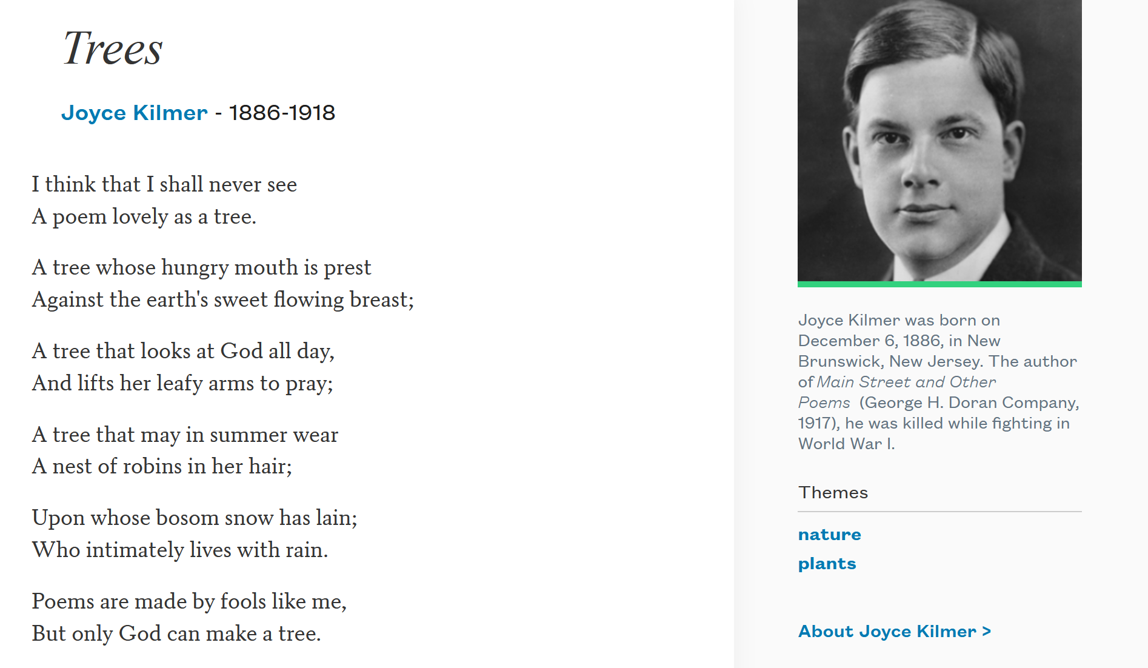
Trees

Slide 2
Steps to write a generic template
Given a (recursive) data definition, you write a generic template by:
  Creating a function header,
  Using cases to break the data input into its variants,
    In each case, list each of the fields as part of the answer
  And, calling the function itself on any recursive fields.

Slide 3
From Last Time: Data Template
data MyList:
| my-empty
| my-link(first, rest :: MyList)
end
Self-reference Definition!

Slide 4
Debrief: lists and recursion
data MyList:
| my-empty
| my-link(first, rest :: MyList)
end
my-empty
my-link(1,
my-link(2,
my-link(3,
my-empty)))
What's different here?
We have a case that's just a special keyword rather than a constructor.
Part of the second case” is of the same type we're defining.
  A recursive definition!

Slide 5
Using my-list Data Template
We use this template to write a function that recursively processes the data:
fun my-list-fun(ml :: MyList) -> ...:
doc: "Template for a fn that takes a MyList"
cases (MyList) ml:
| my-empty => ...
| my-link(f, r) =>
... f ...
... my-list-fun(r) …
end
where:
my-list-fun(...) is ...
end

Slide 6
Tracking rumors
Suppose we want to track gossip in a rumor mill.

Slide 7
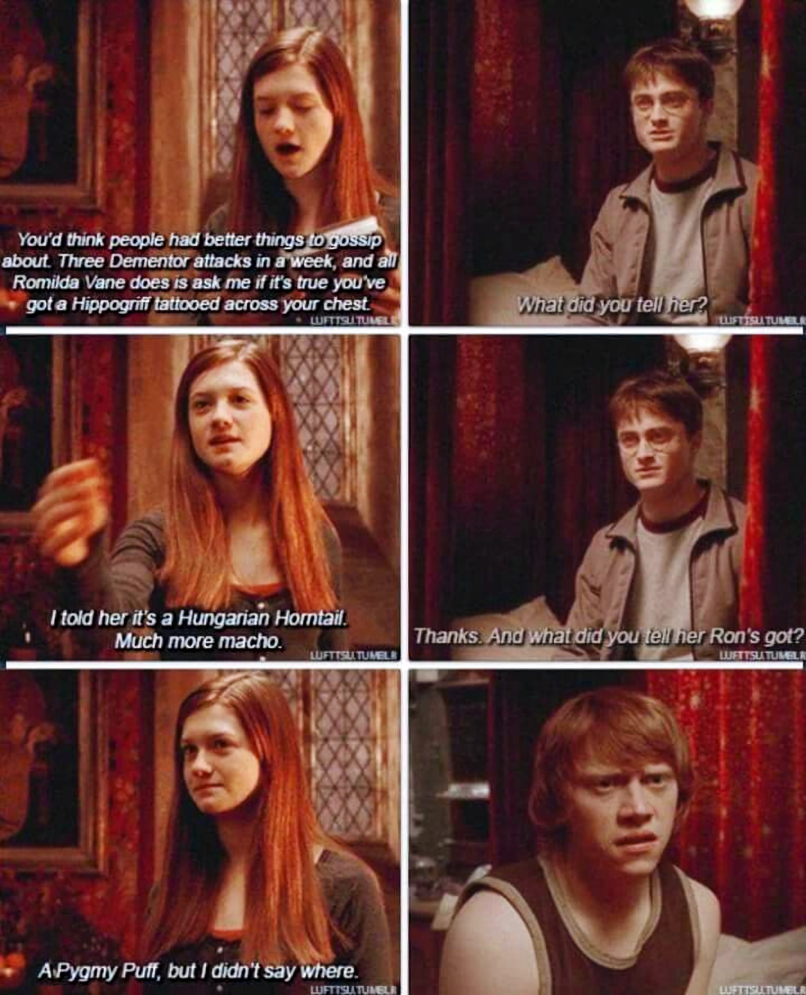
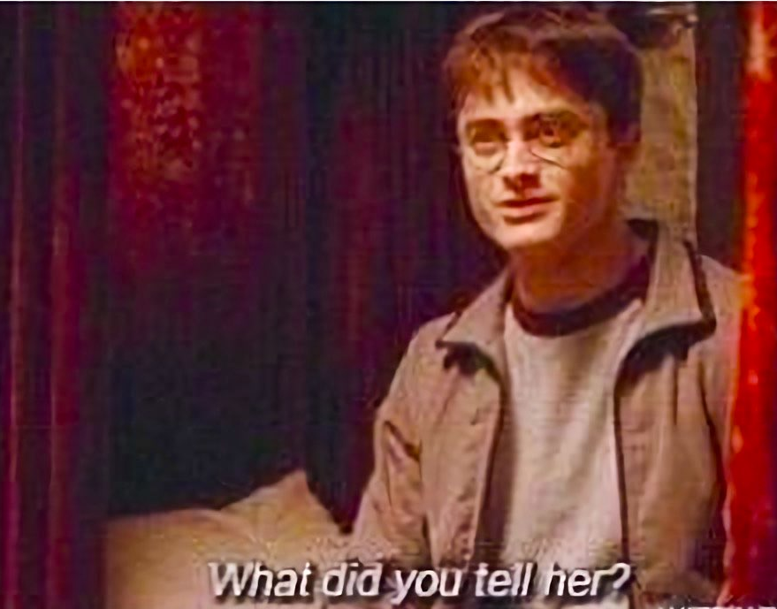
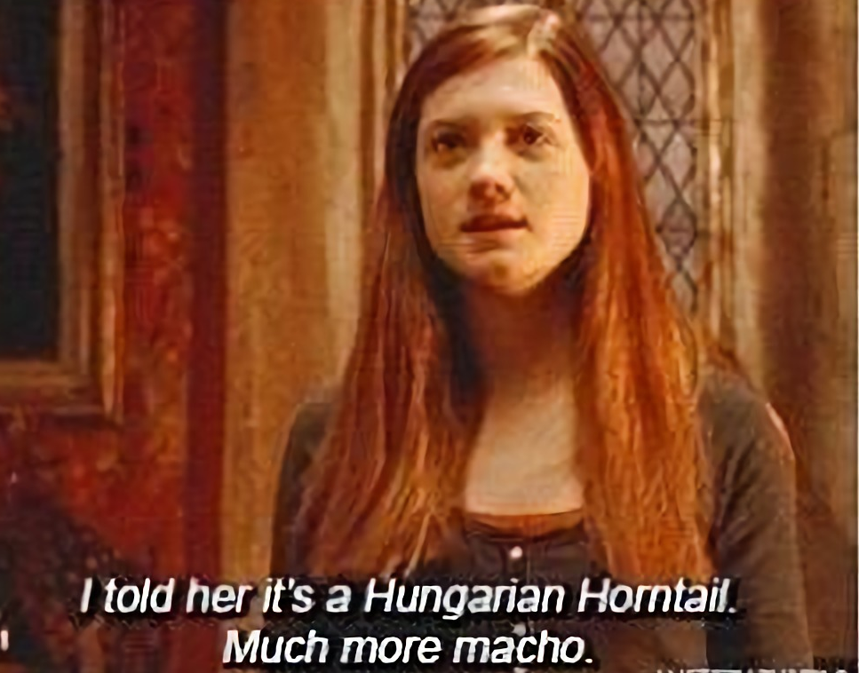
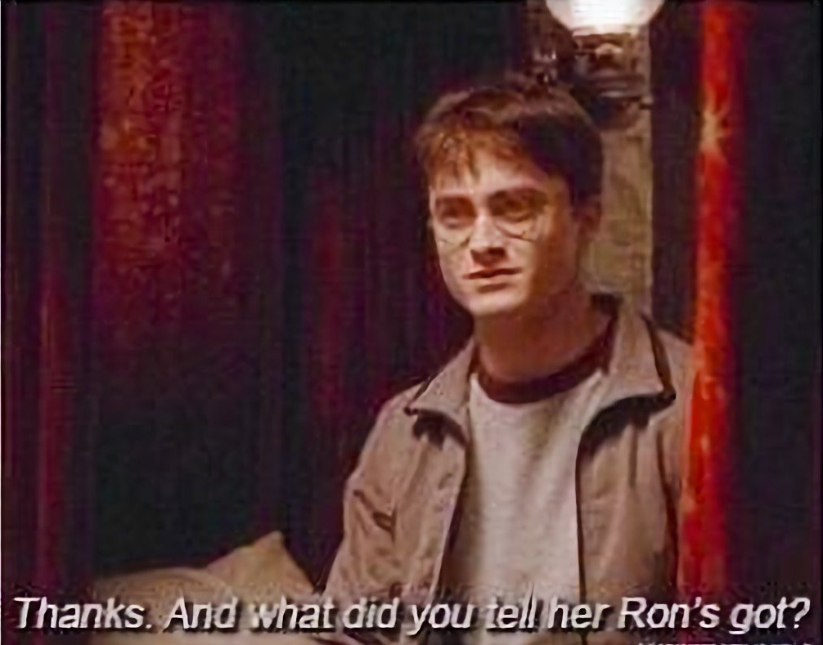
Ginny controls the rumor mill
Notes:
Real rumors can be hurtful, so let's take a fictional one -- Harry's purported tattoo.
[In the book of Half-Blood Prince, but not actually in the film.]

Slide 8

Tracking rumors
Suppose we want to track gossip in a rumor mill.
Pansy
Notes:
[Pansy Parkinson]

Slide 9
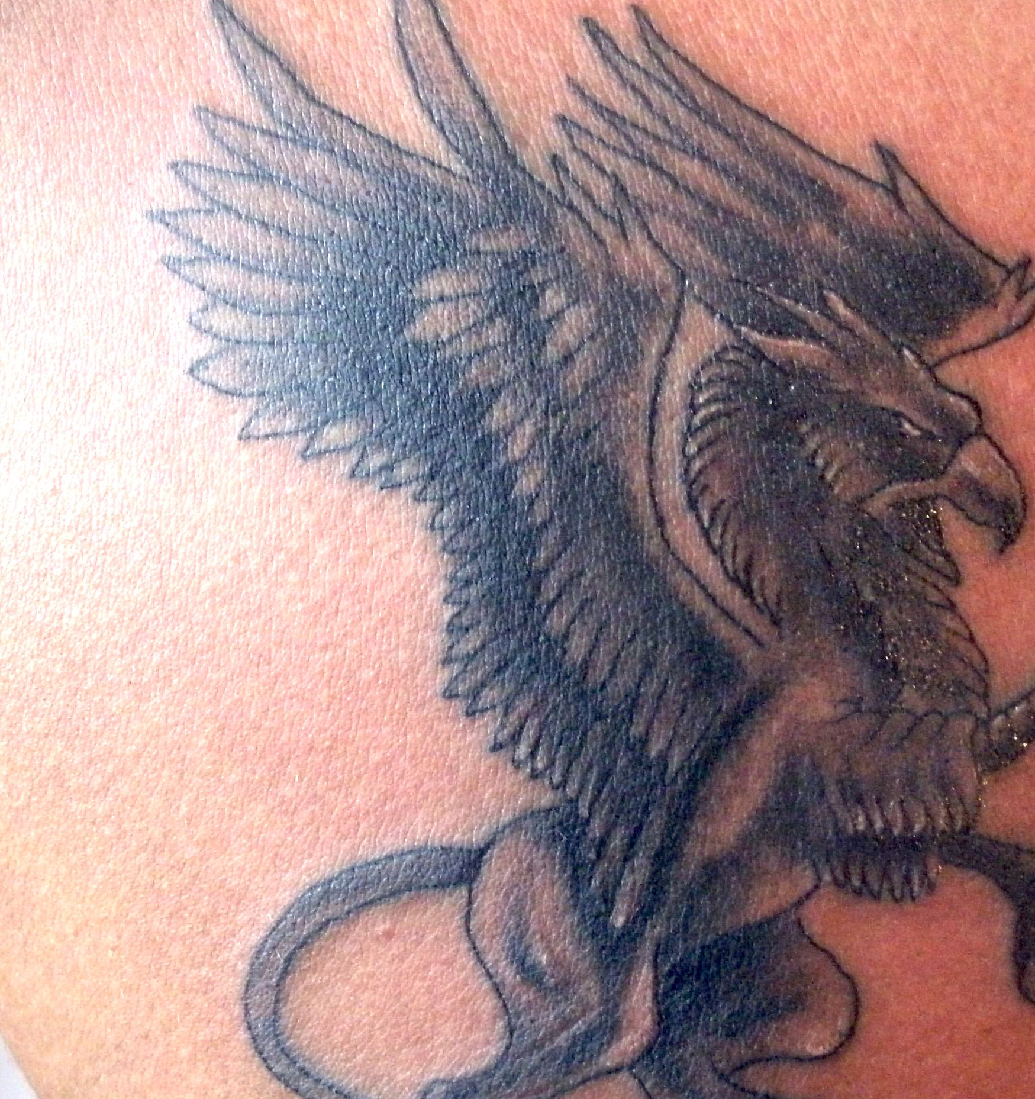
Tracking rumors
Suppose we want to track gossip in a rumor mill.
Pansy

Slide 10


Tracking rumors
Suppose we want to track gossip in a rumor mill.
Cho
Pansy
Draco

Slide 11


Tracking rumors
Suppose we want to track gossip in a rumor mill.
Cho
Pansy
Romilda
Draco
Vincent
Notes:
[Vincent Crabbe; Romilda Vane]

Slide 12

Tracking rumors
Suppose we want to track gossip in a rumor mill.
Cho
Pansy
Romilda
Draco
Ginny
Vincent

Slide 13
Tracking rumors
Suppose we want to track gossip in a rumor mill.
Simplifying assumption: Each person tells at most two others
Cho
Pansy
Romilda
Draco
Ginny
Vincent

Slide 14
Tracking rumors
Suppose we want to track gossip in a rumor mill.
Simplifying assumption: Each person tells at most two others
Cho
Pansy
Romilda
Draco
Ginny
Vincent

Slide 15
If you ignore my silly Harry Potter example, this is a pretty serious problem.
A lot of research right now is focused on building models of how information – and misinformation! – spreads through social networks, both in person and online.
Tracking rumors

Slide 16
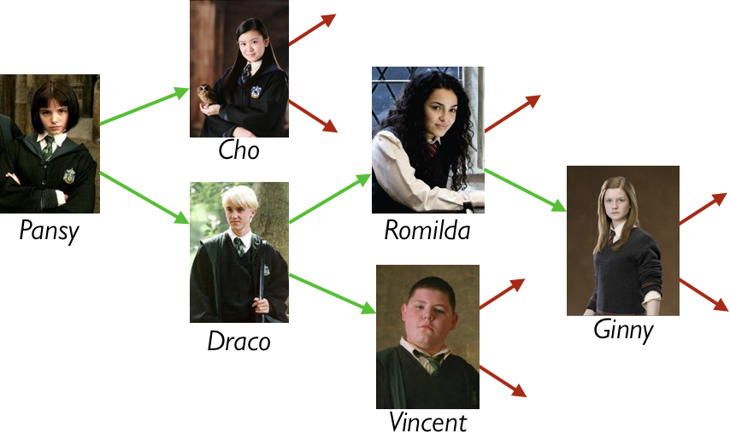
Representing rumor mills
Is a rumor mill simply a list of people?

Slide 17
Representing rumor mills
Question: Is a rumor mill simply a list of people?
Answer: No, because there are relationships among the people.

Slide 18
Representing rumor mills
We could represent these
relations with a table, e.g.,
name :: String | next1 :: String | next2 :: String
"Pansy" | "Cho" | "Draco"
"Cho"
… | … | …
Notes:
If we wanted to write a function to find out if someone hears a rumor that starts with a certain person, we'd need to filter the table again and again to get the next steps. We could do it, but it would be unpleasant.

Slide 19
Representing rumor mills
Using a table doesn’t give us any straightforward way to process the rumor mill.
Could we use something like a list but representing the relations?

Slide 20
Representing rumor mills
data Person:
| person(name :: String, next1 :: Person, next2 :: Person)
end
How about this?

Slide 21
Representing rumor mills
Some people don’t gossip to anyone else – see the red arrows above.
data Person:
| person(name :: String, next1 :: Person, next2 :: Person)
end

Slide 22
Representing rumor mills
data RumorMill:
| no-one
| gossip(name :: String, next1 :: RumorMill, next2 :: RumorMill)
end
How about this?
Notes:
This looks promising.

Slide 23
Example rumor mills
data RumorMill:
| no-one #at the start there is… no-one in the rumor mill!
| gossip(name :: String, next1 :: RumorMill, next2 :: RumorMill)
end
no-one

Slide 24
Example rumor mills
data RumorMill:
| no-one
| gossip(name :: String, next1 :: RumorMill, next2 :: RumorMill)
end
gossip("Ginny", no-one, no-one)
Ginny

Slide 25
Example rumor mills
data RumorMill:
| no-one
| gossip(name :: String, next1 :: RumorMill, next2 :: RumorMill)
end
gossip("Romilda",
no-one,
gossip("Ginny", no-one, no-one))
Romilda
Ginny

Slide 26
gossip("Pansy",
gossip("Cho", no-one, no-one)
gossip("Draco",
gossip("Romilda",
no-one
gossip("Ginny", no-one, no-one))
gossip("Vincent", no-one, no-one)))

Slide 27
Example, using names for the parts
GINNY-MILL =
gossip("Ginny", no-one, no-one)
ROMILDA-MILL =
gossip("Romilda", no-one, GINNY-MILL)
VINCENT-MILL =
gossip("Vincent", no-one, no-one)
DRACO-MILL =
gossip("Draco", ROMILDA-MILL, VINCENT-MILL)
CHO-MILL =
gossip("Cho", no-one, no-one)
PANSY-MILL =
gossip("Pansy", CHO-MILL, DRACO-MILL)
Notes:
Example using names for parts:

Slide 28
A RumorMill is a type of structure called a tree.
  Each element in the tree is called a node.
  The first node in the tree is called the root.
  A node with no children is called a leaf.
Like a list, a tree is recursive: Every subtree is a tree.
Computer Science concepts wrung from a rumor mill

Slide 29
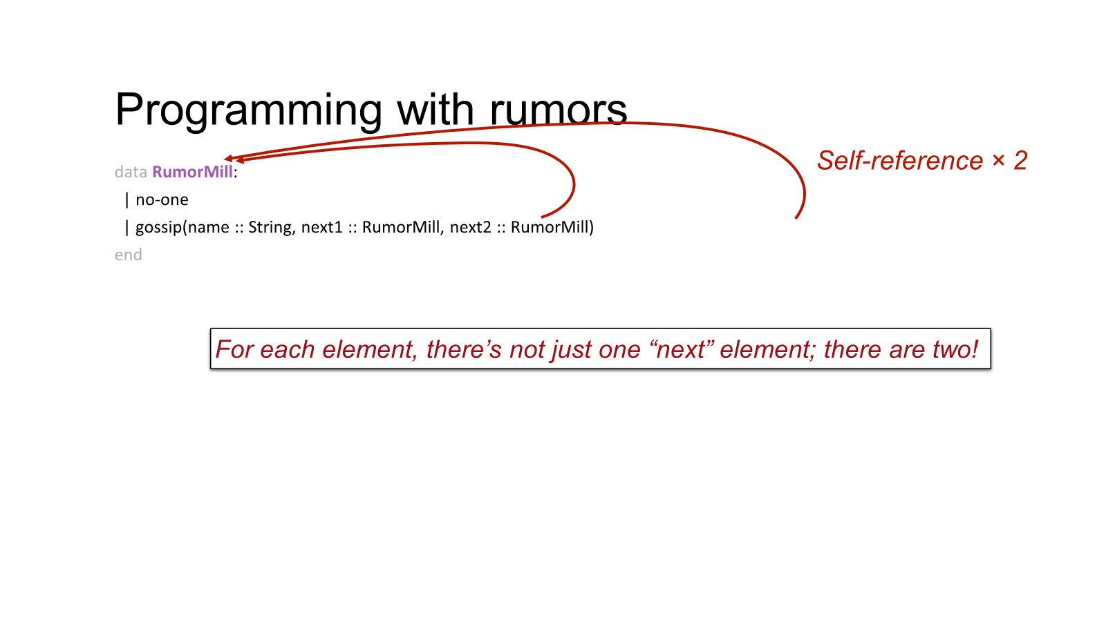
Programming with rumors
data RumorMill:
| no-one
| gossip(name :: String, next1 :: RumorMill, next2 :: RumorMill)
end

Slide 30
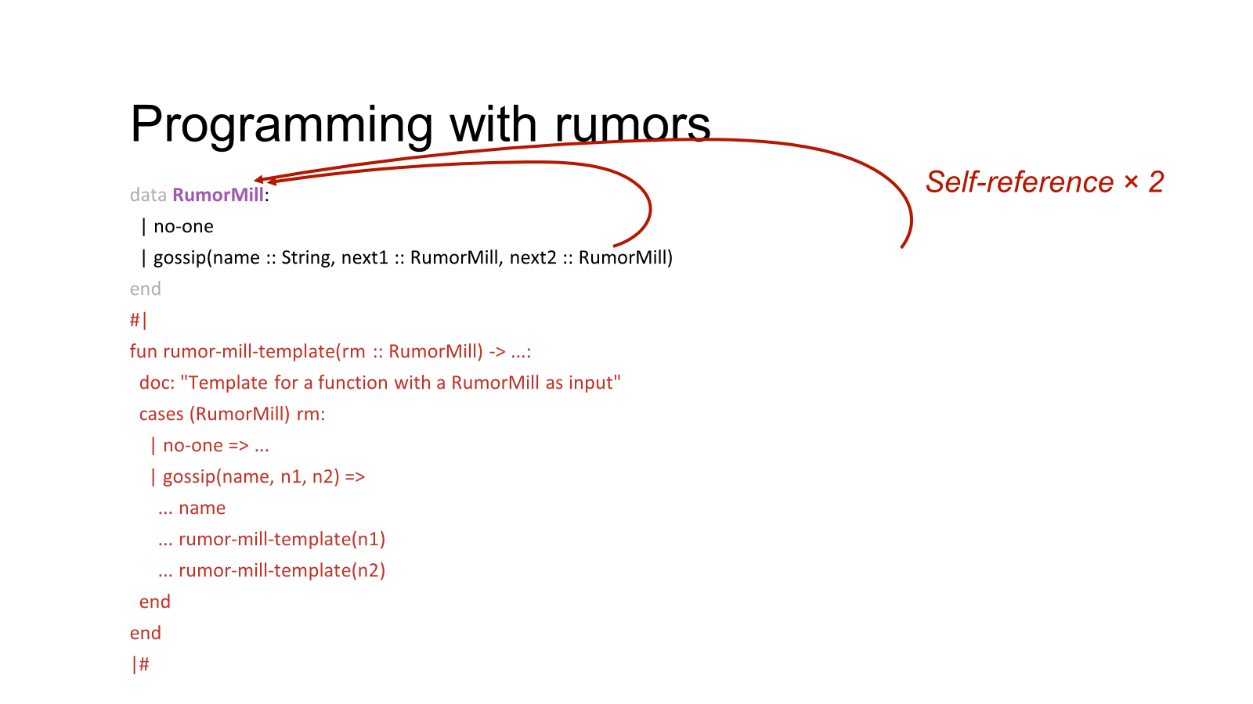
Rumor Mill Template

Slide 31
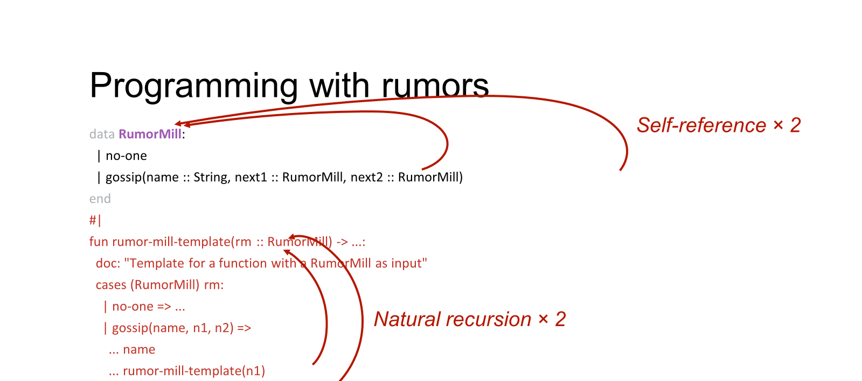
Rumor Mill Template

Slide 32
Link to code
14_new_data_types.arr

Slide 33
Acknowledgements
This lecture incorporates material from:
Kathi Fisler, Brown University,
Marc Smith, Vassar College
And, Jonathan Gordon, Vassar College

