Slide 1
Computer Science I
CMPU 101 § 04/05
5 December 2022

Slide 2
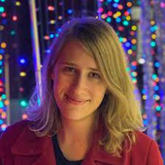
How Technology Changes Our Perceptions and Decision-Making Capabilities
Prairie Goodwin, Vassar College
4:30 pm, 5 December 2022
SP 105

Slide 3
What have we been doing this semester?
Notes:
Today, I’d like to step back a bit from the details to situate what we’ve been doing this semester.

Slide 4
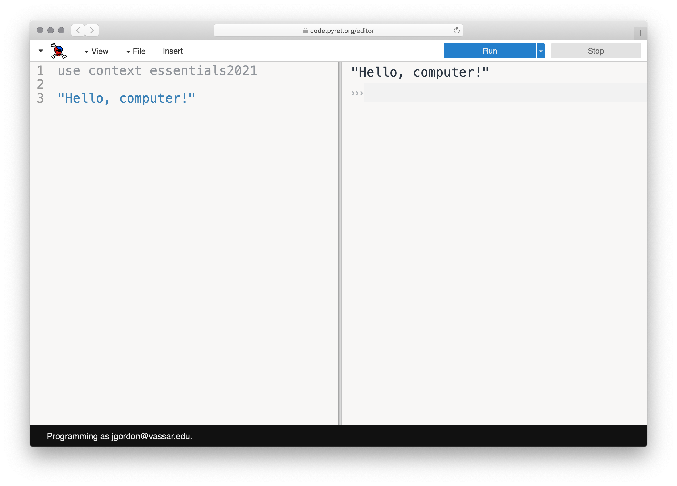
Notes:
Well, we started out playing with Pyret.

Slide 5
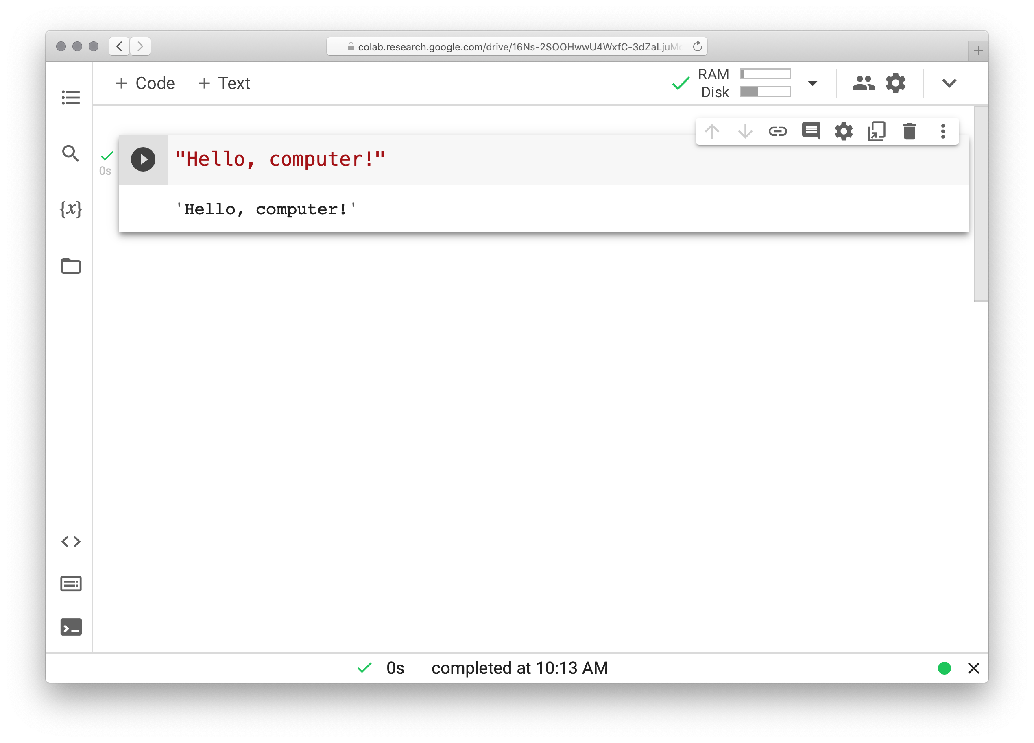
Notes:
And then we played with Python.

Slide 6
We’re not especially interested in Pyret – or Python!
If you’re programming 20 years from now*, it’ll be in a different language, using different tools.
*For me, it has been more than 41 years!
Notes:
But [slide]

Slide 7
Notes:
Instead, consider what we’ve been doing in these languages.

Slide 8
What have we been doing in these languages?
Notes:
Instead, consider what we’ve been doing in these languages.

Slide 9
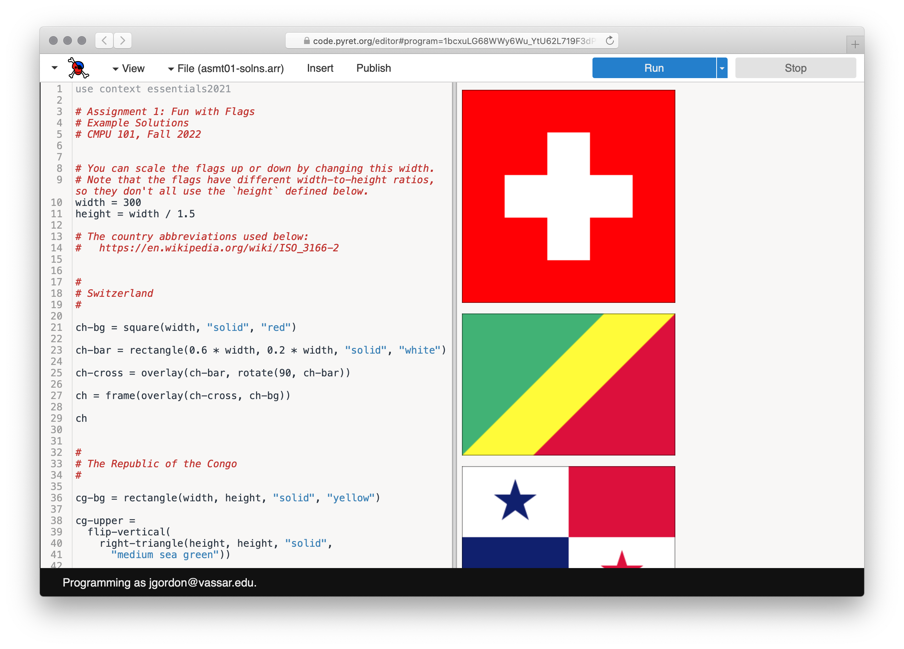
Notes:
We started out drawing some flags.

Slide 10
…
Notes:
And, a couple short months later,

Slide 11
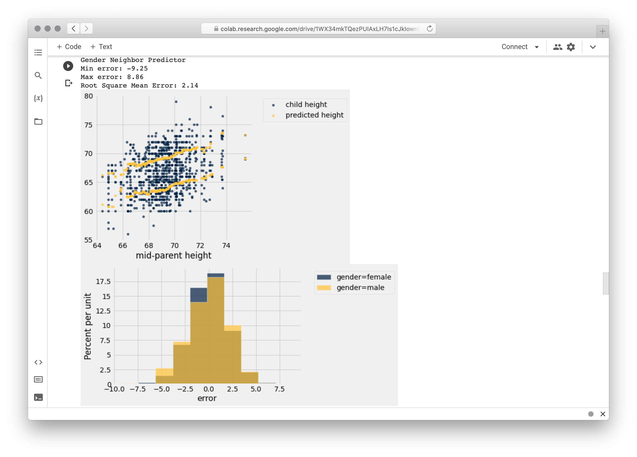
Notes:
we’re making predictions using tables of data.
These don’t seem to have a lot in common!
So, what is it we’ve been doing?

Slide 12
We’ve been practicing computational thinking.
Notes:
Fundamentally, [slide]
Computational thinking isn’t specific to the languages we’re working in or even to computing as we know it.

Slide 13
“Modern computer science is the last 1 percent of the historical timeline of computational thinking. Computer scientists inherited and then perfected computational thinking from a long line of mathematicians, natural philosophers, scientists, and engineers all interested in performing large calculations and complex inferences without error.”
Peter J. Denning & Matti Tedre, Computational Thinking
Notes:
What we think of as computer science is really just the most recent part in the history of intellectual efforts aimed at accurate, efficient calculation and inference.

Slide 14
Origins of computational thinking
Notes:
So where does computer science come from?
Just what is computational thinking before computers?

Slide 15
Before the modern computer age, there was a profession of mathematically trained experts who performed complex calculations as teams.
They were called “computers”.
Notes:
Well, [slide]

Slide 16
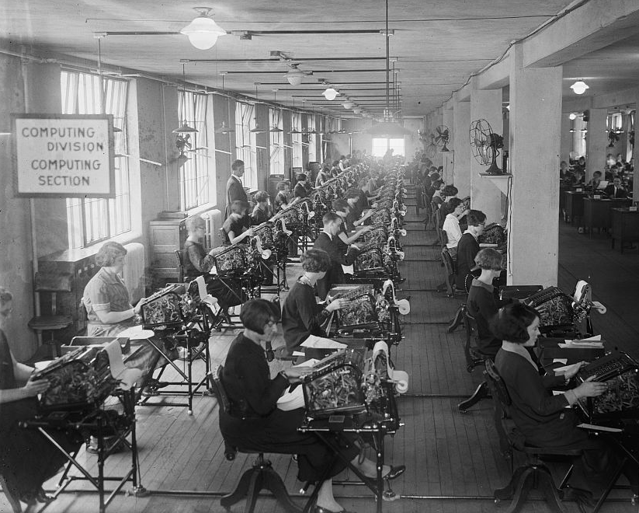
I’m a computer!
Bonus Bureau, Computing Division, 1924, loc.gov/pictures/item/2016838906
Notes:
And they weren’t the first; the term “computer”, meaning “one who computes”, dates back at least to the early 1600s.

Slide 17
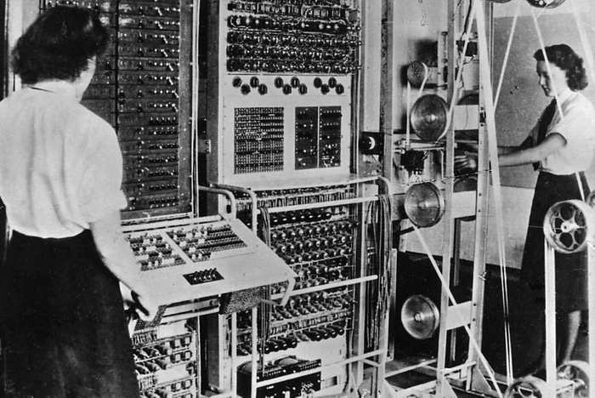
The first electronic computing machines were called “automatic computers” to distinguish them from the human variety.
Colossus Mark 2, 1944*
* Not to be confused with “Colossus, the Forbin Project”
Notes:
[slide]
That’s a bit like saying “color television” or “smart phone”.
This is a picture of Colossus, the first electronic programmable computer, with some of the women who programmed and operated it.

Slide 18
Teams of human computers engaged in computational thinking long before the invention of electronic computers.

Slide 19
Early computational thinking can be seen going back to the records of the Babylonians, who wrote down general procedures for solving mathematical problems around starting around 1800 BCE.
Notes:
[slide]
Although these procedures were carried out by people, they have the same basic features as the functions we write:
They take an input and produce the correct output by following a series of precisely defined steps.
In this way, mathematicians made their expertise available to non-experts, who simply had to follow directions, carrying out simple arithmetic operations in the right order.

Slide 20
Long before this class, you learned these kind of computational methods.

Slide 21
27182818284590
+31415926535897
Notes:
Start by thinking about what you do just to add two big numbers by hand!
You follow a procedure that takes the two inputs...

Slide 22
27182818284590
+31415926535897
7
Notes:
And

Slide 23
27182818284590
+31415926535897
87
1
Notes:
step

Slide 24
27182818284590
+31415926535897
487
1
1
Notes:
by

Slide 25
27182818284590
+31415926535897
0487
1
1
1
Notes:
step

Slide 26
27182818284590
+31415926535897
20487
1
1
1
1
Notes:
...

Slide 27
27182818284590
+31415926535897
820487
1
1
1
1

Slide 28
27182818284590
+31415926535897
4820487
1
1
1
1
1

Slide 29
27182818284590
+31415926535897
44820487
1
1
1
1
1

Slide 30
27182818284590
+31415926535897
744820487
1
1
1
1
1
1

Slide 31
27182818284590
+31415926535897
8744820487
1
1
1
1
1
1

Slide 32
27182818284590
+31415926535897
98744820487
1
1
1
1
1
1

Slide 33
27182818284590
+31415926535897
598744820487
1
1
1
1
1
1

Slide 34
27182818284590
+31415926535897
8598744820487
1
1
1
1
1
1

Slide 35
27182818284590
+31415926535897
58598744820487
1
1
1
1
1
1

Slide 36
27182818284590
+31415926535897
58598744820487
1
1
1
1
1
1
Notes:
You carry out the right operations to get the desired output.

Slide 37
Euclid’s algorithm
Around 300 BCE, the Greek mathematician Euclid gave a method to find the greatest common divisor (GCD) of two numbers, which is the largest integer that divides both numbers.
Notes:
An ancient algorithm, still taught to many schoolchildren today is Euclid’s algorithm, used to find the greatest common divisor for two numbers.

Slide 38
Euclid’s algorithm
Euclid noticed that the GCD of two numbers divides their difference.
So, he repeatedly replaced the larger number with their difference until both were the same.
Notes:
[slide]
Which sounds a lot like writing a recursive function!

Slide 39
Euclid’s algorithm
Euclid noticed that the GCD of two numbers divides their difference.
So, he repeatedly replaced the larger number with their difference until both were the same.
gcd(48, 18)
→ gcd(30, 18)
→ gcd(12, 18)
→ gcd(12, 6)
→ gcd( 6, 6)
→ 6
Notes:
This method was used to reduce fractions – and today it’s one of the basic methods underlying cryptography.
What is this? It’s recursion!

Slide 40
Sieve of Eratosthenes
This is another famous method dating back to the ancient Greeks, used to find all the prime numbers up to some limit.

Slide 41
Sieve of Eratosthenes
2 3 4 5 6 7 8 9 10 11 12 13 14 15 16 17 18
We begin with a list of all the integers, from 2 to the limit.

Slide 42
Sieve of Eratosthenes
2 3 4 5 6 7 8 9 10 11 12 13 14 15 16 17 18
We cross out all the multiples of 2.

Slide 43
Sieve of Eratosthenes
2 3 4 5 6 7 8 9 10 11 12 13 14 15 16 17 18
Then all the multiples of 3.

Slide 44
Sieve of Eratosthenes
2 3 4 5 6 7 8 9 10 11 12 13 14 15 16 17 18
Then all the multiples of 5.

Slide 45
Sieve of Eratosthenes
2 3 4 5 6 7 8 9 10 11 12 13 14 15 16 17 18
And so on, leaving you with only the primes between 2 and the limit you chose.

Slide 46
Sieve of Eratosthenes
After each round of elimination, a new prime will be revealed, and the next round crosses out all its multiples.
Notes:
[slide] What is this? It’s iteration!

Slide 47
These are computational procedures, carried out by hand!

Slide 48
Decomposing computing tasks
Notes:
But computational thinking goes beyond just writing functions.
A big part of computational thinking is breaking problems into parts.
Story time!

Slide 49
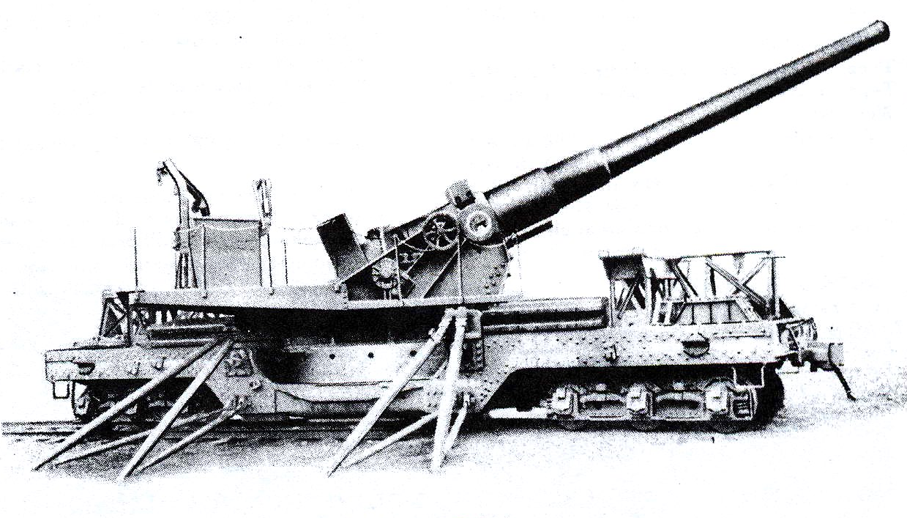
During the time leading up to World War II, the US Army developed ever more sophisticated artillery that could fire shells over several miles.
8-inch Mk. VI railway gun

Slide 50
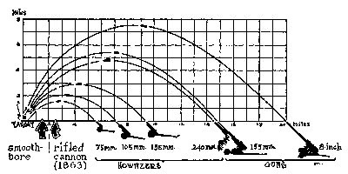
Gunners needed to know how to aim their artillery given
the range,
the difference of elevation, and
the winds.

Slide 51
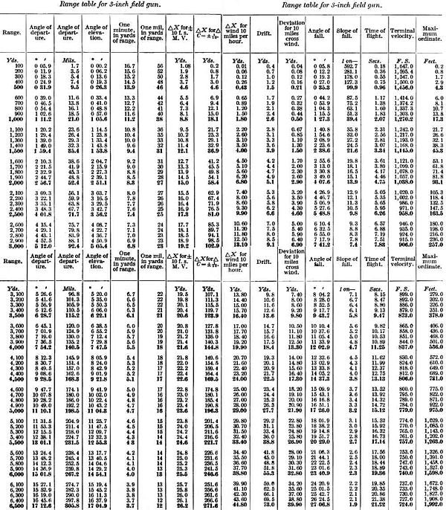
The Army commissioned teams of human computers to work out firing tables for these guns.
The gunners could then simply look up the proper angle and direction to aim their guns, given their measurement of range, elevation, and winds.

Slide 52
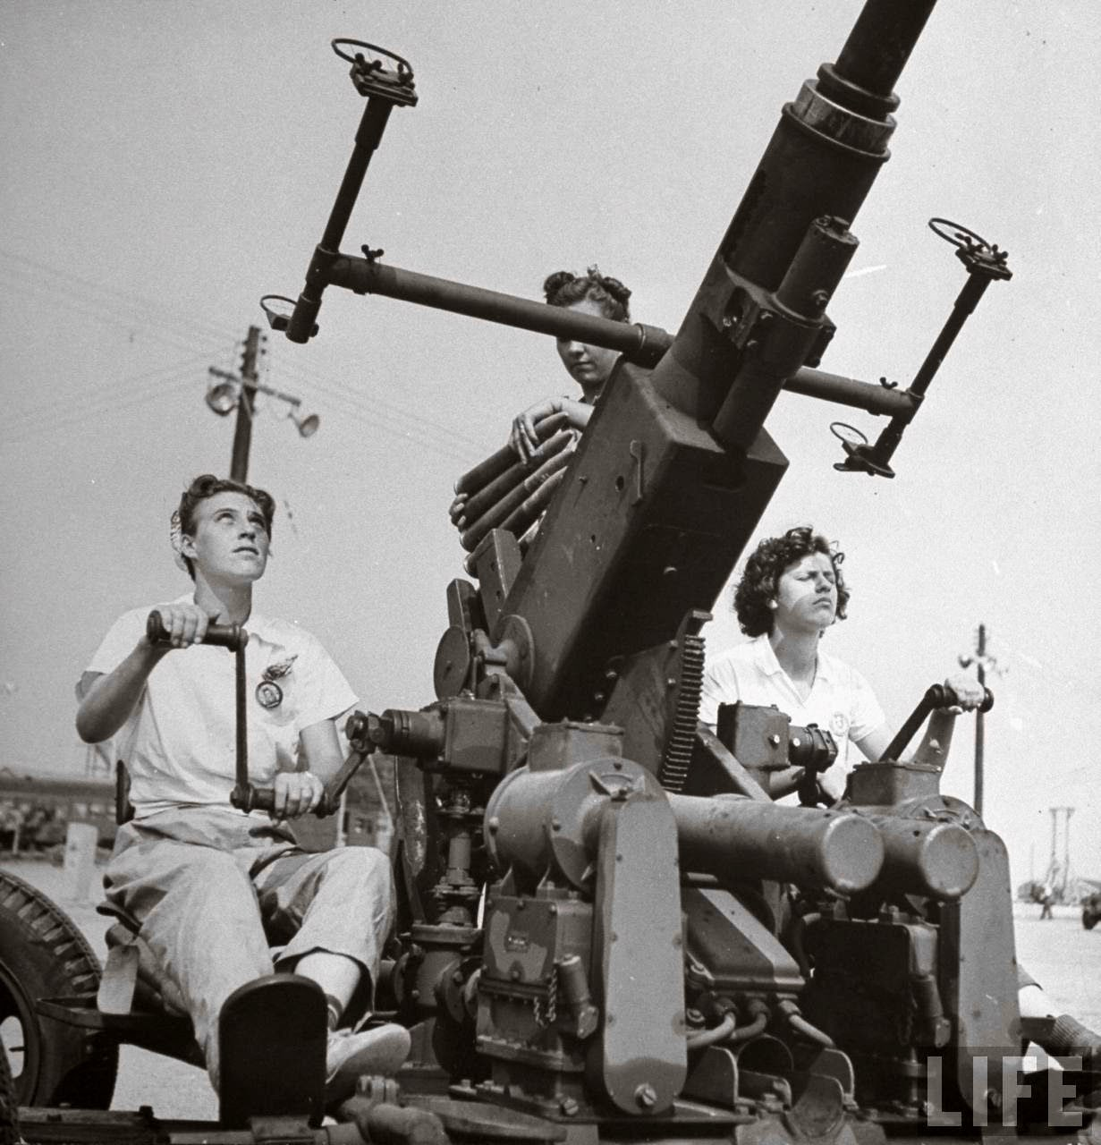
Around 1940, one of these teams comprised women working at Aberdeen Proving Ground in Maryland.

Slide 53
They organized into assembly lines, each doing a different stage of computation, until they compiled the firing tables.
Each assembly line was working on a different input, like running a function
Each of the human computers in the assembly line was carrying out a part of the computation, like running a line of code
Notes:
[slide] Breaking a problem down into these smaller pieces let them carry out the computations much more efficiently.

Slide 54
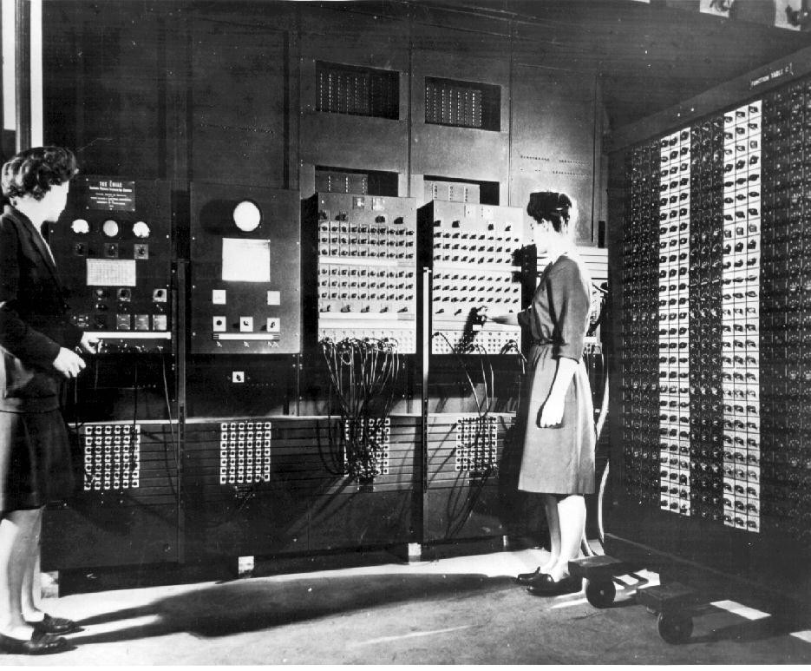
The Army wanted to perform these computations at much larger scales and faster than humans could, which led to using the ENIAC electronic computer.
Notes:
But, [slide]
[Electronic Numerical Integrator and Computer]

Slide 55
Programmable computers

Slide 56
No matter how simple and unambiguous the steps are made, human computers make mistakes – and lots of them!
So, inventors through the ages have sought to make computing machines to allow people to perform longer computations with fewer errors.

Slide 57
This was a slow process, taking us from…

Slide 58
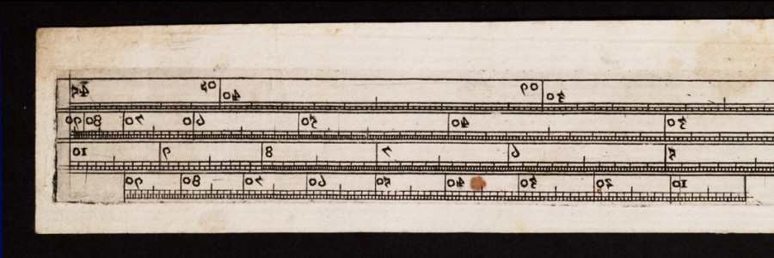
Slide rule
c. 1620

Slide 59
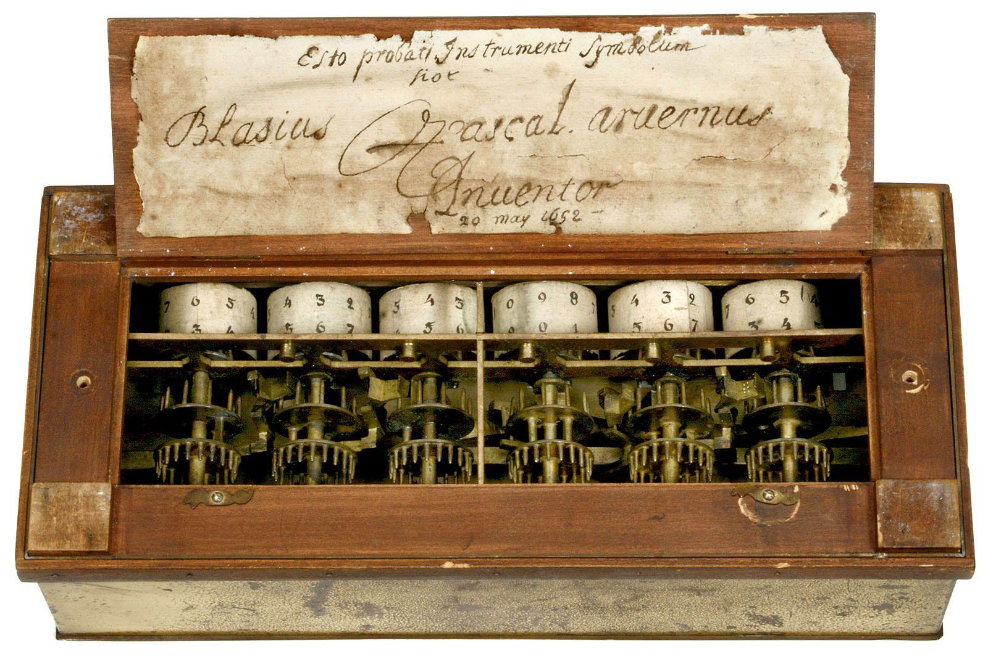
Blaise Pascal’s mechanical calculator
1642
Notes:
[Called the Pascaline or Pascal’s wheel, it could add and subtract but not multiply or divide]

Slide 60
Precursors to the idea of a programmable computer originated well before the electronic computing age.
In the early 1700s, French textile weavers experimented with machines that could weave complex patterns using an automatic loom.

Slide 61
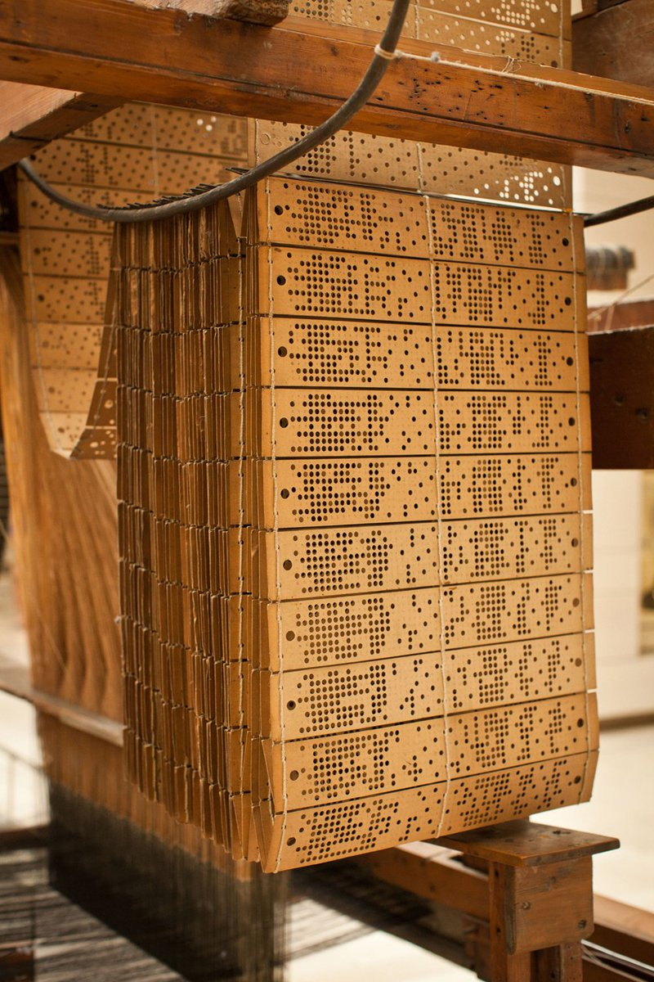
One of the more well known is the Jacquard loom, which was controlled by long chains of punched cards.

Slide 62
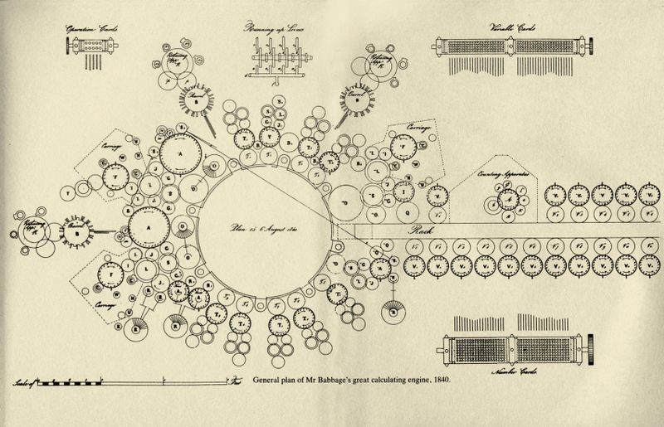
Plan for Babbage’s Analytical Engine
1840
Notes:
Starting around 1837, Charles Babbage conceived of the Analytical Engine, a mechanical computer that would use punched cards, like Jacquard’s loom.
These punched cards would contain a program that would instruct the machine to automatically compute a mathematical function.

Slide 63
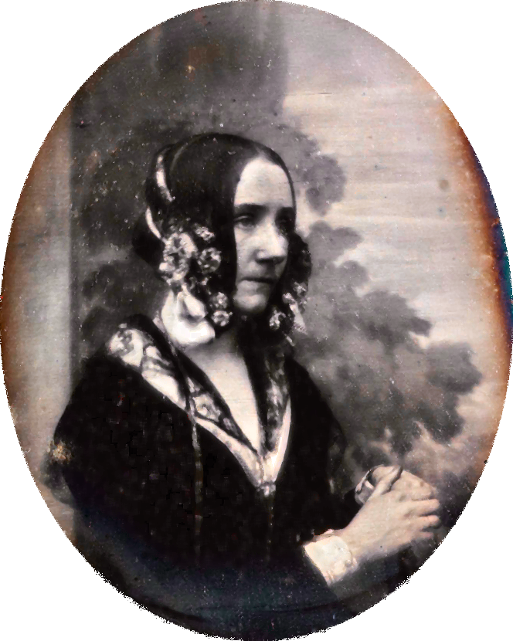
Babbage collaborated with a gifted mathematician, Ada Lovelace, who designed algorithms for the Analytical Engine, even though there was no machine to run them on.
Notes:
[Daughter of Lord Byron.
She assisted Babbage in explaining and promoting his ideas, writing articles describing the operation and use of the analytical engine.
She’s widely considered the first computer programmer, even though she didn’t have a working computer to run her programs on! Remember that when you’re taking your final exam on paper...]

Slide 64
Lovelace saw the Analytical Engine not as a mere calculator but as a processor of any information that could be encoded in symbols.
This insight, that computing programs can calculate not only over numbers but over symbols that can stand for anything in the world, anticipated by a hundred years a key tenet of the modern computer age.
Lovelace saw the computer as an information machine.
Notes:
[slide]
Ironically, some central insights of the computer age come from the age of steam.

Slide 65
While Babbage’s designs for a programmable computer weren’t realized at the time, the age of electronics opened new possibilities.
Notes:
[slide] In the 1930s, there was intense experimentation.

Slide 66
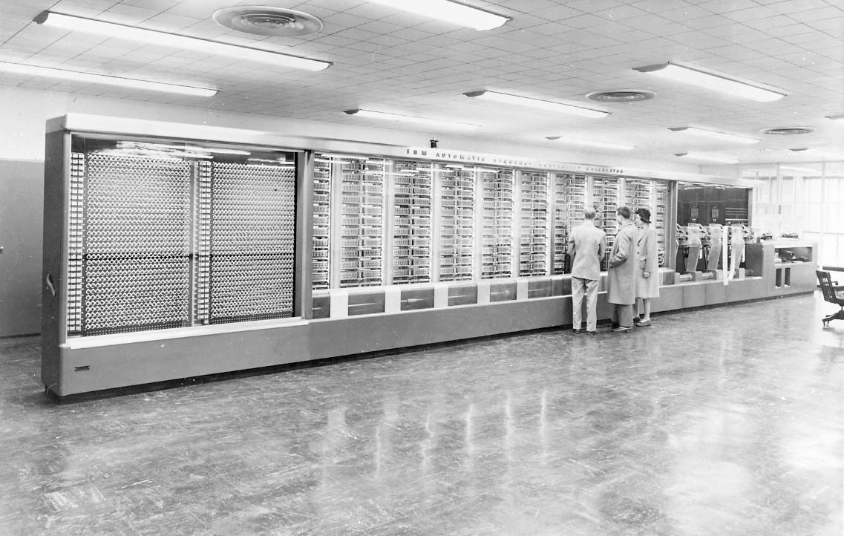
Harvard Mark I
1944
Notes:
Howard Aiken, in partnership with IBM and sponsored by the navy, built the Mark I at Harvard in 1944.
This was an electromechanical – not electronic – computer, whose programs and input data were stored externally on punched paper tapes.

Slide 67
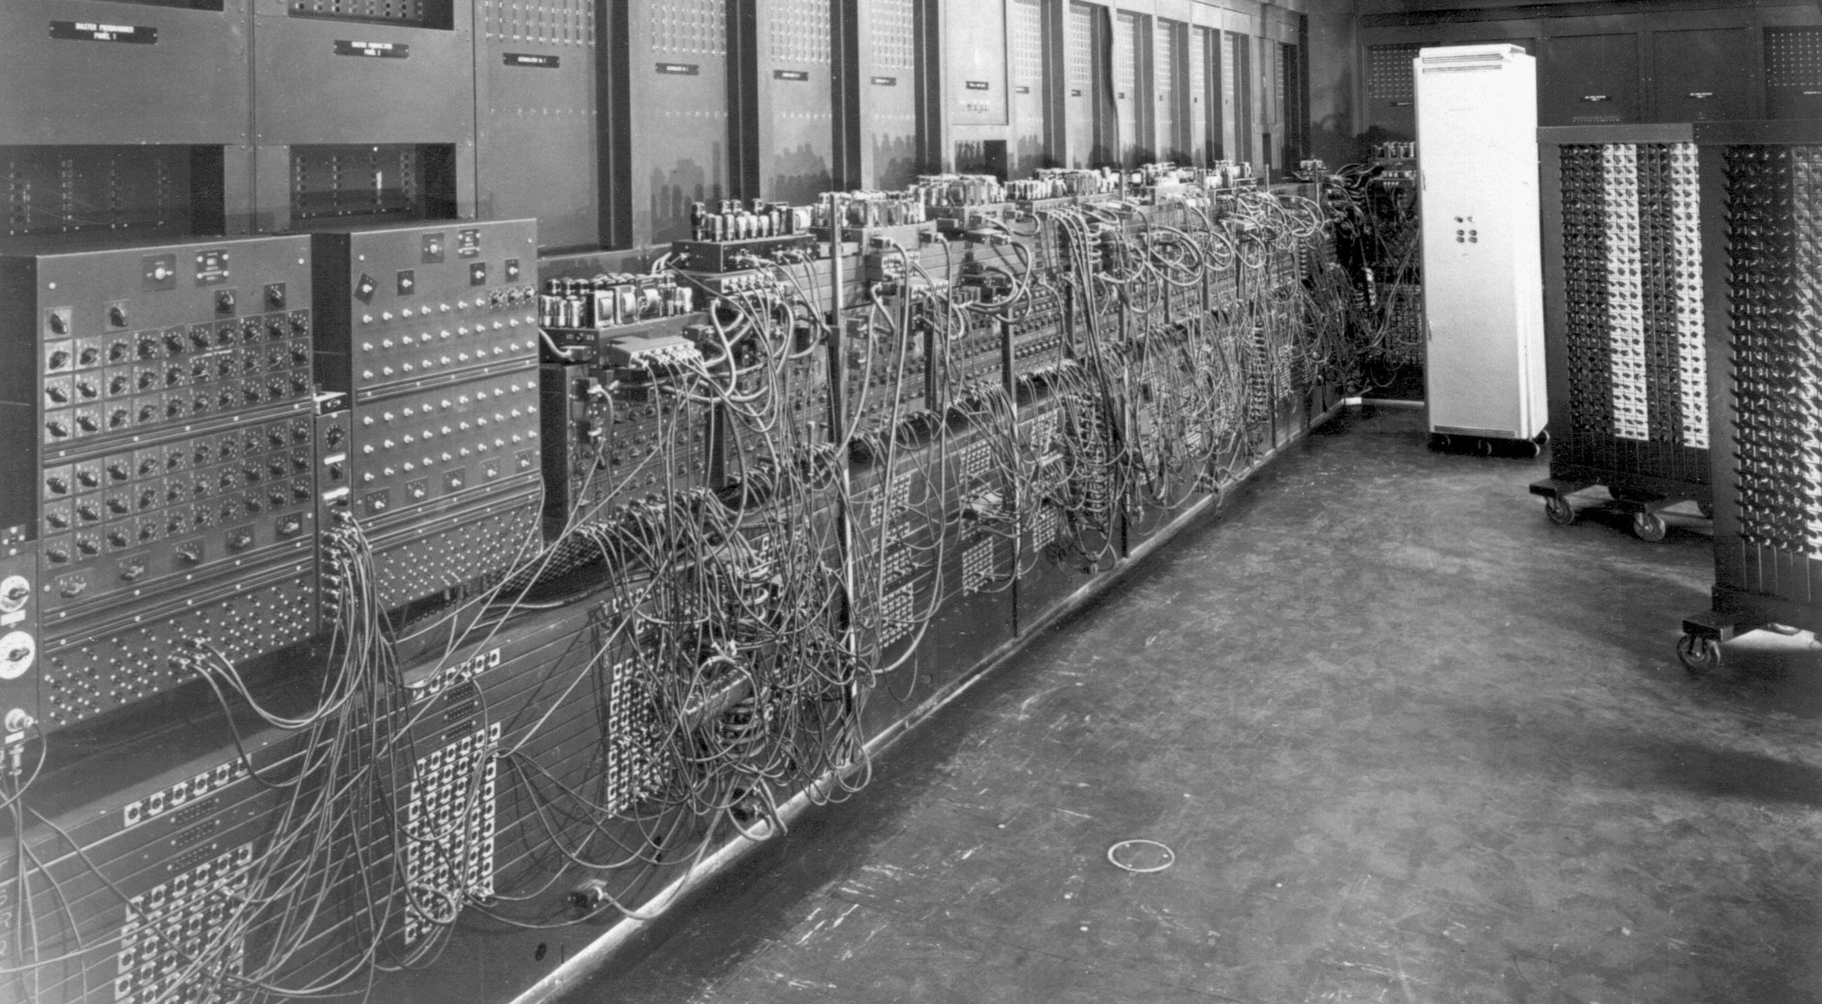
ENIAC
c. 1945
Notes:
ENIAC was the first general-purpose, programmable electronic computer.
Unfortunately, its memory was limited, and it used 18,000 vacuum tubes that gradually wore out. The computer would fail “only” 2-3 times a week!
It took its input from an external wire patch board, which also made programming it quite tedious.

Slide 68
Early computers were very difficult to program, working in languages that were closely tied to the hardware.
Notes:
Even as they became quicker and smaller, [slide]

Slide 69
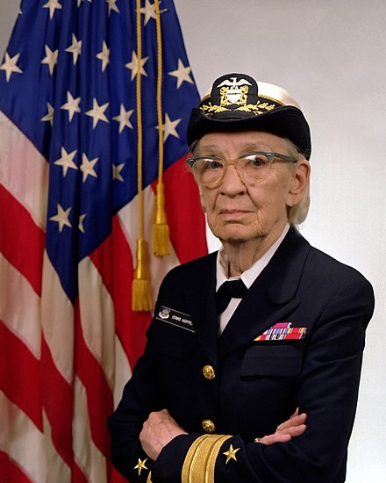
Grace Hopper ’28 popularized the idea of a compiler for machine-independent programming languages and defined FLOW-MATIC, the first English-like data processing language in the early 1950s.
Those ideas were later folded into the popular COBOL language (1959).
Notes:
Hopper had been one of the early programmers of the Harvard Mark I computer.
[COBOL = COmmon Business-Oriented Language]

Slide 70
Since the 1950s, many programming languages have been defined, experienced popularity, and then been supplanted by new designs.

Slide 71
Today, Python is the programming language most often used for work in data science and artificial intelligence.

Slide 72
Programming no longer involves plugging in wires or punching cards, but it’s still hard!

Slide 73
“The programmer, like the poet, works only slightly removed from pure thought-stuff. He builds castles in the air, from air, creating by exertion of the imagination…
Fred Brooks, The Mythical Man Month, 1975
Notes:
In 1975, the (recently deceased) Turing Award recipient Fred Brooks wrote:

Slide 74
“Few media of creation are so flexible, so easy to polish and rework, so readily capable of realizing grand conceptual structures. Yet the program construct, unlike the poet’s words, is real in the sense that it moves and works, producing visible outputs separate from the construct itself…
Fred Brooks, The Mythical Man Month, 1975

Slide 75
“One types the correct incantation on a keyboard, and a display screen comes to life, showing things that never were nor could be… It prints results, draws pictures, produces sounds, moves arms. The magic of myth and legend has come true in our time…
Fred Brooks, The Mythical Man Month, 1975
Notes:
[He’s saying all of this in 1975, way before we had modern video games or Pixar making computer-animated films...]

Slide 76
“The computer resembles the magic of legend in this respect, too. If one character, one pause, of the incantation is not strictly in proper form, the magic doesn’t work. Human beings are not accustomed to being perfect, and few areas of human activity demand it. Adjusting to the requirement for perfection is, I think, the most difficult part of learning to program.”
Fred Brooks, The Mythical Man Month, 1975

Slide 77
Computing with data
Notes:
But we haven’t just been writing programs this semester; we’ve been writing programs to work with data.

Slide 78
We’ve seen some cool data sets during this semester, but there are many, many more you can explore.

Slide 79
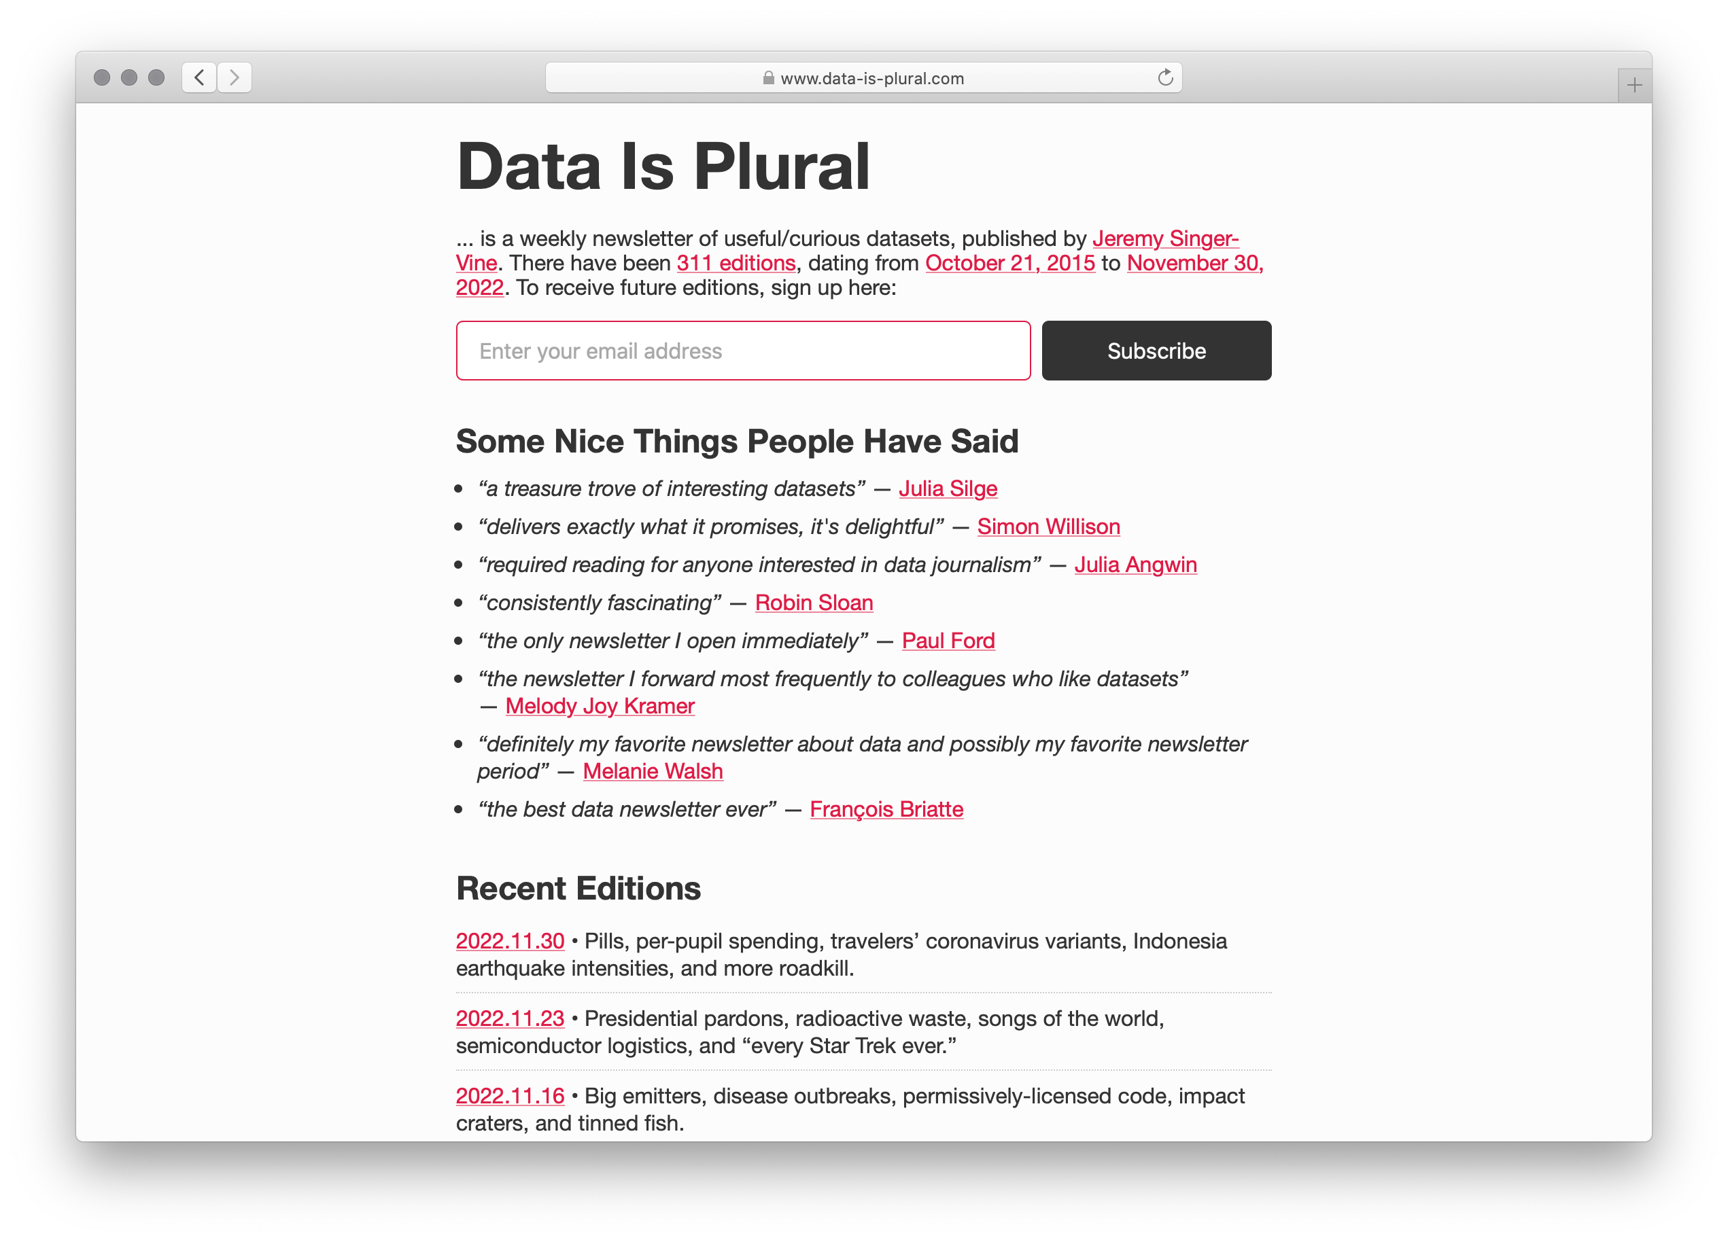
Notes:
A great place to start is the archive of the Data is Plural newsletter.

Slide 80
Building data models
Notes:
But what goes into building a data set? What do we need to think about when we’re looking at a new data set?

Slide 81
Data is situated in the environment where it was gathered.
Consider Galton’s child-height data.
He gathered the data in England c. 1886.
What would happen if you tried to use it to predict heights in Poughkeepsie today? In Guatemala? In China?
Notes:
[slide]
Additionally, ...

Slide 82
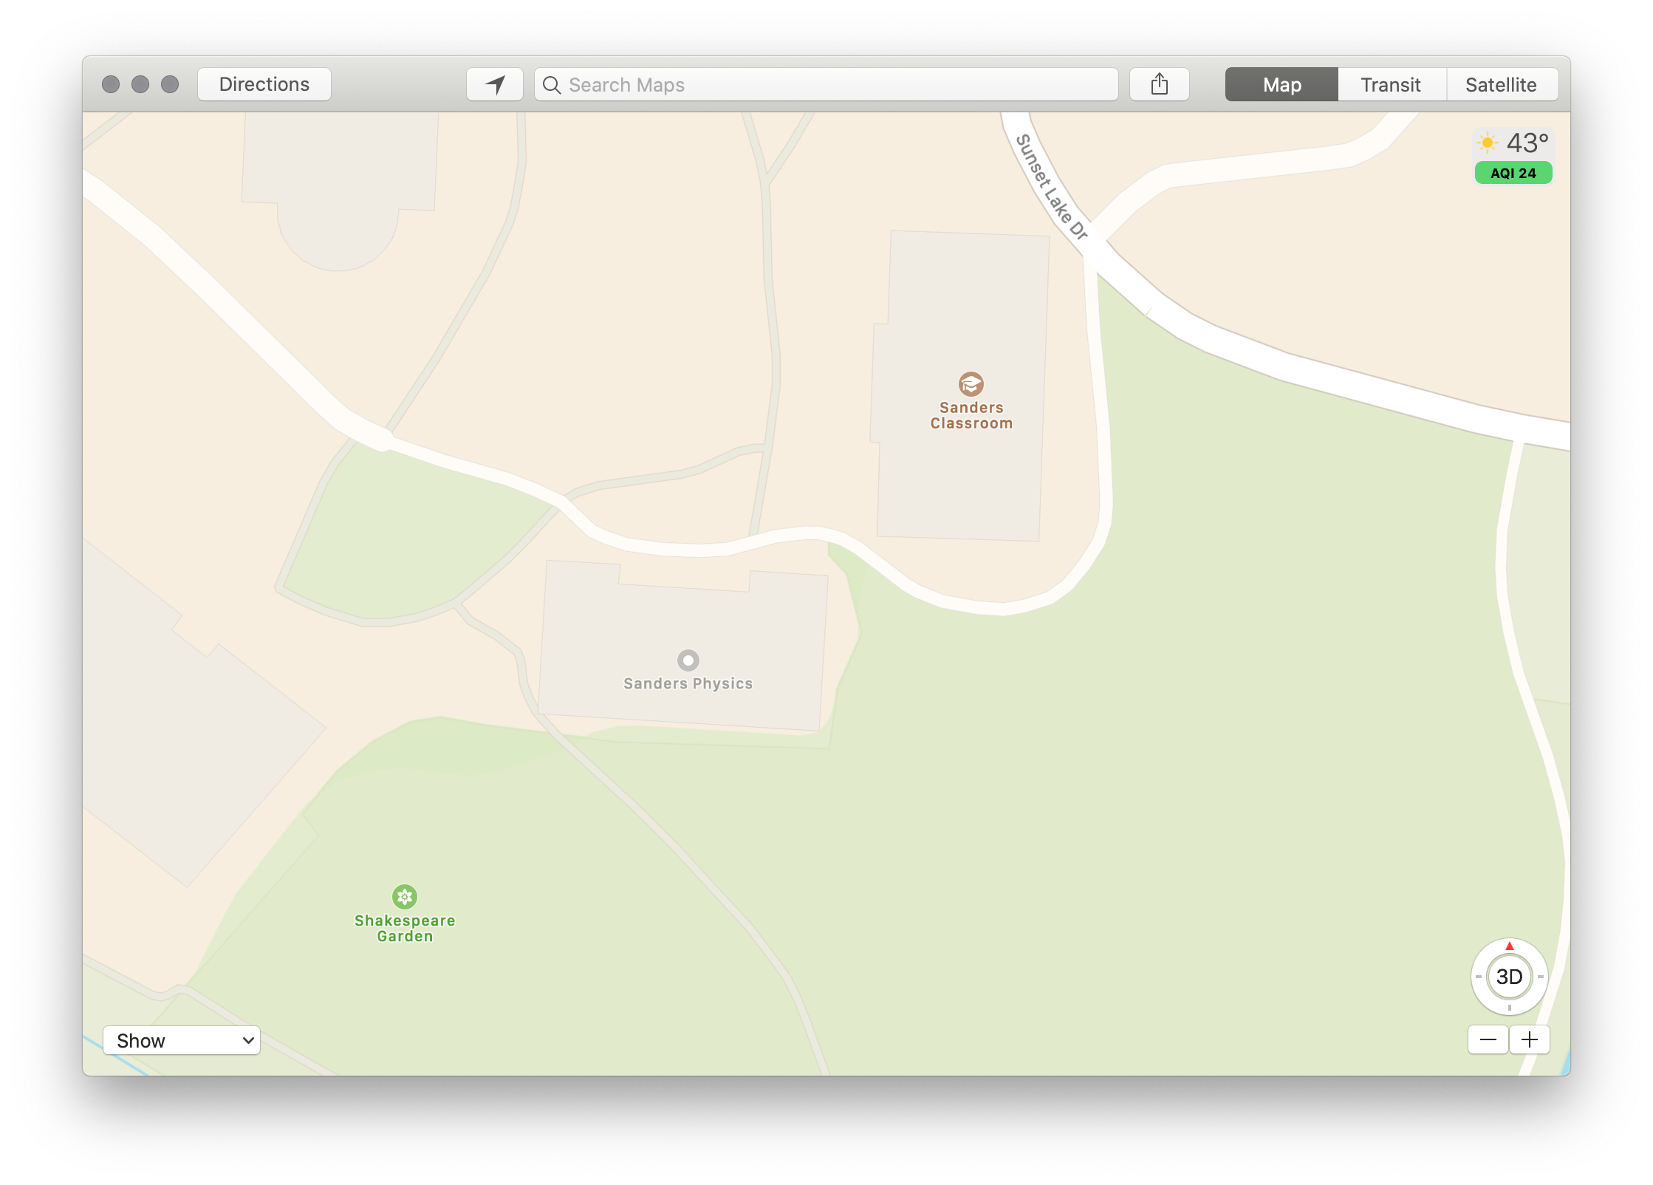
When we collect data, it’s like making a map:
We’re constructing a model, where we choose what to represent, and how to represent it.

Slide 83
“…most of the data and data models we have inherited deal with structures of power, like gender and race, with a crudeness that would never pass muster in a peer-reviewed humanities publication.”
Miriam Posner, “What’s Next: The Radical, Unrealized Potential of Digital Humanities”, 2016

Slide 84
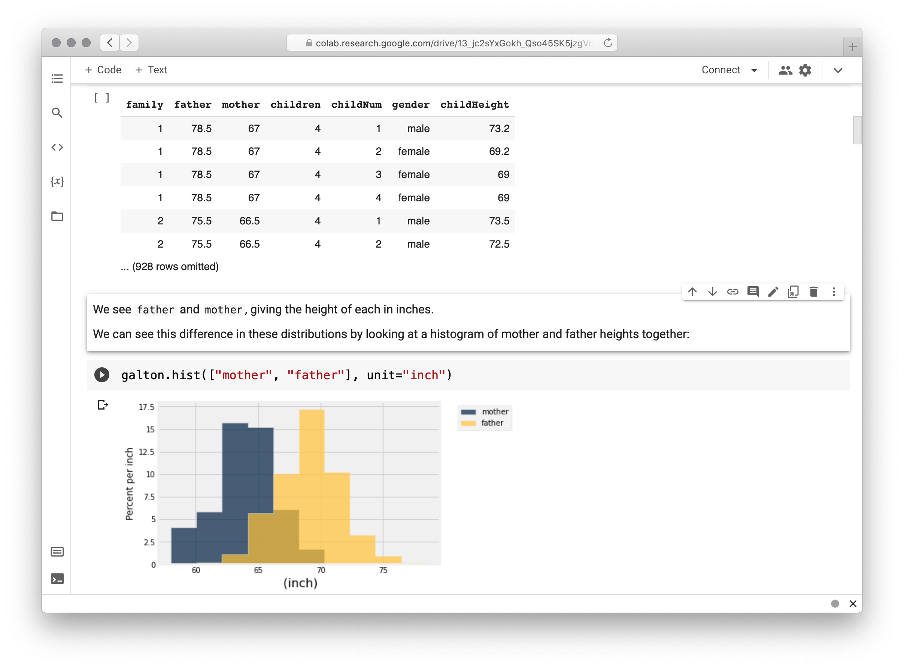
Notes:
Galton’s data represents gender as a binary: male and female.

Slide 85
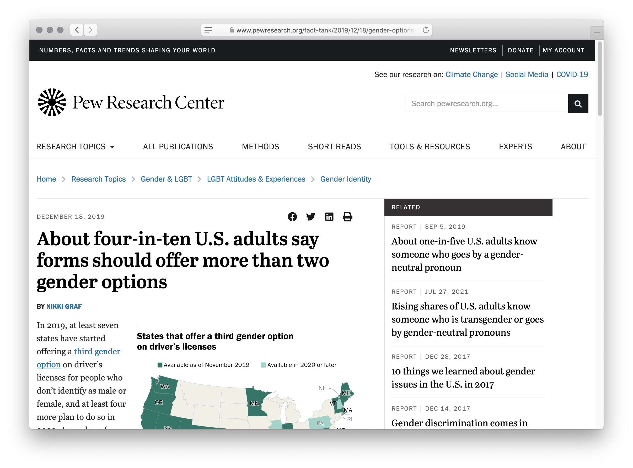
Notes:
While a majority of adults in the US would agree with those being the only options, a significant and growing number disagree!
If we were collecting that information today, that column might look quite different.

Slide 86
“I want us to be more ambitious, to hold ourselves to much higher standards when we are claiming to develop data-based work that depicts people’s lives.”
Miriam Posner, “What’s Next: The Radical, Unrealized Potential of Digital Humanities”, 2016

Slide 87
Data and privacy
Notes:
We need to hold ourselves accountable, not just for how we represent data, but for what data we gather and what predictions we choose to make with it.

Slide 88
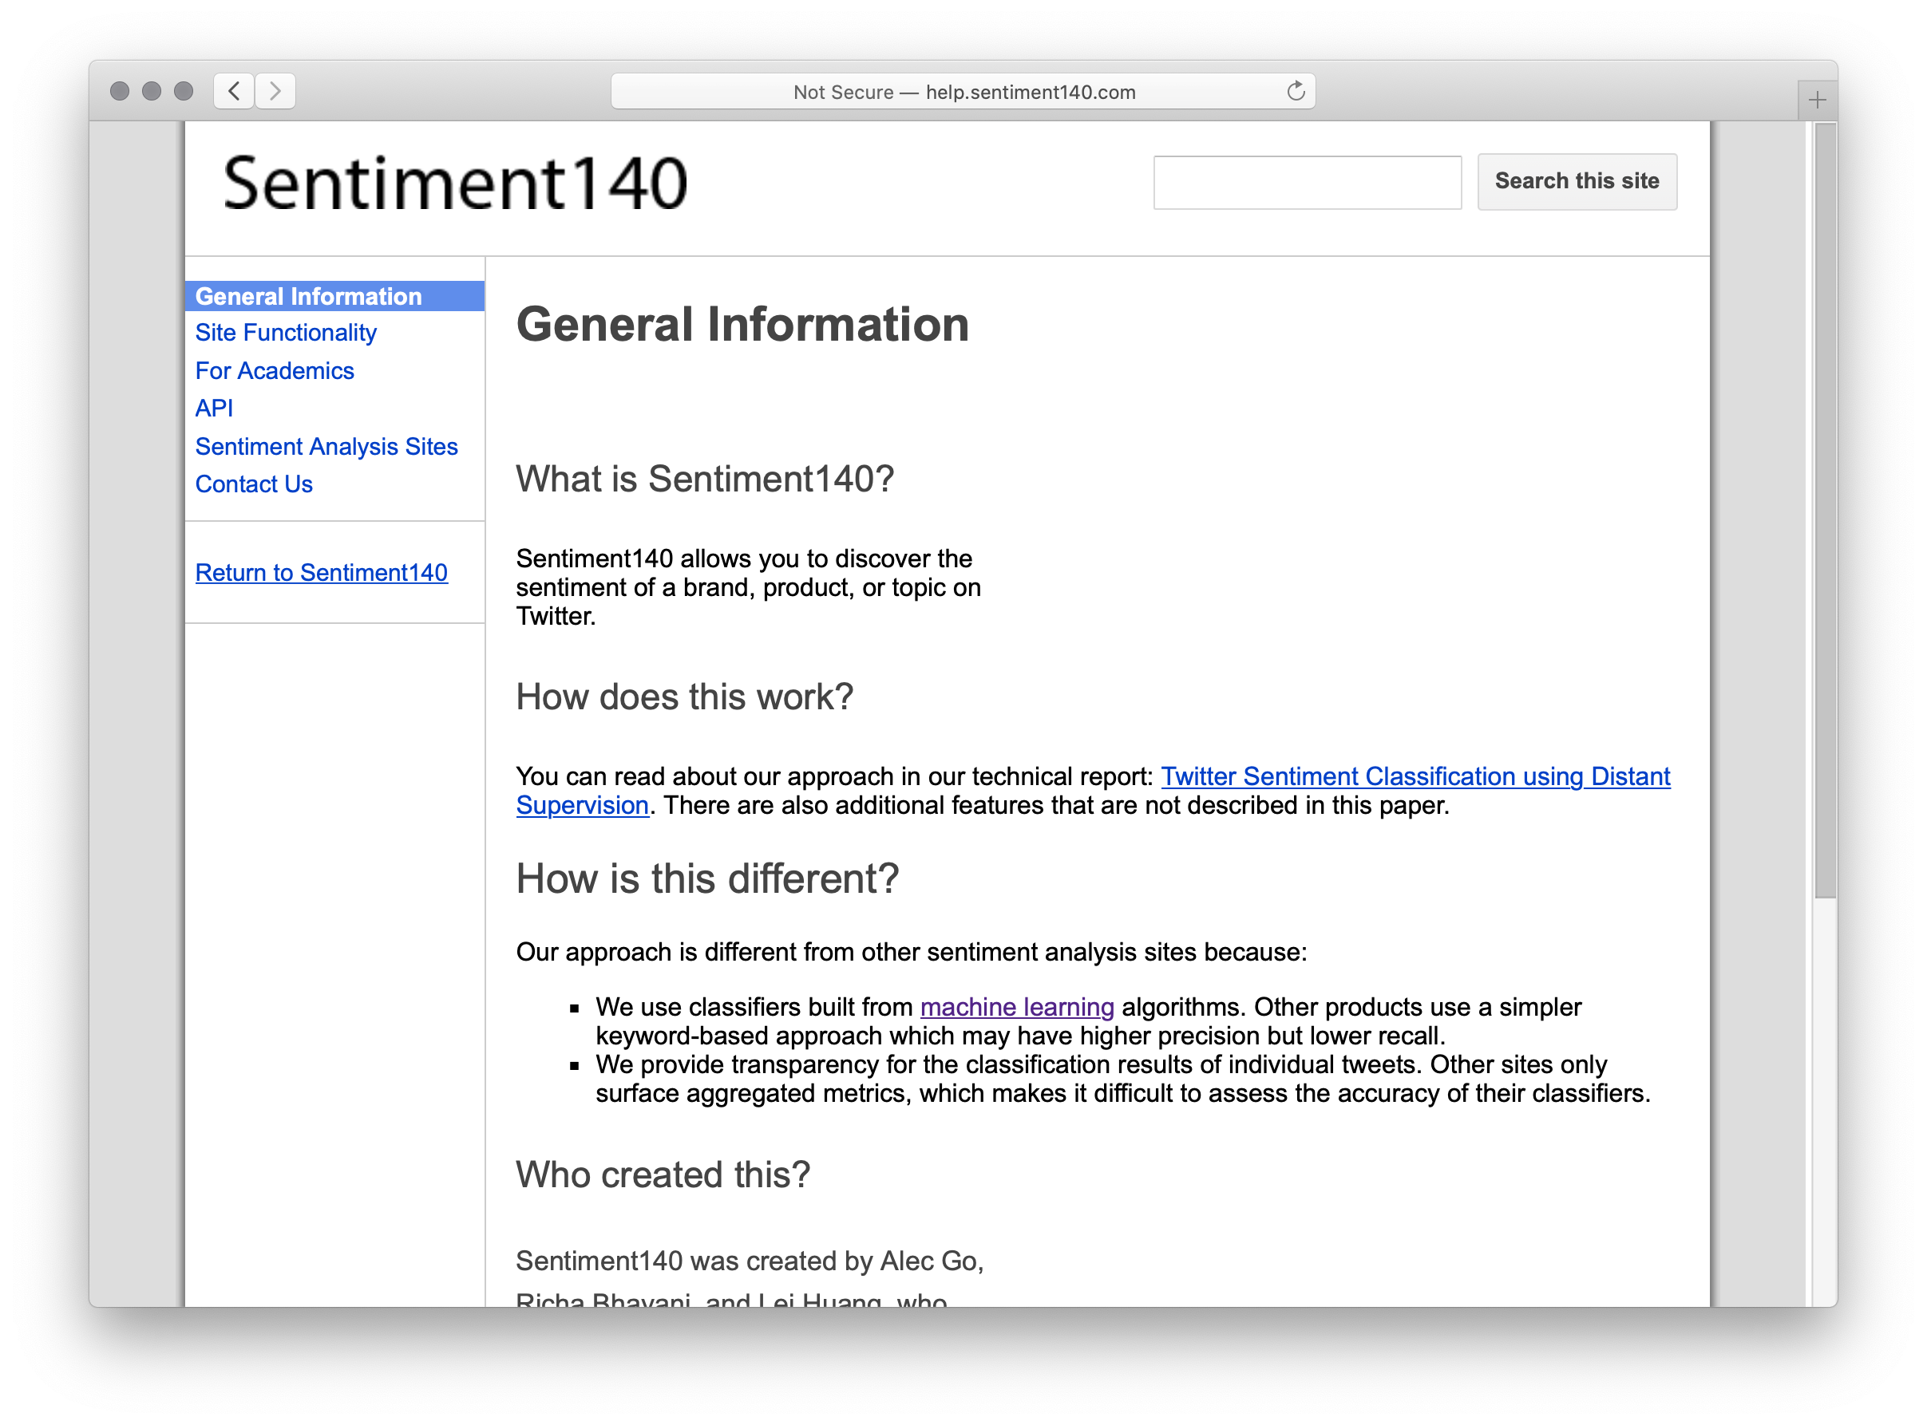
help.sentiment140.com
Notes:
Sentiment140 is a data set used for learning to predict sentiment, that is, emotional responses, from social media like Twitter.
You can download it for free as CSV files.

Slide 89
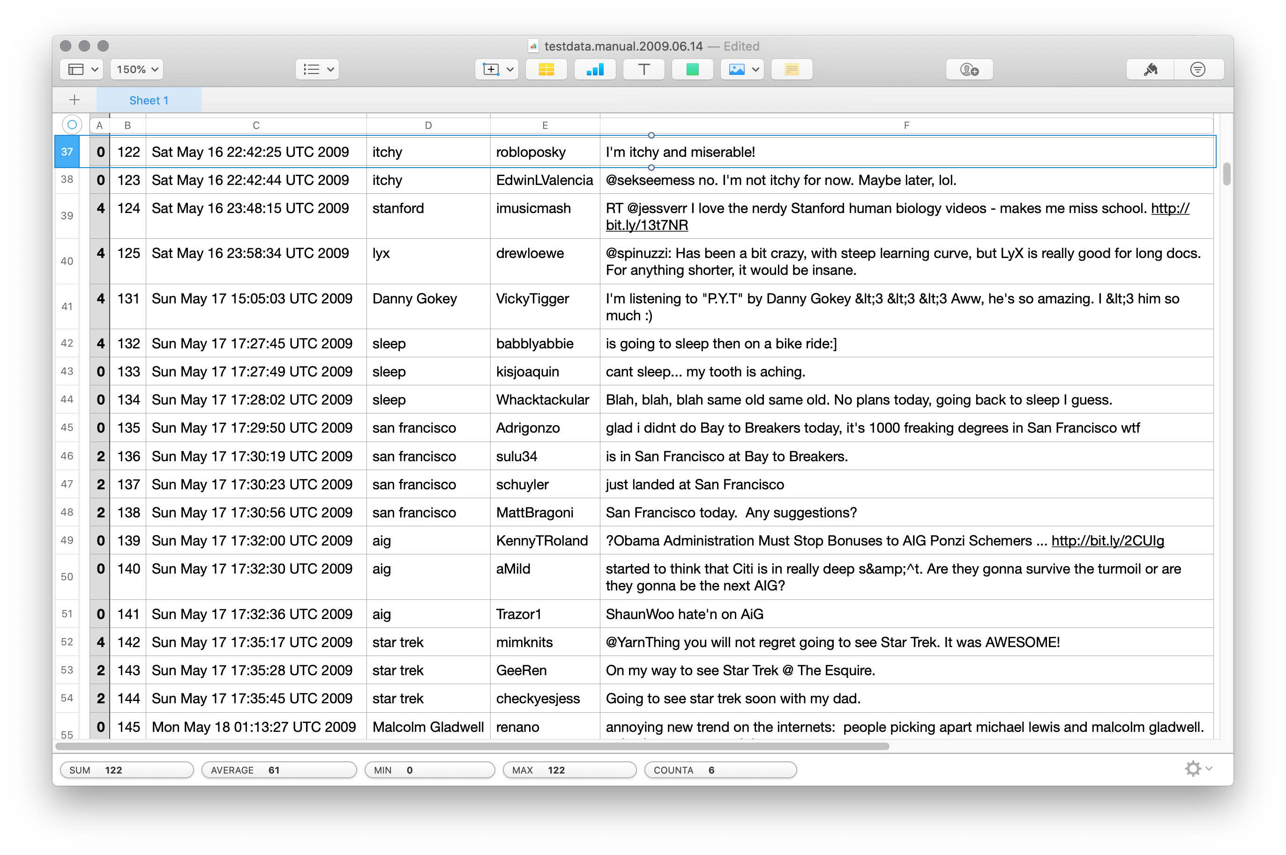
Notes:
When “robloposky” make a public tweet in 2009 that they were itchy and miserable, did they really mean for that data to be preserved forever?
For it to be used for machine learning?
For it to be discussed right here, right now?

Slide 90
“The words and phrases we search for on Google, the times of day we are most active on Facebook, and the number of items we add to our Amazon carts are all tracked and stored as data – data that are then converted into corporate financial gain.”
D’Ignazio & Klein, Data Feminism, 2020

Slide 91
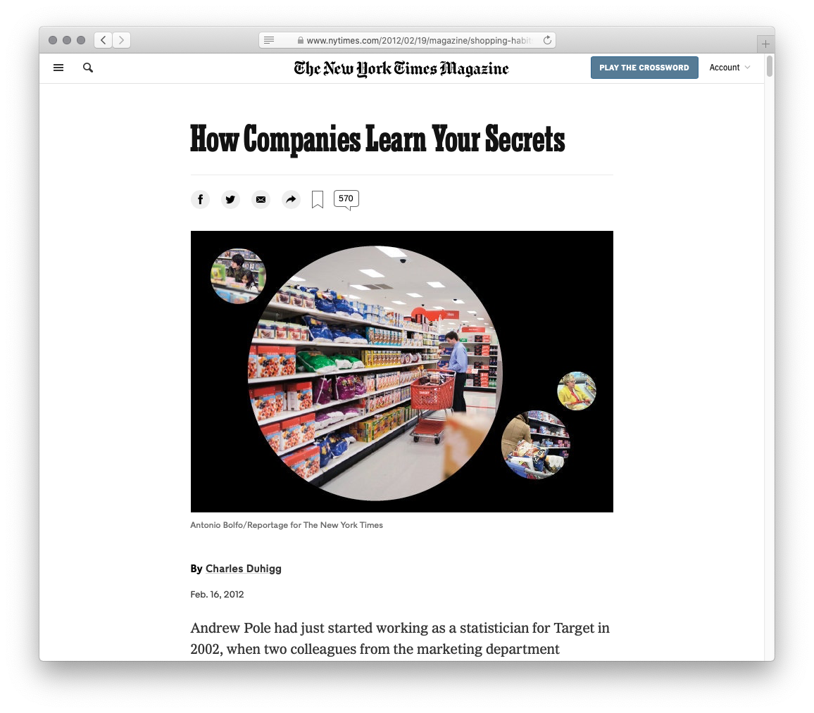
Notes:
Target wants all of your shopping, but people have ingrained habits: Groceries at the grocery store, hardware at the hardware store, etc.
Target wants to know the moment your life is in flux because that’s when your shopping habits are likely to change.
It’s easy to find out if someone moved, but what about other life events, like having a baby?
It’s actually easy for them to find out when you have a baby because birth records are usually public.
But they want to know sooner so they get to you before other stores.
Target wants to know if you’re pregnant.
And they’re good at it. This article recounts a father demanding to see the manager because his high-school daughter was receiving target coupons for baby clothes and cribs.
Guess what Target knew that her father didn’t?

Slide 92
“As Pole’s computers crawled through the data, he was able to identify about 25 products that, when analyzed together, allowed him to assign each shopper a ‘pregnancy prediction’ score. More important, he could also estimate her due date to within a small window, so Target could send coupons timed to very specific stages of her pregnancy.
“One Target employee I spoke to provided a hypothetical example. Take a fictional Target shopper named Jenny Ward, who is 23, lives in Atlanta and in March bought cocoa-butter lotion, a purse large enough to double as a diaper bag, zinc and magnesium supplements and a bright blue rug. There’s, say, an 87 percent chance that she’s pregnant and that her delivery date is sometime in late August.”
Kashmir Hill, “How Target Figured Out a Teen Girl was Pregnant Before Her Father Did”, Forbes, 2012

Slide 93
Computing with data is complex, and it’s not just “technical” issues we need to concern ourselves with!
Notes:
All this is to say: [slide]

Slide 94
Computing with data gives us a lot of power!
We can do a lot of harm, but we can also do a lot of good!

Slide 95
Computer Science I
—or, where do you go from here?

Slide 96
Data types
Naming values
Evaluation
Conditionals (if and cases)
Function signatures
Testing functions
Tabular data
Sanitizing real-world data
Visualization
Higher-order functions
Lambda expressions
Linked lists
Defining structured data
Structurally recursive data and functions
Trees (binary, n-ary)
Python lists and arrays
Iteration (for)
Side effects and mutation
Debugging using print statements
Functional vs imperative languages
Accumulators
Memory and aliasing
Hash tables (dictionaries)
Web APIs and JSON
Numpy arrays
Notes:
We’ve covered a lot of topics in just one class.

Slide 97
Congratulations on making it this far!
Notes:
[slide] But there’s a lot more to see!

Slide 98
CS courses at Vassar

Slide 99
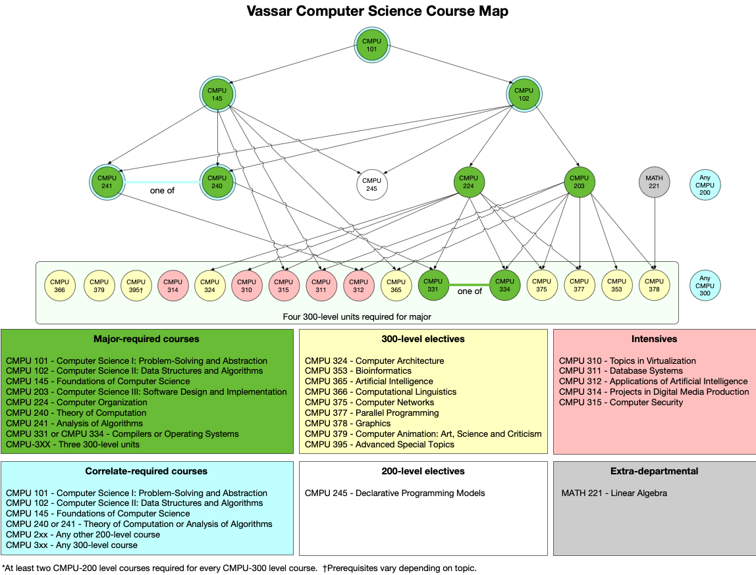

Slide 100
CMPU 102
Data Structures and Algorithms
Notes:
In CMPU 102, you explore a programming paradigm called object-oriented programming, using another programming language, called Java.
You’ll learn more about different kinds of data structures and about writing efficient programs.

Slide 101
CMPU 145
Foundations of Computer Science
Notes:
CMPU 145 is the first step into the world of theoretical computer science, the more math-y side of things where we look at the ideas that make computation possible.
You’ll learn about set theory, logic, probability and more and get practice both writing proofs and implementing the ideas by programming.

Slide 102
Try them out!
If you keep going with the CS major sequence, you work your way up to some really exciting courses, including…
CMPU 240 Theory of Computation
CMPU 366 Computational Linguistics
And, you know, probably some cool courses I don’t teach as well!
Notes:
Even if you never thought CS was for you, if you enjoyed any part of 101, I recommend trying another CS course.
[slide]

Slide 103
Further reading
Notes:
[Winter/summer] break is coming up and I know you need a good book.

Slide 104
Notes:
Recommended, very readable guide to the big ideas of CS – from a low-level understanding of how computers work up. I agree with the cover quote: It’s the best book on computers I’ve ever read.

Slide 105
Notes:
This is my favorite, incredibly clear and readable guide to artificial intelligence. If you’re wondering about the big ideas of AI or whether this is an area you’d like to go into, this is a great book to read.

Slide 106
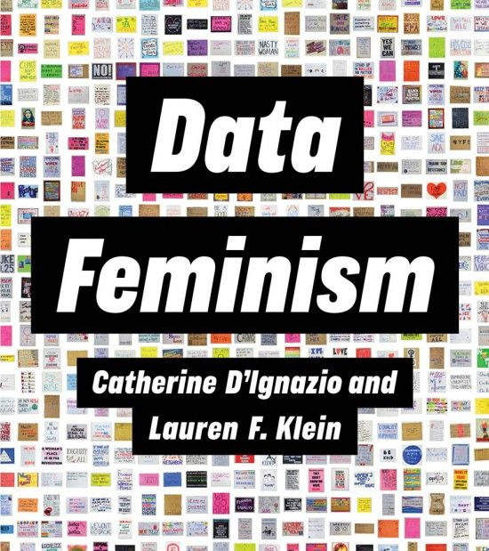
data-feminism.mitpress.mit.edu
Notes:
If you want to know more about how the data we gather and the ways we use it can be harmful and how it can combat harms, from an intersectional feminist perspective, this is a great book -- and it’s available for free online!

Slide 107
That’s it!

Slide 108
On Wednesday, we’ll have a review for Exam 3 where we’ll work through practice problems and answer your questions.

Slide 109
go.vassar.edu/course/evals
Notes:
Numeric sheets are used by the college for deciding things like compensation, contract renewals, and tenure. This is more important for people’s careers than you might imagine, so please fill it out honestly but fairly.
The written feedback is only for me; there’s no point writing “Professor Gordon does such and such” because I’m the only one who reads that. You can give your thoughts about anything to do with the course, but the most useful thing is to imagine a friend is taking this course next semester. What would you want to be the same for them? What would you want to be different?

Slide 110
Acknowledgments
This lecture incorporates material from:
Peter J. Denning & Matti Tedre, Computational Thinking
Miram Posner, UCLA
Edward Tufte, Visual Explanations
And, Jonathan Gordon, Vassar College

