Slide 1
Trees

Slide 2
Steps to write a generic template
Given a (recursive) data definition, you write a generic template by:
Creating a function header,
Using cases to break the data input into its variants,
In each case, list each of the fields as part of the answer
And, calling the function itself on any recursive fields.

Slide 3
Data Definition: Start With A Template
data MyList:
| my-empty
| my-link(first, rest :: MyList)
end
Self-reference Definition!

Slide 4
Debrief: lists and recursion
data MyList:
| my-empty
| my-link(first, rest :: MyList)
end
my-empty
my-link(1,
my-link(2,
my-link(3,
my-empty)))
What's different here?
We have a case that's just a special keyword rather than a constructor.
Part of the second case” is of the same type we're defining.
A recursive definition!

Slide 5
Using my-list Data Template
We use this template to write a function that recursively processes the data:
fun my-fun(ml :: MyList) -> ...:
doc: "Template for a function that takes a MyList"
cases (MyList) ml:
| my-empty => ...
| my-link(f, r) =>
... f ...
... my-fun(r) …
end
where:
my-fun(...) is ...
end

Slide 6
Tracking rumors
Suppose we want to track gossip in a rumor mill.

Slide 7
Ginny controls the rumor mill
Notes:
Real rumors can be hurtful, so let's take a fictional one -- Harry's purported tattoo.
[In the book of Half-Blood Prince, but not actually in the film.]

Slide 8
Tracking rumors
Suppose we want to track gossip in a rumor mill.
Pansy
Notes:
[Pansy Parkinson]

Slide 9
Tracking rumors
Suppose we want to track gossip in a rumor mill.
Pansy

Slide 10
Tracking rumors
Suppose we want to track gossip in a rumor mill.
Cho
Pansy
Draco

Slide 11
Tracking rumors
Suppose we want to track gossip in a rumor mill.
Cho
Pansy
Romilda
Draco
Vincent
Notes:
[Vincent Crabbe; Romilda Vane]

Slide 12
Tracking rumors
Suppose we want to track gossip in a rumor mill.
Cho
Pansy
Romilda
Draco
Ginny
Vincent

Slide 13
Tracking rumors
Suppose we want to track gossip in a rumor mill.
Simplifying assumption: Each person tells at most two others
Cho
Pansy
Romilda
Draco
Ginny
Vincent

Slide 14
Tracking rumors
Suppose we want to track gossip in a rumor mill.
Simplifying assumption: Each person tells at most two others
Cho
Pansy
Romilda
Draco
Ginny
Vincent

Slide 15
If you ignore my silly Harry Potter example, this is a pretty serious problem.
A lot of research right now is focused on building models of how information – and misinformation! – spreads through social networks, both in person and online.
Tracking rumors

Slide 16
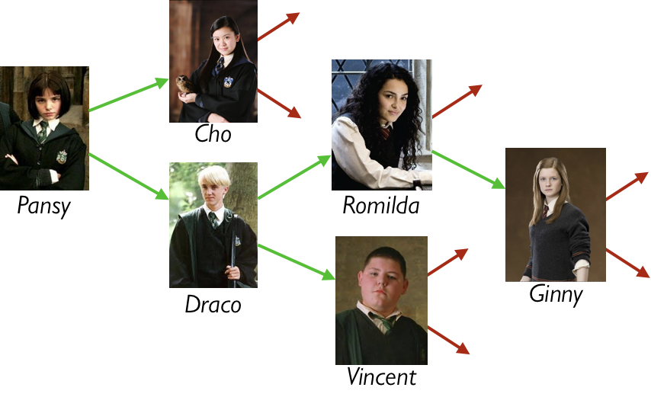
Representing rumor mills
Is a rumor mill simply a list of people?

Slide 17
Representing rumor mills
Question: Is a rumor mill simply a list of people?
Answer: No, because there are relationships among the people.

Slide 18
Representing rumor mills
We could represent these
relations with a table, e.g.,
name :: String | next1 :: String | next2 :: String
"Pansy" | "Cho" | "Draco"
"Cho"
… | … | …
Notes:
If we wanted to write a function to find out if someone hears a rumor that starts with a certain person, we'd need to filter the table again and again to get the next steps. We could do it, but it would be unpleasant.

Slide 19
Representing rumor mills
Using a table doesn’t give us any straightforward way to process the rumor mill.
Could we use something like a list but representing the relations?

Slide 20
Representing rumor mills
data Person:
| person(name :: String, next1 :: Person, next2 :: Person)
end
How about this?

Slide 21
Representing rumor mills
Some people don’t gossip to anyone else – see the red arrows above.
data Person:
| person(name :: String, next1 :: Person, next2 :: Person)
end

Slide 22
Representing rumor mills
data RumorMill:
| no-one
| gossip(name :: String, next1 :: RumorMill, next2 :: RumorMill)
end
How about this?
Notes:
This looks promising.

Slide 23
Example rumor mills
data RumorMill:
| no-one #at the start there is… no-one in the rumor mill!
| gossip(name :: String, next1 :: RumorMill, next2 :: RumorMill)
end
no-one

Slide 24
Example rumor mills
data RumorMill:
| no-one
| gossip(name :: String, next1 :: RumorMill, next2 :: RumorMill)
end
gossip("Ginny", no-one, no-one)
Ginny

Slide 25
Example rumor mills
data RumorMill:
| no-one
| gossip(name :: String, next1 :: RumorMill, next2 :: RumorMill)
end
gossip("Romilda", no-one, gossip("Ginny", no-one, no-one))
Romilda
Ginny

Slide 26
gossip("Pansy", gossip("Cho", no-one, no-one) gossip("Draco", gossip("Romilda", no-one gossip("Ginny", no-one, no-one)) gossip("Vincent", no-one, no-one)))

Slide 27
Example, using names for the parts
GINNY-MILL =
gossip("Ginny", no-one, no-one)
ROMILDA-MILL =
gossip("Romilda", no-one, GINNY-MILL)
VINCENT-MILL =
gossip("Vincent", no-one, no-one)
DRACO-MILL =
gossip("Draco", ROMILDA-MILL, VINCENT-MILL)
CHO-MILL =
gossip("Cho", no-one, no-one)
PANSY-MILL =
gossip("Pansy", CHO-MILL, DRACO-MILL)
Notes:
Example using names for parts:

Slide 28
A RumorMill is a type of structure called a tree.
Each element in the tree is called a node.
The first node in the tree is called the root.
A node with no children is called a leaf.
Like a list, a tree is recursive: Every subtree is a tree.
Computer Science concepts wrung from a rumor mill

Slide 29
Programming with rumors
data RumorMill:
| no-one
| gossip(name :: String, next1 :: RumorMill, next2 :: RumorMill)
end

Slide 30
Rumor Mill Template

Slide 31
Rumor Mill Template

Slide 32
Rumor Mill Examples
Design the function is-informed that takes a person’s name and a rumor mill and determines whether the person is part of the rumor mill.

Slide 33
Rumor Mill Examples
Design the function add-gossip that takes a rumor mill and two names – one new and one old – and adds the new person to the rumor mill, receiving rumors from the old person.
(You can assume the “old person” does not already have two next persons!)

Slide 34
Realism
In our rumor mill, we restricted each person to spread gossip to at most two other people.
This isn’t very realistic; some gossips talk to lots (and lots…) of people
Let’s relax this restriction.
Let each gossip talk to any number of people:

Slide 35
Realism
data Gossip: | gossip(name :: String, next :: List<Gossip>) end
#| fun gossip-template(g :: Gossip) -> ...: ... g.name ... log-template(g.next) end fun log-template(l :: List<Gossip>) -> ...: cases (List) l: | empty => ... | link(f, r) => ... gossip-template(f) ... log-template(r) end end |#

Slide 36
Realism
With the more realistic template, we can…
Design count-gossips which takes a gossip and returns the number of people informed by the gossip (including the starting person)

Slide 37
Link to code Template
14-new-data-types.arr

Slide 38
Acknowledgements
This lecture incorporates material from:
Kathi Fisler, Brown University,
Marc Smith, Vassar College
And, Jonathan Gordon, Vassar College

