Slide 1
Working with Tables
CMPU 101 § 53 · Computer Science I
1 February 2023

Slide 2
Assignment 1
Assignment 2
Lab 2
Due tonight
Out tomorrow
Due Friday

Slide 3
Where are we?

Slide 4
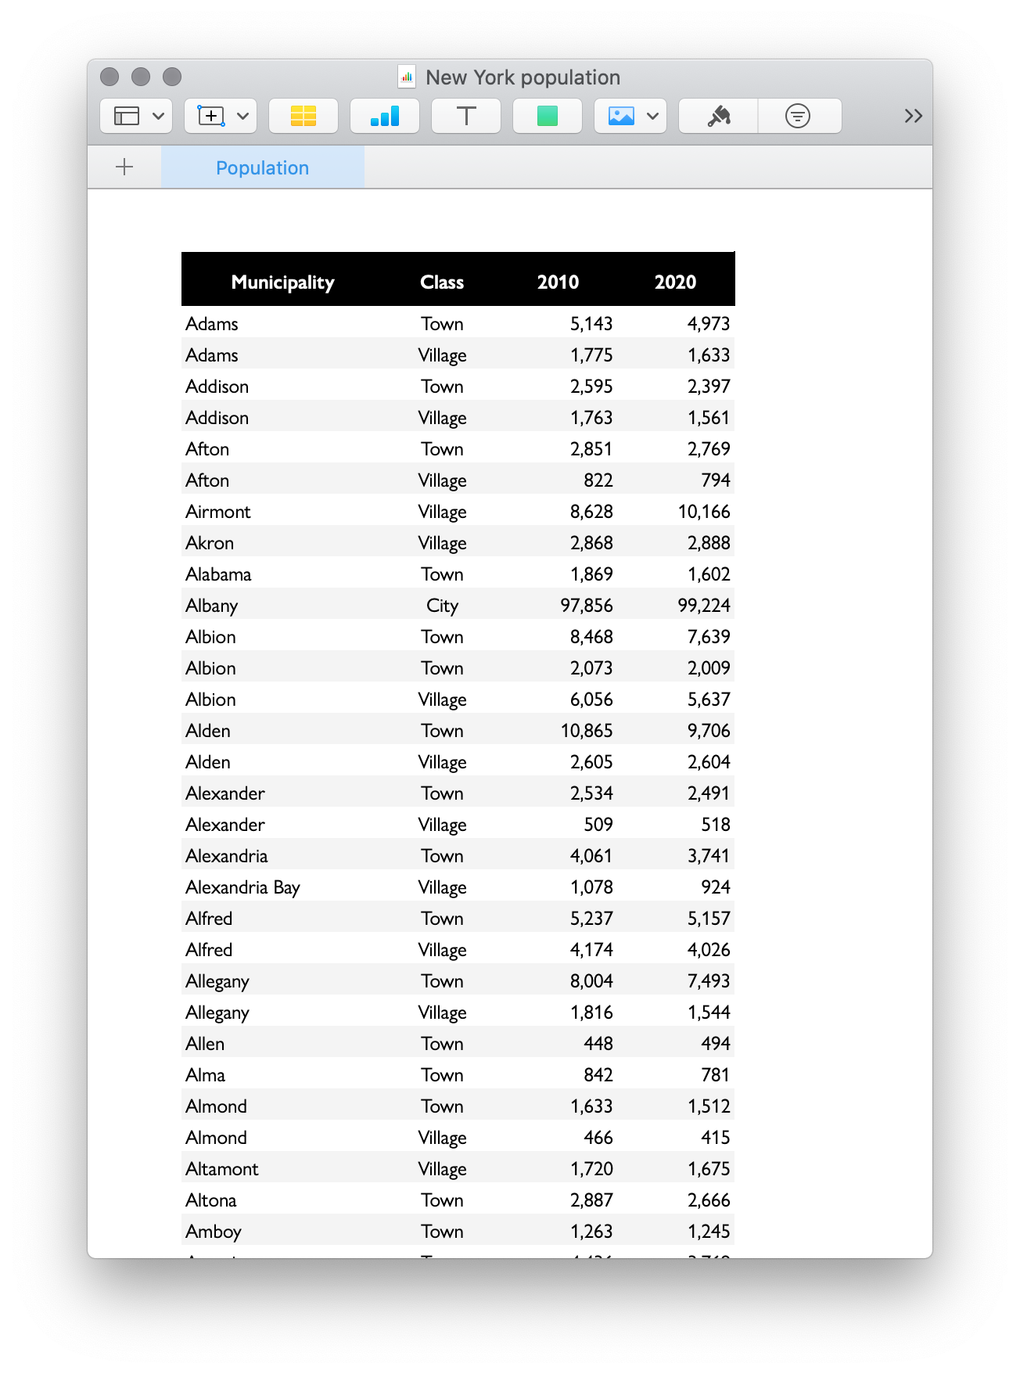
Lots of real-world data is naturally represented as tables.

Slide 5
Lots of real-world data is naturally represented as tables.
municipalities =
table: name, kind, pop-2010, pop-2020
row: "Adams", "Town", 5143, 4973
row: "Adams", "Village", 1775, 1633
row: "Addison", "Town", 2595, 2397
row: "Addison", "Village", 1763, 1561
row: "Afton", "Town", 2851, 2769
...
end

Slide 6
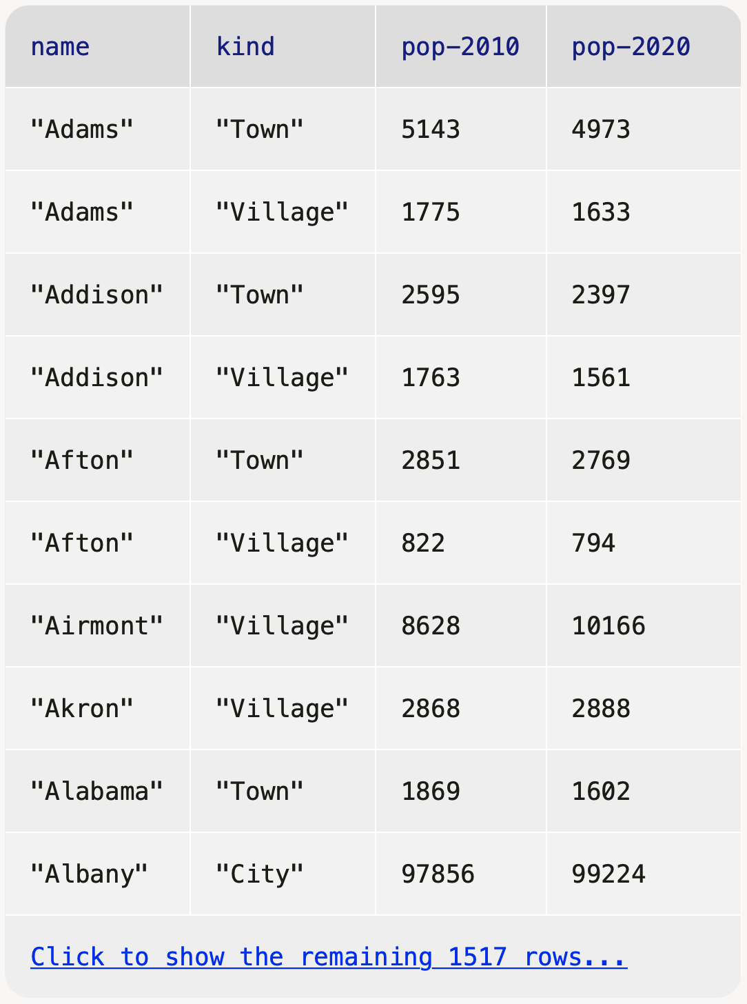
Lots of real-world data is naturally represented as tables.
››› municipalities

Slide 7
Recap: Accessing parts of a table

Slide 8
To get a particular row from a table, we use its numeric index n, counting from 0:
⟨table⟩.row-n(0)

Slide 9
››› municipalities
››› municipalities.row-n(0)

Slide 10
››› municipalities
››› municipalities.row-n(1)

Slide 11
››› municipalities
››› municipalities.row-n(2)

Slide 12
To get a particular column’s value from a row, we specify the column name using square brackets:
⟨row⟩["column name"]

Slide 13
››› municipalities.row-n(0)
Notes:
Start with a row

Slide 14
››› municipalities.row-n(0)
››› municipalities.row-n(0)["name"]
"Adams"
››› municipalities.row-n(0)["pop-2020"]
4973
Notes:
Start with a row

Slide 15
Recap: Ordering tables

Slide 16
To do more with tabular data, first include the textbook library:
include shared-gdrive("dcic-2021",
"1wyQZj_L0qqV9Ekgr9au6RX2iqt2Ga8Ep")

Slide 17
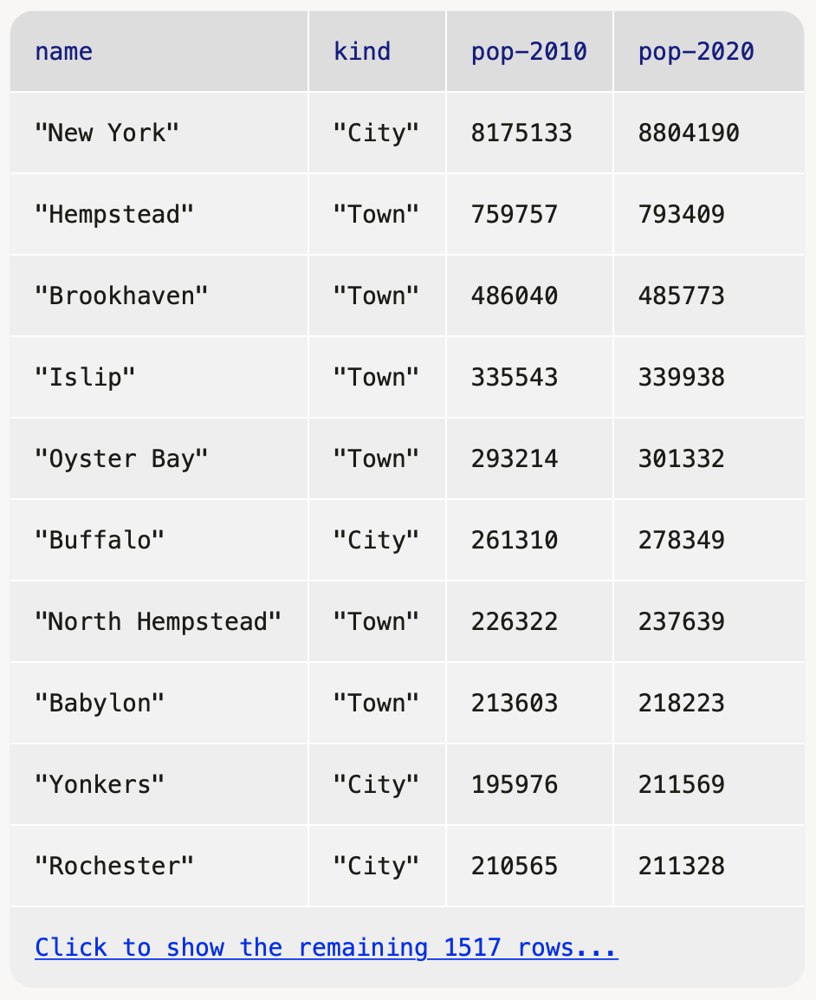
We can transform tabular data to get a particular view. E.g., to order the rows from the highest 2020 population to the lowest:
››› order-by(municipalities, "pop-2020", false)

Slide 18
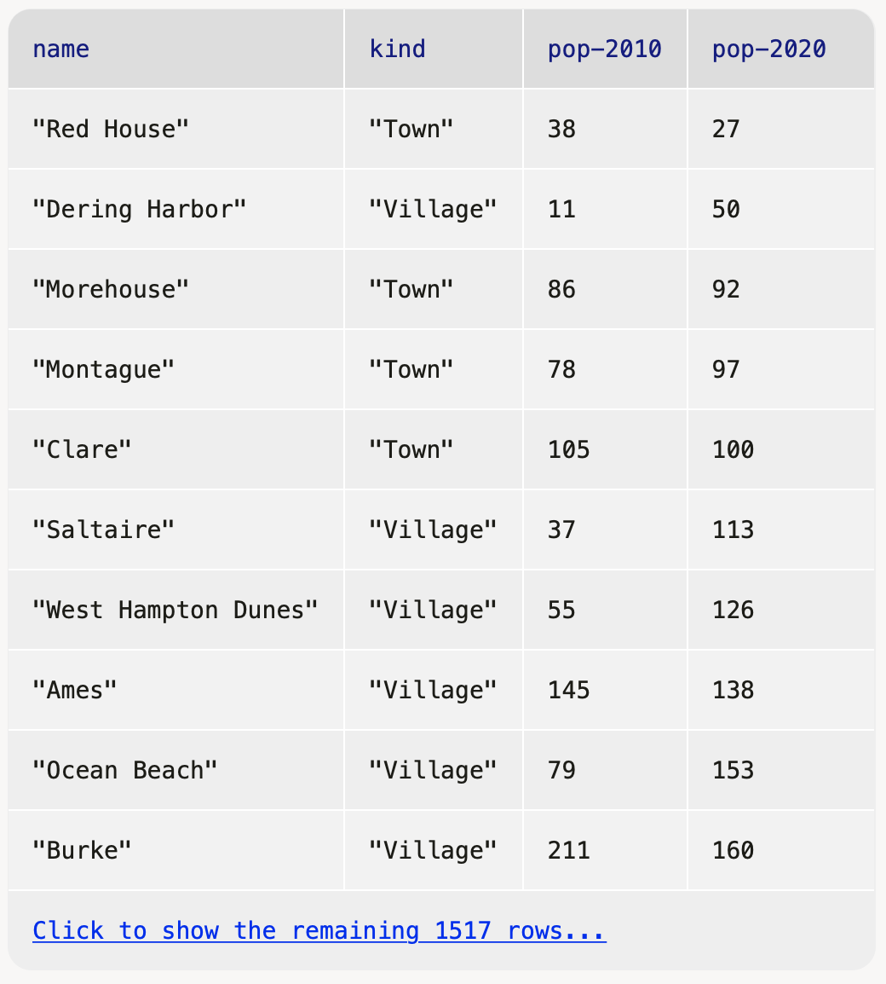
We can transform tabular data to get a particular view. E.g., to order the rows from the highest 2020 population to the lowest:
››› order-by(municipalities, "pop-2020", false)
lowest
highest
true

Slide 19
››› municipalities.row-n(0)
››› order-by(municipalities, "pop-2020", false).row-n(0)
Notes:
This makes it easy to get the row for the municipality with the highest 2020 population.

Slide 20
››› municipalities.row-n(0)
››› order-by(municipalities, "pop-2020", false).row-n(0)
››› ordered = order-by(municipalities, "pop-2020", false)
››› ordered.row-n(0)
Notes:
Or, to make it more readable, we can split the computation into parts, using names

Slide 21
››› ordered = order-by(municipalities, "pop-2020", false)
››› biggest = ordered.row-n(0)
››› biggest["pop-2020"]
8175133
Notes:
So, to see the 2020 population for the biggest municipality, we could write the computation like this.

Slide 22
Recap: Filtering tables

Slide 23
We can use filter-with to get just the towns:
fun is-town(r :: Row) -> Boolean:
doc: "Check if a row is for a town"
r["kind"] == "Town"
end
filter-with(municipalities, is-town)

Slide 24
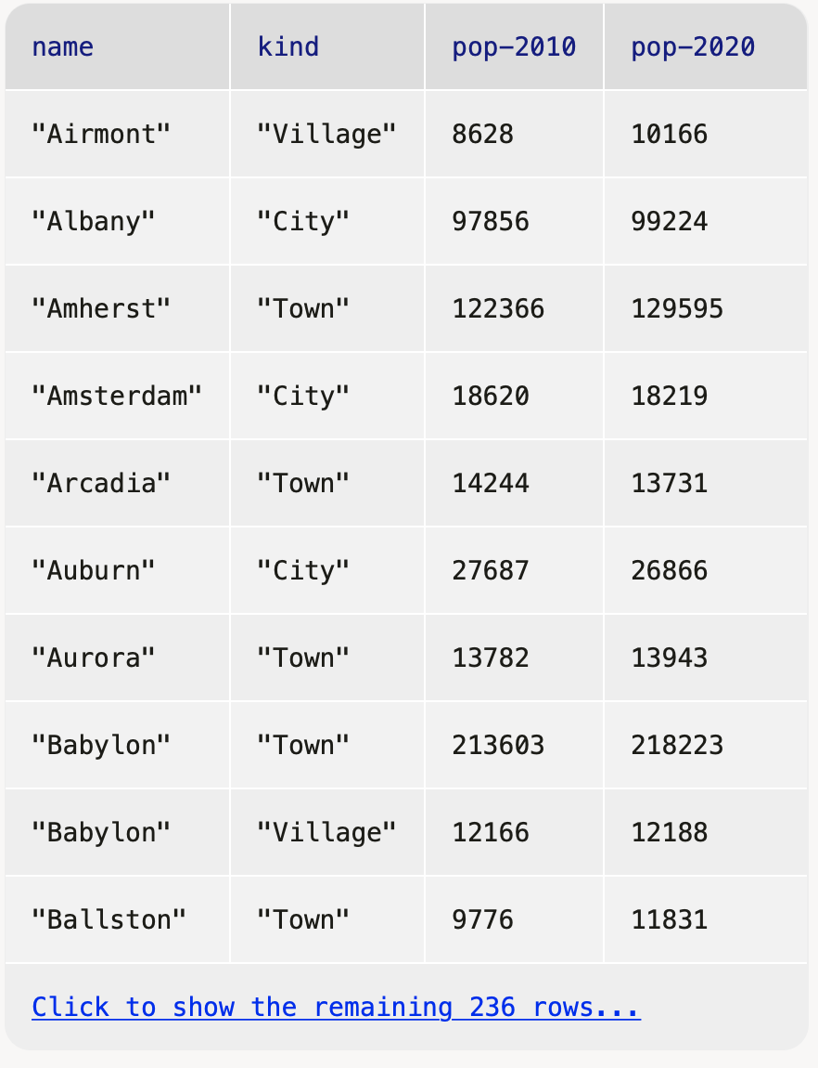
Or we could mke a table keeping only those municipalities with a population over 10,000:
fun big-muni(r :: Row) -> Boolean:
doc: "Return true if the municipality had over 10,000 people had in 2020"
r["pop-2020"] > 10000
end
››› filter-with(municipalities, big-muni)

Slide 25
Exercise

Slide 26
Problem Figure out what the fastest-growing towns are in New York.
Notes:
[slide]
In other words, we want a table containing only towns, sorted by the percent change in population.
How would we go about doing this? It's a relatively complicated problem, so we should break it into steps.

Slide 27
Subtasks:
Filtering to just towns
Calculating percentage change in population
Building a column for percentage change
Sorting on that column in descending order

Slide 28
Subtasks:
Filtering to just towns
Calculating percentage change in population
Building a column for percentage change
Sorting on that column in descending order
Notes:
We did this last time

Slide 29
towns = filter-with(municipalities, is-town)

Slide 30
Subtasks:
Filtering to just towns
Calculating percentage change in population
Building a column for percentage change
Sorting on that column in descending order

Slide 31
towns = filter-with(municipalities, is-town)
fun percent-change(r :: Row) -> Number:
doc: "Compute the percentage change for the population of a municipality between 2010 and 2020"
(r["pop-2020"] - r["pop-2010"]) /
r["pop-2010"]
end
We can write a function that takes a row as input and returns any kind of value, not just a Boolean.

Slide 32
Subtasks:
Filtering to just towns
Calculating percentage change in population
Building a column for percentage change
Sorting on that column in descending order

Slide 33
towns = filter-with(municipalities, is-town)
fun percent-change(r :: Row) -> Number:
doc: "Compute the percentage change for the population of a municipality between 2010 and 2020"
(r["pop-2020"] - r["pop-2010"]) /
r["pop-2010"]
end
towns-with-percent-change =
build-column(towns, "percent-change",
percent-change)
Name of the new column
Name of the function to use
Notes:
In general, a function that takes a row as input can be given to build-column to compute the values for a new column.

Slide 34
Subtasks:
Filtering to just towns
Calculating percentage change in population
Building a column for percentage change
Sorting on that column in descending order

Slide 35
towns = filter-with(municipalities, is-town)
fun percent-change(r :: Row) -> Number:
doc: "Compute the percentage change for the population of a municipality between 2010 and 2020"
(r["pop-2020"] - r["pop-2010"]) /
r["pop-2010"]
end
towns-with-percent-change =
build-column(towns, "percent-change",
percent-change)
fastest-growing-towns =
order-by(towns-with-percent-change,
"percent-change", false)
fastest-growing-towns

Slide 36
Review: Building a column

Slide 37
So, if we have this table, t,
then the result of calling build-column(t, "c", builder) is:
a | b
"dog" | 2
"cat" | 3
a | b | c
"dog" | 2 | builder(<"dog", 2>)
"cat" | 3 | builder(<"cat", 3>)

Slide 38
For example, if we have
fun builder(r :: Row) -> Number:
string-length(row["a"]) + row["b"]
end
Then we end up with the following table:
a | b | c
"dog" | 2 | 5
"cat" | 3 | 6

Slide 39
The values that the builder function returns will be the values in the new column that we’re adding to each row.

Slide 40
build-column ::
(t :: Table,
colname :: String,
builder :: (Row -> A))
-> Table
What’s this argument?
Notes:
What’s going on in that signature? In particular, what’s the type of the builder parameter?
builder needs to be a function that takes a row and returns…something!
The values it returns will be the values in the new column we’re adding to each row

Slide 41
This is the second time we’ve seen a function that takes a function as one of its inputs!
Both filter-with and build-column need a helper function that tells them how to do what we want.
Just as a function is an abstraction over specific computations, filter-with and build-column are abstractions over more specific functions.
They provide the common functionality and the arguments we give provide the specifics.

Slide 42
Interlude: Functional programming

Slide 43
We can
sort the rows a table with order-with,
select certain rows using filter-with, and
add a new column of values with build-column
but none of these functions change the original table!

Slide 44
Just as the expression 2 + 3 doesn’t change the value of 2 or of 3, functions that take a table as input don’t change the original table.
Instead, they return a new table.
Notes:
[slide] That is, our functions behave like mathematical functions do.

Slide 45
This is a paradigm called functional programming.
If you have experience working in other languages, this may seem strange, but it can be extremely useful!
We’ll explore the idea of functional programming more in the coming weeks.

Slide 46
Loading Google Sheets into Pyret

Slide 47
We’ve seen that it’s inconvenient to type a large table into a Pyret program. Last time, we loaded the municipalities table from a separate Pyret file that I prepared ahead of time.
It’s more usual to load a large data set from outside of Pyret.

Slide 48
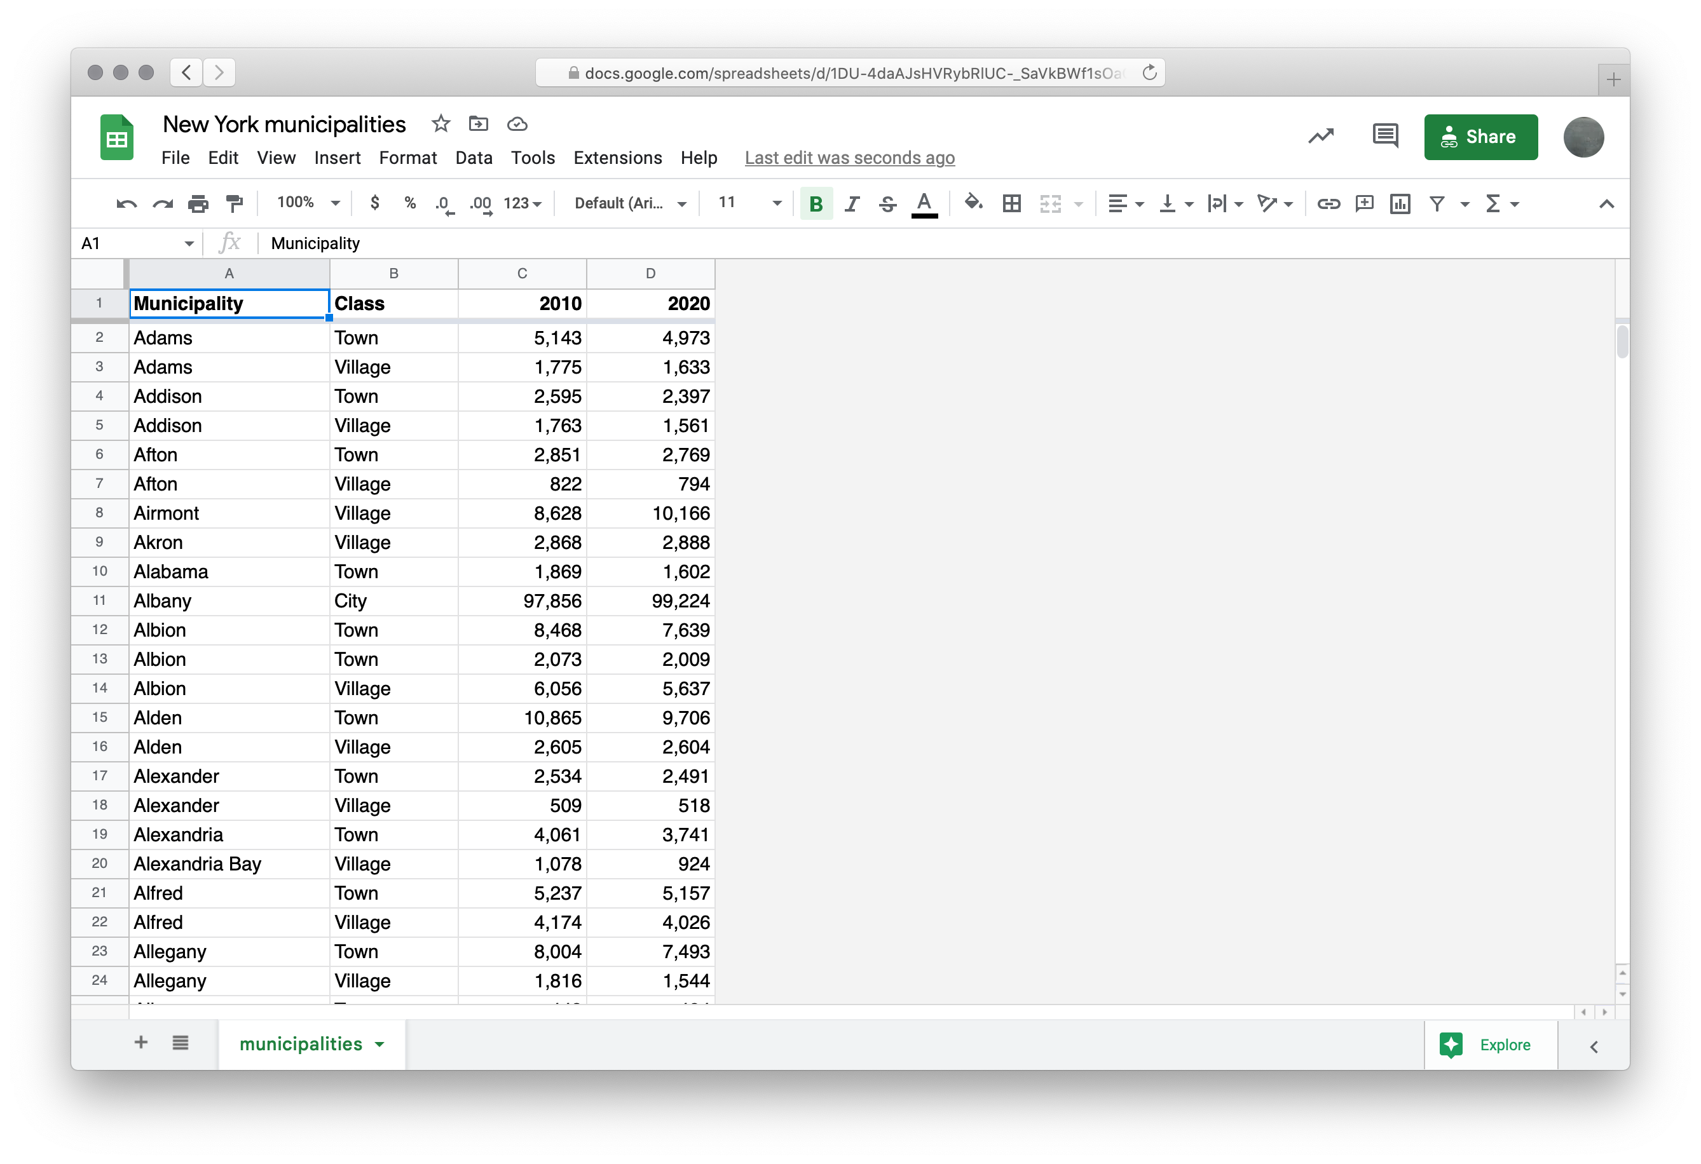
Notes:
We can load this sheet into Pyret

Slide 49
include gdrive-sheets
# The ID of the Google Sheets file, which appears
# in the URL
ssid = "1DU-4daAJsHVRybRlUC-_SaVkBWf1sOaGIfrWfgktlIs"
spreadsheet = load-spreadsheet(ssid)

Slide 50
A spreadsheet might have more than one sheet (the tabs at the bottom of Google Sheets). But, in this case, we just have one:
››› spreadsheet
spreadsheet("municipalities")

Slide 51
To load a table from a spreadsheet, we need to tell Pyret which sheet to load it from and what we want the columns to be called (which can be different from what is in the spreadsheet):
municipalities =
load-table:
name, kind, pop-2010, pop-2020
source:
spreadsheet.sheet-by-name("municipalities",
true)
end
This means there’s a header row that Pyret should skip
Notes:
[slide]
This might look like a lot of code for loading a table, but it's a lot less than the 1000s of lines to write the table contents in Pyret!
And you don't need to memorize this; these are details you can look up when you need them.

Slide 52
Using our table loaded from Google Sheets, let’s revisit our code from earlier for finding the fastest-growing towns.
Notes:
Now we can work with this table the same as if we'd entered it manually. So,
[slide]

Slide 53
fun is-town(r :: Row) -> Boolean:
doc: "Check if a row is for a town"
r["kind"] == "Town"
end
fun percent-change(r :: Row) -> Number:
doc: "Compute the percentage change for the population of a municipality between 2010 and 2020"
(r["pop-2020"] - r["pop-2010"]) / r["pop-2010"]
end
towns = filter-with(municipalities, is-town)
towns-with-percent-change =
build-column(towns, "percent-change", percent-change)
fastest-growing-towns =
order-by(towns-with-percent-change,
"percent-change", false)
fastest-growing-towns
Let’s take these loose expressions and put them in a function!

Slide 54
fun is-town(r :: Row) -> Boolean:
doc: "Check if a row is for a town"
r["kind"] == "Town"
end
fun percent-change(r :: Row) -> Number:
doc: "Compute the percentage change for the population of a municipality between 2010 and 2020"
(r["pop-2020"] - r["pop-2010"]) / r["pop-2010"]
end
fun fastest-growing-towns(munis :: Table) -> Table:
doc: "Return a table of towns ordered by their growth"
towns = filter-with(munis, is-town)
towns-with-percent-change =
build-column(towns, "percent-change", percent-change)
order-by(towns-with-percent-change, "percent-change", false)
end

Slide 55
We’ve done a bit of a bad thing here: We’ve written three functions, but we don’t have tests for any of them!
Let’s see how we can rectify this.

Slide 56
Testing table functions

Slide 57
We can test table program by using test tables.
These are tables that have the same structure as the table for our real data, but which are smaller and contain data that are useful for testing.
Notes:
[slide]
What would good test data look like for this problem?

Slide 58
test-munis =
table: name, kind, pop-2010, pop-2020
row: "Osgiliath", "City", 100, 101
row: "Lake-town", "Town", 100, 102
row: "Bree", "Town", 100, 99
row: "Hobbiton", "Village", 50, 54
end
Notes:
Make up some data! Just a few examples consisting of a mix of cities, towns, and villages, some with increasing populations, others decreasing.

Slide 59
test-munis =
table: name, kind, pop-2010, pop-2020
row: "Osgiliath", "City", 100, 101
row: "Lake-town", "Town", 100, 102
row: "Bree", "Town", 100, 99
row: "Hobbiton", "Village", 50, 54
end
Notes:
Make up some data! Just a few examples consisting of a mix of cities, towns, and villages, some with increasing populations, others decreasing.

Slide 60
Let’s see how we use these test data to write examples for our table functions.

Slide 61
test-munis =
table: name, kind, pop-2010, pop-2020
row: "Osgiliath", "City", 100, 101
row: "Lake-town", "Town", 100, 102
row: "Bree", "Town", 100, 99
row: "Hobbiton", "Village", 50, 54
end
fun is-town(r :: Row) -> Boolean:
doc: "Check if a row is for a town"
r["kind"] == "Town"
end
Notes:
First, we can test is-town. This is a predicate — a function return a Boolean — and we want to make sure it works on inputs that are towns, cities, and villages.

Slide 62
test-munis =
table: name, kind, pop-2010, pop-2020
row: "Osgiliath", "City", 100, 101
row: "Lake-town", "Town", 100, 102
row: "Bree", "Town", 100, 99
row: "Hobbiton", "Village", 50, 54
end
fun is-town(r :: Row) -> Boolean:
doc: "Check if a row is for a town"
r["kind"] == "Town"
where:
is-town(test-munis.row-n(0)) is false
is-town(test-munis.row-n(1)) is true
is-town(test-munis.row-n(3)) is false
end

Slide 63
test-munis =
table: name, kind, pop-2010, pop-2020
row: "Osgiliath", "City", 100, 101
row: "Lake-town", "Town", 100, 102
row: "Bree", "Town", 100, 99
row: "Hobbiton", "Village", 50, 54
end
fun percent-change(r :: Row) -> Number:
doc: "Compute the percentage change for the population of a municipality between 2010 and 2020"
(r["pop-2020"] - r["pop-2010"]) / r["pop-2010"]
end
Notes:
How about percent-change?
In the end we'll only be using it on the towns, but we can test it on cities or villages too.

Slide 64
test-munis =
table: name, kind, pop-2010, pop-2020
row: "Osgiliath", "City", 100, 101
row: "Lake-town", "Town", 100, 102
row: "Bree", "Town", 100, 99
row: "Hobbiton", "Village", 50, 54
end
fun percent-change(r :: Row) -> Number:
doc: "Compute the percentage change for the population of a municipality between 2010 and 2020"
(r["pop-2020"] - r["pop-2010"]) / r["pop-2010"]
where:
percent-change(test-munis.row-n(0)) is 0.01
percent-change(test-munis.row-n(1)) is 0.02
percent-change(test-munis.row-n(2)) is -0.01
end

Slide 65
test-munis =
table: name, kind, pop-2010, pop-2020
row: "Osgiliath", "City", 100, 101
row: "Lake-town", "Town", 100, 102
row: "Bree", "Town", 100, 99
row: "Hobbiton", "Village", 50, 54
end
fun fastest-growing-towns(munis :: Table) -> Table:
doc: "Return a table of towns ordered by their growth"
towns = filter-with(munis, is-town)
towns-with-percent-change =
build-column(towns, "percent-change", percent-change)
order-by(towns-with-percent-change, "percent-change", false)
end
Notes:
Finally, we can test our top-level table function.
It produces a table, so we'll have to construct a new table that it should return.

Slide 66
test-munis =
table: name, kind, pop-2010, pop-2020
row: "Osgiliath", "City", 100, 101
row: "Lake-town", "Town", 100, 102
row: "Bree", "Town", 100, 99
row: "Hobbiton", "Village", 50, 54
end
fun fastest-growing-towns(munis :: Table) -> Table:
...
where:
test-munis-after =
table: name, kind, pop-2010, pop-2020, percent-change
row: "Lake-town", "Town", 100, 102, 0.02
row: "Bree", "Town", 100, 99, -0.01
end
fastest-growing-towns(test-munis) is test-munis-after
end
Don’t just copy the function’s output; think through what it’s supposed to do!
Notes:
It’s important to write out the result table before you see the table produced by the function.
We’re trying to make sure that the function does what it’s supposed to, which means that we have to predict its behavior!
If we just copy in the table it produces, we’re testing the function against its own behavior rather than against our intuitions.
Testing a function against its own previous behavior can be useful if you are planning on changing the function and want to ensure that it still has the same behavior. This is called a regression test.

Slide 67
Visualization

Slide 68
Data scientists use plots for both exploratory and explanatory purposes – they are useful for understanding data in preparation for further analysis and in presenting data to a general audience.

Slide 69
The dcic-2021 library we’ve been using to work with tables includes several functions to generate different kinds of plots like the ones we’ve talked about.
Notes:
[slide]
[Open code from last class by going to the slides PDF and opening the link at the end. Try the examples on the following slides in Pyret.]

Slide 70
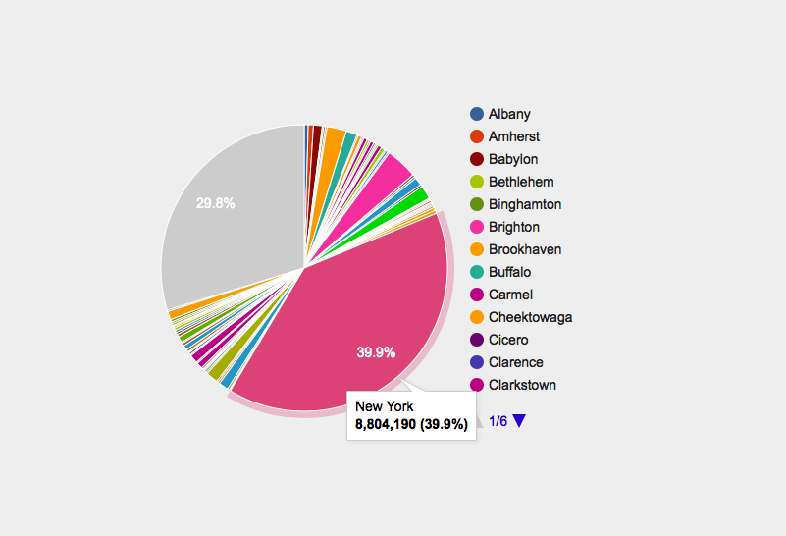
# How is population distributed in the state?
pie-chart(municipalities, "name", "pop-2020")
Notes:
The closest equivalent we have to Florence Nightingale's graphs is the modern pie chart.
We can use a pie chart to visualize a distribution — how much each part contributes to the whole. For instance, we can see the populations of the various municipalities as part of the entire state population.
[advance]
The big grey blob is "other" — that is, ones that are too small to be listed or shown separately.

Slide 71
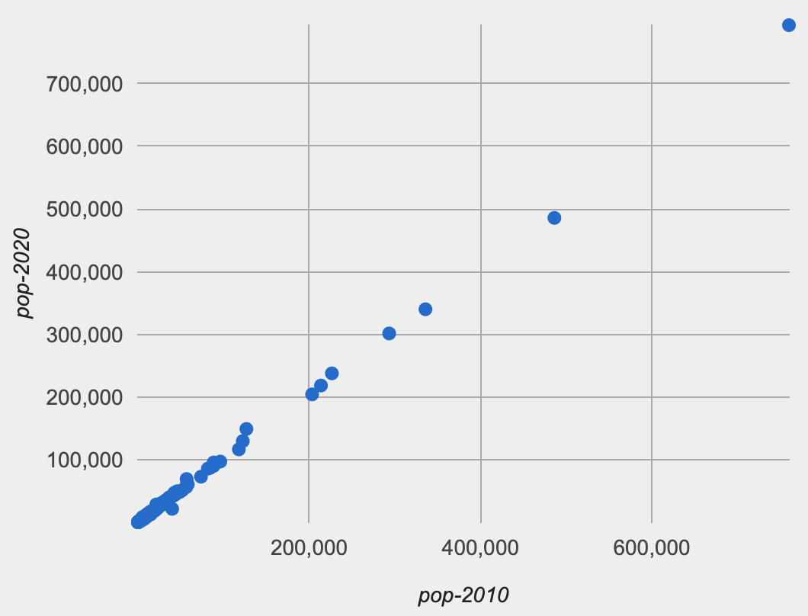
ft = fastest-growing-towns(municipalities)
# Is a town's population in 2010 correlated with
# its population in 2020?
scatter-plot(ft, "pop-2010", "pop-2020")
Notes:
[Switch back to population data.]
We can see a much stronger correlation if we plot the 2010 and 2020 populations. No need to do a linear regression here to see the trend…
This makes sense, right? The population in 2010 is a *very* strong predictor of what the population will be in 2020.
That's like saying how tall a person is in 2022 is a strong predictor of how tall they'll be in 2023. Even if they grow or shrink a bit, they're doing so relative to their current height.

Slide 72
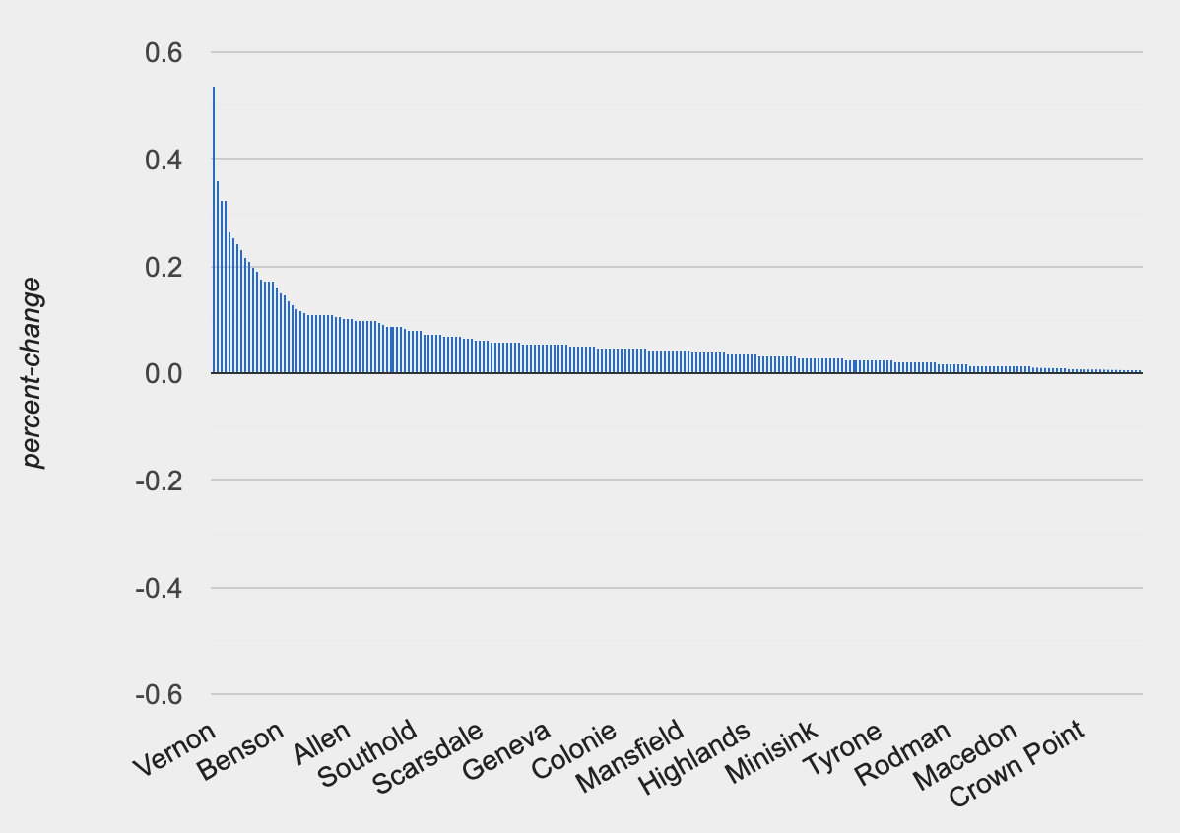
ft = fastest-growing-towns(municipalities)
# Visually present the growth data
bar-chart(ft, "name", "percent-change")
…didn’t any towns shrink?
Notes:
Finally, on Assignment 3, you're asked to use bar charts to visualize changes in the hours of sunlight and moonlight.
You'll see those charts when you finish the assignment, but we can try a different bar chart just to see what one looks like.
Last class, we wrote a function to make a table of towns in NY, ordered by how fast they were growing — the change in population relative to their starting population.
A bar chart shows us the distribution of growth percents we computed.
[advance]
Why aren't we seeing negative values? Didn't any towns shrink? [Check ft table] They did! But there are too many towns and they get cut off!
Don't trust a plot without thinking about it. Always ask if what you're seeing makes sense given what you know about the data.

Slide 73
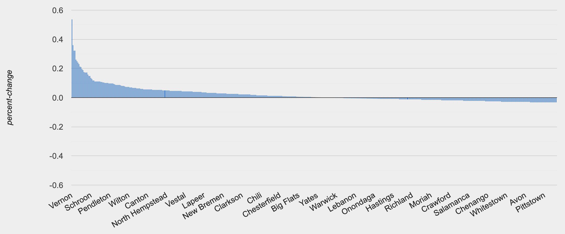
ft = fastest-growing-towns(municipalities)
# Visually present the growth data
bar-chart(ft, "name", "percent-change")
Notes:
If we drag the window to make it wider, it shows us more data.

Slide 74
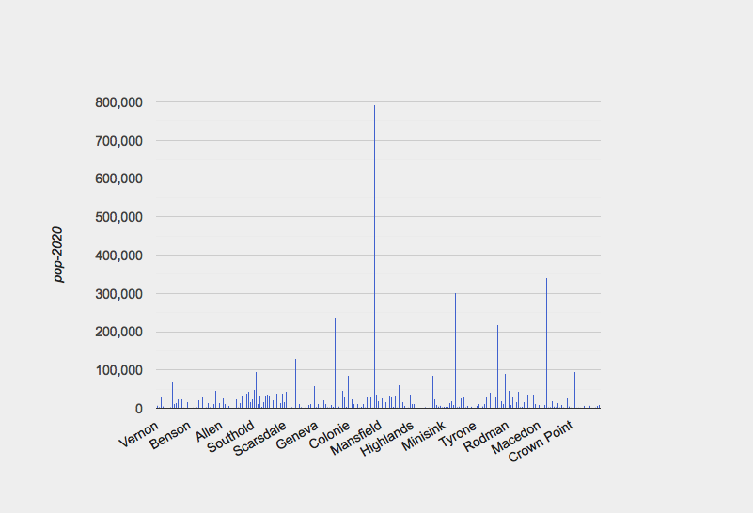
ft = fastest-growing-towns(municipalities)
# Visually present the growth data
bar-chart(ft, "name", "pop-2020")
Notes:
Now if we make the bars are show the actual populations, we see there's a lot of variation without a clear pattern like the fastest growing towns were the biggest or the smallest ones.

Slide 75
Pyret code from class:
https://tinyurl.com/101-2023-02-01

Slide 76
Acknowledgments
This class incorporates material from:
Kathi Fisler, Brown University
Doug Woos, Brown University

