Slide 1
Tables and Lists
CMPU 101 § 54 · Computer Science I
8 February 2023

Slide 2
Where are we? (SEA, then NY, I believe)

Slide 3
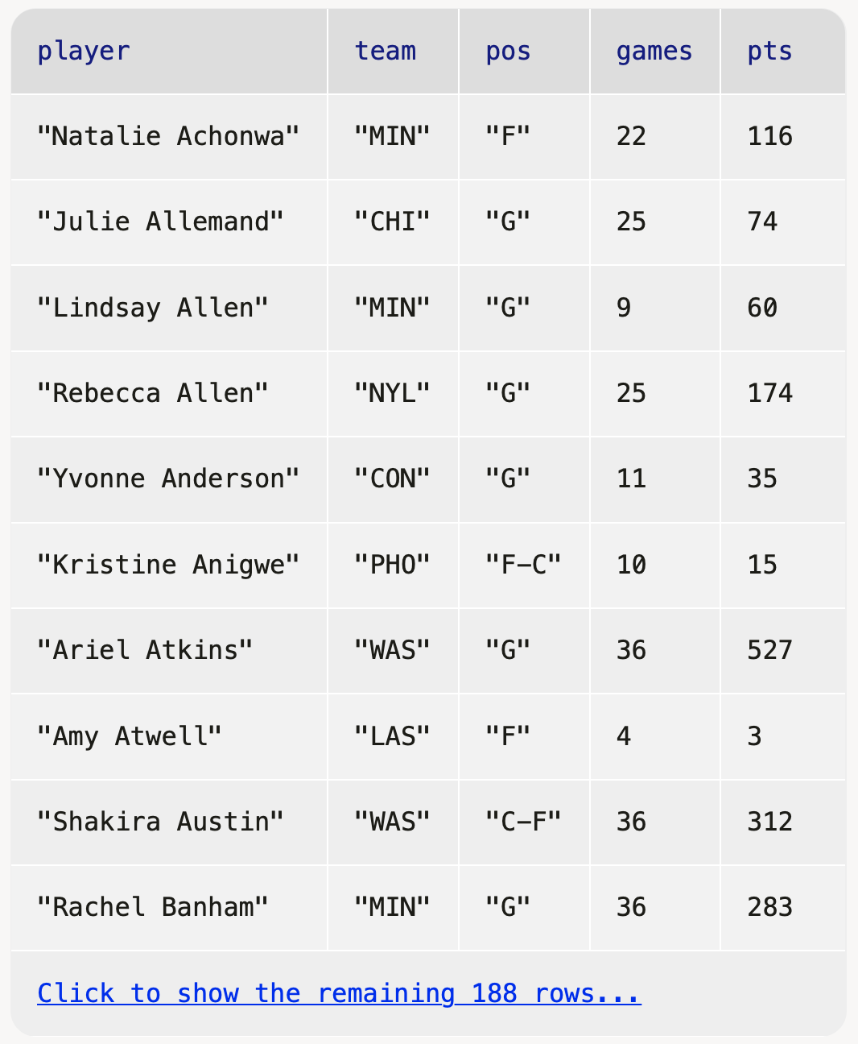
Tables!

Slide 4
Rows!

Slide 5
How do I get just this row from stats?
stats =

Slide 6
n
0
1
2
3
4
5
6
7
8
9
How do I get just this row from stats?
stats =
stats.row-n(2)

Slide 7
How do I get just the rows for players who are guards?

Slide 8
How do I get just the rows for players who are guards?
fun is-guard(player :: Row) -> Boolean:
doc: "Return true if the player's primary position is guard"
player["pos"] == "G"
where:
is-guard(t.row-n(0)) is false
is-guard(t.row-n(1)) is true
end
filter-with(stats,
is-guard)

Slide 9
How do I get just the rows for players who are guards?
fun is-guard(player :: Row) -> Boolean:
doc: "Return true if the player's primary position is guard"
player["pos"] == "G"
where:
is-guard(t.row-n(0)) is false
is-guard(t.row-n(1)) is true
end
filter-with(stats,
lam(player):
player["pos"] == "G"
end)

Slide 10
PL’s rule of Lazy Programming: programmers will invent ways to avoid writing verbose code.
Corollary: A coding solution that allows us to write less code and is functionally equivalent to a solution that requires us to write more code is the preferred solution
This is the only place we want to use this helper function, so there’s no need to name it, document it, etc.
We can write less code (!) with a lambda expression.
filter-with(stats, lam(player): player["pos"] == "G" end)

Slide 11
Notes:
Ok, so...

Slide 12
What about columns?
Notes:
[slide]

Slide 13
frequent-player
"very"
"very"
"no"
"very"
"somewhat"
"somewhat"
"very"
"no"
"very"
"very"
How can I add a new column like this?
Notes:
[slide]

Slide 14
frequent-player
"very"
"very"
"no"
"very"
"somewhat"
"somewhat"
"very"
"no"
"very"
"very"
How can I add a new column like this?
Although we’ll only use this function here, it’ll be too long to conveniently write as a lambda expression.
build-column(stats, "frequent-player", how-frequent)
Notes:
[slide]

Slide 15
frequent-player
"very"
"very"
"no"
"very"
"somewhat"
"somewhat"
"very"
"no"
"very"
"very"
fun how-frequent(player :: Row) -> String:
if player["games"] >= 20:
"very"
else if player["games"] >= 10:
"somewhat"
else:
"no"
end
end
Be sure to add a docstring and where block to make this definition complete!
build-column(stats, "frequent-player", how-frequent)
Notes:
[slide]

Slide 16
Changing a column

Slide 17
So, we’ve seen that we can build a new column based on the values in each row, but what if we just want to change an existing column?

Slide 18
A fake WNBA fan like me can’t remember what these team abbreviations stand for.
Let’s fill in the actual team names.

Slide 19
What are the team names?

Slide 20
DAL
ATL
LVA
CHI
LAS
CON
MIN
IND
PHO
NYL
SEA
WAS
Notes:
Ok, so let's write a function that takes an abbreviation and returns the name.

Slide 21
fun team-name(abbr :: String) -> String:
doc: "Return the name of the team with the given abbreviation"
...
where:
team-name("NYL") is "New York Liberty"
team-name("CHI") is "Chicago Sky"
...
end
Use this as a template:
Start with (grey) keywords
Fill in fun: I/O (input/output), etc.
Fill in doc: with something descriptive
Use ellipses for code (TBD)
Think of tests to write in where: clause
(to help us write the actual function code)
Don’t forget to end the function

Slide 22
fun team-name(abbr :: String) -> String:
doc: "Return the name of the team with the given abbreviation"
...
where:
team-name("NYL") is "New York Liberty"
team-name("CHI") is "Chicago Sky"
...
end
Use this as a template:
Start with (grey) keywords
Fill in fun: I/O (input/output), etc.
Fill in doc: with something descriptive
Use ellipses for code (TBD)
Think of tests to write in where: clause
(to help us write the actual function code)
Don’t forget to end the function
(I don’t have to write “return type”, just “->”)

Slide 23
fun team-name(abbr :: String) -> String:
doc: "Return the name of the team with the given abbreviation"
if abbr == "DAL": "Dallas Wings"
else if abbr == "LVA": "Las Vegas Aces"
...
end
where:
team-name("NYL") is "New York Liberty"
team-name("CHI") is "Chicago Sky"
...
end
This will work, but remember what we said when we introduced tables for looking up population: We want to separate data from computation.

Slide 24
teams =
table: abbr, name
row: "DAL", "Dallas Wings"
row: "LVA", "Las Vegas Aces"
row: "LAS", "Los Angeles Sparks"
row: "MIN", "Minnesota Lynx"
row: "PHO", "Phoenix Mercury"
row: "SEA", "Seattle Storm"
row: "ATL", "Atlanta Dream"
row: "CHI", "Chicago Sky"
row: "CON", "Connecticut Sun"
row: "IND", "Indiana Fever"
row: "NYL", "New York Liberty"
row: "WAS", "Washington Mystics"
end
Let’s use this new table we are calling teams!
Advantage: This makes it easy to add new teams or more information about these teams, in a central place.

Slide 25
teams = ...
fun team-name(abbr :: String) -> String:
doc: "Return the name of the team with the given abbreviation"
# Get the row with abbreviation `abbr`
# Return the value in the `name` column
where:
team-name("NYL") is "New York Liberty"
team-name("CHI") is "Chicago Sky"
...
end

Slide 26
teams = ...
fun team-name(abbr :: String) -> String:
doc: "Return the name of the team with the given abbreviation"
matches =
filter-with(teams, lam(r): r["abbr"] == abbr end)
team = matches.row-n(0)
# Return the value in the `name` column
where:
team-name("NYL") is "New York Liberty"
team-name("CHI") is "Chicago Sky"
...
end

Slide 27
teams = ...
fun team-name(abbr :: String) -> String:
doc: "Return the name of the team with the given abbreviation"
matches =
filter-with(teams, lam(r): r["abbr"] == abbr end)
team = matches.row-n(0)
team["name"]
where:
team-name("NYL") is "New York Liberty"
team-name("CHI") is "Chicago Sky"
...
end

Slide 28
teams = ...
fun team-name(abbr :: String) -> String:
doc: "Return the name of the team with the given abbreviation"
matches =
filter-with(teams, lam(r): r["abbr"] == abbr end)
team = matches.row-n(0)
team["name"]
where:
team-name("NYL") is "New York Liberty"
team-name("CHI") is "Chicago Sky"
...
end
transform-column(stats, "team", team-name)

Slide 30
teams = ...
fun team-name(abbr :: String) -> String:
doc: "Return the name of the team with the given abbreviation"
matches =
filter-with(teams, lam(r): r["abbr"] == abbr end)
team = matches.row-n(0)
team["name"]
where:
team-name("NYL") is "New York Liberty"
team-name("CHI") is "Chicago Sky"
...
end
transform-column(stats, "team", team-name)
0 is too big? That means there were no matching rows! An abbreviation not in our table. What is it?

Slide 31
teams = ...
fun team-name(abbr :: String) -> String:
doc: "Return the name of the team with the given abbreviation"
matches =
filter-with(teams, lam(r): r["abbr"] == abbr end)
if matches.length() == 0:
abbr
else:
team = matches.row-n(0)
team["name"]
end
where:
...
end
transform-column(stats, "team", team-name)

Slide 32
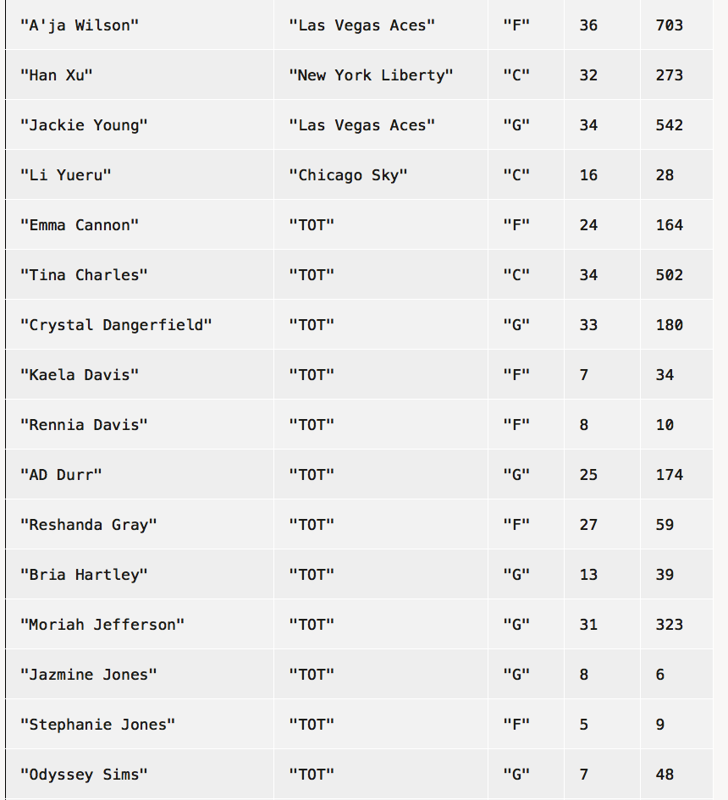
Total? Players who played for more than one team?

Slide 33
What’s a column anyway?

Slide 34
We’ve seen that when you want a row of a table, you use .row-n and get a Row.
What about getting a column?

Slide 35
How do I get just the points column?
stats =

Slide 36
How do I get just the points column?
stats =
stats.column("pts")
Notes:
While rows are indexed by number, columns have these convenient names!

Slide 37
››› stats.get-column("pts")
[list: 116, 74, 60, 174, 35, ...]
The data type isn’t Column; it’s List!
Notes:
Note that there's no name for the column. The names -- column headings -- let us specify which column we want when it's in a table, but if you only have one column, they're unnecessary.

Slide 38
A List is an ordered sequence of data.
For example,
grades = [list: 0.96, 0.73, 1.0, 0.5]
fellowship = [list:
"Frodo", "Sam", "Merry", "Pippin", "Gandalf",
"Legolas", "Gimli", "Aragorn", "Boromir"
]

Slide 39
So, what good is a List?

Slide 40
fun is-nearby(town :: String) -> String:
doc: ...
(town == "Hyde Park") or
(town == "Pleasant Valley") or
(town == "Poughkeepsie") or
(town == "LaGrange")
where:
...
end
😫
Notes:
[Spoilers for the assignment due tonight...]

Slide 41
nearby-towns = [list:
"Hyde Park",
"Pleasant Valley",
"Poughkeepsie",
"LaGrange"
]
fun is-nearby(town :: String) -> String:
doc: ...
nearby-towns.member(town)
where:
...
end

Slide 42
Mad Libs!
Notes:
Let’s play Mad Libs!

Slide 43
Thousands of Plural-Noun ago, there were calendars that enabled the ancient Plural-Noun to divide a year into twelve Plural-Noun, each month into Number weeks, and each week into seven Plural-Noun. At first, people told time by a sun clock, sometimes known as the Noun dial. Ultimately, they invented the great timekeeping devices of today, such as the grandfather Noun, the pocket Noun, the alarm Noun, and, of course, the Body-Part watch. Children learn about clocks and time almost before they learn their A-B- Alphabet-Letter s. They are taught that a day consists of 24 Plural-Noun, an hour has 60 Plural-Noun, and a minute has 60 Plural-Noun. By the time they are in Kindergarten, they know if the big Body-Part is at twelve and the little Body-Part is at three, that it is Number o’clock. I wish we could continue this Adjective lesson, but we’ve run out of Noun.
Notes:
[Write each answer on the text so it appears correctly when I advance]

Slide 44
Thousands of Plural-Noun ago, there were calendars that enabled the ancient Plural-Noun to divide a year into twelve Plural-Noun, each month into Number weeks, and each week into seven Plural-Noun. At first, people told time by a sun clock, sometimes known as the Noun dial. Ultimately, they invented the great timekeeping devices of today, such as the grandfather Noun, the pocket Noun, the alarm Noun, and, of course, the Body-Part watch. Children learn about clocks and time almost before they learn their A-B- Alphabet-Letter s. They are taught that a day consists of 24 Plural-Noun, an hour has 60 Plural-Noun, and a minute has 60 Plural-Noun. By the time they are in Kindergarten, they know if the big Body-Part is at twelve and the little Body-Part is at three, that it is Number o’clock. I wish we could continue this Adjective lesson, but we’ve run out of Noun.
Notes:
[read]
Endless amusement, but too much work!
Let's automate it – make the game play itself!

Slide 45
How can we represent a text?

Slide 46
template = "Thousands of Plural-Noun ago, there were calendars that enabled the ancient Plural-Noun to divide a year into twelve Plural-Noun , each month into Number weeks, and each week into seven Plural-Noun . At first, people told time by a sun clock, sometimes known as the Noun dial. Ultimately, they invented the great timekeeping devices of today, such as the grandfather Noun , the pocket Noun , the alarm Noun , and, of course, the Body-Part watch. Children learn about clocks and time almost before they learn their A-B- Alphabet-Letter s. They are taught that a day consists of 24 Plural-Noun , an hour has 60 Plural-Noun , and a minute has 60 Plural-Noun . By the time they are in Kindergarten, they know if the big Body-Part is at twelve and the little Body-Part is at three, that it is Number o'clock. I wish we could continue this Adjective lesson, but we’ve run out of Noun ."
Notes:
But this isn't easy to work with. We need to be able to access the individual words.

Slide 47
template = "Thousands of Plural-Noun ago, ..."
template-words = string-split-all(template, " ")
››› template-words
[list: "Thousands", "of", "Plural-Noun", "ago", ...]

Slide 48
template = "Thousands of Plural-Noun ago, ..."
template-words = string-split-all(template, " ")
››› template-words
[list: "Thousands", "of", "Plural-Noun", "ago", ...]
We need to substitute a random plural noun here!
Notes:
Let's stop and make a plan.
[May want to do this on the board rather than slides]

Slide 49
"Thousands of Plural-Noun ago, ..."
string-split-all
[list: "Thousands", "of", "Plural-Noun", "ago", ...]
Something like transform-column but for lists
[list: "Thousands", "of", "gazebos", "ago", ...]
Needs a helper function!

Slide 50
"Thousands of Plural-Noun ago, ..."
string-split-all
[list: "Thousands", "of", "Plural-Noun", "ago", ...]
Something like transform-column but for lists
using
[list: "Thousands", "of", "gazebos", "ago", ...]
substitute-word
"Thousands" -> "Thousands"
"Plural-Noun" -> "gazebos"

Slide 51
I’d write the helper function first!

Slide 52
fun substitute-word(w :: String) -> String:
doc: "Substitute a random word if w is a category"
...
where:
substitute-word("Thousands") is "Thousands"
substitute-word("Plural-Noun") is ...
end
Uh oh! We don’t know what
particular word it will be!

Slide 53
fun substitute-word(w :: String) -> String:
doc: "Substitute a random word if w is a category"
...
where:
substitute-word("Thousands") is "Thousands"
substitute-word("Plural-Noun") is-not "Plural-Noun"
end
We know what it isn’t!

Slide 54
plural-nouns = [list: "gazebos", "avocados", "pandas"]
fun substitute-word(w :: String) -> String:
doc: "Substitute a random word if w is a category"
...
where:
substitute-word("Thousands") is "Thousands"
substitute-word("Plural-Noun") is-not "Plural-Noun"
plural-nouns.member(
substitute-word("Plural-Noun"))
is true
end
And we know it’s one of the right choices!

Slide 55
plural-nouns = [list: "gazebos", "avocados", "pandas"]
fun substitute-word(w :: String) -> String:
doc: "Substitute a random word if w is a category"
...
where:
substitute-word("Thousands") is "Thousands"
substitute-word("Plural-Noun") is-not "Plural-Noun"
plural-nouns.member(
substitute-word("Plural-Noun"))
is true
end
The left part of an example can be any expression!

Slide 56
plural-nouns = [list: "gazebos", "avocados", "pandas"]
fun substitute-word(w :: String) -> String:
doc: "Substitute a random word if w is a category"
if w == "Plural-Noun":
...
else:
w
end
where:
...
end

Slide 57
We need a random element of a list.
Time to check the Pyret documentation!

Slide 58
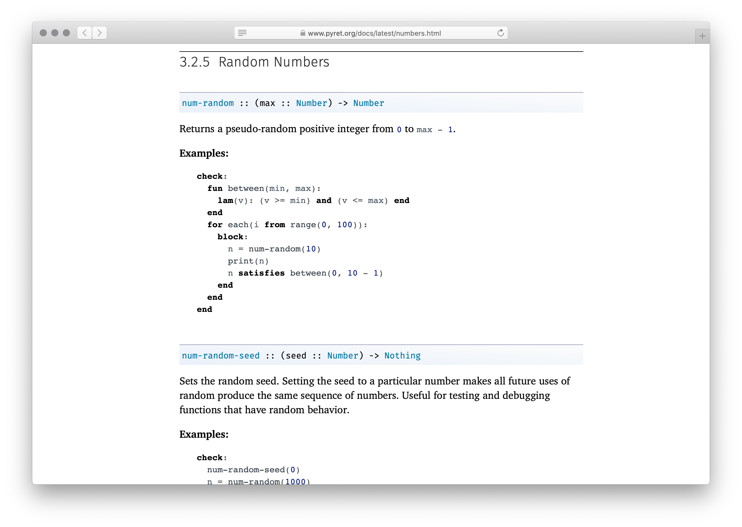

Slide 59
We didn’t find a built-in way to get a random element of a list, but we found a way to get a random number.
How could we use this?

Slide 60
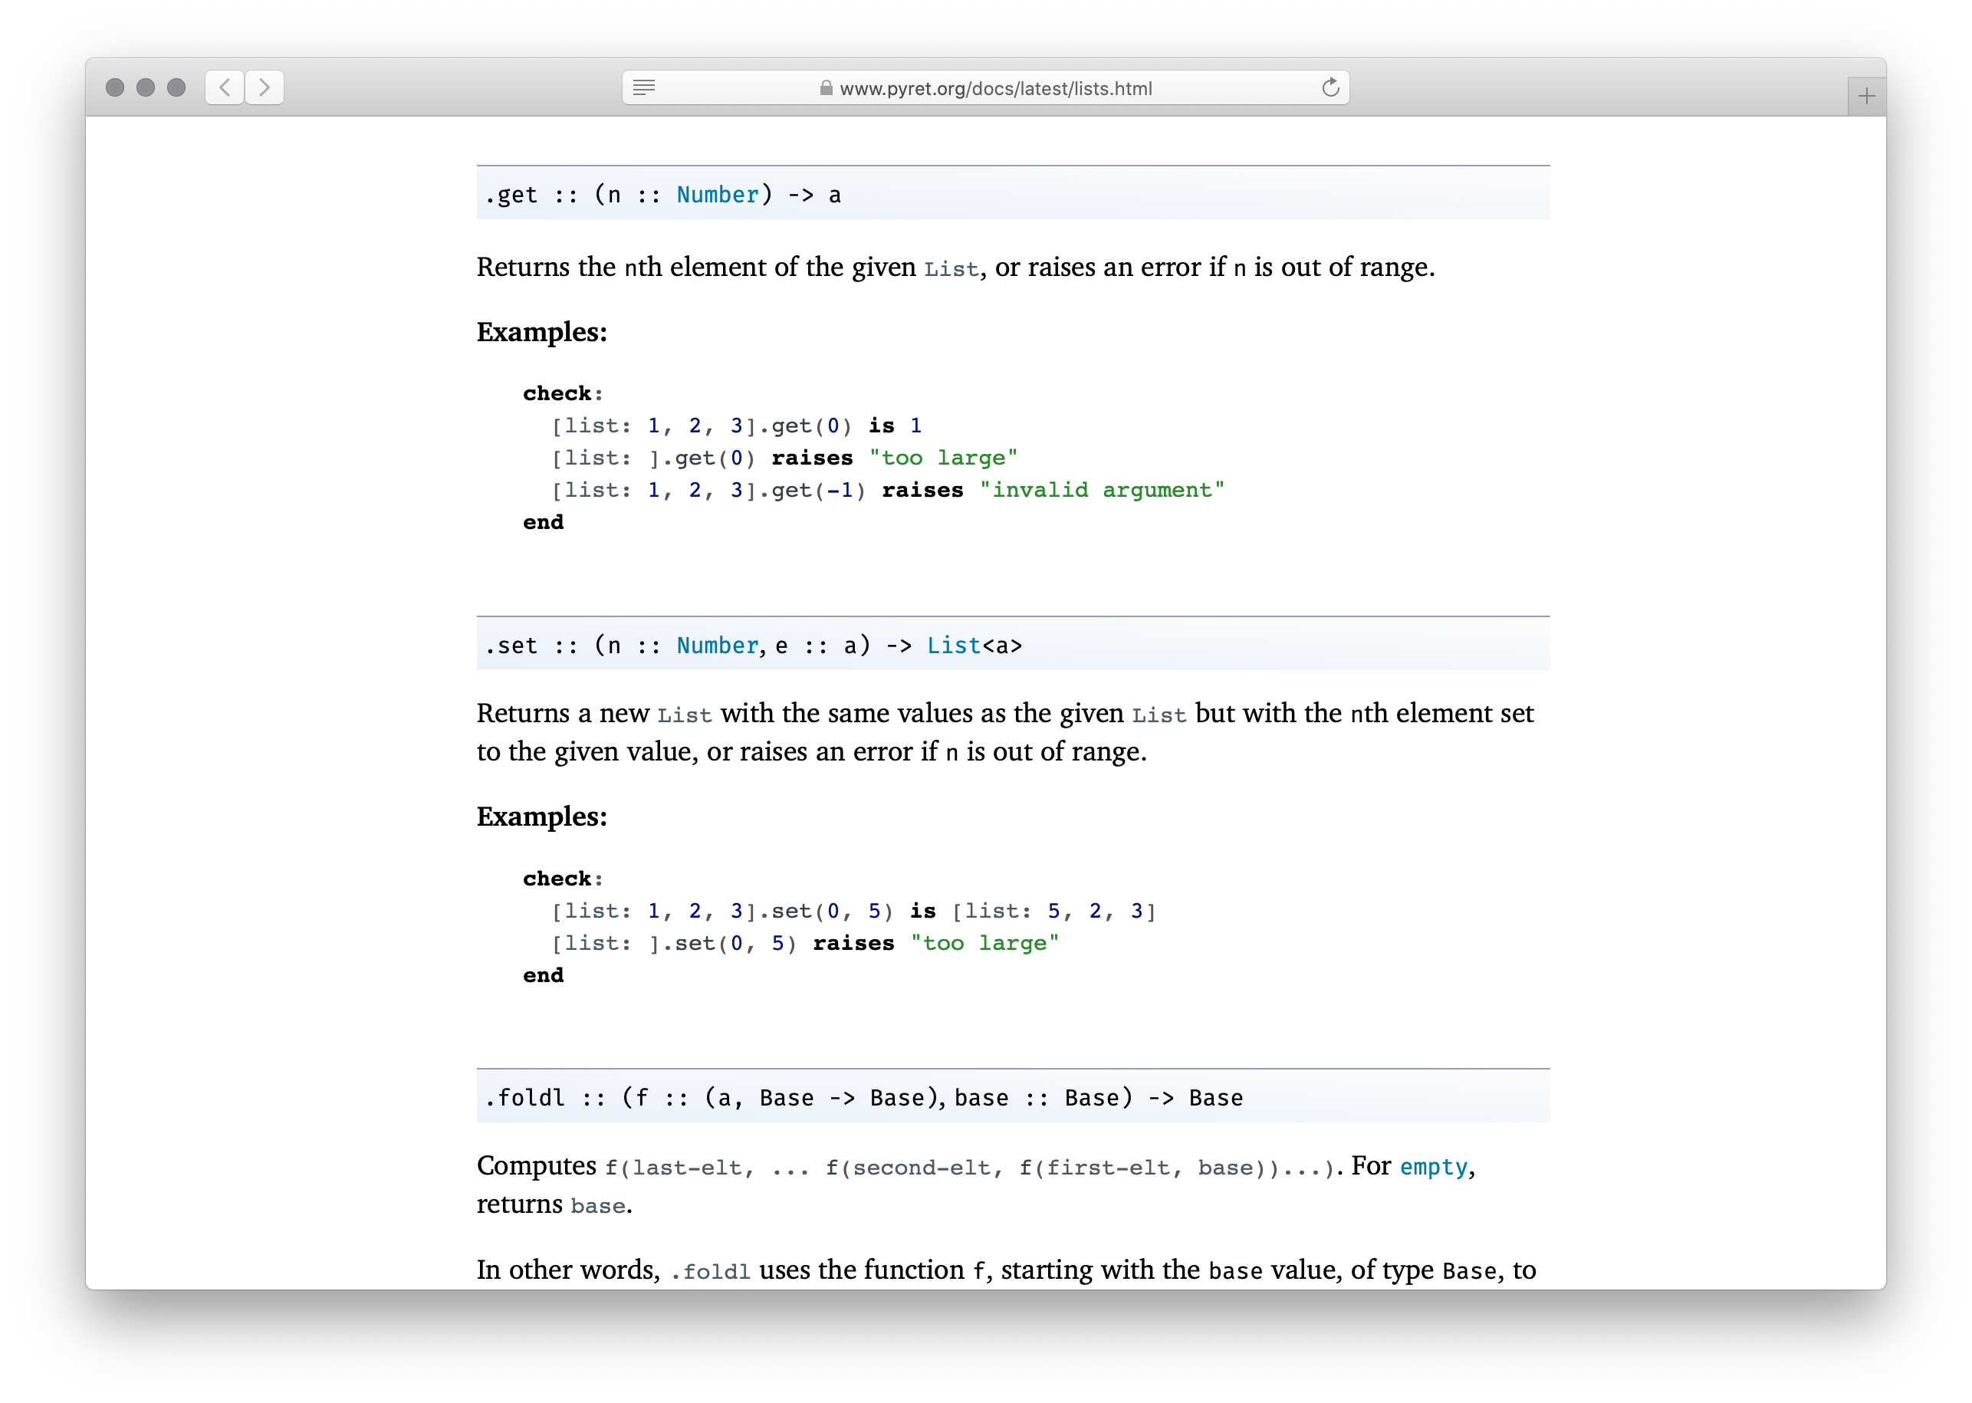

Slide 61
With a table, we could use .row-n to get a specific row by its index number.
With a list, we can use .get to get an item.
Notes:
[slide] Now we have a plan.

Slide 62
Get a random number
Get then list element positioned at that number

Slide 63
plural-nouns = [list: "gazebos", "avocados", "pandas"]
fun substitute-word(w :: String) -> String:
doc: "Substitute a random word if w is a category"
if w == "Plural-Noun":
rand = num-random(3)
plural-nouns.get(rand)
else:
w
end
where:
...
end
Notes:
This will work, but something's terrible. What don't we like?

Slide 64
plural-nouns = [list: "gazebos", "avocados", "pandas"]
fun substitute-word(w :: String) -> String:
doc: "Substitute a random word if w is a category"
if w == "Plural-Noun":
rand = num-random(3)
plural-nouns.get(rand)
else:
w
end
where:
...
end
Notes:
What if we add another possible word?

Slide 65
plural-nouns = [list: "gazebos", "avocados", "pandas", "quokkas"]
fun substitute-word(w :: String) -> String:
doc: "Substitute a random word if w is a category"
if w == "Plural-Noun":
rand = num-random(3)
plural-nouns.get(rand)
else:
w
end
where:
...
end
Notes:
The tests will still pass! Testing randomized functions is difficult, and we need to be careful.

Slide 66
plural-nouns = [list: "gazebos", "avocados", "pandas", "quokkas"]
fun substitute-word(w :: String) -> String:
doc: "Substitute a random word if w is a category"
if w == "Plural-Noun":
rand = num-random(length(plural-nouns))
plural-nouns.get(rand)
else:
w
end
where:
...
end
Notes:
What now?

Slide 67
template = "Thousands of Plural-Noun ago, there were calendars that enabled the ancient Plural-Noun to divide a year into twelve Plural-Noun , each month into Number weeks, and each week into seven Plural-Noun . At first, people told time by a sun clock, sometimes known as the Noun dial. Ultimately, they invented the great timekeeping devices of today, such as the grandfather Noun, the pocket Noun , the alarm Noun , and, of course, the Body-Part watch. Children learn about clocks and time almost before they learn their A-B- Alphabet-Letter s. They are taught that a day consists of 24 Plural-Noun , an hour has 60 Plural-Noun , and a minute has 60 Plural-Noun . By the time they are in Kindergarten, they know if the big Body-Part is at twelve and the little Body-Part is at three, that it is Number o'clock. I wish we could continue this Adjective lesson, but we’ve run out of Noun ."
Notes:
More types!

Slide 68
plural-nouns =
[list: "gazebos", "avocados", "pandas", "quokkas"]
numbers =
[list: "-1", "42", "a billion"]
nouns =
[list: "apple", "computer", "borscht"]
body-parts =
[list: "elbow", "head", "spleen"]
alphabet-letters =
[list: "A", "C", "Z"]
adjectives =
[list: "funky", "boring"]

Slide 69
fun substitute-word(w :: String) -> String:
doc: "Substitute a random word if w is a category"
if w == "Plural-Noun":
rand = num-random(length(plural-nouns))
plural-nouns.get(rand)
else if w == "Number":
rand = ...
else:
w
end
where:
...
end
Don’t repeat yourself!

Slide 70
fun rand-word(l :: List<String>) -> String:
doc: "Return a random word in the given list"
rand = num-random(length(l))
l.get(rand)
where:
plural-nouns.member(rand-word(plural-nouns)) is true
numbers.member(rand-word(numbers)) is true
end
Notes:
This wasn't on our task plan, but we saw a need for a general utility function, so we wrote it!

Slide 71
fun substitute-word(w :: String) -> String:
doc: "Substitute a random word if w is a category"
if w == "Plural-Noun":
rand-word(plural-nouns)
else if w == "Number":
rand-word(numbers)
else if w == "Noun":
rand-word(nouns)
else if w == "Body-Part":
rand-word(body-parts)
else if w == "Alphabet-Letter":
rand-word(alphabet-letters)
else if w == "Adjective":
rand-word(adjectives)
else:
w
end
end
This is still a bit repetitious – but it’s good enough for today!

Slide 72
Go back to the task plan.
We’ve completed our helper, and now we need to
split the input into words
run the helper on every word in the list
Similar to how transform-column runs a function on every row of a table.

Slide 73
fun mad-libs(t :: String) -> String:
doc: "Randomly fill in the blanks in the mad libs template"
words = string-split-all(t, " ")
...
end

Slide 74
Go back to the task plan.
We’ve completed our helper, and now we need to
split the input into words
run the helper on every word in the list
Similar to how transform-column runs a function on every row of a table.
This is called map!

Slide 75
fun mad-libs(t :: String) -> String:
doc: "Randomly fill in the blanks in the mad libs template"
words = string-split-all(t, " ")
map(substitute-word, t)
...
end

Slide 76
Go back to the task plan.
We’ve completed our helper, and now we need to
split the input into words
run the helper on every word in the list
Similar to how transform-column runs a function on every row of a table.
Ok – are we done?

Slide 77
fun mad-libs(t :: String) -> String:
doc: "Randomly fill in the blanks in the mad libs template"
words = string-split-all(t, " ")
map(substitute-word, t)
...
end
This gives us a list of strings. How can we join it back into a single string?

Slide 78
fun mad-libs(t :: String) -> String:
doc: "Randomly fill in the blanks in the mad libs template"
words = string-split-all(t, " ")
words-sub = map(substitute-word, words)
join-str(with-sub, " ")
end

Slide 79
fun mad-libs(t :: String) -> String:
doc: "Randomly fill in the blanks in the mad libs template"
words = string-split-all(t, " ")
words-sub = map(substitute-word, t)
join-str(words-sub, " ")
where:
...
end
What do we know is true about the output?

Slide 80
fun mad-libs(t :: String) -> String:
doc: "Randomly fill in the blanks in the mad libs template"
words = string-split-all(t, " ")
words-sub = map(substitute-word, t)
join-str(words-sub, " ")
where:
mad-libs(template) is-not template
end

Slide 81
fun mad-libs(t :: String) -> String:
doc: "Randomly fill in the blanks in the mad libs template"
words = string-split-all(t, " ")
words-sub = map(substitute-word, t)
join-str(words-sub, " ")
where:
mad-libs(template) is-not template
string-contains(mad-libs(template), "Plural-Noun")
is false
end

Slide 82
Preview: Lists and recursion
Notes:
[This example was way too hard to start with!]

Slide 83
What if join-str didn’t already exist for our convenience?
To write a function that processes a list element by element, we need to understand the real nature of lists.

Slide 84
A list consists of two parts: a first element and the rest of the list.
››› l = [list: 1, 2, 3]
››› l.first
1
››› l.rest
[list: 2, 3]

Slide 85
The first element is linked to the rest and so on until we reach the empty list:
››› link(1, empty)
[list: 1]
››› link(1, link(2, link(3, empty)))
[list: 1, 2, 3]

Slide 86
When we write a function that recursively processes a list, we deal with these two cases – linking an element or being empty:
fun add-nums(l :: List<Number>) -> Number:
cases (List) l:
| empty => 0
| link(f, r) => f + add-nums(r)
end
where:
add-nums([list: ]) is 0
add-nums([list: 1]) is 1 + 0
add-nums([list: 2, 1]) is 2 + 1 + 0
end

Slide 87
In the case of joining strings, we need to know not just if the current list is empty but is the rest of the rest empty. This is how we know whether to add a space or not.

Slide 88
fun join-with-spaces(l :: List<String>) -> String:
doc: "Join the strings in l with a space between each one"
cases (List) l:
| empty => ""
| link(f, r) =>
cases (List) r:
| empty => f
| link(fr, rr) =>
f + " " + join-with-spaces(r)
end
end
where:
join-with-spaces([list: ]) is ""
join-with-spaces([list: "y"]) is "y" + ""
join-with-spaces([list: "x", "y"]) is "x" + " " + "y" + ""
end

Slide 89
Class code:
https://code.pyret.org/editor#share=1pl3aebeS704fGGlxGhSc-NNFaQCBE9On&v=4f2ac8e

Slide 90
Acknowledgments
This class incorporates material from:

