Slide 1
Data analysis and storytelling
Notes:
In this class, when we used data, we were trying to ask questions -- about our physical world, about populations, preferences, and how many times cats were rescued from trees.
But our goal isn’t just to make graphs or report averages; it’s to use computational analysis of data to tell a story.

Slide 2
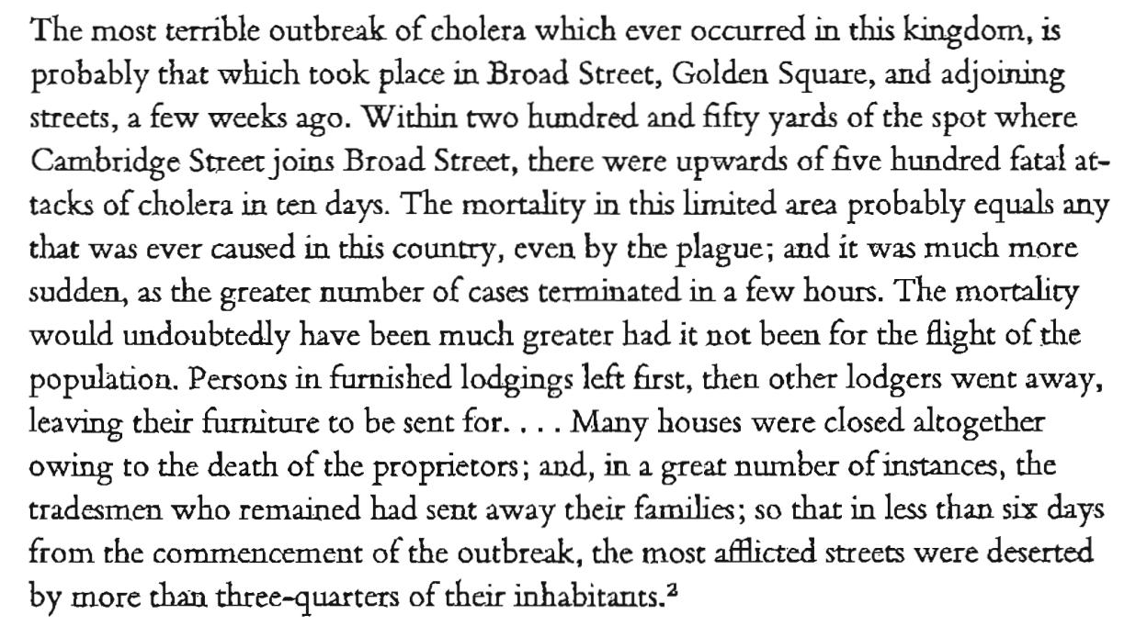
In 1854, there was an outbreak of cholera in central London:
John Snow, On the Mode of Communication of Cholera, 1855
Notes:
A historic example illustrates the power of data analysis. [slide]

Slide 3
The outbreak began on the evening of 31 August 1854.
John Snow, who investigated earlier epidemics, suspected the water from a community pump-well at Broad and Cambridge Streets was contaminated.
However, he couldn’t reach any definitive conclusion from looking at the water.

Slide 4
He obtained a list of 83 cholera deaths from the General Register Office and plotted them on a map.

Slide 5
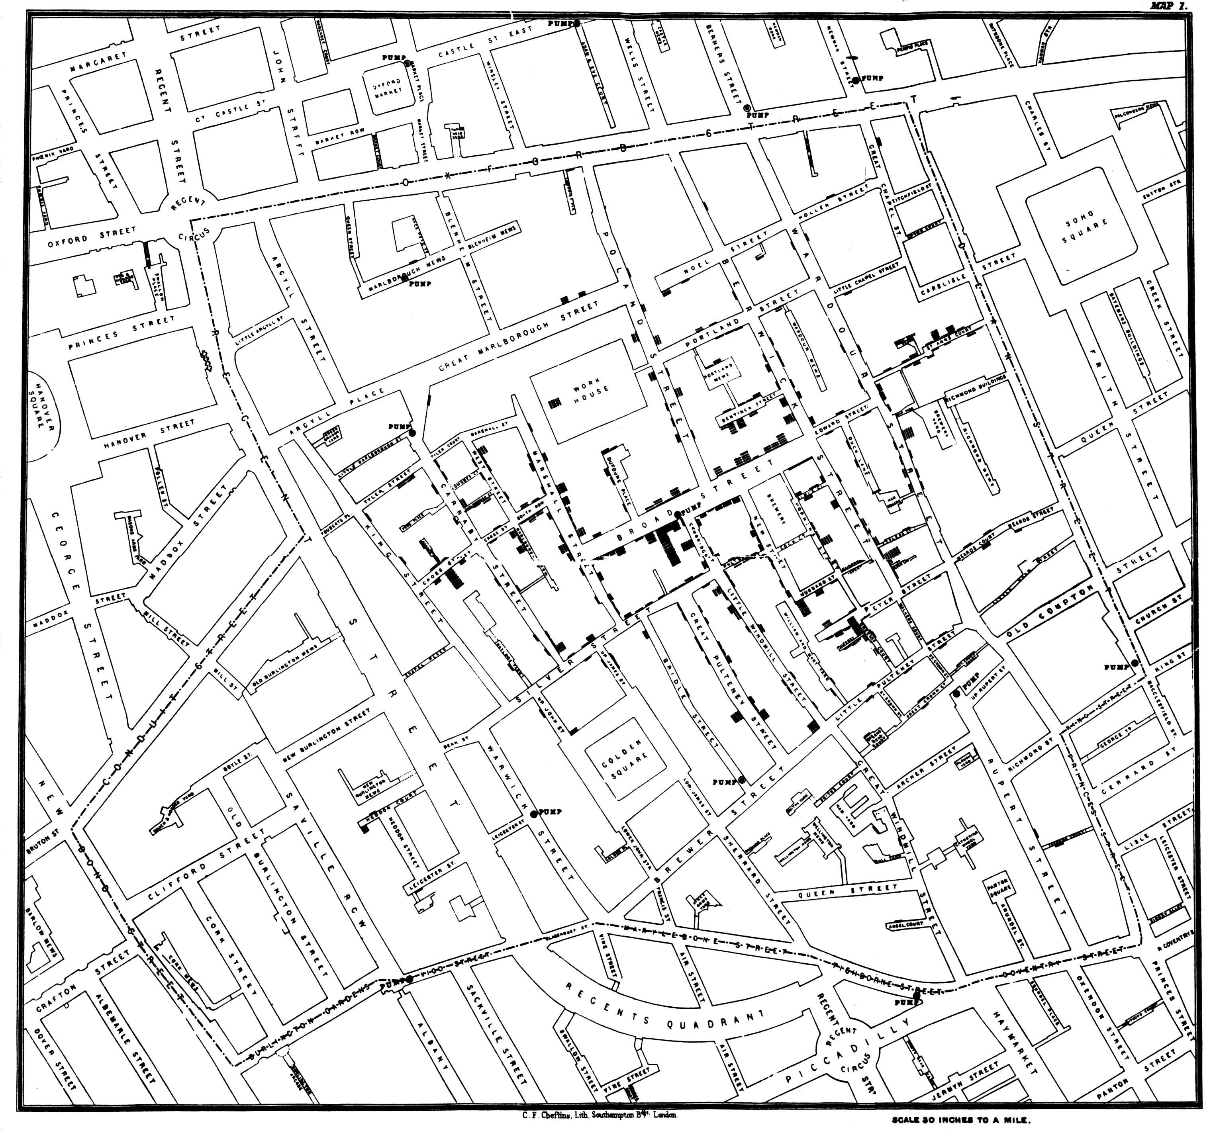
Notes:
The deaths at each address are indicated by little horizontal lines, stacked up from the street like a pile of corpses.
One limitation of the map is that it implies that the population in the area is uniformly distributed. In other words, a house without any deaths means that the inhabitants successfully avoided cholera rather than that the house sits empty.

Slide 6
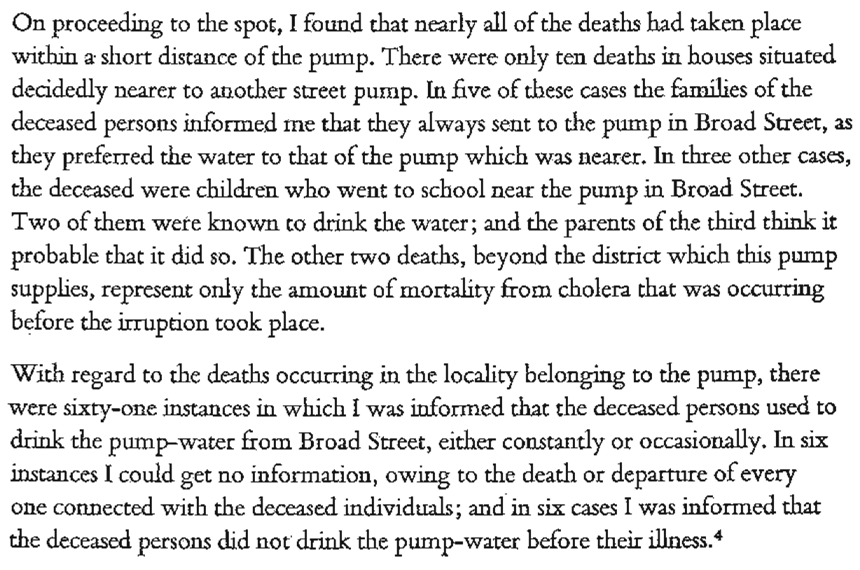
John Snow, On the Mode of Communication of Cholera, 1855

Slide 7
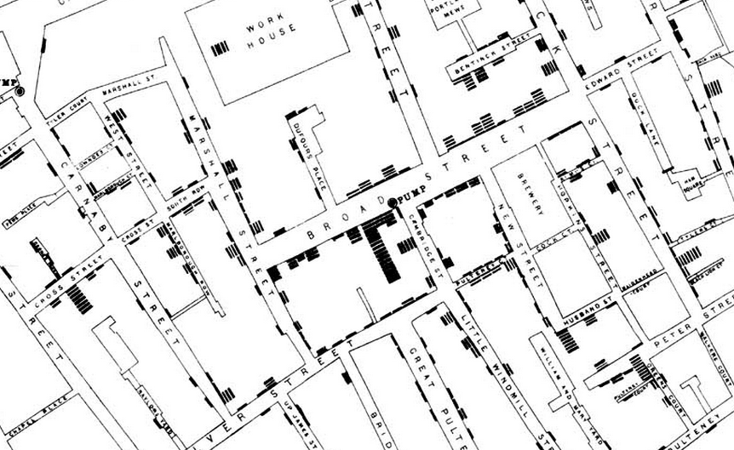
This map pointed to the water from a pump on Broad Street as the likely source of the spread.
Notes:
Snow has made the map big enough to include the locations of the other water pumps in the vicinity, clearly showing a drop-off in cholera deaths where houses are nearer to a different pump.
Visualizing his data allowed Snow to investigate abnormalities in the outbreak. He learned, for example, that the brewery and the workhouse, both near the Broad Street pump, had their own independent water sources and so escaped the outbreak largely unscathed.

Slide 8
It was time to act.
Snow described his findings to the Board of Guardians of St James’s Parish, who were responsible for the water supply.
The Board ordered the pump-handle be removed immediately, and the epidemic soon ended.
Notes:
The result of this intervention was consistent with the idea that choler was transmitted by impure water. Snow’s explanation replaced previously held beliefs that it was spread through the air.

Slide 9
The original data Snow obtained listed the victims’ names and described their circumstances, in order by date of death.
The obvious visualization would be a time series – a display of the progress of the epidemic, either daily or cumulative:

Slide 10
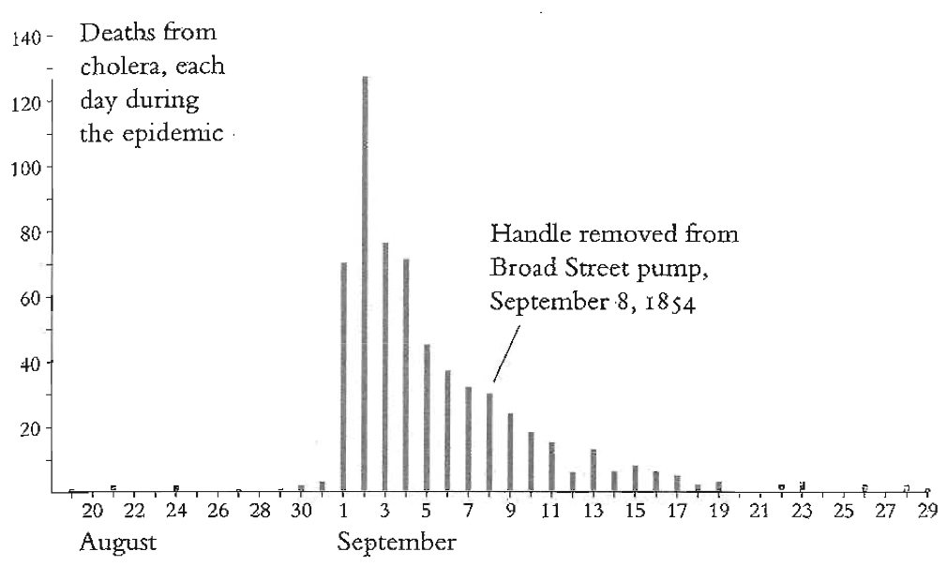
These visualizations would have been practically useless in discovering a strategy for stopping the epidemic.
They can, however, show that removing the pump handle may have been done too late to “save the day”. The epidemic was already in decline:
Notes:
So, the real victory may have been in establishing the means of transmission rather than in saving lives. But removing the pump handle did prevent a recurrence of cholera.

