Slide 1
Generating Fractals
CMPU 101 § 54 · Computer Science I
27 February 2023

Slide 2
Where are we?

Slide 3
data List:
| empty
| link(first :: Any, rest :: List)
end
Self-reference
Recursive data
fun list-fun(lst :: List) -> ...:
cases (List) lst:
| empty => ...
| link(f, r) =>
... f ...
... list-fun(r) ...
end
end
Natural recursion
Recursive functions

Slide 4
The same idea holds for lists, binary trees, trinary trees, n-ary trees, and all kinds of other recursive data types: The structure of the function follows the structure of the data.

Slide 5
The recursive functions we’ve written have used structural (or natural) recursion.
In structural recursion, each recursive call takes some sub-piece of the data.
Going through a list, we keep taking the rest of the list.
Going through a tree, we keep looking at the sub-trees.

Slide 6
Generative recursion
Notes:
Today we'll look at generative recursion.

Slide 7
In generative recursion, the recursive cases are generated based on the problem to be solved.
Generative recursion can be harder because neither the base nor recursive cases follow from a data definition.

Slide 8
Template for generative recursion
fun problem-solver(d) -> ...:
if is-trivial(d):
# Base case: The computation is in some way
# trivial.
... d ...
else:
# Recursive case: Transform the data d to generate
# new problems.
combiner(
...d...,
problem-solver(transform(d)),
...)
end
end

Slide 9
When you write a function with generative recursion you need to be careful about termination – how do you know you’ll ever reach the base case?
Notes:
The structural recursion technique is guaranteed to arrive at the base case by way of the data definition, but generative recursion requires you to define your own terminating condition.

Slide 10
Fractals
Notes:
As a fascinating example of generative recursion, let's look at fractals.

Slide 11
Notes:
A picture that contains a picture of itself is an example of a recursive, self-similar structure; such structures are commonly known as fractals.

Slide 12
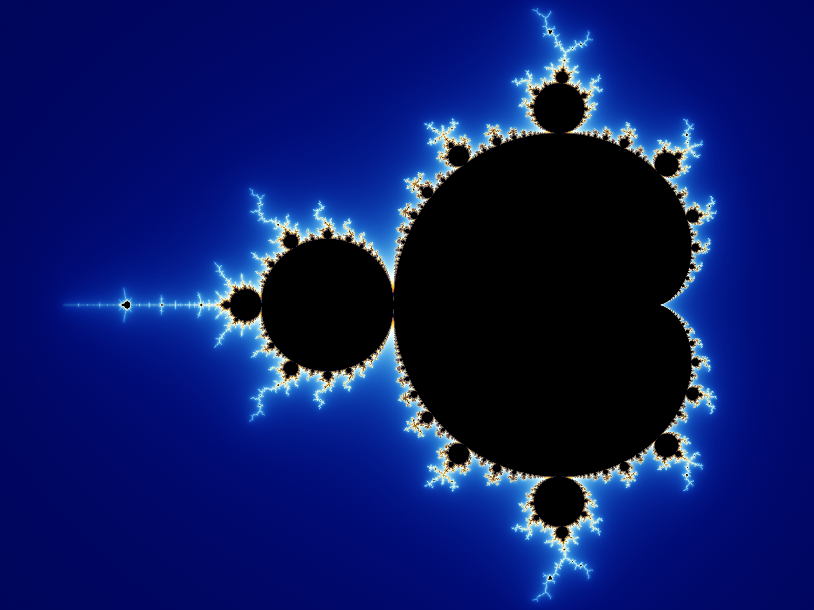
“A fractal is a way of seeing infinity.”
Benoit Mandelbrot
Notes:
[The Mandelbrot set]

Slide 13
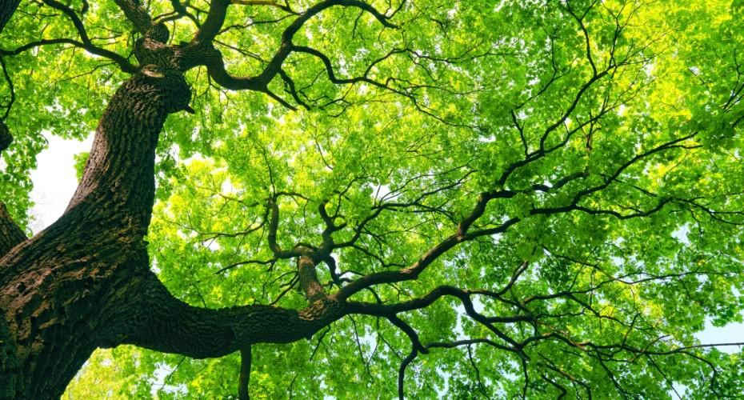
Notes:
In the real world, self-similar structures don’t go on forever: for instance, each branch of a tree looks a lot like a smaller tree, and each of these smaller branches has branches that look like still smaller trees.
This recursion goes on for several levels, but eventually the branches are so small that they do not have branches of their own.
[Also think of breaking down into molecules, atoms, particles, … but you can’t break down infinitely.]

Slide 14
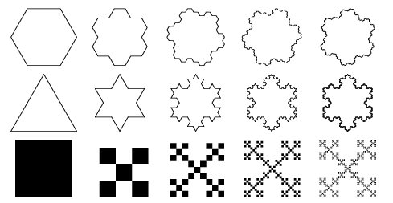
Notes:
There are many different kinds of fractals.

Slide 15
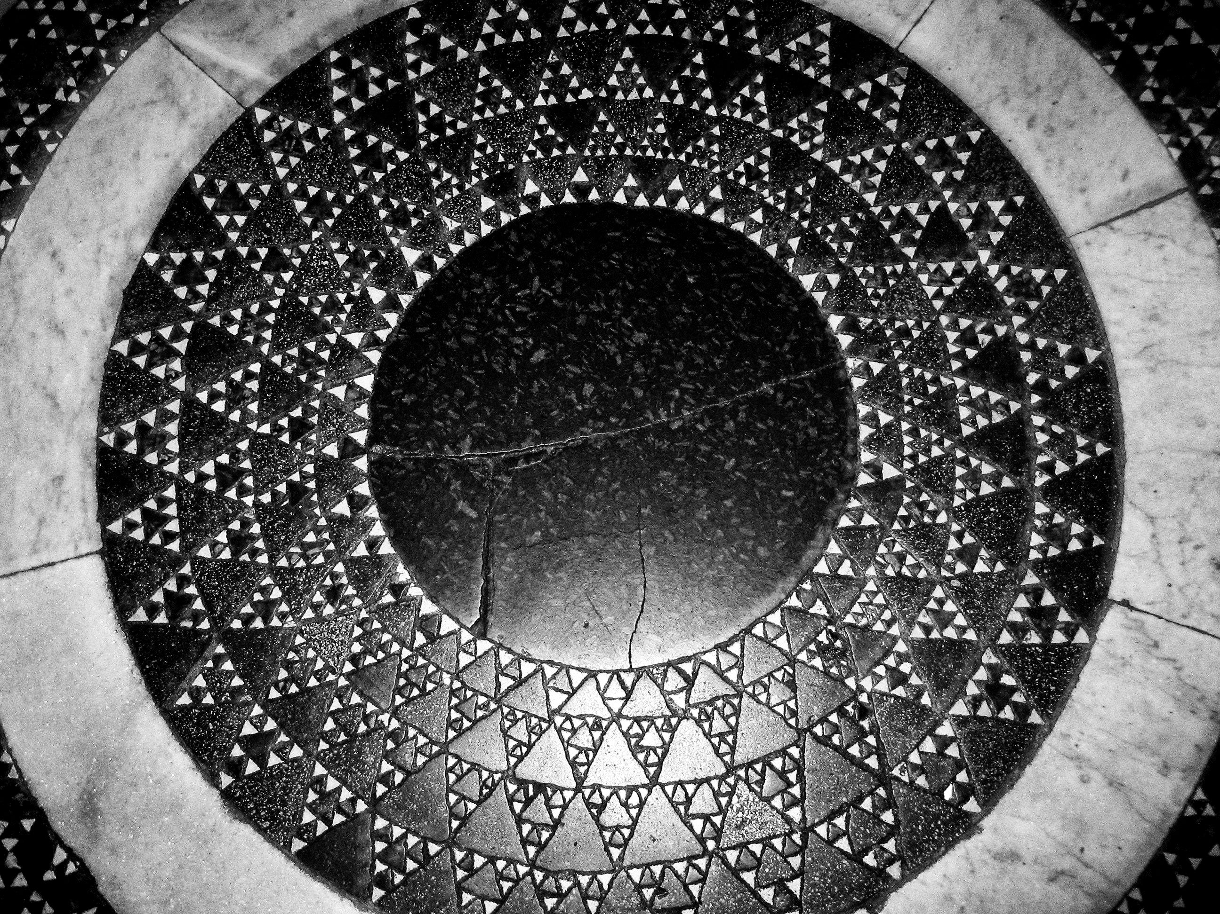
Notes:
In 12th–13th century Italian mosaics, we see an interesting fractal

Slide 16
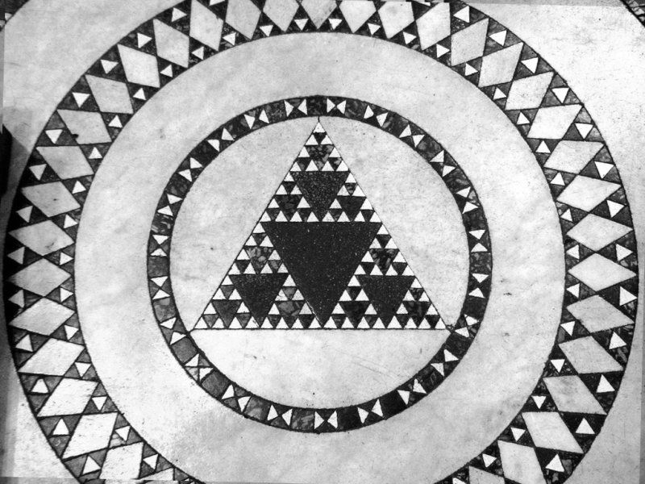
Notes:
This is now called the Sierpinski sieve or Sierpinski gasket, after the mathematician who described in 1915.

Slide 17
Notes:
This is now called the Sierpinski sieve or Sierpinski gasket, after the mathematician who described in 1915.

Slide 18
Useful for motion capture suits, even if you are not “Far From Home.” See: https://patents.google.com/patent/US20130016876
Notes:
This is now called the Sierpinski sieve or Sierpinski gasket, after the mathematician who described in 1915.

Slide 19
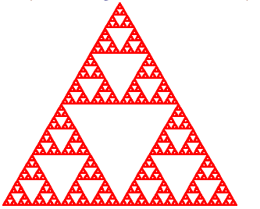
Design a function that consumes a number and produces a Sierpiński triangle of that size:
Start with an equilateral triangle with side length s:
Inside that triangle are three more Sierpiński triangles:
And inside of each of those … and so on.
Producing something that looks like this:
Notes:
Note that the center upside down triangle in the second picture is not an explicit triangle; it’s formed from the other triangles.

Slide 20
s/2
s
Notes:
And we just keep making triangles until the sides are too small to bother continuing.
[Go back to problem def. and switch to CPO.]

Slide 21
[See class code]

Slide 22
How do we know that this function won’t run forever?
Three-part termination argument:
Base case: s <= CUTOFF
Reduction step: s / 2
Argument that repeated application of reduction step will eventually reach the base case:
As long as the cutoff is > 0 and s starts >= 0, repeated division by 2 will eventually be less than the cutoff.

Slide 23
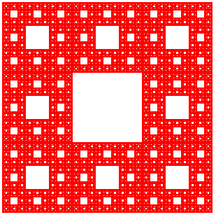
Design a function s-carpet to produce a Sierpiński carpet of size s:

Slide 24
Design a function s-carpet to produce a Sierpiński carpet of size s:
There are eight copies of the recursive call positioned around a blank square
Notes:
First observe how it’s put together:

Slide 25
[See class code]

Slide 26
How do we know that this function won’t run forever?
Three-part termination argument:
Base case: s <= CUTOFF
Reduction step: s / 3
Argument that repeated application of reduction step will eventually reach the base case:
As long as the cutoff is > 0 and s starts >= 0, repeated division by 3 will eventually be less than the cutoff.

Slide 27
Animation

Slide 28
Class code:
tinyurl.com/101-2023-02-27

Slide 29
Acknowledgments
This lecture incorporates material from:
Gregor Kiczales, University of British Columbia
Marc Smith, Vassar College

