Slide 1
Reactive Programs
CMPU 101 § 54 · Computer Science I
1 March 2023

Slide 2
Where are we?

Slide 3
Where are we? Traffic-light world

Slide 7
All traffic lights are the same size and position on the screen.
What distinguishes them?
Asking this helps us think about data

Slide 8
All traffic lights are the same size and position on the screen.
How do we get from one to the other?
Asking this helps us think about functions.
We need more(?), but this is a good start.
i.e. not just how, but when.

Slide 9
Data
Functions
Data definition
Examples
Template
Signature
Docstring
Examples
Body

Slide 10
Data
Functions
Data definition
Examples
Template
Signature
Docstring
Examples
Body

Slide 11
data TrafficLight:
...
end
Notes:
Because there are exactly three colors we want to allow, it’s better not to use a number or a string, but to give a data definition that lists the possibilities.

Slide 12
data TrafficLight:
| green
| yellow
| red
end

Slide 13
Data
Functions
Data definition
Examples
Template
Signature
Docstring
Examples
Body

Slide 14
data TrafficLight:
| green
| yellow
| red
end
TL-GREEN = green
TL-YELLOW = yellow
TL-RED = red
For this data definition, the examples are so trivial we can skip them, but you saw in the pipeline lab how helpful it can be to have examples when you have a lot of possibilities!

Slide 15
data TrafficLight:
| green
| yellow
| red
end

Slide 16
Data
Functions
Data definition
Examples
Template
Signature
Docstring
Examples
Body

Slide 17
data TrafficLight:
| green
| yellow
| red
end

Slide 18
data TrafficLight:
| green
| yellow
| red
end
#|
fun trafficlight-fun(tl :: TrafficLight) -> ...:
|#
Notes:
Template: Remind ourselves how to use the data

Slide 19
data TrafficLight:
| green
| yellow
| red
end
#|
fun trafficlight-fun(tl :: TrafficLight) -> ...:
doc: "TrafficLight template"
cases (TrafficLight) tl:
| green => ...
| yellow => ...
| red => ...
end
where:
trafficlight-fun(green) is ...
trafficlight-fun(yellow) is ...
trafficlight-fun(red) is ...
end |#

Slide 20
Data
Functions
Data definition
Examples
Template
Signature
Docstring
Examples
Body

Slide 21
As we saw* last class, Pyret has a mechanism for supporting interactive programs, called a reactor. It allows us to model the real word**
To use it, first write
include reactors
*Well, we didn’t actually see it, but just go with it ☺
**Not the television show!

Slide 22
reactor:
init: initial-state
to-draw: draw-function
event-type: event-function
end
Event-type allows us to ask “when?” do we want to call the draw-function. The 4’th dimension exists!
Notes:
Up to know, the “When?” question is answered by some user action: enter something on the keyboard, explicitly call a function, click on something, etc.

Slide 23
reactor:
init: initial-state
to-draw: draw-function
event-type: event-function
end
“reactor?” this allows us our program to react to events. What kind of events? Something like…

Slide 24
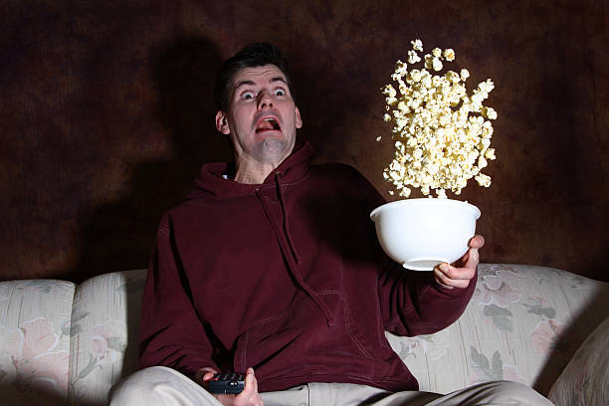
Less nuclear reactor; more person-that-reacts to something.

Slide 25
reactor puts all the pieces together to start things up and allows the program to react to events...

Slide 26
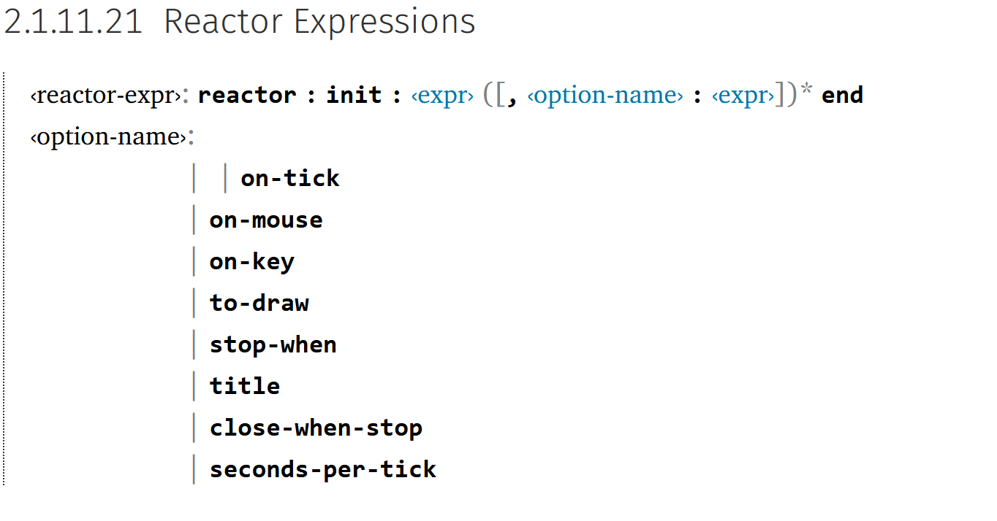
reactor puts all the pieces together to start things up and allows the program to react to events...
Events!

Slide 27
initial state

Slide 28
some event happens…

Slide 29
next state

Slide 30
next state
now the current state

Slide 31
some event happens…

Slide 32
next state
now the current state

Slide 33
some event happens…

Slide 34
next state
now the current state

Slide 35
reactor:
init: initial-state,
to-draw: draw-function,
event-type: event-function
end

Slide 36
reactor:
init: green,
to-draw: draw-function,
event-type: event-function
end

Slide 37
reactor:
init: green,
to-draw: draw-light,
event-type: event-function
end
We haven’t written this; add it to our wishlist!

Slide 38
reactor:
init: green,
to-draw: draw-light,
on-tick: next-light
end
Another function for the wishlist!

Slide 39
So far…
# TrafficLight data
# - definition
# - examples
# - template
# define reactor
# Wishlist:
# - fun draw-light...
# - fun next-light...

Slide 40
Data
Functions
Data definition
Examples
Template
Signature
Docstring
Examples
Body

Slide 41
fun draw-light(tl :: TrafficLight) -> Image:
...
end

Slide 42
fun draw-light(tl :: TrafficLight) -> Image:
...
end
fun next-light(tl :: TrafficLight) -> TrafficLight:
...
end

Slide 43
Data
Functions
Data definition
Examples
Template
Signature
Docstring
Examples
Body

Slide 44
fun draw-light(tl :: TrafficLight) -> Image:
doc: "Draw a circle of the given color, rendering a traffic light"
...
end
fun next-light(tl :: TrafficLight) -> TrafficLight:
...
end

Slide 45
fun draw-light(tl :: TrafficLight) -> Image:
doc: "Draw a circle of the given color, rendering a traffic light"
...
end
fun next-light(tl :: TrafficLight) -> TrafficLight:
doc: "Produce the next light in the sequence green, yellow, red"
...
end

Slide 46
Data
Functions
Data definition
Examples
Template
Signature
Docstring
Examples
Body

Slide 47
fun draw-light(tl :: TrafficLight) -> Image:
doc: "Draw a circle of the given color, rendering a traffic light"
...
where:
draw-light(green) is circle(20, "solid", "green")
draw-light(yellow) is circle(20, "solid", "yellow")
draw-light(red) is circle(20, "solid", "red")
end
fun next-light(tl :: TrafficLight) -> TrafficLight:
doc: "Produce the next light in the sequence green, yellow, red"
...
end

Slide 48
fun draw-light(tl :: TrafficLight) -> Image:
doc: "Draw a circle of the given color, rendering a traffic light"
...
where:
draw-light(green) is circle(20, "solid", "green")
draw-light(yellow) is circle(20, "solid", "yellow")
draw-light(red) is circle(20, "solid", "red")
end
fun next-light(tl :: TrafficLight) -> TrafficLight:
doc: "Produce the next light in the sequence green, yellow, red"
...
where:
next-light(green) is yellow
next-light(yellow) is red
next-light(red) is green
end

Slide 49
Data
Functions
Data definition
Examples
Template
Signature
Docstring
Examples
Body

Slide 50
Starter code:
tinyurl.com/2023-03-01-tl-starter

Slide 51
Code:
tinyurl.com/2023-03-01-tl

Slide 52
Screensaver
Notes:
Let's use reactors to draw a more interesting example

Slide 54
Code:
tinyurl.com/2023-03-01-bounce

Slide 55
Acknowledgments
This lecture incorporates material from:
W. Daniel Hillis, The Pattern on the Stone
Marc Smith, Vassar College
Laney Strange, Northeastern University

