Slide 1
Computer Science I
CMPU 101 § 53
1 May 2023

Slide 2
What have we been doing this semester?
Notes:
Today, I’d like to step back a bit from the details to situate what we’ve been doing this semester.

Slide 3
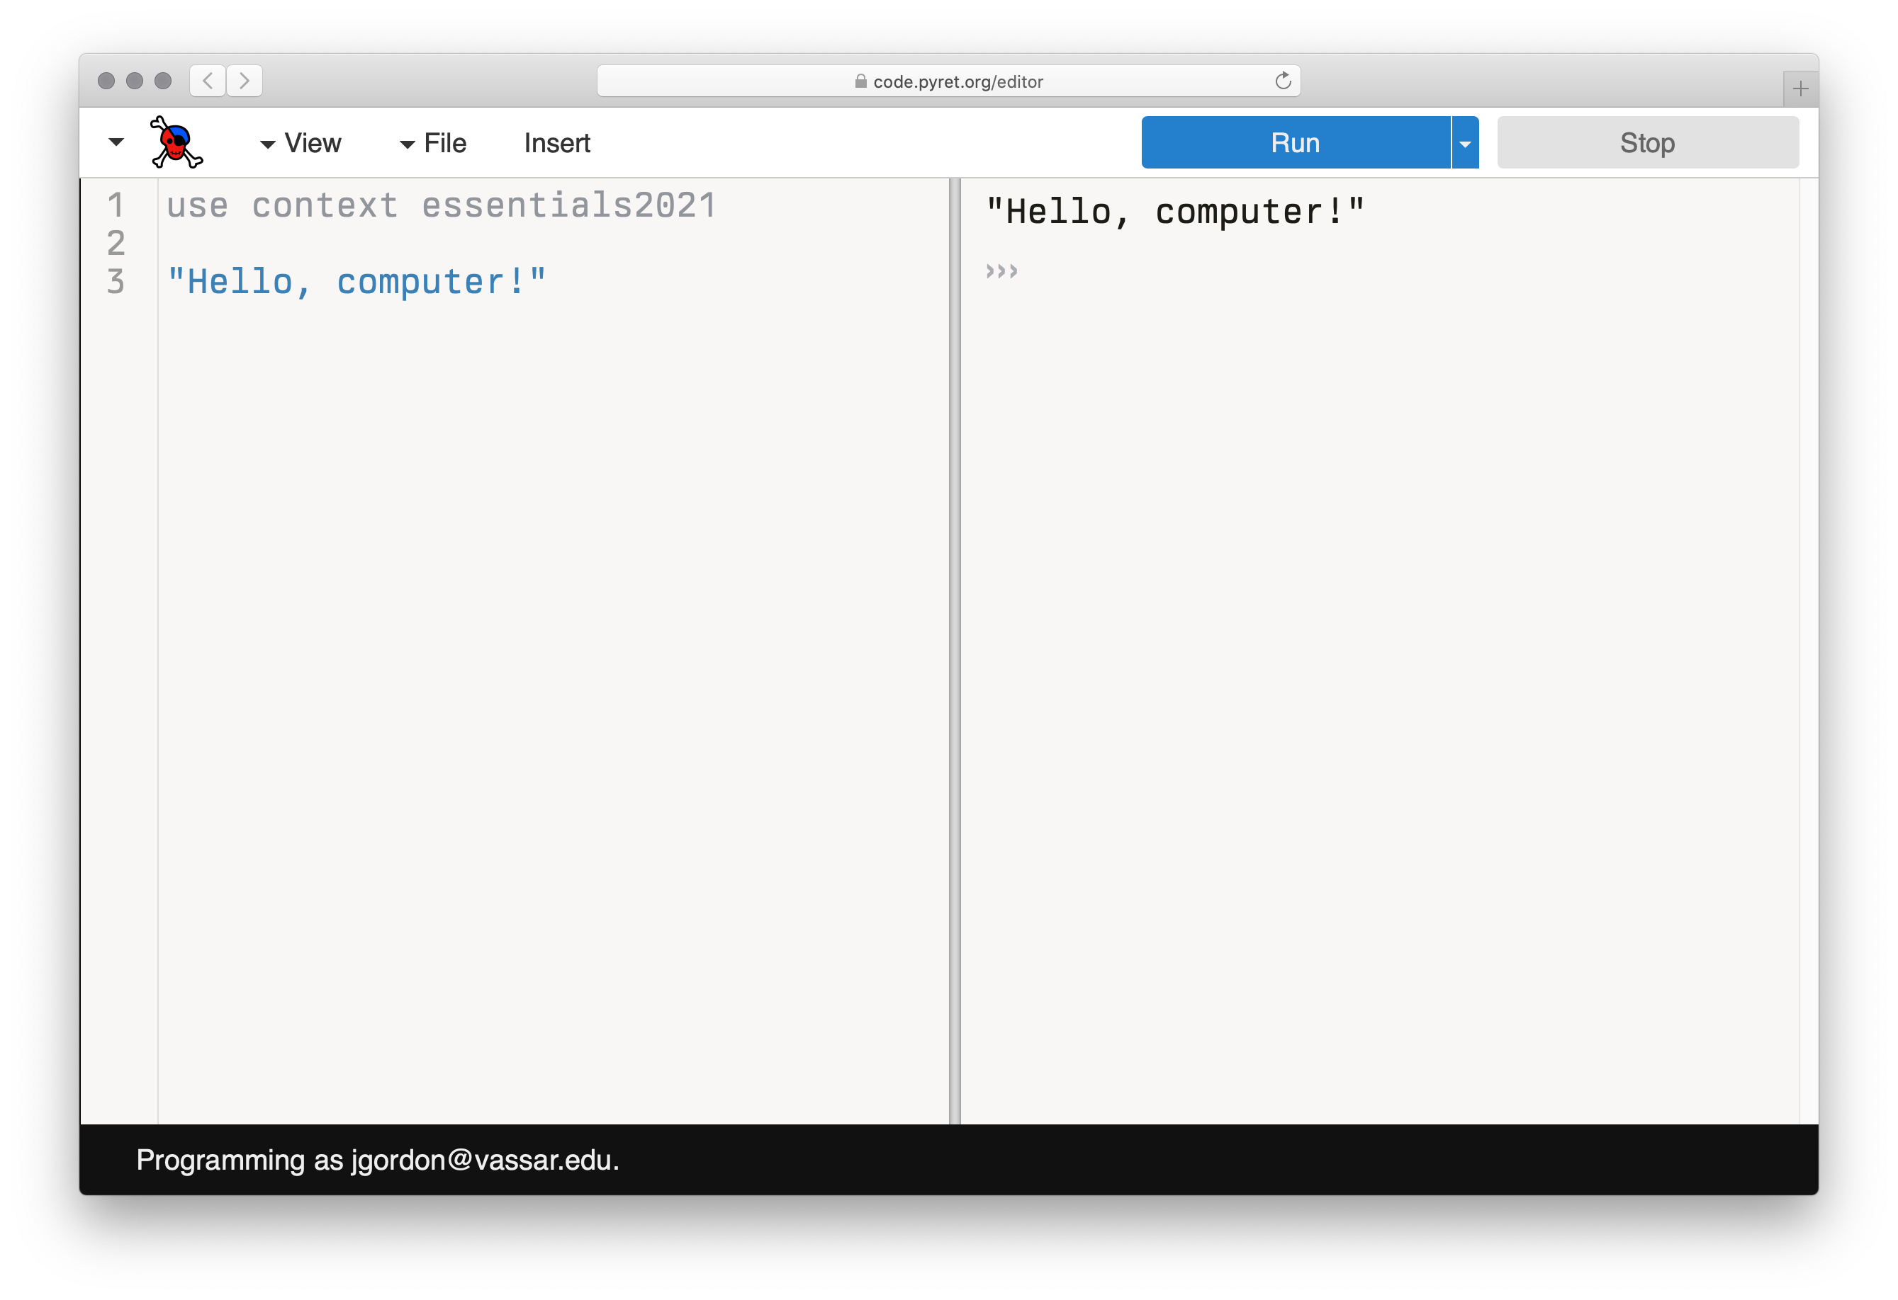
Notes:
Well, we started out playing with Pyret.

Slide 4
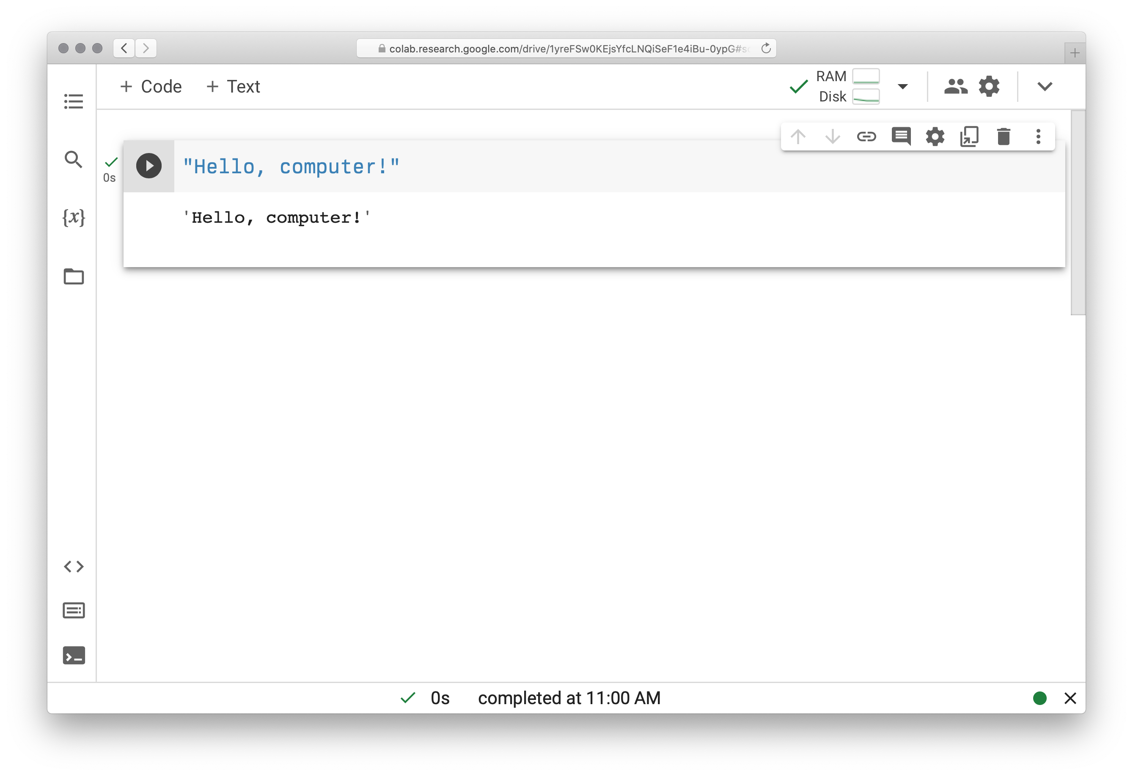
Notes:
And then we played with Python.

Slide 5
We’re not especially interested in Pyret – or Python!
If you’re programming 20 years from now, it will be in a different language, using different tools.
Notes:
But [slide]

Slide 6
What have we been doing in these languages?
Notes:
Instead, consider what we’ve been doing in these languages.

Slide 7
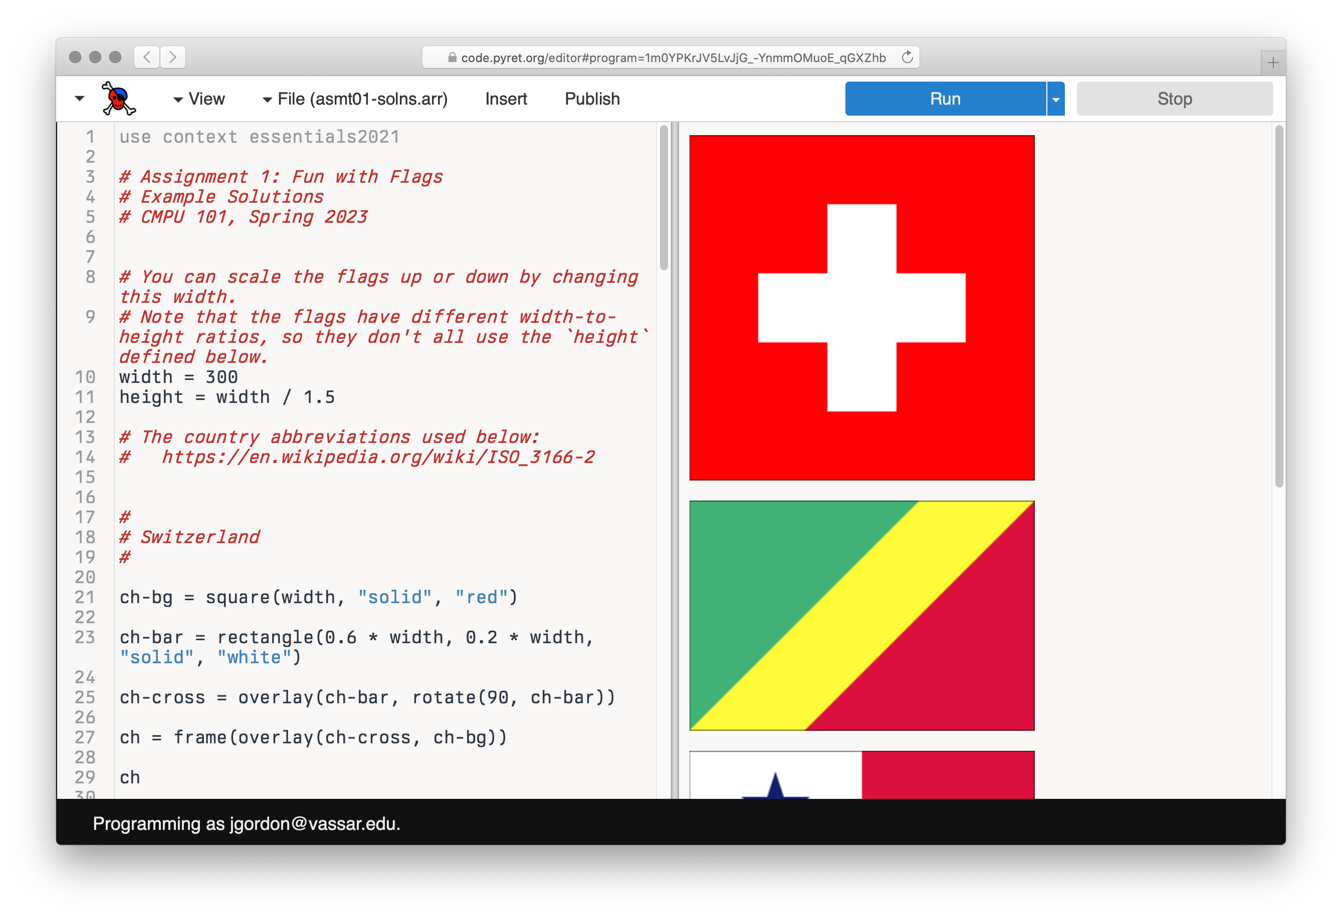
Notes:
We started out drawing some flags.

Slide 8
…
Notes:
And, a couple short months later,

Slide 9
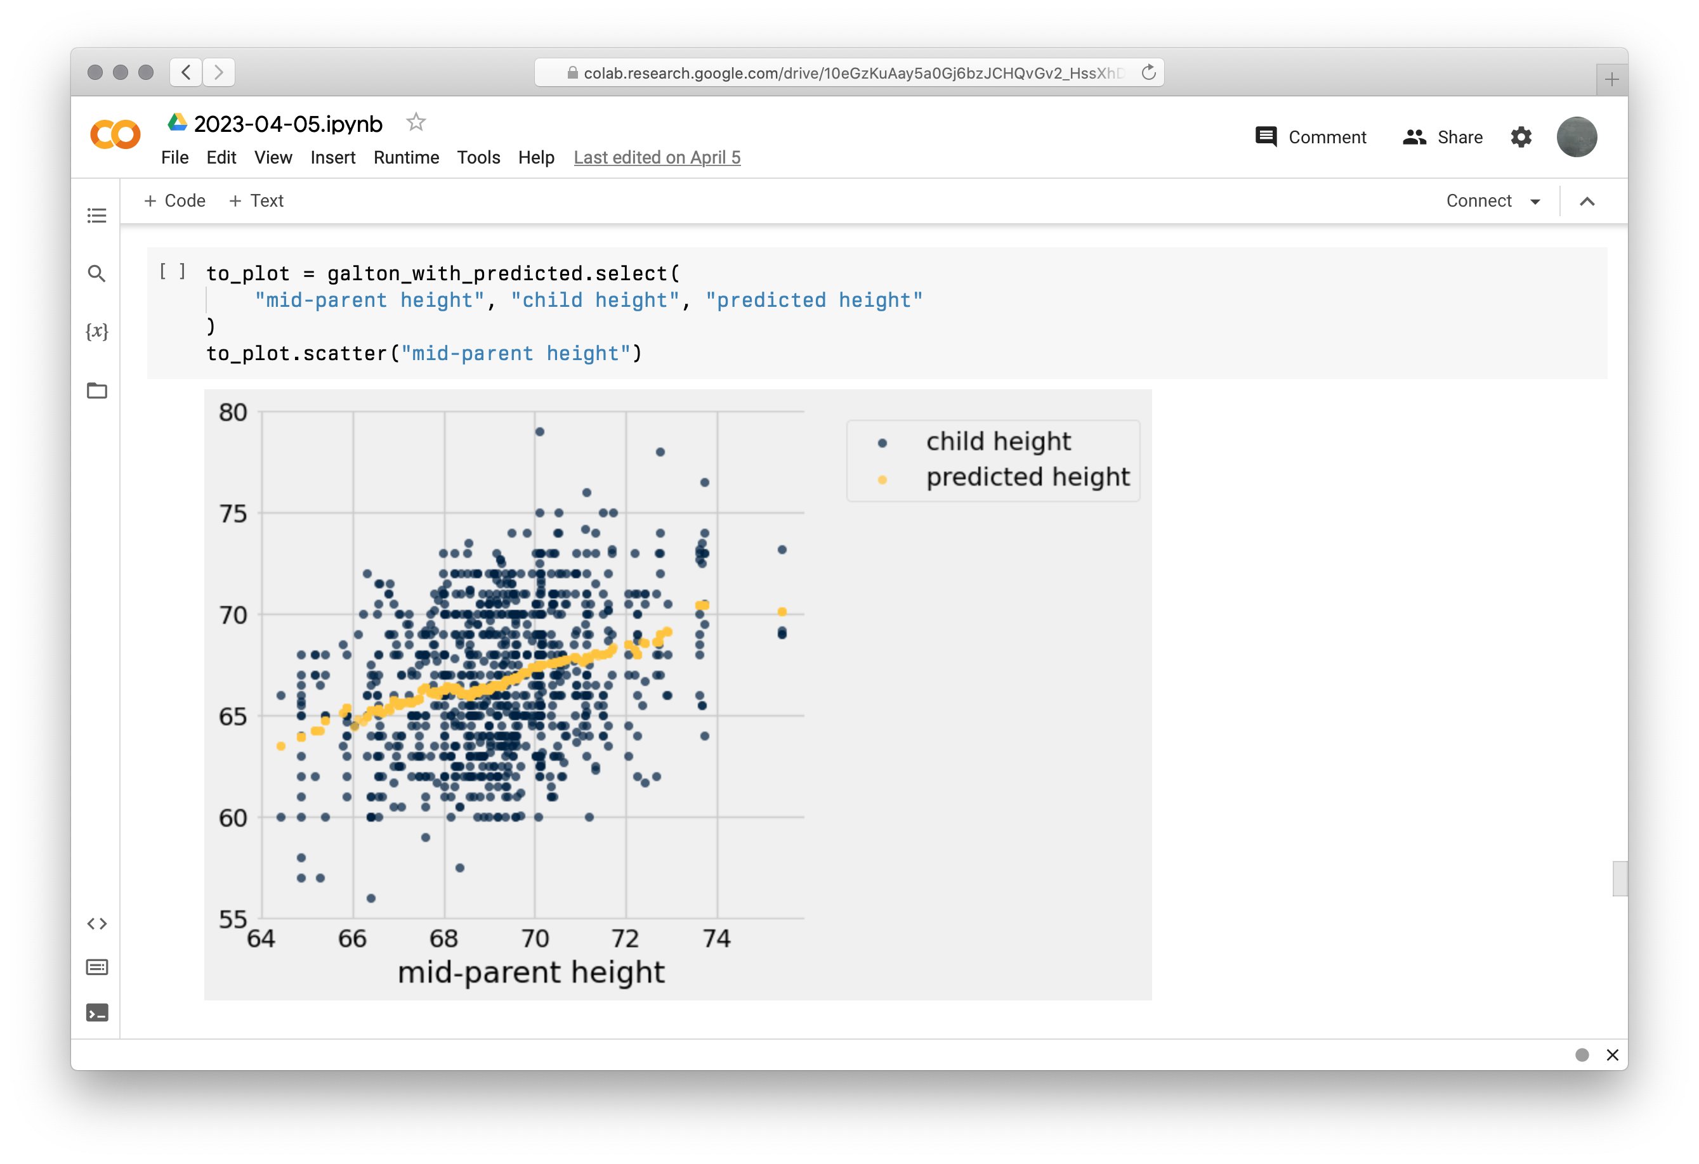
Notes:
...we’re making predictions using tables of data...

Slide 10
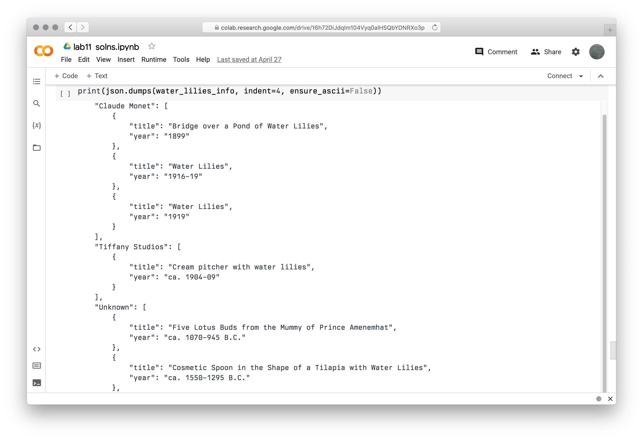
Notes:
...and making dictionaries of artwork we found with the Met's Web API.
On the face of it, these things don’t have a lot in common!
So, what is it we’ve been doing?

Slide 11
We’ve been practicing computational thinking.
Notes:
Fundamentally, [slide]
Computational thinking isn’t specific to the languages we’re working in or even to computing as we know it.

Slide 12
“Modern computer science is the last 1 percent of the historical timeline of computational thinking. Computer scientists inherited and then perfected computational thinking from a long line of mathematicians, natural philosophers, scientists, and engineers all interested in performing large calculations and complex inferences without error.”
Peter J. Denning & Matti Tedre, Computational Thinking
Notes:
What we think of as computer science is really just the most recent part in the history of intellectual efforts aimed at accurate, efficient calculation and inference.

Slide 13
Origins of computational thinking
Notes:
So where does computer science come from?
Just what is computational thinking before computers?

Slide 14
Before the modern computer age, there was a profession of mathematically trained experts who performed complex calculations as teams.
They were called “computers”.
Notes:
Well, [slide]

Slide 15
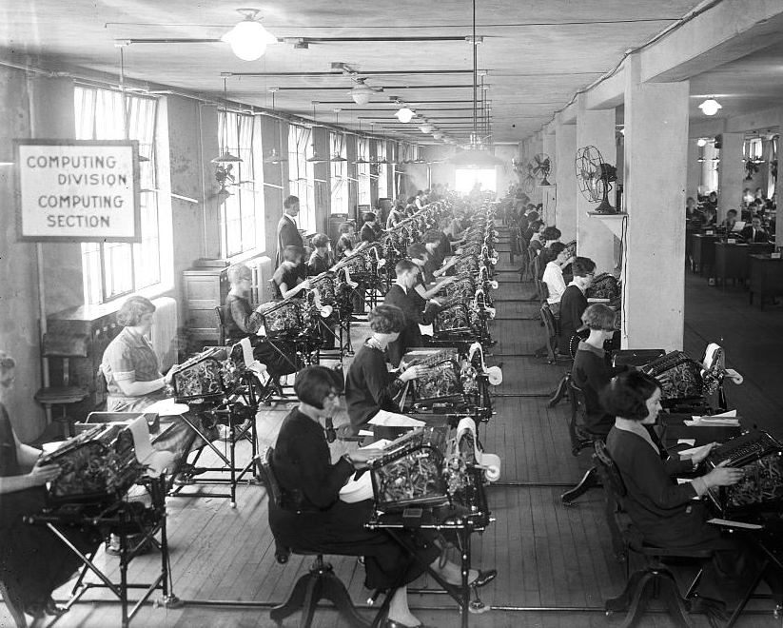
I’m a computer!
Bonus Bureau, Computing Division, 1924, loc.gov/pictures/item/2016838906
Notes:
And they weren’t the first; the term “computer”, meaning “one who computes”, dates back at least to the early 1600s.

Slide 16
Teams of human computers engaged in computational thinking long before the invention of electronic computers.

Slide 17
Early computational thinking can be seen going back to the records of the Babylonians, who wrote down general procedures for solving mathematical problems around starting around 1800 BCE.
Notes:
[slide]
Although these procedures were carried out by people, they have the same basic features as the functions we write:
They take an input and produce the correct output by following a series of precisely defined steps.
In this way, mathematicians made their expertise available to non-experts, who simply had to follow directions, carrying out simple arithmetic operations in the right order.

Slide 18
Long before this class, you learned these kind of computational methods.

Slide 19
27182818284590
+31415926535897
Notes:
Start by thinking about what you do just to add two big numbers by hand!
You follow a procedure that takes the two inputs...

Slide 20
27182818284590
+31415926535897
7
Notes:
And

Slide 21
27182818284590
+31415926535897
87
1
Notes:
step

Slide 22
27182818284590
+31415926535897
487
1
1
Notes:
by

Slide 23
27182818284590
+31415926535897
0487
1
1
1
Notes:
step

Slide 24
27182818284590
+31415926535897
20487
1
1
1
1
Notes:
...

Slide 25
27182818284590
+31415926535897
820487
1
1
1
1

Slide 26
27182818284590
+31415926535897
4820487
1
1
1
1
1

Slide 27
27182818284590
+31415926535897
44820487
1
1
1
1
1

Slide 28
27182818284590
+31415926535897
744820487
1
1
1
1
1
1

Slide 29
27182818284590
+31415926535897
8744820487
1
1
1
1
1
1

Slide 30
27182818284590
+31415926535897
98744820487
1
1
1
1
1
1

Slide 31
27182818284590
+31415926535897
598744820487
1
1
1
1
1
1

Slide 32
27182818284590
+31415926535897
8598744820487
1
1
1
1
1
1

Slide 33
27182818284590
+31415926535897
58598744820487
1
1
1
1
1
1

Slide 34
27182818284590
+31415926535897
58598744820487
1
1
1
1
1
1
Notes:
You carry out the right operations to get the desired output.

Slide 35
Euclid’s algorithm
Around 300 BCE, the Greek mathematician Euclid gave a method to find the greatest common divisor (GCD) of two numbers, which is the largest integer that divides both numbers.
Notes:
An ancient algorithm, still taught to many schoolchildren today is Euclid’s algorithm, used to find the greatest common divisor for two numbers.

Slide 36
Euclid’s algorithm
Euclid noticed that the GCD of two numbers divides their difference.
So, he repeatedly replaced the larger number with their difference until both were the same.
Notes:
[slide]
Which sounds a lot like writing a recursive function!

Slide 37
Euclid’s algorithm
Euclid noticed that the GCD of two numbers divides their difference.
So, he repeatedly replaced the larger number with their difference until both were the same.
gcd(48, 18)
→ gcd(30, 18)
→ gcd(12, 18)
→ gcd(12, 6)
→ gcd( 6, 6)
→ 6
Notes:
This method was used to reduce fractions – and today it’s one of the basic methods underlying cryptography.
What is this? It’s recursion!

Slide 38
Sieve of Eratosthenes
This is another famous method dating back to the ancient Greeks, used to find all the prime numbers up to some limit.

Slide 39
Sieve of Eratosthenes
2 3 4 5 6 7 8 9 10 11 12 13 14 15 16 17 18
We begin with a list of all the integers, from 2 to the limit.

Slide 40
Sieve of Eratosthenes
2 3 4 5 6 7 8 9 10 11 12 13 14 15 16 17 18
We cross out all the multiples of 2.

Slide 41
Sieve of Eratosthenes
2 3 4 5 6 7 8 9 10 11 12 13 14 15 16 17 18
We cross out all the multiples of 2.
Then all the multiples of 3.

Slide 42
Sieve of Eratosthenes
2 3 4 5 6 7 8 9 10 11 12 13 14 15 16 17 18
We cross out all the multiples of 2.
Then all the multiples of 3. And 5.

Slide 43
Sieve of Eratosthenes
2 3 4 5 6 7 8 9 10 11 12 13 14 15 16 17 18
We cross out all the multiples of 2.
Then all the multiples of 3. And 5.
And so on, leaving you with only the primes between 2 and the limit you chose.

Slide 44
Sieve of Eratosthenes
After each round of elimination, a new prime will be revealed, and the next round crosses out all its multiples.
Notes:
[slide] What is this? It’s iteration!

Slide 45
These are computational procedures, carried out by hand!

Slide 46
Programmable computers

Slide 47
No matter how simple and unambiguous the steps are made, human computers make mistakes – and lots of them!
So, inventors through the ages have sought to make computing machines to allow people to perform longer computations with fewer errors.

Slide 48
This was a slow process, taking us from…

Slide 49
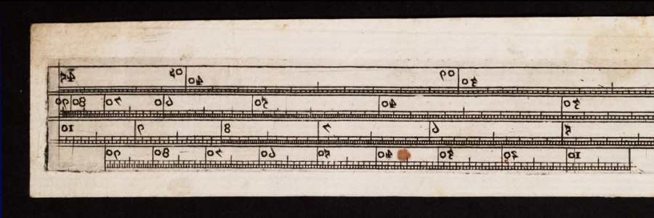
Slide rule
c. 1620

Slide 50
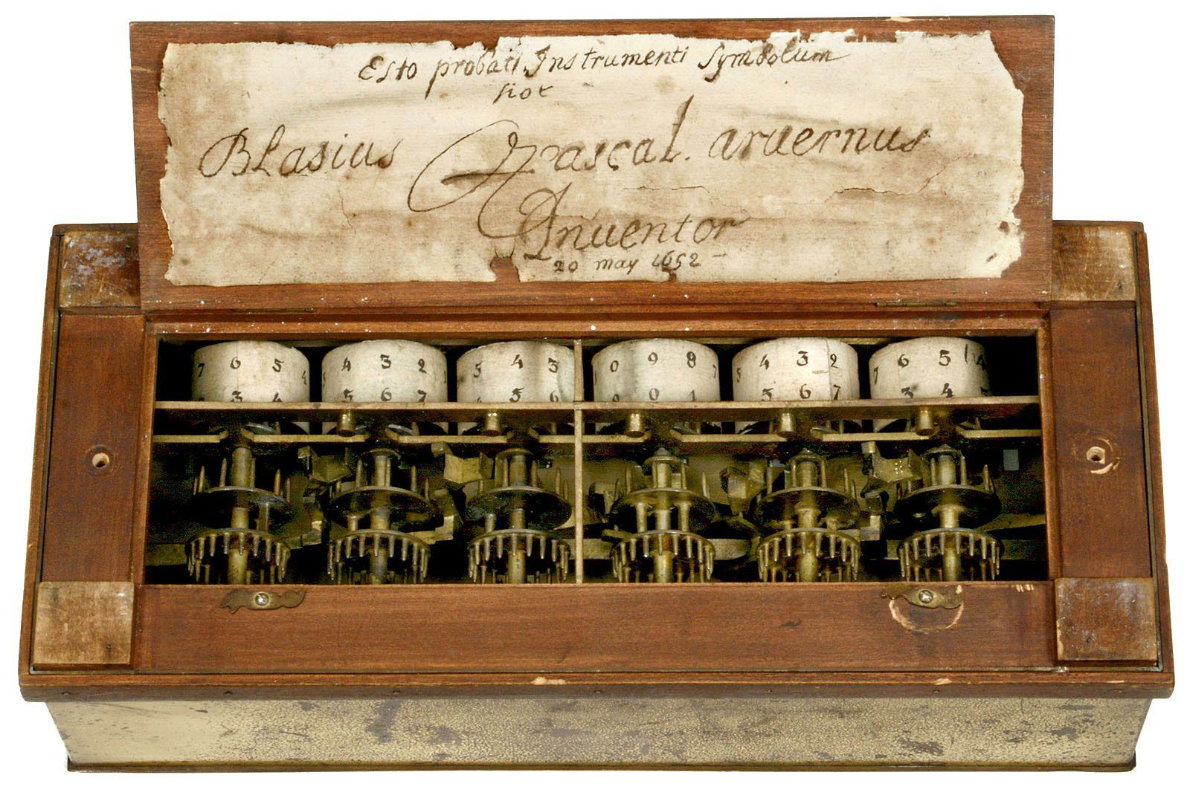
Blaise Pascal’s mechanical calculator
1642
Notes:
[Called the Pascaline or Pascal’s wheel, it could add and subtract but not multiply or divide]

Slide 51
Precursors to the idea of a programmable computer originated well before the electronic computing age.
In the early 1700s, French textile weavers experimented with machines that could weave complex patterns using an automatic loom.

Slide 52
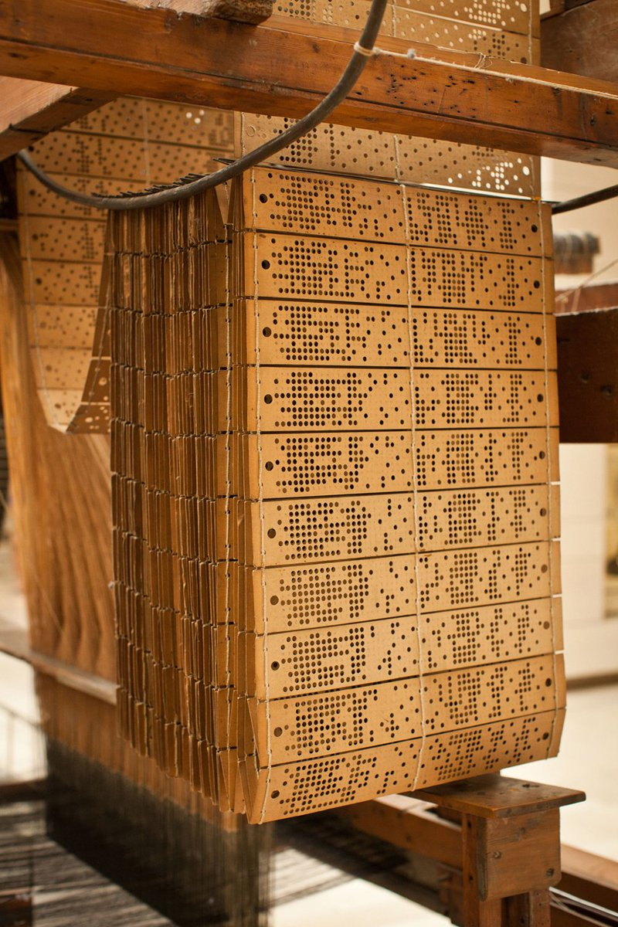
One of the more well known is the Jacquard loom, which was controlled by long chains of punched cards.

Slide 53
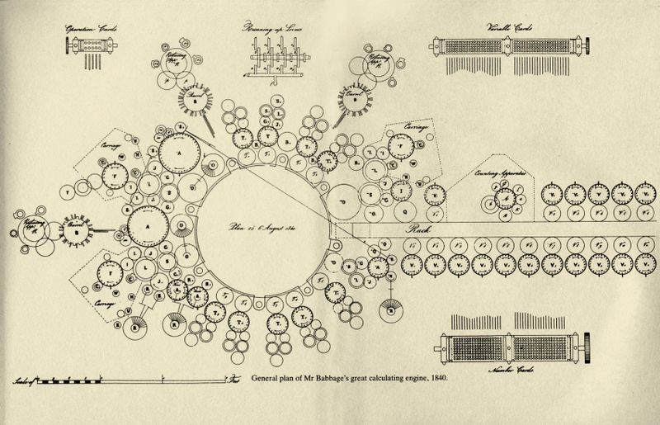
Plan for Babbage’s Analytical Engine
1840
Notes:
Starting around 1837, Charles Babbage conceived of the Analytical Engine, a mechanical computer that would use punched cards, like Jacquard’s loom.
These punched cards would contain a program that would instruct the machine to automatically compute a mathematical function.

Slide 54
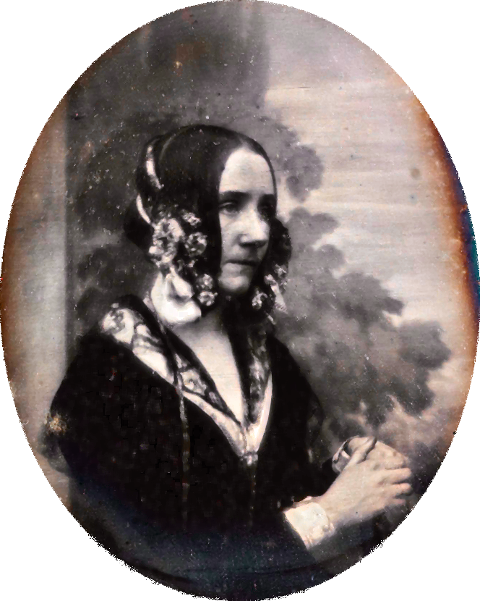
Babbage collaborated with a gifted mathematician, Ada Lovelace, who designed algorithms for the Analytical Engine, even though there was no machine to run them on.
Notes:
[Daughter of Lord Byron.
She assisted Babbage in explaining and promoting his ideas, writing articles describing the operation and use of the analytical engine.
She’s widely considered the first computer programmer, even though she didn’t have a working computer to run her programs on! Remember that when you’re taking your final exam on paper...]

Slide 55
Lovelace saw the Analytical Engine not as a mere calculator but as a processor of any information that could be encoded in symbols.
This insight, that computing programs can calculate not only over numbers but over symbols that can stand for anything in the world, anticipated by a hundred years a key tenet of the modern computer age.
Lovelace saw the computer as an information machine.
Notes:
[slide]
Ironically, some central insights of the computer age come from the age of steam.

Slide 56
While Babbage’s designs for a programmable computer weren’t realized at the time, the age of electronics opened new possibilities.
Notes:
[slide] In the 1930s, there was intense experimentation.

Slide 57
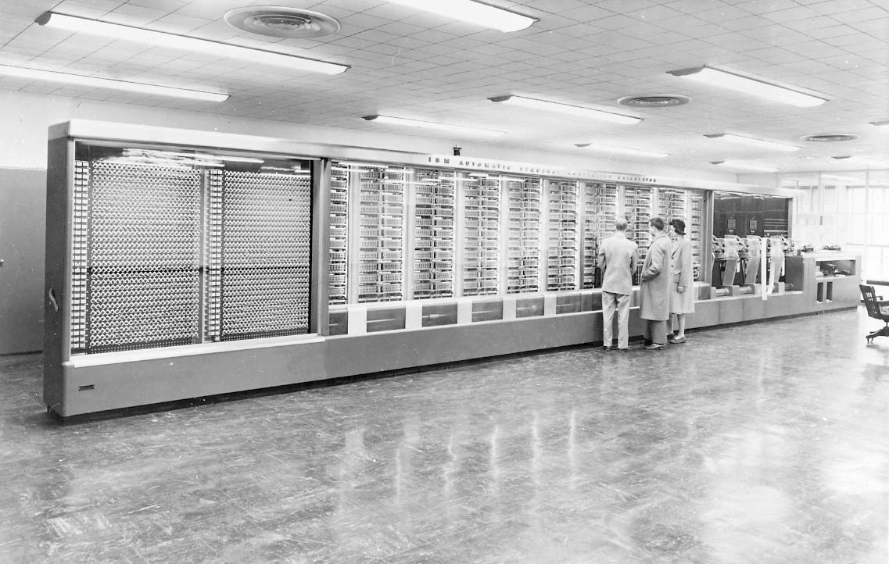
Harvard Mark I
1944
Notes:
Howard Aiken, in partnership with IBM and sponsored by the navy, built the Mark I at Harvard in 1944.
This was an electromechanical – not electronic – computer. It actually had a four-horsepower engine rotating components to make it run.
Its programs and input data were stored externally on punched paper tapes.

Slide 58
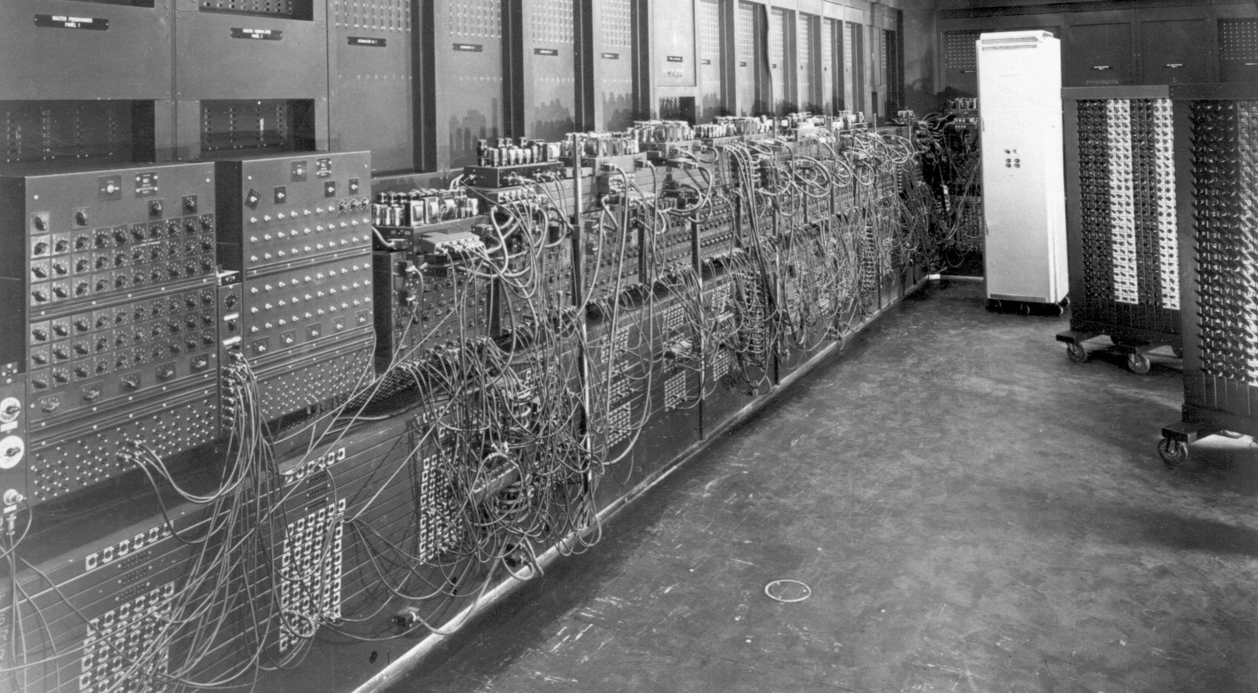
ENIAC
c. 1945
Notes:
ENIAC was the first general-purpose, programmable electronic computer.
Unfortunately, its memory was limited, and it used 18,000 vacuum tubes that gradually wore out. The computer would fail “only” 2-3 times a week!
It took its input from an external wire patch board, which also made programming it quite tedious!

Slide 59
Early computers were very difficult to program, working in languages that were closely tied to the hardware.
Notes:
Even as they became quicker and smaller, [slide]

Slide 60
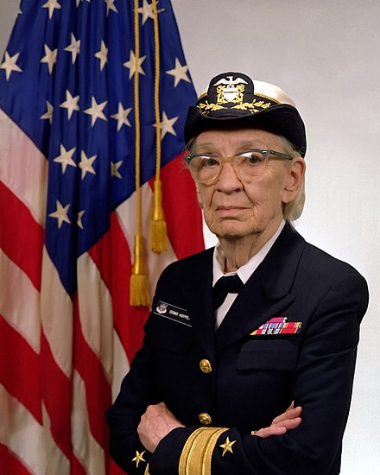
Grace Hopper ’28 popularized the idea of a compiler for machine-independent programming languages and defined FLOW-MATIC, the first English-like data processing language in the early 1950s.
Those ideas were later folded into the popular COBOL language (1959).
Notes:
Hopper had been one of the early programmers of the Harvard Mark I computer.
[COBOL = COmmon Business-Oriented Language]

Slide 61
Since the 1950s, many programming languages have been defined, experienced popularity, and then been supplanted by new designs.

Slide 62
Today, Python is the programming language most often used for work in data science and artificial intelligence.

Slide 63
Programming no longer involves plugging in wires or punching cards, but it’s still hard!

Slide 64
“The programmer, like the poet, works only slightly removed from pure thought-stuff. He builds castles in the air, from air, creating by exertion of the imagination…
Frederick Brooks, The Mythical Man-Month, 1975
Notes:
In 1975, the (recently deceased) Turing Award recipient Fred Brooks wrote:

Slide 65
“Few media of creation are so flexible, so easy to polish and rework, so readily capable of realizing grand conceptual structures. Yet the program construct, unlike the poet’s words, is real in the sense that it moves and works, producing visible outputs separate from the construct itself…
Frederick Brooks, The Mythical Man-Month, 1975

Slide 66
“One types the correct incantation on a keyboard, and a display screen comes to life, showing things that never were nor could be… It prints results, draws pictures, produces sounds, moves arms. The magic of myth and legend has come true in our time…
Frederick Brooks, The Mythical Man-Month, 1975
Notes:
[He’s saying all of this in 1975, way before we had modern video games or Pixar making computer-animated films...]

Slide 67
“The computer resembles the magic of legend in this respect, too. If one character, one pause, of the incantation is not strictly in proper form, the magic doesn’t work. Human beings are not accustomed to being perfect, and few areas of human activity demand it. Adjusting to the requirement for perfection is, I think, the most difficult part of learning to program.”
Frederick Brooks, The Mythical Man-Month, 1975

Slide 68
Computing with data
Notes:
But we haven’t just been writing programs this semester; we’ve been writing programs to work with data.

Slide 69
We’ve seen some cool datasets during this semester – and you got to explore data that was of interest to you for your mini-projects – but there are many, many more datasets you can explore.

Slide 70
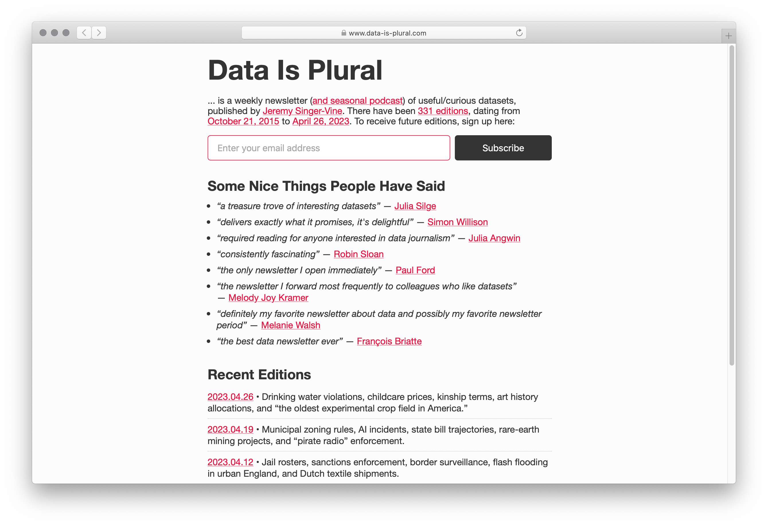
data-is-plural.com
Notes:
A great place to start is the archive of the Data is Plural newsletter.

Slide 71
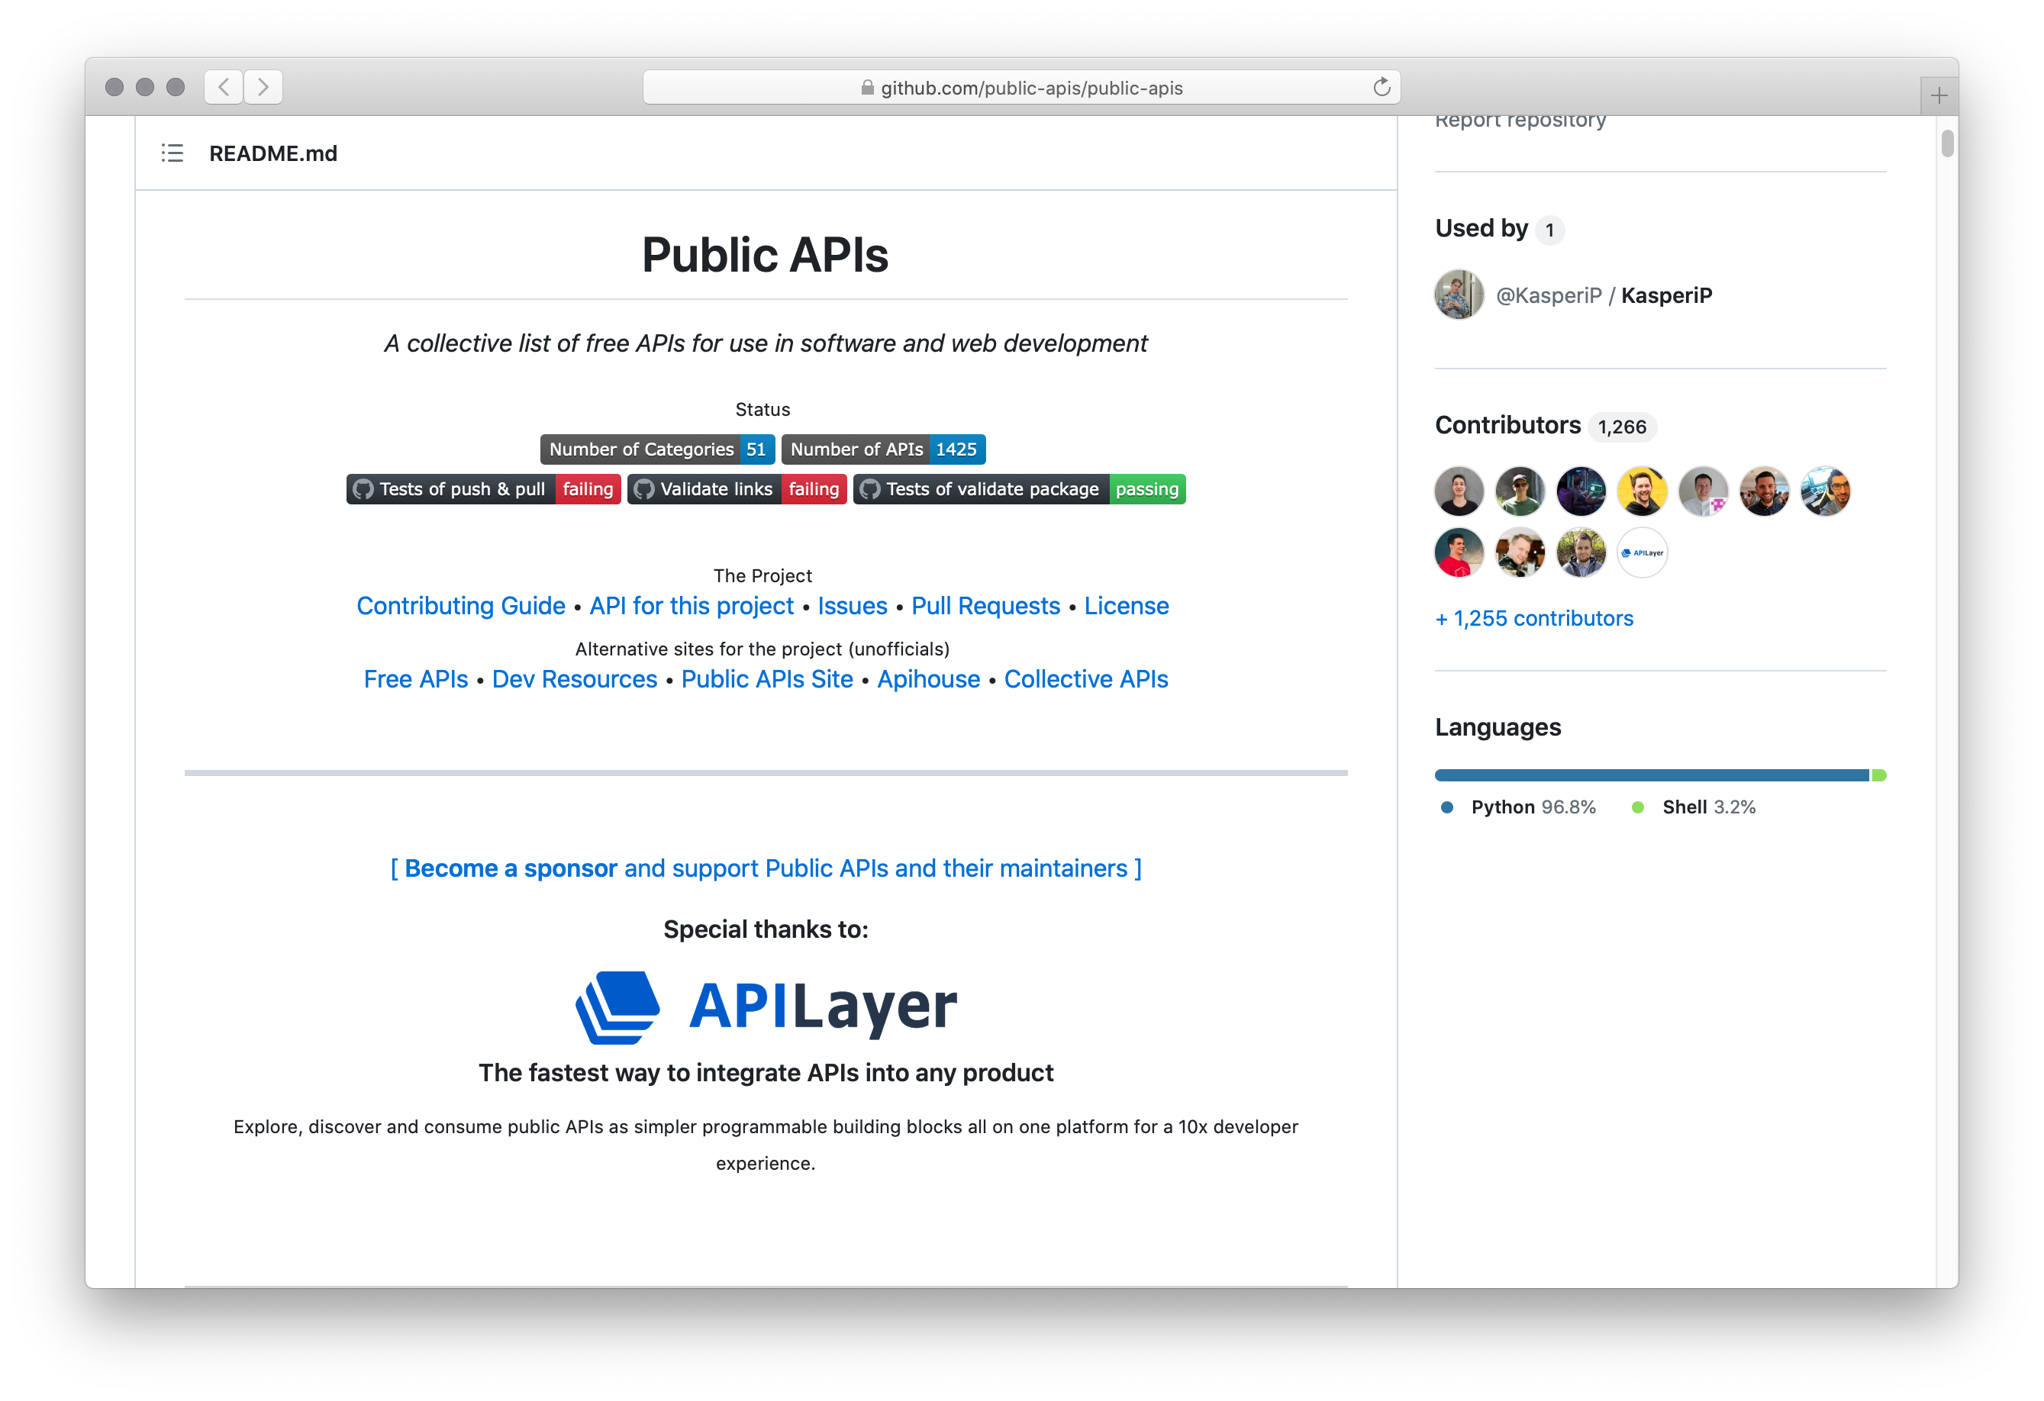
github.com/public-apis/public-apis
Notes:
Or you might want to gather your own data set by sending requests to a Web API, like the public APIs in this list.

Slide 72
Building data models
Notes:
But what goes into building a dataset?
What do we need to think about when we’re looking at a new dataset?

Slide 73
Data is situated in the environment where it was gathered.
Consider Galton’s child-height data.
He gathered the data in England c. 1886.
What would happen if you tried to use it to predict heights in Poughkeepsie today? In Guatemala? In China?
Notes:
[slide]
Additionally, ...

Slide 74
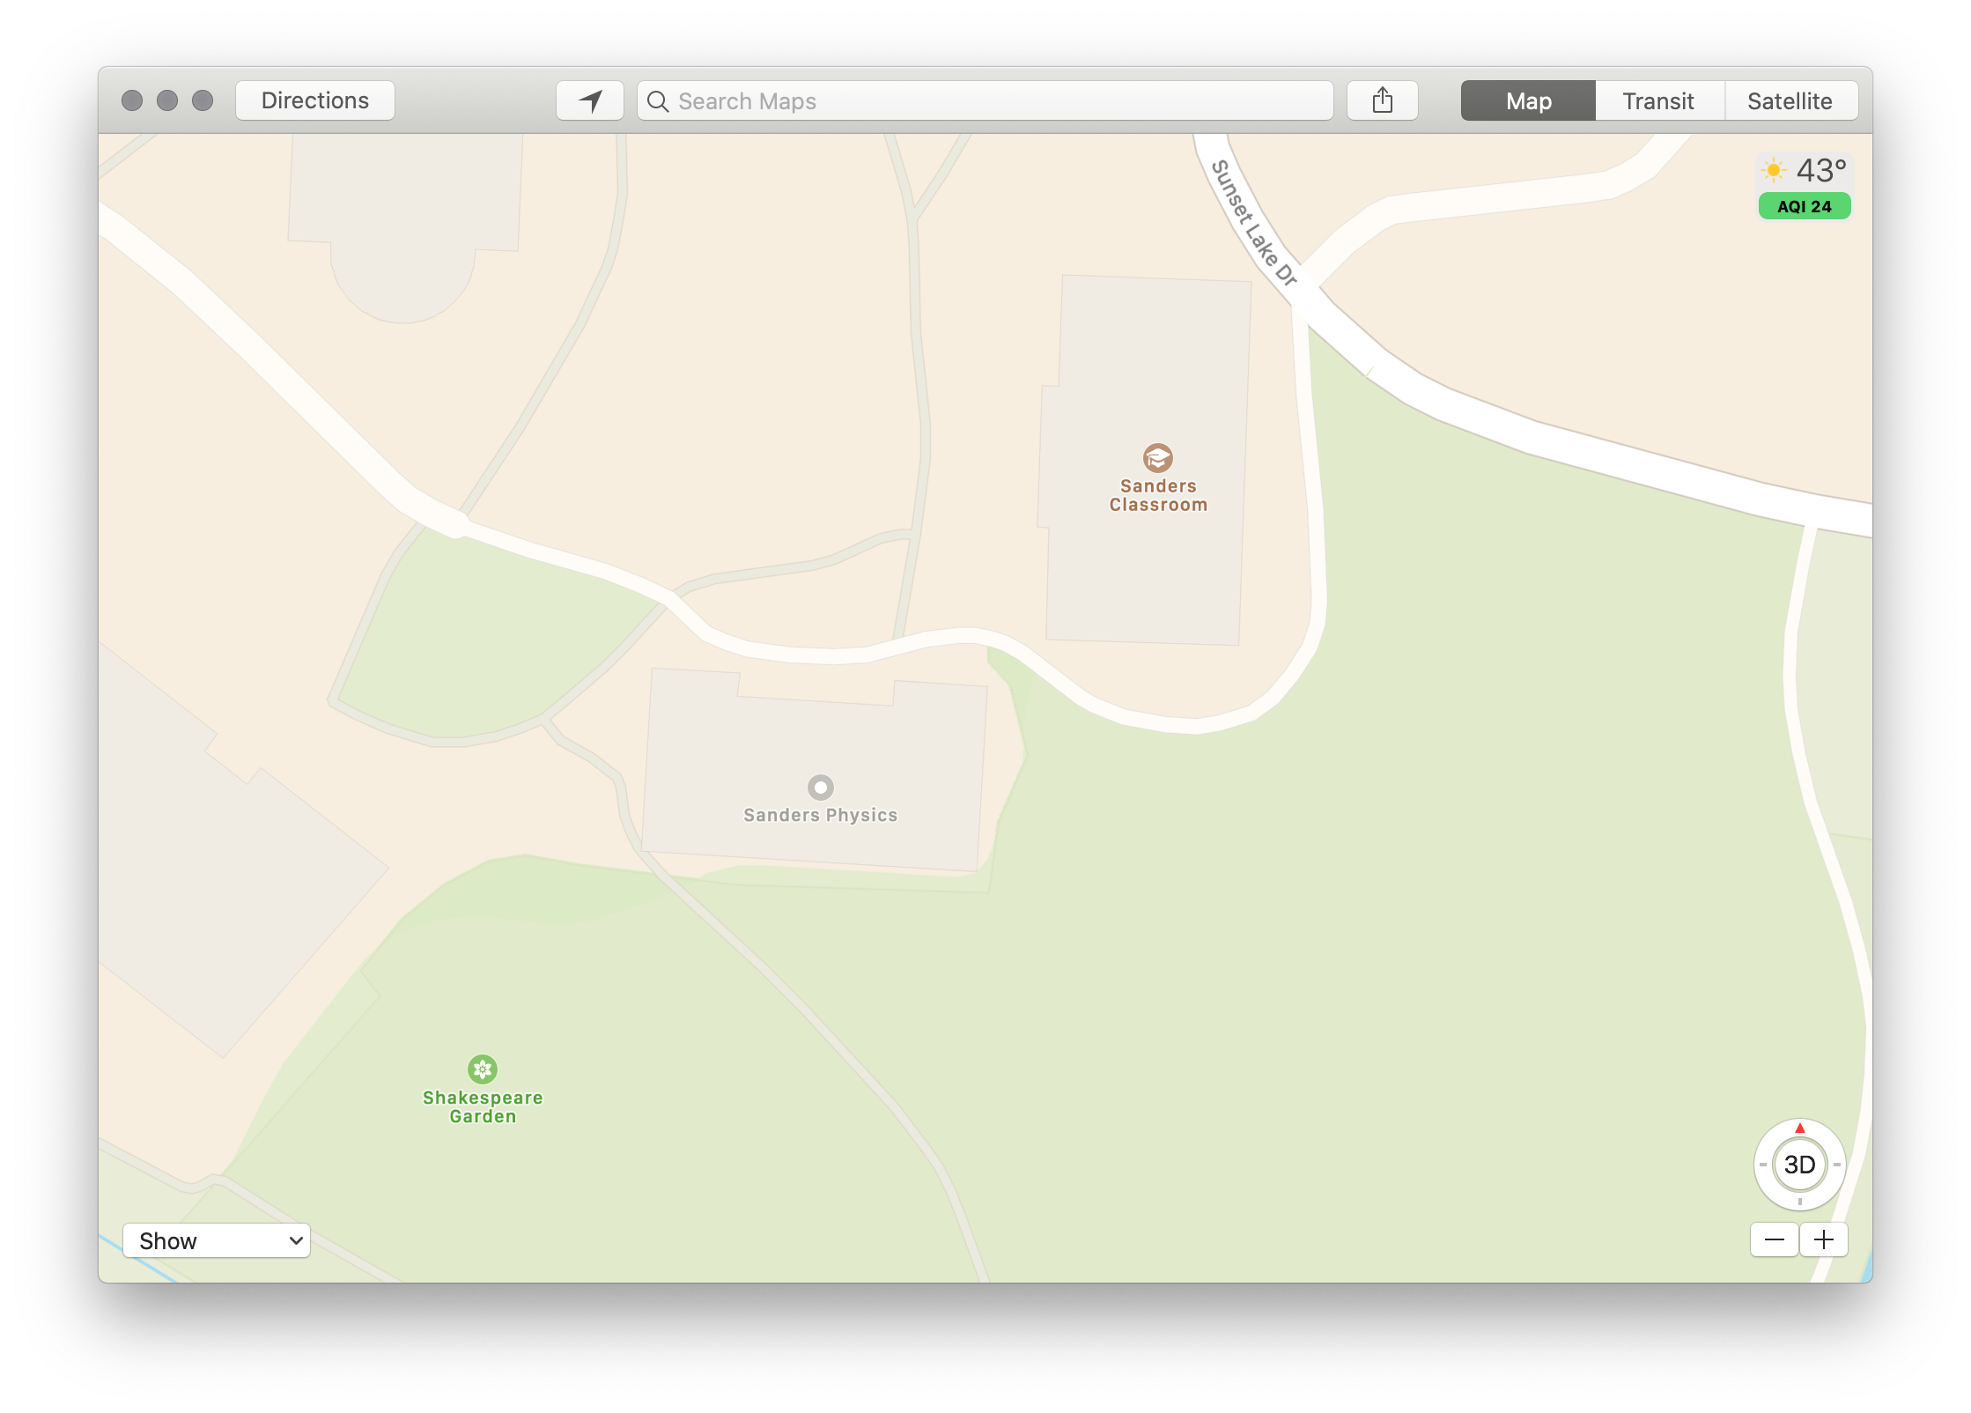
When we collect data, it’s like making a map:
We’re constructing a model, where we choose what to represent, and how to represent it.

Slide 75
“…most of the data and data models we have inherited deal with structures of power, like gender and race, with a crudeness that would never pass muster in a peer-reviewed humanities publication.”
Miriam Posner, “What’s Next: The Radical, Unrealized Potential of Digital Humanities”, 2016

Slide 76
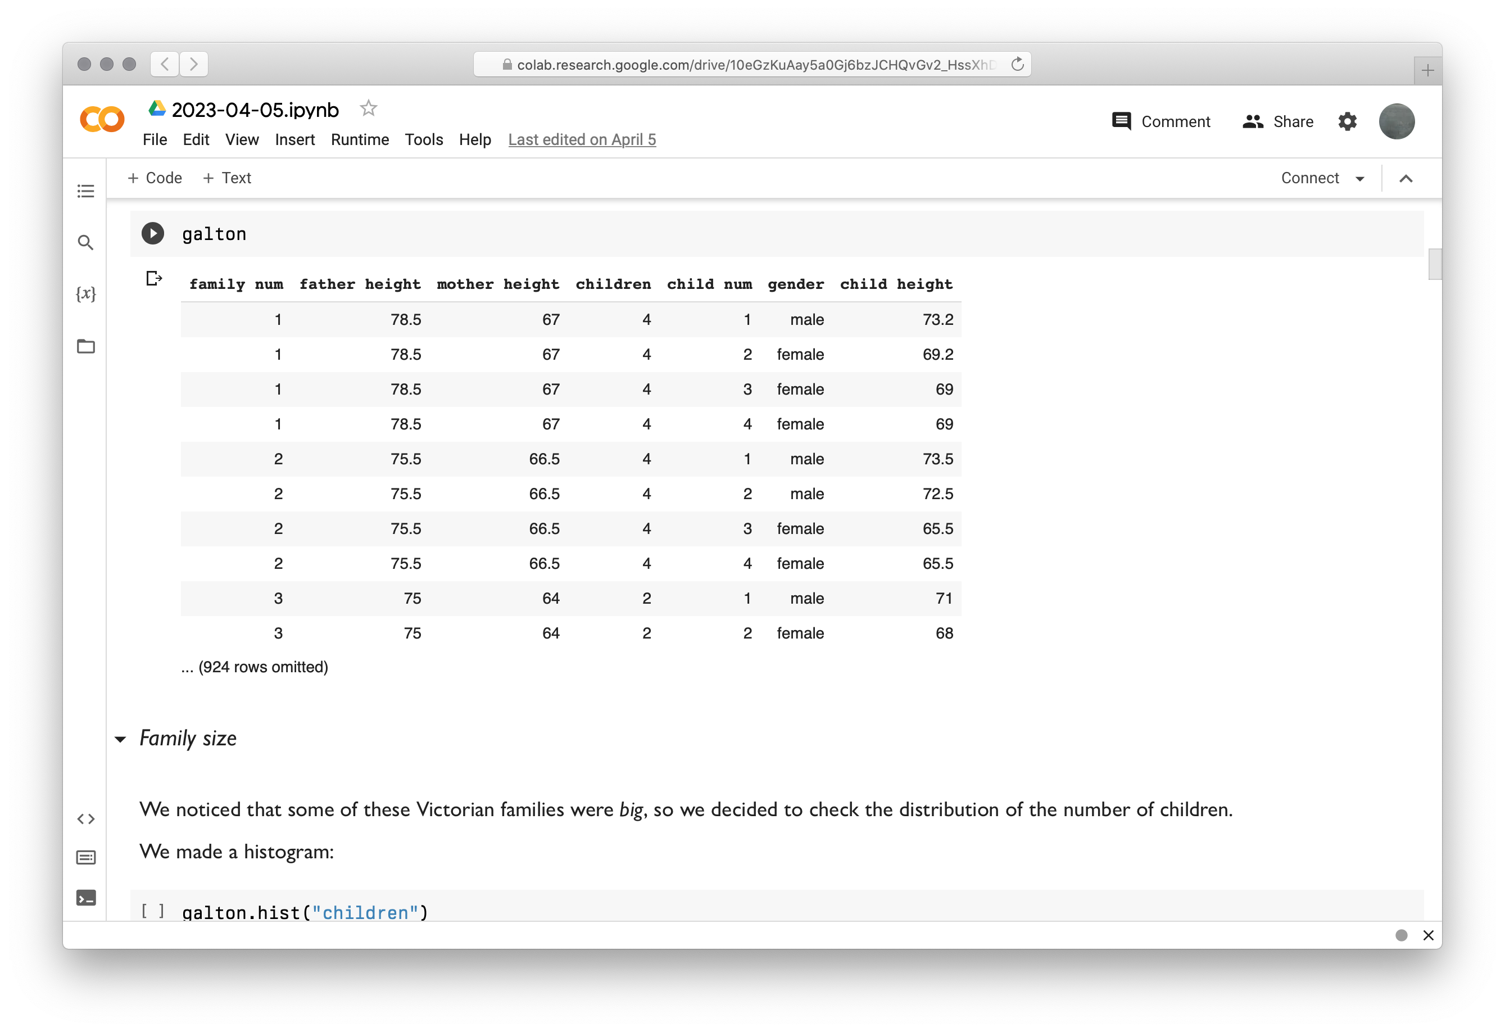
Notes:
Galton’s data represents gender as a binary: male and female.

Slide 77
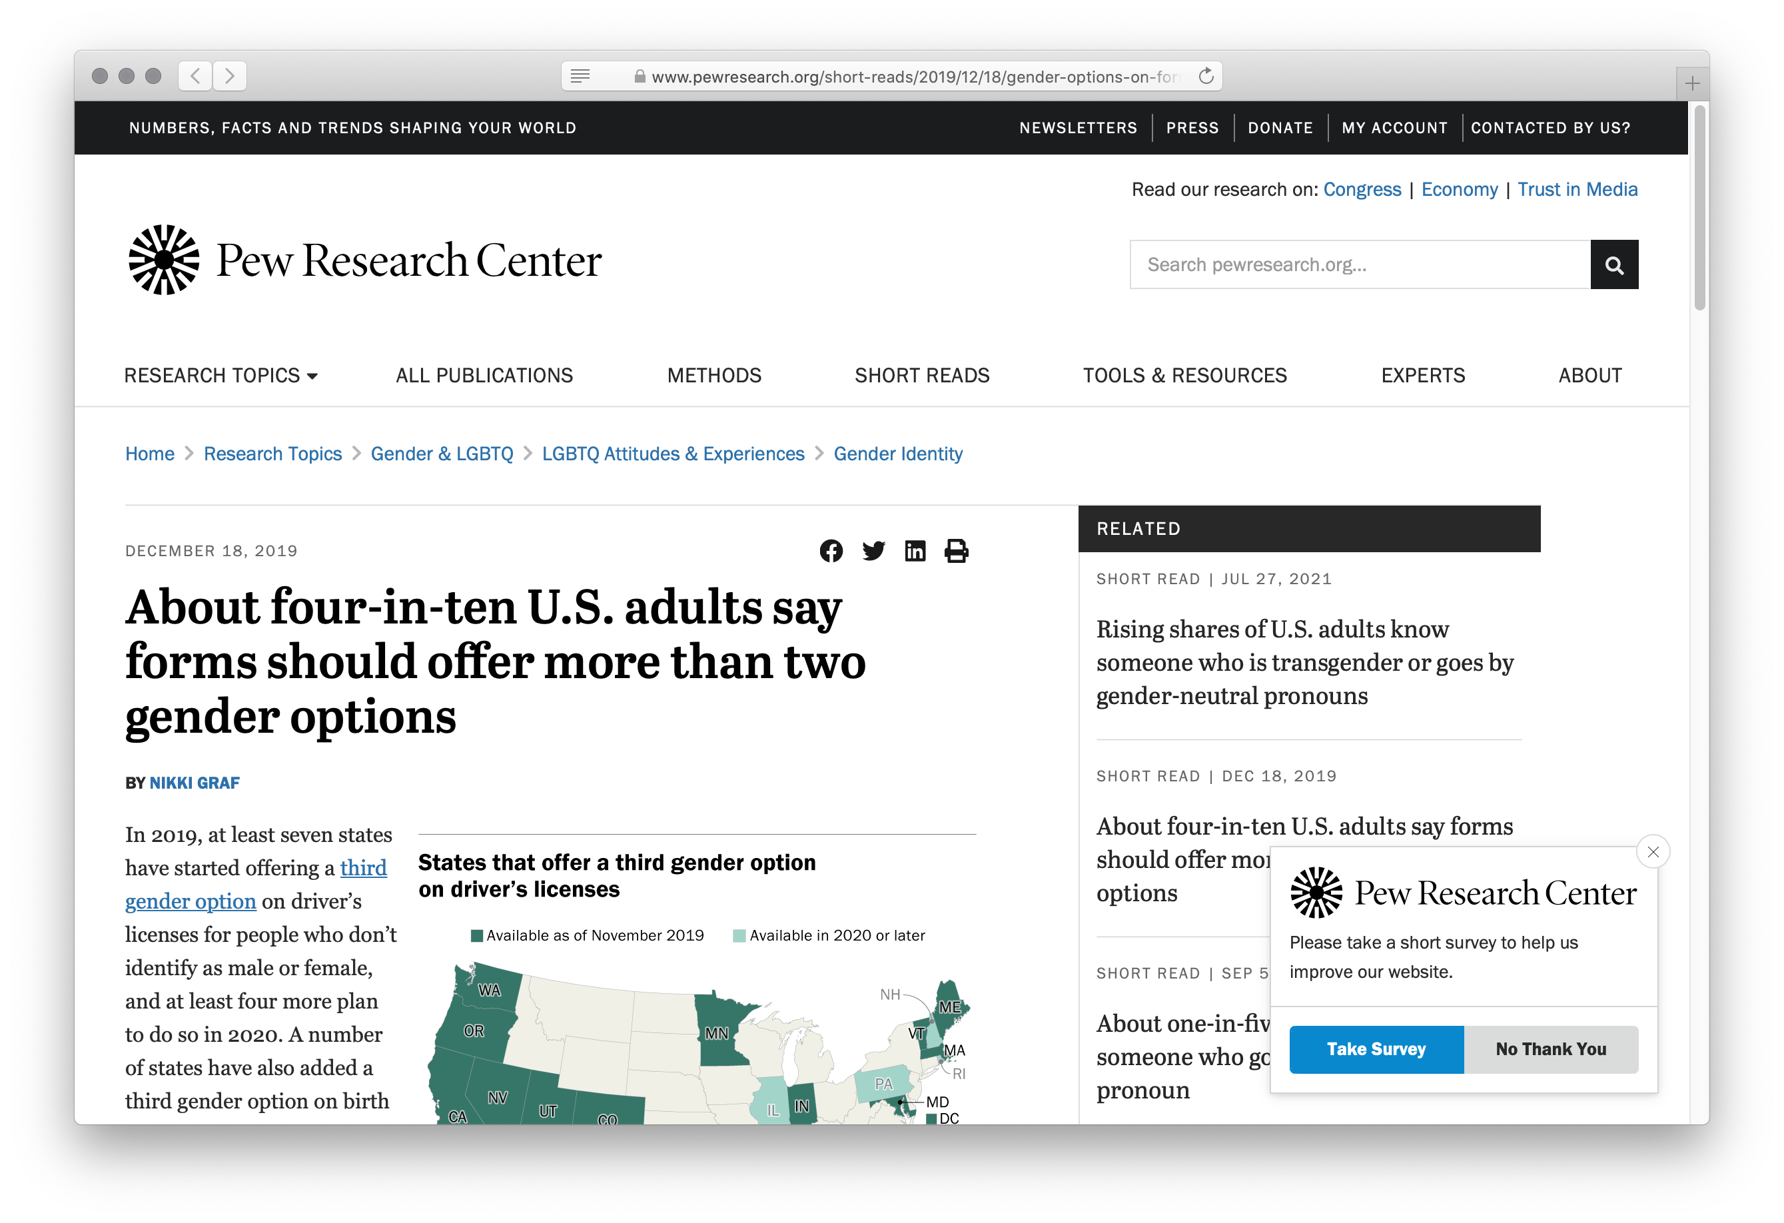
Notes:
While a majority of adults in the US would agree with those being the only options, a significant and growing number disagree!
If we were collecting that information today, that column might look quite different.

Slide 78
“I want us to be more ambitious, to hold ourselves to much higher standards when we are claiming to develop data-based work that depicts people’s lives.”
Miriam Posner, “What’s Next: The Radical, Unrealized Potential of Digital Humanities”, 2016

Slide 79
Data and privacy
Notes:
We need to hold ourselves accountable, not just for how we represent data, but for what data we gather and what predictions we choose to make with it.

Slide 80
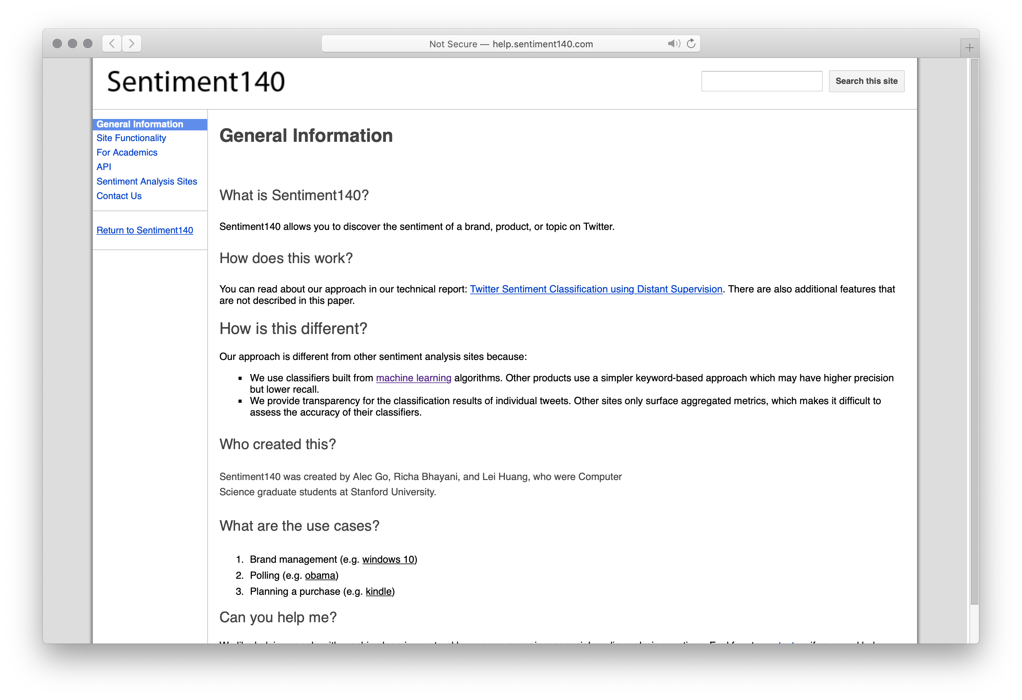
sentiment140.com
Notes:
Sentiment140 is a data set used for learning to predict sentiment, that is, emotional responses, from social media like Twitter.
You can download it for free as CSV files.

Slide 81
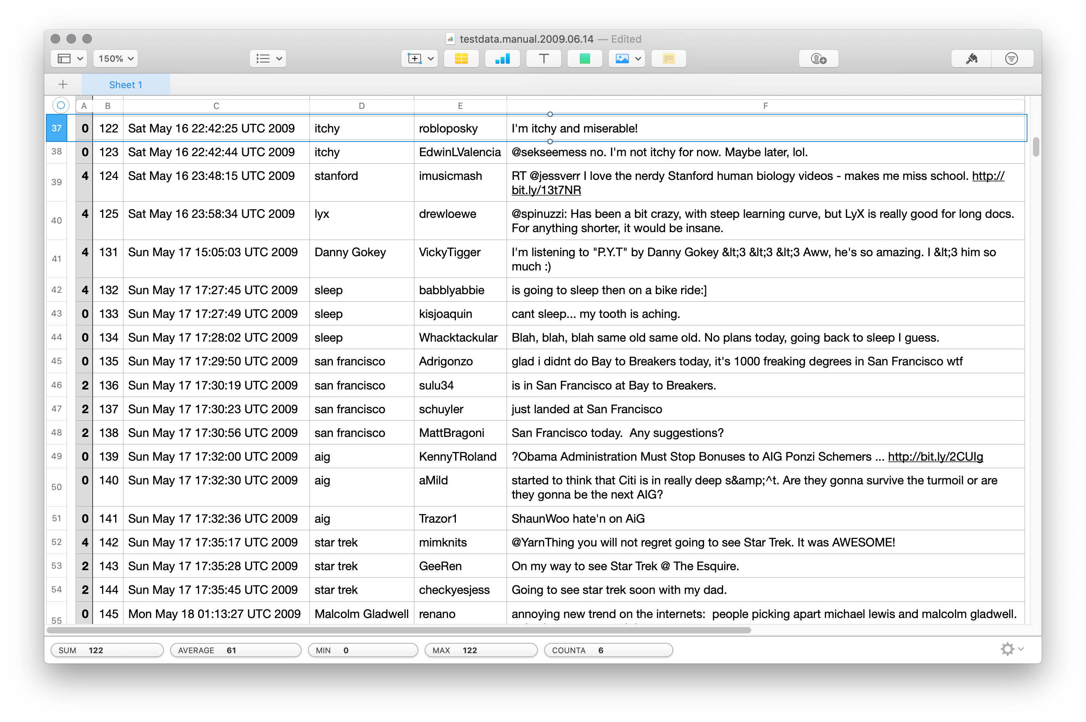
Notes:
When “robloposky” make a public tweet in 2009 that they were itchy and miserable, did they really mean for that data to be preserved forever?
For it to be used for machine learning?
For it to be discussed right here, right now?

Slide 82
“The words and phrases we search for on Google, the times of day we are most active on Facebook, and the number of items we add to our Amazon carts are all tracked and stored as data – data that are then converted into corporate financial gain.”
D’Ignazio & Klein, Data Feminism, 2020

Slide 83
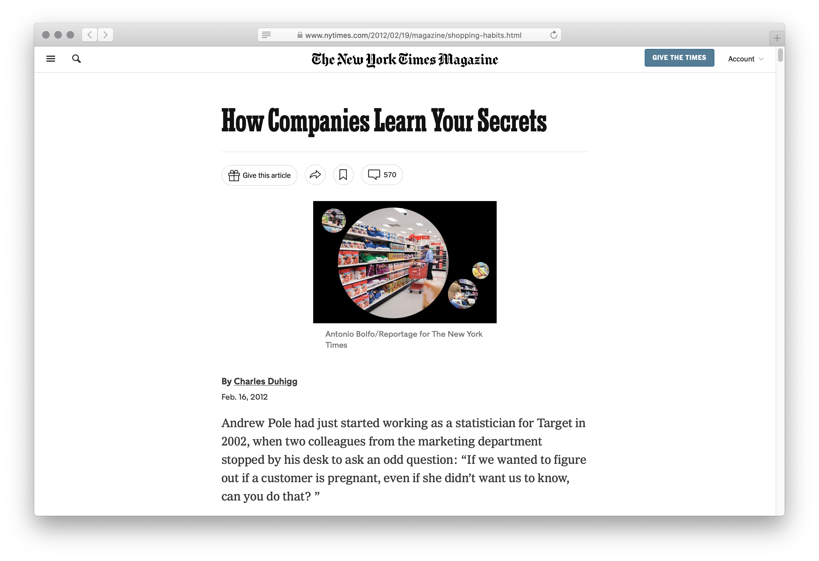
Notes:
Target wants all of your shopping, but people have ingrained habits: Groceries at the grocery store, hardware at the hardware store, etc.
Target wants to know the moment your life is in flux because that’s when your shopping habits are likely to change.
It’s easy to find out if someone moved, but what about other life events, like having a baby?
It’s actually easy for them to find out when you have a baby because birth records are usually public.
But they want to know sooner so they get to you before other stores.
Target wants to know if you’re pregnant.
And they’re good at it. This article recounts a father demanding to see the manager because his high-school daughter was receiving target coupons for baby clothes and cribs.
Guess what Target knew that her father didn’t?

Slide 84
“As Pole’s computers crawled through the data, he was able to identify about 25 products that, when analyzed together, allowed him to assign each shopper a ‘pregnancy prediction’ score. More important, he could also estimate her due date to within a small window, so Target could send coupons timed to very specific stages of her pregnancy.
“One Target employee I spoke to provided a hypothetical example. Take a fictional Target shopper named Jenny Ward, who is 23, lives in Atlanta and in March bought cocoa-butter lotion, a purse large enough to double as a diaper bag, zinc and magnesium supplements and a bright blue rug. There’s, say, an 87 percent chance that she’s pregnant and that her delivery date is sometime in late August.”
Kashmir Hill, “How Target Figured Out a Teen Girl was Pregnant Before Her Father Did”, Forbes, 2012

Slide 85
Computing with data is complex, and it’s not just “technical” issues we need to concern ourselves with!
Notes:
All this is to say: [slide]

Slide 86
Computing with data gives us a lot of power!
We can do a lot of harm, but we can also do a lot of good!

Slide 87
Computer Science I
—or, where do you go from here?

Slide 88
Data types
Naming values
Evaluation
Conditionals (if and cases)
Function signatures
Testing functions
Tabular data
Higher-order functions
Lambda expressions
Linked lists
Defining structured data
Structurally recursive data and functions
Trees (binary, n-ary)
Reactive programs
List and string slicing
List comprehensions
Numpy arrays
Sanitizing real-world data
Visualization
Dataclasses
Side effects and mutation
Functional vs imperative languages
Iteration (for)
Accumulators
Debugging using print statements
Memory and aliasing
Dictionaries (hash tables)
Web APIs and JSON
Notes:
We’ve covered a lot of topics in just one class.

Slide 89
Congratulations on making it this far!
Notes:
[slide] But there’s a lot more to see!

Slide 90
CS courses at Vassar

Slide 91
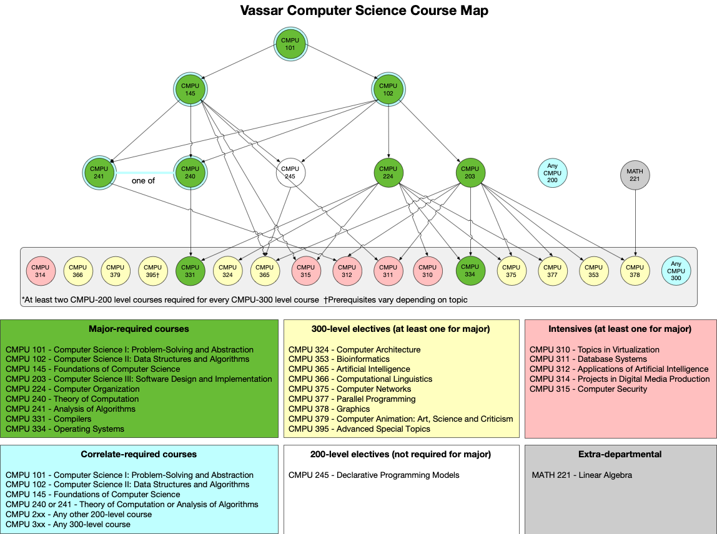

Slide 92
CMPU 102
Data Structures and Algorithms
Notes:
In Computer Science 102, you explore a paradigm called object-oriented programming, using another language, called Java.
You’ll learn more about different kinds of data structures and about writing efficient programs.

Slide 93
CMPU 145
Foundations of Computer Science
Notes:
Computer Science 145 is the first step into the world of theoretical computer science, the more math-y side of things where we look at the ideas that make computation possible.
You’ll learn about set theory, logic, probability and more and get practice both writing proofs and implementing the ideas by programming.

Slide 94
Notes:
And from those three courses, the whole major starts to open up.

Slide 95
Try them out!
If you keep going with the CS major sequence, you work your way up to some really exciting courses, including…
CMPU 240 Theory of Computation
CMPU 366 Computational Linguistics
And, you know, probably some cool courses I don’t teach as well!
Notes:
Even if you never thought computer science was for you, if you enjoyed 101, I recommend trying another CS course.
[slide]

Slide 96
Further reading
Notes:
Summer break is coming up, and I know you're all dying for a good book to read on the beach.

Slide 97
Notes:
Recommended, very readable guide to the big ideas of CS – from a low-level understanding of how computers work up.
I agree with the cover quote: It’s the best book on computers I’ve ever read.

Slide 98
Notes:
This is my favorite, incredibly clear and readable guide to artificial intelligence.
If you’re wondering about the big ideas of AI or whether it’s an area you’d like to go into, this is a great book to read.

Slide 99
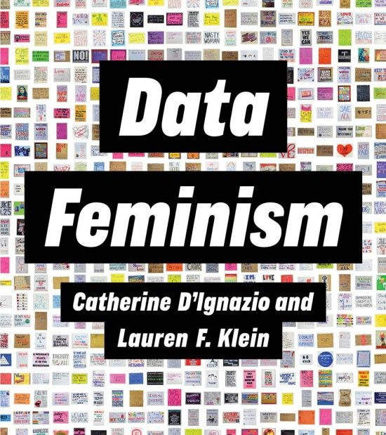
data-feminism.mitpress.mit.edu
Notes:
If you want to know more about how the data we gather and the ways we use it can be harmful and how it can combat harms, from an intersectional feminist perspective, this is a great book -- and it’s available for free online!

Slide 100
That’s it!

Slide 101
We’ll meet some time during study week to review for Exam 2, working through practice problems and answering your questions.

Slide 102
go.vassar.edu/course/evals
Notes:
I'm leaving the rest of the class time for you to fill out the end of class survey.
As a reminder, it has two parts:
The numeric sheets are used by the college for important decisions about people's careers. You should fill these out honestly but fairly. Remember that asking whether a course met its objectives or was taught effectively is very different than asking whether you enjoyed every lecture and assignment.
The other part of the survey is the written feedback. I am the only one who reeds this. You can give me your thoughts about anything to do with the course, but the most useful thing is to imagine a friend is taking this course next semester. What would you want to be the same for them? What would you want to be different?

Slide 103
Acknowledgments
This lecture incorporates material from:
Frederick P. Brooks, Jr, The Mythical Man-Month
Peter J. Denning & Matti Tedre, Computational Thinking
Miram Posner, UCLA
Marc Smith, Vassar College

