Slide 1
CMPU-102-51 Spring 2020
Data Structures and Algorithms
Lab #0: Introduction to
Object-Oriented Programming and Java
Rui Meireles
Peter Lemieszewski

Slide 2
Introduction to Object-Oriented Programming
(Eck 1.1, 1.5)

Slide 3
Object-Oriented Programming (OOP)
Programs as models of the real world
  Send messages between objects to simulate the temporal evolution of a set of real world phenomena
Objects are the model building blocks (i.e. Lego pieces)
  Combine data/state and behavior, are composed of:
    Fields: object-specific data
    Methods: procedures that act upon the fields
3 main pillars:
  Encapsulation: state and behavior bottled inside objects
  Inheritance: specialized types share general type's state and behavior
  Polymorphism: a method may be implemented differently by different subclasses (or the same class)

Slide 4
OOP Pillars 1/3
3 main pillars:
  Encapsulation: state and behavior bottled inside objects
  Inheritance: specialized types share general type's state and behavior
  Polymorphism: a method may be implemented differently by different subclasses (or the same class)
data and possible actions on that data within a class definition
  An abstraction of a real world “thing”
  A kind of blueprint that contains the specifications for a class
    No data exists outside/beyond what is in the blueprint
    No access to data beyond what actions are allowed in the blueprint
    … all within the confines of that class
Notes:
The only means by which you can access data in a class is via these actions (methods/functions/

Slide 5
OOP Pillars 2/3
3 main pillars:
  Encapsulation: state and behavior bottled inside objects
  Inheritance: specialized classes share general class's state and behavior
  Polymorphism: a method may be implemented differently by different subclasses (or the same class)
A hierarchy of classifications
  Also known as class derivation
  Similar concept to taxonomy ranks in biology
  Define a general class, dog
    A specialized class could be pug
    Dogs and pugs share generalized state and behavior
    But pugs (for example) have that a short, curly tail and the cutest short-muzzled face
Notes:
Consider a Light Switch

Slide 6
OOP Pillars 3/3
3 main pillars:
  Encapsulation: state and behavior bottled inside objects
  Inheritance: specialized classes share general class's state and behavior
  Polymorphism: a method may be implemented differently by different subclasses (or the same class)
The same method name can be implemented differently by different subclasses
  Also known as virtual functions
The same name can be used to define different actions based on different data
  aka function overloading, depends on different kinds of input data
Notes:
Consider a Light Switch

Slide 7
Class diagrams
UML (Unified Modeling Language) class diagrams give us a simple notation to document/communicate our designs
Class
Fields
Methods
Inheritance
relationship

Slide 8
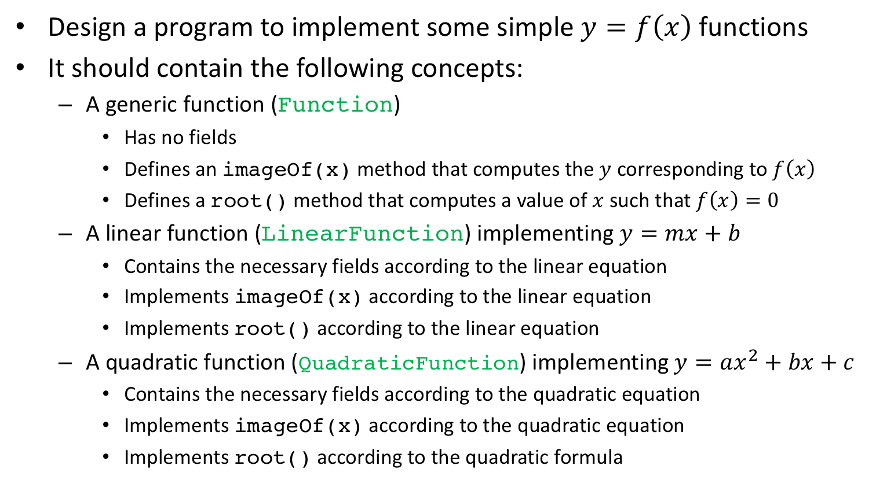
Exercise: OOP modeling (1/2)
Design a program to implement some simple $y=f\left(x\right)$ functions
It should contain the following concepts:
  A generic function (Function)
    Has no fields
    Defines an imageOf(x) method that computes the $y$ corresponding to $f\left(x\right)$
    Defines a root() method that computes a value of $x$ such that $f\left(x\right)=0$
  A linear function (LinearFunction) implementing $y=mx+b$
    Contains the necessary fields according to the linear equation
    Implements imageOf(x) according to the linear equation
    Implements root() according to the linear equation
  A quadratic function (QuadraticFunction) implementing $y=ax^{2}+bx+c$
    Contains the necessary fields according to the quadratic equation
    Implements imageOf(x) according to the quadratic equation
    Implements root() according to the quadratic formula

Slide 9
Exercise: OOP modeling (2/2)
You are to:
  Draw a class diagram for the problem here described.
  Identify the use of each the 3 OOP pillars in your design.
  If we were to add a new type of function, say an exponential, would your design need to be scrapped? How would you proceed?

Slide 10
Exercise: OOP modeling (solution)

Slide 11
Introduction to Java
(IPUJ 2.1-2.3)

Slide 12
The Java programming language
Released in 1995 by Sun Microsystems
  Named after Java coffee
Used in everything from web servers to mobile apps
  Notable example: Android OS apps
Why Java?
  Clean OOP implementation
  Ease of use:
    Clear, consistent syntax
    Great built-in libraries
    Great documentation
    Platform-independent
  It became popular as the nascent internet itself became popular
  Popularity: #1 in TIOBE index January 2019
    For you, it means lots of resources available!

Slide 13
A Java "Hello world"
  /*
  * this is a multiline comment
  */
  // this is a single line comment
  class HelloWorld{ // class definition
  public static void main(String[] args){ // exec. starts here
  System.out.println("Hello world!"); // call print
  }
  }
All Java code is written in the context of a class
  Strongly encourages object-oriented design
Execution begins at a special method called main
Please don't worry about the details at this point!

Slide 14
Running Java programs (1/2)
Java needs to be translated into machine code before it's executed
Traditionally, there are 2 possible strategies:
  Compilation: translation performed prior to execution
    Good: fast execution; bad: resulting program can only be executed in one type of computer
  Interpretation: translation performed on-the-fly as program runs
    Good: any computer for which there is an interpreter can run the program; bad: slow
Java wanted both speed and platform independence so its designers opted for a hybrid approach:
  They designed a custom Java ISA that is lower level than Java, but higher level than typical machine code
    Java machine code is also known as Java byte code
    Java source code is compiled into Java byte code before it is executed
  Then, an interpreter translates Java byte code into machine code on-the-fly
    Interpreter is known as a Java Virtual Machine
Notes:
Curiosity: there are some actual physical processors capable of running Java natively. Check https://en.wikipedia.org/wiki/Java_processor if curious.

Slide 15
Running Java programs (2/2)
Java programs: compile once; run in "any" machine!
Let's now try our hello world:
  Create a HelloWorld.java file with the contents of slide 10
  Compile the file by running javac HelloWorld.java on the shell
  A HelloWorld.class file has been created, containing the byte code
  Inspect the byte code by running javap -verbose HelloWorld.class
  Finally, run the program with "java HelloWorld". The java command will execute the main method of the specified class.
  Don't forget that you can always compile and run Java programs from the shell!

Slide 16
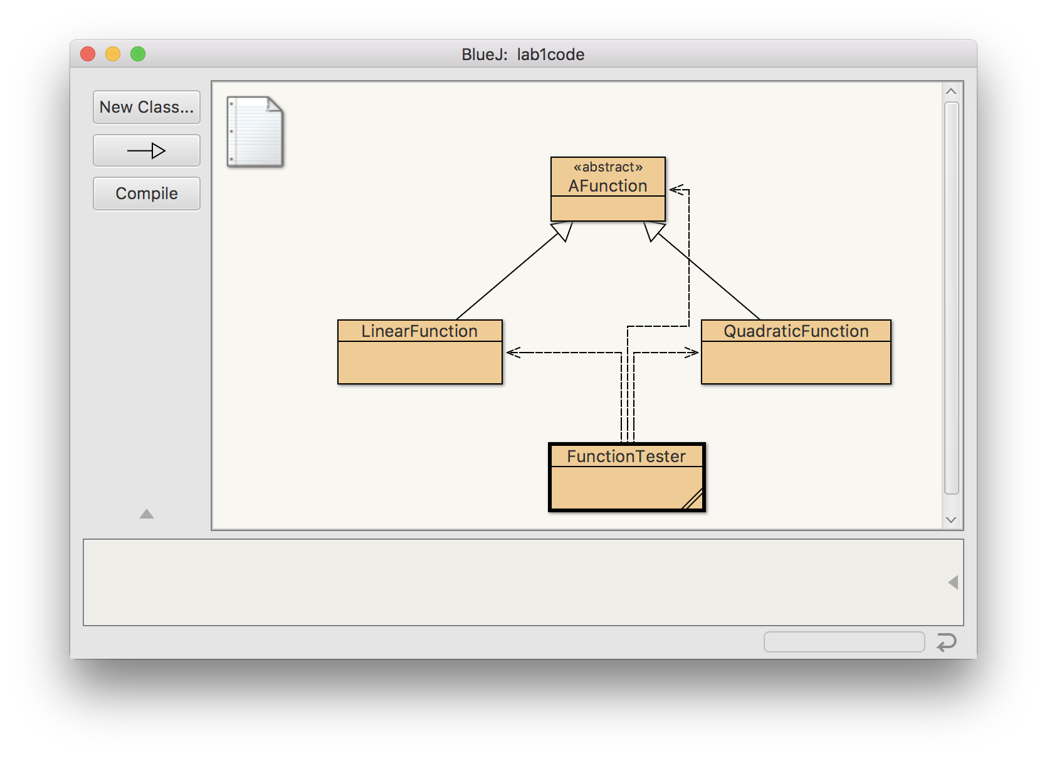
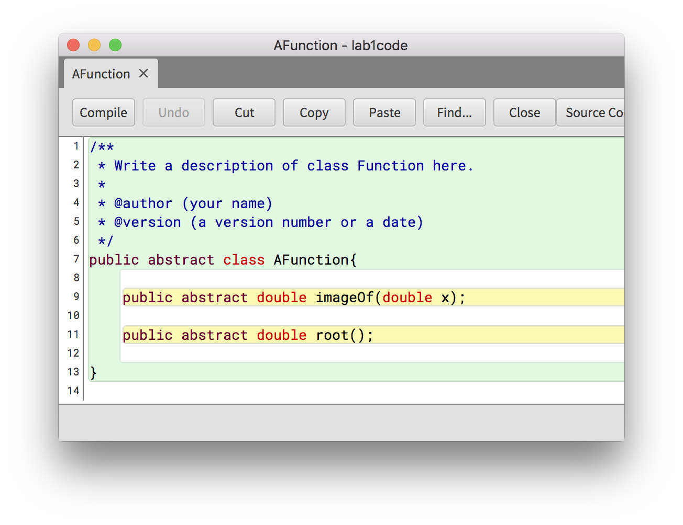
The BlueJ IDE
An Integrated Development Environment (IDE) is a program designed to make software development easy and fun
BlueJ is a minimalistic Java IDE designed for education
  Features automated class diagrams, syntax highlighting, and a debugger
  Written in Java, runs on all common computer systems

Slide 17
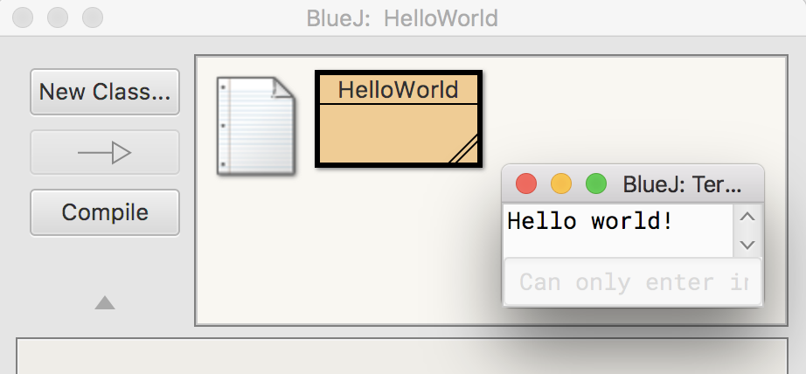
The BlueJ IDE: exercise
Instructions:
  Launch BlueJ
  Create a new project
  Create a new class called HelloWorld
  Click on the new class's icon to open up the text editor
  Replace the class's stub code with the code we had before
  Press the compile button (or use the keyboard shortcut Ctrl-K)
  Right click on the class's icon and choose void main(String[] args)
  Press OK in the dialog that pops ups (it is used to pass arguments to the program, but ours doesn't have any)

