Slide 1
CMPU-102-01 Spring 2020 Data Structures and Algorithms
Lecture #7: Java variable scope continued; type casting; final variables
Rui Meireles
Peter Lemieszewski

Slide 2
Java variable scope

Slide 3
Variable scope
The scope of a variable is the portion of code from which it can be accessed
Determines name collision domain
Java has two main types of variables:
Class-level variables
Instance fields (pertain to specific object)
Class static fields
Method-local variables (includes method parameters)

Slide 4
Scope of instance and class static fields
Accessible from anywhere in the class where they are declared
this used to disambiguate from method-local variables of same name
E.g. this.variable = variable;, often used in constructors
Optional access modifier can modify scope
E.g.:
private int ssn; // accessible within class
public String name; // accessible everywhere
Modifier/Accessible from | Class | Package | Subclass | World
public | ✓ | ✓ | ✓ | ✓
protected | ✓ | ✓ | ✓ | ✗
no modifier (package priv) | ✓ | ✓ | ✗ | ✗
private | ✓ | ✗ | ✗ | ✗

Slide 5
Method-local variables
Accessible within the code block , {i.e. curly brackets}, where they are declared
Block of code can be:
Method body (e.g. for parameters)
If-block, else-block, switch-case, loop-block, etc
Generally a piece of code surrounded by brackets
Can be nested
Method-local variables
Always need to be initialized before use (no default value)
Cannot be static
No homonymous variables can be in scope simultaneously
Examples:
void method(int arg){
int arg = 0; // wait, what??!?
}
int i = 0; // yuck!
for(int i=0; i<10; i++){…}
for(int i=0; i<10; i++…){…}
int i = 0; // ok!
int i; // also ok
for(i=0; i<10; i++){…}

Slide 6
In-class exercise: what is the output?
public class Test{ static int x = 11; private int y = 33; public void method1(int x){ Test t = new Test(); this.x = x; y = 44; System.out.println("Test.x = " + Test.x); System.out.println("t.x = " + t.x); System.out.println("t.y = " + t.y); System.out.println("y = " + y); } public static void main(String args[]){ Test t = new Test(); // implicit empty construtor t.method1(5); } }

Slide 7
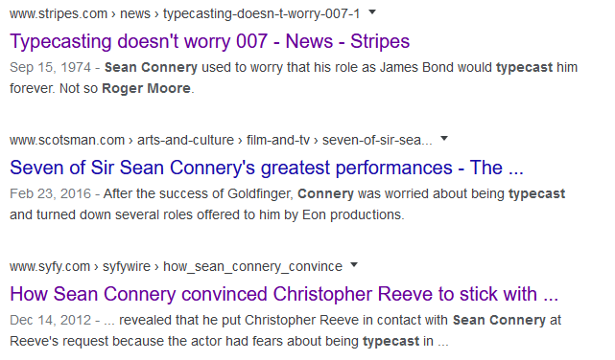
Java type casting

Slide 8
Type casting
Sometimes it is useful to convert from one data type to another
Called a type cast
Motivating example: imagine we want to simulate a die roll
We have the Math.random() method
Gives us a random double in [0,1)
But we need an integer in [1,6]
Solution: convert from double to int
int dieRoll = (int) (6*Math.random()+1);
new type
note: parentheses are mandatory
expression of ‘old’ type
note: parentheses only needed here to override precedence rules
General format: (<new-type>) <expr-of-old-type>

Slide 9
Java operator precedence summary
In decreasing precedence order:
Type | Operators
Member | (), [], .
Unary suffix | ++ (post-increment), --(post-decrement)
Unary prefix | ++ (pre), -- (pre), !, unary -, unary +, type-cast
Multiplication and division | *, /, %
Addition and subtraction | +, -
Relational | <, >, <=, >=
Equality/inequality | ==, !=
Boolean and | &&
Boolean or | ||
Conditional (ternary) operator | ?
Assignment operators | =, +=, -=, *=, /=, %=

Slide 10
Explicit vs implicit type casts
When the programmer specifies a cast we say it’s an explicit cast
Compiler implicitly converts for the programmer’s convenience
Implicit type casts: String +
Any variable to be appended to a String is cast to String before the fact
int temp = 80;
char symbol = 'F';
System.out.println("Hello, it is " + temp + " degrees “ + symbol + " today");
For object-reference variables, method Object.toString() is used
Like we’ve done in the labs!
E.g. String s = "" + LinearFunction(2, 3);

Slide 11
Primitive-type casting
Numeric primitive-type casts that don’t imply a loss of precision are performed implicitly
Examples:
int a = 10;
double b = a; // a cast to double before assignment
double c = 4.0 + a; // a cast to double before addition
Potentially-lossy conversions must be performed explicitly
double x = 1.0;
int b = 3/x; // will not compile
int b = (int) (3/x); // will compile, may loose precision
int half = 1/2; // will compile because integer division!
In general, booleans can’t be cast to other types, and vice-versa
Appending to string using operator + is exception
short
long
byte
int
double
char
float

Slide 12
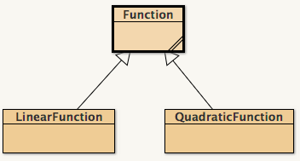
Object-type casting
Casting from subclass to superclass is performed implicitly
E.g. Function f = new LinearFunction(m, b);
Casting from superclass to subclass must be explicit
E.g: LinearFunction lf = (LinearFunction) f;
Will cause a ClassCastException error at runtime if object was not originally of that subclass
Casting between other classes is prohibited
Even from sibling to sibling
E.g. QuadraticFunction qf = (QuadraticFunction) lf; Will not compile!

Slide 13
Converting between incompatible types
Generally speaking, unrelated types can not be cast directly
Memory constraints!
E.g. this will not compile:
String s = "10";
int n = (int) s;
When such a conversion is required, one must perform it manually
I.e. create an object of the new type with the right characteristics
E.g. scan the string from right to left and add digit*10^{index}
Java standard library provides many useful conversion methods
E.g. the static method Integer.parseInt(String s) will create an int out of a String object representing an integer
Very useful to read program arguments
E.g. public static void main(String[] args){
int intArg = Integer.parseInt(args[0]);
…
}

Slide 14
In-class exercise
Will these Java snippets compile?
long a = 10; int b = a;
boolean a = true; long b = a;
int a = 2; double b = (byte) a;
char c = 'G'; String s = (String) c;
LinearFunction lf = (LinearFunction) new QuadraticFunction(1, 2, 3);
String s = "Hello " + new LinearFunction(3,2);
int i = new String("787");
Notes:
Answer key:
No
No
Yes
No
No
Yes
No

