Slide 1
CMPU-102-51 Spring 2020 Data Structures and Algorithms
Lecture #8 9: Java type casting continued; Final variables; Exceptions
We’ll pick up with slide 6
Rui Meireles
Peter Lemieszewski

Slide 2
Java type casting

Slide 3
Type casting
General format: (<new-type>) <expr-of-old-type>
E.g.: int dieRoll = (int) (6*Math.random()+1);
Some casts can be performed implicitly:
From smaller to larger numeric type
Appending to string using operator +
From subclass to superclass
Others have to be explicit:
From larger to smaller numeric type
From superclass to subclass
Yet some other casts can’t be performed at all:
E.g. from boolean to something else
E.g. can’t cast between classes not related by inheritance, including siblings

Slide 4
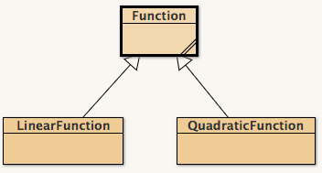
Object-type casting
Casting from subclass to superclass is performed implicitly
E.g. Function f = new LinearFunction(m, b);
Casting from superclass to subclass must be explicit
E.g: LinearFunction lf = (LinearFunction) f;
Will cause a ClassCastException error at runtime if object was not originally of that subclass
Casting between other classes is prohibited
Even from sibling to sibling
E.g. QuadraticFunction qf = (QuadraticFunction) lf; Will not compile!

Slide 5
Safe downstream casting: instanceof
<obj> instanceof <Class>
Is true if variable obj is an instance of class Class, false otherwise
Only applicable to object-reference type variables
Useful when we need to distinguish between different subclasses
E.g. (counting linear functions in array):
Function[] farray;
… // initialize array
int nlf = 0;
for (int i=0; i < farray.length; i++)
if (farray[i] instanceof LinearFunction)
nlf++;
E.g. safe casting (i.e. no potential ClassCastException):
if (farray[0] instanceof LinearFunction)
LinearFunction lf = (LinearFunction) farray[0];

Slide 6
We left off here last week
Will these Java snippets compile?
long a = 10; int b = a;
boolean a = true; long b = a;
int a = 2; double b = (byte) a;
char c = 'G'; String s = (String) c;
LinearFunction lf = (LinearFunction) new QuadraticFunction(1, 2, 3);
String s = "Hello " + new LinearFunction(3,2);
int i = new String("787");
Notes:
Answer key:
No
No
Yes
No
No
Yes
No

Slide 7
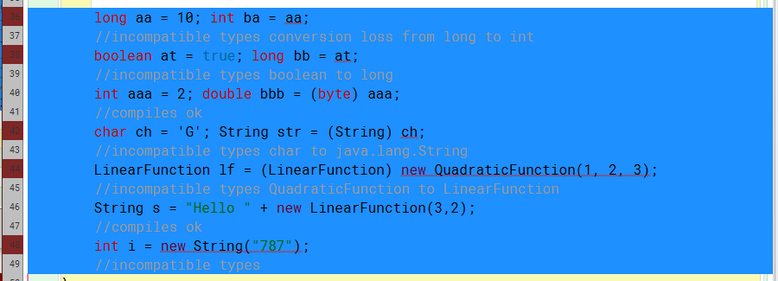
In-class exercise - answers
Notes:
Answer key:
No
No
Yes
No
No
Yes
No

Slide 8
Final variables

Slide 9
Final variables
final variables can not be changed once they are initialized
Reasons for using them: efficiency or design
Declaration: final <dataType> <varName>;
Makes primitive types constants, e.g.:
class Math{
public static final double PI = 3.14159265358979323846;
}
For object-reference type variables:
Makes the reference constant, but not the object itself!
E.g. final Person p = new Person();
p.setAge(23); // OK!
p = new Person(); // compilation error!

Slide 10
Final variables
Initialization at declaration not mandatory
Class-level variables
Can also be initialized in the constructor (but nowhere else)
Method-local variables
Can be initialized anywhere within scope
final keyword can be applied to method parameters as well
Effect: variable can‘t be changed inside method

Slide 11
Final variables: example/exercise
Will this code compile? Why or why not?
class HaveCodeWillCompile{
public static void main(String[] args){
final int[] a = new int[10];
for (int i=0; i < a.length; i++)
a[i] = (int) (Math.random()*100); // rand [0-99]
a = new int[10]; // zero everything out
}
Notes:
Arrays are object-reference variables. So changing contents is fine, but replacing with another object (a = new int[10];) is not!

Slide 12
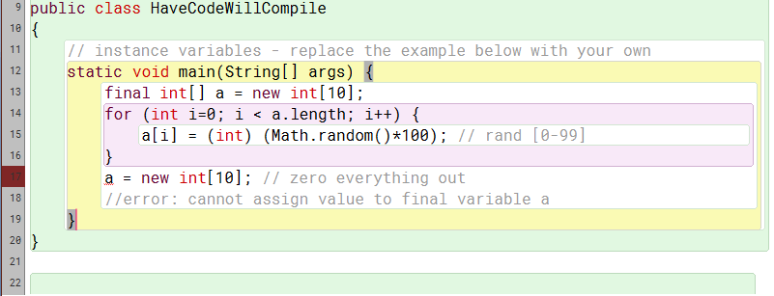
In-class exercise - answers
Will this code compile? Why or why not?
Answer: No. See comment on line 18.
Notes:
Answer key:
No
No
Yes
No
No
Yes
No

Slide 13
Javadoc also known as: Don’t @me, @Java! (IPUJ 4.5.4)

Slide 14
Java API documentation
Java’s documentation is one of its strong points
Complete documentation concerning:
Packages
Classes
Methods
Fields
Java 10 documentation available at https://docs.oracle.com/javase/10/docs/api/

Slide 15
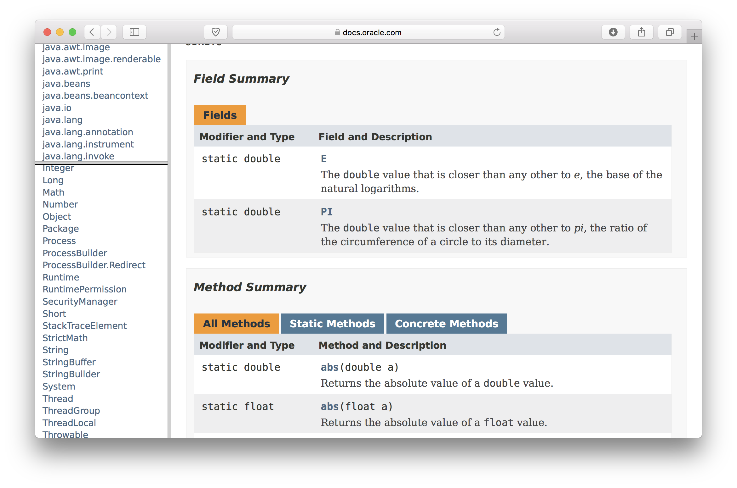
Example: Math class

Slide 16
Javadoc
Javadoc is a documentation generation tool
Documentation for our own code!
Generate HTML (i.e. web) pages from comments:
/** <your comment here> */
Documents your classes, fields, and methods to & for others.
Comments must come before the declaration of the class/field/method they refer to. E.g.:
Comments for private fields and methods are not published
but are still useful for the developer
Does not replace comments inside methods, complements them
/** A simple variable for a simple class. */
int intVariable;

Slide 17
Javadoc tags
Javadoc comments can include:
Plain text
HTML tags: e.g. <p>paragraph</p>
Doc tags: special Javadoc commands
Doc tags used for classes:
@author <author-name>
@version <version-name>
Doc tags used for methods:
@param <parameter-name> <parameter-description>
@return <return-value-description>
@throws <exception-class> <exception-description>
A tag’s text is ended by the beginning of another tag
or the end of the comment

Slide 18
Javadoc documentation example
/**
* A simple Javadoc test class.
* @author Pete Lemieszewski
* @version 0.91 pre-release
*/
public class JavadocTest{
/** A simple variable for a simple class. */
int intVariable;
...
}

Slide 19
Javadoc method documentation example
/**
* This subroutine computes the area of a rectangle, given its width
and height. Both length and width should be non-negative numbers.
*
* @param width the length of one side of the rectangle
* @param height the length the second side of the rectangle
* @return the area of the rectangle
* @throws IllegalArgumentException if either width or height are negative.
*/
public static double areaOfRectangle(double width, double height) {
if (width < 0 || height < 0)
throw new IllegalArgumentException("Sides must be non-negative.");
double area;
area = width * height;
return area;
}

Slide 20
Generating Javadoc pages
From BlueJ: from main window choose Tools → Project Documentation
From command line: javadoc <Class.java> or javadoc *.java
Example output:

Slide 21
General documentation guidelines
Documentation is key to code readability and maintainability
Use Javadoc to document your classes, methods and public class-level variables
Pay attention to naming:
Good naming reduces the need for comments
Pick names that are specific to the problem’s context
Inside each method, comment non-trivial blocks
Triviality is somewhat subjective, you’ll know it when you see it
Can you tell what it does by just glancing at it? If not, comment.
Always pay attention to formatting
One indentation level per block improves readability

Slide 22
Exceptions (IPUJ 3.7)

Slide 23
Program errors
Syntactic errors
Code does not represent a valid program in the language we’re using
Detected at compile time (for compiled languages, of course)
E.g. missing bracket or semi-colon
Semantic errors
Program exhibits unexpected behavior
Mostly detected at runtime (i.e. during execution)
Compiler can detect some, e.g. uninitialized variable
E.g. factorial method returns wrong value, or abnormally ends (abends)
See BSOD

Slide 24
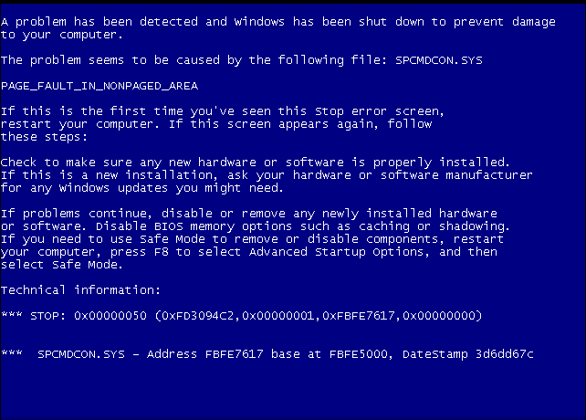
Program errors
Syntactic errors
Code does not represent a valid program in the language we’re using
Detected at compile time (for compiled languages, of course)
E.g. missing bracket or semi-colon
Semantic errors
Program exhibits unexpected behavior
Mostly detected at runtime (i.e. during execution)
Compiler can detect some, e.g. uninitialized variable
E.g. factorial method returns wrong value, or abnormally ends (abends
See BSOD
Image in public domain via: https://en.wikipedia.org/wiki/Blue_screen_of_death#/media/File:Windows_XP_BSOD.png

Slide 25
Java exceptions
Semantic errors may affect normal program control flow
Instead of crashing immediately, as some languages will, Java has a sophisticated error reporting mechanism called exceptions
When an error occurs within a method, an exception is thrown
The method caller is then notified and has two options:
Either catch that exception and attempt to recover from the error, or
Let the exception propagate to the next level up in the call stack
If an exception reaches the main method and is not caught there, the program crashes and an error message is printed to System.err (the terminal, by default). E.g.:

Slide 26
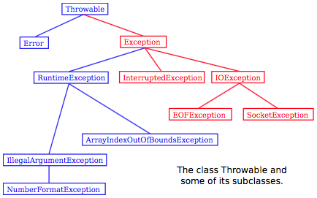
A hierarchy of exceptions
Exceptions are object-type variables
There is a large hierarchy of exceptions
Common exceptions
ArrayIndexOutOfBoundsException
NullPointerException

Slide 27
Know when to catch them, when to throw them
Catch exceptions that we can recover from
Subclasses of Error should not be caught
They represent serious problems within the Java Virtual Machine itself
Exceptions such as NullPointerException or ArrayIndexOutOfBoundsException should not be caught
They indicate the presence of bugs in the code
Bugs should be fixed, not masked!

Slide 28
How to learn if a method throws an exception
The Java API lists the exceptions each method can throw
https://docs.oracle.com/javase/10/docs/api/
Created via javadoc: @throws

Slide 29
Catching exceptions
try {
<try-block>
} catch (<ExceptionClass> <exceptionName>){
<catch-block>
}
If an exception occurs within the try block, control will jump to the catch block
Will catch exceptions of class ExceptionClass or subclass of it
Example: opening a non-existing file
try {
FileReader fr = new FileReader(filename);
} catch (FileNotFoundException e){
... // ask the user for a new filename
}

Slide 30
In-class exercise: exceptions
The following code reads a sequence of integers from the keyboard. Modify it so it doesn’t crash if the user inputs a non-integer value. Make it try again instead.
Hint: Use exceptions!
More: Integer.parseInt(String s) throws a NumberFormatException if s doesn’t contain a parsable integer
Scanner scanner = new Scanner(System.in);
while(true){
String inputStr = scanner.next();
int inputInt = Integer.parseInt(inputStr); // modify
if (inputInt == 0)
break;
... // do something interesting with inputInt
}

Slide 31
In-class exercise: exceptions solution
Scanner scanner = new Scanner(System.in);
while(true){
String inputStr = scanner.next();
int inputInt = 0;
try {
inputInt = Integer.parseInt(inputStr);
} catch(NumberFormatException e){
System.out.println("Invalid input. int need.");
continue; // try again
}
if (inputInt == 0)
break;
... // do something interesting with inputInt
}

