Slide 1
CMPU-102-51 Spring 2020 Data Structures and Algorithms
Lecture #10: Java exceptions continued; Debugging
Rui Meireles
Peter Lemieszewski

Slide 2
Exceptions (IPUJ 3.7)

Slide 3
Program errors
Syntactic errors
Code does not represent a valid program in the language we’re using
Detected at compile time (for compiled languages, of course)
E.g. missing bracket or semi-colon
Semantic errors
Program exhibits unexpected behavior
Mostly detected at runtime (i.e. during execution)
Compiler can detect some, e.g. uninitialized variable
E.g. factorial method returns wrong value, or abnormally ends (abends)
See BSOD

Slide 4
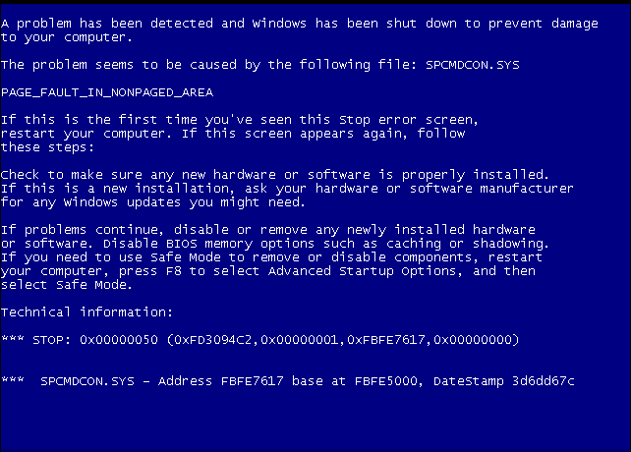
Program errors
Syntactic errors
Code does not represent a valid program in the language we’re using
Detected at compile time (for compiled languages, of course)
E.g. missing bracket or semi-colon
Semantic errors
Program exhibits unexpected behavior
Mostly detected at runtime (i.e. during execution)
Compiler can detect some, e.g. uninitialized variable
E.g. factorial method returns wrong value, or abnormally ends (abends
See BSOD
Image in public domain via: https://en.wikipedia.org/wiki/Blue_screen_of_death#/media/File:Windows_XP_BSOD.png

Slide 5
Java exceptions
Semantic errors may affect normal program control flow
Instead of crashing immediately, as some languages will, Java has a sophisticated error reporting mechanism called exceptions
When an error occurs within a method, an exception is thrown
The method caller is then notified and has two options:
Either catch that exception and attempt to recover from the error, or
Let the exception propagate to the next level up in the call stack
If an exception reaches the main method and is not caught there, the program crashes and an error message is printed to System.err (the terminal, by default). E.g.:

Slide 6
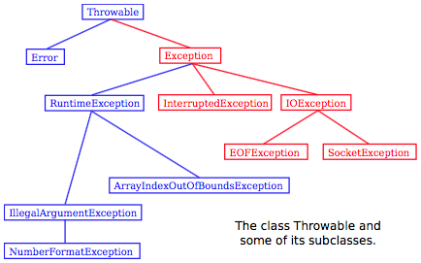
Java exceptions
A powerful error-handling mechanism
Exceptions are objects that are thrown
Can be caught using a try-catch block
Otherwise propagated to caller
Example – reading integer sequence:
Scanner scanner = new Scanner(System.in);
while(true){
String inputStr = scanner.next();
int inputInt = 0;
try {
inputInt = Integer.parseInt(inputStr);
} catch(NumberFormatException e){
System.out.println("Invalid input. int need.");
continue; // try again
}
if (inputInt == 0) break;
... // do something interesting with inputInt
}

Slide 7
Using the exception object
The catch block has access to the exception object
We can use it to learn more about the exception
All exceptions inherit from Throwable
Useful method examples:
String getMessage()
void printStackTrace(PrintStream s)
Example
try {
inputInt = Integer.parseInt(inputStr);
} catch(NumberFormatException e){
System.err.println("Exception: " + e.getMessage());
e.printStackTrace(System.err); // print to standard error
... // recover in some way
}

Slide 8
Throwing exceptions
Methods that throw exceptions must list them in the signature. E.g.: int factorial(int n) throws IllegalArgumentException
If different exceptions can be thrown, a comma-separated list is used
Exceptions are thrown using the throw keyword
Keyword must be followed by an exception object
Must be an instance of Throwable
In practice it will be an Exception
Error is used for Java Virtual Machine errors
Example
int factorial (int n) throws IllegalArgumentException {
if (n < 0)
throw new IllegalArgumentException("n! req. n >= 0");
int fac = 1;
for (int i=n; i>1; i--)
fac *= i;
return fac;
}

Slide 9
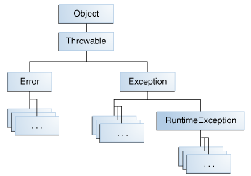
Checked vs unchecked exceptions
Code won’t compile until any potential checked exception is either explicitly caught (try-catch) or re-thrown
E.g. call: FileReader fr = new FileReader(filename);
Checked are all that aren’t instances of RuntimeException
E.g. FileNotFoundException
Unchecked exception are all others
Catching them is optional and not recommended in general
They’re all instances of RuntimeException
Guidelines:
If exception can be avoided programmatically it should be unchecked, otherwise checked
In practice there are “exceptions”
E.g. NumberFormatException when reading user input

Slide 10
Creating our own exception classes
If no existing exception class perfectly captures the situation, we can create a new one
Choosing a superclass:
Pick the semantically closest one
If unchecked must be subclass of RuntimeException
Class contents: typically minimalistic, with just a constructor, optionally taking in an error message
Example: let’s create a more specialized exception class for factorial:
public class NegativeArgumentException
extends IllegalArgumentException {
public NegativeArgumentException(){ super(); }
public NegativeArgumentException(String msg){ super(msg); }
}

Slide 11
Exception class usage example
public class NegativeArgumentException
extends IllegalArgumentException {
public NegativeArgumentException(){ super(); }
public NegativeArgumentException(String msg){ super(msg); }
}
int factorial (int n) throws NegativeArgumentException {
if (n < 0)
throw new NegativeArgumentException("n! req. n >= 0");
int fac = 1;
for (int i=n; i>1; i--)
fac *= i;
return fac;
}

Slide 12
Exceptions vs special values
Many situations can be dealt using either one or the other
Pros of exceptions relative to special values
Better-defined structure
Easy to distinguish different type of errors vs e.g. null return value
Can be checked by the compiler (mandatory error handling)
Cons of exceptions
Sometimes make code more complicated
Less efficient in terms of processing time
Rough guideline
Use special values for common, unexceptional situations, exceptions for rest
Notes:
Rough guideline
Use special values for common, unexceptional situations
E.g. in the polynomial division, the indivisible error should likely not be an exception. It’s a common and expected occurrence.

Slide 13
Debugging

Slide 14
Program correctness
Should be our first and major goal
Second is efficiency
Types of errors
Syntax errors
Written code does not translate into a valid set of instructions
Detected at compile time
E.g. missing semi-colon at the end of statement
Semantic errors or bugs
The program doesn’t do what it is supposed to do
Mostly detected at runtime (compiler can detect some, e.g. uninitialized variable)
E.g. program crashes when provided with a certain input or gives wrong result

Slide 15
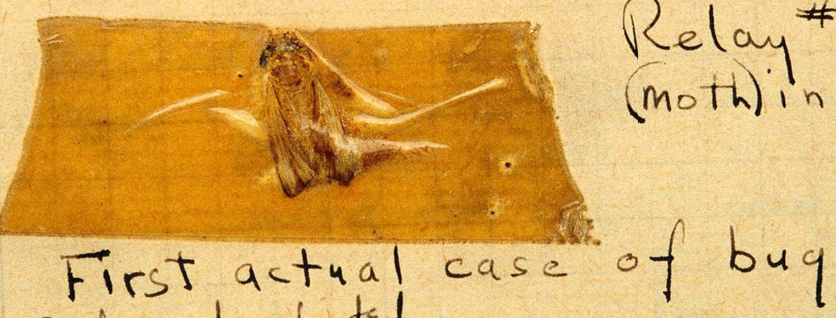
Debugging
Process through which we identify and eliminate bugs
Typical bug symptoms
Uncaught exception (e.g. NullPointerException)
Unexpected output
Lack of termination (e.g. infinite loop)
Bug identification strategies
Add print messages at strategic points
Sometimes it’s the only option. E.g. on embedded systems lacking a debugger
Assertions (recommended)
Use a debugger (recommended)
Grace Hopper found the 1st literal bug in 1947
Notes:
Grace Hopper 1947 at Havard

Slide 16
Catching bugs early: assert
The assert keyword can be used to test program invariants
Syntax: assert <boolean-expr>;
E.g. assert i > 0;
Semantics:
Expression should be true during normal program execution
A false expression triggers a java.lang.AssertionError and halts program execution
Optionally, assert <boolean-expr> : <msg>;
A String representation of msg is printed along with the AssertionError
E.g. assert i > 0 : "i was: " + i;
Assertions are disabled by default
Why? Performance (i.e. not for use in production code)
Enabling assertions:
Command line execution: java -enableassertions, or -ea
Since its designed for education, BlueJ enables assertions automatically

Slide 17
Assertion example
switch(suit){
case "CLUBS":
…
break;
case "DIAMONDS":
…
break;
case "HEARTS":
…
break;
case "SPADES":
…
break;
default: // if we get here, false it is…
assert false : "unexpected suit " + suit;
}

Slide 18
Assertion usage guidelines
Because assertions are not guaranteed to be enabled, they should not be required for program correctness
It follows that assertions should not be used to:
Check arguments in public methods, because specification has to be obeyed regardless
Throwing an IllegalArgumentException is preferred
Produce side-effects
E.g. assert matrixa.add(matrixb); // from lab #3
Addition will not be performed if assertions are disabled
Program semantics will change!

Slide 19
Debugger
A debugger is a software development tool that lets us pause execution, inspect internal state, and execute in “slow motion”
The workflow is as follows:
Pick line of code where the debugging is to start, known as a breakpoint
Run the program
If and when the breakpoint is reached, execution will halt and you will be able to inspect the program’s state and step through the program one line at a time. There two different types of step commands:
Step: execute the next line of code without drilling down into method calls
Step into: execute the next line of code, but if that line involves a method call, step inside it so its execution can be debugged
The continue command can be used at any time to resume program execution

Slide 20
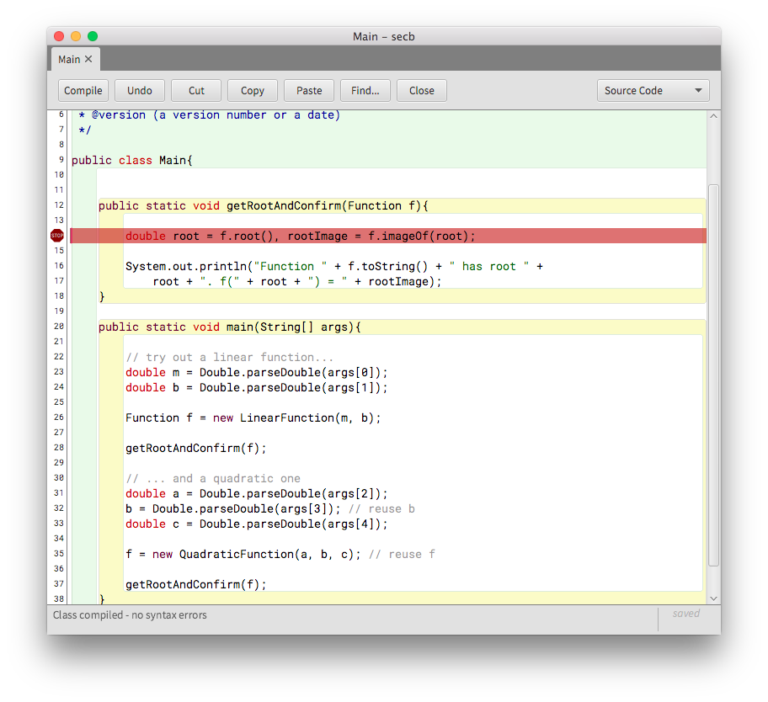
BlueJ’s debugger: breakpoints
Setting a breakpoint is done by clicking on the left sidebar
The file must be compiled for this to work
A white sidebar indicates a compiled file, a grey one indicates an uncompiled file
Changing the source file will automatically remove the breakpoint
Once all breakpoints have been created, run the program normally

Slide 21
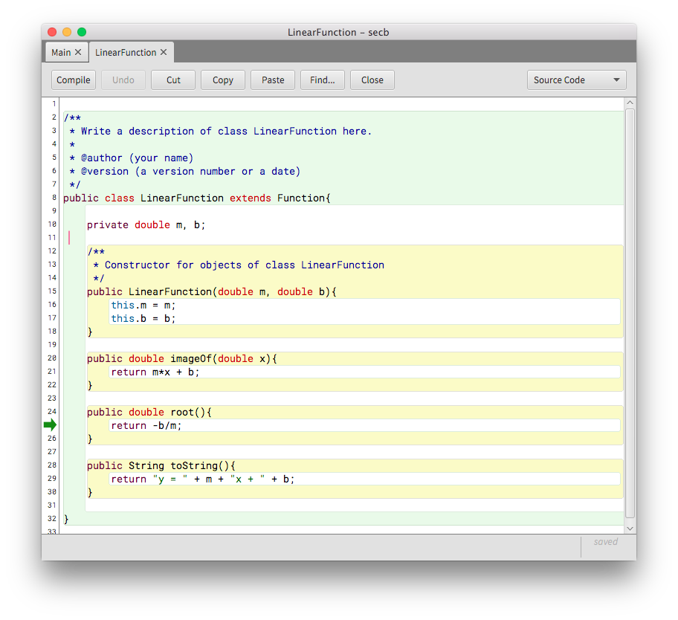
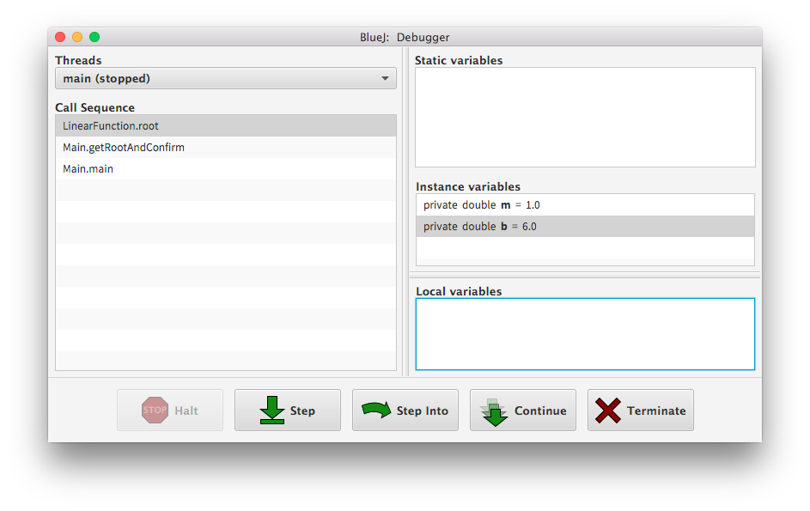
BlueJ’s debugger: execution
Execution will halt at breakpoints and you’ll be able to inspect the call stack, the variable contents, and step through the program

