Slide 1
CMPU-102-51 Spring 2020 endtimes
Data Structures and Algorithms
Lecture #14: The linked list data structure
Rui Meireles
Peter Lemieszewski

Slide 2
The linked list data structure
(IPUJ 7.2)

Slide 3
The linked list data structure
Recall the array data structure
  A collection of items of a given type
  Indexed
  Fixed size
  Items contiguous in memory
    Simple arithmetic yields access to any element
The linked list data structure
  Also a collection of items of a given type
  Indexed
  Variable size
    We can add and remove elements, at any location
  Items not necessarily contiguous in memory
Notes:
A linked list is also an ADT, but I guess we’ll introduce ADTs later.

Slide 4
Linked lists
Composed of a sequence of nodes
Each list node is essentially a container and holds:
  A value
  A reference to the next node on the list
E.g. class Node { Object value; Node next; }
We say the list is recursively defined:
  All we need is a reference to the head node
    Other nodes accessible by following the next references
  Last element identified by null next reference
  Can add or remove elements in any position

Slide 5
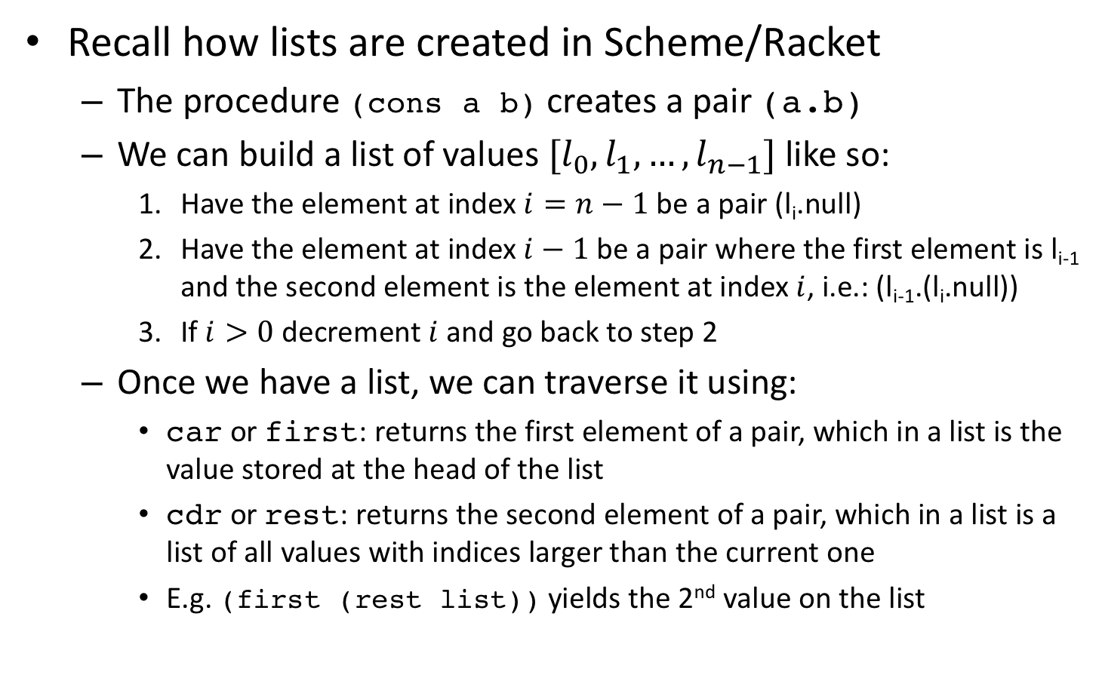
Emulating Scheme’s/Racket’s lists
Recall how lists are created in Scheme/Racket
  The procedure (cons a b) creates a pair (a.b)
  We can build a list of values $[l_{0},l_{1}, …,l_{n−1}]$ like so:
    Have the element at index $i=n−1$ be a pair (l_{i}.null)
    Have the element at index $i−1$ be a pair where the first element is l_{i-1} and the second element is the element at index $i$, i.e.: (l_{i-1}.(l_{i}.null))
    If $i>0$ decrement $i$ and go back to step 2
  Once we have a list, we can traverse it using:
    car or first: returns the first element of a pair, which in a list is the value stored at the head of the list
    cdr or rest: returns the second element of a pair, which in a list is a list of all values with indices larger than the current one
    E.g. (first (rest list)) yields the 2nd value on the list
Notes:
All classes that contain the words implements IList at the end of the class signature must provide method bodies for the length and sum methods.

Slide 6
A Scheme-style list implementation
public class Node {
private Object value;
private Node next;
public Node(Object value, Node next){
this.value = value;
this.next = next;
}
public Node(Object value){ // special for last node
this(value, null);
}
public Object first(){ return this.value; }
public Node rest(){ return this.next; }
}
Notes:
All classes that contain the words implements IList at the end of the class signature must provide method bodies for the length and sum methods.

Slide 7
Scheme-style list usage
What does this code print?
Node node = new Node(10);
for (int i=9; i > 0; i--)
node = new Node(i, node);
int acc = 0;
while (node != null){
acc += (Integer) node.first();
node = node.rest();
}
System.out.println(acc);
Notes:
It prints the sum from 1 to 10, which is 55.

Slide 8
General list traversal
This code traverses a list starting at headNode:
Node curNode = headNode;
while (curNode != null){
... // do something with curNode.first();
curNode = curNode.rest();
}
A for loop works just as well:
for (Node curNode = headNode; curNode != null; curNode = curNode.rest())
{
... // do something with curNode.first();
}
Notes:
All classes that contain the words implements IList at the end of the class signature must provide method bodies for the length and sum methods.

Slide 9
Inserting an element
Let us add a useful “rest setter” to our class definition:
public void setRest(Node next){ this.next = next; }
Now we can insert a new element after node joeNode:
Node larryNode = new Node("larry");
larryNode.setRest(joeNode.rest());
joeNode.setRest(larryNode);
Note that order
is important!

Slide 10
Finding the right place to insert
E.g. inserting an element into a sorted list of integers
  Non-decreasing order, which we want to preserve
Starting at headNode, traverse list until larger element is found, then insert before it:
Node newNode = new Node(3);
Node cur = headNode, prev = null;
while (cur != null &&
((Integer)cur.first()) <= ((Integer)newNode.first())){
prev = cur; // need to save previous
cur = cur.rest();
}
if (prev != null) prev.setRest(newNode);
newNode.setRest(cur);

Slide 11
Doubly-linked list
Our list can only be traversed in one direction: head → tail
  Called a singly-linked list
Sometimes it would be useful to go in the reverse direction
Solution: have a previous reference in each list node
  Yielding a doubly-linked list
public class Node {
...
private Node previous = null;
public Node getPrev(){ return previous; }
public Node setPrev(Node previous){ this.previous = previous; }
}
Notes:
All classes that contain the words implements IList at the end of the class signature must provide method bodies for the length and sum methods.

Slide 12
In-order insertion with a doubly-linked list
Need to update previous references:
Node newNode = new Node(3), cur = headNode, prev = null;
while (cur != null &&
((Integer)cur.first()) <= ((Integer)newNode.first())){
prev = cur;
cur = node.rest();
}
newNode.setRest(cur);
newNode.setPrevious(prev);
if (prev != null) prev.setRest(newNode);
if (cur != null) cur.setPrevious(newNode);
newNode
prev
cur

Slide 13
Removing an element
Is as simple as updating the next node reference
  For a singly-linked list!
Let’s remove the element after node janeNode:
Node remNode = janeNode.rest();
if (remNode != null)
janeNode.setRest(remNode.rest());
X
remNode
Notes:
All classes that contain the words implements IList at the end of the class signature must provide method bodies for the length and sum methods.

Slide 14
In-class exercise: list length
How can we write a method that returns the number of nodes in linked list, starting with the node passed as argument?
public int length(Node node){
...
}
Notes:
All classes that contain the words implements IList at the end of the class signature must provide method bodies for the length and sum methods.

Slide 15
In-class exercise solution: list length
How can we write a method that returns the number of nodes in linked list, starting with the node passed as argument?
  If we’re in a recursive mood:
  If we’re feeling iterative:
public int length(Node node){
return node == null ? 0 : 1 + length(node.rest());
}
public int length(Node node){
int len = 0;
for (Node cur = node; cur != null; cur = cur.rest())
len++;
return len;
}
Notes:
All classes that contain the words implements IList at the end of the class signature must provide method bodies for the length and sum methods.

Slide 16
Our list implementation is limited
Good:
  It’s very general, holds any kind of object
Bad:
  Requires casting (which is annoying and error-prone)
    Lurking danger: unrelated data types can be mixed in same list
public class Node { Object value; Node next; }
Node n = new Node();
n.value = "Hello world";
String hello = (String) n.value;

Slide 17
Java’s linked list implementation
(IPUJ 10.1-10.2)

Slide 18
java.util.LinkedList
Java includes a sophisticated linked list implementation
  The java.util.LinkedList class
Is a parametrized type, also known as generic type
  Object declaration specifies data type of list values
  Syntax: LinkedList<DataType> <varName>;
  If no parameter is specified, Object is assumed
  E.g.:
    LinkedList<String> stringList;
    LinkedList objectList;
  Recall subclass types can be used as superclass types
  Wrapper classes needed for primitive types. E.g.:
    LinkedList<Integer> anIntegerList;

