Slide 1
CMPU-102-01 Fall 2019
Data Structures and Algorithms
Lecture #15: The linked list data structure, continued (slide 6)
Rui Meireles
Peter Lemieszewski

Slide 2
The linked list data structure
(IPUJ 7.2)

Slide 3
The linked list data structure
Recall the array data structure
  A collection of items of a given type
  Indexed
  Fixed size
  Items contiguous in memory
    Simple arithmetic yields access to any element
The linked list data structure
  Also a collection of items of a given type
  Indexed
  Variable size
    We can add and remove elements, at any location
  Items not necessarily contiguous in memory
Notes:
A linked list is also an ADT, but I guess we’ll introduce ADTs later.

Slide 4
Linked lists
Composed of a sequence of nodes
Each list node holds:
  A value
  A reference to the next node on the list
E.g. class Node { Object value; Node next; }
We say the list is recursively defined:
  All we need is a reference to the head node
    Other nodes accessible by following the next references
  Last element identified by null next reference
  Can add or remove elements in any position

Slide 5
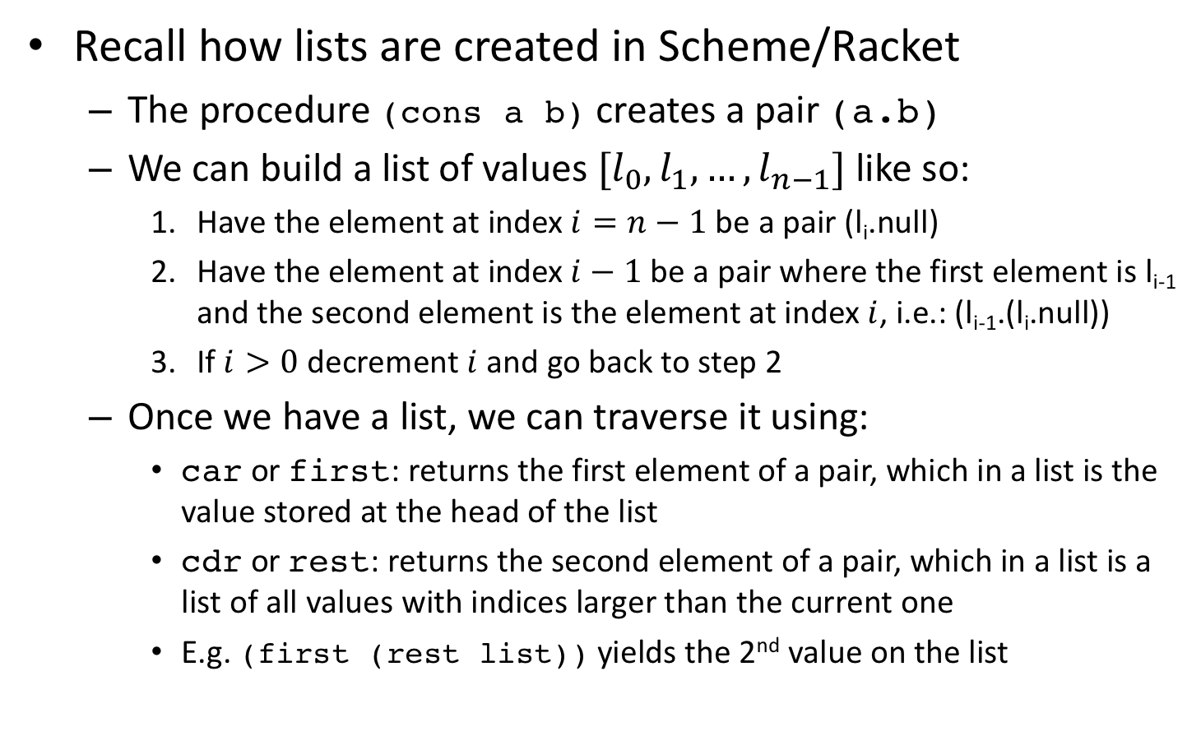
Emulating Scheme’s/Racket’s lists
Recall how lists are created in Scheme/Racket
  The procedure (cons a b) creates a pair (a.b)
  We can build a list of values $[l_{0},l_{1}, …,l_{n−1}]$ like so:
    Have the element at index $i=n−1$ be a pair (l_{i}.null)
    Have the element at index $i−1$ be a pair where the first element is l_{i-1} and the second element is the element at index $i$, i.e.: (l_{i-1}.(l_{i}.null))
    If $i>0$ decrement $i$ and go back to step 2
  Once we have a list, we can traverse it using:
    car or first: returns the first element of a pair, which in a list is the value stored at the head of the list
    cdr or rest: returns the second element of a pair, which in a list is a list of all values with indices larger than the current one
    E.g. (first (rest list)) yields the 2nd value on the list
Notes:
All classes that contain the words implements IList at the end of the class signature must provide method bodies for the length and sum methods.

Slide 6
A Scheme-style list implementation
public class Node {
private Object value;
private Node next;
public Node(Object value, Node next){
this.value = value;
this.next = next;
}
public Node(Object value){ // special for last node
this(value, null);
}
public Object first(){ return this.value; }
public Node rest(){ return this.next; }
}
Notes:
All classes that contain the words implements IList at the end of the class signature must provide method bodies for the length and sum methods.

Slide 7
Pick up here 3/31: Gangnam Scheme-style
What does this code print?
Node node = new Node(10);
for (int i=9; i > 0; i--)
node = new Node(i, node);
int acc = 0;
while (node != null){
acc += (Integer) node.first();
node = node.rest();
}
System.out.println(acc);
Notes:
It prints the sum from 1 to 10, which is 55.

Slide 8
Pick up here 3/31: Gangnam Scheme-style
Let’s look at this code in BlueJ
Node node = new Node(10);
for (int i=9; i > 0; i--)
node = new Node(i, node);
int acc = 0;
while (node != null){
acc += (Integer) node.first();
node = node.rest();
}
System.out.println(acc);
Notes:
It prints the sum from 1 to 10, which is 55.

Slide 9
General list traversal
This code traverses a list starting at headNode:
Node currentNode = headNode;
while (currentNode != null){
... // do something with currentNode.first();
currentNode = currentNode.rest();
}
A for loop works just as well:
for (Node currentNode = headNode;
currentNode != null;
currentNode = currentNode.rest()){
... // do something with currentNode.first();
}
Notes:
All classes that contain the words implements IList at the end of the class signature must provide method bodies for the length and sum methods.

Slide 10
Inserting an element
Let us add a useful “rest setter” to our class definition:
public void setRest(Node next){ this.next = next; }
Now we can insert a new element after node joeNode:
Node larryNode = new Node("larry");
larryNode.setRest(joeNode.rest());
joeNode.setRest(larryNode);
Note that order
is important!

Slide 11
Finding the right place to insert
E.g. inserting an element into a sorted list of integers
  Non-decreasing order, which we want to preserve
Starting at headNode, traverse list until larger element is found, then insert before it:
Node newNode = new Node(3);
Node current = headNode, previous = null;
while (current != null &&
((Integer)current.first()) <= ((Integer)newNode.first())){
previous = current; // need to save previous
current = current.rest();
}
if (previous != null) prev.setRest(newNode);
newNode.setRest(current);

Slide 12
Subway Analogy
The Scheme style of using first/rest should be familiar to you
This is not the only way to think of the Node class implementation.
  Tokyo’s Yamanote Subway analogy again
    https://en.wikipedia.org/wiki/Yamanote_Line
  You may use a NYC Number 7 (Flushing bound) train analogy instead!
    https://en.wikipedia.org/wiki/7_(New_York_City_Subway_service)
You get on the train on Tokyo Station (C.W.)/ (or Times Square, 42 Street east bound)
  This is where you start/begin, is your “first node” “head node”, etc.
    It is also where you currently are (your current node)
  The next stop is the next node
    When you arrive, that is your current node
  Continue to get to the next station (i.e. getNext(node)) until…
    Hmm, the Yamanote Line is circular. What does this mean for our analogy?
    The 7 train ends at Main St, flushing. What does this mean for our analogy?
Notes:
It prints the sum from 1 to 10, which is 55.

Slide 13
Subway Analogy: More…
The Scheme style of using first/rest should be familiar to you
This is not the only way to think of the Node class implementation.
  Tokyo’s Yamanote Subway analogy again
    https://en.wikipedia.org/wiki/Yamanote_Line
  You may use a NYC Number 7 (Flushing bound) train analogy instead!
    https://en.wikipedia.org/wiki/7_(New_York_City_Subway_service)
You get on the train on Tokyo Station (C.W.)/ (or Times Square, 42 Street east bound)
  This is where you start/begin, is your “first node” “head node”, etc.
    It is also where you currently are (your current node)
  The next stop is the next node
    When you arrive, that is your current node
  Continue to get to the next station (i.e. getNext(node)) until…
    Hmm, the Yamanote Line is circular. Next of last node == first/head/etc.
    The 7 train ends at Main St, flushing. Next of last node == null
Notes:
It prints the sum from 1 to 10, which is 55.

Slide 14
Interrupt: Java Interface 1
We have to revisit a method signature first
  The most basic form of a signature is method name & parameter list
  e.g. add(Matrix m);
Java compiler requires the method name or the parameter list to be different for methods in a class.
Different method name?
  No Problem: add(Matrix m); subtract(Matrix m);
Same method name?
  The parameters must be different: add(Matrix m); add(int[] a);
  Otherwise Java cannot differentiate between the two!
The parameters for a signature just need the type(s): add(Matrix);
method declaration includes more:
  Access modifier | return type |name | parameter list: type and name
  Public Matrix add(Matrix m);
But not the body of the method!
Notes:
All classes that contain the words implements IList at the end of the class signature must provide method bodies for the length and sum methods.

Slide 15
Interrupt: Java Interface 2
A Java interface is a group of related methods that have no bodies
  Related? How? By the interface keyword + name (like a Java Class!)
  No bodies? i.e. no implementations, just method declarations
According to Wikipedia (https://en.wikipedia.org/wiki/Interface_(Java) )
  An interface is an abstract type that specifies behavior that are to be implemented by a class (or multiple classes)
Interfaces: form a contract between the class & Java programmer.
A class that implements an interface must have bodies for all method declarations.
Interface IMatrix {
void add(int[] a);
}
class Matrix implements Imatrix {
//etc…
}
Notes:
All classes that contain the words implements IList at the end of the class signature must provide method bodies for the length and sum methods.

Slide 16
Doubly-linked list
Our single-linked list can only be traversed in one direction:
  Clockwise or eastbound (depending on the train analogy)
Sometimes it would be useful to go in the reverse direction
  Counter clockwise or westbound
Solution: have a previous reference in each list node
  Yielding a doubly-linked list
public class Node {
...
private Node previous = null;
public Node getPrevious(){ return previous; }
public Node setPrevious(Node previous){ this.previous = previous; }
}
Notes:
All classes that contain the words implements IList at the end of the class signature must provide method bodies for the length and sum methods.

Slide 17
In-order insertion with a doubly-linked list
Need to update previous references:
Node newNode = new Node(3), cur = headNode, prev = null;
while (cur != null &&
((Integer)cur.first()) <= ((Integer)newNode.first())){
prev = cur;
cur = node.rest();
}
newNode.setRest(cur);
newNode.setPrevious(prev);
if (prev != null) prev.setRest(newNode);
if (cur != null) cur.setPrevious(newNode);
newNode
prev
cur

Slide 18
Removing an element
Is as simple as updating the next node reference
  For a singly-linked list!
Let’s remove the element after node janeNode:
Node remNode = janeNode.rest();
if (remNode != null)
janeNode.setRest(remNode.rest());
X
remNode
Notes:
All classes that contain the words implements IList at the end of the class signature must provide method bodies for the length and sum methods.

Slide 19
In-class exercise: list length
How can we write a method that returns the number of nodes in linked list, starting with the node passed as argument?
public int length(Node node){
...
}
Notes:
All classes that contain the words implements IList at the end of the class signature must provide method bodies for the length and sum methods.

Slide 20
In-class exercise solution: list length
How can we write a method that returns the number of nodes in linked list, starting with the node passed as argument?
  If we’re in a recursive mood:
  If we’re feeling iterative:
public int length(Node node){
return node == null ? 0 : 1 + length(node.rest());
}
public int length(Node node){
int len = 0;
for (Node cur = node; cur != null; cur = cur.rest())
len++;
return len;
}
Notes:
All classes that contain the words implements IList at the end of the class signature must provide method bodies for the length and sum methods.

Slide 21
Our list implementation is limited
Good:
  It’s very general, holds any kind of object
Bad:
  Requires casting (which is annoying and error-prone)
    Lurking danger: unrelated data types can be mixed in same list
public class Node { Object value; Node next; }
Node n = new Node();
n.value = "Hello world";
String hello = (String) n.value;

Slide 22
Java’s linked list implementation
(IPUJ 10.1-10.2)

Slide 23
java.util.LinkedList
Java includes a sophisticated linked list implementation
  The java.util.LinkedList class
Is a parametrized type, also known as generic type
  Object declaration specifies data type of list values
  Syntax: LinkedList<DataType> <varName>;
  If no parameter is specified, Object is assumed
  E.g.:
    LinkedList<String> stringList;
    LinkedList objectList;
  Recall subclass types can be used as superclass types
  Wrapper classes needed for primitive types. E.g.:
    LinkedList<Integer> anIntegerList;

Slide 24
LinkedList methods
LinkedList implements the List<E> interface
Some useful methods:
  add(E elem): append elem to end of list
  add(int idx, E elem): insert elem at index idx
  remove(int idx): remove and return element at index idx
  get(int idx): return element at index idx
  indexOf(Object o): returns index of object o, if it is present on the list, or -1 otherwise
    Note how any object is accepted, not only of type E
    Object.equals() is used for the comparison
  size(): returns number of elements in list

Slide 25
LinkedList usage example: FIFO
Let us implement a FIFO (First-In, First-Out) queue:
import java.util.LinkedList;
public class FifoQueue{
LinkedList<String> q;
FifoQueue(){ q = new LinkedList<String>(); }
void enqueue(String name){ q.add(name); }
String dequeue(){
String rval = q.size() > 0 ? q.remove(0) : null;
return rval;
}
}

Slide 26
FIFO usage example
Let’s use the LinkedList-based FIFO queue:
public static void main(String[] args){
FifoQueue fifo = new FifoQueue();
fifo.enqueue("Mickey");
fifo.enqueue("Donald");
fifo.enqueue("Pluto");
for (String name = fifo.dequeue();
name != null;
name = fifo.dequeue()){
System.out.printf("It's your turn %s!\n", name);
}
}

Slide 27
In-class exercise: write a LIFO queue
Write a LIFO (Last-In, First-Out) queue for strings:
public class LifoQueue{
LinkedList<String> q;
LifoQueue(){ q = new LinkedList<String>(); }
void enqueue(String name){ … }
String dequeue(){ … }
}
Recall the following useful methods:
  add(E elem): append elem to end of list
  add(int idx, E elem): insert elem at index idx
  remove(int idx): removes and returns element at index idx
  size(): returns length of list

Slide 28
Useful LinkedList Methods
Let’s carry over the useful methods of LinkedList…

Slide 29
In-class exercise: LIFO queue solution
A LIFO (Last-In, First-Out) queue:
public class LifoQueue{
LinkedList<String> q;
LifoQueue(){ q = new LinkedList<String>(); }
void enqueue(String name){ /*???*/ }
String dequeue(){
String rval;
/*???*/
return rval;
}
}

Slide 30
Creating generic classes
We can create our own classes generic with suffix <T>
  T is an example name, you can use some other name, as long as it is inside diamond braces
public class LifoQueue<T>{
LinkedList<T> q;
LifoQueue(){ q = new LinkedList<T>(); }
void enqueue(T name){ q.add(0, name); }
T dequeue(){
T rval = q.size() > 0 ? q.remove(0) : null;
return rval;
}
}

Slide 31
Using our generic LIFO
Let’s use the LinkedList-based LIFO queue:
public static void main(String[] args){
LifoQueue<String> lifo = new LifoQueue<String>();
lifo.enqueue("Mickey");
lifo.enqueue("Donald");
lifo.enqueue("Pluto");
for(String name = lifo.dequeue();
name != null;
name = lifo.dequeue()){
System.out.printf("It's your turn %s!\n", name);
}
}

Slide 32
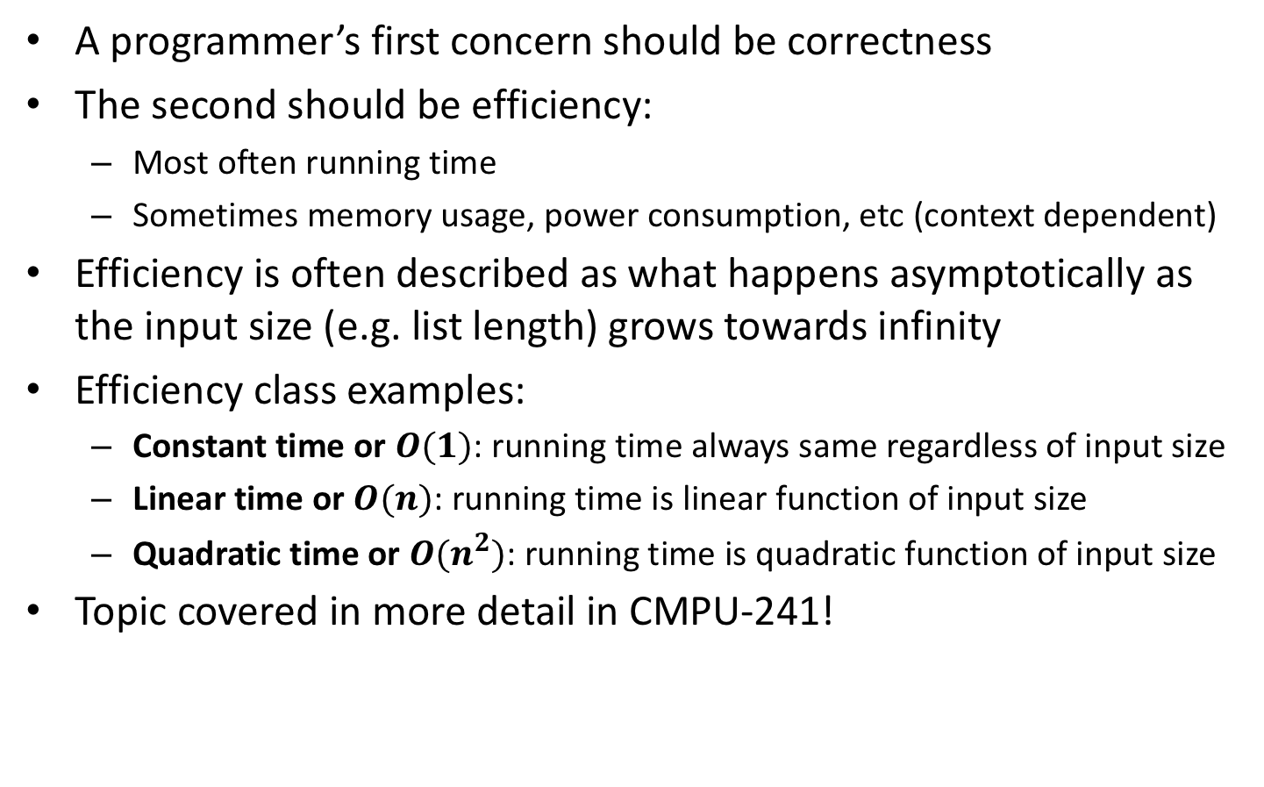
Running time efficiency
A programmer’s first concern should be correctness
The second should be efficiency:
  Most often running time
  Sometimes memory usage, power consumption, etc (context dependent)
Efficiency is often described as what happens asymptotically as the input size (e.g. list length) grows towards infinity
Efficiency class examples:
  Constant time or $O(1)$: running time always same regardless of input size
  Linear time or $O(n)$: running time is linear function of input size
  Quadratic time or $O(n^{2})$: running time is quadratic function of input size
Topic covered in more detail in CMPU-241!
Notes:
For ArrayList
get is O(1)
add is O(1) amortized, but O(n) worst-case since the array must be resized and copied
remove is O(n)

Slide 33
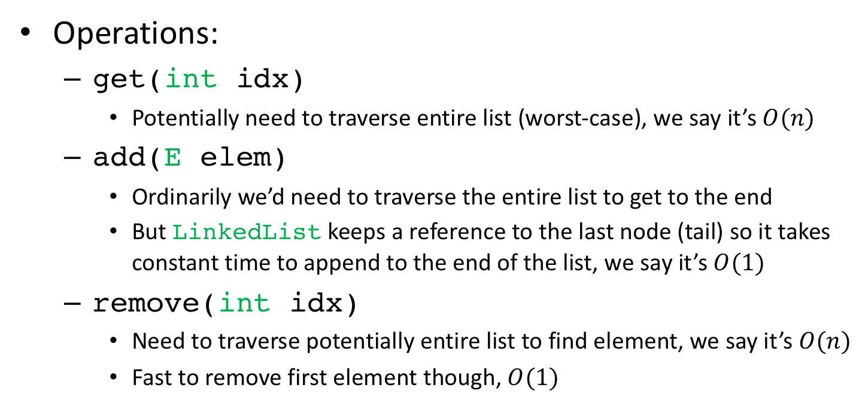
LinkedList running time efficiency
Operations:
  get(intidx)
    Potentially need to traverse entire list (worst-case), we say it’s $O(n)$
  add(Eelem)
    Ordinarily we’d need to traverse the entire list to get to the end
    But LinkedList keeps a reference to the last node (tail) so it takes constant time to append to the end of the list, we say it’s $O(1)$
  remove(intidx)
    Need to traverse potentially entire list to find element, we say it’s $O(n)$
    Fast to remove first element though, $O(1)$
Notes:
For ArrayList
get is O(1)
add is O(1) amortized, but O(n) worst-case since the array must be resized and copied
remove is O(n)

Slide 34
An alternative to LinkedList
Random accesses are inefficient for LinkedLists
  E.g. performing get() on random indices
Lists that are accessed randomly often but rarely changed benefit from a different implementation
Recall arrays:
  Fixed-sized collection of elements of a given type
  Contiguous memory allocation allows fast random-access
We can implement a list using an array
  Arrays enable fast random access
    At a price, as we’ll see
Notes:
For ArrayList
get is O(1)
add is O(1) amortized, but O(n) worst-case since the array must be resized and copied
remove is O(n)

Slide 35
Implementing a list using an array
public class StringArrayList {
private String[] array = new String[10];
private int lsize = 0; // how much is occupied
public void add(String item){ // add at end
if(lsize == array.length){ // array already full!
String[] newArray = new String[2*array.length];
for(int i=0; i < array.length; i++) // copy over
newArray[i] = array[i];
array = newArray;
}
array[lsize] = item;
lsize++;
}
}
Notes:
For ArrayList
get is O(1)
add is O(1) amortized, but O(n) worst-case since the array must be resized and copied
remove is O(n)

Slide 36
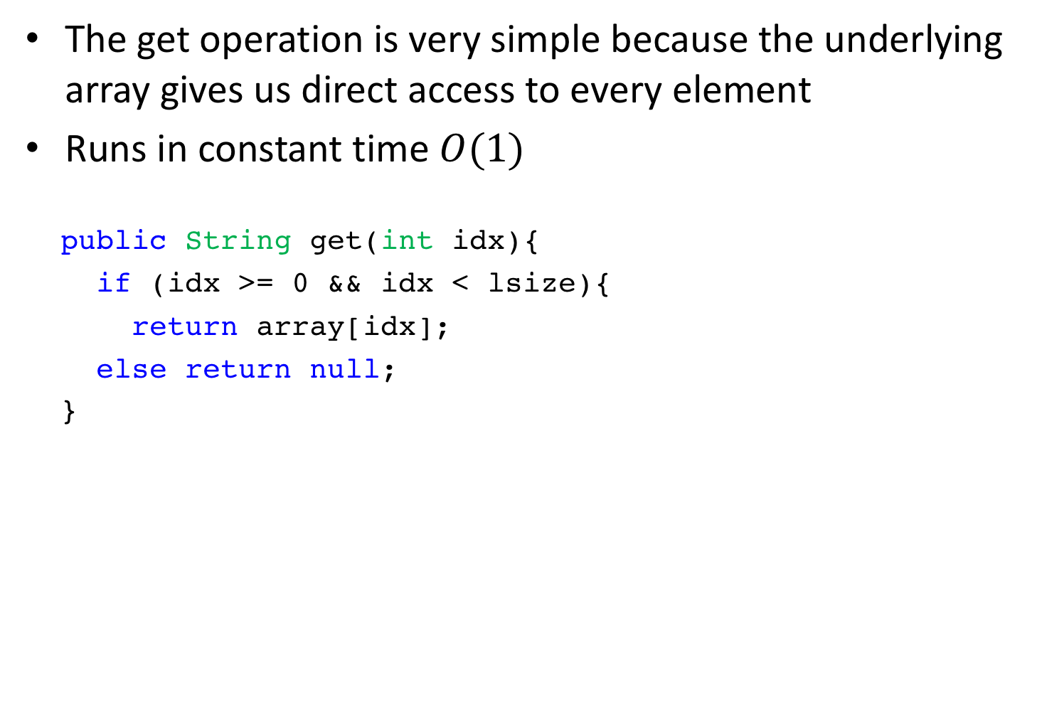
Array-based list: get
The get operation is very simple because the underlying array gives us direct access to every element
Runs in constant time $O(1)$
publicString get(intidx){
if (idx>= 0 &&idx<lsize){
return array[idx];
else returnnull;
}

Slide 37
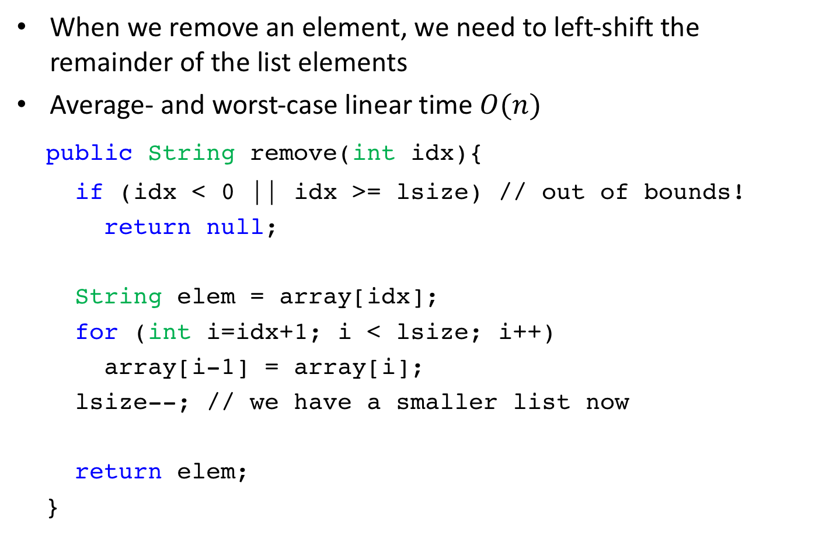
Array-based list: remove
When we remove an element, we need to left-shift the remainder of the list elements
Average- and worst-case linear time $O(n)$
publicString remove(intidx){
if (idx< 0 || idx>= lsize) // out of bounds!
returnnull;
Stringelem = array[idx];
for (inti=idx+1; i<lsize; i++)
array[i-1] = array[i];
lsize--; // we have a smaller list now
returnelem;
}

Slide 38
java.util.ArrayList
Array-based alternative to LinkedList
  Uses an array instead of a linked list of nodes
Both implement List<E> and are therefore interchangeable
Example declarations:
  List<String> strList = new ArrayList<String>();
  List<String> strList = new LinkedList<String>();

