Slide 1
CMPU-102-01 Fall 2019 Data Structures and Algorithms
Lecture #16: Java’s collections framework
Rui Meireles
Assistant Prof. of Computer Science, Vassar College, USA

Slide 2
Java’s list implementations (IPUJ 10.1-10.2)

Slide 3
An alternative to LinkedList
Random accesses are inefficient for LinkedLists
E.g. performing get() on random indices
Lists that are accessed randomly often but rarely changed benefit from a different implementation
Recall arrays:
Fixed-sized collection of elements of a given type
Contiguous memory allocation allows fast random-access
We can implement a list using an array
Arrays enable fast random access
At a price, as we’ll see
Notes:
For ArrayList
get is O(1)
add is O(1) amortized, but O(n) worst-case since the array must be resized and copied
remove is O(n)

Slide 4
Implementing a list using an array
public class StringArrayList {
private String[] array = new String[10];
private int lsize = 0; // how much is occupied
public void add(String item){ // add at end
if(lsize == array.length){ // array already full!
String[] newArray = new String[2*array.length];
for(int i=0; i < array.length; i++) // copy over
newArray[i] = array[i];
array = newArray;
}
array[lsize] = item;
lsize++;
}
}
Notes:
For ArrayList
get is O(1)
add is O(1) amortized, but O(n) worst-case since the array must be resized and copied
remove is O(n)

Slide 5
ArrayList implementation summary
Start out with an empty array with a certain capacity
Add elements until array becomes full, at which point every element is copied over to a new, 2x larger array
Worst-case running time is linear (copy)
Average-case for append (non-full array) is constant time
Accessing elements is always constant time
Removing element in the “middle” of the array requires subsequent elements to be shifted left
Average- and worst-case running times are linear
Inserting element in the “middle” of the array requires subsequent elements to be shifted right
Average- and worst-case running times are linear
Notes:
This slide is kind of unnecessary. Should remove the next time around.

Slide 6
java.util.ArrayList
Array-based alternative to LinkedList
Uses an array instead of a linked list of nodes
Both implement List<E> and are therefore interchangeable
Example declarations:
List<String> strList = new ArrayList<String>();
List<String> strList = new LinkedList<String>();

Slide 7
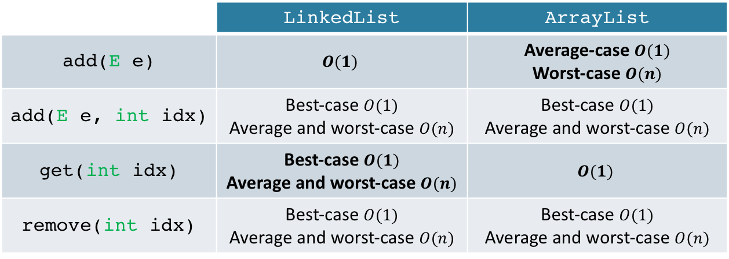
ArrayList or LinkedList?
Performance comparison (running time):
 | LinkedList | ArrayList
add(E e) | $$O(1)$$ | Average-case $O(1)$ Worst-case$O(n)$
add(E e, intidx) | Best-case $O(1)$ Average and worst-case$O(n)$ | Best-case $O(1)$ Average and worst-case$O(n)$
get(intidx) | Best-case $O(1)$ Average and worst-case$O(n)$ | $$O(1)$$
remove(intidx) | Best-case $O(1)$ Average and worst-case$O(n)$ | Best-case $O(1)$ Average and worst-case$O(n)$
Best choice depends on use case:
Lots of random accesses → ArrayList
Lots of insertions at ends → LinkedList
Memory usage consideration:
ArrayList does not shrink the array automatically when the list size decreases. An explicit call to trimToSize() is needed.

Slide 8
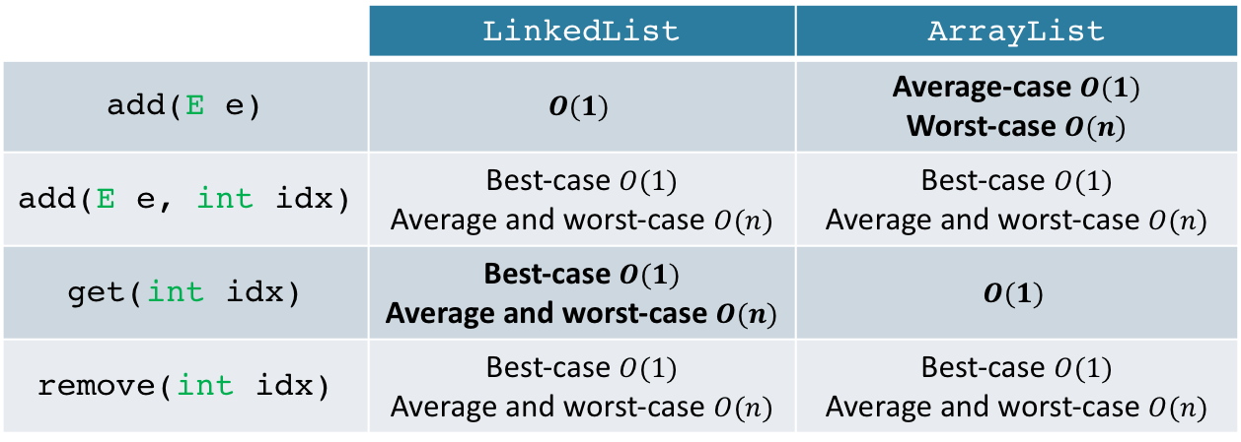
In-class exercise: ArrayList or LinkedList?
Which would you choose to:
Implement a FIFO (First-In-First-Out) queue?
Implement a database of historical sports match statistics, to be used in a Wikipedia-type site (i.e. random access)?
 | LinkedList | ArrayList
add(E e) | $$O(1)$$ | Average-case $O(1)$ Worst-case$O(n)$
add(E e, intidx) | Best-case $O(1)$ Average and worst-case$O(n)$ | Best-case $O(1)$ Average and worst-case$O(n)$
get(intidx) | Best-case $O(1)$ Average and worst-case$O(n)$ | $$O(1)$$
remove(intidx) | Best-case $O(1)$ Average and worst-case$O(n)$ | Best-case $O(1)$ Average and worst-case$O(n)$

Slide 9
Another array-based list: Vector
Differs only in detail from ArrayList:
It is synchronized
Meaning it is safe to share a vector between multiple threads
This makes it slower, so ArrayList is preferred if synchronization not needed
Array grows more slowly
ArrayList doubles array size when out of space, Vector increases it by 50%

Slide 10
Java’s collections framework (IPUJ Chapter 10)

Slide 11
Abstract data type (ADT)
List is an example of an Abstract Data Type (ADT)
Type defined by its behavior (semantics) from the user’s point of view
Semantics defined by method contracts, typically in an interface in Java
Largely independent from the way in which it is implemented
A data structure is an implementation of an ADT
Way to organize data in order to implement desired behavior
An ADT is abstract, a data structure is concrete
Implementation won’t affect functionality, but can affect performance
LinkedList, ArrayList and Vector are all data structures

Slide 12
Java collections framework
Set of ADT interfaces and data structures that implement them

Slide 13
The Collection interface
A Java collection represents a generic group of objects
Ordered or not, with repetition or not
All collections implement java.util.Collection<E>
Corollary: they all support Java generics
Some useful methods:
add(E elem): add element to collection, returns true if collection changed
contains(Object o): returns true if o is present in collection, false otherwise
remove(Object o): remove o from collection, returns true if collection changed
size(): returns number of elements in collection
Notes:
Add returns boolen, true if collection changed.,

Slide 14
Collection traversal
Going through the elements in a collection one by one
We can use a for-each loop:
Collection<String> strCol = new ArrayList<String>();
for (String str : strCol){
System.out.println(str);
}
If the collection is a a list we can use the get() method:
List<String> strList = new ArrayList<String>();
for (int i=0; i < strList.size(); i++){
System.out.println(strList.get(i));
}

Slide 15
Collection traversal using iterators
Since traversing a collection is very common Java provides another way to do it: using an Iterator
Has cursor that guides us through the collection, one element at a time
More powerful than for-each loop (supports removal)
Even if get() is available, is often more efficient, e.g. for linked lists
The Collection interface extends Iterable, meaning all collections support iteration
Iterator provides the following methods:
hasNext(): returns true if the collection has more elements
next(): returns next element in collection and moves cursor forwards
remove(): removes last element returned by the iterator from collection

Slide 16
Using an iterator
Obtaining an iterator
Collections have an iterator() method that returns one
Example usage:
Collection<String> strList = new LinkedList<String>();
...
Iterator<String> itr = strList.iterator();
while (itr.hasNext()) {
String s = itr.next();
System.out.println(s);
}

Slide 17
The ListIterator class
Collections that implement interface List also support an additional type of iterator called ListIterator
Obtained through the listIterator() method
Has many additional methods:
add(E e): add element at current position (before next())
hasPrevious(): returns true if there is an element before cursor
previous(): returns previous element and moves cursor backwards
previousIndex(): returns index of element of subsequent call to previous()
nextIndex(): returns index of element of subsequent call to next()
set(E e): replaces last element returned by previous() or next() with e

Slide 18
ListIterator example: in-class exercise
What are the output and side effects of the following program?
List<Integer> l = new LinkedList<Integer>();
for (int i=0; i < 10; i++)
l.add(i);
ListIterator<Integer> itr = l.listIterator();
int acc = 0;
while (itr.hasNext()){
int curVal = itr.next();
acc += curVal;
itr.set(acc);
}
System.out.println(itr.previous());

