Slide 1
CMPU-102-51 Spring 2020
Data Structures and Algorithms
Lecture #17: Java’s collections:
Iterator, sets
Rui Meireles
Peter Lemieszewski

Slide 2
Java’s collections framework
(IPUJ Chapter 10)

Slide 3
Java collections framework
Set of ADT interfaces and data structures that implement them

Slide 4
The ListIterator class
Collections that implement interface List also support an additional type of iterator called ListIterator
  Obtained through the listIterator() method
Has many additional methods:
  add(E e): add element at current position (before next())
  hasPrevious(): returns true if there is an element before cursor
  previous(): returns previous element and moves cursor backwards
  previousIndex(): returns index of element of subsequent call to previous()
  nextIndex(): returns index of element of subsequent call to next()
  set(E e): replaces last element returned by previous() or next() with e

Slide 5
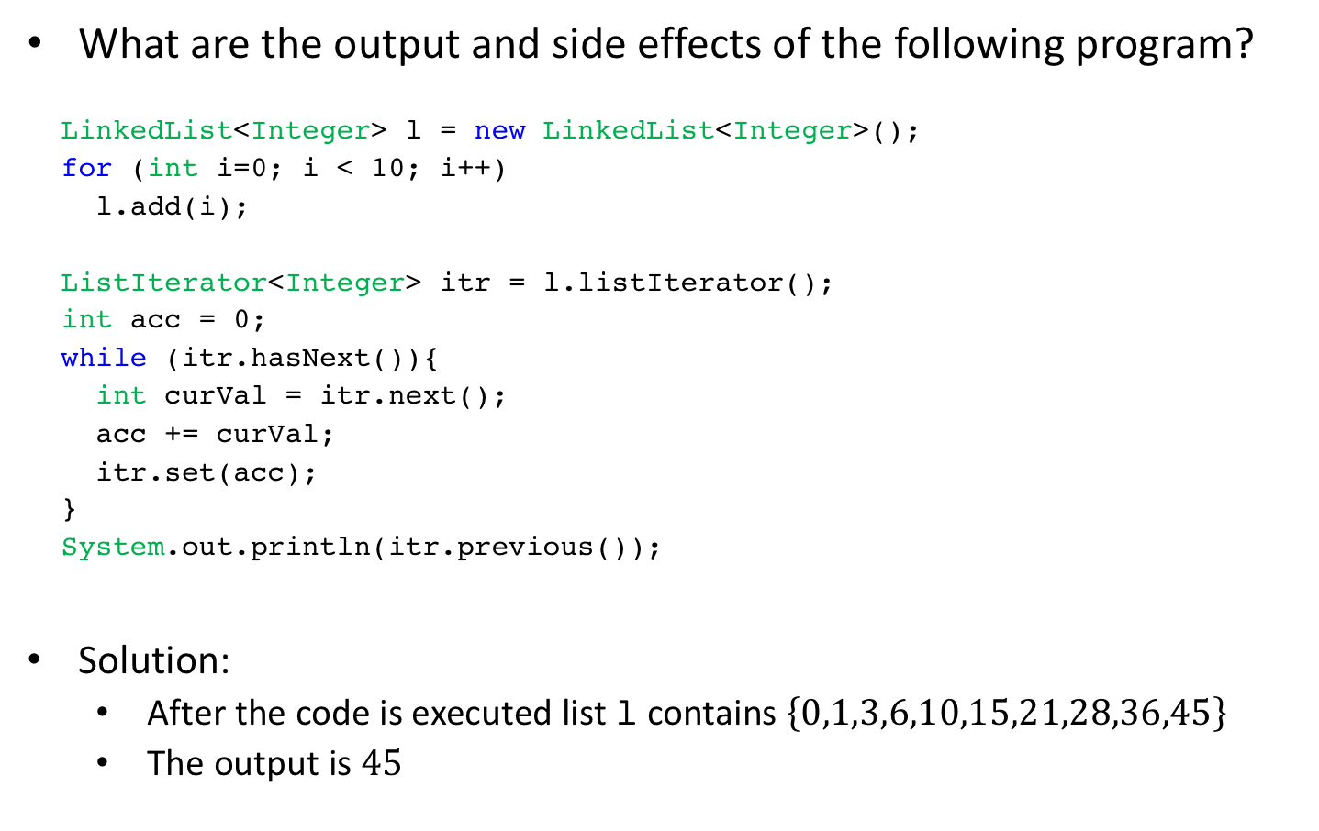
ListIterator: example
What are the output and side effects of the following program?
LinkedList<Integer> l = newLinkedList<Integer>();
for (inti=0; i< 10; i++)
l.add(i);
ListIterator<Integer>itr = l.listIterator();
intacc = 0;
while (itr.hasNext()){
intcurVal = itr.next();
acc += curVal;
itr.set(acc);
}
System.out.println(itr.previous());
Solution:
  After the code is executed list l contains $\left\{0,1,3,6,10,15,21,28,36,45\right\}$
  The output is $45$

Slide 6
Java collections: sets
(IPUJ Chapter 10)

Slide 7
Sets, generally.
A set is a collection of distinct elements that can be identified by a common trait. But…
“ <the elements> need not even be physical objects; they may in turn be abstract items. For example, they can be numbers, geometric figures, items of computer code, colours (!), concepts or whatever you like.”*
MORE:
Sets have unique items only! (no duplicates)
  Beware of the dreaded DuplicateElementException
The Set interface extends Collection and contains no additional methods other than those inherited from Collection
Two Set objects are equal if they contain the same elements
* Sets, Logic and Maths for Computing, Second Edition, by David Makinson

Slide 8
Java collections framework
Set of data structures implementing many common ADTs

Slide 9
The Set interface
A duplicate-free unordered collection of elements
Same methods as defined in Collection (with different semantics)
  add(E elem): add element to collection, returns false if already exists
  remove(Object o): remove object o from collection, return true if removed, false if didn’t exist (no exception ??!?)
  contains(Object o): returns true if o is present in collection, false otherwise
(no exceptions ??!?)

Slide 10
Set class hierarchy
HashSet: uses hashing for fast element lookup
LinkedHashSet: like HashSet but also keeps linked list between elements that allows for insertion-order iteration
TreeSet: keeps set elements sorted using a tree data structure
EnumSet: specialized set for constants

Slide 11
Set example usage
String[] names = {"Jay", "Alice", "Melvor", "Erica"};
Set<String> nset = new HashSet<String>();
for (int i=0; i < names.length; i++)
nset.add(names[i]);
System.out.println("What names am I thinking of?");
Scanner scanner = new Scanner(System.in);
while (true){
String guess = scanner.next();
if (guess.toLowerCase().equals("exit"))
break;
if (nset.contains(guess))
System.out.println("Lucky guess!");
else System.out.println("No. Try again?!");
}

Slide 12
What is hashing?
HashSet uses hashing and an array to improve performance
  A hash function takes in an object and outputs an integer hash code
Desirable hash function properties:
  Determinism: always output the same value for a given input
  Defined range: fixed-size output
  Uniformity: every output equally likely
Java provides a hash function in the Object class:
  int hashCode(): returns integer hash code for any object
  E.g. "hello".hashCode() returns 99162322

Slide 13
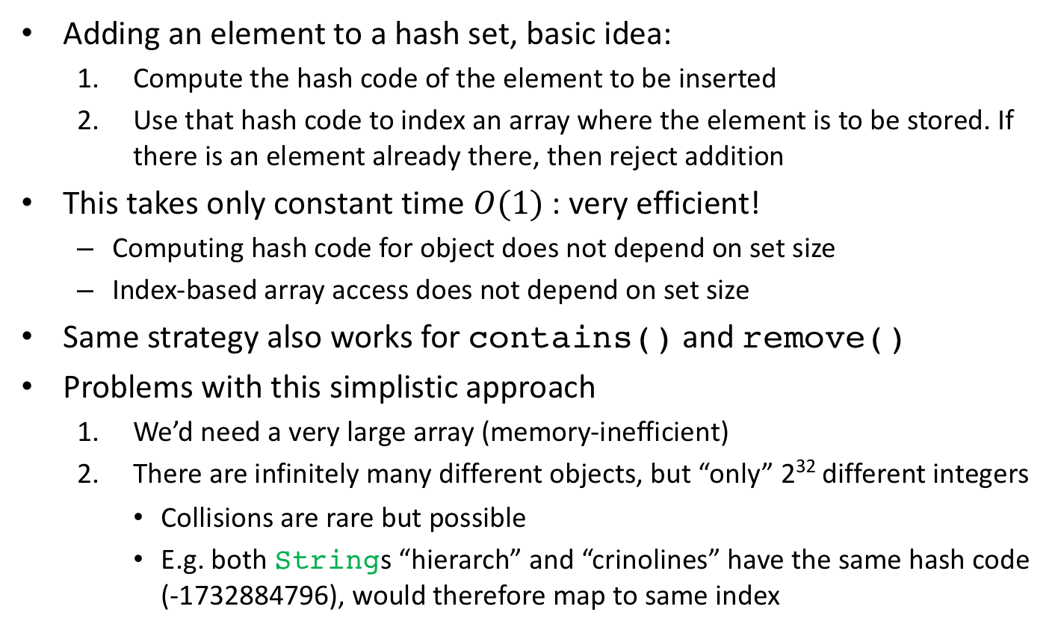
Using hashing to implement a set
Adding an element to a hash set, basic idea:
  Compute the hash code of the element to be inserted
  Use that hash code to index an array where the element is to be stored. If there is an element already there, then reject addition
This takes only constant time $O(1)$: very efficient!
  Computing hash code for object does not depend on set size
  Index-based array access does not depend on set size
Same strategy also works for contains() and remove()
Problems with this simplistic approach
  We’d need a very large array (memory-inefficient)
  There are infinitely many different objects, but “only” 2³² different integers
    Collisions are rare but possible
    E.g. both Strings “hierarch” and “crinolines” have the same hash code (-1732884796), would therefore map to same index

Slide 14
Bucket hashing
Idea:
  Have a reasonably-sized array a (size N_BUCKETS) where each element is a bucket that can hold multiple elements (e.g. a List)
    List[] a = new LinkedList[N_BUCKETS];
  Compute bucket for an element e as:
  int bucket = Math.abs(e.hashCode()) % N_BUCKETS;
  Use the List in a[bucket] to implement the set operations:
    For add(): a[bucket].add(e)
    For contains(): a[bucket].contains(e)
    For remove(): a[bucket].remove(e)

Slide 15
HashSet
HashSet uses bucket hashing for fast lookup
Example, adding elements:
String[] names = {"Jay", "Alice", "Melvor", "Erica"};
Set<String> nset = new HashSet<String>();
for (int i=0; i < names.length; i++)
nset.add(names[i]);
0
1
Jay
Erica
String | Bucket
Jay | 0
Alice | 3
Melvor | 3
Erica | 0
2
null
null
3
Alice
Melvor
null
null
Testing existence:
nset.contains("Melvor");

Slide 16
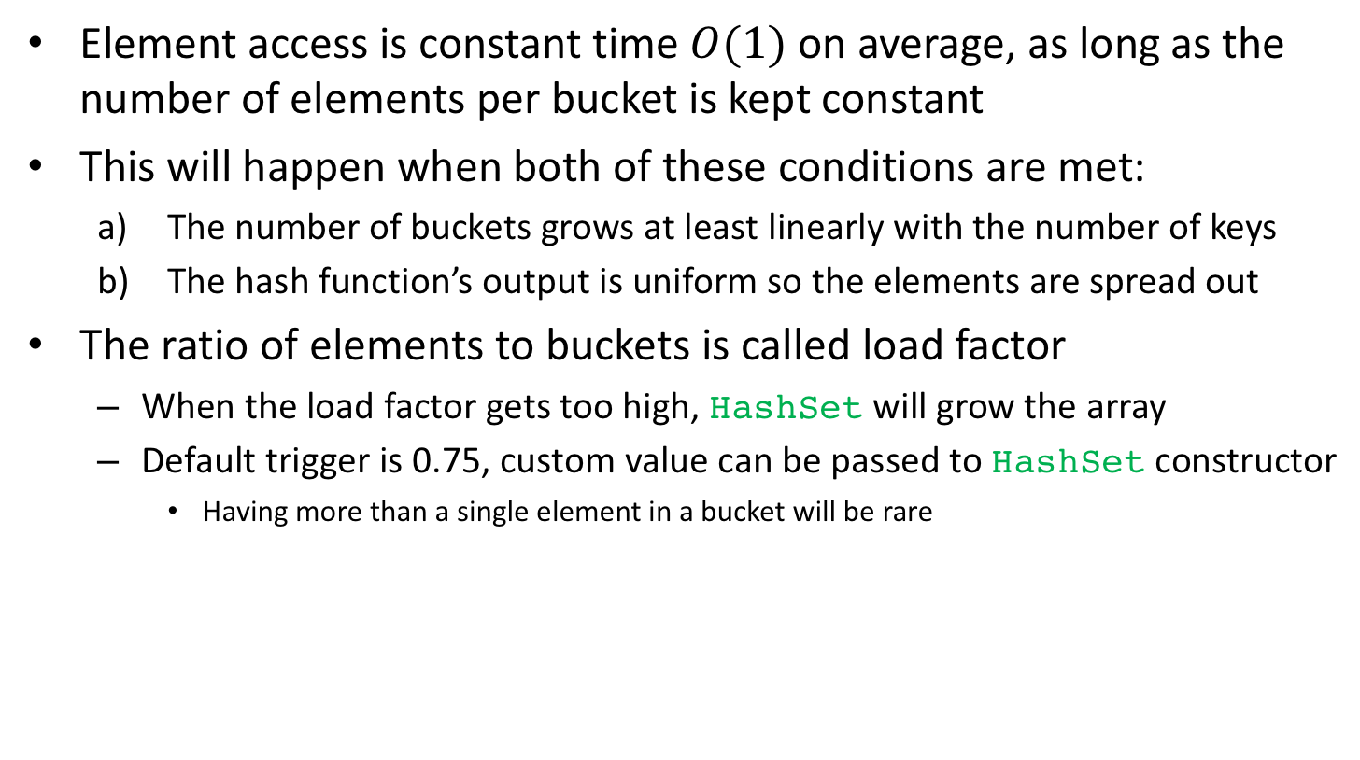
Bucket hashing performance
Element access is constant time $O(1)$ on average, as long as the number of elements per bucket is kept constant
This will happen when both of these conditions are met:
  The number of buckets grows at least linearly with the number of keys
  The hash function’s output is uniform so the elements are spread out
The ratio of elements to buckets is called load factor
  When the load factor gets too high, HashSet will grow the array
  Default trigger is 0.75, custom value can be passed to HashSet constructor
    Having more than a single element in a bucket will be rare

