Slide 1
CMPU-102-51 Spring 2020
Data Structures and Algorithms
Lecture #17: Java’s collections: (re)queue
Rui Meireles
Peter Lemieszewski

Slide 2
Java’s collections framework
(IPUJ Chapter 10)

Slide 3
Java collections framework
Set of ADT interfaces and data structures that implement them

Slide 4
Set class hierarchy
HashSet: uses hashing for fast element lookup
LinkedHashSet: like HashSet but also keeps linked list between elements that allows for insertion-order iteration
TreeSet: keeps set elements sorted using a tree data structure
EnumSet: specialized set for constants

Slide 5
Set example usage
String[] names = {"Jay", "Alice", "Melvor", "Erica"};
Set<String> nset = new HashSet<String>();
for (int i=0; i < names.length; i++)
nset.add(names[i]);
System.out.println("What names am I thinking of?");
Scanner scanner = new Scanner(System.in);
while (true){
String guess = scanner.next();
if (guess.toLowerCase().equals("exit"))
break;
if (nset.contains(guess))
System.out.println("Lucky guess!");
else System.out.println("No. Try again?!");
}

Slide 6
What is hashing?
HashSet uses hashing and an array to improve performance
  A hash function takes in an object and outputs an integer hash code
Desirable hash function properties:
  Determinism: always output the same value for a given input
  Defined range: fixed-size output
  Uniformity: every output equally likely
Java provides a hash function in the Object class:
  int hashCode(): returns integer hash code for any object
  E.g. "hello".hashCode() returns 99162322

Slide 7
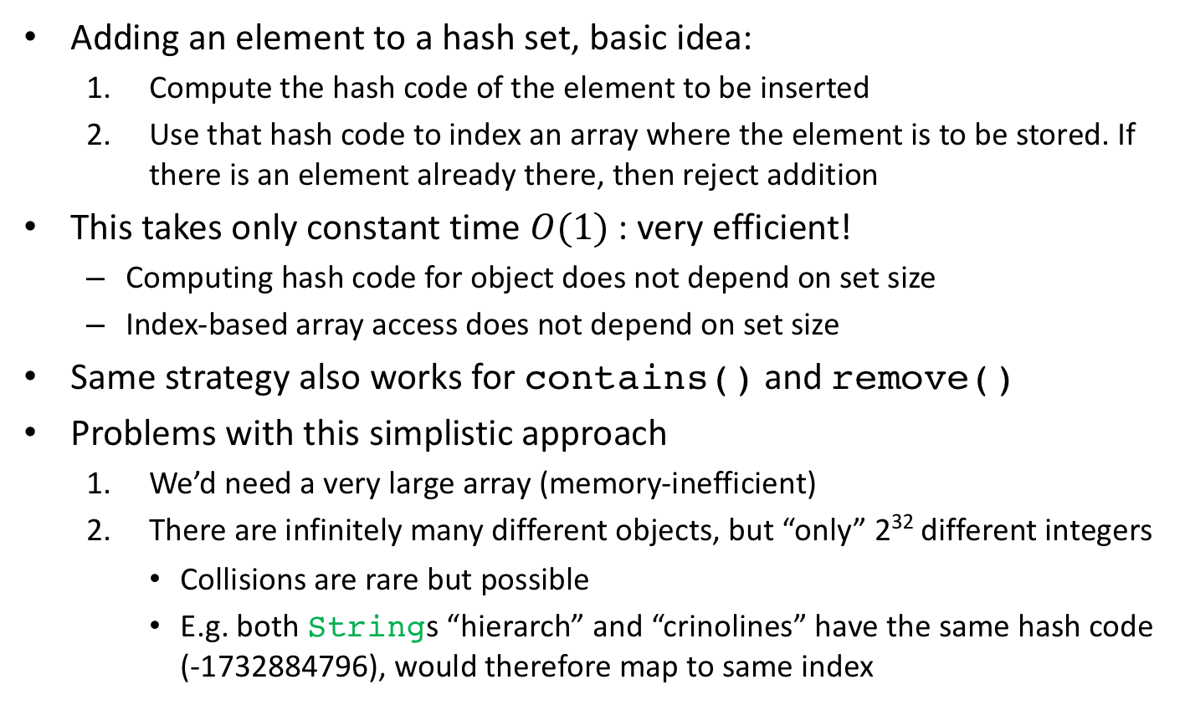
Using hashing to implement a set
Adding an element to a hash set, basic idea:
  Compute the hash code of the element to be inserted
  Use that hash code to index an array where the element is to be stored. If there is an element already there, then reject addition
This takes only constant time $O(1)$: very efficient!
  Computing hash code for object does not depend on set size
  Index-based array access does not depend on set size
Same strategy also works for contains() and remove()
Problems with this simplistic approach
  We’d need a very large array (memory-inefficient)
  There are infinitely many different objects, but “only” 2³² different integers
    Collisions are rare but possible
    E.g. both Strings “hierarch” and “crinolines” have the same hash code (-1732884796), would therefore map to same index

Slide 8
Bucket hashing
Idea:
  Have a reasonably-sized array a (size N_BUCKETS) where each element is a bucket that can hold multiple elements (e.g. a List)
    List[] a = new LinkedList[N_BUCKETS];
  Compute bucket for an element e as:
  int bucket = Math.abs(e.hashCode()) % N_BUCKETS;
  Use the List in a[bucket] to implement the set operations:
    For add(): a[bucket].add(e)
    For contains(): a[bucket].contains(e)
    For remove(): a[bucket].remove(e)

Slide 9
HashSet
HashSet uses bucket hashing for fast lookup
Example, adding elements:
String[] names = {"Jay", "Alice", "Melvor", "Erica"};
Set<String> nset = new HashSet<String>();
for (int i=0; i < names.length; i++)
nset.add(names[i]);
0
1
Jay
Erica
String | Bucket
Jay | 0
Alice | 3
Melvor | 3
Erica | 0
2
null
null
3
Alice
Melvor
null
null
Testing existence:
nset.contains("Melvor");

Slide 10
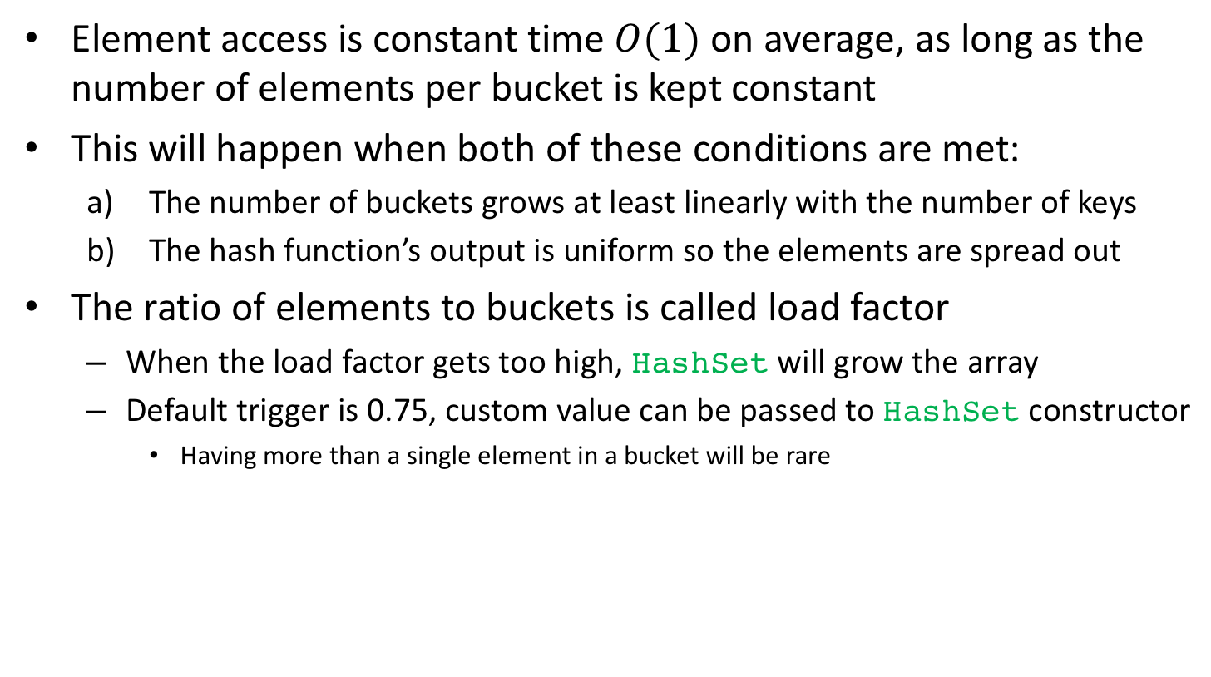
Bucket hashing performance
Element access is constant time $O(1)$ on average, as long as the number of elements per bucket is kept constant
This will happen when both of these conditions are met:
  The number of buckets grows at least linearly with the number of keys
  The hash function’s output is uniform so the elements are spread out
The ratio of elements to buckets is called load factor
  When the load factor gets too high, HashSet will grow the array
  Default trigger is 0.75, custom value can be passed to HashSet constructor
    Having more than a single element in a bucket will be rare

Slide 11
Java’s collections framework: queues
(IPUJ Chapter 10)

Slide 12
The Queue interface
A queue is an ADT that imposes an order on element access
We are able to:
  add (enqueue) and remove (dequeue) elements
  examine element at head of queue without removing it
The order in which elements are removed obeys a certain rule:
  First-In, First-Out (FIFO) queue
  Last-In, First-Out (LIFO) queue
  Priority queue: highest-priority element removed first

Slide 13
Queue interface methods
Queue provides two sets of methods, distinguished by the way they deal with exceptional situations:
add() throws an IllegalStateException if there is no space left on the queue (some queue implementations have limited capacity), offer() returns false instead
remove() and element() throw a NoSuchElementException if the queue is empty, poll() and peek() return null instead
 | Throws exception | Returns special value
Insert | add(E e) | offer(E e)
Remove | remove() | poll()
Examine head | element() | peek()

Slide 14
The Stack class
The traditional name given to a LIFO queue is stack
The traditional names for the stack operations are:
  push(E e): place element e on the top of the stack and return said element
  pop(): remove element from top of stack and return it
  peek(): return element on top of stack without removing it
Java has a class called Stack that inherits from Vector but it’s old and Deque is preferred (functionally equivalent but faster)

Slide 15
The PriorityQueue class
Always keeps the highest-priority element at head
  Note that the remaining elements are not necessarily ordered!
In a PriorityQueue, the smallest element has highest priority
  This is what is called a min-priority queue
  A queue where larger means higher priority is a max-priority queue

Slide 16
The Comparable interface
But how does the queue know the elements’ priorities?
  Queue elements should implement the Comparable<T> interface
compareTo() must return a negative integer if the this object is “smaller” than the argument o, zero if it is equal, and a positive integer if it is “larger” than o
The order thus established is known as the natural order

Slide 17
PriorityQueue and Comparable
Many common classes implement the Comparable interface
  E.g. String, Date, wrapper classes like Integer, Long and Double
  When in doubt, flat out consult the Javadoc
Using a non-Comparable class will result in a ClassCastExcception when PriorityQueue attempts to cast the elements to Comparable in order to compare them
  Happens when the 2nd element is added to the queue!

Slide 18
PriorityQueue: in-class exercise
Use a priority queue to sort an array of Strings alphabetically
String[] sa = {"Jay", "Alice", "Melvor", "Erica"};
... // your code here
for (int i=0; i < sa.length; i++)
System.out.println(sa[i]);
Recall the Queue interface methods:
 | Throws exception | Returns special value
Insert | add(E e) | offer(E e)
Remove | remove() | poll()
Examine head | element() | peek()

Slide 19
PriorityQueue: in-class exercise solution
Use a priority queue to sort an array of Strings alphabetically
String[] sa = {"Jay", "Alice", "Melvor", "Erica"};
PriorityQueue<String> pq = new PriorityQueue<String>();
for (int i=0; i < sa.length; i++) // add to priority queue
pq.add(sa[i]);
for (int i=0; i < sa.length; i++) // remove from queue
sa[i] = pq.remove();
for (int i=0; i < sa.length; i++)
System.out.println(sa[i]);

Slide 20
PriorityQueue usage example
Let’s sort an array of Strings alphabetically:
String[] sa = {"Jay", "Alice", "Melvor", "Erica"};
PriorityQueue<String> pq = new PriorityQueue<String>();
for (int i=0; i < sa.length; i++) // add to priority queue
pq.add(sa[i]);
for (int i=0; i < sa.length; i++) // remove from queue
sa[i] = pq.remove();
for (int i=0; i < sa.length; i++)
System.out.println(sa[i]);

Slide 21
Custom comparator for PriorityQueue
If the objects we want to store do not implement Comparable we can pass a Comparator-implementing object to the constructor
  Can also be used to override natural order
Return value semantics same as compareTo() from Comparable:
  negative integer if o1 < o2
  zero if both arguments are equal
  positive integer if o1 > o2

Slide 22
Custom comparator example (1/2)
Let’s sort an array of Strings in reverse-alphabetical order:
public class RevCmp implements Comparator<String> {
public int compare(String s1, String s2){
return -1 * s1.compareTo(s2);
}
}
String[] sa = {"Jay", "Alice", "Melvor", "Erica"};
Queue<String> pq = new PriorityQueue<String>(new RevCmp());
for (int i=0; i < sa.length; i++) pq.add(sa[i]);
for (int i=0; i < sa.length; i++) sa[i] = pq.remove();
for (int i=0; i < sa.length; i++) System.out.println(sa[i]);
Note that, for convenience, there is a generic built-in reverse Comparator accessible through the static method Collections.reverseOrder()

Slide 23
Custom comparator example (2/2)
This is how we could implement a generic reverse comparator that works with any Comparable<T> type:
public class RevCmp<T extends Comparable<T>>
implements Comparator<T> {
public int compare(T o1, T o2){
return -1 * o1.compareTo(o2);
}
}
String[] sa = {"Jay", "Alice", "Melvor", "Erica"};
Comparator<String> rc = new RevCmp<String>();
Queue<String> pq = new PriorityQueue<String>(rc);
for (int i=0; i < sa.length; i++) pq.add(sa[i]);
for (int i=0; i < sa.length; i++) sa[i] = pq.remove();
for (int i=0; i < sa.length; i++) System.out.println(sa[i]);

