Slide 1
CMPU-102-51 Spring 2020
Data Structures and Algorithms
Lecture #19: Java’s collections: maps
+ algorithmic analysis introduction
Rui Meireles
Peter Lemieszewski

Slide 2
Java’s collections framework: maps
(IPUJ Chapter 10)

Slide 3
Java collections framework
Set of data structures implementing many common ADTs

Slide 4
The java.util.Map interface
Lists allow us to access elements by index
  Often not very useful
Map is an ADT that defines a content-associative memory
  Stored values referenced by a key, not an index (maps key to value)
  Map keys are unique
  Also know as a dictionary (word → definition)
  Keys can be numeric or not
Very common in practice, e.g.:
  Access driver record using driver’s license id

Slide 5
java.util.Map iteration (1/2)
Map does not implement Collection, so no iterator built-in
We can use the entrySet() method to obtain one though
  Returns a set of map entries, which we can then iterate over. E.g.:
Map<Integer,String> map = new HashMap<Integer,String>();
...
Set<Map.Entry<Integer,String>> entrySet = map.entrySet();
Iterator<Map.Entry<Integer,String>> itr = entrySet.iterator();
while (itr.hasNext()){
Map.Entry<Integer,String> e = itr.next();
System.out.printf("key %d: value %s\n", e.getKey(), e.getValue());
}
Alternatively, using a for-each loop:
for (Map.Entry<Integer,String> e : map.entrySet())
System.out.printf("key %d: value %s\n", e.getKey(), e.getValue());

Slide 6
java.util.Map iteration (2/2)
Map does not implement Collection, so no iterator built-in
Another option is to use the keySet() method
  Returns set of keys instead of set of entries
  Can then use get() method to obtain the value for a given key. E.g.:
Map<Integer,String> map = new HashMap<Integer,String>();
...
Set<Integer> keySet = map.keySet();
Iterator<Integer> itr = keySet.iterator();
while (itr.hasNext()){
int key = itr.next();
String value = map.get(key);
System.out.printf("key %d: value %s\n", key, value);
}
A map and its key set are tightly-coupled
  Removal from key set will remove element from map
    But note that addition to key set is not supported, throws exception
  Addition to map will be reflected in key set
Notes:
Throws UnsupportedOperationException.

Slide 7
Map class hierarchy
Very similar to the Set hierarchy
HashTable, HashMap , LinkedHashMap
  Use hashing for fast element lookup
TreeMap
  Keeps set elements sorted using a tree data structure, like TreeSet
Notes:
Hashtable is synchronized, whereas HashMap is not. This makes HashMap better for non-threaded applications, as unsynchronized Objects typically perform better than synchronized ones.
Hashtable does not allow null keys or values. HashMap allows one null key and any number of null values.
One of HashMap's subclasses is LinkedHashMap, so in the event that you'd want predictable iteration order (which is insertion order by default), you could easily swap out the HashMap for a LinkedHashMap. This wouldn't be as easy if you were using Hashtable.

Slide 8
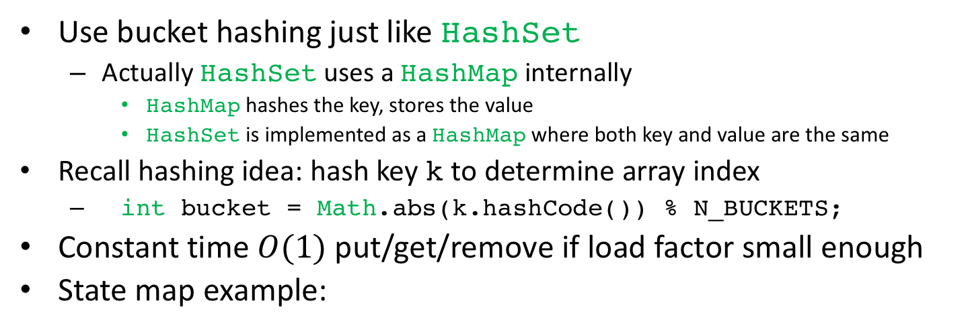
The hash-based Maps
Use bucket hashing just like HashSet
  Actually HashSetuses a HashMapinternally
    HashMap hashes the key, stores the value
    HashSet is implemented as a HashMap where both key and value are the same
Recall hashing idea: hash key k to determine array index
  int bucket = Math.abs(k.hashCode()) % N_BUCKETS;
Constant time $O(1)$ put/get/remove if load factor small enough
State map example:
HashMap<String,String> map = new HashMap<>();
map.put("TX", "Texas");
map.put("ID", "Idaho");
map.put("ME", "Maine");
map.put("UT", "Utah");
String state = map.get("UT");
0
ID
UT
1
Idaho
Utah
2
null
null
3
TX
ME
Texas
Maine
null
null
Notes:
Hashtable is synchronized, whereas HashMap is not. This makes HashMap better for non-threaded applications, as unsynchronized Objects typically perform better than synchronized ones.
Hashtable does not allow null keys or values. HashMap allows one null key and any number of null values.
One of HashMap's subclasses is LinkedHashMap, so in the event that you'd want predictable iteration order (which is insertion order by default), you could easily swap out the HashMap for a LinkedHashMap. This wouldn't be as easy if you were using Hashtable.

Slide 9
The hash-based Maps
Use bucket hashing just like HashSet
  Actually HashSetuses a HashMapinternally
    HashMap hashes the key, stores the value
    HashSet is implemented as a HashMap where both key and value are the same
Recall hashing idea: hash key k to determine array index
  int bucket = Math.abs(k.hashCode()) % N_BUCKETS;
Constant time $O(1)$ put/get/remove if load factor small enough
State map example:
From display on the right, I spy 4 internal components!
Hash value
Key
Data associated with that key
“next” reference
These 4 components make up a map’s node!
compare to linked list node…
0
ID
UT
1
Idaho
Utah
2
null
null
3
TX
ME
Texas
Maine
null
null
Notes:
Hashtable is synchronized, whereas HashMap is not. This makes HashMap better for non-threaded applications, as unsynchronized Objects typically perform better than synchronized ones.
Hashtable does not allow null keys or values. HashMap allows one null key and any number of null values.
One of HashMap's subclasses is LinkedHashMap, so in the event that you'd want predictable iteration order (which is insertion order by default), you could easily swap out the HashMap for a LinkedHashMap. This wouldn't be as easy if you were using Hashtable.

Slide 10
Differences between hash-based Maps
HashMap is the “standard” implementation
HashTable is older, synchronized
  Useful for multi-threaded applications
  Unnecessarily slow for single-threaded ones
  Hash table is a traditional name for this data structure
HashTable does not allow null keys or values
  HashMap allows one null key, unlimited null values
LinkedHashMap is a subclass of HashMap that keeps a linked list between nodes that enables iteration in a predictable order
  Choose between insertion-order (default) and access-order upon construction
Notes:
Hashtable is synchronized, whereas HashMap is not. This makes HashMap better for non-threaded applications, as unsynchronized Objects typically perform better than synchronized ones.
Hashtable does not allow null keys or values. HashMap allows one null key and any number of null values.
One of HashMap's subclasses is LinkedHashMap, so in the event that you'd want predictable iteration order (which is insertion order by default), you could easily swap out the HashMap for a LinkedHashMap. This wouldn't be as easy if you were using Hashtable.

Slide 11
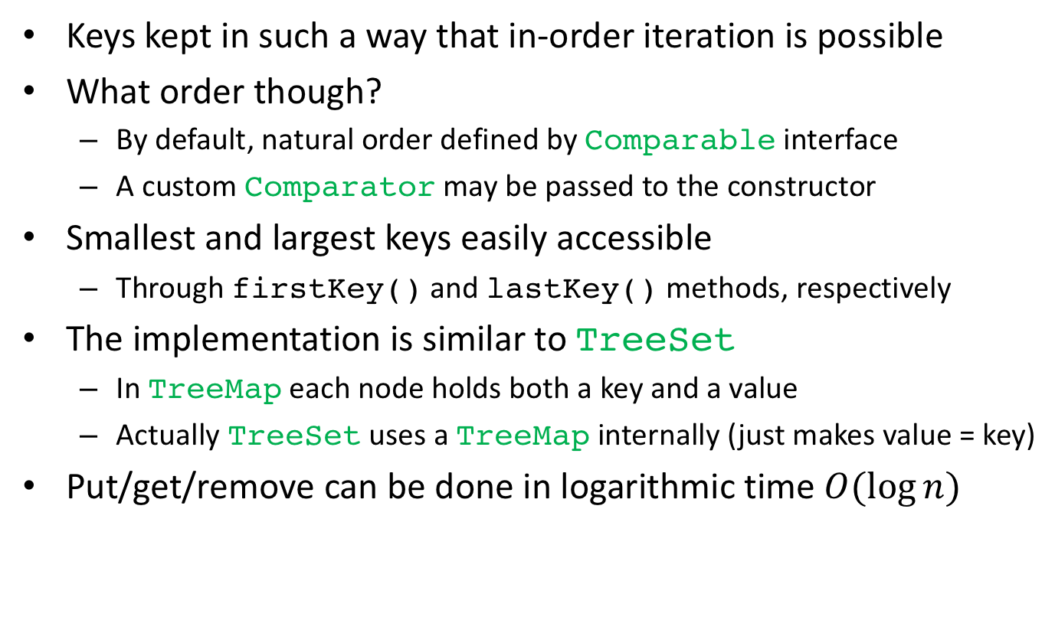
Sorted maps
Keys kept in such a way that in-order iteration is possible
What order though?
  By default, natural order defined by Comparable interface
  A custom Comparator may be passed to the constructor
Smallest and largest keys easily accessible
  Through firstKey() and lastKey() methods, respectively
The implementation is similar to TreeSet
  In TreeMap each node holds both a key and a value
  Actually TreeSet uses a TreeMap internally (just makes value = key)
Put/get/remove can be done in logarithmic time $O(\log{n})$

Slide 12
How to choose a Map
TreeMap if you need in-order iteration
HashTable if you need multi-threading synchronization
LinkedHashMap if you need insertion-order iteration
HashMap for anything else (most commonly used)

Slide 13
One more time:
Java collections framework
Set of ADT interfaces and data structures implementing them

Slide 14
Algorithmic Analysis
(IPUJ Chapter 8, section 5)

Slide 15
Analysis of Algorithms
After proving (demonstrating)? That an algorithm is correct,
  what then?
We can ask if the algorithm is “good!”
  David Eck, via our textbook, would frame the question in terms of “efficiency.”
“And what is good, Phaedrus,
And what is not good—
Need we ask anyone to tell us these things?”
― Robert M. Pirsig, Zen and the Art of Motorcycle Maintenance: An Inquiry Into Values
- see also: https://en.wikipedia.org/wiki/Phaedrus_(dialogue)

Slide 16
An Asymptotic Analysis
A quantitative analysis of the performance of an algorithm (or program):
  Based on relative performance of other algorithms that solve the same problem
  Also based on data, (and sometimes independent of the data).
    e.g. a collection of size n, accessing element i <= n)
In industry, the term used is the number of machine language instructions (we can also use the generic term, operations.)
Mathematically (and according to wikipedia) the term used is “Big O” or “Big Oh” notation. (This is what we will use.)
  The “Order” of a function. That is,
  The limits of a function, f(x), when x approaches infinity.

Slide 17
An example from Maps
Recall this slide from our discussion of Maps
O(1) refers to constant time to perform put/get/remove
  Independent of the data: the size of the Map (i.e. data) is irrelevant.
    Umm, what about the “if load factor small enough” part?

Slide 18
An example from Maps
Recall this slide from our discussion of Maps
O(1) refers to constant time to perform put/get/remove
  Independent of the data: the size of the Map (i.e. data) is irrelevant.
    Umm, what about the “if load factor small enough” part?
  This assumes we don’t need to search within the bucket!
    Sometimes, the kind of data is important: [best/worst/average] case

Slide 19
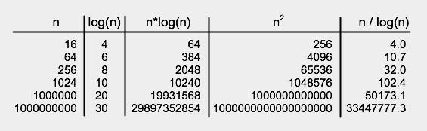
Basic Orders of Algorithmic Growth
O(1) – Constant time (e.g. inserting element in a not-full array)
O(n) – Constant growth, based on n (e.g. inserting element in a linked list)
O(n²) – Power function, exponent is a constant (e.g. bubble sort)
O(2^{n}) – Power function, exponential growth
O(log(n)) – Logarithmic growth (e.g. binary search)
The following chart, from our textbook, shows relative order

Slide 20
We can segue into …
A discussion of sorting algorithms !
Consider $1200 stimulus checks.
  Hopefully, you or your family received on already!
  What does this have to do with sorting algorithms?

Slide 21
We can segue into … (cont.)
A discussion of sorting algorithms:
Consider $1200 stimulus checks.
  Hopefully, you or your family received on already!
  This:
According to marketwatch.com,
  https://www.marketwatch.com/story/when-are-stimulus-checks-being-sent-out-how-to-keep-tabs-on-yours-2020-04-10
After direct deposit funds are deposited into accounts. . .
In early May, the IRS will start mailing paper checks to households, at a rate of 5 million per week. The paper checks will first go to the households with the lowest adjusted gross incomes, and continue upwards.
Translated: the IRS will sort all household incomes in the USA
  according to income (low-to-high)
  and mail checks according to this sort order.
I wonder what kind of sorting algorithm will be used?
  Maybe it’ll be some Cobol application too
Notes:
Segue is one of those words that require help to pronounce. Kinda like epitome.

Slide 22
… Sorting Algorithms
According to toptal.com,
  https://www.toptal.com/developers/sorting-algorithms
The ideal sorting algorithm, which doesn’t exist by the way, should. . .
Avoid moving/swapping equal elements
Require a minimum of extra memory (Big-O notation: O(1) )
Have, in worst-case, element/key comparisons of O(nlog(n))
Have, in worst-case, moving/swapping elements of O(n)
Be more efficient when the data is nearly sorted already
  Data can be arranged randomly, nearly sorted, nearly reverse sorted,
  Even mostly different or mostly the same (like yearly incomes maybe?)
The best algorithm, in other words, is the one that:
works best for the data we want to sort.

Slide 23
The Bubble Sort
The basic idea: consider an unordered (by height) All-Star baseball (?) team
Sorting rules:
You can only “see” two players at a time
You start on the left hand side (players numbered from 0 to n-1)
Compare two players (Aaron Judge tall, Jose Altuve small)
If the one on the left is taller, swap the positions of these two players
Move one position to the right
When you reach the end of the line start over again (step 2) until sorted!
  After the first pass, Aaron Judge will be in his final position, N-1)
  After second pass, say Freddy Adu is in his final position, N-2)
  After last pass, everyone is sorted: Sachin Tendulkar, Jose Altuve, Freddy Adu, Aaron Judge
The basic algorithm (low to high):
  for (backwards= numberOfElements-1; backwards > 1; backwards--) { // outer loop: consider elements from back -> front of list
  for (forwards= 0; forwards < backwards; forwards++) { // inner loop: consider elements front -> back of list
  if ( array[forwards] > array[forwards+1]) // if the relative elements are out of order
  swap(forwards, forwards+1); // swap the elements
  }
  } // Let’s look at the code in action!

Slide 24
The Bubble Sort Algorithm
The basic algorithm (larger font):
  for (backwards= numberOfElements-1; backwards > 1; backwards--) {// outer loop:
  for (forwards= 0; forwards < backwards; forwards++) { // inner loop
  if ( array[forwards] > array[forwards+1]) // “You’re out of order!”
  swap(forwards, forwards+1); // swap the elements
  }
  } // Let’s look at the code in action!

