Slide 1
CMPU-102-01 Fall 2021
Data Structures and Algorithms
Lecture #6: Java arrays; variable scope;
Rui Meireles
Peter Lemieszewski

Slide 2
Previously, on CMPU-102…
Object-Oriented Programming (OOP)
  3 pillars: encapsulation, inheritance, polymorphism
Introduction to Java
  Classes, methods, fields
  Static members
  Packages and import statements
  Expressions
  Text input/output
  Control flow

Slide 3
The array data structure
(IPUJ 3.8)

Slide 4
Definition of data structure
Algorithm
  An unambiguous specification of a method to solve a given class of problems
Data structure
  A way to organize data that allows us to use it efficiently in an algorithm
Example problem: find the maximum value in a set of numbers
How would we like the numbers to be organized?
  Have all the numbers one after another in memory
  Have a reference to the first number and the size of each element
    We can then access any element easily:
      i^{th} element is at memory address (first element address + (i-1) * sizeof(element))
This is exactly what an array is!

Slide 5
For Emphasis
Algorithm
  An unambiguous specification of a method to solve a given class of problems
Data structure
  A way to organize data that allows us to use it efficiently in an algorithm
Example problem: find the maximum value in a set of numbers
How would we like the numbers to be organized?
  Have all the numbers one after another in memory
  Have a reference to the first number and the size of each element
    We can then access any element easily:
      i^{th} element is at memory address (first element address + (i-1) * sizeof(element))
Count array elements starting with ordinal number 0
3
This is exactly what an array is!

Slide 6
Java arrays
Array definition: fixed-size collection of elements of same type
  Elements can be either an object-reference or primitive type
  Relationship to Scheme:
    Think of a Java array as a mutable Scheme vector where all elements are of same type
Declaration distinguished by square brackets [] suffix on data type.
  String[] names;
  int[] ages;
Arrays can be used anywhere a variable is declared
  Class fields
  Method-local variables, including parameters
Same access rules as other variables (e.g. public, private, etc)
Can also be static (what’s a synonym for static?) a: common
An array is an object (even arrays of primitive types)
  Virtually everything is an object in Java, even plain old data types (pod) can be uses as an object (int vs Int, double vs Double, etc.)

Slide 7
Java array initialization
Initialization using default value for type:
  String[] names;
  names = new String[100]; // reserve memory for 100 element String array
  int[] ages = new int[100];
  Note even primitive types require the new keyword
    Because arrays are always objects, we must reserve memory for each unit/element!
Initialization by enumeration:
  String[] names = {"Dorothy", "Tin Man", "Lion"};
  int[] ages = {16, 35, 12};
Once an array is initialized, its length is forever fixed
  Why? Java will use the memory immediately after it for something else
  Can be accessed as <array>.length,
  e.g. ages.length, names.length

Slide 8
Array access
Individual array elements can be accessed using varName[idx]
  idx is integer expression representing the position of the element we want
Indices in Java begin at zero and go to array length – 1
  Every array has a length field
  Trying to access elements outside of this range will yield an ArrayIndexOutOfBoundsException
a[2]
a[3]
Examples:
  int[] array = {3, 54, 34, 32, 23, 1, 43, 999, 45};
  int firstElement = a[0]; // firstElement = 3;
  int firstTwo = a[0] + a[1]; // firstTwo = 3 + 54 = 57
  a[a.length-1] = 0; // last element of set to 0

Slide 9
Array usage example
Problem: find the maximum value in a set of integer numbers
Solution
  Store the numbers in an array
  Use a loop to go through the array elements and compare each one with the previously-known maximum
public static int findMax(int[] array){
int max = Integer.MIN_VALUE; // smallest possible value
for (int i=0; i<array.length; i++) // Here loop control is for accessing array inexes!
if (array[i] > max)
max = array[i];
return max;
}

Slide 10
“For-each” loop
Different for() loop - easy way to scan through all elements in array
  Obviates the need for []s
Format: for (<dataType> <varName> : <arrayName>){…}
Alternative findMax implementation using for each:
public static int findMax(int[] array){
int max = Integer.MIN_VALUE;
for (int number : array)
if (number > max)
max = number;
return max;
}
Note downside: position information is lost!

Slide 11
Multi-dimensional arrays
An array element can itself be an array:
  Multi-dimensional arrays or meta-arrays
These are arrays of arrays!
Declaration and instantiation use concatenation of []s
Examples:
  int[][] matrix; // creates 2D array, i.e. matrix, of integers
  double[][][] coords3d; // creates 3D array of doubles
Initialization through enumeration possible. E.g.:
  int[][] matrix = {{1,2,3},{4,5,6}}; // creates 2x3 matrix
Initialization using new also possible. E.g.:
  int[][] matrix = new int[2][3]; // creates 2x3 matrix of zeros

Slide 12
Accessing multi-dimensional arrays
Concatenation of []s used to access inner dimensions
Example for int[][] m = {{3,94,67},{4,44,13}};

Slide 13
In-class exercise: matrix findMax
Problem: find the maximum value in a matrix of integers
  public static int findMax(int[][] matrix){…}
Hints:
  Loops can be nested
  Arrays have a length field
public static int findMax(int[][] matrix){
int max = Integer.MIN_VALUE;
…
return max;
}

Slide 14
matrix findMax solution
Problem: find the maximum value in a matrix of integers
  public static int findMax(int[][] matrix){…}
Hints:
  Loops can be nested
  Arrays have a length field
public static int findMax(int[][] matrix){
int max = Integer.MIN_VALUE;
for (int i=0; i < matrix.length; i++)
for (int j=0; j < matrix[i].length; j++)
if (matrix[i][j] > max)
max = matrix[i][j];
return max;
}

Slide 15
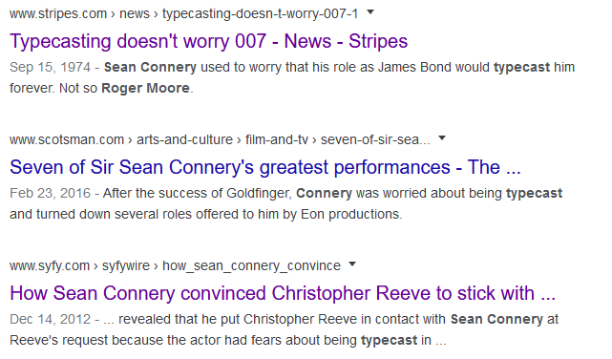
Java type casting

Slide 16
Type casting
Sometimes it is useful to convert from one data type to another
  Called a type cast
Motivating example: imagine we want to simulate a die roll
We have the Math.random() method
  Gives us a random double in [0,1)
  But we need an integer in [1,6]
Solution: convert from double to int
  int dieRoll = (int) (6*Math.random()+1);
new type
note: parentheses are mandatory
expression of ‘old’ type
note: parentheses only needed here to override precedence rules
General format: (<new-type>) <expr-of-old-type>

Slide 17
Java operator precedence summary
In decreasing precedence order:
Type | Operators
Member | (), [], .
Unary suffix | ++ (post-increment), --(post-decrement)
Unary prefix | ++ (pre), -- (pre), !, unary -, unary +, type-cast
Multiplication and division | *, /, %
Addition and subtraction | +, -
Relational | <, >, <=, >=
Equality/inequality | ==, !=
Boolean and | &&
Boolean or | ||
Conditional (ternary) operator | ?
Assignment operators | =, +=, -=, *=, /=, %=

Slide 18
Explicit vs implicit type casts
When the programmer specifies a cast we say it’s an explicit cast
Compiler implicitly converts for the programmer’s convenience
Implicit type casts: String +
  Any variable to be appended to a String is cast to String before the fact
  int temp = 80;
  char symbol = 'F';
  System.out.println("Hello, it is " + temp + " degrees “ + symbol + " today");
  For object-reference variables, method Object.toString() is used
      Like we’ve done in the labs!
    E.g. String s = "" + LinearFunction(2, 3);

Slide 19
Primitive-type casting
Numeric primitive-type casts that don’t imply a loss of precision are performed implicitly
Examples:
  int a = 10;
  double b = a; // a cast to double before assignment
  double c = 4.0 + a; // a cast to double before addition
Potentially-lossy conversions must be performed explicitly
  double x = 1.0;
  int b = 3/x; // will not compile
  int b = (int) (3/x); // will compile, may loose precision
  int half = 1/2; // will compile because integer division!
In general, booleans can’t be cast to other types, and vice-versa
  Appending to string using operator + is exception
short
long
byte
int
double
char
float

Slide 20
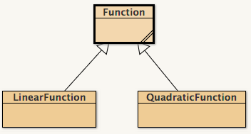
Object-type casting
Casting from subclass to superclass is performed implicitly
  E.g. Function f = new LinearFunction(m, b);
Casting from superclass to subclass must be explicit
  E.g: LinearFunction lf = (LinearFunction) f;
  Will cause a ClassCastException error at runtime if object was not originally of that subclass
Casting between other classes is prohibited
  Even from sibling to sibling
  E.g. QuadraticFunction qf = (QuadraticFunction) lf; Will not compile!

Slide 21
Converting between incompatible types
Generally speaking, unrelated types can not be cast directly
  Memory constraints!
E.g. this will not compile:
  String s = "10";
  int n = (int) s;
When such a conversion is required, one must perform it manually
  I.e. create an object of the new type with the right characteristics
  E.g. scan the string from right to left and add digit*10^{index}
Java standard library provides many useful conversion methods
E.g. the static method Integer.parseInt(String s) will create an int out of a String object representing an integer
  Very useful to read program arguments
  E.g. public static void main(String[] args){
  int intArg = Integer.parseInt(args[0]);
  …
  }

Slide 22
In-class exercise
Will these Java snippets compile?
  long a = 10; int b = a;
  boolean a = true; long b = a;
  int a = 2; double b = (byte) a;
  char c = 'G'; String s = (String) c;
  LinearFunction lf = (LinearFunction) new QuadraticFunction(1, 2, 3);
  String s = "Hello " + new LinearFunction(3,2);
  int i = new String("787");
Notes:
Answer key:
No
No
Yes
No
No
Yes
No

Slide 23
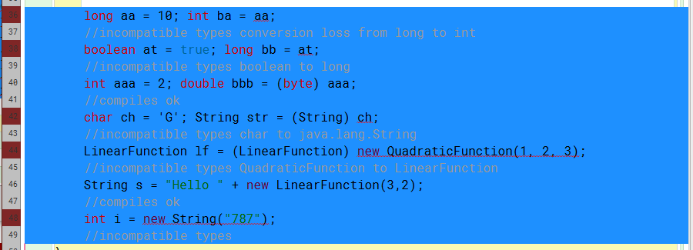
In-class exercise - answers
Notes:
Answer key:
No
No
Yes
No
No
Yes
No

