Slide 1
CMPU-102 Fall 2021
Data Structures and Algorithms
Lecture #11:
The hash map data structure
Hannah Gommerstadt & Rui Meireles
Assistant Profs. of Computer Science, Vassar College, USA

Slide 2
The hash map data structure

Slide 3




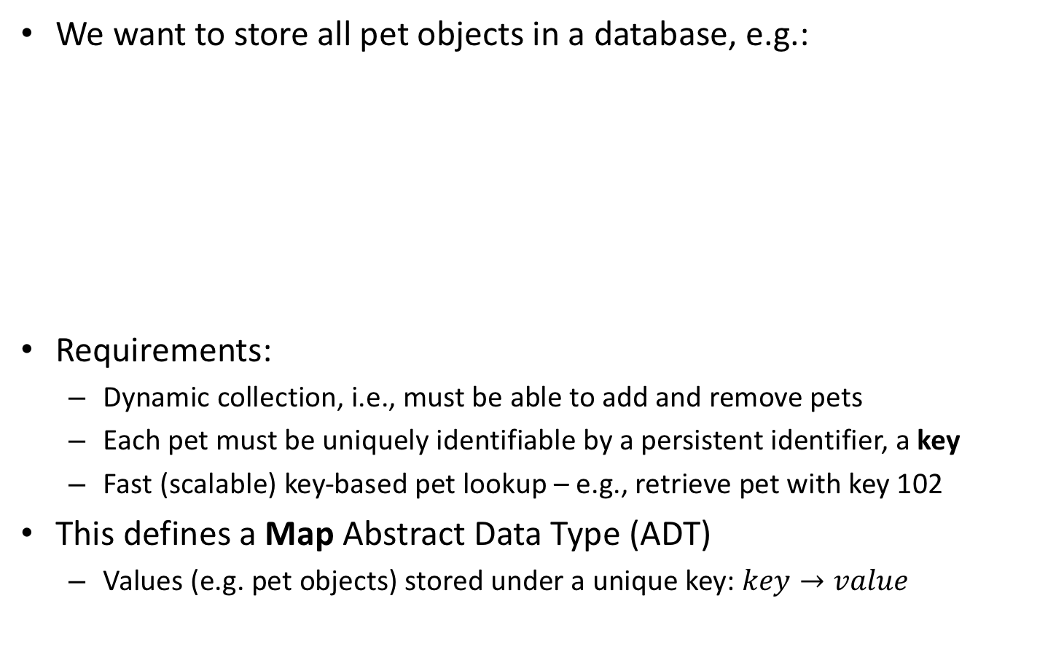
Scenario: pet inventory
We want to store all pet objects in a database, e.g.:
Requirements:
  Dynamic collection, i.e., must be able to add and remove pets
  Each pet must be uniquely identifiable by a persistent identifier, a key
  Fast (scalable) key-based pet lookup – e.g., retrieve pet with key 102
This defines a Map Abstract Data Type (ADT)
  Values (e.g. pet objects) stored under a unique key: $key→value$
Pet #102
name: Pika
color: yellow
height: 16”
age: 20 years
Pet #227
name: Milu
color: white
height: 22”
age: 10 years
Pet #352
name: Peppa
color: pink
height: 30”
age: 4 years
Pet #382
name: Luna
color: black
height: 25”
age: 13 years

Slide 4
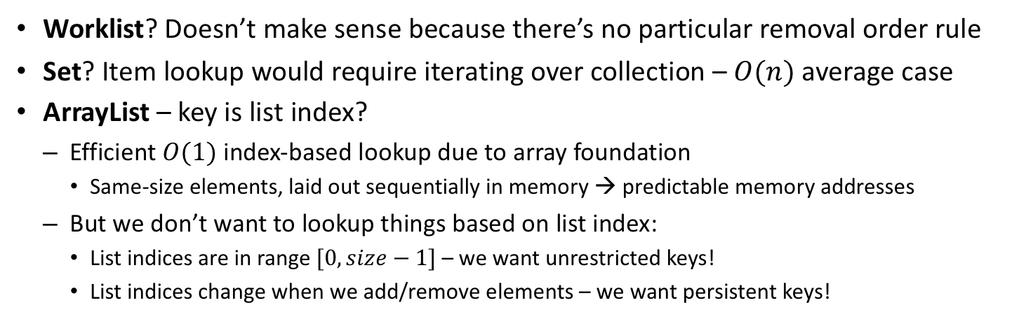
What can we use to implement a map?
Worklist? Doesn’t make sense because there’s no particular removal order rule
Set? Item lookup would require iterating over collection – $O(n)$ average case
ArrayList– key is list index?
  Efficient $O(1)$ index-based lookup due to array foundation
    Same-size elements, laid out sequentially in memory → predictable memory addresses
  But we don’t want to lookup things based on list index:
    List indices are in range $[0,size−1]$ – we want unrestricted keys!
    List indices change when we add/remove elements – we want persistent keys!
Notes:
To build upon later

Slide 5
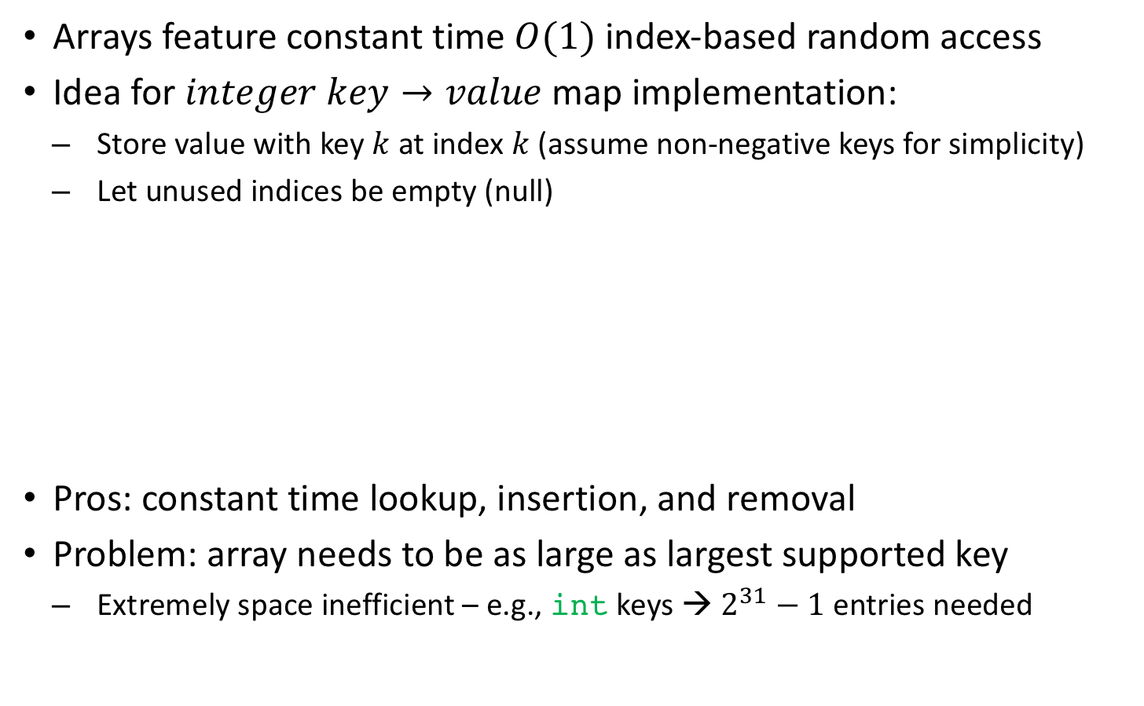
Array-based map implementation
Arrays feature constant time $O(1)$ index-based random access
Idea for $integer key→value$ map implementation:
  Store value with key $k$ at index $k$ (assume non-negative keys for simplicity)
  Let unused indices be empty (null)
Pros: constant time lookup, insertion, and removal
Problem: array needs to be as large as largest supported key
  Extremely space inefficient – e.g., int keys → $2^{31}−1$ entries needed

Slide 6


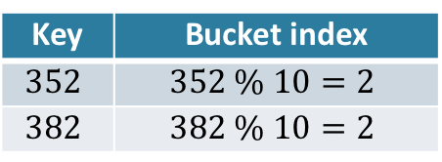
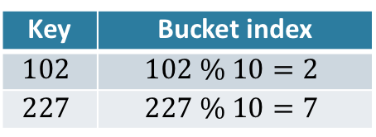
Array-based map with buckets (1/3)
It’s impractical to have an array the length of the keys’ range
Idea: let multiple values share a single array index
  Each array entry is a bucket of values, with bucket a variable-size collection
  Store value with key $k$ at index $k \% array.length$
Example with array of length 10:
Key | Bucket index
$$102$$ | $$102 \% 10=2$$
$$227$$ | $$227 \% 10=7$$
Key | Bucket index
$$352$$ | $$352 \% 10=2$$
$$382$$ | $$382 \% 10=2$$

Slide 7
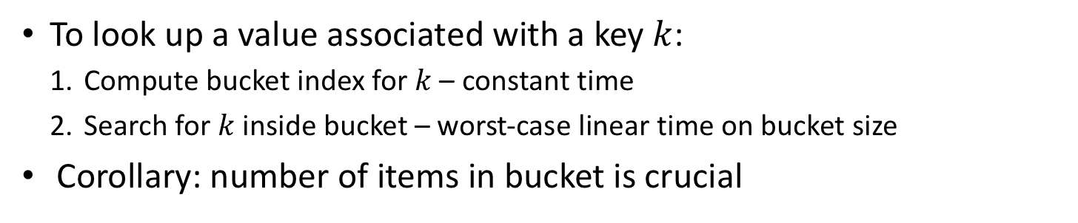
Array-based map with buckets (2/3)
To look up a value associated with a key $k$:
  Compute bucket index for $k$ – constant time
  Search for $k$ inside bucket – worst-case linear time on bucket size
Corollary: number of items in bucket is crucial
Notes:
But we can’t control the keys

Slide 8
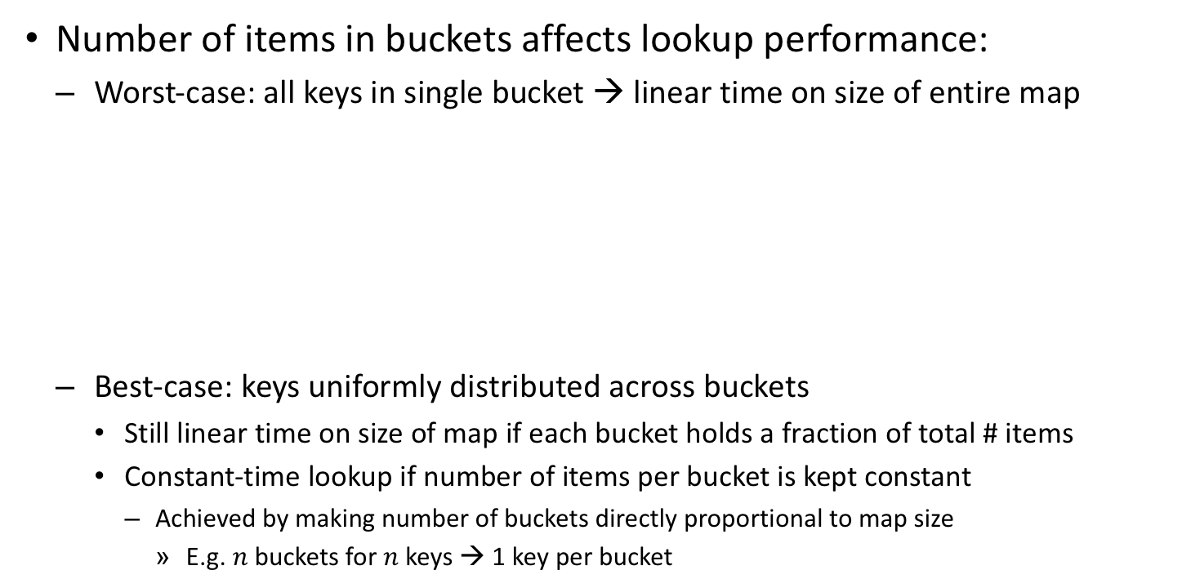
Array-based map with buckets (3/3)
Number of items in buckets affects lookup performance:
  Worst-case: all keys in single bucket → linear time on size of entire map
  Best-case: keys uniformly distributed across buckets
    Still linear time on size of map if each bucket holds a fraction of total # items
    Constant-time lookup if number of items per bucket is kept constant
      Achieved by making number of buckets directly proportional to map size
        E.g. $n$ buckets for $n$ keys → 1 key per bucket
Notes:
But we can’t control the keys

Slide 9
Maps with non-integer keys
It’s often the case that we want maps that use non-integer keys
  E.g. look up pet information based on the pet’s name
Need to convert key into non-negative integer for bucket selection
  Conversion performed by a hash function:
  A good hash function:
    Is deterministic: a given input always yields same output
    Has uniform output: every output equally likely – good for item distribution
Pika
color: yellow
height: 16”
Milu
color: white
height: 22”
Peppa
color: pink
height: 30”
Luna
color: black
height: 25”
Notes:
Pseudo-random number generator that sets the seed to the key and then generates a pseudo-random number

Slide 10
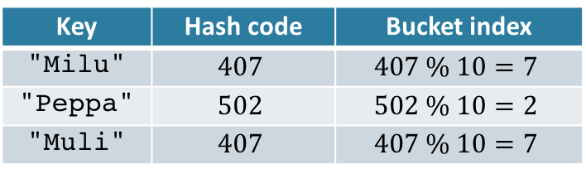
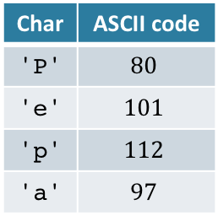
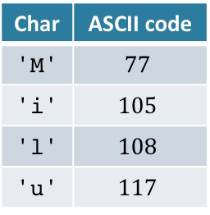
Bucket hashing example
Example hash function for strings: sum of characters’ ASCII codes
Example hash and bucket computation (array of length 10):
public int hash(String s){
int hash = 0; // start out as zero
char[] chara = s.toCharArray(); // string's chars
for (char c : chara) hash += c; // sum up char values
return hash;
}
Char | ASCII code
'M' | $$77$$
'i' | $$105$$
'l' | $$108$$
'u' | $$117$$
Char | ASCII code
'P' | $$80$$
'e' | $$101$$
'p' | $$112$$
'a' | $$97$$
Key | Hash code | Bucket index
"Milu" | $$407$$ | $$407 \% 10=7$$
"Peppa" | $$502$$ | $$502 \% 10=2$$
"Muli" | $$407$$ | $$407 \% 10=7$$
Notes:
https://research.cs.vt.edu/AVresearch/hashing/strings.php
Is this a good hash function?
- It’s deterministic
- Output uniformity depends on whether the values of the sums are large relative to the number of buckets

Slide 11
Map ADT and implementation

Slide 12
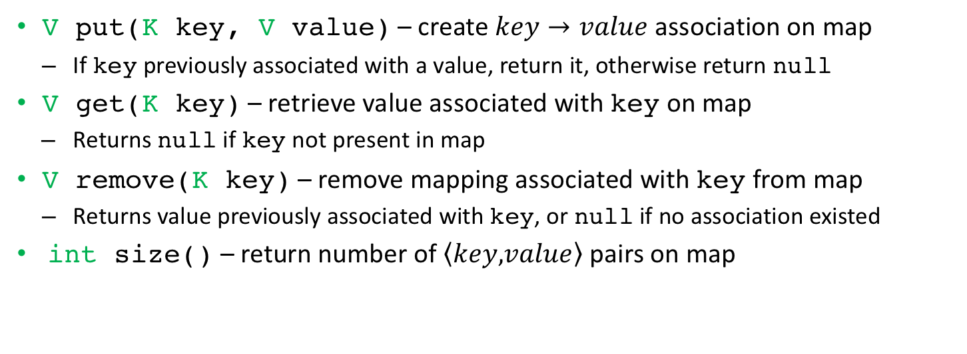
The MyMap interface
V put(K key, V value) – create $key→value$ association on map
  If key previously associated with a value, return it, otherwise return null
V get(K key) – retrieve value associated with key on map
  Returns null if key not present in map
V remove(K key) – remove mapping associated with key from map
  Returns value previously associated with key, or null if no association existed
int size() – return number of $\left\langle key,\right.\left.value\right\rangle$pairs on map
Notes:
We kno
Parametrized with 2 types, one for key, another one for value.

Slide 13
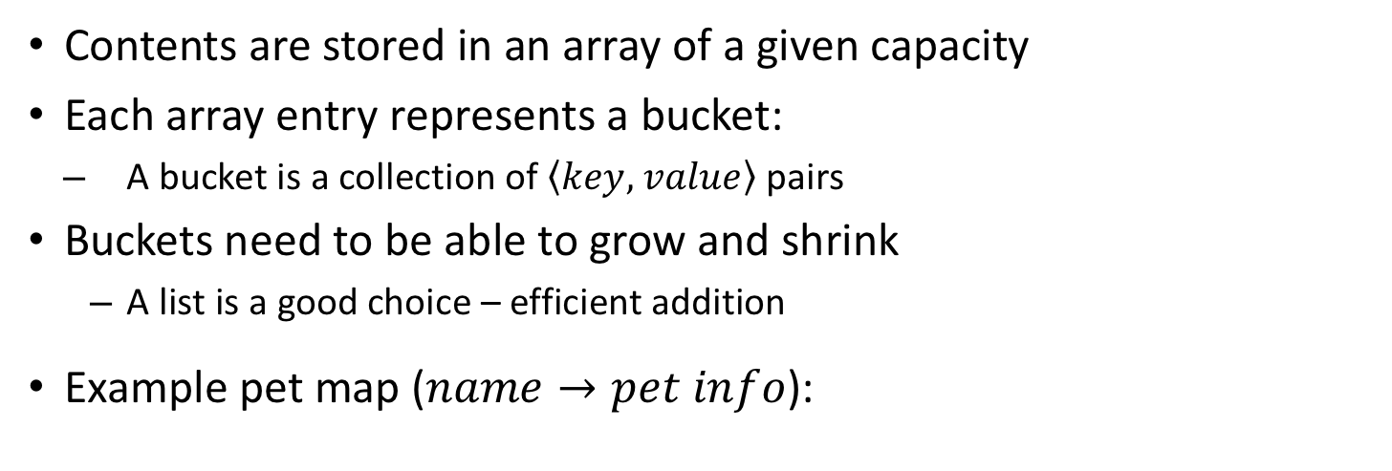
Hash map implementation: structure
Contents are stored in an array of a given capacity
Each array entry represents a bucket:
  A bucket is a collection of $\left\langle key,\right. \left.value\right\rangle$ pairs
Buckets need to be able to grow and shrink
  A list is a good choice – efficient addition
Example pet map ($name→pet info$):
Peppa
color: pink
height: 30”
Jigglypuff
color: pink
height: 20”
Pika
color: yellow
height: 16”
Milu
color: white
height: 22”
Luna
color: black
height: 25”

Slide 14
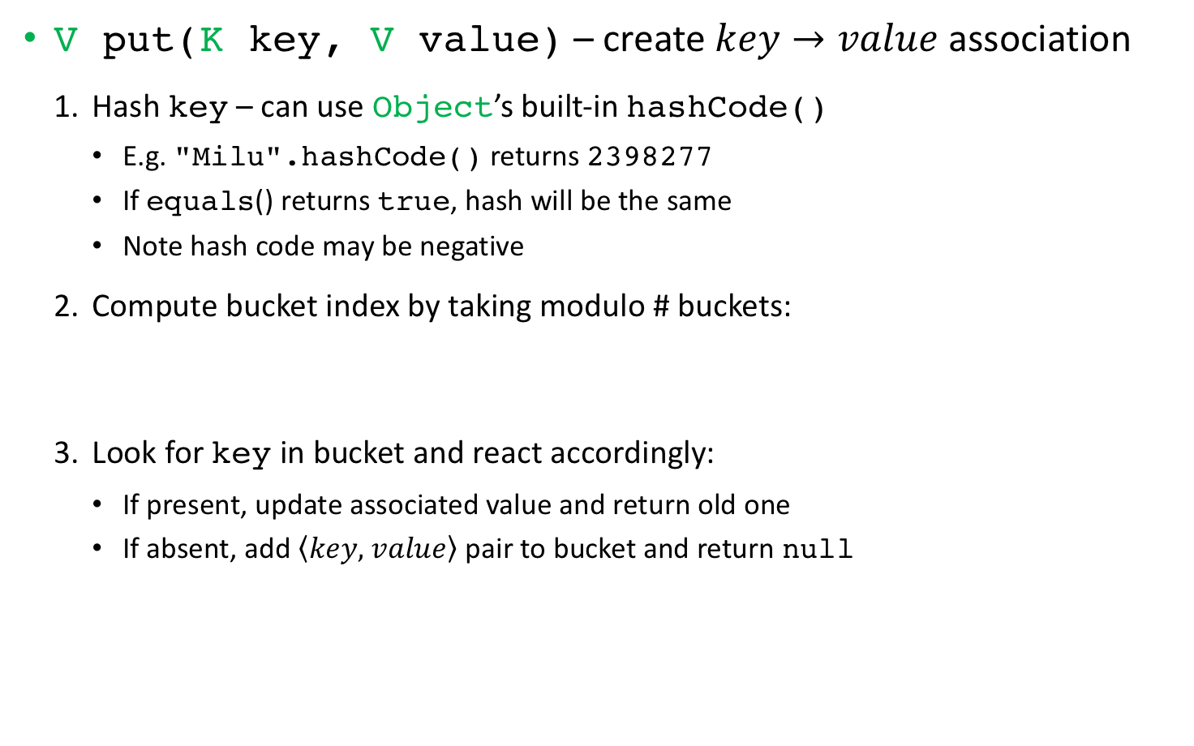
Hash map implementation: put()
V put(K key, V value) – create $key→value$ association
  Hash key – can use Object’s built-in hashCode()
    E.g. "Milu".hashCode() returns 2398277
    If equals() returns true, hash will be the same
    Note hash code may be negative
  Compute bucket index by taking modulo # buckets:
  Look for key in bucket and react accordingly:
    If present, update associated value and return old one
    If absent, add $\left\langle key,\right. \left.value\right\rangle$ pair to bucket and return null
Math.abs(hash) % array.length
Notes:
Parametrized with 2 types, one for key, another one for value

Slide 15


Hash map put() example
Add Charizard to our pet map:
  Compute hash: hashCode() returns -718748212
  Compute bucket index: 718748212 % 10 = 2
  Compare with pre-existing bucket keys ("Peppa")
  Since "Charizard" is new, add $\left\langle key,\right.\left. value\right\rangle$ pair to list and return null
Charizard
color: orange
height: 67”
Charizard
color: orange
height: 67”
Notes:
Talk running time

Slide 16
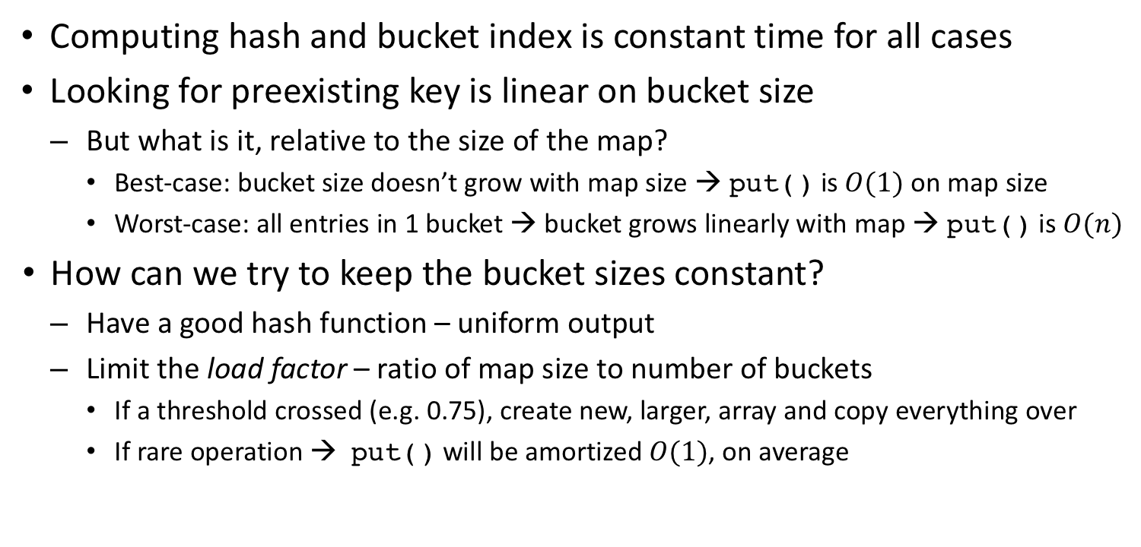
Hash map put() running time
Computing hash and bucket index is constant time for all cases
Looking for preexisting key is linear on bucket size
  But what is it, relative to the size of the map?
    Best-case: bucket size doesn’t grow with map size → put() is $O(1)$ on map size
    Worst-case: all entries in 1 bucket → bucket grows linearly with map → put() is $O(n)$
How can we try to keep the bucket sizes constant?
  Have a good hash function – uniform output
  Limit the load factor – ratio of map size to number of buckets
    If a threshold crossed (e.g. 0.75), create new, larger, array and copy everything over
    If rare operation → put() will be amortized $O(1)$, on average
resize & rehash
Notes:
Copy everything over → resize and rehash

Slide 17
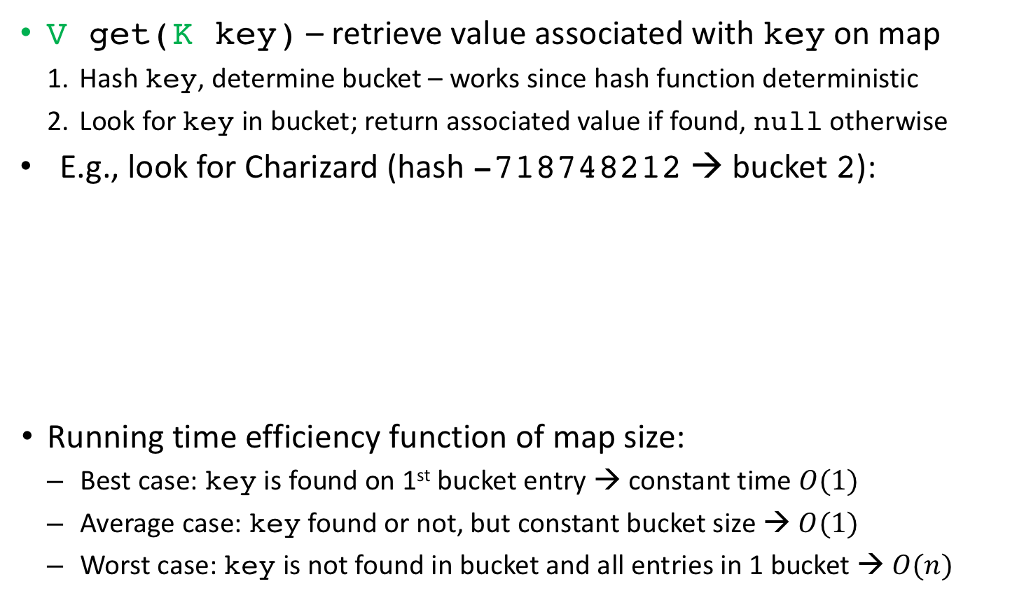
Hash map implementation: get()
V get(K key) – retrieve value associated with key on map
  Hash key, determine bucket – works since hash function deterministic
  Look for key in bucket; return associated value if found, null otherwise
E.g., look for Charizard (hash -718748212→ bucket2):
Running time efficiency function of map size:
  Best case: key is found on 1st bucket entry → constant time $O(1)$
  Average case: key found or not, but constant bucket size → $O(1)$
  Worst case: key is not found in bucket and all entries in 1 bucket → $O(n)$
Notes:
Parametrized with 2 types, one for key, another one for value

Slide 18
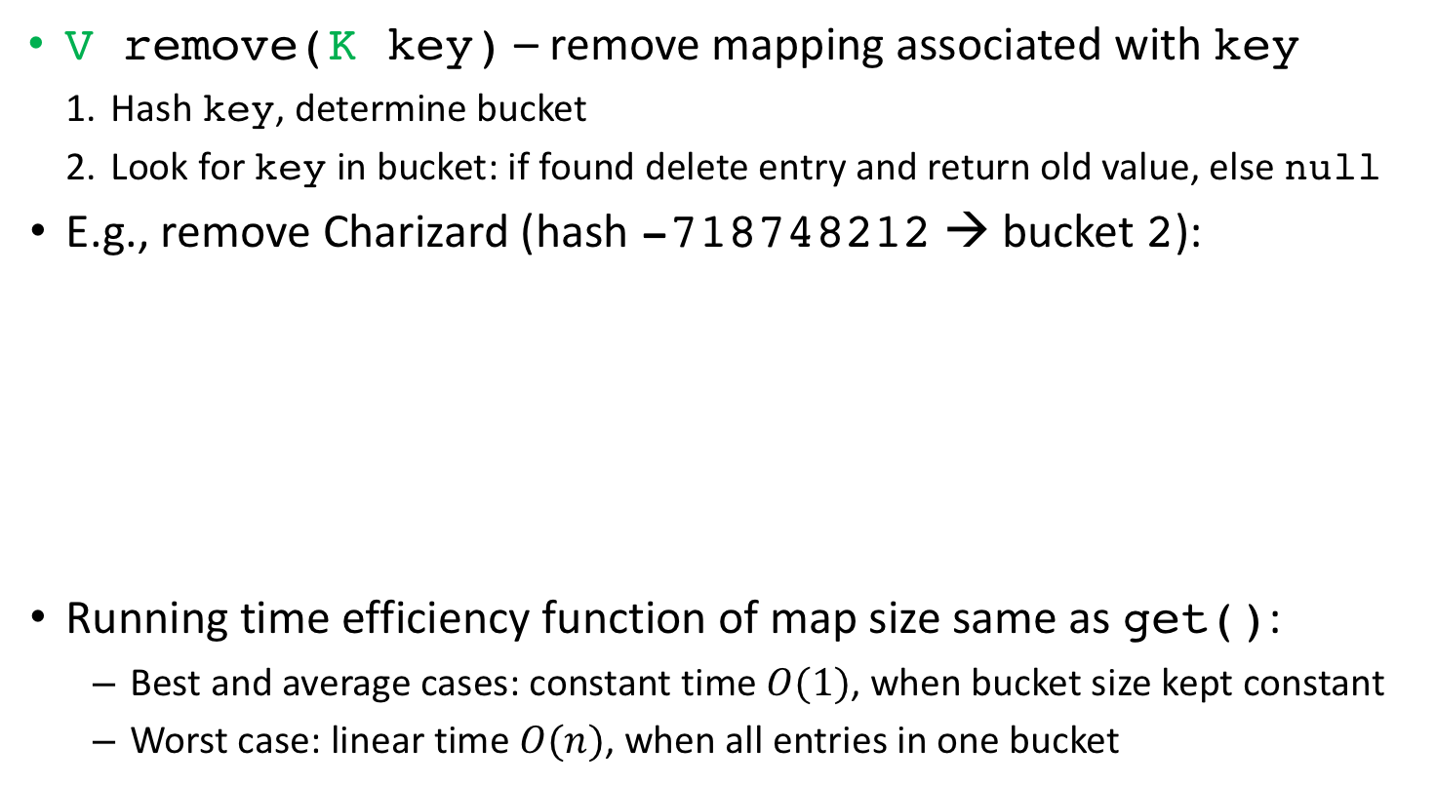
Hash map implementation: remove()
V remove(K key) – remove mapping associated with key
  Hash key, determine bucket
  Look for key in bucket: if found delete entry and return old value, else null
E.g., remove Charizard (hash -718748212→ bucket2):
Running time efficiency function of map size same as get():
  Best and average cases: constant time $O(1)$, when bucket size kept constant
  Worst case: linear time $O(n)$, when all entries in one bucket
✗
Notes:
Parametrized with 2 types, one for key, another one for value

Slide 19
MyMap usage example
Let’s create and interact with a string-keyed pet map:
public class Pet{
String color; int height;
public Pet(String c, int h){ color = c; height = h; }
}
MyMap<String,Pet> petMap = new MyHashMap<String,Pet>();
petMap.put("Pika", new Pet("yellow", 16)); // add Pika
petMap.put("Milu", new Pet("white", 22)); // add Milu
petMap.size(); // returns 2
petMap.get("Peppa"); // returns null
Pet p = petMap.get("Pika"); // p refers to Pika pet
petMap.remove("Pika"); // removes and returns
p = petMap.get("Pika"); // p becomes null
petMap.size(); // returns 1

Slide 20
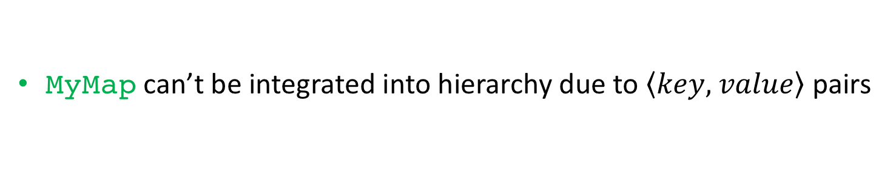
Our collections framework so far
MyMap can’t be integrated into hierarchy due to $\left\langle key,\right. \left.value\right\rangle$ pairs

Slide 21
Java standard library’s Map ADT

Slide 22
Java’s Map Abstract Data Type
Java features a Map ADT with a hash map implementation
  Class java.util.HashMap, implements interface java.util.Map
Usage is identical to that of our own map interface
  Features all the methods we’ve defined, plus more
import java.util.Map; // since outside java.lang
import java.util.HashMap; // java.util.* also ok
Map<String,Pet> petMap = new HashMap<String,Pet>();
petMap.put("Pika", new Pet("yellow", 16)); // add Pika
petMap.put("Milu", new Pet("white", 22)); // add Milu
petMap.size(); // returns 2
petMap.get("Peppa"); // returns null
Pet p = petMap.get("Pika"); // p refers to Pika pet
petMap.remove("Pika"); // removes and returns
p = petMap.get("Pika"); // p becomes null

Slide 23
Exercise

Slide 24
Exercise: hash map implementation
Use a hash map data structure to implement the MyMap interface
  Insertion, removal, and lookup

Slide 25
Lecture #10 extra

Slide 26
What is hashing?
HashSet uses hashing and an array to improve performance
  A hash function takes in an object and outputs an integer hash code
Desirable hash function properties:
  Determinism: always output the same value for a given input
  Defined range: fixed-size output
  Uniformity: every output equally likely
Java provides a hash function in the Object class:
  int hashCode(): returns integer hash code for any object
  E.g. "hello".hashCode() returns 99162322

Slide 27
Bucket hashing
Idea:
  Have a reasonably-sized array a (size N_BUCKETS) where each element is a bucket that can hold multiple elements (e.g. a List)
    List[] a = new LinkedList[N_BUCKETS];
  Compute bucket for an element e as:
  int bucket = Math.abs(e.hashCode()) % N_BUCKETS;
  Use the List in a[bucket] to implement the set operations:
    For add(): a[bucket].add(e)
    For contains(): a[bucket].contains(e)
    For remove(): a[bucket].remove(e)

Slide 28
HashSet
HashSet uses bucket hashing for fast lookup
Example, adding elements:
String[] names = {"Jay", "Alice", "Melvor", "Erica"};
Set<String> nset = new HashSet<String>();
for (int i=0; i < names.length; i++)
nset.add(names[i]);
0
1
Jay
Erica
String | Bucket
Jay | 0
Alice | 3
Melvor | 3
Erica | 0
2
null
null
3
Alice
Melvor
null
null
Testing existence:
nset.contains("Melvor");

Slide 29
The java.util.Map interface
Lists allow us to access elements by index
  Often not very useful
Map is an ADT that defines a content-associative memory
  Stored values referenced by a key, not an index (maps key to value)
  Map keys are unique
  Also know as a dictionary (word → definition)
  Keys can be numeric or not
Very common in practice, e.g.:
  Access driver record using driver’s license id

Slide 30
The java.util.Map interface
Methods:
  put(K key, V value): store value associated with key, replacing previous value if key already existed. Returns pre-existing value or null if none existed.
  get(Object key): returns value associated with key if one exists or null otherwise.
  remove(Object key): remove value with specified key from map. Returns removed value or null if key did not exist in map.
Map is a doubly-parameterized data type, one for key, one for value
  Declaration has form Map<KeyDataType, ValueDataType> varName;
  E.g.: Map<Integer, String> map;

Slide 31
Map usage example: state info database
Imagine we want to create a database to lookup state information
The data pertaining to a given state is stored in a State object
public class State{
private String name;
private String capital;
private int population;
public State(String name, String capital, int population){
this.name = name;
this.capital = capital;
this.population = population;
}
public String getName(){ return name; }
public String getCapital(){ return capital; }
public int getPopulation(){ return population; }
}

Slide 32
Map usage example: state info database
We can now create a map using e.g. two letter state code as key
Map<String,State> stateMap = new HashMap<String,State>(); stateMap.put("AL", new State("Alabama", "Montgomery", 4779736)); stateMap.put("CA", new State("California", "Los Angeles", 37253956)); stateMap.put("NY", new State("New York", "New York", 19378102));
// add all the other states ...
Scanner scanner = new Scanner(System.in);
while (true) {
System.out.print("Enter two-letter state code: ");
String code = scanner.next().toUpperCase();
if (code.equals("EXIT")) break;
State state = stateMap.get(code);
if (state == null)
System.out.printf("Unknown state %s\n", code);
else System.out.printf("%s's info: capital: %s, population: %d\n",
state.getName(), state.getCapital(), state.getPopulation()); }

Slide 33
In-class exercise: sports team stats
Use a map to implement a sports team statistics database
public class TeamStats{
public int wins;
public int losses;
}
public class StatsDB{
private Map<String,TeamStats> smap = new HashMap<String,TeamStats>();
public float getWinRatio(String teamName){ … } // ret -1 if not found
public boolean recordWin(String teamName){ … } // ret false if not found
public boolean recordLoss(String teamName){ … } // ret false if not found
}

Slide 34
In-class exercise: sports team stats solution
public class StatsDB{
private Map<String,TeamStats> smap = new HashMap<String,TeamStats>();
public float getWinRatio(String teamName){
TeamStats s = smap.get(teamName);
return s != null ? ((float)s.wins)/(s.wins+s.losses) : -1;
}
public boolean recordWin(String teamName){
TeamStats s = smap.get(teamName);
boolean retval = s != null;
if (retval){ s.wins++; } // stored stats are changed
return retval;
}
public boolean recordLoss(String teamName){
TeamStats s = smap.get(teamName);
boolean retval = s != null;
if (retval){ s.losses++; } // stored stats are changed
return retval;
}
}

Slide 35
Java’s collections framework: maps
(IPUJ Chapter 10)

Slide 36
Java collections framework
Set of data structures implementing many common ADTs

Slide 37
The java.util.Map interface
Lists allow us to access elements by index
  Often not very useful
Map is an ADT that defines a content-associative memory
  Stored values referenced by a key, not an index (maps key to value)
  Map keys are unique
  Also know as a dictionary (word → definition)
  Keys can be numeric or not
Very common in practice, e.g.:
  Access driver record using driver’s license id

Slide 38
java.util.Map iteration (1/2)
Map does not implement Collection, so no iterator built-in
We can use the entrySet() method to obtain one though
  Returns a set of map entries, which we can then iterate over. E.g.:
Map<Integer,String> map = new HashMap<Integer,String>();
...
Set<Map.Entry<Integer,String>> entrySet = map.entrySet();
Iterator<Map.Entry<Integer,String>> itr = entrySet.iterator();
while (itr.hasNext()){
Map.Entry<Integer,String> e = itr.next();
System.out.printf("key %d: value %s\n", e.getKey(), e.getValue());
}
Alternatively, using a for-each loop:
for (Map.Entry<Integer,String> e : map.entrySet())
System.out.printf("key %d: value %s\n", e.getKey(), e.getValue());

Slide 39
java.util.Map iteration (2/2)
Map does not implement Collection, so no iterator built-in
Another option is to use the keySet() method
  Returns set of keys instead of set of entries
  Can then use get() method to obtain the value for a given key. E.g.:
Map<Integer,String> map = new HashMap<Integer,String>();
...
Set<Integer> keySet = map.keySet();
Iterator<Integer> itr = keySet.iterator();
while (itr.hasNext()){
int key = itr.next();
String value = map.get(key);
System.out.printf("key %d: value %s\n", key, value);
}
A map and its key set are tightly-coupled
  Removal from key set will remove element from map
    But note that addition to key set is not supported, throws exception
  Addition to map will be reflected in key set
Notes:
Throws UnsupportedOperationException.

Slide 40
Map class hierarchy
Very similar to the Set hierarchy
HashTable, HashMap , LinkedHashMap
  Use hashing for fast element lookup
TreeMap
  Keeps set elements sorted using a tree data structure, like TreeSet
Notes:
Hashtable is synchronized, whereas HashMap is not. This makes HashMap better for non-threaded applications, as unsynchronized Objects typically perform better than synchronized ones.
Hashtable does not allow null keys or values. HashMap allows one null key and any number of null values.
One of HashMap's subclasses is LinkedHashMap, so in the event that you'd want predictable iteration order (which is insertion order by default), you could easily swap out the HashMap for a LinkedHashMap. This wouldn't be as easy if you were using Hashtable.

Slide 41
The hash-based Maps
Use bucket hashing just like HashSet
  Actually HashSetuses a HashMapinternally
    HashMap hashes the key, stores the value
    HashSet is implemented as a HashMap where both key and value are the same
Recall hashing idea: hash key k to determine array index
  int bucket = Math.abs(k.hashCode()) % N_BUCKETS;
Constant time $O(1)$ put/get/remove if load factor small enough
State map example:
HashMap<String,String> map = new HashMap<String,String>();
map.put("TX", "Texas");
map.put("ID", "Idaho");
map.put("ME", "Maine");
map.put("UT", "Utah");
String state = map.get("UT");
0
ID
UT
1
Idaho
Utah
2
null
null
3
TX
ME
Texas
Maine
null
null
Notes:
Hashtable is synchronized, whereas HashMap is not. This makes HashMap better for non-threaded applications, as unsynchronized Objects typically perform better than synchronized ones.
Hashtable does not allow null keys or values. HashMap allows one null key and any number of null values.
One of HashMap's subclasses is LinkedHashMap, so in the event that you'd want predictable iteration order (which is insertion order by default), you could easily swap out the HashMap for a LinkedHashMap. This wouldn't be as easy if you were using Hashtable.

Slide 42
Differences between hash-based Maps
HashMap is the “standard” implementation
HashTable is older, synchronized
  Useful for multi-threaded applications
  Unnecessarily slow for single-threaded ones
  Hash table is a traditional name for this data structure
HashTable does not allow null keys or values
  HashMap allows one null key, unlimited null values
LinkedHashMap is a subclass of HashMap that keeps a linked list between nodes that enables iteration in a predictable order
  Choose between insertion-order (default) and access-order upon construction
Notes:
Hashtable is synchronized, whereas HashMap is not. This makes HashMap better for non-threaded applications, as unsynchronized Objects typically perform better than synchronized ones.
Hashtable does not allow null keys or values. HashMap allows one null key and any number of null values.
One of HashMap's subclasses is LinkedHashMap, so in the event that you'd want predictable iteration order (which is insertion order by default), you could easily swap out the HashMap for a LinkedHashMap. This wouldn't be as easy if you were using Hashtable.

Slide 43
Java collections framework
Set of ADT interfaces and data structures implementing them

Slide 44
How to choose a Map
TreeMap if you need in-order iteration
HashTable if you need multi-threading synchronization
LinkedHashMap if you need insertion-order iteration
HashMap for anything else (most commonly used)

Slide 45
Lecture #10 end

