Slide 1
CMPU-102-01 Fall, 2021
Data Structures and Algorithms
Week 5 Lecture Notes:
Final notes on Java type casting;
Final variables;
Exceptions
Rui Meireles
Peter Lemieszewski

Slide 2
Java type casting

Slide 3
Type casting
General format: (<new-type>) <expr-of-old-type>
  E.g.: int dieRoll = (int) (6*Math.random()+1);
Some casts can be performed implicitly:
  From smaller to larger numeric type
  Appending to string using operator +
  From subclass to superclass
Others have to be explicit:
  From larger to smaller numeric type
  From superclass to subclass
Yet some other casts can’t be performed at all:
  E.g. from boolean to something else
  E.g. can’t cast between classes not related by inheritance, including siblings

Slide 4
Explicit vs implicit type casts
When the programmer specifies a cast we say it’s an explicit cast
Compiler implicitly converts for the programmer’s convenience
Implicit type casts: String +
  Any variable to be appended to a String is cast to String before the fact
  int temp = 80;
  char symbol = 'F';
  System.out.println("Hello, it is " + temp + " degrees “ + symbol + " today");
  For object-reference variables, method Object.toString() is used
      Like we’ve done in the labs!
    E.g. String s = "" + LinearFunction(2, 3);

Slide 5
Primitive-type casting
Numeric primitive-type casts that don’t imply a loss of precision are performed implicitly
Examples:
  int a = 10;
  double b = a; // a cast to double before assignment
  double c = 4.0 + a; // a cast to double before addition
Potentially-lossy conversions must be performed explicitly
  double x = 1.0;
  int b = 3/x; // will not compile
  int b = (int) (3/x); // will compile, may loose precision
  int half = 1/2; // will compile because integer division!
In general, booleans can’t be cast to other types, and vice-versa
  Appending to string using operator + is exception
short
long
byte
int
double
char
float

Slide 6
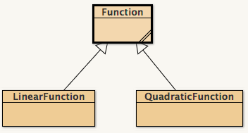
Object-type casting
Casting from subclass to superclass is performed implicitly
  E.g. Function f = new LinearFunction(m, b);
Casting from superclass to subclass must be explicit
  E.g: LinearFunction lf = (LinearFunction) f;
  Will cause a ClassCastException error at runtime if object was not originally of that subclass
Casting between other classes is prohibited
  Even from sibling to sibling
  E.g. QuadraticFunction qf = (QuadraticFunction) lf; Will not compile!

Slide 7
Safe downstream casting: instanceof
<obj> instanceof <Class>
  Is true if variable obj is an instance of class Class, false otherwise
  Only applicable to object-reference type variables
Useful when we need to distinguish between different subclasses
E.g. (counting linear functions in array):
Function[] farray;
… // initialize array
int nlf = 0;
for (int i=0; i < farray.length; i++)
if (farray[i] instanceof LinearFunction)
nlf++;
E.g. safe casting (i.e. no potential ClassCastException):
if (farray[0] instanceof LinearFunction)
LinearFunction lf = (LinearFunction) farray[0];

Slide 8
In-class exercise
Will these Java snippets compile?
  long a = 10; int b = a;
  boolean a = true; long b = a;
  int a = 2; double b = (byte) a;
  char c = 'G'; String s = (String) c;
  LinearFunction lf = (LinearFunction) new QuadraticFunction(1, 2, 3);
  String s = "Hello " + new LinearFunction(3,2);
  int i = new String("787");
Notes:
Answer key:
No
No
Yes
No
No
Yes
No

Slide 9
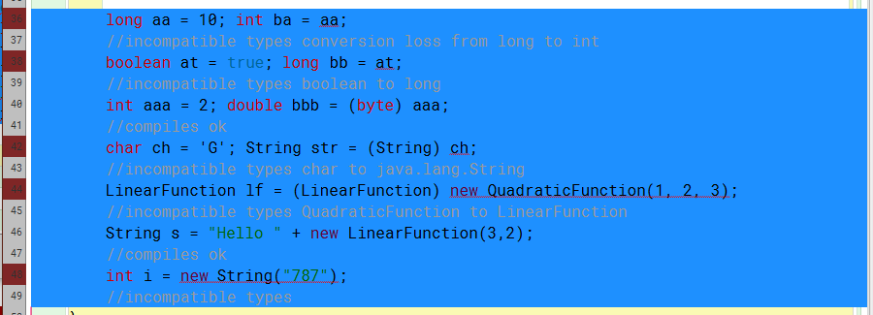
In-class exercise - answers
Notes:
Answer key:
No
No
Yes
No
No
Yes
No

Slide 10
Final variables

Slide 11
Final variables
final variables can not be changed once they are initialized
Reasons for using them: efficiency or design
Declaration: final <dataType> <varName>;
Makes primitive types constants, e.g.:
  class Math{
  public static final double PI = 3.14159265358979323846;
  }
For object-reference type variables:
  Makes the reference constant, but not the object itself!
  E.g. final Person p = new Person();
  p.setAge(23); // OK!
  p = new Person(); // compilation error!

Slide 12
Final variables
Initialization at declaration not mandatory
  Class-level variables
    Can also be initialized in the constructor (but nowhere else)
  Method-local variables
    Can be initialized anywhere within scope
final keyword can be applied to method parameters as well
  Effect: variable can‘t be changed inside method

Slide 13
Final variables: example/exercise
Will this code compile? Why or why not?
class HaveCodeWillCompile{
public static void main(String[] args){
final int[] a = new int[10];
for (int i=0; i < a.length; i++)
a[i] = (int) (Math.random()*100); // rand [0-99]
a = new int[10]; // zero everything out
}
Notes:
Arrays are object-reference variables. So changing contents is fine, but replacing with another object (a = new int[10];) is not!

Slide 14
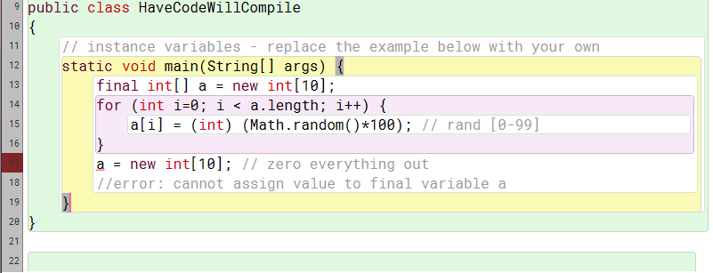
In-class exercise - answers
Will this code compile? Why or why not?
Answer: No. See comment on line 18.
Notes:
Answer key:
No
No
Yes
No
No
Yes
No

Slide 15
Javadoc also known as: Don’t @me!
(IPUJ 4.5.4)

Slide 16
Java API documentation
Java’s documentation is one of its strong points
Complete documentation concerning:
  Packages
  Classes
  Methods
  Fields
Java 10 documentation available at https://docs.oracle.com/javase/10/docs/api/

Slide 17
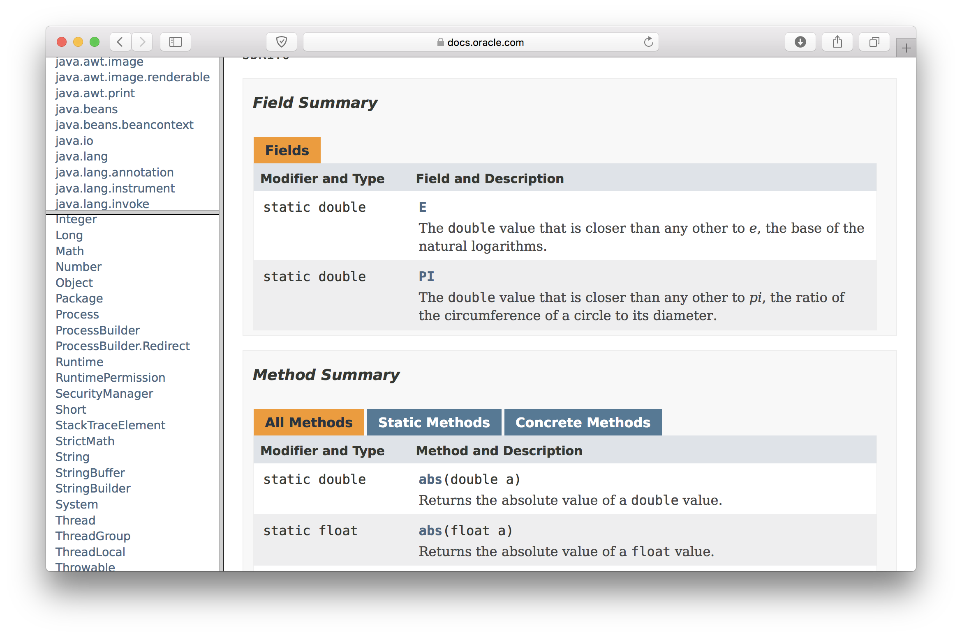
Example: Math class

Slide 18
Javadoc
Javadoc is a documentation generation tool
  Lets us generate official-looking documentation for our own code!
Uses comments in source code to generate HTML (i.e. web) pages
Comments are of the form /** <your comment here> */
We can use Javadoc to document classes, fields, and methods
Comments must come right before the declaration of the class/field/method they refer to. E.g.:
Comments for private fields and methods will not show up in the generated pages, but are still useful for the developer
Does not replace comments inside methods, complements them
/** A simple variable for a simple class. */
int intVariable;

Slide 19
Javadoc tags
Javadoc comments can include:
  Plain text
  HTML tags: e.g. <p>paragraph</p>
  Doc tags: special Javadoc commands
Doc tags used for classes:
  @author <author-name>
  @version <version-name>
Doc tags used for methods:
  @param <parameter-name> <parameter-description>
  @return <return-value-description>
  @throws <exception-class> <exception-description>
Comments outside of doc tags are used as a general description
A tag’s text is ended by the beginning of another tag or the end of the comment it’s in

Slide 20
Javadoc documentation example
/**
* A simple Javadoc test class.
* @author Rui Meireles
* @version 1.0 gold
*/
public class JavadocTest{
/** A simple variable for a simple class. */
int intVariable;
...
}

Slide 21
Javadoc method documentation example
/**
* This subroutine computes the area of a rectangle, given its width
and height. Both length and width should be non-negative numbers.
*
* @param width the length of one side of the rectangle
* @param height the length the second side of the rectangle
* @return the area of the rectangle
* @throws IllegalArgumentException if either width or height are negative.
*/
public static double areaOfRectangle(double width, double height) {
if (width < 0 || height < 0)
throw new IllegalArgumentException("Sides must be non-negative.");
double area;
area = width * height;
return area;
}

Slide 22
Generating Javadoc pages
From command line: javadoc <Class.java> or javadoc *.java
From BlueJ: from main window choose Tools → Project Documentation
Example output:

Slide 23
General documentation guidelines
Documentation is key to code readability and maintainability
Use Javadoc to document your classes, methods and public class-level variables
Pay attention to naming:
  Good naming reduces the need for comments
  Pick names that are specific to the problem’s context
Inside each method, comment non-trivial blocks
  Triviality is somewhat subjective, you’ll know it when you see it
    Can you tell what it does by just glancing at it? If not, comment.
Always pay attention to formatting
  One indentation level per block improves readability

Slide 24
Exceptions
(IPUJ 3.7)

Slide 25
Program errors
Syntactic errors
  Code does not represent a valid program in the language we’re using
  Detected at compile time (for compiled languages, of course)
  E.g. missing bracket or semi-colon
Semantic errors
  Program exhibits unexpected behavior
  Mostly detected at runtime (i.e. during execution)
    Compiler can detect some, e.g. uninitialized variable
  E.g. factorial method returns wrong value, or crashes

Slide 26
Java exceptions
Semantic errors may affect normal program control flow
Instead of crashing immediately, as some languages will, Java has a sophisticated error reporting mechanism called exceptions
When an error occurs within a method, an exception is thrown
The method caller is then notified and has two options:
  Either catch that exception and attempt to recover from the error, or
  Let the exception propagate to the next level up in the call stack
If an exception reaches the main method and is not caught there, the program crashes and an error message is printed to System.err (the terminal, by default). E.g.:

Slide 27
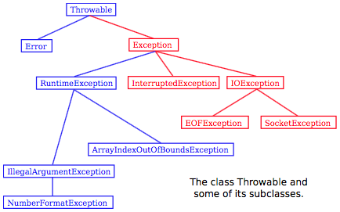
A hierarchy of exceptions
Exceptions are object-type variables
There is a large hierarchy of exceptions
Common exceptions
  ArrayIndexOutOfBoundsException
  NullPointerException

Slide 28
Know when to catch them, when to throw them
We should only catch exceptions that we can recover from
Subclasses of Error should not be caught
  They represent serious problems within the Java Virtual Machine itself
  Exceptions such as NullPointerException or ArrayIndexOutOfBoundsException should not be caught
  They indicate the presence of bugs in the code
    Bugs should be fixed, not masked!

Slide 29
How to learn if a method throws an exception
The Java API lists the exceptions each method can throw
  https://docs.oracle.com/javase/10/docs/api/
Example:

Slide 30
Catching exceptions
try {
<try-block>
} catch (<ExceptionClass> <exceptionName>){
<catch-block>
}
If an exception occurs within the try block, control will jump to the catch block
Will catch exceptions of class ExceptionClass or subclass of it
Example: opening an inexistent file
try {
FileReader fr = new FileReader(filename);
} catch (FileNotFoundException e){
... // ask the user for a new filename
}

Slide 31
In-class exercise: exceptions
The following code reads a sequence of integers from the keyboard. Modify it so it doesn’t crash if the user inputs a non-integer value. Make it try again instead.
Hint: Use exceptions!
More: Integer.parseInt(String s) throws a NumberFormatException if s doesn’t contain a parsable integer
Scanner scanner = new Scanner(System.in);
while(true){
String inputStr = scanner.next();
int inputInt = Integer.parseInt(inputStr); // modify
if (inputInt == 0)
break;
... // do something interesting with inputInt
}

Slide 32
In-class exercise: exceptions solution
Scanner scanner = new Scanner(System.in);
while(true){
String inputStr = scanner.next();
int inputInt = 0;
try {
inputInt = Integer.parseInt(inputStr);
} catch(NumberFormatException e){
System.out.println("Invalid input. int need.");
continue; // try again
}
if (inputInt == 0)
break;
... // do something interesting with inputInt
}

