Slide 1
CMPU-102-01 Fall 2021
Data Structures and Algorithms
More looping: for each,
Debugging,
Unified Modeling Language,
Methods
Rui Meireles
Peter Lemieszewski

Slide 2
For each

Slide 3
for each vs. for loop
Let’s add the elements of an array, using method sum:
>// Returns the sum of the elements of a>
int sum(int[] a) {
int result = 0;
for (int i=0; i < a.length; i++)
result += a[i];
return result;
}

Slide 4
for each vs. for loop
As we have seen, variable of i can be problematic:
Where to start i, Where to end i, scope, etc.
An easier way: for each
General format:
for (type variable : array)
// i.e. declare variable to be same type as
// the type being used by array.
{
statements using var;
}

Slide 5
for each vs. for loop
From Oracle’s website:
The for-each construct … hides the index variable. The following method returns the sum of the values in an int array:
>// Returns the sum of the elements of a>
int sum(int[]) {
int result = 0;
for (int i : a)
// variable i replaces the indexed array element
result += i;
return result;
}

Slide 6
Debugging

Slide 7
Program correctness
Should be our first and major goal
  Second is efficiency
Types of errors
  Syntax errors
    Written code does not translate into a valid set of instructions
    Detected at compile time
    E.g. missing semi-colon at the end of statement
  Semantic errors or bugs
    The program doesn’t do what it is supposed to do
    Mostly detected at runtime (compiler can detect some, e.g. uninitialized variable)
    E.g. program crashes when provided with a certain input or gives wrong result

Slide 8
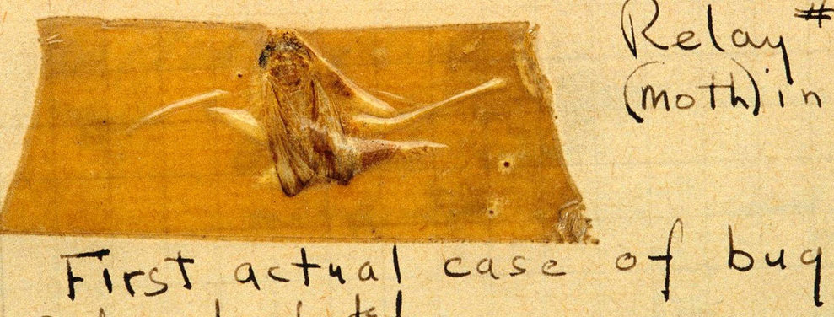
Debugging
Process through which we identify and eliminate bugs
Typical bug symptoms
  Uncaught exception (e.g. NullPointerException)
  Unexpected output
  Lack of termination (e.g. infinite loop)
Bug identification strategies
  Add print messages at strategic points
    Sometimes it’s the only option. E.g. on embedded systems lacking a debugger
  Assertions
  Use a debugger
    (line-by-line program execution)
Grace Hopper found the 1st bug in 1947
Notes:
Grace Hopper 1947 at Havard

Slide 9
Catching bugs early: assert
The assert keyword can be used to test program invariants
Syntax: assert <boolean-expr>;
  E.g. assert i > 0;
Semantics:
  Expression should be true during normal program execution
  A false expression triggers a java.lang.AssertionError and halts program execution
Optionally, assert <boolean-expr> : <msg>;
  A String representation of msg is printed along with the AssertionError
  E.g. assert i > 0 : "i was: " + i;
Assertions are disabled by default
  Why? Performance (i.e. not for use in production code)
  Enabling assertions:
    Command line execution: java -enableassertions, or -ea
    Since its designed for education, BlueJ enables assertions automatically

Slide 10
Assertion example
  switch(suit){
  case "CLUBS":
  …
  break;
  case "DIAMONDS":
  …
  break;
  case "HEARTS":
  …
  break;
  case "SPADES":
  …
  break;
  default: // if we get here, false it is…
  assert false : "unexpected suit " + suit;
  }

Slide 11
Assertion usage guidelines
Because assertions are not guaranteed to be enabled, they should not be required for program correctness
It follows that assertions should not be used to:
  Check arguments in public methods, because specification has to be obeyed regardless
    Throwing an IllegalArgumentException is preferred
  Produce side-effects
    E.g. assert matrixa.add(matrixb); // from lab #3
    Addition will not be performed if assertions are disabled
      Program semantics will change!

Slide 12
Debugger
A debugger is a software development tool that lets us pause execution, inspect internal state, and execute in “slow motion”
The workflow is as follows:
  Pick line of code where the debugging is to start, known as a breakpoint
  Run the program
  If and when the breakpoint is reached, execution will halt and you will be able to inspect the program’s state and step through the program one line at a time. There two different types of step commands:
    Step: execute the next line of code without drilling down into method calls
    Step into: execute the next line of code, but if that line involves a method call, step inside it so its execution can be debugged
  The continue command can be used at any time to resume program execution

Slide 13
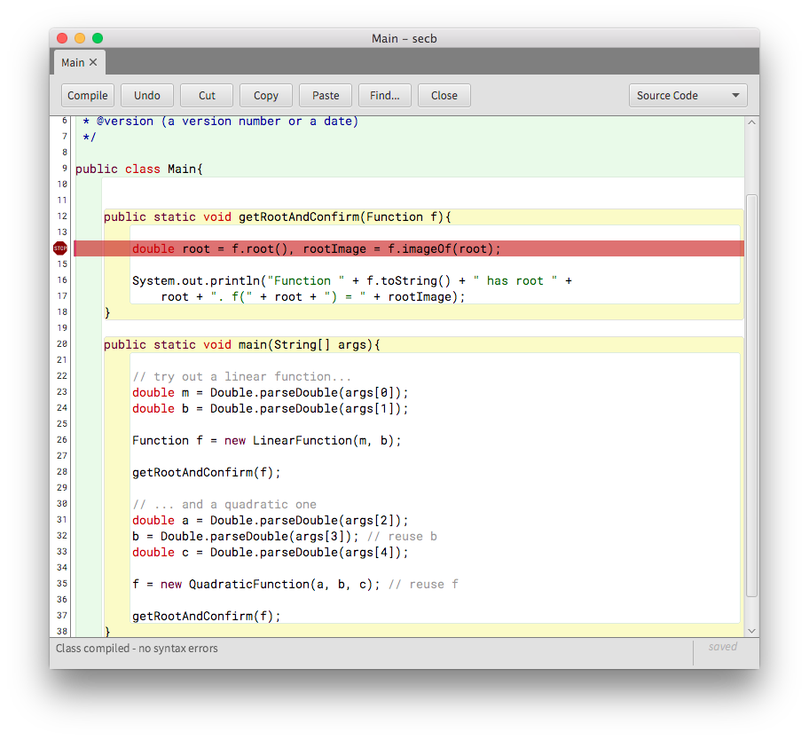
BlueJ’s debugger: breakpoints
Setting a breakpoint is done by clicking on the left sidebar
  The file must be compiled for this to work
  A white sidebar indicates a compiled file, a grey one indicates an uncompiled file
Changing the source file will automatically remove the breakpoint
Once all breakpoints have been created, run the program normally

Slide 14
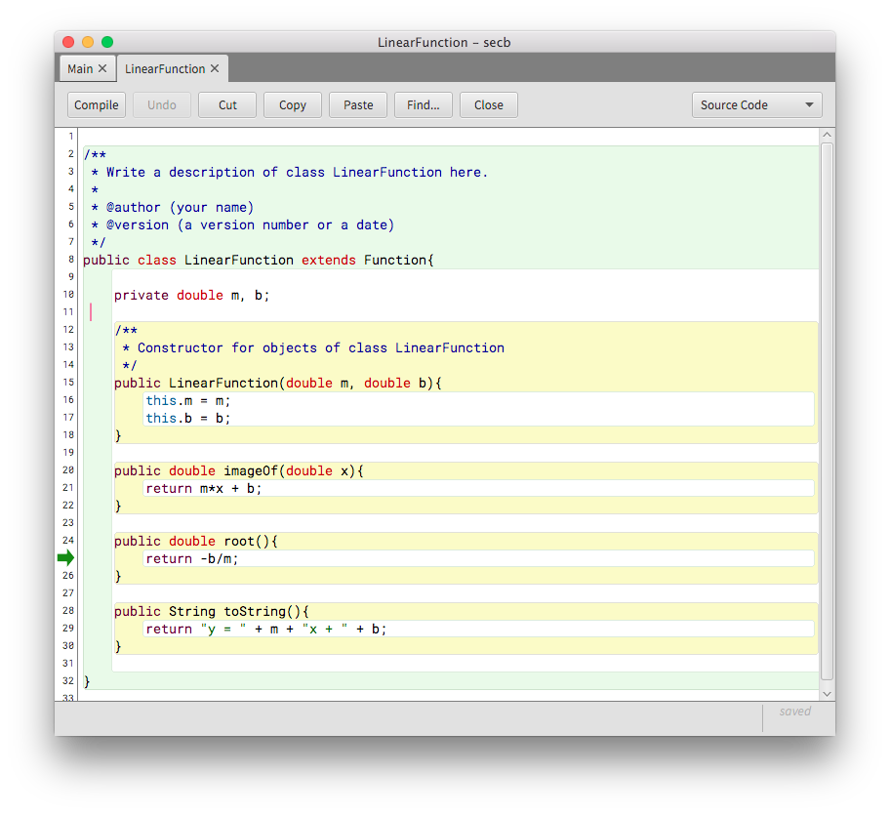
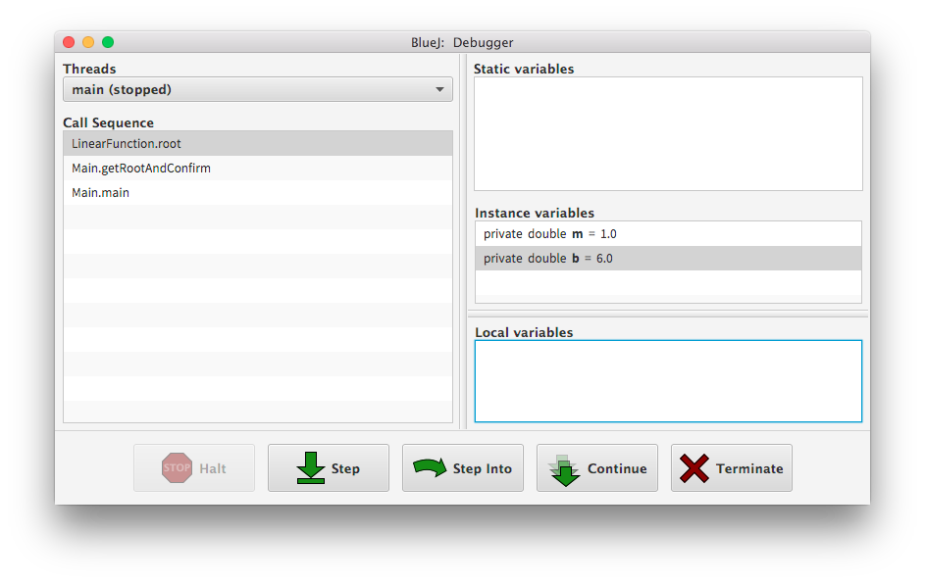
BlueJ’s debugger: execution
Execution will halt at breakpoints and you’ll be able to inspect the call stack, the variable contents, and step through the program

Slide 15
More about Object-Oriented Programming

Slide 16
Recall Object-Oriented Programming
A program as a model of the real world
Object is the building block
An object:
  Has state: instance variables
  Has behavior: methods
  Interacts with other objects: by calling their methods
Objects are grouped into classes
  Shared behavior
  Shared state structure (not content)

Slide 17
Class structure
Class name
Class members
  Fields (static or instance)
  Methods
UML (Unified Modeling Language) class representation:
Class name
fields
methods

Slide 18
Inheritance
Reuse common state/behavior while introducing some new specific state/behavior
Promotes code reuse, modularity, scalability
Terminology, synonyms:
  Superclass ← Subclass
  Parent class ← Child class
  Base class ← Derived class
Definition:
  class Subclass extends Superclass {...}
  E.g. class Student extends Person {...}
indicates
inheritance

Slide 19
More about methods

Slide 20
What is a method, really?
A named code block that can be referenced by its name
Input: specified by parameter list
Output: optional return value
Format:
[access] <returnType> <methodName>(<paramList>){ // signa.
… // method body
}
E.g. compute the area of a rectangle:
double areaOfRectangle(double h, double l){
return h*l;
}
Calling a method changes the flow of the program
  Execution at call location is suspended, resumed once called method returns
  Think of the method call as pasting the code of the method over the call

Slide 21
Usefulness of methods
They hide complexity
  Caller only needs to know what it does, not how it does it
They allow us to break down complex problems into multiple simpler ones that can be combined to obtain overall solution
  This is called decomposition
Programs provide services to users
  Methods provide services to programs
Complete Task
Subtask 1
Subtask 2
Subtask 3
Subtask 2a
Subtask 2b

Slide 22
Utility methods
A rule of thumb…
Methods that implement well-defined algorithms whose output depends solely on its parameters
  I.e. they don’t depend on additional state, e.g. instance variables
They are typically implemented as static methods
  Called as ClassName.methodName();
    E.g. Math.random();
  And… class methods do not need an associated object! It’s true!

