Slide 1
CMPU-102-01 Fall 2021 Data Structures and Algorithms
Debugging,
Unified Modeling Language,
Methods
Rui Meireles
Peter Lemieszewski

Slide 2
Debugging

Slide 3
Program correctness
Should be our first and major goal
Second is efficiency
Types of errors
Syntax errors
Written code does not translate into a valid set of instructions
Detected at compile time
E.g. missing semi-colon at the end of statement
Semantic errors or bugs
The program doesn’t do what it is supposed to do
Mostly detected at runtime (compiler can detect some, e.g. uninitialized variable)
E.g. program crashes when provided with a certain input or gives wrong result

Slide 4
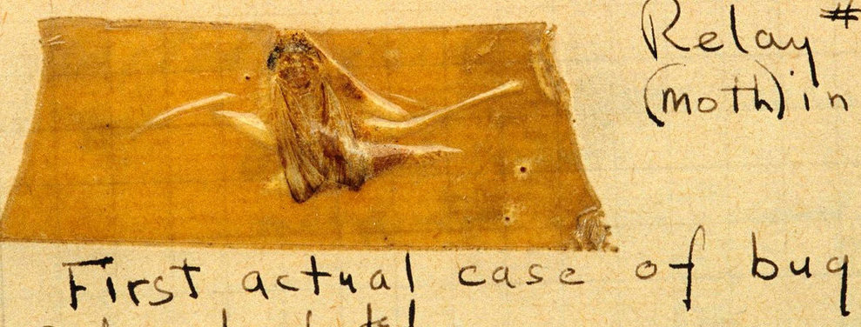
Debugging
Process through which we identify and eliminate bugs
Typical bug symptoms
Uncaught exception (e.g. NullPointerException)
Unexpected output
Lack of termination (e.g. infinite loop)
Bug identification strategies
Add print messages at strategic points
Sometimes it’s the only option. E.g. on embedded systems lacking a debugger
Assertions
Use a debugger
(line-by-line program execution)
Grace Hopper found the 1st bug in 1947
Notes:
Grace Hopper 1947 at Havard

Slide 5
Catching bugs early: assert
The assert keyword can be used to test program invariants
Syntax: assert <boolean-expr>;
E.g. assert i > 0;
Semantics:
Expression should be true during normal program execution
A false expression triggers a java.lang.AssertionError and halts program execution
Optionally, assert <boolean-expr> : <msg>;
A String representation of msg is printed along with the AssertionError
E.g. assert i > 0 : "i was: " + i;
Assertions are disabled by default
Why? Performance (i.e. not for use in production code)
Enabling assertions:
Command line execution: java -enableassertions, or -ea
Since its designed for education, BlueJ enables assertions automatically

Slide 6
Assertion example
switch(suit){
case "CLUBS":
…
break;
case "DIAMONDS":
…
break;
case "HEARTS":
…
break;
case "SPADES":
…
break;
default: // if we get here, false it is…
assert false : "unexpected suit " + suit;
}

Slide 7
Assertion usage guidelines
Because assertions are not guaranteed to be enabled, they should not be required for program correctness
It follows that assertions should not be used to:
Check arguments in public methods, because specification has to be obeyed regardless
Throwing an IllegalArgumentException is preferred
Produce side-effects
E.g. assert matrixa.add(matrixb); // from lab #3
Addition will not be performed if assertions are disabled
Program semantics will change!

Slide 8
Debugger
A debugger is a software development tool that lets us pause execution, inspect internal state, and execute in “slow motion”
The workflow is as follows:
Pick line of code where the debugging is to start, known as a breakpoint
Run the program
If and when the breakpoint is reached, execution will halt and you will be able to inspect the program’s state and step through the program one line at a time. There two different types of step commands:
Step: execute the next line of code without drilling down into method calls
Step into: execute the next line of code, but if that line involves a method call, step inside it so its execution can be debugged
The continue command can be used at any time to resume program execution

Slide 9
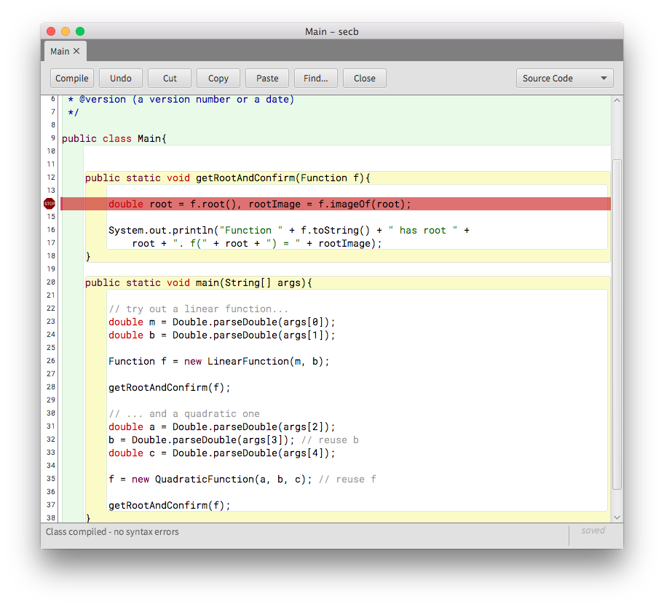
BlueJ’s debugger: breakpoints
Setting a breakpoint is done by clicking on the left sidebar
The file must be compiled for this to work
A white sidebar indicates a compiled file, a grey one indicates an uncompiled file
Changing the source file will automatically remove the breakpoint
Once all breakpoints have been created, run the program normally

Slide 10
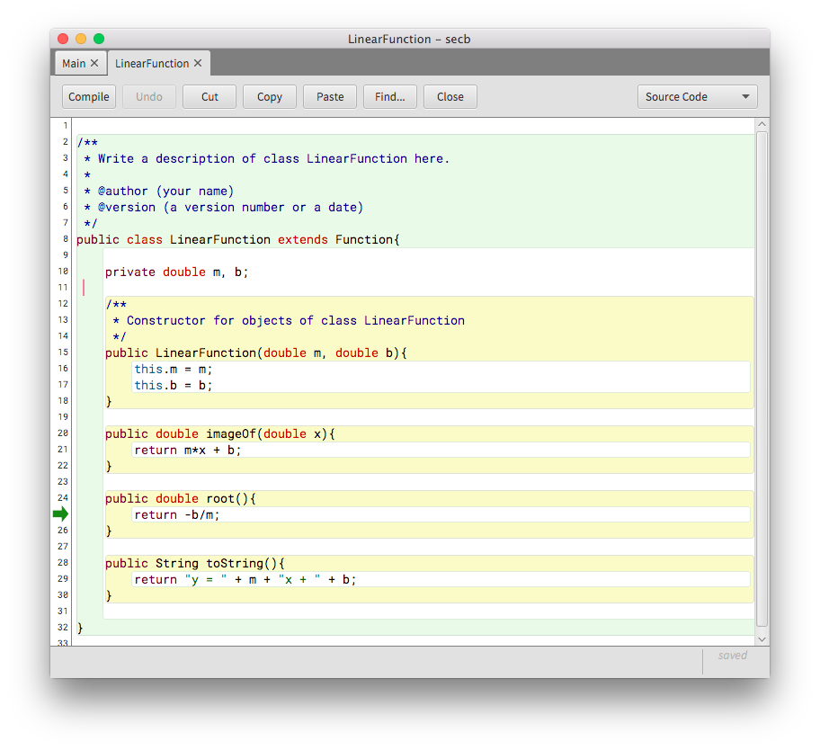
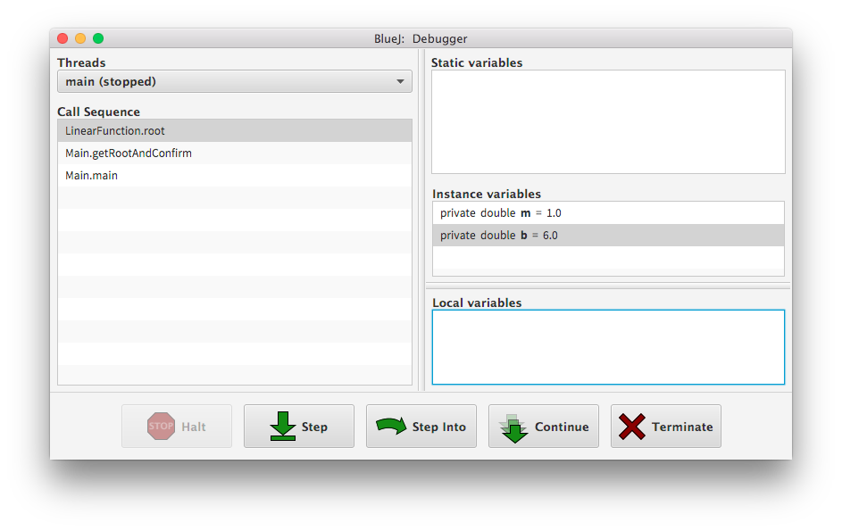
BlueJ’s debugger: execution
Execution will halt at breakpoints and you’ll be able to inspect the call stack, the variable contents, and step through the program

Slide 11
More about Object-Oriented Programming

Slide 12
Recall Object-Oriented Programming
A program as a model of the real world
Object is the building block
An object:
Has state: instance variables
Has behavior: methods
Interacts with other objects: by calling their methods
Objects are grouped into classes
Shared behavior
Shared state structure (not content)

Slide 13
Class structure
Class name
Class members
Fields (static or instance)
Methods
UML (Unified Modeling Language) class representation:
Class name
fields
methods

Slide 14
Inheritance
Reuse common state/behavior while introducing some new specific state/behavior
Promotes code reuse, modularity, scalability
Terminology, synonyms:
Superclass ← Subclass
Parent class ← Child class
Base class ← Derived class
Definition:
class Subclass extends Superclass {...}
E.g. class Student extends Person {...}
indicates
inheritance

Slide 15
More about methods

Slide 16
What is a method, really?
A named code block that can be referenced by its name
Input: specified by parameter list
Output: optional return value
Format:
[access] <returnType> <methodName>(<paramList>){ // signa.
… // method body
}
E.g. compute the area of a rectangle:
double areaOfRectangle(double h, double l){
return h*l;
}
Calling a method changes the flow of the program
Execution at call location is suspended, resumed once called method returns
Think of the method call as pasting the code of the method over the call

Slide 17
Usefulness of methods
They hide complexity
Caller only needs to know what it does, not how it does it
They allow us to break down complex problems into multiple simpler ones that can be combined to obtain overall solution
This is called decomposition
Programs provide services to users
Methods provide services to programs
Complete Task
Subtask 1
Subtask 2
Subtask 3
Subtask 2a
Subtask 2b

Slide 18
Utility methods
A rule of thumb…
Methods that implement well-defined algorithms whose output depends solely on its parameters
I.e. they don’t depend on additional state, e.g. instance variables
They are typically implemented as static methods
Called as ClassName.methodName();
E.g. Math.random();
And… class methods do not need an associated object! It’s true!

