Slide 1
CMPU-102-01 Fall 2021 Data Structures and Algorithms
Week 7: Debugging Review,
Methods
Rui Meireles
Peter Lemieszewski

Slide 2
Debugging

Slide 3
Program correctness
Should be our first and major goal
Second is efficiency
Types of errors
Syntax errors
Written code does not translate into a valid set of instructions
Detected at compile time
E.g. missing semi-colon at the end of statement
Semantic errors or bugs
The program doesn’t do what it is supposed to do
Mostly detected at runtime (compiler can detect some, e.g. uninitialized variable)
E.g. program crashes when provided with a certain input or gives wrong result

Slide 4
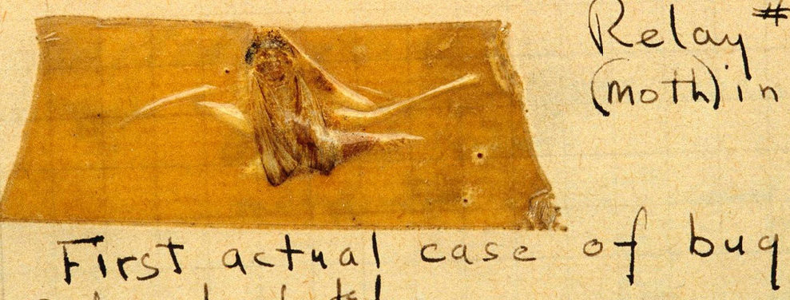
Debugging
Process through which we identify and eliminate bugs
Typical bug symptoms
Uncaught exception (e.g. NullPointerException)
Unexpected output
Lack of termination (e.g. infinite loop)
Bug identification strategies
Add print messages at strategic points
Sometimes it’s the only option. E.g. on embedded systems lacking a debugger
Assertions (recommended)
Use a debugger (recommended)
Grace Hopper found the 1st literal bug in 1947
Notes:
Grace Hopper 1947 at Havard

Slide 5
Catching bugs early: assert
The assert keyword can be used to test program invariants
Syntax: assert <boolean-expr>;
E.g. assert i > 0;
Semantics:
Expression should be true during normal program execution
A false expression triggers a java.lang.AssertionError and halts program execution
Optionally, assert <boolean-expr> : <msg>;
A String representation of msg is printed along with the AssertionError
E.g. assert i > 0 : "i was: " + i;
Assertions are disabled by default
Why? Performance (i.e. not for use in production code)
Enabling assertions:
Command line execution: java -enableassertions, or -ea
Since its designed for education, BlueJ enables assertions automatically

Slide 6
Assertion example
switch(suit){
case "CLUBS":
…
break;
case "DIAMONDS":
…
break;
case "HEARTS":
…
break;
case "SPADES":
…
break;
default: // if we get here, false it is…
assert false : "unexpected suit " + suit;
}

Slide 7
Assertion usage guidelines
Because assertions are not guaranteed to be enabled, they should not be required for program correctness
It follows that assertions should not be used to:
Check arguments in public methods, because specification has to be obeyed regardless
Throwing an IllegalArgumentException is preferred
Produce side-effects
E.g. assert matrixa.add(matrixb); // from lab #3
Addition will not be performed if assertions are disabled
Program semantics will change!

Slide 8
Debugger
A debugger is a software development tool that lets us pause execution, inspect internal state, and execute in “slow motion”
The workflow is as follows:
Pick line of code where the debugging is to start, known as a breakpoint
Run the program
If and when the breakpoint is reached, execution will halt and you will be able to inspect the program’s state and step through the program one line at a time. There two different types of step commands:
Step: execute the next line of code without drilling down into method calls
Step into: execute the next line of code, but if that line involves a method call, step inside it so its execution can be debugged
The continue command can be used at any time to resume program execution

Slide 9
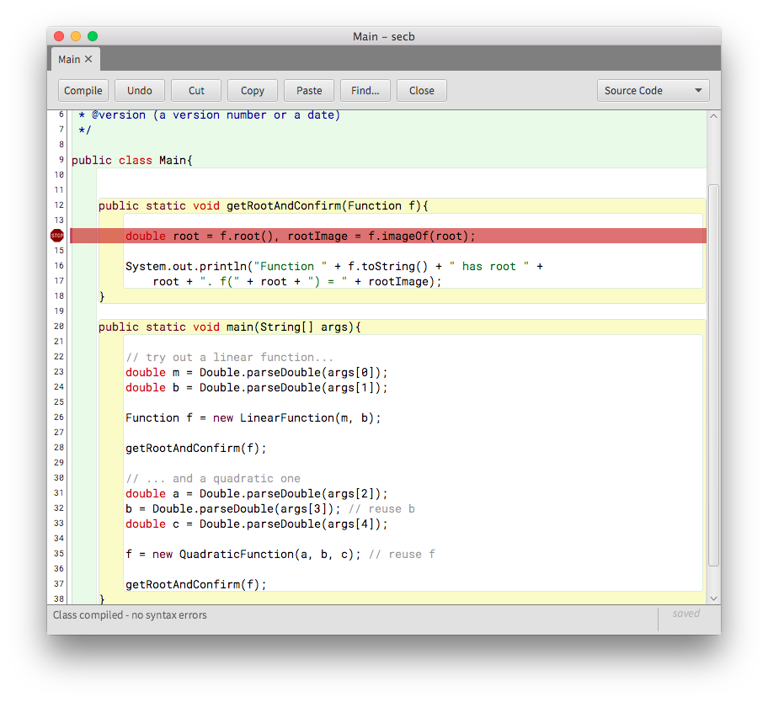
BlueJ’s debugger: breakpoints
Setting a breakpoint is done by clicking on the left sidebar
The file must be compiled for this to work
A white sidebar indicates a compiled file, a grey one indicates an uncompiled file
Changing the source file will automatically remove the breakpoint
Once all breakpoints have been created, run the program normally

Slide 10
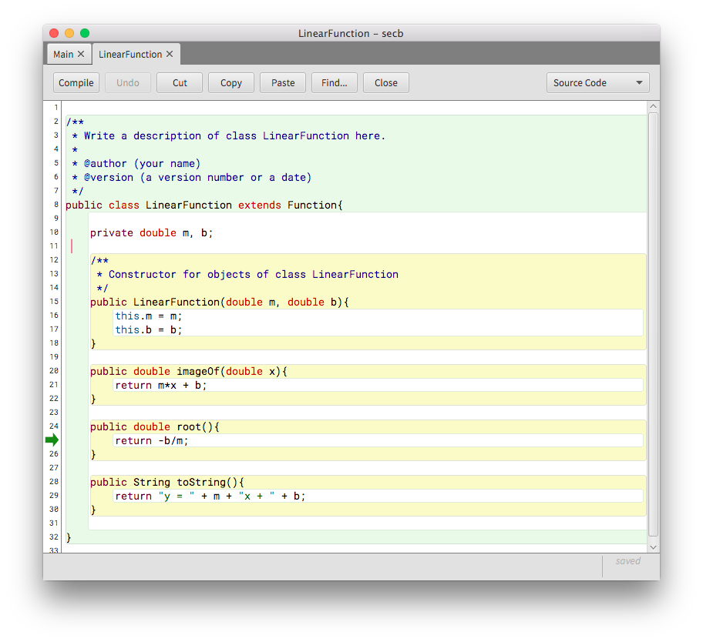
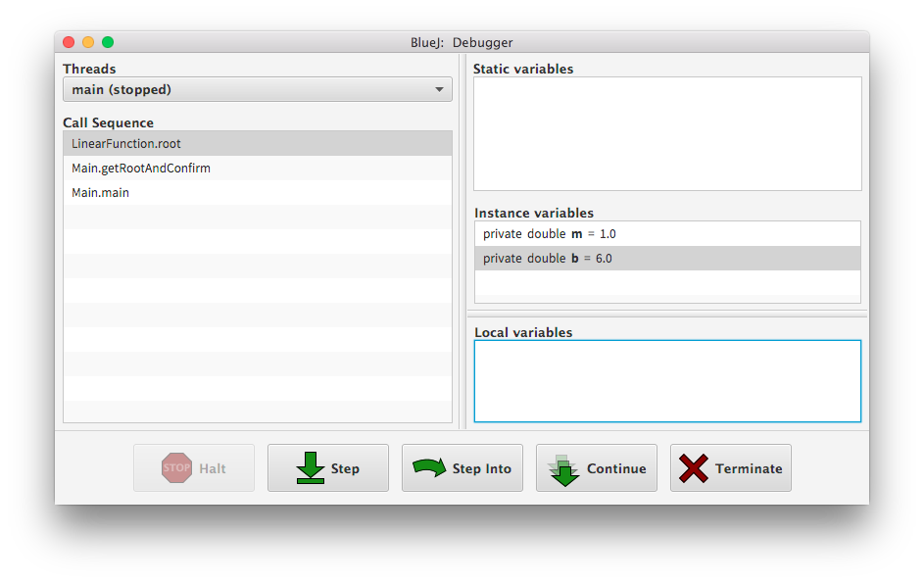
BlueJ’s debugger: execution
Execution will halt at breakpoints and you’ll be able to inspect the call stack, the variable contents, and step through the program

Slide 11
More about methods

Slide 12
What is a method, really?
A named code block that can be referenced by its name
Input: specified by parameter list
Output: optional return value
Methods:
Implement algorithms
Hide complexity
Allow us to break down complex problems into multiple simpler ones
Decomposition
Format:
[access] <returnType> <methodName>(<paramList>){ // sign.
… // method body
}
E.g. compute the area of a rectangle:
double rectArea(double h, double l){ return h*l; }

Slide 13
Utility methods
Methods that implement well-defined algorithms whose output depends solely on its parameters
I.e. they don’t depend on additional state, e.g. instance variables
They are typically implemented as static methods
Called as ClassName.methodName();
E.g. Math.random();

Slide 14
Useful utility methods in the Math class
Math.abs(x)
Returns the absolute value of x
Math.min(x, y)
Returns the smaller of x and y
Math.max(x, y)
Returns the larger of x and y
Math.sqrt(x)
Returns the square root of x
Math.log(x)
Returns the natural logarithm of x (log_{e} x )
Math.exp(x)
Returns the inverse logarithm of x (e ^{x} )
Math.pow(x, y)
Returns the value of x raised to the y power (x ^{y} )
Math.sin(theta)
Returns the sine of theta, measured in radians
Math.cos(theta)
Returns the cosine of theta
Math.tan(theta)
Returns the tangent of theta
Math.asin(x)
Returns the angle whose sine is x
Math.acos(x)
Returns the angle whose cosine is x
Math.atan(x)
Returns the angle whose tangent is x
Math.toRadians(degs)
Converts an angle from degrees to radians
Math.toDegrees(rads)
Converts an angle from radians to degrees

Slide 15
In-class exercise: powers of two
Write a utility method called isPowerOfTwo:
Input: an integer n
Output: true if n is a power of two (i.e. 1, 2, 4, 8, 16, 32, etc), and false otherwise.
public static boolean isPowerOfTwo(int n){
...
}

Slide 16
In-class exercise: powers of two solution
Input: an integer n
Output: true if n is a power of two (i.e. 1, 2, 4, 8, 16, 32, etc), and false otherwise.
public static boolean isPowerOfTwo(int n){
int i = 1;
for (; i < n; i*=2);
return i == n;
}
public static boolean isPowerOfTwo(int n){
if (n < 1)
return false;
while (n > 1) {
if (n % 2 != 0)
return false;
n /= 2;
}
return true;
}

Slide 17
Instance methods
Methods whose output depends not only on the method arguments but also on an instance’s state
Instance can be thought of as an implicit/hidden argument to the method
Not static, called as objName.methodName()
class Person(){
String name;
Person(String name) { this.name = name; }
String getName() { return name; }
}
Person andre = new Person("Andre");
Person mary = new Person("Mary");
System.out.println(andre.getName());
System.out.println(mary.getName());

Slide 18
Method calls as messages
In object-oriented languages like Java, the act of calling a method is often described in terms of sending a message to an object. For example, the method call:
rect.setColor(Color.RED);
is regarded metaphorically as sending a message to the rect object asking it to change its color to red.
setColor(Color.RED)
The object to which a message is sent is called the receiver
Notes:
I can delete this slide in the future.

Slide 19
Constructor methods
Used to create new object
Always same name as class
No return value in signature
But actually return reference to newly-created object
Typically initialize instance fields. E.g.:
class Person{
String name;
Person(String name){ this.name = name; }
Person(){ this.name = "John Doe"; }
}
Called with new keyword, e.g.:
Person p = new Person("Catherine");

Slide 20
Getters and setters
If class fields are made public, they can be modified by external parties in potentially harmful ways
One way to deal with this is to make field private and:
Have a getX() method to allow others to read it
Have a setX() method to allow others to change it in a controlled way
E.g.: public class Test{
private int pcent;
public int getPercentage(){
return this.pcent;
}
public void setPercentage(int pcent){
if (pcent >= 0 && pcent <= 100)
this.pcent = pcent;
}
}

Slide 21
Method side effects
When a method changes some state that outlives the method itself we say it has side effects
E.g. setter methods typically have a void return type
Usefulness is the side effect of a certain instance variable changing
public class Test{
private int pcent;
public void setPercentage(int pcent){
if (pcent >= 0 && pcent <= 100)
this.pcent = pcent;
}
}

Slide 22
Parameter passing
There are two general strategies: by value and by reference
Java passes arguments by value (pass-by-value):
Primitive types: the method receives a copy of the contents
Object-reference types: the method receives a copy of the reference
Implications
Changes to value of primitive-type variables will not propagate outside of method
Changes to object contents will propagate outside of method
The same logic applies to return values
If a method returns a reference to an object, the object may be changed outside of the method

Slide 23
Parameter passing: in-class exercise
What does this program print?
class Person{
String name;
Person(String name){ this.name = name; }
}
void someMethod(Person p, int age){
age++;
p.name = "Roger";
p = new Person("Ronald");
p.name = "Hatter";
}
Person p = new Person("Ronald");
int age = 10;
someMethod(p, age);
System.out.printf("Name: %s, age: %d", p.name, age);
Notes:
Queen of hearts
White queen, red queen

Slide 24
The root of the class hierarchy
All classes implicitly inherit from class Object
Useful methods inherited from Object:
boolean equals(Object o)
Returns true if both instance and argument refer to the same object
E.g. Person a = new Person("Mary");
Person b = new Person("Mary");
a.equals(b); // false
Person c = a;
a.equals(c); // true
String toString()
Returns a String representation of the instance
Returns "ClassName@hashCode”
E.g. Person@232204a1

Slide 25
Method overriding (1/2)
Subclasses can replace a superclass' method implementation by specifying a method with the same signature
Same name, return type, and parameter list
We call this method overriding
At runtime, the subclass method will be the one executed
Even in situations like these:
public class SuperClass{ int m(){ return 0; } }
public class SubClass extends SuperClass{
int m(){ return 1; }
}
…
SuperClass s = new SubClass();
System.out.println(s.m());

Slide 26
Method overriding (2/2)
String toString() and boolean equals(Object o) are commonly overwritten. E.g.:
public class Person{
String name;
long ssn;
boolean equals(Object o){
return (o instanceof Person) &&
((Person)o).ssn == this.ssn;
}
String toString(){
return "Name: " + this.name +
", ssn: " + this.ssn;
}
}

