Slide 1
CMPU-102-51 Spring 2020
Data Structures and Algorithms
Lecture #16: Java’s collections framework
Rui Meireles
Peter Lemieszewski

Slide 2
Java’s linked list implementation
(IPUJ 10.1-10.2)

Slide 3
java.util.LinkedList
Java includes a sophisticated linked list implementation
  The java.util.LinkedList class
Is a parametrized type, also known as generic type
  Object declaration specifies data type of list values
  Syntax: LinkedList<DataType> <varName>;
  If no parameter is specified, Object is assumed
  E.g.:
    LinkedList<String> stringList;
    LinkedList objectList;
  Recall subclass types can be used as superclass types
  Wrapper classes needed for primitive types. E.g.:
    LinkedList<Integer> anIntegerList;

Slide 4
LinkedList methods
LinkedList implements the List<E> interface
Some useful methods:
  add(E elem): append elem to end of list
  add(int idx, E elem): insert elem at index idx
  remove(int idx): remove and return element at index idx
  get(int idx): return element at index idx
  indexOf(Object o): returns index of object o, if it is present on the list, or -1 otherwise
    Note how any object is accepted, not only of type E
    Object.equals() is used for the comparison
  size(): returns number of elements in list

Slide 5
LinkedList usage example: FIFO
Let us implement a FIFO (First-In, First-Out) queue:
import java.util.LinkedList;
public class FifoQueue{
LinkedList<String> q;
FifoQueue(){ q = new LinkedList<String>(); }
void enqueue(String name){ q.add(name); }
String dequeue(){
String rval = q.size() > 0 ? q.remove(0) : null;
return rval;
}
}

Slide 6
FIFO usage example
Let’s use the LinkedList-based FIFO queue:
public static void main(String[] args){
FifoQueue fifo = new FifoQueue();
fifo.enqueue("Mickey");
fifo.enqueue("Donald");
fifo.enqueue("Pluto");
for (String name = fifo.dequeue();
name != null;
name = fifo.dequeue()){
System.out.printf("It's your turn %s!\n", name);
}
}

Slide 7
In-class exercise: write a LIFO queue
Write a LIFO (Last-In, First-Out) queue for strings:
public class LifoQueue{
LinkedList<String> q;
LifoQueue(){ q = new LinkedList<String>(); }
void enqueue(String name){ … }
String dequeue(){ … }
}
Recall the following useful methods:
  add(E elem): append elem to end of list
  add(int idx, E elem): insert elem at index idx
  remove(int idx): removes and returns element at index idx
  size(): returns length of list

Slide 8
Useful LinkedList Methods
Let’s carry over the useful methods of LinkedList…

Slide 9
In-class exercise: LIFO queue solution
A LIFO (Last-In, First-Out) queue:
public class LifoQueue{
LinkedList<String> q;
LifoQueue(){ q = new LinkedList<String>(); }
void enqueue(String name){ /*???*/ }
String dequeue(){
String rval;
/*???*/
return rval;
}
}

Slide 10
Creating generic classes
We can create our own classes generic with suffix <T>
  T is an example name, you can use some other name, as long as it is inside diamond braces
public class LifoQueue<T>{
LinkedList<T> q;
LifoQueue(){ q = new LinkedList<T>(); }
void enqueue(T name){ q.add(0, name); }
T dequeue(){
T rval = q.size() > 0 ? q.remove(0) : null;
return rval;
}
}

Slide 11
Using our generic LIFO
Let’s use the LinkedList-based LIFO queue:
public static void main(String[] args){
LifoQueue<String> lifo = new LifoQueue<String>();
lifo.enqueue("Mickey");
lifo.enqueue("Donald");
lifo.enqueue("Pluto");
for(String name = lifo.dequeue();
name != null;
name = lifo.dequeue()){
System.out.printf("It's your turn %s!\n", name);
}
}

Slide 12
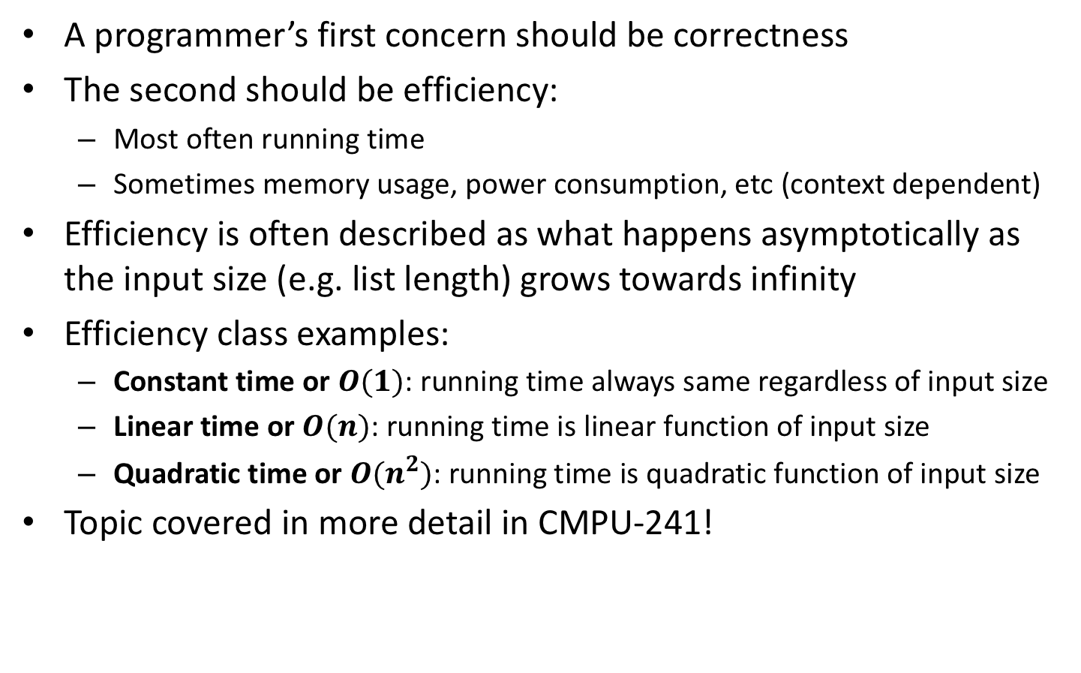
Running time efficiency
A programmer’s first concern should be correctness
The second should be efficiency:
  Most often running time
  Sometimes memory usage, power consumption, etc (context dependent)
Efficiency is often described as what happens asymptotically as the input size (e.g. list length) grows towards infinity
Efficiency class examples:
  Constant time or $O(1)$: running time always same regardless of input size
  Linear time or $O(n)$: running time is linear function of input size
  Quadratic time or $O(n^{2})$: running time is quadratic function of input size
Topic covered in more detail in CMPU-241!
Notes:
For ArrayList
get is O(1)
add is O(1) amortized, but O(n) worst-case since the array must be resized and copied
remove is O(n)

Slide 13
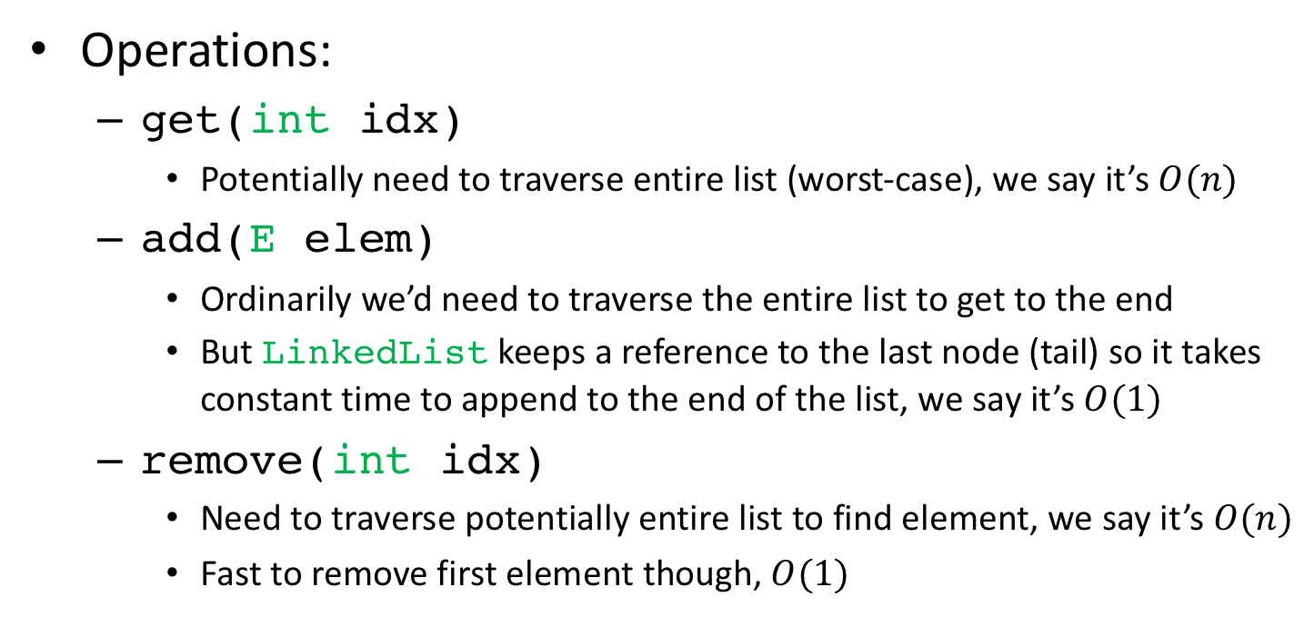
LinkedList running time efficiency
Operations:
  get(intidx)
    Potentially need to traverse entire list (worst-case), we say it’s $O(n)$
  add(Eelem)
    Ordinarily we’d need to traverse the entire list to get to the end
    But LinkedList keeps a reference to the last node (tail) so it takes constant time to append to the end of the list, we say it’s $O(1)$
  remove(intidx)
    Need to traverse potentially entire list to find element, we say it’s $O(n)$
    Fast to remove first element though, $O(1)$
Notes:
For ArrayList
get is O(1)
add is O(1) amortized, but O(n) worst-case since the array must be resized and copied
remove is O(n)

Slide 14
Java’s list implementations
(IPUJ 10.1-10.2)

Slide 15
An alternative to LinkedList
Random accesses are inefficient for LinkedLists
  E.g. performing get() on random indices
Lists that are accessed randomly often but rarely changed benefit from a different implementation
Recall arrays:
  Fixed-sized collection of elements of a given type
  Contiguous memory allocation allows fast random-access
We can implement a list using an array
  Arrays enable fast random access
    At a price, as we’ll see
Notes:
For ArrayList
get is O(1)
add is O(1) amortized, but O(n) worst-case since the array must be resized and copied
remove is O(n)

Slide 16
Implementing a list using an array
public class StringArrayList {
private String[] array = new String[10];
private int lsize = 0; // how much is occupied
public void add(String item){ // add at end
if(lsize == array.length){ // array already full!
String[] newArray = new String[2*array.length];
for(int i=0; i < array.length; i++) // copy over
newArray[i] = array[i];
array = newArray;
}
array[lsize] = item;
lsize++;
}
}
Notes:
For ArrayList
get is O(1)
add is O(1) amortized, but O(n) worst-case since the array must be resized and copied
remove is O(n)

Slide 17
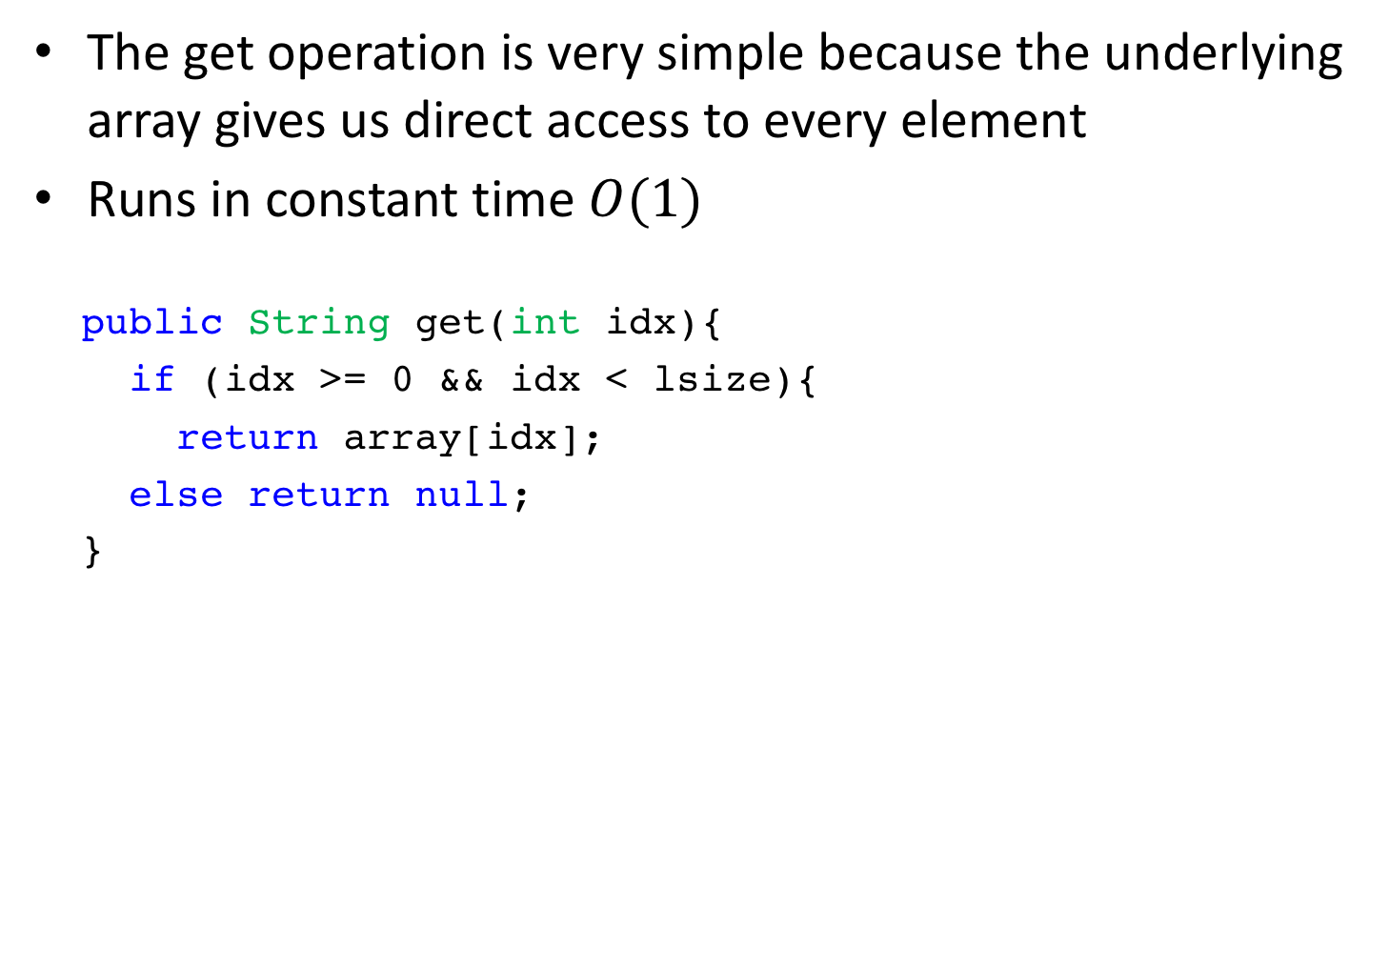
Array-based list: get
The get operation is very simple because the underlying array gives us direct access to every element
Runs in constant time $O(1)$
publicString get(intidx){
if (idx>= 0 &&idx<lsize){
return array[idx];
else returnnull;
}

Slide 18
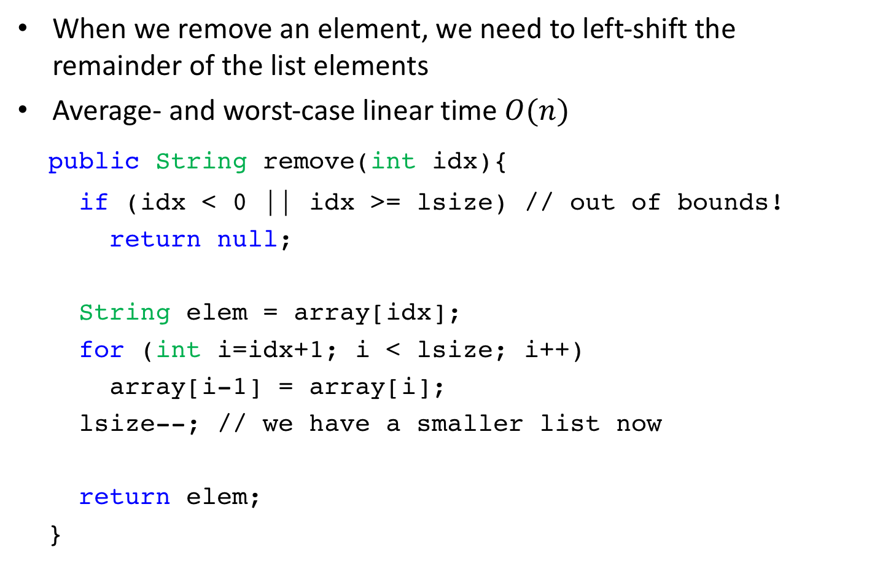
Array-based list: remove
When we remove an element, we need to left-shift the remainder of the list elements
Average- and worst-case linear time $O(n)$
publicString remove(intidx){
if (idx< 0 || idx>= lsize) // out of bounds!
returnnull;
Stringelem = array[idx];
for (inti=idx+1; i<lsize; i++)
array[i-1] = array[i];
lsize--; // we have a smaller list now
returnelem;
}

Slide 19
java.util.ArrayList
Array-based alternative to LinkedList
  Uses an array instead of a linked list of nodes
Both implement List<E> and are therefore interchangeable
Example declarations:
  List<String> strList = new ArrayList<String>();
  List<String> strList = new LinkedList<String>();

Slide 20
An alternative to LinkedList
Random accesses are inefficient for LinkedLists
  E.g. performing get() on random indices
Lists that are accessed randomly often but rarely changed benefit from a different implementation
Recall arrays:
  Fixed-sized collection of elements of a given type
  Contiguous memory allocation allows fast random-access
We can implement a list using an array
  Arrays enable fast random access
    At a price, as we’ll see
Notes:
For ArrayList
get is O(1)
add is O(1) amortized, but O(n) worst-case since the array must be resized and copied
remove is O(n)

Slide 21
Implementing a list using an array
public class StringArrayList {
private String[] array = new String[10];
private int lsize = 0; // how much is occupied
public void add(String item){ // add at end
if(lsize == array.length){ // array already full!
String[] newArray = new String[2*array.length];
for(int i=0; i < array.length; i++) // copy over
newArray[i] = array[i];
array = newArray;
}
array[lsize] = item;
lsize++;
}
}
Notes:
For ArrayList
get is O(1)
add is O(1) amortized, but O(n) worst-case since the array must be resized and copied
remove is O(n)

Slide 22
ArrayList implementation: more
Also see chapter 7.3 in our text book.
How could we use it? Here’s an example…
import textio.TextIO;
import java.util.ArrayList;
/**
* Reads a list of non-zero numbers from the user, then prints
* out the input numbers in the reverse of the order in which
* the were entered. There is no limit on the number of inputs.
*/
public class ReverseWithArrayList {
public static void main(String[] args) {
ArrayList<Integer> list;
list = new ArrayList<Integer>();
System.out.println("Enter some non-zero integers. Enter 0 to end.");
while (true) {
System.out.print("? ");
int number = TextIO.getlnInt();
if (number == 0)
break;
list.add(number);
}
System.out.println();
System.out.println("Your numbers in reverse are:");
for (int i = list.size() - 1; i >= 0; i--) {
System.out.printf("%10d%n", list.get(i));
}
}
}

Slide 23
java.util.ArrayList
Array-based alternative to LinkedList
  Uses an array instead of a linked list of nodes
Both implement List<E> and are therefore interchangeable
Example declarations:
  List<String> strList = new ArrayList<String>();
  List<String> strList = new LinkedList<String>();

Slide 24
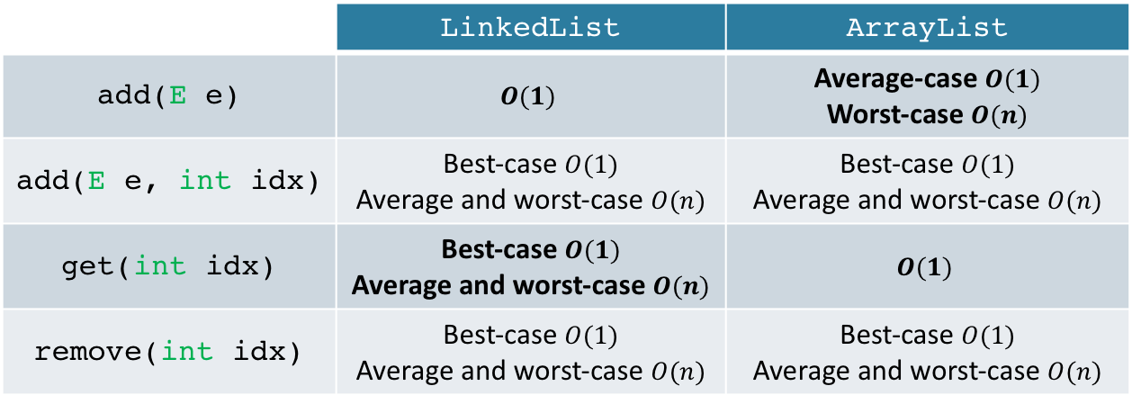
ArrayList or LinkedList?
Performance comparison (running time):
 | LinkedList | ArrayList
add(E e) | $$O(1)$$ | Average-case $O(1)$ Worst-case$O(n)$
add(E e, intidx) | Best-case $O(1)$ Average and worst-case$O(n)$ | Best-case $O(1)$ Average and worst-case$O(n)$
get(intidx) | Best-case $O(1)$ Average and worst-case$O(n)$ | $$O(1)$$
remove(intidx) | Best-case $O(1)$ Average and worst-case$O(n)$ | Best-case $O(1)$ Average and worst-case$O(n)$
Best choice depends on use case:
  Lots of random accesses → ArrayList
  Lots of insertions at ends → LinkedList
Memory usage consideration:
  ArrayList does not shrink the array automatically when the list size decreases. An explicit call to trimToSize() is needed.

Slide 25
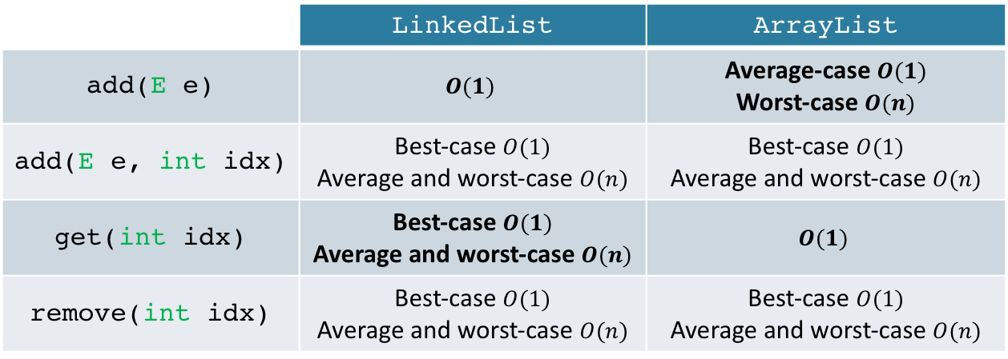
In-class exercise: ArrayList or LinkedList?
Which would you choose to:
  Implement a FIFO (First-In-First-Out) queue?
  Implement a database of historical sports match statistics, to be used in a Wikipedia-type site (i.e. random access)?
 | LinkedList | ArrayList
add(E e) | $$O(1)$$ | Average-case $O(1)$ Worst-case$O(n)$
add(E e, intidx) | Best-case $O(1)$ Average and worst-case$O(n)$ | Best-case $O(1)$ Average and worst-case$O(n)$
get(intidx) | Best-case $O(1)$ Average and worst-case$O(n)$ | $$O(1)$$
remove(intidx) | Best-case $O(1)$ Average and worst-case$O(n)$ | Best-case $O(1)$ Average and worst-case$O(n)$

Slide 26
Another array-based list: Vector
Differs only in detail from ArrayList:
  It is synchronized
    Meaning it is safe to share a vector between multiple threads
    This makes it slower, so ArrayList is preferred if synchronization not needed
  Array grows more slowly
    ArrayList doubles array size when out of space, Vector increases it by 50%

Slide 27
Java’s collections framework
(IPUJ Chapter 10)

Slide 28
Abstract data type (ADT)
List is an example of an Abstract Data Type (ADT)
  Type defined by its behavior (semantics) from the user’s point of view
    Semantics defined by method contracts, typically in an interface in Java
  Largely independent from the way in which it is implemented
A data structure is an implementation of an ADT
  Way to organize data in order to implement desired behavior
  An ADT is abstract, a data structure is concrete
  Implementation won’t affect functionality, but can affect performance
  LinkedList, ArrayList and Vector are all data structures

Slide 29
Java collections framework
Set of ADT interfaces and data structures that implement them

Slide 30
The Collection interface
A Java collection represents a generic group of objects
  Ordered or not, with repetition or not
All collections implement java.util.Collection<E>
  Corollary: they all support Java generics
Some useful methods:
  add(E elem): add element to collection, returns true if collection changed
  contains(Object o): returns true if o is present in collection, false otherwise
  remove(Object o): remove o from collection, returns true if collection changed
  size(): returns number of elements in collection
Notes:
Add returns boolen, true if collection changed.,

Slide 31
Collection traversal
Going through the elements in a collection one by one
We can use a for-each loop:
Collection<String> strCol = new ArrayList<String>();
for (String str : strCol){
System.out.println(str);
}
If the collection is a a list we can use the get() method:
List<String> strList = new ArrayList<String>();
for (int i=0; i < strList.size(); i++){
System.out.println(strList.get(i));
}

Slide 32

Collection traversal using iterators
Since traversing a collection is very common Java provides another way to do it: using an Iterator
  Has cursor that guides us through the collection, one element at a time
  More powerful than for-each loop (supports removal)
  Even if get() is available, is often more efficient, e.g. for linked lists
The Collection interface extends Iterable, meaning all collections support iteration
Iterator provides the following methods:
  hasNext(): returns true if the collection has more elements
  next(): returns next element in collection and moves cursor forwards
  remove(): removes last element returned by the iterator from collection

Slide 33
Using an iterator
Obtaining an iterator
  Collections have an iterator() method that returns one
Example usage:
Collection<String> strList = new LinkedList<String>();
...
Iterator<String> itr = strList.iterator();
while (itr.hasNext()) {
String s = itr.next();
System.out.println(s);
}

Slide 34
The ListIterator class
Collections that implement interface List also support an additional type of iterator called ListIterator
  Obtained through the listIterator() method
Has many additional methods:
  add(E e): add element at current position (before next())
  hasPrevious(): returns true if there is an element before cursor
  previous(): returns previous element and moves cursor backwards
  previousIndex(): returns index of element of subsequent call to previous()
  nextIndex(): returns index of element of subsequent call to next()
  set(E e): replaces last element returned by previous() or next() with e

Slide 35
ListIterator example: in-class exercise
What are the output and side effects of the following program?
List<Integer> l = new LinkedList<Integer>();
for (int i=0; i < 10; i++)
l.add(i);
ListIterator<Integer> itr = l.listIterator();
int acc = 0;
while (itr.hasNext()){
int curVal = itr.next();
acc += curVal;
itr.set(acc);
}
System.out.println(itr.previous());

