Slide 1
CMPU-102 Fall 2021
Data Structures and Algorithms
Lab #0: Java warmup
Material courtesy of:
Hannah Gommerstadt & Rui Meireles
Assistant Profs. of Computer Science, Vassar College, USA

Slide 2
Introduction to Java
(IPUJ 2.1-2.3)

Slide 3
The Java programming language
Released in 1995 by Sun Microsystems
  Named after Java coffee
Used in everything from web servers to mobile apps
  Notable example: Android OS apps
Why Java?
  Clean OOP implementation
  Ease of use:
    Clear, consistent syntax
    Great built-in libraries
    Great documentation
    Platform-independent
  Popularity: #2 in TIOBE index August 2020
    Means lots of resources available

Slide 4
A Java "Hello world"
  public class HelloWorld{ // class definition
  public static void main(String[] args){ // exec. starts here
  System.out.println("Hello world!"); // call print
  }
  }
All Java code is written in the context of a class
  Strongly encourages object-oriented design
Execution begins at a special method called main
Please don't worry about the details at this point!

Slide 5
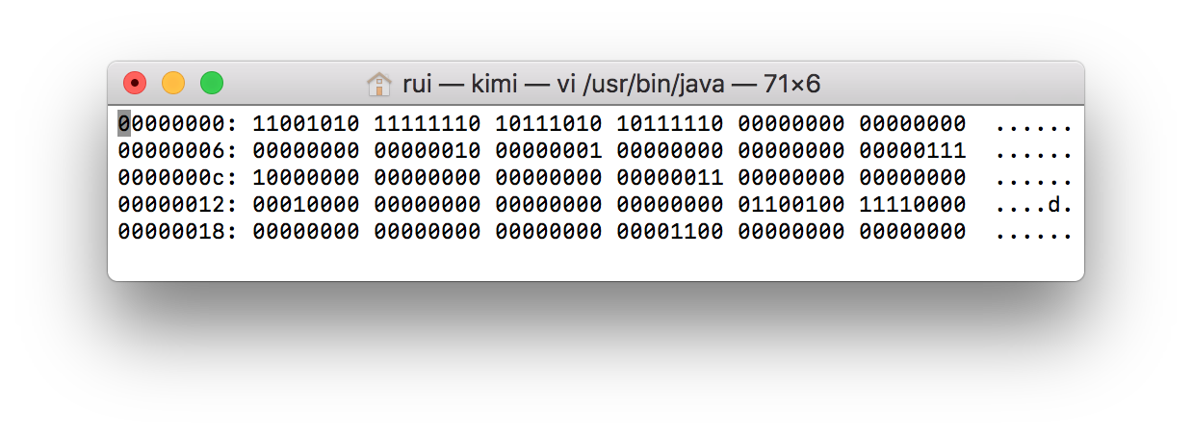
Running Java programs (1/3)
All computers understand is machine code
  Simple instructions determined by computer’s architecture
  Corollary: Java needs to be translated into machine code for execution
Traditionally, there are 2 possible strategies:
  Compilation: translation performed prior to execution by compiler
    Good: fast execution; bad: resulting program can only be executed in one type of computer
    Examples: C, C++
  Interpretation: translation performed on-the-fly by interpreter
    Good: any computer for which there is an interpreter can run the program; bad: slow
    Examples: Racket, Python
Notes:
Curiosity: there are some actual physical processors capable of running Java natively. Check https://en.wikipedia.org/wiki/Java_processor if curious.

Slide 6
Running Java programs (1/2)
Java’s designers wanted both speed and platform independence so they opted for a hybrid approach:
  They designed a custom “virtual” architecture that is lower level than Java, but higher level than typical machine code – known as Java byte code
  First, Java source code is compiled into Java byte code before it is executed
  Then, an interpreter translates Java byte code into machine code on-the-fly
    Interpreter is known as Java Virtual Machine
Result: compile once, run “anywhere”, and pretty fast too!
Notes:
Curiosity: there are some actual physical processors capable of running Java natively. Check https://en.wikipedia.org/wiki/Java_processor if curious.

Slide 7
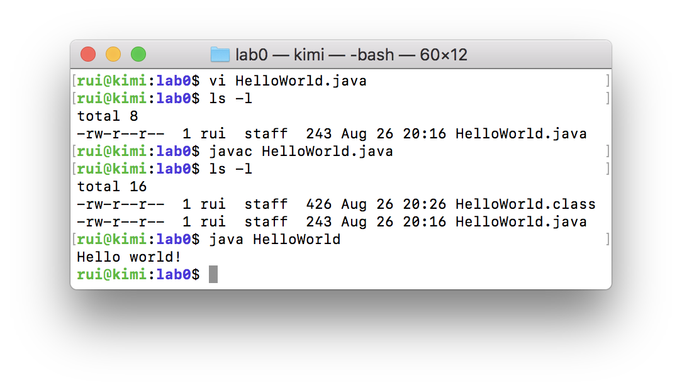
Running Java from the command line
Let's now try running our “Hello world!” program:
  Create a HelloWorld.java file with the contents of slide 4
  Compile the file by running javac HelloWorld.java on the shell. This will create a HelloWorld.class file, containing Java byte code.
  Inspect the byte code by running javap -verbose HelloWorld.class
  Finally, run the program with "java HelloWorld". The java command will execute the main method of the specified class.
Never forget that you can run Java from the command line. It can be very useful, e.g. when other means give you trouble.

Slide 8
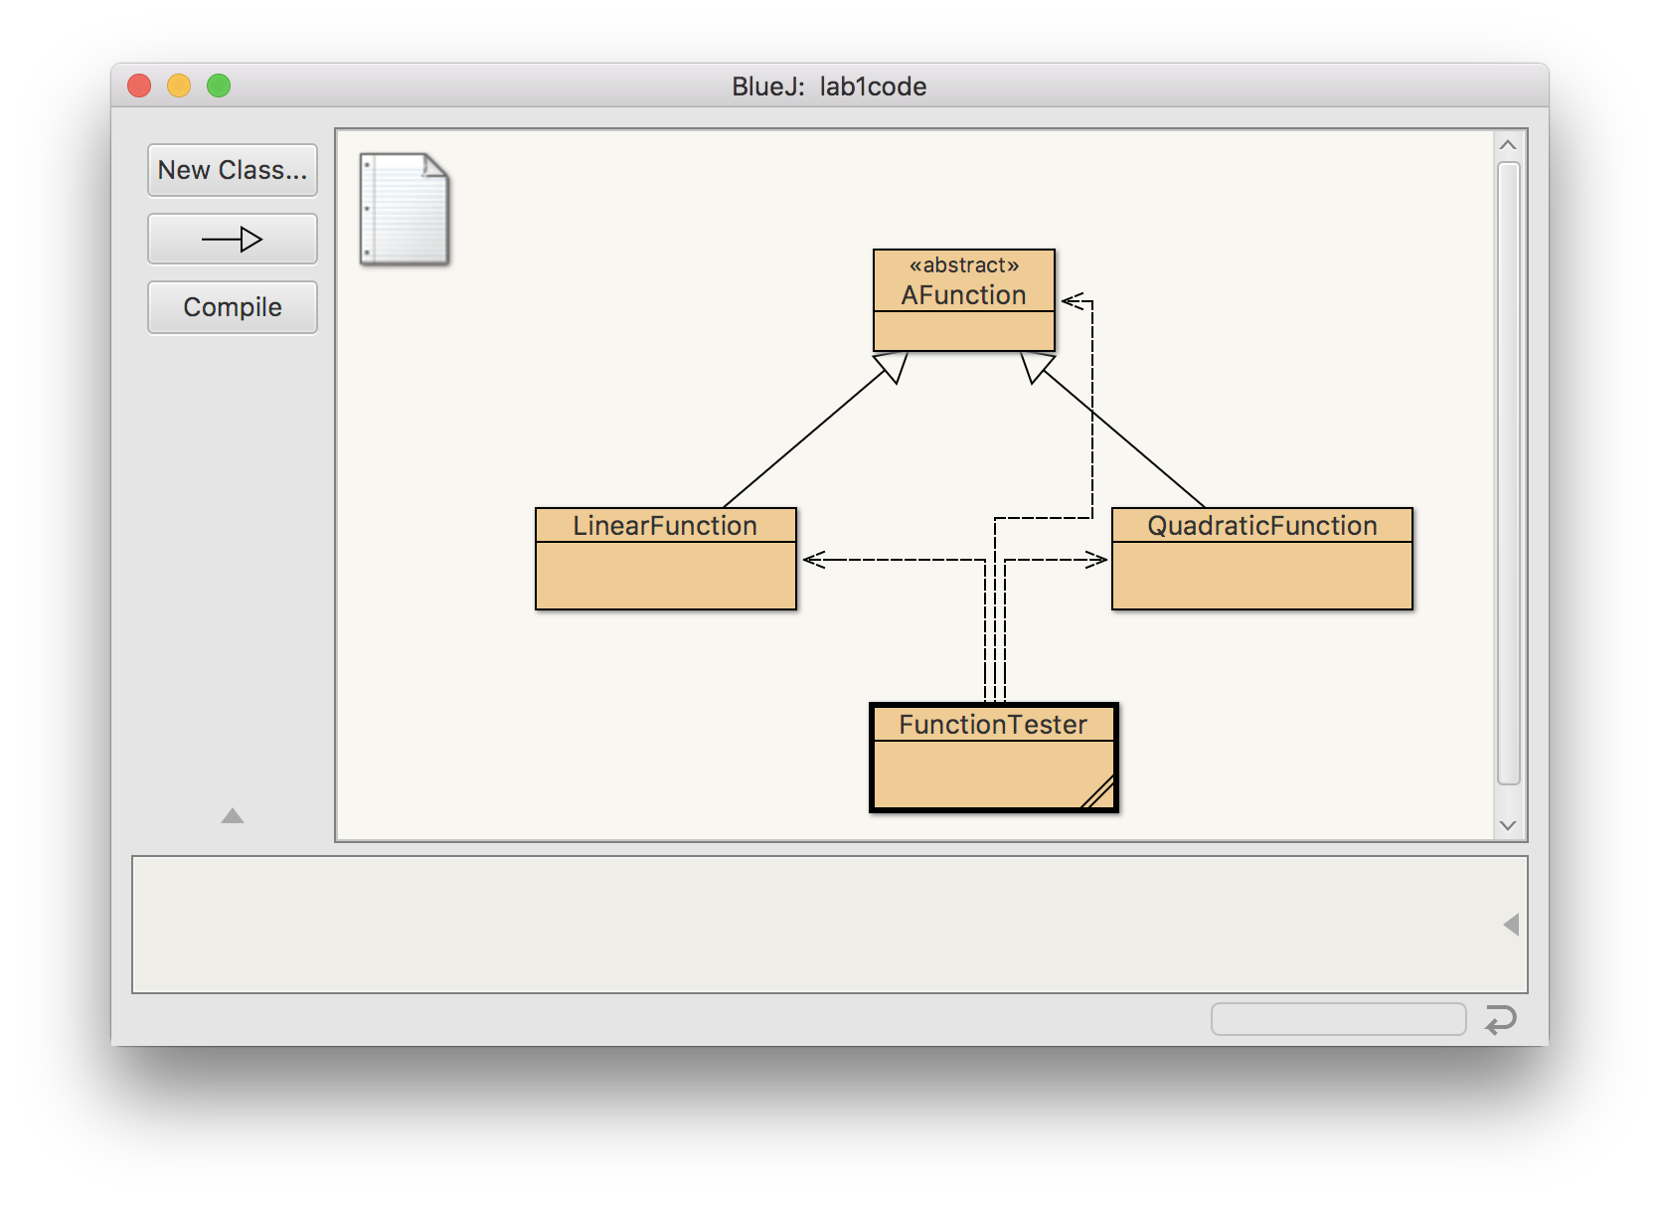
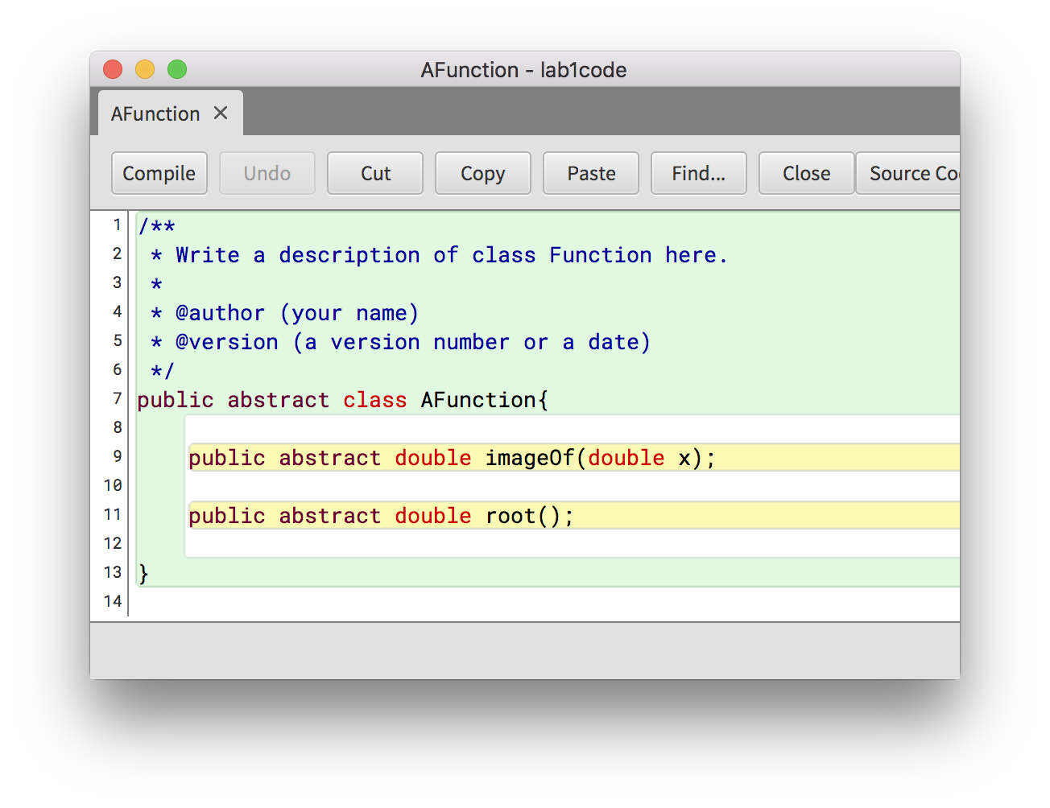
The BlueJ IDE
An Integrated Development Environment (IDE) is a program designed to make software development easy and fun
BlueJ is a minimalistic Java IDE designed for education
  Features class diagrams auto-generation, syntax highlighting, and a debugger
  Written in Java, so it runs on all common computer systems
  Pre-installed on CS machines, get from https://www.bluej.org for personal devices

Slide 9
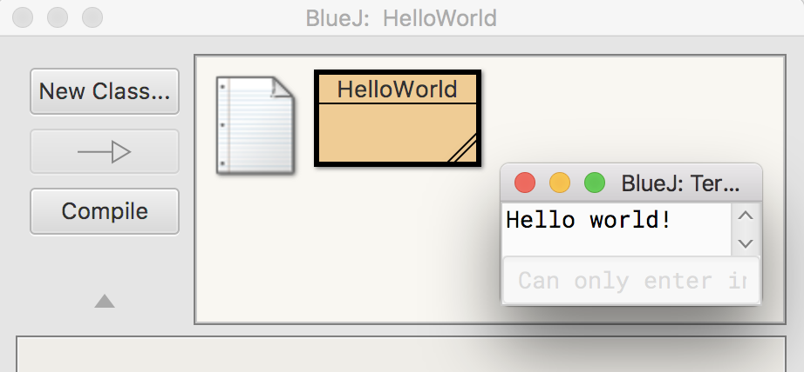
Running programs from within BlueJ
Instructions:
  Launch BlueJ
  Create a new project
  Create a new class called HelloWorld
  Click on the new class's icon to open up the text editor
  Replace the class's stub code with the “Hello world” code from earlier
  Press the compile button (or use the keyboard shortcut Ctrl-K)
  Right click on the class's icon and choose void main(String[] args)
  Press OK in the dialog that pops ups (it is used to pass arguments to the program, but ours doesn't have any)

Slide 10
BlueJ and objects (1/5)
We can create objects, inspect their state, and call their methods using BlueJ’s menus. Let’s try it:
  Download the “cmpu102-lab0-college” (zip or tar.gz) BlueJ project from Moodle. This project includes code to model a (very) simple college:
  Extract the project archive and open the package.bluej file with BlueJ
  Compile the code.

Slide 11
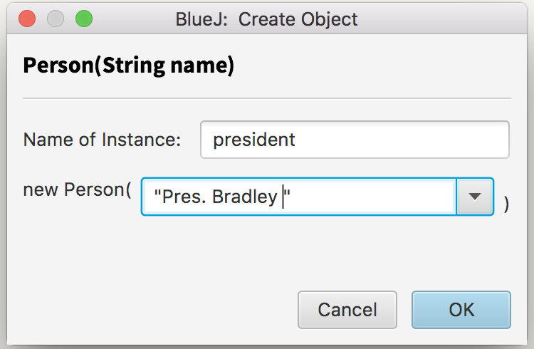
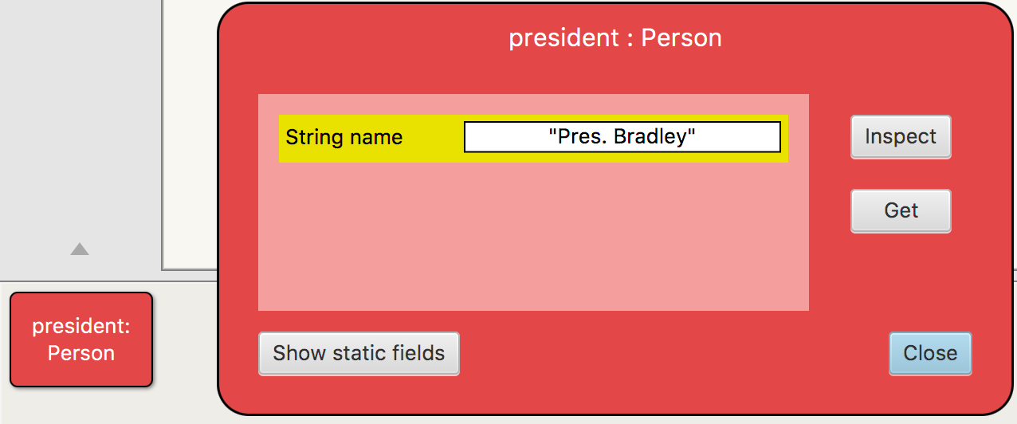
BlueJ and objects (2/5)
Create a Person object called president by right-clicking the Person class and selecting new Person(String name). Name the object president, and let its name field be "Pres. Bradley". Remember to always use quotation marks to delimit strings.
The new object will be shown on the window’s bottom left. Right-click on it and select inspect.
Right-click the president object again, and select String toString(). This will call the corresponding method, which returns a textual representation of the object.

Slide 12
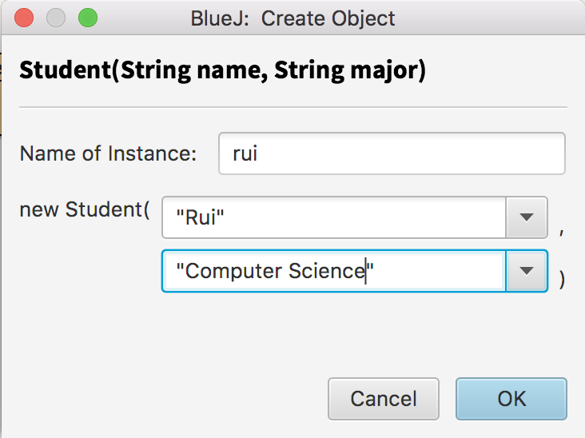
BlueJ and objects (3/5)
Create a Student object. Give it whatever name and attributes you’d like.
Using the right-click menu, inspect the list of method available for the student object you just created.
Call String toString() on the student object. How does the output compare with the one from the president object? What can you say about the toString() method?

Slide 13
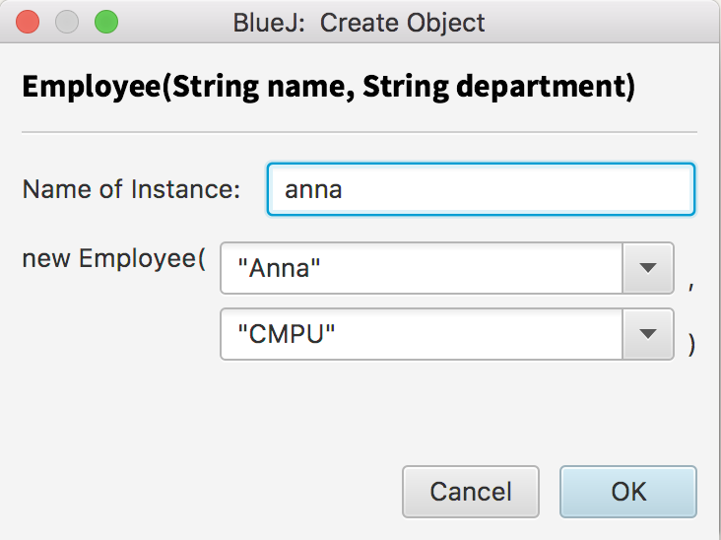
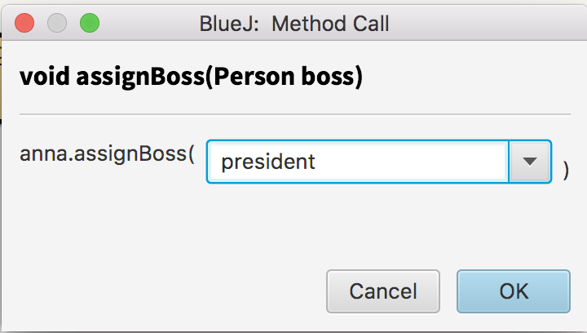
BlueJ and objects (4/5)
Create an Employee object. Give it whatever name and attributes you’d like.
Using the right-click menu, call the assignBoss(Person boss) method on the employee you’ve created. Specify the president object as an argument to the method.

Slide 14
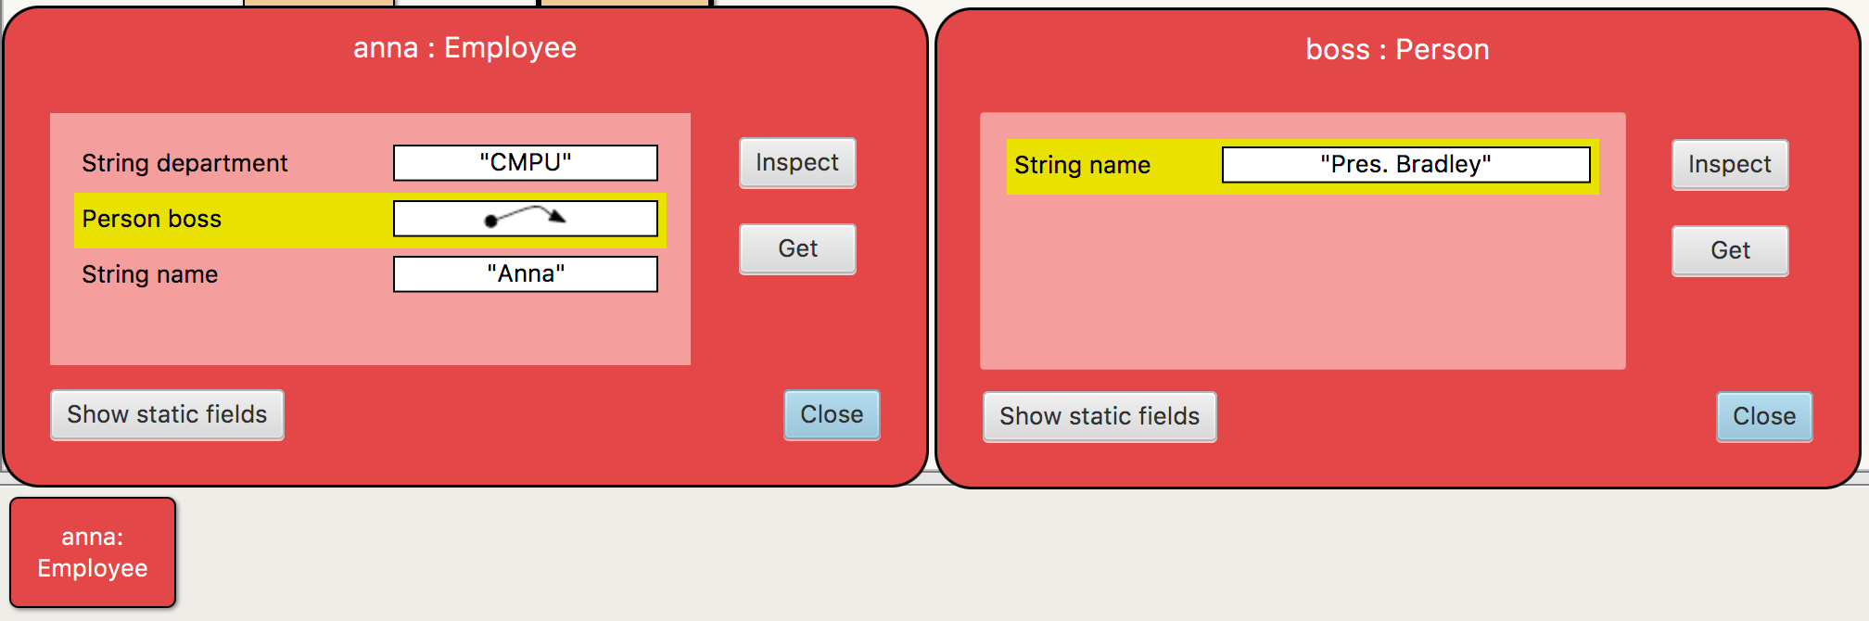
BlueJ and objects (5/5)
Inspect the employee object. Notice how a reference to the boss Person was created.
Call the String toString() method on the employee object. What is returned and how does it compare with previous calls to toString() on other objects?
Finally, remember that you can create and inspect objects in this manner in future assignments! It’s a useful debugging tool.

Slide 15
Extra

Slide 16
Introduction to Object-Oriented Programming
(IPUJ 1.1, 1.5)

Slide 17
Object-Oriented Programming (OOP)
Programs as models of the real world
  Send messages between objects to simulate the temporal evolution of a set of real world phenomena
Objects are the model building blocks (i.e. Lego pieces)
  Combine data/state and behavior, are composed of:
    Fields: object-specific data
    Methods: procedures that act upon the fields
3 main pillars:
  Encapsulation: state and behavior bottled inside objects
  Inheritance: specialized types share general type's state and behavior
  Polymorphism: a method may be implemented differently by different subclasses

Slide 18
Class diagrams
UML (Unified Modeling Language) class diagrams give us a simple notation to document/communicate our designs
Class
Fields
Methods
Inheritance
relationship

Slide 19
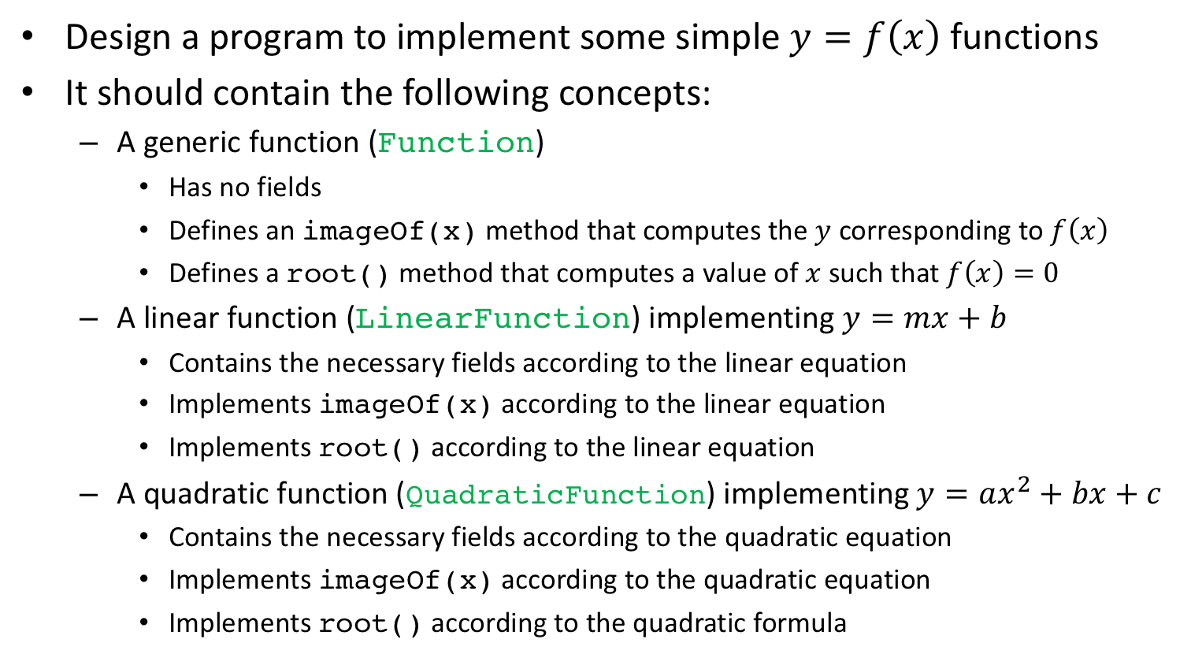
Exercise: OOP modeling (1/2)
Design a program to implement some simple $y=f\left(x\right)$ functions
It should contain the following concepts:
  A generic function (Function)
    Has no fields
    Defines an imageOf(x) method that computes the $y$ corresponding to $f\left(x\right)$
    Defines a root() method that computes a value of $x$ such that $f\left(x\right)=0$
  A linear function (LinearFunction) implementing $y=mx+b$
    Contains the necessary fields according to the linear equation
    Implements imageOf(x) according to the linear equation
    Implements root() according to the linear equation
  A quadratic function (QuadraticFunction) implementing $y=ax^{2}+bx+c$
    Contains the necessary fields according to the quadratic equation
    Implements imageOf(x) according to the quadratic equation
    Implements root() according to the quadratic formula

Slide 20
Exercise: OOP modeling (2/2)
You are to:
  Draw a class diagram for the problem here described.
  Identify the use of each the 3 OOP pillars in your design.
  If we were to add a new type of function, say an exponent, would your design need to be scrapped? How would you proceed?
  Bring your (handwritten or printed) solution to class on Tuesday and we’ll review together.

