Slide 1
CMPU-102 Fall 2021
Data Structures and Algorithms
Lecture #12: Priority queues;
Sorting – insertion sort
Hannah Gommerstadt & Rui Meireles
Assistant Profs. of Computer Science, Vassar College, USA

Slide 2
The Priority Queue ADT

Slide 3
Worklists
Worklist: collection of elements where removal order obeys a rule
  Is a “meta-ADT”: different types of worklists specify different removal rules
Removal rule is tied to some element property
First In, First Out
(FIFO)
Last In, First Out
(LIFO)
Notes:
For queues and stacks

Slide 4
Priority queue
A worklist where items are removed based on their relative priority
  Remove the most urgent item on the worklist; ties broken by arrival order
Analogy: hospital emergency room queue
How do we determine priority? By the items’ relative magnitude!
  Smallest item has highest priority → min-priority queue
  Largest item has highest priority → max-priority queue
Designed by macrovector / Freepik
Notes:
2 types of priority queues – min-priority queue, max-priority queue.

Slide 5
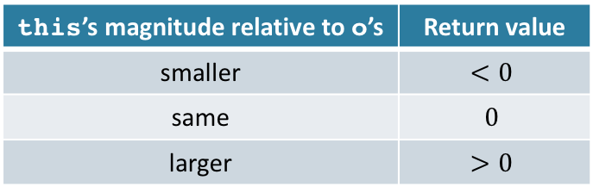
Comparing items
Elements may not be numeric, how to determine which is smallest?
  Have item data type implement the Comparable interface
    Defines int compareTo(T o), which has the following semantics:
Interface implementer must decide how comparison is performed
  E.g., the String class uses alphabetic order: earlier is smaller
this’s magnitude relative to o’s | Return value
smaller | $$<0$$
same | $$0$$
larger | $$>0$$
String pika = "Pika", milu = "Milu";
assert(pika.compareTo(milu) > 0); // succeeds
assert(pika.compareTo(pika) == 0); // succeeds
assert(milu.compareTo(pika) < 0); // succeeds
Notes:
A lot of standard library classes already implement Comparable, like String,Date, Integer, Long, etc

Slide 6
The MyPriorityQueue interface
MyPriorityQueue adds no new methods – just refines semantics
  boolean add(E elem): adds elem, and returns true on success
  E remove(): removes and returns highest-priority element, or null if empty
    Let us go with the smallest element – min-priority queue
  E peek() : returns highest-priority element, or null if none
    Doesn’t change the queue’s contents

Slide 7
Priority queue implementation

Slide 8




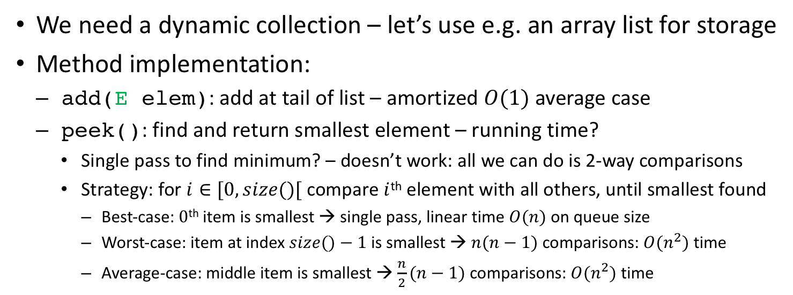
Priority queue implementation: 1st attempt
We need a dynamic collection – let’s use e.g. an array list for storage
Method implementation:
  add(Eelem): add at tail of list – amortized $O(1)$ average case
  peek(): find and return smallest element – running time?
    Single pass to find minimum? – doesn’t work: all we can do is 2-way comparisons
    Strategy: for$i∈[0,size()[$ compare $i$^{th} element with all others, until smallest found
      Best-case: $0$^{th} item is smallest → single pass, linear time $O(n)$ on queue size
      Worst-case: item at index $size()−1$ is smallest →$n(n−1)$ comparisons: $O(n^{2})$ time
      Average-case: middle item is smallest →$\frac{n}{2}(n−1)$ comparisons: $O(n^{2})$ time
Elem #0
name: Pika
injury: 10
Elem #1
name: Milu
injury: 5
Elem #2
name: Peppa
injury: 7
Elem #3
name: Luna
injury: 20
It’s only when we compare Luna against all others that we find the minimum
Notes:
Average case will also be quadratic, just with smaller constant.
Remove is no better than peek(), because we need to

Slide 9
Array-based priority queue
Idea:
  Use array to store priority queue items
  Add items at indices such as to keep everything ordered by priority
E.g., a pet clinic’s priority queue:
add ”Milu”, injury 5
add ”Pika”, injury 10
add ”Luna”, injury 20

Slide 10
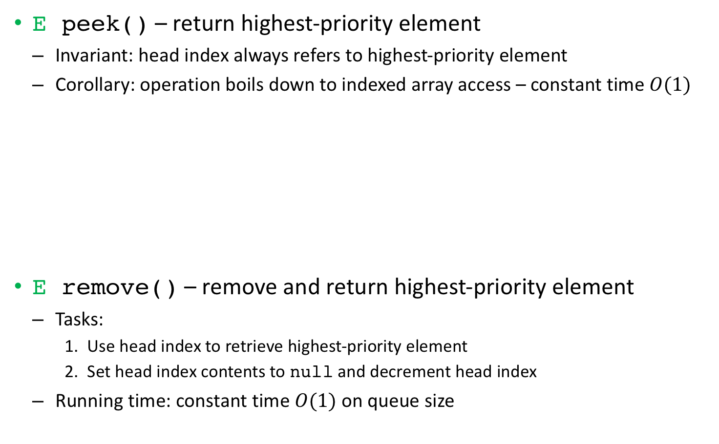
Array-based prio. queue: peek & remove
E peek() – return highest-priority element
  Invariant: head index always refers to highest-priority element
  Corollary: operation boils down to indexed array access – constant time $O(1)$
E remove() – remove and return highest-priority element
  Tasks:
    Use head index to retrieve highest-priority element
    Set head index contents to null and decrement head index
  Running time: constant time $O(1)$ on queue size
remove()
returns Luna
Notes:
3 constant-time operations is itself constant time
This is good, but surely we’ll have to pay a price when adding elements to the queue?

Slide 11
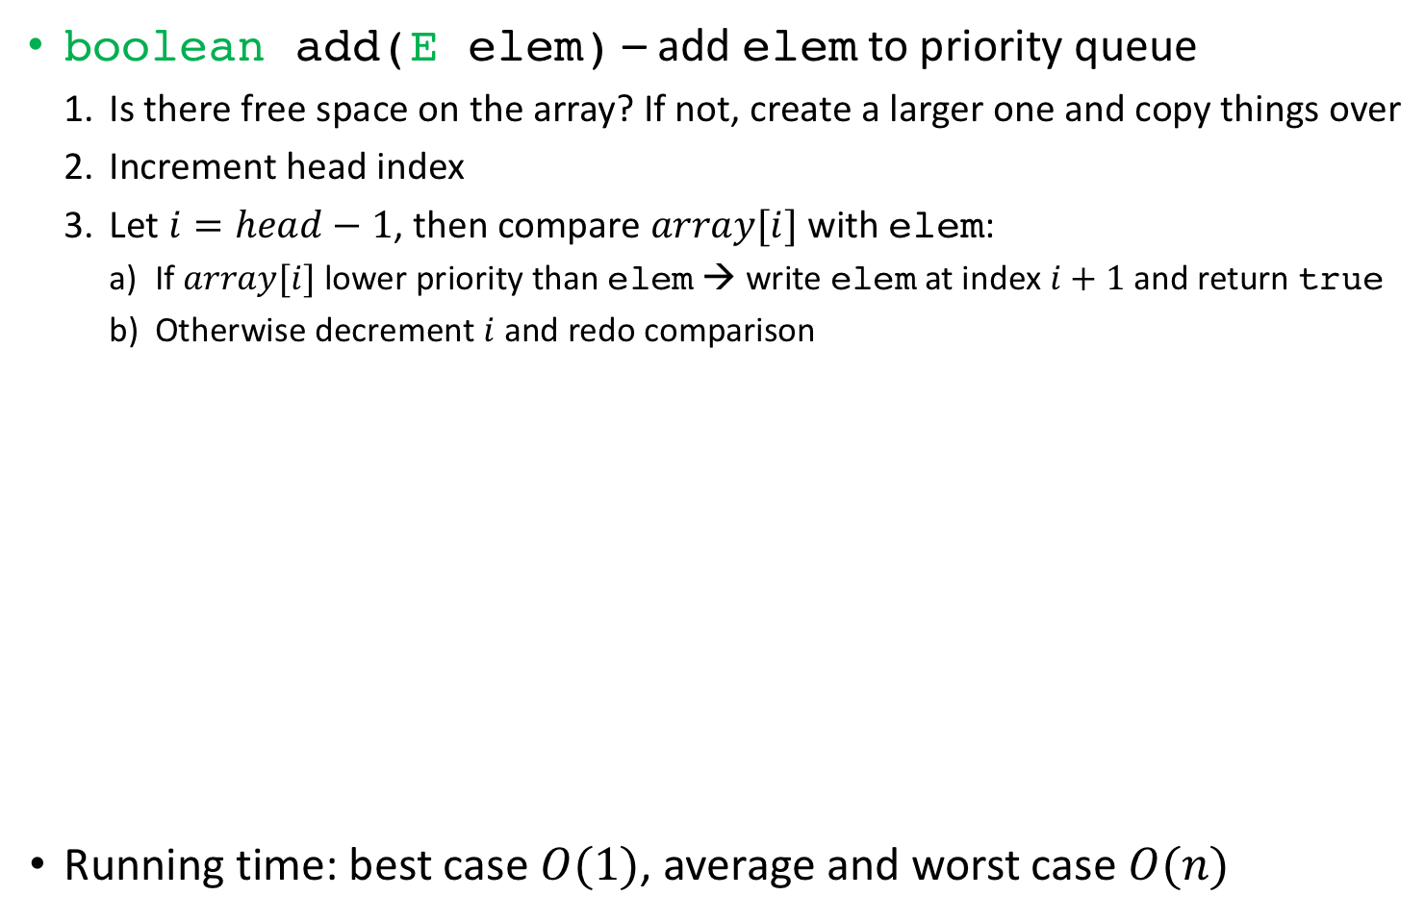
Array-based priority queue: add()
boolean add(Eelem) – add elem to priority queue
  Is there free space on the array? If not, create a larger one and copy things over
  Increment head index
  Let $i=head−1$, then compare $array[i]$ with elem:
    If $array[i]$ lower priority than elem→ write elem at index $i+1$ and return true
    Otherwise decrement $i$ and redo comparison
Running time: best case $O(1)$, average and worst case $O(n)$
7
Notes:
We need to add in the right place.
Caveat we’re assuming priorities do not change after insertion

Slide 12
MyPriorityQueue usage example
Let’s create and interact with a pet clinic’s priority queue:
public class Pet implements Comparable<Pet>{
String name; int injury;
public Pet(String n, int i){ name = n; injury = i; }
public int compareTo(Pet opet){
return opet.injury - injury; // big injury smaller
}
}
MyPriorityQueue<Pet> petPqueue =
new MyArrayPriorityQueue<Pet>();
petPqueue.add(new Pet("Milu", 5)); // add Milu
petPqueue.add(new Pet("Pika", 10)); // add Pika
petPqueue.size(); // returns 2
Pet p1 = petPqueue.remove(); // p1 refers to pet Pika
Pet p2 = petPqueue.peek(); // p2 refers to pet Milu
petPqueue.size(); // returns 1

Slide 13
Our collections framework so far

Slide 14
Java standard library’s
Priority Queue

Slide 15
Java’s priority queue implementation
Java features an efficient Priority queue implementation
  java.util.PriorityQueue class implements java.util.Queue
Same semantics as ours: Comparable-based min-priority queue
Similar interface, except for method names:
  Addition via offer(), removal via poll()
import java.util.Queue; // import java.util.* also OK
import java.util.PriorityQueue;
Queue<Pet> petPqueue = new PriorityQueue<Pet>();
petPqueue.offer(new Pet("Milu", 5)); // add Milu
petPqueue.offer(new Pet("Pika", 10)); // add Pika
petPqueue.size(); // returns 2
Pet p1 = petPqueue.poll(); // p1 refers to pet Pika
Pet p2 = petPqueue.peek(); // p2 refers to pet Milu
petPqueue.size(); // returns 1
Notes:
Luna, Milu, Peppa, Pika

Slide 16
Exercise

Slide 17
Exercise: priority queue implementation
Code an implementation of the Priority Queue operations
  Using the array-based strategy we discussed

Slide 18
Sorting – insertion sort

Slide 19
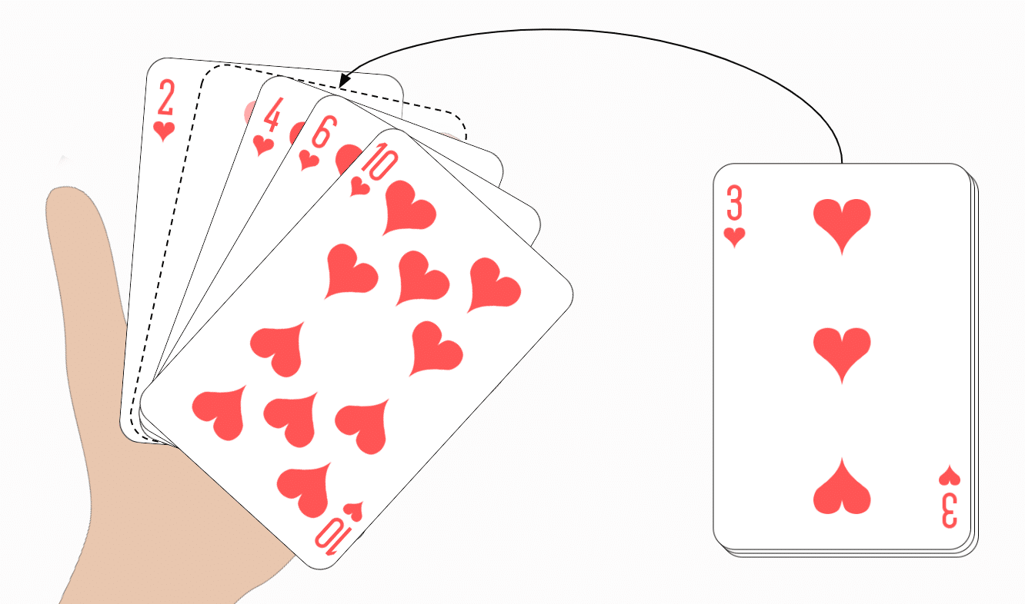
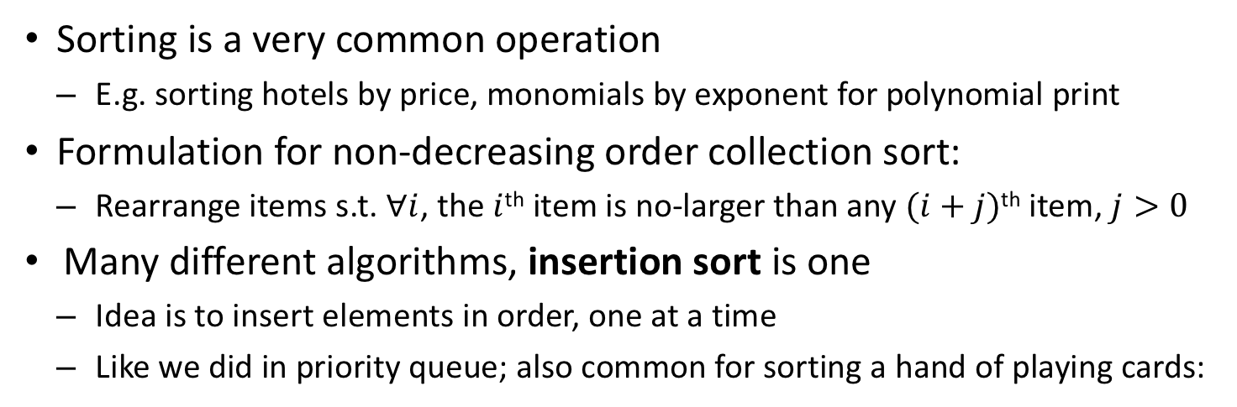
Insertion sort
Sorting is a very common operation
  E.g. sorting hotels by price, monomials by exponent for polynomial print
Formulation for non-decreasing order collection sort:
  Rearrange items s.t.$∀i$, the $i$^{th}item is no-larger than any $(i+j)$^{th} item, $j>0$
Many different algorithms, insertion sort is one
  Idea is to insert elements in order, one at a time
  Like we did in priority queue; also common for sorting a hand of playing cards:
www.happycoders.eu
Notes:
Insertion sorting a hand of playing cards:
Start by picking a card with your left hand
Pick a card with your right hand
Insert it in order into the left hand pile
Repeat steps 2 and 3 until no cards left

Slide 20
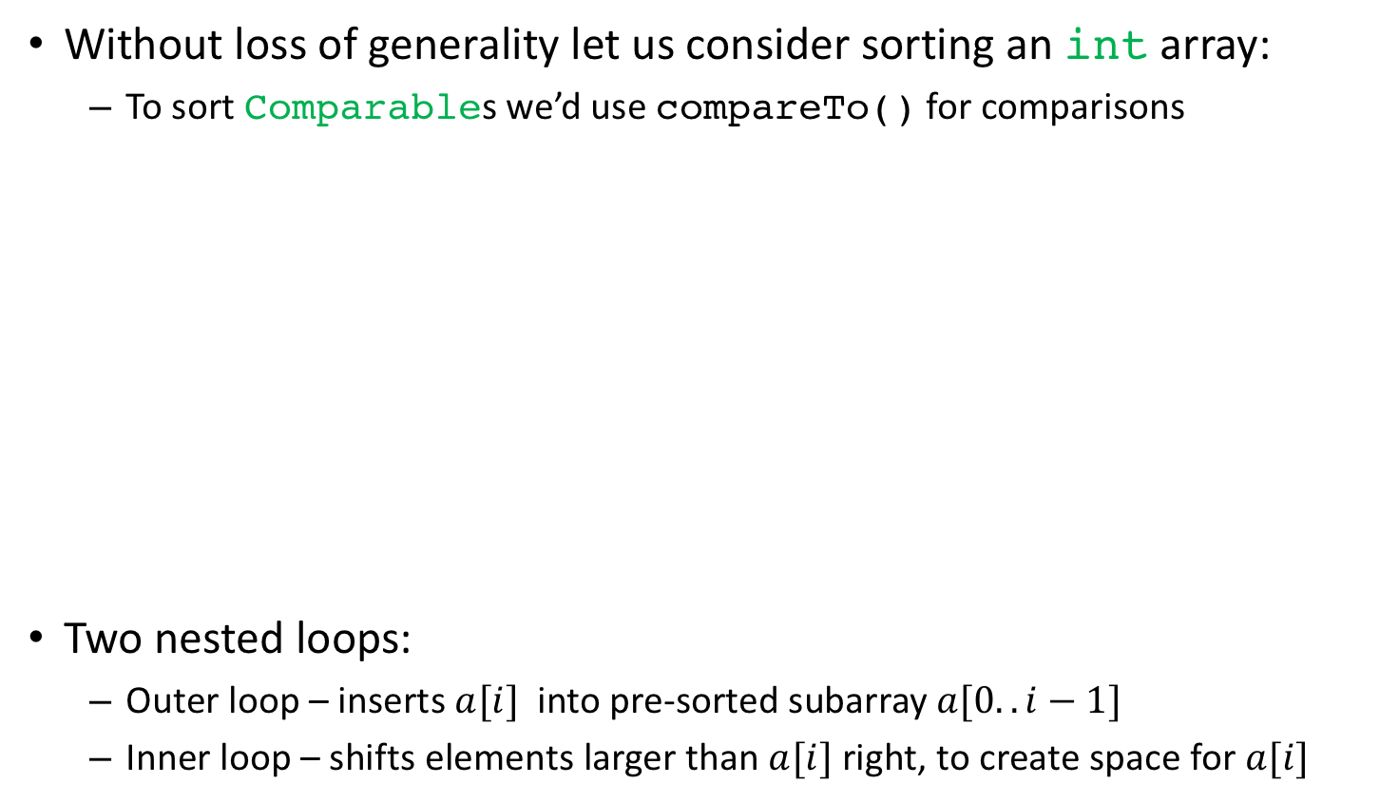
Insertion sort: code
Without loss of generality let us consider sorting an int array:
  To sort Comparables we’d use compareTo() for comparisons
Two nested loops:
  Outer loop – inserts $a[i]$ into pre-sorted subarray $a[0..i−1]$
  Inner loop – shifts elements larger than $a[i]$ right, to create space for $a[i]$
1 void insertionSort(int[] a){
2 for (int i=1; i < a.length; i++){
3 int elem = a[i]; // elem to insert this iteration
4 int j = i-1; // index of 1st elem to compare against
5 for (; j >= 0 && a[j] > elem; j--)
6 a[j+1] = a[j]; // right shift larger elems
7 a[j+1] = elem; // finally write elem in its place
8 }
9 }

Slide 21
Insertion sort: example
1 void insertionSort(int[] a){
2 for (int i=1; i < a.length; i++){
3 int elem = a[i]; // elem to insert this iteration
4 int j = i-1; // index of 1st elem to compare against
5 for (; j >= 0 && a[j] > elem; j--)
6 a[j+1] = a[j]; // right shift larger elems
7 a[j+1] = elem; // finally write elem in its place
8 }
9 }
int[] array = {5,2,4,6,1,3}; insertionSort(array);
0 1 2 3 4 5
0 1 2 3 4 5
0 1 2 3 4 5
0 1 2 3 4 5
0 1 2 3 4 5
0 1 2 3 4 5

Slide 22
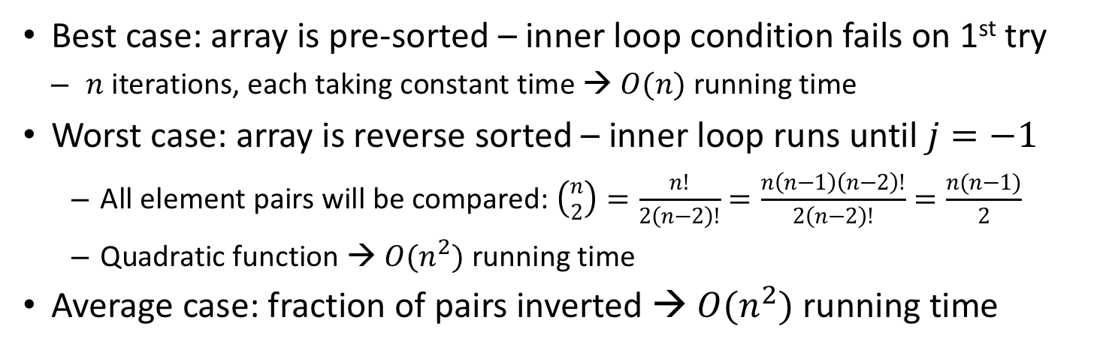
Insertion sort: running time
1 void insertionSort(int[] a){
2 for (int i=1; i < a.length; i++){
3 int elem = a[i]; // elem to insert this iteration
4 int j = i-1; // index of 1st elem to compare against
5 for (; j >= 0 && a[j] > elem; j--)
6 a[j+1] = a[j]; // right shift larger elems
7 a[j+1] = elem; // finally write elem in its place
8 }
9 }
Best case: array is pre-sorted – inner loop condition fails on 1st try
  $n$ iterations, each taking constant time → $O(n)$ running time
Worst case: array is reverse sorted – inner loop runs until $j=−1$
  All element pairs will be compared: $\left({n \atop 2}\right)=\frac{n!}{2\left(n−2\right)!}=\frac{n\left(n−1\right)\left(n−2\right)!}{2\left(n−2\right)!}=\frac{n(n−1)}{2}$
  Quadratic function → $O(n^{2})$ running time
Average case: fraction of pairs inverted → $O(n^{2})$ running time
Notes:
Good insertion sort running time analysis: https://stackoverflow.com/questions/17055341/why-is-insertion-sort-Θn2-in-the-average-case/17055342#17055342
To answer this question, let's first determine how we can evaluate the runtime of insertion sort. If we can find a nice mathematical expression for the runtime, we can then manipulate that expression to determine the average runtime.
The key observation we need to have is that the runtime of insertion sort is closely related to the number of inversions in the input array. An inversion in an array is a pair of elements A[i] and A[j] that are in the wrong relative order - that is, i < j, but A[j] < A[i]. For example, in this array:
0 1 3 2 4 5 There is one inversion: the 3 and 2 should be switched. In this array:
4 1 0 3 2 There are 6 inversions:
4 and 1
4 and 0
4 and 3
4 and 2
1 and 0
3 and 2
One important property of inversions is that a sorted array has no inversions in it, since every element should be smaller than everything coming after it and larger than everything coming before it.
The reason this is significant is that there is a direct link between the amount of work done in insertion sort and the number of inversions in the original array. To see this, let's review some quick pseudocode for insertion sort:
For i = 2 .. n: (Assuming 1-indexing)
Set j = i - 1.
While A[j] > A[j + 1]:
Swap A[j] and A[j + 1].
Set j = j - 1.
Normally, when determining the total amount of work done by a function like this, we could determine the maximum amount of work done by the inner loop, then multiply it by the number of iterations of the outer loop. This will give an upper bound, but not necessarily a tight bound. A better way to account for the total work done is to recognize that there are two different sources of work:
The outer loop, which counts 2, 3, ..., n, and
The inner loop, which performs swaps.
That outer loop always does Θ(n) work. The inner loop, however, does an amount of work that's proportional to the total number of swaps made across the entire runtime of the algorithm. To see how much work that loop will do, we will need to determine how many total swaps are made across all iterations of the algorithm.
This is where inversions come in. Notice that when insertion sort runs, it always swaps adjacent elements in the array, and it only swaps the two elements if they form an inversion. So what happens to the total number of inversions in the array after we perform a swap? Well, graphically, we have this:
[---- X ----] A[j] A[j+1] [---- Y ----] Here, X is the part of the array coming before the swapped pair and Y is the part of the array coming after the swapped pair.
Let's suppose that we swap A[j] and A[j+1]. What happens to the number of inversions? Well, let's consider some arbitrary inversion between two elements. There are 6 possibilities:
Both elements are in X, or both elements are in Y, or one element is in X and one element is in Y. Then the inversion is still there, since we didn't move any of those elements.
One element is in X or Y and the other is either A[j] or A[j+1]. Then the inversion is still there, since the relative orderings of the elements haven't changed, even though their absolute positions might have.
One element is A[j] and the other A[j+1]. Then the inversion is removed after the swap.
This means that after performing a swap, we decrease the number of inversions by exactly one, because only the inversion of the adjacent pair has disappeared. This is hugely important for the following reason: If we start off with I inversions, each swap will decrease the number by exactly one. Once no inversions are left, no more swaps are performed. Therefore, the number of swaps equals the number of inversions!
Given this, we can accurately express the runtime of insertion sort as Θ(n + I), where I is the number of inversions of the original array. This matches our original runtime bounds - in a sorted array, there are 0 inversions, and the runtime is Θ(n + 0) = Θ(n), and in a reverse-sorted array, there are n(n - 1)/2 inversions, and the runtime is Θ(n + n(n-1)/2) = Θ(n²). Nifty!
So now we have a super precise way of analyzing the runtime of insertion sort given a particular array. Let's see how we can analyze its average runtime. To do this, we'll need to make an assumption about the distribution of the inputs. Since insertion sort is a comparison-based sorting algorithm, the actual values of the input array don't actually matter; only their relative ordering actually matters. In what follows, I'm going to assume that all the array elements are distinct, though if this isn't the case the analysis doesn't change all that much. I'll point out where things go off-script when we get there.
To solve this problem, we're going to introduce a bunch of indicator variables of the form X_{ij}, where X_{ij} is a random variable that is 1 if A[i] and A[j] form an inversion and 0 otherwise. There will be n(n - 1)/2 of these variables, one for each distinct pair of elements. Note that these variables account for each possible inversion in the array.
Given these X's, we can define a new random variable I that is equal to the total number of inversions in the array. This will be given by the sum of the X's:
I = Σ X_{ij}
We're interested in E[I], the expected number of inversions in the array. Using linearity of expectation, this is
E[I] = E[Σ X_{ij}] = Σ E[X_{ij}]
So now if we can get the value of E[X_{ij}], we can determine the expected number of inversions and, therefore, the expected runtime!
Fortunately, since all the X_{ij}'s are binary indicator variables, we have that
E[X_{ij}] = Pr[X_{ij} = 1] = Pr[A[i] and A[j] are an inversion]
So what's the probability, given a random input array with no duplicates, that A[i] and A[j] are an inversion? Well, half the time, A[i] will be less than A[j], and the other half of the time A[i] will be greater than A[j]. (If duplicates are allowed, there's a sneaky extra term to handle duplicates, but we'll ignore that for now). Consequently, the probability that there's an inversion between A[i] and A[j] is 1 / 2. Therefore:
E[I] = ΣE[X_{ij}] = Σ (1 / 2)
Since there are n(n - 1)/2 terms in the sum, this works out to
E[I] = n(n - 1) / 4 = Θ(n²)
And so, on expectation, there will be Θ(n²) inversions, so on expectation the runtime will be Θ(n² + n) = Θ(n²). This explains why the average-case behavior of insertion sort is Θ(n²).

Slide 23
Java’s built-in sorting
java.util.Collections provides a method for sorting lists:
  static void sort(List<T> list)
    Uses order defined by T’s implementation of Comparable
  static void sort(List<T> list, Comparator<T> c)
    Uses order defined by custom Comparator object c
Example:
import java.util.*; // for compactness
List<String> list = new ArrayList<String>(); // empty list
String[] sarray = {"Pika", "Milu", "Peppa", "Luna"};
for (String s : sarray) list.add(s); // add to list
Collections.sort(list); // alphabetical sort
Collections.sort(list, Collections.reverseOrder()); // reverse alpha
Notes:
Actual signatures:
public static <T extends Comparable<? super T>> void sort(List<T> list)
public static <T> void sort(List<T> list, Comparator<? super T> c)
Don’t really know why

Slide 24
Lecture #12 extra

Slide 25
The PriorityQueue class
Always keeps the highest-priority element at head
  Note that the remaining elements are not necessarily ordered!
In a PriorityQueue, the smallest element has highest priority
  This is what is called a min-priority queue
  A queue where larger means higher priority is a max-priority queue

Slide 26
The Comparable interface
But how does the queue know the elements’ priorities?
  Queue elements should implement the Comparable<T> interface
compareTo() must return a negative integer if the this object is “smaller” than the argument o, zero if it is equal, and a positive integer if it is “larger” than o
The order thus established is known as the natural order

Slide 27
PriorityQueue and Comparable
Many common classes implement the Comparable interface
  E.g. String, Date, wrapper classes like Integer, Long and Double
  When in doubt, flat out consult the Javadoc
Using a non-Comparable class will result in a ClassCastExcception when PriorityQueue attempts to cast the elements to Comparable in order to compare them
  Happens when the 2nd element is added to the queue!

Slide 28
PriorityQueue: in-class exercise
Use a priority queue to sort an array of Strings alphabetically
String[] sa = {"Jay", "Alice", "Melvor", "Erica"};
... // your code here
for (int i=0; i < sa.length; i++)
System.out.println(sa[i]);
Recall the Queue interface methods:
 | Throws exception | Returns special value
Insert | add(E e) | offer(E e)
Remove | remove() | poll()
Examine head | element() | peek()

Slide 29
PriorityQueue: in-class exercise solution
Use a priority queue to sort an array of Strings alphabetically
String[] sa = {"Jay", "Alice", "Melvor", "Erica"};
PriorityQueue<String> pq = new PriorityQueue<String>();
for (int i=0; i < sa.length; i++) // add to priority queue
pq.add(sa[i]);
for (int i=0; i < sa.length; i++) // remove from queue
sa[i] = pq.remove();
for (int i=0; i < sa.length; i++)
System.out.println(sa[i]);

Slide 30
PriorityQueue usage example
Let’s sort an array of Strings alphabetically:
String[] sa = {"Jay", "Alice", "Melvor", "Erica"};
PriorityQueue<String> pq = new PriorityQueue<String>();
for (int i=0; i < sa.length; i++) // add to priority queue
pq.add(sa[i]);
for (int i=0; i < sa.length; i++) // remove from queue
sa[i] = pq.remove();
for (int i=0; i < sa.length; i++)
System.out.println(sa[i]);

Slide 31
Custom comparator for PriorityQueue
If the objects we want to store do not implement Comparable we can pass a Comparator-implementing object to the constructor
  Can also be used to override natural order
Return value semantics same as compareTo() from Comparable:
  negative integer if o1 < o2
  zero if both arguments are equal
  positive integer if o1 > o2

Slide 32
Custom comparator example (1/2)
Let’s sort an array of Strings in reverse-alphabetical order:
public class RevCmp implements Comparator<String> {
public int compare(String s1, String s2){
return -1 * s1.compareTo(s2);
}
}
String[] sa = {"Jay", "Alice", "Melvor", "Erica"};
Queue<String> pq = new PriorityQueue<String>(new RevCmp());
for (int i=0; i < sa.length; i++) pq.add(sa[i]);
for (int i=0; i < sa.length; i++) sa[i] = pq.remove();
for (int i=0; i < sa.length; i++) System.out.println(sa[i]);
Note that, for convenience, there is a generic built-in reverse Comparator accessible through the static method Collections.reverseOrder()

Slide 33
Custom comparator example (2/2)
This is how we could implement a generic reverse comparator that works with any Comparable<T> type:
public class RevCmp<T extends Comparable<T>>
implements Comparator<T> {
public int compare(T o1, T o2){
return -1 * o1.compareTo(o2);
}
}
String[] sa = {"Jay", "Alice", "Melvor", "Erica"};
Comparator<String> rc = new RevCmp<String>();
Queue<String> pq = new PriorityQueue<String>(rc);
for (int i=0; i < sa.length; i++) pq.add(sa[i]);
for (int i=0; i < sa.length; i++) sa[i] = pq.remove();
for (int i=0; i < sa.length; i++) System.out.println(sa[i]);

Slide 34
How to choose a Queue
Use PriorityQueue if non-insertion related priority needed, Deque otherwise
  PriorityQueueis slower because it needs to maintain partial order
Between the two Deques
  Both have average $O(1)$ operations but ArrayDeque is typically faster:
    Does not allocate nodes upon insertion
    Uses circular array so insertions at ends do not require shifting existing elements
    If initial capacity is chosen appropriately, array resizing should be infrequent

Slide 35
Proving correctness of insertion sort
Loop invariant:
At the start of each for loop iteration, the subarray $A[1..j−1]$ consists of the elements originally in $A[1..j−1]$, but in sorted order
InsertionSort(A)
1. for j = 2 to A.length
2. key = A[j]
3. i = j - 1
4. while i > 0 and A[i] > key
5. A[i + 1] = A[i]
6. i = i - 1
7. A[i + 1] = key
We need to show:
  That the loop invariant is true before 1st iteration (initialization);
  That if invariant holds for before iteration $k$, it also holds before iteration $k+1$ (maintenance), and;
  That invariant implies the output is the desired one when the loop terminates (termination)
Notes:
Explain what the notation A[i..j-1] means.
Show an example of how insertions sort works.
Any ideas how we might go about proving this loop invariant? Induction!
Suppose that for each positive integer n we have a statement S(n) that is either true or false.
Show that
S(1) -- the base case -- is true (Basis step)
Assume that S(i) is true for all i < n + 1 (Inductive hypothesis)
Use the inductive hypothesis to show that S(n+1) is true (Inductive step)

Slide 36
Insertion sort efficiency: instruction counting
Let $t_{j}$ represent the number of times line 4 is executed for each value of $j$
InsertionSort(A) count
1. for j = 2 toA.length$n$
2. key = A[j] $n−1$
3. i = j - 1 $n−1$
4. whilei> 0 and A[i] > key
5. A[i + 1] = A[i]
6. i = i - 1
7. A[i + 1] = key $n−1$
( $\sum_{u}^{n}{1}=n−u+1$ )
Notes:
Add costs and times column on board.
Best case:
- always find that A[i] < = key the first time while is tested in line 4.
- Running time, T(n) = an + b for constants a and b.
Worst case
- always find that A[i] > key in while loop test of line 4.
- have to compare key to all elements to left of the jth position (j - 1) elements.
- summation j as j goes from 1 to n is known as an arithmetic series. This series will appear often in analyses.
* show value of summations in while loop
- Running time is an^2 + bn + c for constants a, b, and c

Slide 37
Insertion sort: time complexity
InsertionSort(A)
1. for j = 2 to A.length
2. key = A[j]
3. i = j - 1
4. while i > 0 and A[i] > key
5. A[i + 1] = A[i]
6. i = i - 1
7. A[i + 1] = key
Does the running time vary by more than a constant for different input instances?
What is the best-case running time?
  Presorted array, while loop always fails immediately
  Let $c_{l}$ represent the execution cost of line $l$
  $T\left(n\right)=c_{1}n+c_{2}\left(n−1\right)+c_{3}\left(n−1\right)+c_{4}\left(n−1\right)+c_{7}\left(n−1\right)=\left(c_{1}+c_{2}+c_{3}+c_{4}+c_{7}\right)n−\left(c_{2}+c_{3}+c_{4}+c_{7}\right)=an−b$
  Linear time!
What is the worst-case running time?
Notes:
Add costs and times column on board.
Best case:
- always find that A[i] < = key the first time while is tested in line 4.
- Running time, T(n) = an + b for constants a and b.
Worst case
- always find that A[i] > key in while loop test of line 4.
- have to compare key to all elements to left of the jth position (j - 1) elements.
- summation j as j goes from 1 to n is known as an arithmetic series. This series will appear often in analyses.
* show value of summations in while loop
- Running time is an^2 + bn + c for constants a, b, and c

Slide 38
Insertion sort: worst-case time complexity
Worst-case occurs when input array is in strictly descending order
InsertionSort(A)
1. for j = 2 to A.length
2. key = A[j]
3. i = j - 1
4. while i > 0 and A[i] > key
5. A[i + 1] = A[i]
6. i = i - 1
7. A[i + 1] = key
For each iteration of the outer loop:
  Line 4 will be executed $j$ times:
  Lines 5 and 6 will be executed $j−1$ times:
$$\sum_{j=2}^{n}{t_{j}=}\sum_{j=2}^{n}{j}$$
$$\sum_{j=2}^{n}{t_{j}}=\sum_{j=2}^{n}{j−1}=\sum_{j=1}^{n−1}{j}$$
Notes:
Add costs and times column on board.
Best case:
- always find that A[i] < = key the first time while is tested in line 4.
- Running time, T(n) = an + b for constants a and b.
Worst case
- always find that A[i] > key in while loop test of line 4.
- have to compare key to all elements to left of the jth position (j - 1) elements.
- summation j as j goes from 1 to n is known as an arithmetic series. This series will appear often in analyses.
* show value of summations in while loop
- Running time is an^2 + bn + c for constants a, b, and c

Slide 39
Insertion sort: worst-case time complexity
Input array in descending order
$$\sum_{k=1}^{n}{k}=\frac{\left.n(n+1\right)}{2}$$
Useful rule:
InsertionSort(A)
1. for j = 2 to A.length
2. key = A[j]
3. i = j - 1
4. while i > 0 and A[i] > key
5. A[i + 1] = A[i]
6. i = i - 1
7. A[i + 1] = key
$$\sum_{j=2}^{n}{j}=\frac{\left.n(n+1\right)}{2}−1$$
Corollaries:
$$\sum_{j=2}^{n}{(j−1)}=\sum_{j=1}^{n−1}{j}=\frac{\left.(n−1\right)n}{2}$$
$$T\left(n\right)=c_{1}n+c_{2}\left(n−1\right)+c_{3}\left(n−1\right)+c_{4}\sum_{j=2}^{n}{j+}c_{5}\sum_{j=2}^{n}{(j−1)}+c_{6}\sum_{j=2}^{n}{(j−1)}+c_{7}\left(n−1\right)=$$
$$c_{1}n+c_{2}\left(n−1\right)+c_{3}\left(n−1\right)+c_{4}\left(\frac{n(n+1)}{2}−1\right)+c_{5}\left(\frac{\left(n−1\right)n}{2}\right)+c_{6}\left(\frac{\left(n−1\right)n}{2}\right)+c_{7}\left(n−1\right)=$$
$$\left(\frac{c_{4}}{2}+\frac{c_{5}}{2}+\frac{c_{6}}{2}\right)n^{2}+\left(c_{1}+c_{2}+c_{3}+\frac{c_{4}}{2}−\frac{c_{5}}{2}−\frac{c_{6}}{2}+c_{7}\right)n−\left(c_{2}+c_{3}+c_{4}+c_{7}\right)=an^{2}+bn+c$$
Running time dominated by quadratic term as $n$ grows unbounded
Notes:
Add costs and times column on board.
Best case:
- always find that A[i] < = key the first time while is tested in line 4.
- Running time, T(n) = an + b for constants a and b.
Worst case
- always find that A[i] > key in while loop test of line 4.
- have to compare key to all elements to left of the jth position (j - 1) elements.
- summation j as j goes from 1 to n is known as an arithmetic series. This series will appear often in analyses.
* show value of summations in while loop
- Running time is an^2 + bn + c for constants a, b, and c

Slide 40
A little detour: sorting

Slide 41
How is sorting actually performed?
Many possibilities, bubble sort is one of the simplest algorithms
  Idea: compare every adjacent pair and swap if out of order
1. void bubbleSort(int[] a){
2. int n = a.length;
3. for (int i = 0; i < n-1; i++)
4. for (int j = n-1; j > i; j--)
5. if (a[j] < a[j-1]){ // must swap a[j] and a[j-1]
6. int tmp = a[j];
7. a[j] = a[j-1];
8. a[j-1] = tmp;
9. }
10. }

Slide 42
Bubble sort example (1/2)
1. void bubbleSort(int[] a){
2. int n = a.length;
3. for (int i = 0; i < n-1; i++)
4. for (int j = n-1; j > i; j--)
5. if (a[j] < a[j-1]){ // must swap a[j] and a[j-1]
6. int tmp = a[j];
7. a[j] = a[j-1];
8. a[j-1] = tmp;
9. }
10. }

Slide 43
Bubble sort example (2/2)
1. void bubbleSort(int[] a){
2. int n = a.length;
3. for (int i = 0; i < n-1; i++)
4. for (int j = n-1; j > i; j--)
5. if (a[j] < a[j-1]){ // must swap a[j] and a[j-1]
6. int tmp = a[j];
7. a[j] = a[j-1];
8. a[j-1] = tmp;
9. }
10. }
...

Slide 44
Bubble sort correctness
1. void bubbleSort(int[] a){
2. int n = a.length;
3. for (int i = 0; i < n-1; i++)
4. for (int j = n-1; j > i; j--)
5. if (a[j] < a[j-1]){ // must swap a[j] and a[j-1]
6. int tmp = a[j];
7. a[j] = a[j-1];
8. a[j-1] = tmp;
9. }
10. }
Correctness proof sketch:
  Before each iteration of the loop of line 3, $a\left[0..i−1\right]$ holds the $i$ smallest elements sorted in non-decreasing order
    Before 1st iteration $a\left[0..−1\right]$ is vacuously sorted; each iteration will make $a\left[i\right]$ hold proper value
  Termination:
    $i=n−1$ (first value for which the loop condition becomes false)
    $a\left[0..i−1\right]=a[0..n−2]$ holds smallest $n−1$ elements and is sorted;
    $a\left[n−1\right]$ holds largest element;
    Therefore the entire array is sorted.

Slide 45
Bubble sort running time
1. void bubbleSort(int[] a){
2. int n = a.length;
3. for (int i = 0; i < n-1; i++)
4. for (int j = n-1; j > i; j--)
5. if (a[j] < a[j-1]){ // must swap a[j] and a[j-1]
6. int tmp = a[j];
7. a[j] = a[j-1];
8. a[j-1] = tmp;
9. }
10. }
Every pair is compared and there are these many pairs:
$$\left({n \atop 2}\right)=\frac{n!}{2\left(n−2\right)!}=\frac{n\left(n−1\right)\left(n−2\right)!}{2\left(n−2\right)!}=\frac{n(n−1)}{2}∈O(n^{2})$$
Quadratic running time $O(n^{2})$
Java uses more efficient (and complex) sorting algorithms
  Merge sort, covered in detail in CMPU-241

Slide 46
Sorting in Java
Sorting is very useful beyond priority queues
  E.g. list enrolled students in alphabetical order
java.util.Collections provides a method for sorting lists
The method is overloaded, having two versions:
  static void sort(List<T> list): orders list in natural order (i.e. order defined by Comparable’s compareTo() method). Elements must implement Comparable.
  static void sort(List<T> list, Comparator<T> c): orders list in order defined by Comparator c.
Notes:
Actual signatures:
public static <T extends Comparable<? super T>> void sort(List<T> list)
public static <T> void sort(List<T> list, Comparator<? super T> c)
Don’t really know why

Slide 47
List sorting example
Let’s sort an array of Strings:
List<String> l = new ArrayList<String>();
String[] sa = {"Jay", "Alice", "Melvor", "Erica"};
for (int i=0; i < sa.length; i++)
l.add(sa[i]);
Collections.sort(l); // alphabetical
Collections.sort(l, Collections.reverseOrder()); // rev alpha

Slide 48
PriorityQueue and sorting
3
5
4
11
10
7
9
20
12
50
13
A tree is made of nodes and edges connecting parent and child
  Each node has a key; one single parentless node called root
  Binary tree: every node has at most 2 children
PriorityQueue uses special kind of binary tree called a heap:
  Min-heap: parent’s key not larger than children’s (root has smallest key)
  Max-heap: parent’s key not smaller than children’s (root has largest key)
All PriorityQueue needs to do is maintain the heap property
  Less work than keeping everything sorted, can be done in logarithmic time

Slide 49
Lecture #12 end

