Slide 1
CMPU-102 Fall 2020
Data Structures and Algorithms
Lecture #10: Collections framework; Stacks & queues
Hannah Gommerstadt & Rui Meireles
Assistant Profs. of Computer Science, Vassar College, USA

Slide 2
Building a collections framework

Slide 3
Collections
We’ve built two kinds of variable-size collections of elements so far:
  List: ordered
  Set: unordered, without repetition
We can generalize by creating a Collection Abstract Data Type
  Represents a general variable-size collection; root of collections hierarchy
Notes:
We’ve seen two kinds of variable-size collections so far: set and list
Can we generalize? Yes
Benefit is polymorphism: can write code that works for any collecction.

Slide 4
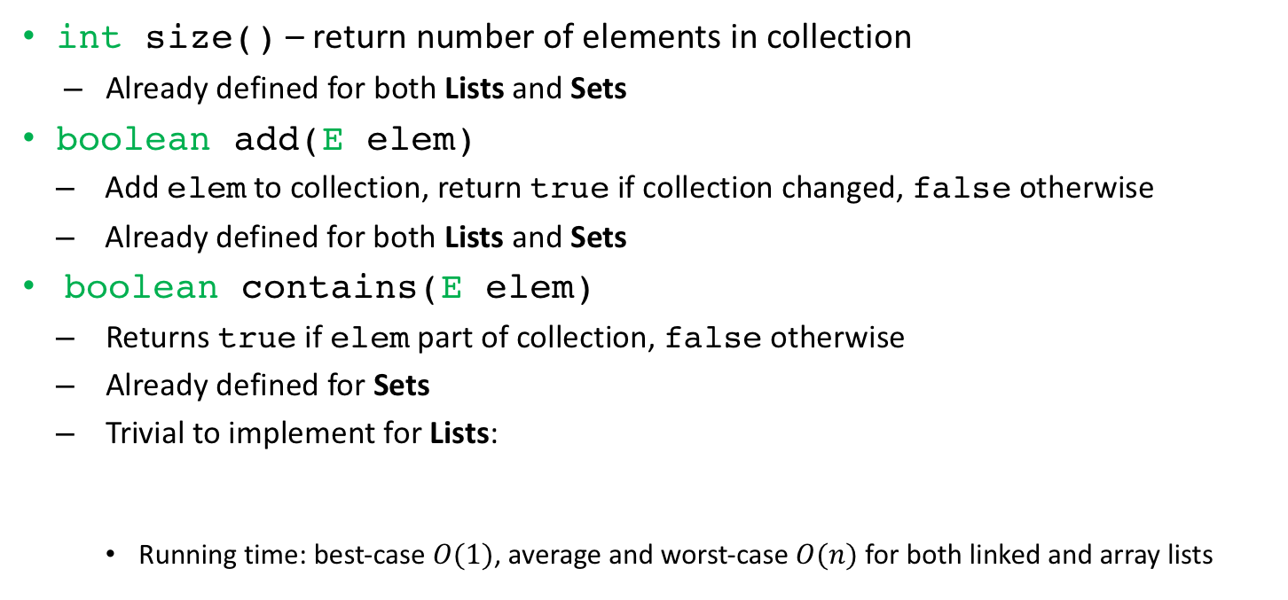
Collection ADT methods (1/2)
int size() – return number of elements in collection
  Already defined for both Lists and Sets
boolean add(Eelem)
  Add elem to collection, return true if collection changed, false otherwise
  Already defined for both Lists and Sets
boolean contains(Eelem)
  Returns true if elem part of collection, false otherwise
  Already defined for Sets
  Trivial to implement for Lists:
    Running time: best-case $O(1)$, average and worst-case $O(n)$ for both linked and array lists
public boolean contains(E elem){ return this.indexOf(elem) != -1; }

Slide 5
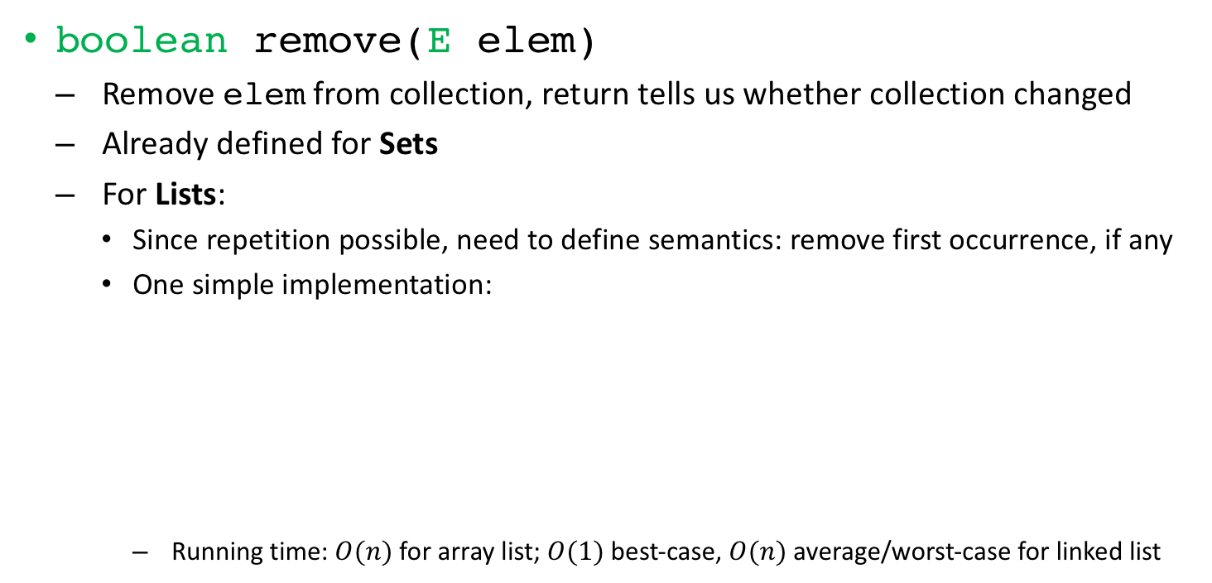
Collection ADT methods (2/2)
boolean remove(Eelem)
  Remove elem from collection, return tells us whether collection changed
  Already defined for Sets
  For Lists:
    Since repetition possible, need to define semantics: remove first occurrence, if any
    One simple implementation:
      Running time: $O(n)$ for array list; $O(1)$ best-case, $O(n)$ average/worst-case for linked list
public boolean remove(E elem){
int idx = this.indexOf(elem); // where is elem?
boolean exists = idx != -1; // does elem exist?
if (exists) this.remove(idx); // remove if it exists
return exists; // collection was changed if elem existed
}
Notes:
Highlight the fact that we could do better than this by doing a single pass instead of 2 passes.

Slide 6
Collection ADT: iterators
We’d like to be able to traverse a collection, visiting each element
  E.g. for printing the names of all pets in a collection
An iterator is an object that let’s us do just that
  Has cursor pointer initialized to 1st element, then advanced by one at a time
  Two methods:
    boolean hasNext() – returns true if there are more elements to visit, false otherwise
    E next() – returns next element to be visited and advances cursor, otherwise returns null
call to next() returns "Pika" and advances cursor
Notes:
Lists have a get method that we could use for iteration, but sets don’t. This gives us a general way to iterate.

Slide 7
Iterator usage example
MyCollection’s iterator() – returns iterator for collection
  Can use it to visit all of the elements, one at a time. E.g., using a loop:
Note: the order in which elements are visited isn’t guaranteed
  Some collections have no order associated with elements
MyCollection<String> myPets = new MySetMyLinkedList();
myPets.add("Pika"); myPets.add("Milu"); ...
for (MyIterator<String> itr = myPets.iterator(); itr.hasNext(); ){
String pet = itr.next(); // retrieve elem and advance cursor
... // do something with pet
}
Notes:
Linear time iteration as long as iterator is constant time.

Slide 8
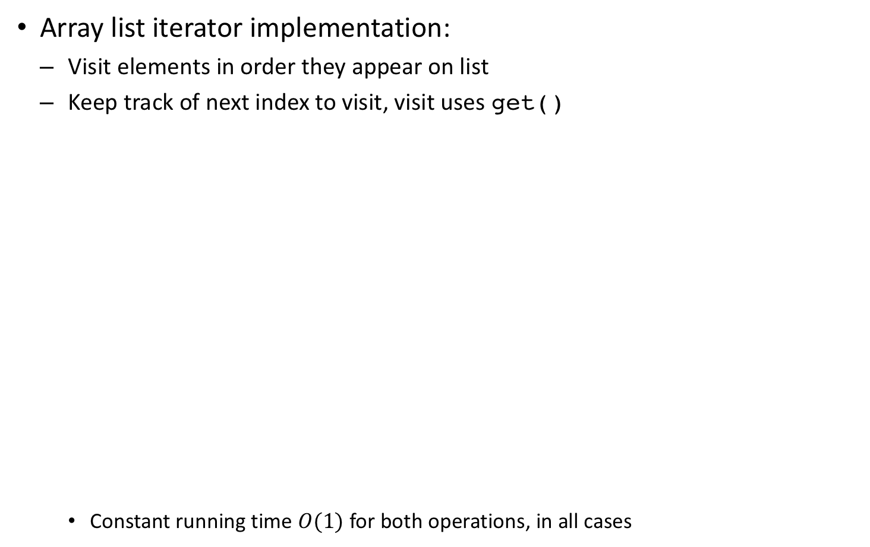
Iterator implementation example
Array list iterator implementation:
  Visit elements in order they appear on list
  Keep track of next index to visit, visit uses get()
    Constant running time $O(1)$ for both operations, in all cases
class MyArrayListItr<E> implements MyIterator<E>{
private MyArrayList<E> al; // what we’re iterating over
private int nextIdx = 0; // the next idx to visit
MyArrayListItr(MyArrayList<E> al){ this.al = al; }
public boolean hasNext(){
return this.nextIdx < this.al.size();
}
public E next(){
E retval = null; // default value
if (this.hasNext()) retval = this.al.get(nextIdx++);
return retval;
}
}
Notes:
Could this work for linked lists? Say yes, but highlight fact that it wouldn’t be very efficient.
Because get is linear time on average. Iterators should have constant time operations.

Slide 9
Java standard library’s ADT collections framework

Slide 10
Java’s ADT collections framework
Java features a comprehensive ADT collections framework
  Structure and semantics extremely similar to those of our own framework
  Collection classes and interfaces are part of the java.util package
  Partial view:
Notes:
HashSet is an efficient set implementation

Slide 11
Java’s collections usage example
Usage is identical to that of our own collections framework
  Extra syntactic sugar: iteration using for-each loop possible
import java.util.Collection; // since outside java.lang
import java.util.HashSet; // java.util.* also ok
import java.util.Iterator; // yes, it’s there too
...
Collection<String> myPets = new HashSet();
myPets.add("Pika"); myPets.add("Milu"); ...
...
Iterator<String> itr = myPets.iterator();
while (itr.hasNext()){ // explicit iteration
String pet = itr.next();
... // do something with pet
}
...
for (String pet : myPets){ // sugar-coated iteration
... // do something with pet
}

Slide 12
Worklists: stacks and queues

Slide 13

The worklist Abstract Data Type
Worklist: collection of elements where removal order obeys a rule
  Is a “meta-ADT”: different types of worklists specify different removal rules
Removal rule is tied to some element property, e.g. addition order:
Queue
1st item added is 1st to be removed
FIFO – First In, First Out
Removal order same as addition
Analogy: supermarket queue
Stack
Last item added is 1st to be removed
LIFO – Last In, First Out
Removal order is reverse of addition
Analogy: stack of books
Notes:
Enrichen our collections framework by adding more ADTs.

Slide 14
Worklist methods
boolean add(E elem) – adds elem to collection, return true on success
  Inherited from MyCollection interface
  Traditional names provided as synonyms: enqueue() for Queue, push() for Stack
E remove() – remove and return next item on Worklist, or null if none
  Traditional names provided as synonyms: dequeue() for Queue, pop() for Stack
E peek() – return next item to be removed from Worklist, or null if none
  Does not change the Worklist’s contents
Notes:
For small inputs, almost anything is good enough
Gap will increase further, as array size increases

Slide 15
Worklist usage example
Let’s add some pets to a Queue and a Stack, and then remove them:
Queue<String> petQueue = new MyQueueMyLinkedList();
Stack<String> petStack = new MyStackMyLinkedList();
String[] pets = {"Pika", "Milu", "Peppa", "Luna"};
for (String pet : pets){
petQueue.enqueue(pet); // add synonym
petStack.push(pet); // add synonym
}
for (int i=petQueue.size(); i > 0; i--){
String dequeued = petQueue.dequeue(); // remove
String popped = petStack.pop(); // remove
... // do something with removed elements
}
Queue
head
“Pika”
head
“Milu”
head
“Peppa”
head
“Luna”
Stack
head
“Luna”
head
“Peppa”
head
“Milu”
head
“Pika”
Notes:
For small inputs, almost anything is good enough
Gap will increase further, as array size increases

Slide 16
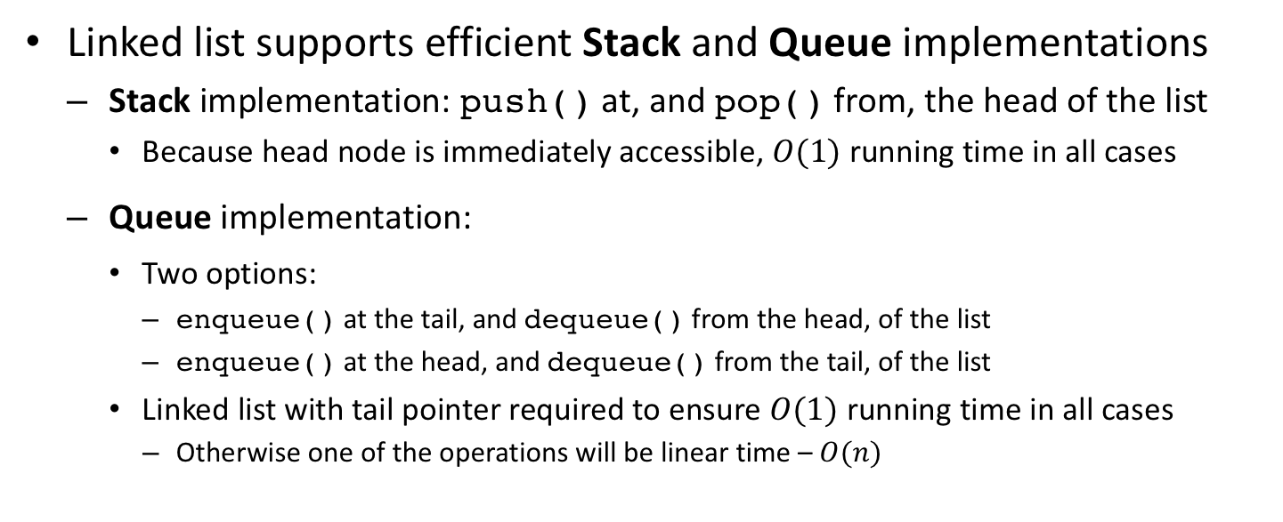
Linked list-based worklist implementation
enqueue()
push()
pop()
dequeue()
Linked list supports efficient Stack and Queue implementations
  Stack implementation: push() at, and pop() from, the head of the list
    Because head node is immediately accessible, $O(1)$ running time in all cases
  Queue implementation:
    Two options:
      enqueue() at the tail, and dequeue() from the head, of the list
      enqueue() at the head, and dequeue() from the tail, of the list
    Linked list with tail pointer required to ensure $O(1)$ running time in all cases
      Otherwise one of the operations will be linear time – $O(n)$

Slide 17
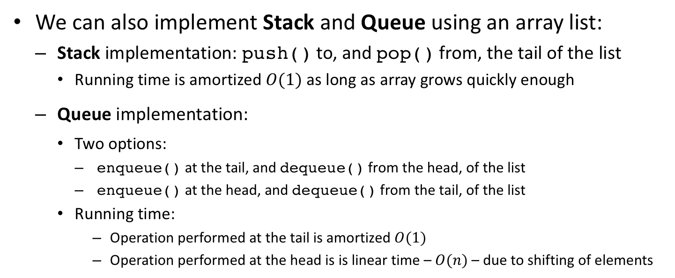
Array list-based worklist implementation
push()
pop()
enqueue()
dequeue()
We can also implement Stack and Queue using an array list:
  Stack implementation: push() to, and pop() from, the tail of the list
    Running time is amortized $O(1)$ as long as array grows quickly enough
  Queue implementation:
    Two options:
      enqueue() at the tail, and dequeue() from the head, of the list
      enqueue() at the head, and dequeue() from the tail, of the list
    Running time:
      Operation performed at the tail is amortized $O(1)$
      Operation performed at the head is is linear time – $O(n)$ – due to shifting of elements

Slide 18
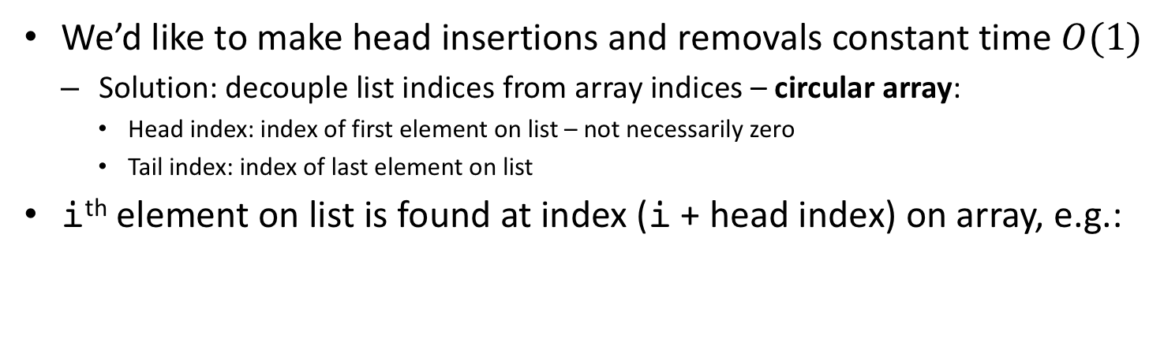
Array list optimization: circular array
We’d like to make head insertions and removals constant time $O(1)$
  Solution: decouple list indices from array indices – circular array:
    Head index: index of first element on list – not necessarily zero
    Tail index: index of last element on list
i^{th} element on list is found at index (i + head index) on array, e.g.:
enqueue("Ren")
dequeue()
enqueue("Puff")

Slide 19
Our collections framework so far
Notes:
To build upon later

Slide 20
Java standard library’s stacks and queues

Slide 21
Java’s stacks and queues
Java’s worklist-related class hierarchy is convoluted (legacy reasons)
Stacks and Queues fall under the purview of the Deque interface
  Stands for double-ended queue – two sets of methods:
    offerFirst(), pollFirst(), and peekFirst() to work with the head
    offerLast(), pollLast(), and peekLast() to work with the tail
  Emulate desired ADT behavior through careful method selection, e.g.:
import java.util.*; // for compactness
Deque<String> petStack = new ArrayDeque();
String[] pets = {"Pika", "Milu", "Peppa", "Luna"};
for (String pet : pets)
petStack.offerFirst(pet); // stack push
for (int i=petStack.size(); i > 0; i--){
String popped = petStack.pollFirst(); // stack pop
... // do something with popped element
}
Notes:
Array deque uses a circular array

Slide 22
Exercise

Slide 23
Exercise: worklist implementation
Write MyLinkedList-based implementations for both the MyQueue and MyStack Abstract Data Types
  Challenge: try to optimize running time efficiency

Slide 24
Lecture #10 legacy material

Slide 25
Java’s collections framework: queues
(IPUJ Chapter 10)

Slide 26
How to choose a Queue
Use PriorityQueue if non-insertion related priority needed, Deque otherwise
  PriorityQueueis slower because it needs to maintain partial order
Between the two Deques
  Both have average $O(1)$ operations but ArrayDeque is typically faster:
    Does not allocate nodes upon insertion
    Uses circular array so insertions at ends do not require shifting existing elements
    If initial capacity is chosen appropriately, array resizing should be infrequent

Slide 27
The Queue interface
A queue is an ADT that imposes an order on element access
We are able to:
  add (enqueue) and remove (dequeue) elements
  examine element at head of queue without removing it
The order in which elements are removed obeys a certain rule:
  First-In, First-Out (FIFO) queue
  Last-In, First-Out (LIFO) queue
  Priority queue: highest-priority element removed first

Slide 28
Queue interface methods
Queue provides two sets of methods, distinguished by the way they deal with exceptional situations:
add() throws an IllegalStateException if there is no space left on the queue (some queue implementations have limited capacity), offer() returns false instead
remove() and element() throw a NoSuchElementException if the queue is empty, poll() and peek() return null instead
 | Throws exception | Returns special value
Insert | add(E e) | offer(E e)
Remove | remove() | poll()
Examine head | element() | peek()

Slide 29
Queue class hierarchy
PriorityQueue keeps partial order, removes highest-priority element 1st
Deque is a double-ended queue, supports both FIFO and LIFO logics
  LinkedList and ArrayDeque just differ in the underlying data structure used to implement the interface
  We can use both as either a FIFO or LIFO

Slide 30
java.util.Deque interface
Deque is a double-ended queue, supports both FIFO and LIFO logics
Like Queue, Deque provides two sets of methods, distinguished by how they deal with exceptional situations:
 | Head |  | Tail
 | Exception | Special value | Exception | Special value
Insert | addFirst(e) | offerFirst(e) | addLast(e) | offerLast(e)
Remove | removeFirst() | pollFirst() | removeLast() | pollLast()
Examine | getFirst() | peekFirst() | getLast() | peekLast()

Slide 31
Deque usage example: FIFO
Using a Deque as a FIFO queue
Deque<String> fifo = new ArrayDeque<String>();
fifo.addLast("Mickey");
fifo.addLast("Donald");
fifo.addLast("Pluto");
while (fifo.peekFirst() != null){
System.out.printf("It's your turn %s!\n",
fifo.removeFirst());
}
Note how since we’re peeking first, it is safe to use remove()

Slide 32
Deque usage example: LIFO
Using a Deque as a LIFO queue
Deque<String> lifo = new ArrayDeque<String>();
lifo.addFirst("Mickey");
lifo.addFirst("Donald");
lifo.addFirst("Pluto");
while (lifo.peekFirst() != null){
System.out.printf("It's your turn %s!\n",
lifo.removeFirst());
}

Slide 33
The Stack class
The traditional name given to a LIFO queue is stack
The traditional names for the stack operations are:
  push(E e): place element e on the top of the stack and return said element
  pop(): remove element from top of stack and return it
  peek(): return element on top of stack without removing it
Java has a class called Stack that inherits from Vector but it’s old and Deque is preferred (functionally equivalent but faster)

Slide 34
Lecture #10 end

