Slide 1
CMPU-102 Fall 2021
Data Structures and Algorithms
Lecture #13: Divide and conquer – binary search & merge sort
Hannah Gommerstadt & Rui Meireles
Assistant Profs. of Computer Science, Vassar College, USA
Notes:
Today we’ll talk about the divide and conquer algorithm design paradigm.

Slide 2
Binary search

Slide 3
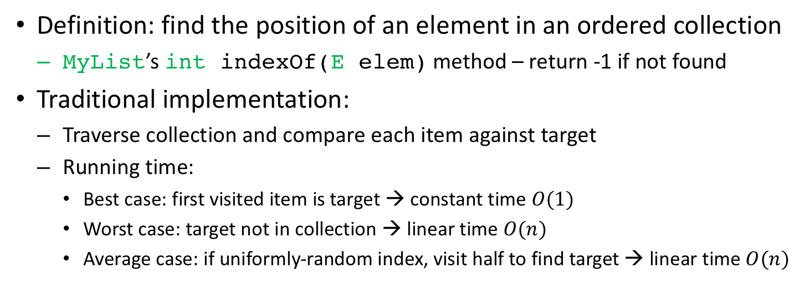
The search problem
Definition: find the position of an element in an ordered collection
  MyList’sintindexOf(Eelem) method – return -1 if not found
Traditional implementation:
  Traverse collection and compare each item against target
  Running time:
    Best case: first visited item is target → constant time $O(1)$
    Worst case: target not in collection → linear time $O(n)$
    Average case: if uniformly-random index, visit half to find target → linear time $O(n)$
Notes:
We’d like to make searches more efficient, for instance in a collection where lookups are very common operations.

Slide 4
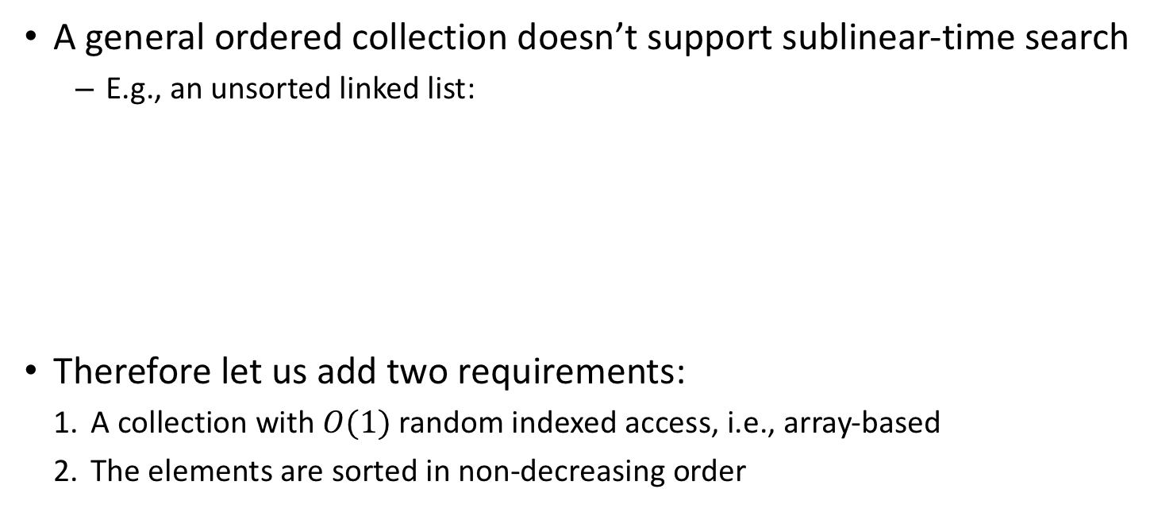
Enabling a faster search
A general ordered collection doesn’t support sublinear-time search
  E.g., an unsorted linked list:
Therefore let us add two requirements:
  A collection with $O(1)$ random indexed access, i.e., array-based
  The elements are sorted in non-decreasing order
Notes:
Use the example of looking for the index of value 3.
1. Lets us access the value at any index in constant time
2. Tells us whether a value appears before or after another one

Slide 5
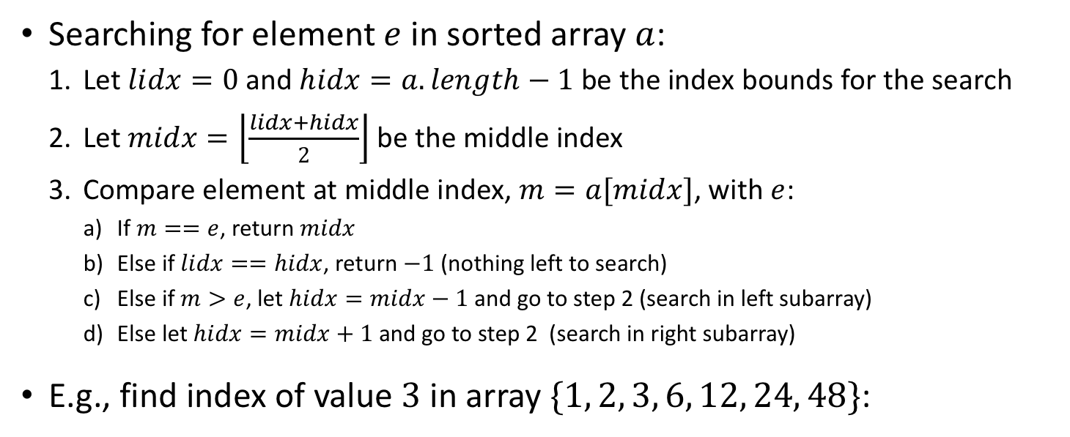
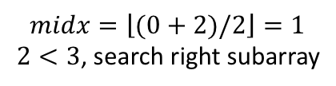
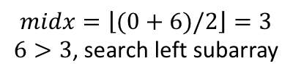
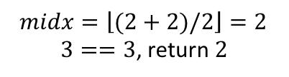
Binary search algorithm
Searching for element $e$ in sorted array $a$:
  Let $lidx=0$ and $hidx=a.length−1$ be the index bounds for the search
  Let $midx=\left\lfloor \frac{lidx+hidx}{2}\right\rfloor$ be the middle index
  Compare element at middle index, $m=a[midx]$, with $e$:
    If $m==e$, return $midx$
    Else if $lidx==hidx$, return $−1$ (nothing left to search)
    Else if $m>e$, let $hidx=midx−1$ and go to step 2 (search in left subarray)
    Else let $hidx=midx+1$ and go to step 2 (search in right subarray)
E.g., find index of value $3$ in array $\{1, 2, 3, 6, 12, 24, 48\}$:
$$midx=\left\lfloor (0+6)/2\right\rfloor =3$$
$6>3$, search left subarray
$$midx=\left\lfloor (0+2)/2\right\rfloor =1$$
$2<3$, search right subarray
$$midx=\left\lfloor (2+2)/2\right\rfloor =2$$
$3==3$, return $2$
Notes:
For queues and stacks

Slide 6

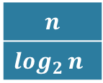
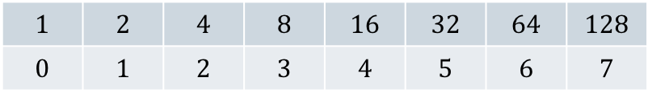
Binary search running time
$$Running time=\#iterations × work per iteration$$
Constant work per iteration → # iterations determines running time
  Best case: target found on 1st try →$O(1)$ running time
  Worst case: target not found in array, how many iterations?
    Search range is cut in half every iteration → need $⌊\log_{2}{n⌋}$ iterations to get to size 1
    Why? Logarithm is inverse of exponentiation: $b^{x}=y≡\log_{b}{y}=x$
      $\log_{b}{y}=x$→ $x$ is the number of times we need to multiply $1$ by $b$ to get $y$
    Total # iterations $=1+⌊\log_{2}{n⌋}$ →$O(\log{n})$ running time
  Average case: uniform input distribution → ½ # iterations → $O(\log{n})$
$$n$$
$\log_{2}{n}$
$$1$$ | $$2$$ | $$4$$ | $$8$$ | $$16$$ | $$32$$ | $$64$$ | $$128$$
$$0$$ | $$1$$ | $$2$$ | $$3$$ | $$4$$ | $$5$$ | $$6$$ | $$7$$
Notes:
Constant work done in an iteration is some arithmetic, indexed array access, and a couple of (2) comparisons.

Slide 7
Divide and conquer

Slide 8
Divide and conquer

Slide 9
Divide and conquer
A common algorithm design paradigm:
  Recursively subdivide problem into smaller ones until they become trivial
  Combine solutions to small problems to solve original problem
Notes:
Divide and conquer lends itself well to parallelization, as different cores can work on different, independent, subproblems simultaneously.

Slide 10

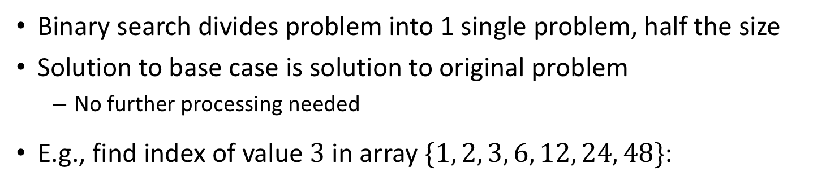



Binary search as a divide-and-conquer algorithm
Binary search divides problem into 1 single problem, half the size
Solution to base case is solution to original problem
  No further processing needed
E.g., find index of value $3$ in array $\{1, 2, 3, 6, 12, 24, 48\}$:
Problem of size $7$
Problem of size $⌊7/2{⌋}=3$
Problem of size $⌊3/2{⌋}=1$
Solution is $2$
Notes:
Binary search is an example of a divide-and-conquer algorithm, just a very simple one at that.

Slide 11
Merge sort

Slide 12
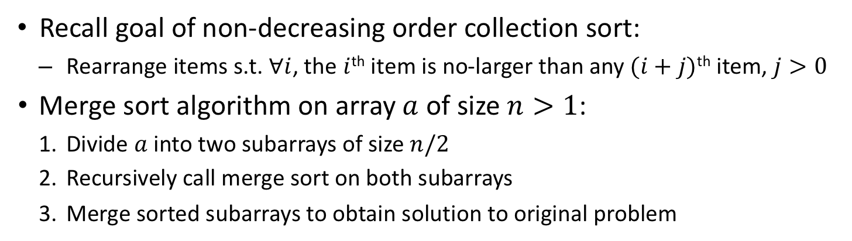
Merge sort
Recall goal of non-decreasing order collection sort:
  Rearrange items s.t.$∀i$, the $i$^{th}item is no-larger than any $(i+j)$^{th} item, $j>0$
Merge sort algorithm on array $a$ of size $n>1$:
      Divide $a$ into two subarrays of size $n/2$
      Recursively call merge sort on both subarrays
      Merge sorted subarrays to obtain solution to original problem
Notes:
Merge sort is the algorithm used by Java’s Collections.sort() method

Slide 13
Merge sort: code (1/3)
Without loss of generality let us consider sorting an int array:
  To sort Comparables we’d use compareTo() for comparisons
1 void mergeSort(int[] a){ mergeSort(a, 0, a.length-1); }
1 /* sort subarray a[lidx..hidx] */
2 void mergeSort(int[] a, int lidx, int hidx){
3 if (lidx < hidx){ // more than 1 elem?
4 int midx = (lidx+hidx)/2; // middle index (int div)
5 mergeSort(a, lidx, midx); // sort left subarray
6 mergeSort(a, midx+1, hidx); // sort right subarray
7 merge(a, lidx, midx, hidx); // combine sorted subarrays
8 }
9 }
lidx=0, hidx=3, midx=1
lidx=0, hidx=1, midx=0
lidx=2, hidx=3, midx=2
lidx=hidx=0
lidx=hidx=3
Notes:
Recursive procedure. mergeSort() method is overloaded to help us get started.
Void return data type because sorting done in place, meaning the contents of input array a are changed by the procedure.
Pink is the divide stage, green is the combine stage.

Slide 14
Merge sort: code (2/3)
Copy subarrays to prevent premature overwriting during merge
1 /* merge subarrays a[lidx..midx] and a[midx+1..hidx] */
2 void merge(int[] a, int lidx, int midx, int hidx){
3 int[] la = copySubarray(a, midx-lidx+1, lidx); // copy left array
4 int[] ra = copySubarray(a, hidx-midx, midx+1); // copy right array
5 ... // actual merge goes here
10 }
1 /* return copy of subarray a[sidx..sidx+len] */
2 int[] copySubarray(int[] a, int n, int sidx){
2 int[] suba = new int[n]; // create new array
3 for (int i=0; i < n && i < a.length; i++) // copy n elems
4 suba[i] = a[sidx+i]; // use sidx as offset
5 return suba;
6 }
la: n=2, sidx=0
lidx=0, hidx=3, midx=1
ra: n=2, sidx=2
Notes:
Reading from and writing to the same array can lead to premature overwritting.
To prevent overwriting we need to create copies of the left and right subarrays.

Slide 15
Merge sort: code (3/3)
1 /* merge subarrays a[lidx..midx] and a[midx+1..hidx] */
2 void merge(int[] a, int lidx, int midx, int hidx){
3 ... // create left & right subarray copies la and ra
5 int lti=0, rti=0; // left and right top indices
6 for (int i=lidx; i <= hidx; i++) // determine what a[i] should be
7 if (lti < la.length && (rti >= ra.length || la[lti] <= ra[rti]))
8 a[i] = la[lti++]; // left top not larger or out of right
9 else a[i] = ra[rti++]; // right top smaller or out of left
10 }
initial state
i=0
i=1
i=2
i=3
final state
Notes:
Here we do the actual merge.
Left and right subarrays are looked at as piles of elements.
Note how this is a linear time operation in all cases

Slide 16
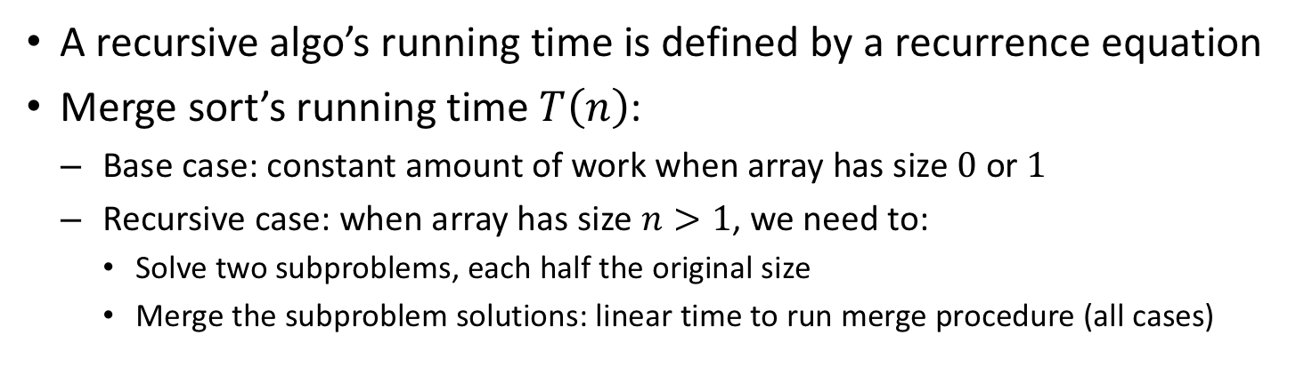
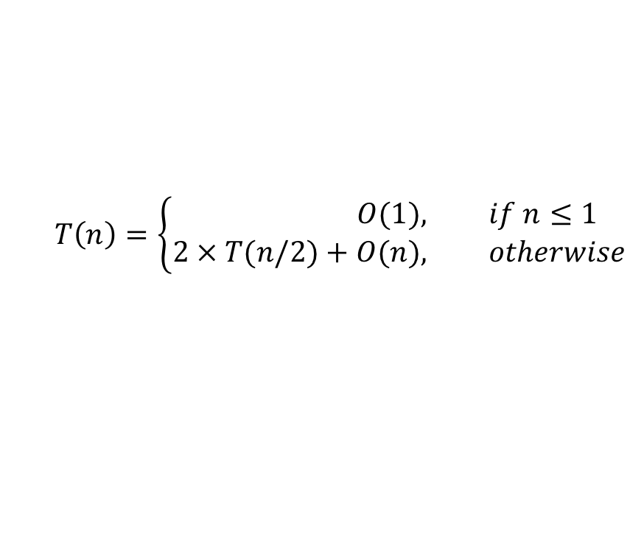
Merge sort: running time (1/2)
A recursive algo’s running time is defined by a recurrence equation
Merge sort’s running time $T\left(n\right)$:
  Base case: constant amount of work when array has size $0$ or $1$
  Recursive case: when array has size $n>1$, we need to:
    Solve two subproblems, each half the original size
    Merge the subproblem solutions: linear time to run merge procedure (all cases)
$$T\left(n\right)=\left\{\begin{aligned}O(1), &if n≤1 \\ 2 × T(n/2)+O(n), &otherwise\end{aligned}\right.$$
Notes:
Makes sense because we know that consecutively dividing n by 2 gets us down to 1 in log_2 steps

Slide 17
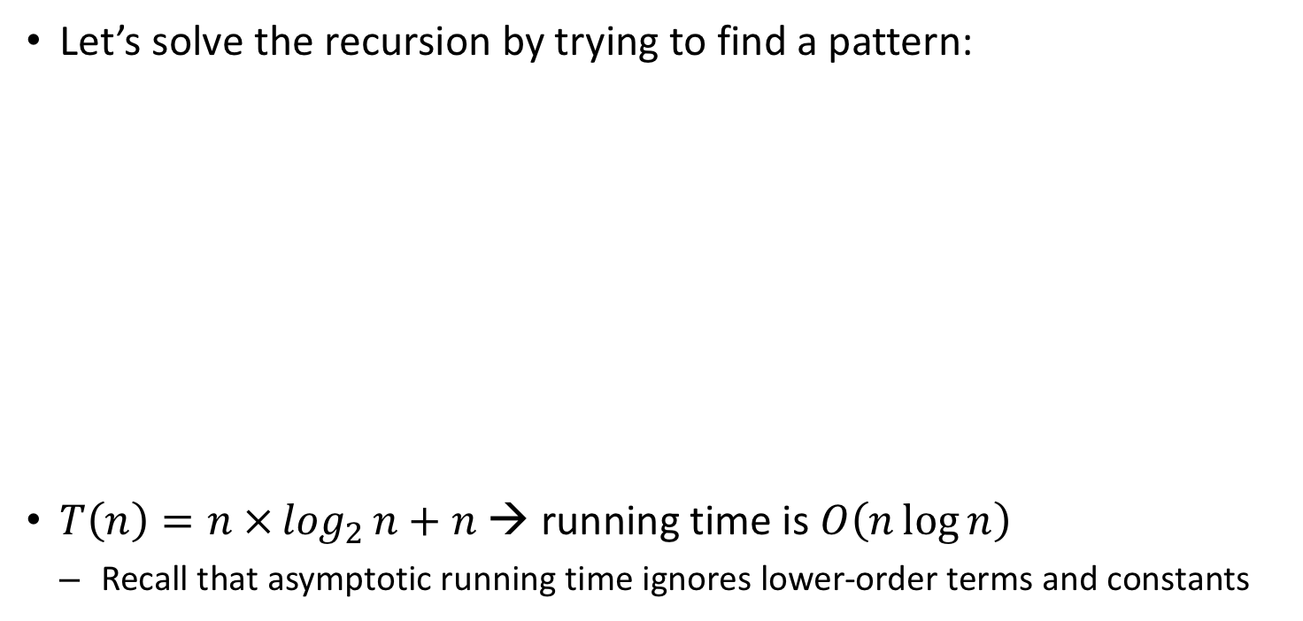
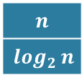
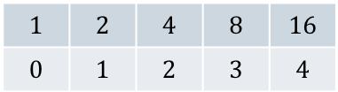
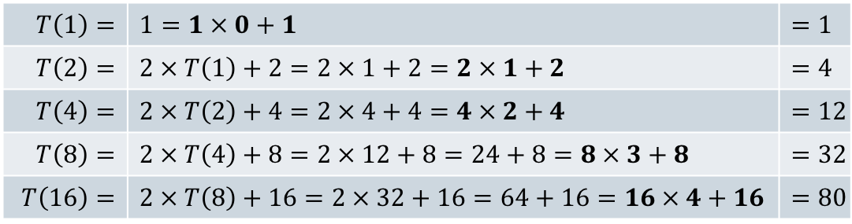
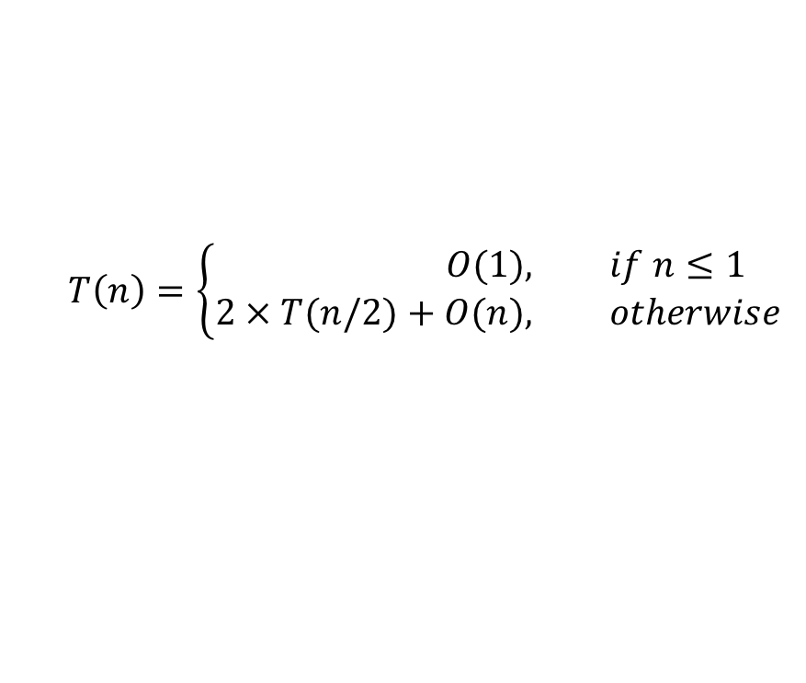
Merge sort: running time (2/2)
$$T\left(n\right)=\left\{\begin{aligned}O(1), &if n≤1 \\ 2 × T(n/2)+O(n), &otherwise\end{aligned}\right.$$
Let’s solve the recursion by trying to find a pattern:
$T\left(n\right)=n ×\log_{2}{n}+n$ → running time is $O\left(n\log{n}\right)$
  Recall that asymptotic running time ignores lower-order terms and constants
$$T\left(1\right)=$$ | $$1=1 × 0+1$$ | $$=1$$
$$T\left(2\right)=$$ | $$2 × T\left(1\right)+2=2 × 1+2=2 × 1+2$$ | $$=4$$
$$T\left(4\right)=$$ | $$2 × T\left(2\right)+4=2 × 4+4=4 × 2+4$$ | $$=12$$
$$T\left(8\right)=$$ | $$2 × T\left(4\right)+8=2 × 12+8=24+8=8 × 3+8$$ | $$=32$$
$$T\left(16\right)=$$ | $$2 × T\left(8\right)+16=2 × 32+16=64+16=16 × 4+16$$ | $$=80$$
$$n$$
$\log_{2}{n}$
$$1$$ | $$2$$ | $$4$$ | $$8$$ | $$16$$
$$0$$ | $$1$$ | $$2$$ | $$3$$ | $$4$$
Notes:
N log n is the best-known bound for a comparison-based sorting algorithm.
Divide and conquer can be very efficient. Also note how computation can be parallelized.

Slide 18
Exercise

Slide 19
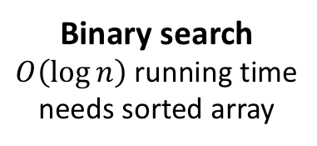
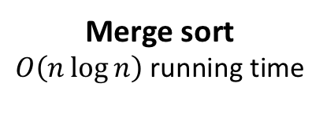
Exercise: implementation
Adapt merge sort to work with arrays of Comparable objects
Write an Java implementation of binary search
Merge sort
$O\left(n\log{n}\right)$ running time
Binary search
$O\left(\log{n}\right)$ running time
needs sorted array

