Slide 1
CMPU-145: Foundations of Computer Science Spring, 2019
1, sections 1.1 – 1.4 and 4.2

Slide 2
Topics
We’ll cover:
set theory – collecting things together
relations – comparing things
functions – associating one item with another
recursion and induction – recycling outputs as inputs
propositional & quantificational logic – reasoning
building complex proofs out of simple ones
And definitions/symbols/notations

Slide 3
SETS… 機関士：何者（なにもの）かによって、爆発物（ばくはつぶつ）が仕掛（しか）けられたようです。
A set is simply a collection of distinct items, called elements.
The elements in a set can be real
(e.g., the set of students in this room or books in the library)
…or abstract
(e.g., the alphabet or a set of other sets),
but the set itself is an abstract construct.
Important Points:
Even if the set only contains one element (a singleton), the set is distinct from its elements: The set {1} vs. the element 1
Sets can contain sets, which can contains sets, which can contains sets…
The text book uses the phrase “A collection of sets”

Slide 4
Sets (more…)
Elements of a set
To show that something is an element of a set, we use the symbol ∈, e.g.,
x ∈ A
To say it’s not an element, we add a slash:
x ∉ A
Relations between sets
The relations that can hold between two sets include:
subset
identity
proper subset

Slide 5
Sets (subsets)
Subset Definition:
For any two sets A and B, A is a subset of B (A ⊆ B) if and only if for every x, if x ∈ A, then x ∈ B.
Equivalent statement: there is no element of A that is not an element of B.
If A is not a subset of B, we write A ⊈ B.
Pro tip: use iff instead of “if and only if”

Slide 6
Sets (Identity)
Identity of sets definition:
A and B are identical (A = B) if both A ⊆ B and B ⊆ A.
In this case, every element of A is an element of B and
Every element of B is an element of A.
That is, they are sets of the exact same elements.
Careful, for a given element, there is a difference between the value and the representation of the value.
If A and B are not identical, we write A ≠ B.

Slide 7
Sets (Identity…)
Let’s take a look at an example!
Is {0, 2, 8} = {|√4|, 0/5, 2³}?

Slide 8
Sets (Identity…)
Let’s take a look at an example.
Is {0, 2, 8} = {|√4|, 0/5, 2³}?
Yes. They’re written in different ways, but they represent the same values.
The values are identical.

Slide 9
Sets (proper subset)
Proper subset definition
For sets A and B, A is a proper subset of B (A ⊂ B) iff A ⊆ B, but A ≠ B.
Every element of A is also an element of B,
but A is not identical to B.

Slide 10
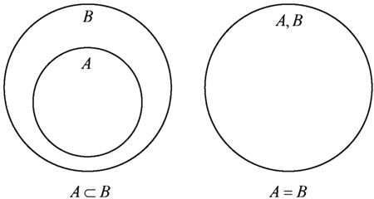
Sets (diagrams)
Euler Diagrams:
(I encourage you to take a closer look at the life of Leonhard Euler)

Slide 11
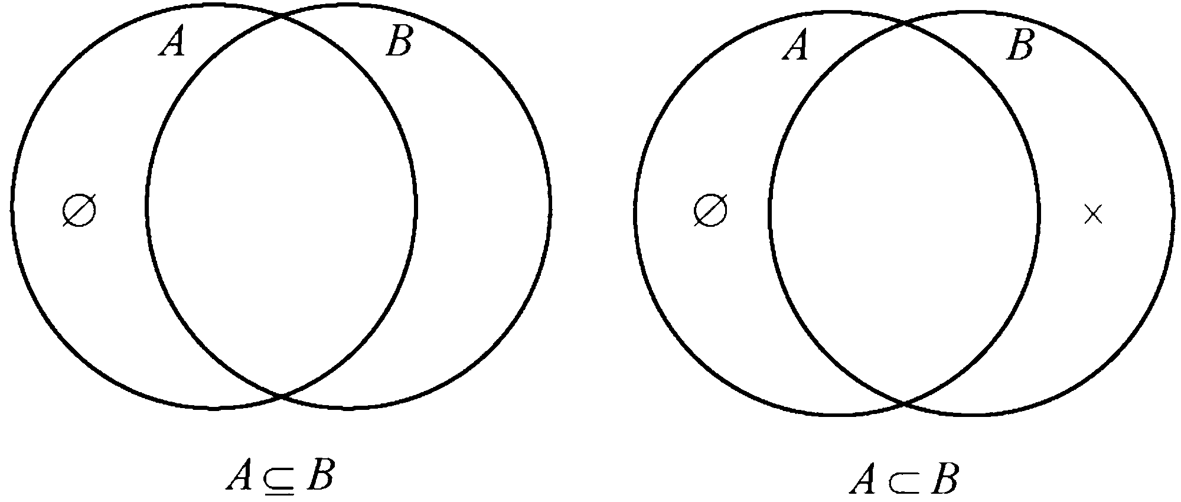
Sets (diagrams)
Venn Diagrams: (Named after John Venn)

Slide 12
Sets (diagrams)
Given A ⊂ B ⊂ C ,Which is easier?
To diagram these relationships in a single Euler diagram or…
To diagram these relationships in a single Venn diagram?

Slide 13
Induction (proofs)
Lets prove the following theorem: For any two sets A and B, if A ⊂ B, then there is some element of B that is not an element of A.

Slide 14
Induction (proofs)
THEOREM. For any two sets A and B, if A ⊂ B, then there is some element of B that is not an element of A.
PROOF.
Let A and B be any sets such that A ⊂ B. We must show that there is some element of B that is not an element of A.
Since A ⊂ B, we know that A ⊆ B, but A ≠ B.
Since A ≠ B, we know that it is not the case that both A ⊆ B and B ⊆ A hold.
Thus, either A ⊈ B or B ⊈ A must be true.
Since A ⊆ B, it must be that B ⊈ A.
Since B ⊈ A, it is not the case that for all x, if x ∈ B, then x ∈ A.
Thus, there must be some x for which x ∈ B holds, but x ∈ A doesn’t hold.

Slide 15
Induction (proof guide)
When you’re asked to prove something, how can you do so?
Be clear about what you need to prove. Consider breaking the theorem/statement into parts.
Refer to the definitions for the terms used.
E.g., what does it mean when A is a subset of B?
When we provide a definition, it’s for you to use.
Use things you’ve already proved, e.g., in a previous exercise, in class or even the textbook.

Slide 16
Proofs (exercises)
A = B iff neither A ⊂ B nor B ⊂ A.
True or false?

Slide 17
Proofs (exercises)
A = B iff neither A ⊂ B nor B ⊂ A.
True or false?
False.
Counterexample: A = {1}, B = {2}
With “iff” we need to show the statement in “both directions” are true (or, not):
If A = B, then neither A ⊂ B nor B ⊂ A: True
If neither A ⊂ B nor B ⊂ A, then A = B: False

Slide 18
Proofs (exercises)
Prove the theorem “For any sets A, B, and C, if A ⊆ B and B ⊆ C, then A ⊆ C.”

Slide 19
Proofs (exercises)
Let’s prove the theorem “For any sets A, B, and C, if A ⊆ B and B ⊆ C, then A ⊆ C.”
Proof: Let A, B, and C be any sets such that A ⊆ B and B ⊆ C.
Goal (1). Show that A ⊆ C.
Let’s restate the goal: show that for all x, if x ∈ A, then x ∈ C.
To prove Goal 1: Let x be any element of A. (i.e., let x ∈ A be arbitrary.)
New Goal (2): Show that x ∈ C.
Proof of Goal 2:
Given that x ∈ A and A ⊆ B, it follows that x ∈ B.
(Recall the definition: A ⊆ B means that for any x, if x ∈ A, then x ∈ B).
Given that x ∈ B and B ⊆ C, it follows that x ∈ C.
We have proven our New Goal (2).
We have proven Goal (1) and our theorem!

Slide 20
Induction (proof guide)
It is worth repeating!
When you’re asked to prove something, how can you do so?
Be clear about what you need to prove. Consider breaking the theorem/statement into parts.
Refer to the definitions for the terms used. (They are clues!)
E.g., what does it mean when A is a subset of B?
When we provide a definition, it’s for you to use.
Use things you’ve already proved, e.g., in a previous exercise, in class or even the textbook.

