Slide 1
CMPU-145: Foundations of Computer Science Spring, 2019
Not Chapter 1, and not Chapter 2. It is the middle ground between light and shadow, between science and superstition, and it lies between the pit of man's fears and the summit of his knowledge.

Slide 2
(Bi)Conditional Statements from last week
The conditional if α then β is true in virtually all cases
The lone exception: when α is true and β is false.
Also written as α => β

Slide 3
Conditional Statement: truth table (corrected)
α | β | α=>β
TRUE | TRUE | TRUE
TRUE | FALSE | FALSE
FALSE | TRUE | TRUE
FALSE | FALSE | TRUE

Slide 4
Biconditional Statement: α
The biconditional statement, α if and only if β is true
whenever α and β have the same truth value
α if and only if β is false
whenever they have opposite truth values
Also written as α iff β, α ⬄ β, or α≡β

Slide 5
Biconditional Statement: truth table (updated symbol)
α | β | α⬄β
TRUE | TRUE | TRUE
TRUE | FALSE | FALSE
FALSE | TRUE | FALSE
FALSE | FALSE | TRUE (!)

Slide 6
NEW! Conditional / BiConditional Statements
Material from
https://en.wikipedia.org/wiki/Wason_selection_task
Given 4 cards, each with a color on side, a number on the other
Cards show a 3, 8, red color, brown color
Which card (or cards) do you have to turn over to test the following:
If a card shows an even number on one side of the card,
Then the opposite side of the card is red.

Slide 7
NEW! Conditional / BiConditional Statements
Material from
https://en.wikipedia.org/wiki/Wason_selection_task
Given 4 cards, each with a color on side, a number on the other
Cards show a 3, 8, red color, brown color
Which card (or cards) do you have to turn over to test the following:
If a card shows an even number on one side of the card,
Then the opposite side of the card is red.
Can we all agree on this?
If the 8 card is not red on the obverse, the proposition is not correct.
α = T, β = F, ➔F
What else, if anything?

Slide 8
Let’s rephrase as a social construct
If you receive “meals on wheels” (ready-made food delivered to your home)
Then you are over 65 years of age.
Two cards represent ages: 19 and 72
Two cards represent meals on wheels: Receiving MOW, Not receiving MOW
What card(s) should you turn over in this case?

Slide 9
Let’s rephrase as a social construct
If you receive “meals on wheels” (ready-made food delivered to your home)
Then you are over 65 years of age.
Two cards represent meals on wheels: Receiving MOW, Not receiving MOW
Two cards represent ages: 19 and 72
What card(s) should you turn over in this case?
Receiving MOW ! Because: There better be a number >= 65 on the obverse.
If there’s like a 55, someone is ‘ripping off’ the govt.
α = T, β = F, ➔F or α = T, β = T, ➔T

Slide 10
Let’s rephrase as a social construct
If you receive “meals on wheels” (ready-made food delivered to your home) : α
Then you are over 65 years of age: β
Two cards represent meals on wheels: Receiving MOW, Not receiving MOW
Two cards represent ages: 19 and 72
What card(s) should you turn over in this case?
Receiving MOW ! There better be a number >= 65 on the obverse.
If there’s like a 55, someone is ‘ripping off’ the govt.
α = T, β = F, ➔F or α = T, β = T, ➔T
Similarly, if a 19 year old is getting meals on wheels…
α = T, β = F, ➔F and the statement will not be true.
Notes:
Think of an example where someone or some group needs to qualify for an achievement or benefit… driving, drinking, running a marathon, etc.

Slide 11
Revisiting Power Sets (p24 in our textbook)
Let’s take a look at exercise 1.4 (a) on Power sets:
Prove the following: For any sets A and B, if A ⊆ B, then 𝒫(A) ⊆ 𝒫(B)

Slide 12
Power Set Theorem
For any sets A and B, if A ⊆ B, then 𝒫(A) ⊆ 𝒫(B)

Slide 13
Power Set Theorem
For any sets A and B, if A ⊆ B, then 𝒫(A) ⊆ 𝒫(B)
How do we approach this? Let’s restate the premise with concrete example…
Let A and B be two sets s.t. A ⊆ B
Then let’s restate our goal, if we can…
Goal: show that 𝒫(A) ⊆ 𝒫(B)
i.e. Restated Goal: show that for all x, if x ⊆ 𝒫(A), then x ⊆ 𝒫(B)
Now the proof…
By definition of power set: since x ⊆ 𝒫(A), it follows that x ⊆ A
We’ve proven that: since x ⊆ A and A ⊆ B, it follows that x ⊆ B
By definition of power set: since x ⊆ B, it follows that x ⊆ 𝒫(B)
The restated goal has been shown true, the theorem is proven true too!

Slide 14
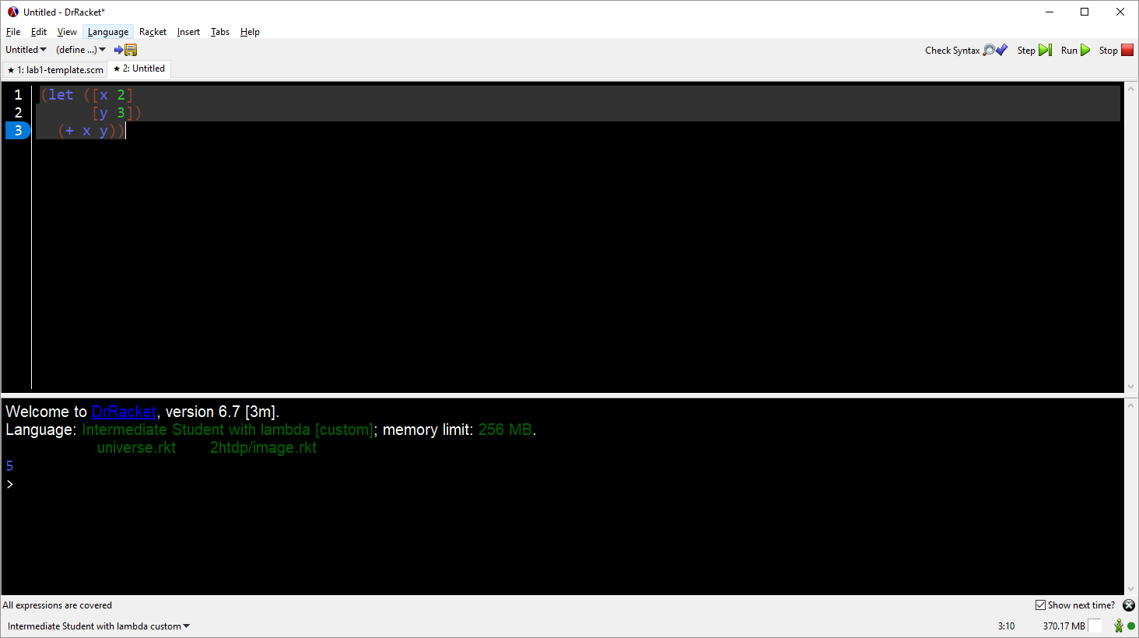
Some information for tonight’s lab
don’t forget to right click on an api to find out what it does!
don’t forget to step through your code to debug if the output is not what you expect
if code doesn’t build as you expect it to, check/change the language being used!

Slide 15
DrRacket api’s (procedures)
From the Racket Reference, let’s look more closely at:
cons
list
append
map

Slide 16
DrRacket api’s
cons
(cons x y) → list?
x : any/x y : list?
Constructs a list.
list
append
map

Slide 17
DrRacket api’s
cons
list
(list x ...) → list?
x : any/c
Constructs a list of its arguments.
> (list 1 2 3 4 5 6 7 8 9 0)
(1 2 3 4 5 6 7 8 9 0)
append
map

Slide 18
DrRacket api’s (procedures)
cons
list
append
(append l ...) → (listof any)
l : (listof any)
Creates a single list from several, by concatenation of the items. In ISL and up: append also works when applied to one list or none.
> (append (cons 1 (cons 2 '())) (cons "a" (cons "b" '())))(1 2 "a" "b")
> (append)()
map

Slide 19
DrRacket api’s (procedures)
map : Constructs a new list by applying a function to each item on one or more existing lists:
Form:
(map f (list x-1 ... x-n)) = (list (f x-1) ... (f x-n))
(map f (list x-1 ... x-n) (list y-1 ... y-n)) = (list (f x-1 y-1) ... (f x-n y-n))
> (map add1 '(3 -4.01 2/5))
(4 -3.01 7/5)
> (map (lambda (x) (list 'my-list (+ x 1))) '(3 -4.01 2/5))
((my-list 4) (my-list -3.01) (my-list 7/5))
> (map (lambda (x y) (+ x (* x y))) '(3 -4 2/5) '(1 2 3))
(6 -12 8/5)

Slide 20
DrRacket api’s (procedures)
let and let*
(let* ([name expr-for-let] ...) expression)
Like letrec, but each name can only be used in expression, and in expr-for-lets occuring after that name.
syntax
(let ([name expr-for-let] ...) expression)
Like letrec, but the defined names can be used only in the last expression, not the expr-for-lets next to the names.
(letrec ([name expr-for-let] ...) expression)
Like local, but with a simpler syntax. Each name defines a variable (or a function) with the value of the corresponding expr-for-let. If expr-for-let is a lambda, letrec defines a function, otherwise it defines a variable.
(local [definition ...] expression)
Groups related definitions for use in expression. Each definition can be either a define or a define-struct.
When evaluating local, each definition is evaluated in order, and finally the body expression is evaluated. Only the expressions within the local (including the right-hand-sides of the definitions and the expression) may refer to the names defined by the definitions. If a name defined in the local is the same as a top-level binding, the inner one “shadows” the outer one. That is, inside the local, any references to that name refer to the inner one.

Slide 21
DrRacket api’s (procedures)
let and let*
(let* ([name expr-for-let] ...) expression)
Like letrec, but each name can only be used in expression, and in expr-for-lets occuring after that name.
syntax
(let ([name expr-for-let] ...) expression)
Like letrec, but the defined names can be used only in the last expression, not the expr-for-lets next to the names.
(letrec ([name expr-for-let] ...) expression)
Like local, but with a simpler syntax. Each name defines a variable (or a function) with the value of the corresponding expr-for-let. If expr-for-let is a lambda, letrec defines a function, otherwise it defines a variable.
(local [definition ...] expression)
Groups related definitions for use in expression. Each definition can be either a define or a define-struct.
When evaluating local, each definition is evaluated in order, and finally the body expression is evaluated. Only the expressions within the local (including the right-hand-sides of the definitions and the expression) may refer to the names defined by the definitions. If a name defined in the local is the same as a top-level binding, the inner one “shadows” the outer one. That is, inside the local, any references to that name refer to the inner one.
WHAT??!?

Slide 22
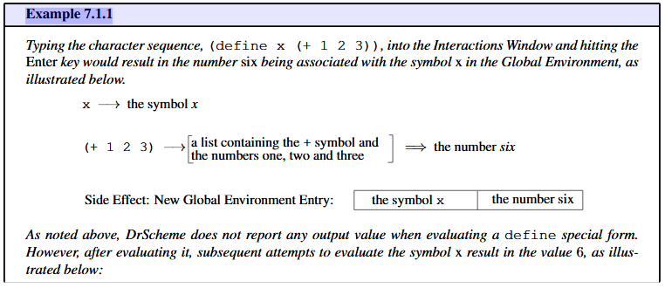
Let and Let* (with apologies to Paul McCartney)
Let’s start again.
In Professor Hunsberger’s textbook, Introduction to Computer Science via Scheme, p35, the special form of define is discussed. Check out example 7.1.1

Slide 23
Let
The Racket Guide provides the following introduction in 4.6 Local Binding
Although internal defines can be used for local binding, Racket provides three forms that give the programmer more control over bindings:
let, let* and letrec.
A let form binds a set of identifiers, each to the result of some expression, for use in the let body:
(let ([id expr] ...) body ...+)
The [id expr] is not very different than the define a few slides back.
An example, already in progress…
…(let ([x (+ x 1 2 3)]
[y (+ x 4 5 6)]) body)
Notes:
The closest parallel may be to think of let constructs as temporary #define macros in c/c++.

Slide 24
Let
An example, already in progress…
(define (favorite-number x)
(let ([x (+ x 1 2 3)]
[y (+ x 4 5 6)])
(+ x y + 21)))
Here, expressions are evaluated from before the let expression
If we test this define with x set to zero, what happens?
[x (+ x 1 2 3)] => let x be set to 0 + 1 + 2 + 3
[y (+ x 4 5 6)] => let y be set to 0 + 4 + 5 + 6
( + x y + 21 ) => (body) => 6 + 15 + 21 = 42
Notes:
Pay attention to the red text.

Slide 25
Let*
The Racket Guide provides the following for let* in 4.6 Local Binding
The syntax of let* is the same as let:
(let* ([id expr] ...) body ...+)
The difference is that each id is available for use in later exprs, as well as in the body. Furthermore, the ids need not be distinct, and the most recent binding is the visible one.
Another (!) example, already in progress…
…(let*([x (+ x 1 2 3)]
[y (+ x 4 5 6)]) body)
Notes:
The closest parallel may be to think of let constructs as temporary #define macros in c/c++.

Slide 26
Let*
An example, already in progress…
(define (favorite-number x)
(let ([x (+ x 1 2 3)]
[y (+ x 4 5 6)])
(+ x y + 21)))
Here, expressions are evaluated based on previous bindings
If we test this define with x set to zero, what happens?
[x (+ x 1 2 3)] => let x be set to 0 + 1 + 2 + 3 = 6
[y (+ x 4 5 6)] => let y be set to 6 + 4 + 5 + 6
( + x y + 21 ) => (body) => 6 + 21 + 21 = 48 :-\
Notes:
Pay attention to the red and blue text. Y is setup based on the local binding within the let expression.

