Slide 1
CMPU-145: Foundations of Computer Science Spring, 2019
Lab Preview 2/12

Slide 2
DrRacket api’s (we saw this one last time)
map : Constructs a new list by applying a function to each item on one or more existing lists:
Form:
(map f (list x-1 ... x-n)) = (list (f x-1) ... (f x-n))
(map f (list x-1 ... x-n) (list y-1 ... y-n)) = (list (f x-1 y-1) ... (f x-n y-n))
> (map even? '(1 2 3 4))
'(#f #t #f #t)

Slide 3
DrRacket api’s (andmap) I
(andmap p? [l]) → boolean (that’s a single value)
p? : (X ... -> boolean) l : (listof X) = ...
Determines whether p? holds for all items of l ...:
(andmap p (list x-1 ... x-n)) = (and (p x-1) ... (p x-n))
> (map even? '(1 2 3 4))
'(#f #t #f #t)
>(andmap even? '(2 4 6))
#true

Slide 4
DrRacket api’s (andmap) II
(andmap p? [l]) → boolean (that’s a single value)
p? : (X ... -> boolean) l : (listof X) = ...
Determines whether p? holds for all items of l ...:
(andmap p (list x-1 ... x-n)) = (and (p x-1) ... (p x-n))
>(andmap even? '(1 3 5))
#false
short circuting employed

Slide 5
DrRacket api’s (andmap) III
(andmap p? [l]) → boolean (that’s a single value)
p? : (X ... -> boolean) l : (listof X) = ...
Determines whether p? holds for all items of l ...:
(andmap p (list x-1 ... x-n)) = (and (p x-1) ... (p x-n))
>(andmap even? '(1 3 5))
#false
btw, short circuting is employed
i.e. evaluate each element, but stop when #false is found
Prevents the program from performing wasteful calculations.
Possibly prevent a coding disaster.

Slide 6
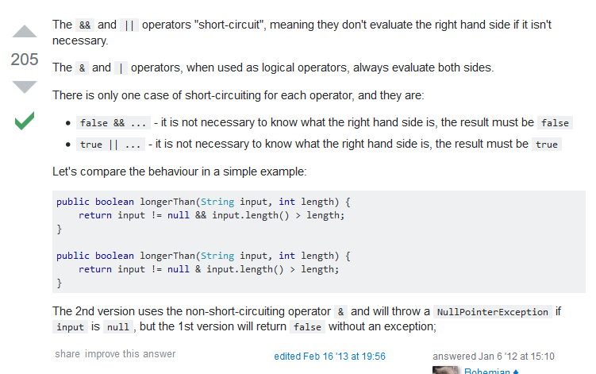
Short Circuit
Let’s Review this concept a bit (!) more with Java
Enter “short circuit” in search engine
https://stackoverflow.com/questions/8759868/java-logical-operator-short-circuiting
Notes:
& can be used as a bit-wise operator (to “and” bits) as well as an operator that returns true / false.

Slide 7
Short Circuit
Why design a programming language with && and &
Such that && will perform short circuits
Such that & does not perform any short circuiting
Isn’t NULLPTREXCEPTION a horrible, no good, awful thing to have happen ??!?
In that particular test case, yes, a programmer would choose operator &&*
Consider the following:
if ((EuroExchangeRate==Favorable) && TransmitToBroker(EuroExchangeRate)) {
BuyEuros(myDollars);
}
Maybe TransmitToBroker() must be executed all of the time.
But, begs the question: Why not use two separate statements?
Moral of the story: Document your intentions in code clearly!
Block comments are good!

Slide 8
Presented for your consideration
Consider:
(ormap even? '(1 2 3 4 ))
What is the output?
What should DrRacket do in terms of short circuiting here?

Slide 9
Presented for your consideration
Consider:
(ormap even? '(1 2 3 4 ))
What is the output?
#true
What should DrRacket do in terms of short circuiting here?
Stop further evaluations when #true is found.

Slide 10
Elements in a list (ひとつ)
We should already by familiar with first
Give me the first element of a list
What other elements can be accessed directly?

Slide 11
Elements in a list (ふたつ)
We should already by familiar with first
Give me the first element of a list
What other elements can be accessed directly?
second
third
fourth
fifth
sixth
seventh
eighth
…and that’s all ☹

Slide 12
Swapping elements
Consider:
void swap (int* x, int* y) {
int* z = x;
x = y;
y = z;
}
//c/c++ code
How do we do something like this in scheme?
reverse
How could we implement our own version of reverse?
… in an ordered pair, for example.

Slide 13
Swapping elements
Consider:
void swap (int* x, int* y) {
int* z = x;
x = y;
y = z;
}
// sample c/c++ code
How do we do something like this in scheme?
reverse
How could we implement our own version of reverse?
… in an ordered pair, for example.
We would want something like ‘(second first)

Slide 14
Swap v1
Consider:
(define swap
(lambda (pair)
(cons (second pair) (first pair))
))
(swap '(1 2))
No!
cons: second argument must be a list, but received 2 and 1

Slide 15
Swap v2
Consider:
(define swap
(lambda (pair)
(cons (second pair) (rest pair))
))
(swap '(1 2))
Better, but still: No!
'(2 2)
We need a list in that partition of the list, we don’t really have one!

Slide 16
Swap v3
Consider:
(define swapv3
(lambda (pair)
(cons (second pair) (cons (first pair) '())
)))
(swapv3 '(1 2))
Better-er
'(2 1)
Looks like: This works for an ordered pair. What about more generally?
i.e. what if we want to reverse an entire list? Well, reverse would do it for us.
How about a DIY version?
We would need “second” to be a call to “swap” again
Even though ‘() would be good for a pair, we would want first to be last, second to be next to last, etc.
We couldn’t call it swap any more either…

Slide 17
diy-reverse-v2, part a
(define (diy-reverse-v2 input-list initially-empty-list)
(cond
((null?
;; if the input list is empty, what should be output?
(else
(diy-reverse-v2 (rest input-list)
(cons (first input-list) initially-empty-list))
)))
Looks like: This works for an ordered pair. What about more generally?
i.e. what if we want to reverse an entire list? Well, reverse would do it for us.
How about a DIY version?
We would need “second” to be a call to “swap” again !
So, recursive calls. That means we would need a “null?” case too!
Also, it is ok to use ‘() to test out our v4, but we can’t force this on, say a cmpu-101 student…
How about we define an interface with just one parameter, just like reverse.
How do we do it?

Slide 18
diy-reverse-v2, part a
(define (diy-reverse-v2 input-list initially-empty-list)
(cond
((null?
;; if the input list is empty, what should be output?
(else
(diy-reverse-v2 (rest input-list)
(cons (first input-list) initially-empty-list))
)))
Looks like: This works for an ordered pair. What about more generally?
i.e. what if we want to reverse an entire list? Well, reverse would do it for us.
How about a DIY version?
We would need “second” to be a call to “swap” again !
So, recursive calls. That means we would need a “null?” case too!
Also, it is ok to use ‘() to test out our v4, but we can’t force this on, say a cmpu-101 student…
How about we define an interface with just one parameter, just like reverse.
How do we do it? Wrapper functions awre wready fowr the job!

Slide 19
diy-reverse-v2, part b – wrapper functions
(define (diy-reverse-v2 input-list initially-empty-list)
(cond
((null?
;; if the input list is empty, what should be output?
(else
(diy-reverse-v2 (rest input-list)
(cons (first input-list) initially-empty-list))
)))
;;The Wrapper Function will be “ the middleman”
One face (external interface) for end users
Another face (internal interface) used to call @TheRealWorkingFunction
(define (diy-reverse input-list)
(diy-reverse-v2 input-list '()))

