Slide 1
CMPU-145: Foundations of Computer Science
Spring, 2019
2 - 2.5 2.6 2.7: Equivalence Relations, Partitions & Examples

Slide 2
Equivalence relation/Partition definitions
Today…
Equivalence Relation: Examples
    Examples where items are “essentially the same” based on the relation
      We’ll be careful to enforce the definition components (r/s/t)
    We will go over the homework together (don’t hand it in!)
Partition: Examples
  Examples where we “chop up” a set into subsets
    We’ll be careful to enforce the definition components (!empty/disjoint/exhaustion)
Converting:
  ER -> Partition
  Partition -> ER
Is this useful?
  Spoiler alert: yes.

Slide 3
Equivalence relation examples I
In the art world: Consider the relation more and less:
  “Less is more” and “More is less” .
    Is it an equivalence relation?
How would we partition this?
  “Less is more” – Mies Van der Rohe, modernist architect
  “More is less” – Ad Reinhardt, abstract artist
  From “Second Edition: The Essential Guide to Revisioning Photography,” by John Paul Caponigro

Slide 4
Equivalence relation examples I
In the art world: Consider the relation more and less:
  “Less is more” and “More is less” .
    Is it an equivalence relation?
    i.e. Does it fit our definition of an ER?
      Yes!
      In the art world, not so much.
How would we partition this?
  “Less is more” – Mies Van der Rohe, modernist architect
  “More is less” – Ad Reinhardt, abstract artist
  From “Second Edition: The Essential Guide to Revisioning Photography,” by John Paul Caponigro

Slide 5
Equivalence relation examples I
In the art world: Consider the relation more and less:
  “Less is more” and “More is less” .
    Is it an equivalence relation?
    i.e. Does it fit our definition of an ER?
      Yes!
      In the art world, not so much.
How would we partition this?
  There are two elements so 2^{N} ways
  Reminder: power set is a good reference:
    {less}, {more}
    {less, more}
  “Less is more” – Mies Van der Rohe, modernist architect
  “More is less” – Ad Reinhardt, abstract artist
  From “Second Edition: The Essential Guide to Revisioning Photography,” by John Paul Caponigro

Slide 6
Equivalence relation examples II
In the physics world: Consider a vector: (via Merriam-Webster)
  … represented by a directed line segment whose length represents the magnitude and whose orientation in (2D, 3D) space represents the direction
  Is the representation of a directed line segment an equivalence relation?
    (r): length and direction of directed line segment a is the same as directed line segment a
    (s): length and direction of directed line segment a is the same as directed line segment b
    (t): length and direction of directed line segment a is the same as directed line segments b, c

Slide 7
Equivalence relation examples III
Using an earlier example: Parent of:
  The relation R is: X is a Parent of
  Is the representation of a directed line segment an equivalence relation?

Slide 8
Equivalence relation examples III
Using an earlier example: Parent of:
  The relation R is: X is a Parent of
  Is the representation of a directed line segment an equivalence relation?
    (r): x is a Parent of a -> (a,a) ∈ R
    (s): x is a parent of a, x is a parent of b -> (a,b) ∈ R, (b,a) ∈ R
    (t): x is a parent of a, x is a parent of b, x is a parent of c -> (a,b) ∈ R, (b,c) ∈ R , (a,c) ∈ R

Slide 9
Equivalence relation examples III
Using an earlier example: Parent of:
  The relation R is: X is a Parent of
  Is the representation of a directed line segment an equivalence relation?
    (r): x is a Parent of a -> (a,a) ∈ R
    (s): x is a parent of a, x is a parent of b -> (a,b) ∈ R, (b,a) ∈ R
    (t): x is a parent of a, x is a parent of b, x is a parent of c -> (a,b) ∈ R, (b,c) ∈ R , (a,c) ∈ R
  Yes.

Slide 10
Equivalence relation examples IV
One more: Result of the modulo function:
  Over, say, positive integers, the result of X mod2 will be ? 0 or 1
    Similarly, for X mod3, the result will be either 0, 1, 2
  So, 16 mod3 = 22 mod3 = 25 mod3.
    We can informally follow the definition components to see if the definition works, and say:
    Yes. For R = result of x mod k , R is an equivalence relation
  More… There is general case: {(a,b)∣a,b∈Z,a≡b (mod k)}
    (And a formal proof too)

Slide 11
Equivalence relation examples IV
One more: Result of the modulo function:
  Over, say, integers, the result of X mod2 will be ? 0 or 1
    Similarly, for X mod3, the result will be either 0, 1, 2
  So, 16 mod3 = 22 mod3 = 25 mod3.
    We can informally follow the definition components to see if the definition works, and say:
    Yes. For R = result of x mod k , R is an equivalence relation
  More… There is general case: {(a,b)∣a,b∈Z,a≡b (mod k)}
    (And a formal proof too)
  More… More… Partitions:
    For a given k, we can partition integers into k different equivalence classes
      Eg for k = 3, all integers will belong to one of {0}, {1}, {2}

Slide 12
Equivalence relations: Homework
Let R be the relation on A that is defined by a and b have the same birthday:
    (r): a -> (a,a) ∈ R (trivially)
    (s): a and b have the same birthday -> (a,b) ∈ R, (b,a) ∈ R (b and a have the same birthday)
    (t): a, b have the same birthday, b, c have the same birthday
      -> (a,b) ∈ R, (b,c) ∈ R , (a,c) ∈ R (a and c have the same birthday)
Let R be the relation on A that is defined by the first 8 characters of a are the same as the first 8 characters of b (F8)
    (r): a -> (a,a) ∈ R (trivially)
    (s): F8 of a and F8 of b -> (a,b) ∈ R, (b,a) ∈ R
    SupermanTheMovie, SupermanTheComicBook ∈ R -> SupermanTheComicBook, SupermainTheMovie ∈ R
    (t): F8 of a, F8 of b, F8 of c -> (a,b) ∈ R, (b,c) ∈ R , (a,c) ∈ R
    SupermanTheMovie, SupermanTheComicBook ∈ R -> SupermanTheComicBook, SupermainTheMusical ∈ R
    SupermanTheMovie, SupermanTheMusical ∈ R

Slide 13
Consider A = {1,2,3} and the Power set
𝒫(A) = {∅, {1}, {2}, {3}, {1, 2}, {1, 3}, {2, 3}, {1, 2, 3}}
  For discussion, eliminate the empty set: 2^{N} – 1 elements
  Let’s create partitions via combinations of 𝒫(A) - ∅
  Such that we fulfill the properties of a partition.
    P1 = {{1}, {2}, {3}}
    P2 = {{1}, {2, 3}}
    P3 = {{1, 2}, {3}}
    P4 = {{1, 3}, {2}}
    P5 = {{1, 2, 3}}
    Any others?

Slide 14
Consider A = {1,2,3} and the Power set
𝒫(A) = {∅, {1}, {2}, {3}, {1, 2}, {1, 3}, {2, 3}, {1, 2, 3}}
  For discussion, eliminate the empty set: 2^{N} – 1 elements
  Let’s create partitions via combinations of 𝒫(A) - ∅
  Such that we fulfill the properties of a partition.
    P1 = {{1}, {2}, {3}}
    P2 = {{1}, {2, 3}}
    P3 = {{1, 2}, {3}}
    P4 = {{1, 3}, {2}}
    P5 = {{1, 2, 3}}
    Any others? No.

Slide 15
Given a partition, create an equivalence relation
  How do we start?
  Start with the definition (r/s/t) and a specific example
    P1 = {{1}, {2}, {3}}

Slide 16
Given a partition, create an equivalence relation
  How do we start?
  Start with the definition (r/s/t) and a specific example
    P1 = {{1}, {2}, {3}}
      When we have a singleton, we can think of the reflexive property
      a -> (a,a) ∈ R

Slide 17
Given a partition, create an equivalence relation
  How do we start?
  Start with the definition (r/s/t) and a specific example
    P1 = {{1}, {2}, {3}}
      When we have a singleton, we can think of the reflexive property
      a -> (a,a) ∈ R ➔
      (1,1) (2,2) (3,3)

Slide 18
Given a partition, create an equivalence relation
  How do we start?
  Start with the definition (r/s/t) and a specific example
    P1 = {{1}, {2}, {3}}
      When we have a singleton, we can think of the reflexive property
      a -> (a,a) ∈ R ➔
      (1,1) (2,2) (3,3)
      What about symmetry? We will end up with c. again.

Slide 19
Given a partition, create an equivalence relation
  How do we start?
  Start with the definition (r/s/t) and a specific example
    P1 = {{1}, {2}, {3}}
      When we have a singleton, we can think of the reflexive property
      a -> (a,a) ∈ R ➔
      (1,1) (2,2) (3,3)
      What about symmetry? We will end up with c. again
      Similarly, with transitivity & singletons, we end up with c. again
      So. (1,1) (2,2) (3,3) make up the ordered pairs of the equivalence relation

Slide 20
Given a partition, create an equivalence relation
  How about using a partition with 2 items, not 3?
    There will have to be one singleton in these partitions!
    P1 = {{1}, {2}, {3}}
    P2 = {{1}, {2, 3}}
    P3 = {{1, 2}, {3}}
    P4 = {{1, 3}, {2}}
    P5 = {{1, 2, 3}}

Slide 21
Given a partition, create an equivalence relation
  Let’s continue with…
    2. P2 = {{1}, {2, 3}}
      When we have a singleton, we can think of the reflexive property
      a -> (a,a) ∈ R (1,1) (2,2) (3,3)
      What about symmetry? (a,b) ∈ R, (b,a) ∈ R
      We have (2,3), we must also add (3,2)
      As before, with transitivity & singletons, we end up with b. again
      Also, with transitivity & a single pair, we end up with d. How?

Slide 22
Given a partition, create an equivalence relation
  Let’s continue with…
    2. P2 = {{1}, {2, 3}}
      When we have a singleton, we can think of the reflexivity: (1,1)
      a -> (a,a) ∈ R 2 & 3 also need reflexive pairs: (2,2) (3,3)
      What about symmetry? (a,b) ∈ R, (b,a) ∈ R
      We have (2,3), we must also add (3,2)
      As before, with transitivity & singletons, we end up with b. again
      Also, with transitivity & a single pair, we end up with d. How?
      (2,3) -> (3,2) -> (2,2)
      So. (1,1) (2,2) (3,3) (2,3) (3,2) make up the ordered pairs of this equivalence relation

Slide 23
Given a partition, create an equivalence relation
  How about using a partition with 2 items, not 3?
    The results will be similar for partitions P3 and P4…
    P1 = {{1}, {2}, {3}}
    P2 = {{1}, {2, 3}}
    P3 = {{1, 2}, {3}}
    P4 = {{1, 3}, {2}}
    P5 = {{1, 2, 3}}

Slide 24
Given a partition, create an equivalence relation
  There is additional “complexity” for partition P5.
    We’ll have to create ordered pairs for the transitivity component of an equivalence relation
    P1 = {{1}, {2}, {3}}
    P2 = {{1}, {2, 3}}
    P3 = {{1, 2}, {3}}
    P4 = {{1, 3}, {2}}
    P5 = {{1, 2, 3}}

Slide 25
Given an equivalence relation, create a partition I
  “To flip the script”,
  Do the opposite of what we did before
    and use the components of partition definition.
      Q1 = {(1,1), (2,2), (3,3)}
      If we have an ordered pair of the form (a,a)

Slide 26
Given an equivalence relation, create a partition II
  “To flip the script”,
  Do the opposite of what we did before
    and use the components of partition definition.
      Q1 = {(1,1), (2,2), (3,3)}
      If we have an ordered pair of the form (a,a)
      We have a singleton (*3 in this example) : {{1}, {2}, {3}}
      etc. etc. etc.

Slide 27
Given an equivalence relation, create a partition III
  “To flip the script”,
  Do the opposite of what we did before
    and use the components of partition definition.
      Q1 = {(1,1), (2,2), (3,3)}
      If we have an ordered pair of the form (a,a)
      We have a singleton (*3 in this example) : {{1}, {2}, {3}}
      Q2 = {(1,1), (2,2), (2,3), (3,2), (3,3)}
      Use 1. (above) for {1} only. Why?

Slide 28
Given an equivalence relation, create a partition IV
  “To flip the script”,
  Do the opposite of what we did before
    and use the components of partition definition.
      Q1 = {(1,1), (2,2), (3,3)}
      If we have an ordered pair of the form (a,a)
      We have a singleton (*3 in this example) : {{1}, {2}, {3}}
      Q2 = {(1,1), (2,2), (2,3), (3,2), (3,3)}
      Use 1. (above) for {1} only. why?
      Since elements 2 and 3 are part of a symmetric relation,
        {2, 3} will suffice – no need to add {2} or {3}
      Complete answer for P2: {{1}, {2, 3}}

Slide 29
Equivalence Relations <--> Partitions
Given: A = {1,2,3}
Possible partitions
P1 = {{1}, {2}, {3}}
P2 = {{1}, {2, 3}}
P3 = {{1, 2}, {3}}
P4 = {{1, 3}, {2}}
P5 = {{1, 2, 3}}
and associated equivalence relations
Q1 = {(1,1), (2,2), (3,3)}
Q2 = {(1,1), (2,2), (2,3), (3,2), (3,3)}
Q3 = {(1,1), (1,2), (2,1), (2,2), (3,3)}
Q4 = {(1,1), (1,3), (3,1), (3,3), (2,2)}
Q5 = {(1,1), (1,2), (1,3), (2,3), (2,1), (3,1), (3,2), (2,2),(3,3)}

Slide 30
Is this useful?
It turns out the language we are using…
  Is the language of databases.
    DB2
    sql and variants (mysql, sql-lite)
    Even <take a deep breath> MS Access!
  Partitions allows a DBA to break up table/other data into small pieces
      (without the worry of unintentionally leaving out any data)
    Advantages? Consider: all cameras for sale on Ebay at any one time.
      Would you create one table of them all (thousands)?
        With associated data, how big would that table be (GB)?

Slide 31
Is this useful?
  Let’s go to the documentation!
  https://docs.oracle.com/en/database/oracle/oracle-database/19/vldbg/partition-concepts.html#GUID-EA7EF5CB-DD49-43AF-889A-F83AAC0D7D51
  https://developer.ibm.com/tutorials/dm-0605ahuja2/

Slide 32
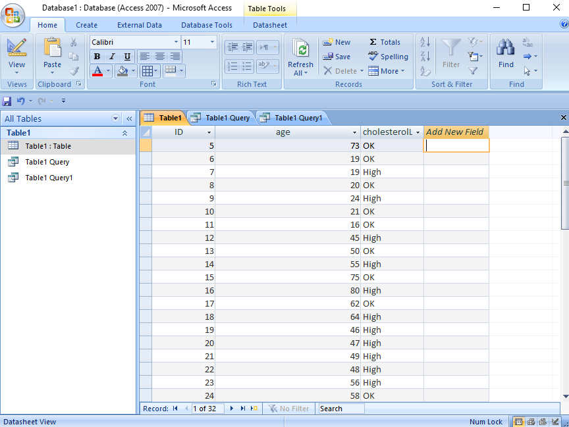
Related: sql and MS Access example
Simple example, pretty much just a spreadsheet (which is what a table is)
Age and cholesterol level (ok or too high)
How do we correlate this data?
  Is there something meaningful here?

Slide 33
Sql and MS Access example
SELECT DISTINCTROW Table1.[cholesterolLVL], Partition([Age],0,100,10) AS Age_Range, Count([Age]) AS Range_Count
FROM Table1
GROUP BY [cholesterolLVL], Partition([Age],0,100,10);
This example asks MS Access to
  Show us cholesterol levels for everyone in table
    (high or ok)
  & partition the data based on age (Age_Range) into 10 year increments
  & count the total cholesterol levels for each 10 year bracket

Slide 34
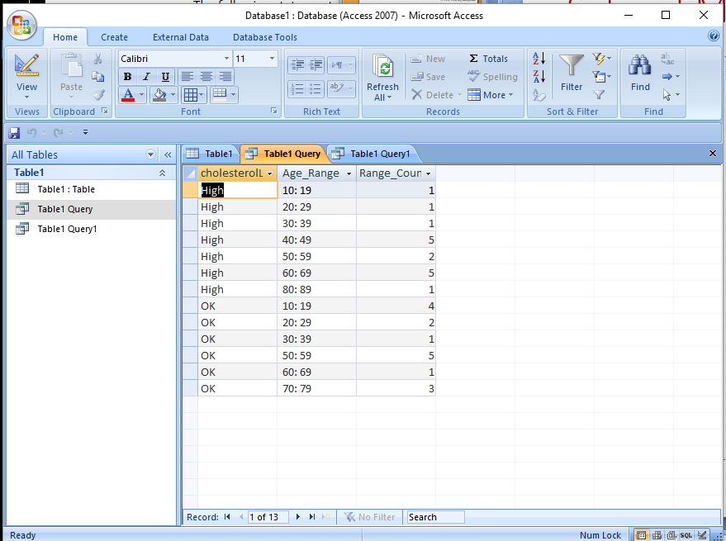
Sql and MS Access example
Data would suggest participants in the study from ages 40 – 49 should proactively manage their cholesterol
  Via diet, medication, exercise…
Partitioning also provides an arguably better way to view data.

Slide 35
Using relations to order things (not like with Alexa)
Consider searching on Ebay for a camera.
We can show the items by price (say, low to high)
  We can use < operator to order the items for sale
Should the order have transitivity?
  Yes – you wouldn’t use Ebay very much if it isn’t!
Should the order have reflexivity?

Slide 36
Using relations to order things (not like with Alexa)
Consider searching on Ebay for a camera.
We can show the items by price (say, low to high)
  We can use < operator to order the items for sale
Should the order have transitivity?
  Yes – you wouldn’t use Ebay very much if it isn’t!
Should the order have reflexivity?
  Yes: If we want to include more than one camera at the same price i.e. we are inclusive (<= )
  No: If we only want a strict order (<)

Slide 37
Order and Symmetry | Symmetry and Order
We’re still looking for that camera on Ebay.
Can the list of cameras for sale be symmetric?
  The list presented to us would make no sense to use
  And we would have… what kind of relation?
If (a,b) ∈ R then (b,a) ∉ R, for all a != b
  “antisymmetric”

Slide 38
Definition: Partial Order of A.
If a relation R over a set A is reflexive, transitive, and antisymmetric it is a partial order of A.
The ⊆ relation is a partial order.
  Earlier: we used the fact that A⊆B and B⊆A means A=B.
  Here, B is not a subset of A!
Example:
All even numbers (i.e. divisible by 2) is a partial ordering R over the set of positive integers, N⁺

Slide 39
Definition: Total Ordering.
A reflexive relation R over a set A is complete over A iff for all a, b ∈ A,
  either (a, b) ∈ R or (b, a) ∈ R (or both).
A (relation, set) pair where the relation is complete over the set is called a total ordering or linear ordering.
  also known as a poset

Slide 40
Total Ordering: examples
<= over N
Dictionary
What about just < over N?
  Not a total order, Makinson refers to “<“ as the strict part of <=
⊆ over the power set of A ?
  Not a total order: say {a} and {b} are in the power set
  {a} ⊆ {b} and {b} ⊆ {a}

Slide 41
Next time
  Chapter 3, Functions.
  Spoiler alert: a function is really just a specific kind of relation

