Slide 1
CMPU-145: Foundations of Computer Science Spring, 2019
3: Functions , continued… 3.3, 3.4

Slide 2
Injections, Surjections & Bijections
The inverse of a function and its properties are the impetus for …
Injectivity (another name for one-to-one)
Surjectivity (every element of B maps to A)
Bijectivity (combine the properties of Injectivity and Surjectivity)

Slide 3
Injectivity
A function f : A → B is injective (or one-to-one) iff …
Whenever a ≠ a′, then f (a) ≠ f (a′).
In other words, if and only if…
distinct inputs yield distinct outputs
Using mathematical notation:
∀ b ∈ B, there is at most one a ∈ A s.t. f(a) = b

Slide 4
Surjectivity
A function f: A → B is surjective with respect to (or is onto) B iff …
∀ b ∈ B ∃ a ∈ A with f (a) = b.
In other words, if and only if…
every element of B is the result of an element of A under f.
The range of f is B.

Slide 5
Bijectivity
A function f: A → B that is both injective and surjective is called a bijection between A and B
Also: a function f: A → B is a bijection between A and B iff …
its inverse, f ⁻¹ is a function from B to A (f ⁻¹ : B → A)

Slide 6
Injections, Surjections & Bijections 1
Let’s take a look at some digraphs to illustrate these concepts.

Slide 7
Injections, Surjections & Bijections 2
Let’s take a look at some digraphs to illustrate these concepts.
Thanks to wikipedia, https://en.wikipedia.org/wiki/Injective_function
What kind of functions are these?

Slide 8
Injections, Surjections & Bijections 3
Let’s take a look at some digraphs to illustrate these concepts.
Thanks to wikipedia, https://en.wikipedia.org/wiki/Injective_function
What kind of functions are these?
These look like one-to-one . . . mapping, But these do not . . .

Slide 9
Injections, Surjections & Bijections 4
Let’s take a look at some digraphs to illustrate these concepts.
Thanks to wikipedia, https://en.wikipedia.org/wiki/Injective_function
What kind of functions are these?
So: injective functions . . . Not injective functions . . .

Slide 10
Injections, Surjections & Bijections 5
Let’s take a look at some digraphs to illustrate these concepts.
Thanks to wikipedia, https://en.wikipedia.org/wiki/Injective_function
Injective Injective Not injective Not Injective
Any surjective functions?

Slide 11
Injections, Surjections & Bijections 6
Let’s take a look at some digraphs to illustrate these concepts.
Thanks to wikipedia, https://en.wikipedia.org/wiki/Injective_function
Injective Injective Not injective Not Injective
Any surjective functions? YES and NO

Slide 12
Injections, Surjections & Bijections 7
Let’s take a look at some digraphs to illustrate these concepts.
Thanks to wikipedia, https://en.wikipedia.org/wiki/Injective_function
Injective Injective Not injective Not Injective
Not Surjective Surjective Surjective Not Surjective

Slide 13
Injections, Surjections & Bijections 8
Let’s take a look at some digraphs to illustrate these concepts.
Thanks to wikipedia, https://en.wikipedia.org/wiki/Injective_function
Injective Bijective Not injective Not Injective
Not Surjective Surjective Not Surjective

Slide 14
Section 3.4
Where we examine cardinality for finite sets.
Notation: #(A) or |A|
Meaning: number of elements.

Slide 15
Cardinality
Recall the recent programming assignment many-to-one.
If a relation from A to B is many-to-one, that suggests something about the relative sizes of its source A and target B.
We can be more precise with this concept for functions across finite sets!

Slide 16
Equinumerosity
For finite sets A and B, |A| = |B| iff there is a bijective function f: A → B.
|A| = n = |B| so we can match each member of A with the member of B with the same number and vice versa.
memcpy() these definitions ☺
f: A→B is injective iff for any x, y ε A, whenever x ≠ y, f(x) ≠ f(y)
f: A→B is surjective iff for all bεB, ∃ some a ε A s.t. f(a)=b
f: A→B is bijective iff it is injective and surjective

Slide 17
Comparison
For finite sets A and B, |A| ≤ |B| iff…
there is an injective function f: A → B
memcpy (frontal–lobe, “f: A→B is injective iff for any x, y ε A, whenever x ≠ y, f(x) ≠ f(y)”, 64);

Slide 18
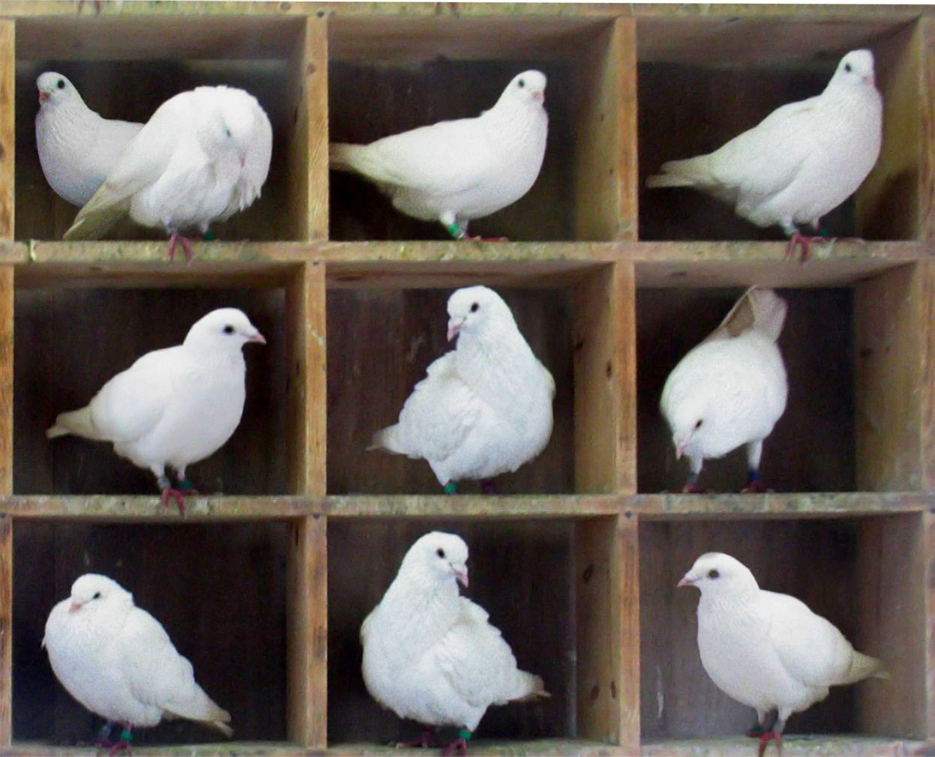
The Pigeon Hole Principle
Informally, if you have more pigeons than “holes” for the pigeons to rest, then at least one “hole” must have more than one pigeon in it.
Pigeons-in-holes.jpg by en:User:BenFrantzDale;
this image by en:User:McKay –
Transferred from en.wikipedia to Commons.;
Original text : Edited from Image:Pigeons-in-holes.jpg

Slide 19
The Pigeon Hole Principle
For finite sets A and B, |A| > |B| then no function f: A → B is injective.
i.e. some value of a ∈ A must share some b.

Slide 20
The Pigeon Hole Principle, Example
In an auditorium filled with 500 students, what are the odds that someone shares a birthday with someone else?
Consider A = the set of students in the auditorium,
B = the number of days in a year
(366, assuming a leap year is equally likely as any other day)
f: A → B = the birthday of each student.
|A| = 500 > 366 ≥ |B|
Therefore, there is a b ∈ B s.t. f(a) = b for multiple a’s
Turns out that the probability P = 0.5 ~ 23 people.

Slide 21
The Pigeon Hole Principle, Generalized
For finite sets A and B, if |A| > k*|B|, then for every
function f: A → B, there is a b ∈ B such that b = f(a)
for at least k + 1 distinct a ∈ A.

Slide 22
The Pigeon Hole Principle, Generalized Example
In that same cafetorium filled with 500 students, can we tell anything about the number of people born in a particular month
Consider A = the set of students in the auditorium,
B = the number of months in a year
f: A → B = the birth month of each student. (and, 12 * 40 = 480)
|A| = 500 > 4380 = 40 * |B|
Therefore, there is one month where 41 people were born.

Slide 23
To be continued…
fin

