Slide 1
CMPU-145: Foundations of Computer Science Spring, 2019
4: Induction and Recursion

Slide 2
Context
Induction: used to describe a method for (mathematical) proofs
Recursion: used to describe definition/constructions of sets and functions
Same, but different…

Slide 3
circulus in demonstrando
Latin for circular reasoning
as in the following from the movie, “Idocracy.”*
Pvt. Joe Bowers: What are these electrolytes? Do you even know?
Secretary of State: They're... what they use to make Brawndo!
Pvt. Joe Bowers: But why do they use them to make Brawndo?
Secretary of Defense: [raises hand after a pause] Because Brawndo's got electrolytes.
As it applies here, no proof should simply assume what it is trying to prove.
*example from: https://www.logicallyfallacious.com/tools/lp/Bo/LogicalFallacies/66/Circular-Reasoning

Slide 4
Step-wise logic
We can make use of results from previous steps in our:
Inductive proofs,
Recursive definitons
The value of a function for a given argument can be defined in terms of its value for previous arguments
A proof for a fact about an item may assume that we have already proven this fact for items that are simpler/more basic

Slide 5
Induction
Inductive proofs have existed since… forever, however….
The inductive method was first described by Augustus de Morgan
in 1838.
Proof by induction consists of reasoning from:
an assumption (or assumptions)
to: progressive results that we can expect to hold true

Slide 6
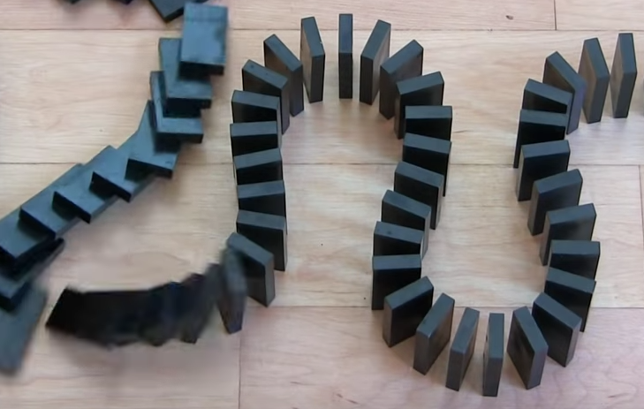
How should we approach mathematical induction?
The domino theory analogy:
Show that the dominos will all fall down
Start with the first domino <big push>
Ensure the rest of the dominos are setup
Examine a random domino in the sequence, the k^{th} domino.
If you can show the k^{th} domino falls, the (k+1)^{st} will also fall!

Slide 7
Induction Precepts
For an inductive proof to be valid, or, universally true, it must be complete.
What is known to apply for a particular case must be shown to apply for every particular case of that kind.
Before we can draft an inductive proof, we need:
a clear, stepwise ordering of the domain we’re working on,
a clearly specified starting point

Slide 8
Induction Precepts
For an inductive proof to be valid, or, universally true, it must be complete.
What is known to apply for a particular case must be shown to apply for every particular case of that kind.
Before we can draft an inductive proof, we need:
a clear, stepwise ordering of the domain we’re working on,
a clearly specified starting point

Slide 9
Induction Starting Points
Positive integers
Stepwise ordering: n → n + 1
Starting point: 1
All integers
Stepwise ordering: n → n + 1
Starting point: ?
Rational numbers
Stepwise ordering: ?
Starting point: ?
Induction may not be appropriate for all domains.

Slide 10
Induction Example
The setup: find a formula for the sum of the first n positive integers:
f(1) = 1 = 1
f(2) = 1 + 2 = 3
f(3) = 1 + 2 + 3 = 6
f(4) = 1 + 2 + 3 + 4 = 10
If we keep trying more examples, we find a pattern holds:
f(n) = n(n + 1)/2
How?

Slide 11
Induction Example
The guy who invented the photoshop filter Gaussian Blur :-) Carl Friedrich Gauss noticed the following:
Start at both ends of the sequence – group the pairs and add them.
1 + 2 + 3 + ... + (n − 2) + (n − 1) + n
Each pair of terms adds up to n + 1, and you’ll have n/2 pairs!

Slide 12
Induction Proof I
THEOREM. 0 + 1 + 2 + 3 + ⋯ + n = n(n + 1)/2, for all natural numbers n.
PROOF. By induction.
Let P(n) be the proposition: 0 + 1 + 2 + ⋯ + n = n(n + 1)/2.
Base case: P(0) is the proposition: 0 = 0(0 + 1)/2, which is true.
Recursive case: Let k be an arbitrary positive integer.
Assume that P(k) holds:
assume that: 0 + 1 + 2 + ⋯ + k = k(k + 1)/2.
This assumption that P(k) holds is called the inductive hypothesis.
Now, Prove that P(k + 1) holds:
prove that 0 + 1 + 2 + ⋯ + k + (k + 1) = (k + 1)(k + 2)/2.

Slide 13
Induction Proof II
Using k+1, our “induction goal” is to show that
0 + 1 + 2 + ⋯ + k + (k + 1) = (k + 1)(k + 2)/2
LHS = (0 + 1 + 2 + ⋯ + k) + (k + 1) arranging brackets
= k(k + 1)/2 + (k + 1) by inductive hypothesis
= (k(k + 1) + 2(k + 1))/2 by arithmetic
= (k2 + 3k + 2)/2 by arithmetic
= (k + 1)(k + 2)/2 by arithmetic
= RHS
QED

Slide 14
To be continued…
“Underneath every inductive proof lurks a recursive definition.”

