Slide 1
CMPU-145: Foundations of Computer Science Spring, 2019
4: Induction and Recursion continued

Slide 2
When proving f(n) = n(n+1)/2…
we left off with this…
“Underneath every inductive proof lurks a recursive definition.”

Slide 3
Here’s why:
We could use induction to prove this theorem:
because we can define the function in a recursive way:
f(n) = n(n+1)/2
Base case: f(1) = 1
Recursive step: for n>= 1, f(n+1) = f(n) + (n+1)
Recursive step: for n > 1, f(n) = f(n-1) + n
(equivalent statements)

Slide 4
How does one code this using DrRacket’s IDE?
(define sum-to-n
(lambda (n)
(if (= n 1)
1
(+ (sum-to-n (- n 1)) n
> (sum-to-n 7)
28

Slide 5
Using DrRacket’s Debugger I
First iteration

Slide 6
Using DrRacket’s Debugger II
Third iteration
n == 5 (7-5+1 = 3rd iteration)
Note the stack!
Notes:
We continue to recursively call sum-to-n which means we continue to push the stack

Slide 7
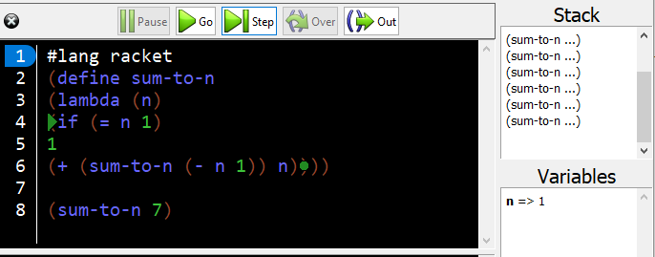
Using DrRacket’s Debugger III
Seventh iteration: up until now we kept pushing the stack. We are at the…
Bottom of the stack.
we’re about to get f(1) = 1

Slide 8
Using DrRacket’s Debugger IV
We pop the stack. And we continue to iteratively calculate f(n)
f(2) = f(1) +2 = 1 + 2 = 3

Slide 9
Using DrRacket’s Debugger is referred to as
Bottom-up, or, forward function evaluation.
With psuedo code, we use something like this loop: for (i = 1, I <= n, i++)
f(1) = 1
f(2) = f(1) + 2 = 1 + 2 = 3
f(3) = f(2) + 3 = 3 + 3 = 6
f(4) = f(3) + 4 = 6 + 4 = 10
f(5) = f(4) + 5 = 10 + 5 = 15
f(6) = f(5) + 6 = 15 + 6 = 21
f(7) = f(6) + 7 = 21 + 7 = 28 = final answer.

Slide 10
We can also perform:
Top-down, or, backward function evaluation.
We could write code to perform these iterations too:
f(7) = f(6) + 7
= (f(5) + 6) + 7
= ((f(4) + 5) + 6) + 7
= (((f(3) + 4) + 5) + 6) + 7
= ((((f(2) + 3) + 4) + 5) + 6) + 7
= (((((f(1) + 2) + 3) + 4) + 5) + 6) + 7
= (((((1 + 2) + 3) + 4) + 5) + 6) + 7
= ((((3 + 3) + 4) + 5) + 6) + 7
= (((6 + 4) + 5) + 6) + 7
= ((10 + 5) + 6) + 7
= (15 + 6) + 7
= 21 + 7
= 28 = final answer.

Slide 11
Top-down vs. Bottom-up: Which is the better choice?
Let’s refer to simple recursion algorithm cost as
Something like O(n) or O(n^{k}) algorithms.
And expensive recursion algorithm cost as
Something like O(c^{n})
It may be more efficient to perform calculations one way vs. another.
And it is more important as the algorithm costs more.

Slide 12
Cumulative Recursive Definitions
When defining f(n) using f(n-1) we “reach back” one iteration.
From n => n-1
Recursive definitions can “reach back” multiple steps too.
Let’s see one that does this.

Slide 13
The Fibonacci Sequence
The Fibonacci sequence is a famous problem first published*(!) in 1202 in the Liber abaci by Italian merchant and mathematician Leonardo di Pisa.
aka - Figlio dei Bonacci or “son of the Bonaccis”
Commonly described as pairs of rabbits and associated procreation.

Slide 14
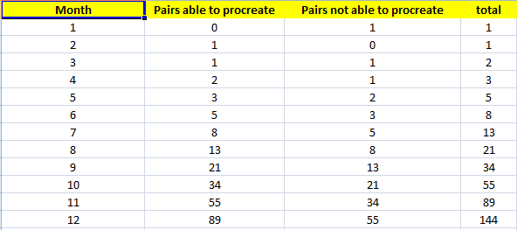
The Fibonacci Sequence
Commonly described using a pair of newly born rabbits, male and female, placed in a hutch.
In two months, these rabbits began their breeding cycle and produced one pair of rabbits, one male and one female.
The original rabbits and their offspring continued to breed in, the first pair of offspring appearing at the parental age of two months, and a new pair every month thereafter – always one male and one female.
Notes:
Question: What the total number of rabbit pairs at the beginning of each month during the first year?

Slide 15
The Cumulative recursive definition
Using the “Total” column (previous slide) the sequence shows that every successive term is the sum of the two preceding terms.
0+1=1 1+1=2 1+2=3 2+3=5 3+5=8 5+8=13 8+13=21
1 1 2 3 5 8 13 21 34 55 89 144
The Fibonacci number sequence (recursive) definition:
f(n) = n for n < 2
f(n) = f(n − 1) + f(n − 2) for n ≥ 2

Slide 16
Aside: About that Mathemagical Calculation* I
Reminder 1: We started our recursive definition this way:
f(0) = 0
f(1) = 1
Reminder 2: the “first” twelve numbers in the fib.sequenc:
0 1 1 2 3 5 8 13 21 34 55 89 144
Why should we be restricted to 0 and 1 as starting values?
Couldn’t we choose any two number and arrive at some conclusion about the number sequence?
*Inspired by youtuber singingbanana: https://www.youtube.com/channel/UCMpizQXRt817D0qpBQZ2TlA

Slide 17
Aside: About that Mathemagical Calculation II
Reminder 1: We started our recursive definition this way:
f(0) = 0
f(1) = 1
Reminder 2: the “first” twelve numbers in the fib.sequenc:
0 1 1 2 3 5 8 13 21 34 55 89 144
Why should we be restricted to 0 and 1 as starting values?
Couldn’t we choose any two number and arrive at some conclusion about the number sequence?
Spoiler alert: we could! And we could call it aribitrary fibonacci
(or… a-fib)

Slide 18
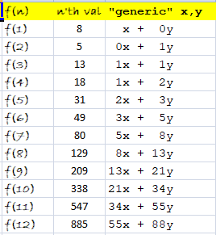
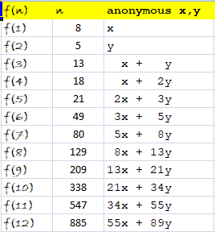
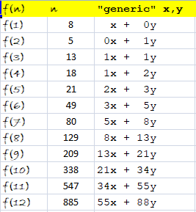
Aside: About that Mathemagical Calculation III
Let’s try an arbitrary/generic x and y: (I’ll choose 5 and 8)
f(0) = y, f(1) = x -> f(0) = 5, f(1) = 8
Then, the n’th value:

Slide 19
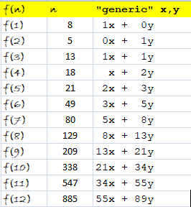
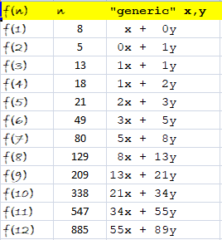
Aside: About that Mathemagical Calculation IV
Actually, let’s reset our “generic” f(n) for n = 0 and n = 1
And take a look at the constants C and D that are multiplying x and y respectively

Slide 20
Aside: About that Mathemagical Calculation V
Take a look at the constants C and D that are multiplying x and y respectively
CX + DY

Slide 21
Aside: About that Mathemagical Calculation VI
Hmm…
CX + DY
C and D, poorly
circled in red, look like…

Slide 22
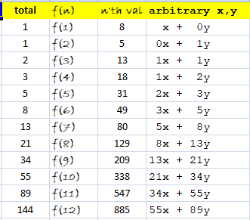
Aside: About that Mathemagical Calculation VII
Hmm…
CX + DY
C and D, poorly
circled in red, look like…
THE FIBONACCI SEQUENCE !!1!
Check the rabbit chart again.

Slide 23
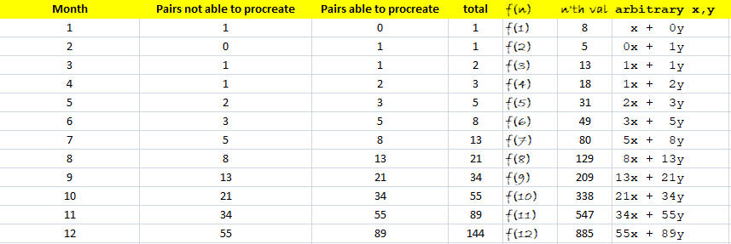
The Fibonacci Sequence
The “Pairs” columns were switched to match the coefficients for x and y in the last column, “arbitrary x,y”
Note that the “arbitrary x,y” column, used to calculate the n’th val column is not a recursive definition. Only the coefficients are calculated recursively.

Slide 24
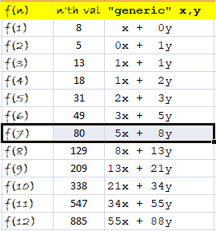
One Last Mathemagical Thought
How is it so easy to get the sum of the first 10 of our “a-fib* numbers?”
If we add the first 10 x’s and y’s in the “generic” column, we can get to add all of the numbers!
55x + 88y = 11*(5x + 8y)
And, (5x + 8y) is
the seventh item.
f(7) = 80.
Sum = 11*80 = 880.

Slide 25
Wait.What ??!?1?
How is it so easy to get the sum of the first 10 “a-fib numbers?”
It looks like the sum is
f(12) – f(2) !
Or, 885
– 5
= 880

Slide 26
Wait.What ??!?1?
How is it so easy to get the sum of the first 10 “a-fib numbers?”
It looks like the sum is
f(12) – f(2)
Or, 885
– 5
= 880
Yes. It is true.
Sum of first n “a-fib
numbers” is f_{s}(n) and
f_{s}(n) = f(n+2) - f(2)

Slide 27
Back to our regularly scheduled program: fib
Defining the recursive fibonacci algorithm in racket:
(define fib
(lambda (n)
(if (<= n 1) ;; one could enter (fib -5) !
n
(+ (fib (- n 1))
(fib (- n 2))
))))

Slide 28
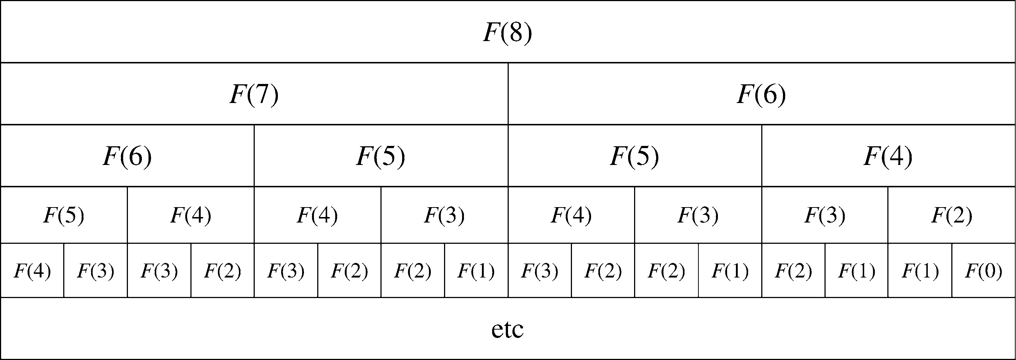
Is this fibonacci algorithm efficient?
tldr; No.
The answer from Makinson: No. Because calculations.
More precisely, redundant calculations...
Table 4.1 from Makinson.

Slide 29
Recursive Algorithm Efficiency
There are cases where bottom-up/forward evaluation is less efficient, e.g.,
Base case: f(0) = 2
Recursion step:
f(n) = f(n − 1)n for odd n > 0, and
f(n) = f(n/2) for even n > 0
We can quickly calculate f(8) top-down:
f(8) = f(4) = f(2) = f(1) = f(0)1 = 21 = 2
If we calculate f(8) bottom-up, we would recalculate all of the odd values.
We shouldn’t have to do that.
More in tonight’s lab.

