Slide 1
CMPU-145: Foundations of Computer Science Spring, 2019
6: More Probability. But you probably knew that already.

Slide 2
From Last Week (mostly)
The Basics. . .
The sample space S is a set of outcomes (eg 3x coin flip)
An event is a one subset of S (eg cont: HHT)
Uniform distribution is when each outcome is equally likely
Not always the case! (consider rolling a pair of dice)
Probability space = sample space S + probability function p
If probability function is uniform, probability of event E, p(E) =|E|/|S|
Probability of all events (subsets) in S is 1, i.e. p(S) = 1
Addition principle:
Disjoint sets: |A∪B| = |A| + |B|
Generally: |A∪B| = |A| + |B| − |A∩B|
Two events, A and B are independent iff p(A ∩ B) = p(A) · p(B)

Slide 3
One more example*… I
Our class has 27 students with 6 students (usually) sitting in the “first row”. If I select all randomly…
What are the odds that all the students in the front row being selected before everyone else?
Sample space: ...?
Distribution: … ?

Slide 4
One more example… II
Our class has 27 students with 6 students (usually) sitting in the “first row”. If I select all students randomly…
What are the odds that all the students in the front row being selected before everyone else?
Sample space: the set of all permutations when selecting all students = P(27,27) = 27!
Distribution: Uniform
Cases for front row students selected first: P(6,6) * P(21,21)
Prob. = P(6,6) * P(21,21) / P(27,27) = 6! * 21! / 27! ~ 3.4%

Slide 5
A Prize Drawing Example From Last Time…
N contestants enter a prize drawing. N = 27
Three distinct winners are picked at random and in order(first,second,third)
Sample space: ...?
Distribution: … ?

Slide 6
A Prize Drawing Example II
N contestants enter a prize drawing. N = 27
Three distinct winners are picked at random and in order(first,second,third)
Sample space: The set of permutations of 3 winners from 27.
P(27,3) = 27!/(27-3)! = 27!/24! = 27*26*25
Distribution: Uniform
Probability of picking the 3 distinct winners: P(3dw) = 1/17550.

Slide 7
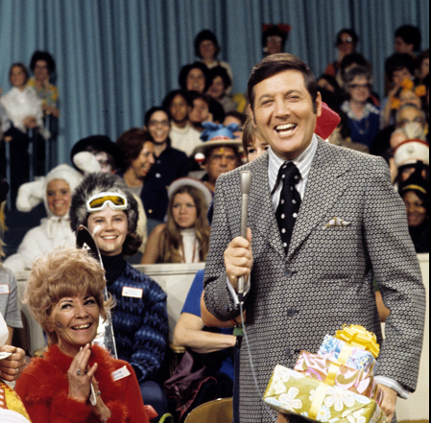
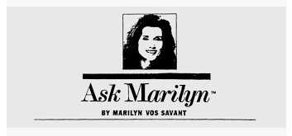
And Now… The Monty Hall Problem.
The Principles.
Monty Hall: co-creator and host of the game show, “Let’s Make A Deal”
Marilyn Vos Savant: author of a weekly “puzzle” published in Parade Magazine.
Marilyn vs Savant, from https://priceonomics.com/the-time-everyone-corrected-the-worlds-smartest/
Monty Hall, in a 1969 photo, hosts Let's Make A Deal.
ABC Photo Archives/ABC via Getty Images

Slide 8
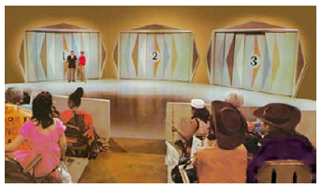
And Now… The Monty Hall Problem.
The Game.
There are 3 Doors…
From: letsmakeadeal.com

Slide 9
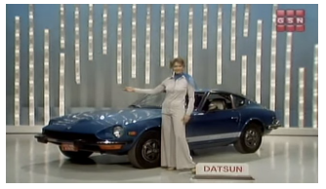
And Now… The Monty Hall Problem.
The Grand Prize.
One awesome prize behind one of the doors… (a car)
From: letsmakeadeal.com

Slide 10
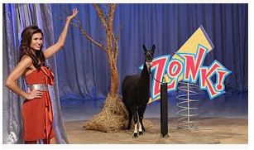
And Now… The Monty Hall Problem.
Behind the other two doors…
Bupkes! (errr… Zonk! not the grand prize)
From: letsmakeadeal.com . The problem traditionally refers to a goat behind 2 doors. Note: Not actually a goat!

Slide 11
The Monty Hall Problem I
Your task: Select one door to win the awesome prize!
However, after selecting a door, Monty Hall opens one of the other two doors to reveal a goat. (Everyone calls it a goat.)
Then, you are asked, “Do you want to switch your choice to the other (unopened) door?
What should you do?

Slide 12
The Monty Hall Problem II
Your task: Select one door to win the awesome prize!
Let’s try some live simulations. We’ll choose 3 people at random.

Slide 13
The Monty Hall Problem III
Behind The Doors.
Probability of picking the grand prize car: p(C) = 1/3
Probability of picking the goat: p(G) = 2/3
Two scenarios:
You picked the grand prize door: Monty can choose either unopened door to reveal a goat.
You picked a goat: Monty has only one unopened door to reveal a goat.
Monty’s choice give you information about the door you didn’t pick.

Slide 14
The Monty Hall Problem IV
One way of looking at this:
odds you picked the winning door: p(C) = 1/3
Odds the winning door is one you didn’t pick p(!C) = 2/3
Odds are you didn’t pick the winning door ☹

Slide 15
The Monty Hall Problem V
One way of looking at this:
odds you picked the winning door: p(C) = 1/3
Odds the winning door is one you didn’t pick p(!C) = 2/3
Odds are you didn’t pick the winning door ☹
The odds are still 2/3 but one door is eliminated, so switching improves your odds to p(C) = 2/3

Slide 16
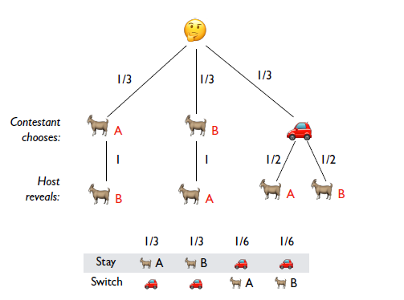
Another view of the strategy
Never switch: p(C) = 1/3 p(G) = 2/3
Always switch: p(C) = 2/3 p(G) = 1/3
Switching improves your odds.

Slide 17
For The Lab
We will build on our gen-and-test methodology and try out some
Basic poker hands
at least 4-of-a-kind.
we’ll need to simplify our card deck too.
Let’s look at some sample code.

