Slide 1
CMPU-145: Foundations of Computer Science Spring, 2019
6: 6.4, 6.6, 6.7 Conditional Prob. Independence, & Bayes

Slide 2
Is {nothing/something/everything} related?
Sometimes, it helps to know some information regarding the probability of an event
Such as with the Monty Hall problem
Some events may also be affected by time and/or causality.
If you flip a coin two times, and you know the first flip: heads
Does it matter when assessing the probability of the second coin flip?
If a marathon runner stubs a toe before a race…
Does it matter when assessing how the time-to-finish the race
Does it matter if the injury occurred a week before the race or immediately before the start?

Slide 3
Conditional Probability I
Let’s ask what the probability of some event is, given that some other event occurred?
Example: You roll a pair of fair dice. What is the probability that at least one of the dice is showing a 3, given that their sum is 5?
The sample space of all rolls of two dice:
S = {(i, j) | i, j e ∈ {1, 2, 3, 4, 5, 6}}
Q: is this the correct sample space here?

Slide 4
Conditional Probability II
Let’s ask what the probability of some event is, given that some other event occurred?
Example: You roll a pair of fair dice. What is the probability that at least one of the dice is showing a 3, given that their sum is 5?
The sample space of all rolls of two dice:
S = {(i, j) | i, j ∈ {1, 2, 3, 4, 5, 6}}
A: We want the subset of S, i.e. the set of all rolls that sum to 5:
S = {(i, j) | i + j = 5 ∈ {1, 2, 3, 4, 5, 6}}
Then, from that sample space, could consider the event that at least one of the dice shows a 3

Slide 5
Conditional Probability III
Notation: We can write that probability as p(A | B). Terminology:
Let S be our sample space: all rolls of two dice
Let A be the event that at least one of the dice shows a 3
Let B be the event that the sum of the dice is 5
Consider the conditional probability of A given B
Calculation: p(A | B) = p(A ∩ B) / p(B)
p(B) = 4/36 (4 different ways to roll 5)
(1,4) (4,1) (2,3) (3,2)
p(A ∩ B) = 2/36 (2 different ways to roll 5 when one die is 3)
(2,3) (3,2)
p(A | B) = (2/36) / (4/36) = 2/4 = 0.5

Slide 6
Conditional Probability IV
Q: Is conditional probability commutative?
i.e. is p(A | B) == p(B | A) ?
A: Intuitively, the answer should be: No.
Let’s try p(A |B) = probability of the sum of dice roll is 5,
given one die roll = 3
p(A ∩ B) = 2/36 still…
(2,3) (3,2)
P(B) = (1/6): there’s one 3 on a die. [= 6/36]
p(A | B) = (2/36) / (6/36) = 1/3 = 0.34

Slide 7
Conditional Probability – Another Example (6.4.2)
In a writer’s group...
60% of the members write novels
30% of the members write poetry
10% of the members write both novels and poetry
15% of the members write songs
100% of the songwriters write poetry
80% of the songwriters write love poetry
0% of the novelists write love poetry
What is the probability that a random poet also writes songs?
What is the probability that a songwriter also writes novels?

Slide 8
Conditional Probability – Another Example (part 1)
In a writer’s group...
60% of the members write novels
30% of the members write poetry
10% of the members write both novels and poetry
15% of the members write songs
100% of the songwriters write poetry
80% of the songwriters write love poetry
0% of the novelists write love poetry
What is the probability that a random poet also writes songs?
p(B) = 0.3 (30%)
p(A ∩ B) = 0.1 (10%)
p(A | B) = (0.1/0.3) = 1/3 = 0.34

Slide 9
Conditional Probability – Another Example (part 2)
In a writer’s group...
60% of the members write novels
30% of the members write poetry
10% of the members write both novels and poetry
15% of the members write songs
100% of the songwriters write poetry
80% of the songwriters write love poetry
0% of the novelists write love poetry
What is the probability that a songwriter also writes novels?
p(B) = 0.6 (60%)
p(A ∩ B) = ???
p(A | B) = ???
Notes:
Hmm, what can we state here?

Slide 10
Conditional Probability – Another Example (part 2)
In a writer’s group...
60% of the members write novels
30% of the members write poetry
10% of the members write both novels and poetry
15% of the members write songs
100% of the songwriters write poetry
80% of the songwriters write love poetry
0% of the novelists write love poetry
What is the probability that a songwriter also writes novels?
The example leads us to a way to predict an upper bounds case.
15% songwriters, 80% write love poetry . . .
At least 12% songwriters don’t write novels
Since 15% are songwriters, (15%-12% = 3%) at most also write novels
p(A | B) <= 0.03/0.15 or 0.2
Notes:
Hmm, what can we state here?

Slide 11
Conditional Probability – One Last Thought
Does driving a red car lead to a shorter lifespan ? Maybe…
Does eating yogurt lead to a longer lifespan ? Maybe…
If time and/or a correlation is involved,
it does not mean that causation is involved!
This is a logical fallacy: there may not be any cause and effect relationship.
In Latin: Post hoc ergo propter hoc. “after this, therefore because of this”
Notes:
(Since the king died after a solar eclipse, the solar eclipse caused the king’s death!) or if the streets are wet, then it rained!

Slide 12
Independent Events (6.6)
The notion of events being independent arises frequently in
Probability
i.e., when a fair coin is flipped, its landing Heads or Tails is taken to be independent of the outcomes of any other flips of that coin
Independence can be defined in terms of probabilities:
If p is a prob. function on a (finite) sample space S, with events A, B.
Then, A is independent of B iff p(A) = p(A | B)
Or p(B) = 0.

Slide 13
Independent Events: second definition
If p is a prob. function on a (finite) sample space S, with events A, B.
Then, A is independent of B iff p(A ∩ B) = p(A) * p(B)
It is equivalent to … iff p(A) = p(A | B) Or p(B) = 0.
Also equivalent statements:
A and B are independent iff ...
A and !B are independent iff...
!A and B are independent iff...
!A and !B are independent

Slide 14
An Example
Woot.com RC sells refurbished computers. 5% of the computers they sell are defective (real web site, fake stat!)
A customer just bought 3 computers from them.
Assume:
the 3 computers are a random sample, and
Each computer’s performance, including any defects, is independent of each other,
What is the probability . . .
that all 3 computers are defective?
that none of the computers are defective?
that at least one of the computers is defective?

Slide 15
An Example
Woot.com RC sells refurbished computers. 5% of the computers they sell are defective (real web site, fake stat!)
A customer just bought 3 computers from them.
Assume:
the 3 computers are a random sample, and
Each computer’s performance, including any defects, is independent of each other,
What is the probability of 3 independent events s.t.
all 3 computers are defective?
= p(A)*p(B)*p(C) = .05*.05*.05 = .000125
none of the computers are defective?
= p(A)*p(B)*p(C) = .95*.95*.95 = 0.857
at least one of the computers is defective? i.e. 1 or 2 or 3 are defective
= p(1d) + p(2d) + p(3d) = .05 + .05*.05*.95 + .000125

Slide 16
Bayes’ Theorem
We know, generally, these are not equivalent
p(A | B), the probability of event A given B
p(B | A), the probability of event B given A
However, a Presbyterian minister, Thomas Bayes is credited with the theorem that describes a relationship between these two probabilities.
Bayesian probability: epistemic confidence in an outcome.
Def: epistemic: relating to knowledge or to the degree of knowing
Important in AI work: computer hardware advancements (e.g. branch prediction & caching), investing, fortune telling
e.g., IBM Watson, google targeted ads, netflix recommendations
Notes:
If you watch a netflix show, say the genre is Korean Drama, and you rate it +, netflix is confident in showing you more Korean Drama offerings. I may have embelished on that last item…

Slide 17
Bayes’ Theorem: Statement
Assume p(A), p(B) are non-zero, then
p(A | B) = p(B | A) * p(A) / p(B)
Restated: if we know the prior probabilities of p(A), p(B)we can calculate
p(A | B) from p(B | A)
p(B | A) from p(A | B)

Slide 18
Bayes’ Theorem: Special Case
A special case of Bayes’ Theorem relates conditional probabilities to both the probability that an event occurs and the probability that it doesn’t occur!
Assume p(A), p(!A), p(B) are all non-zero
i.e. we need for p(B | A), p(B | !A), p(A | B) all to be defined), then:
p(A | B) = p(B | A) * p(A)
__________________________________
p(B | A) * p(A) + p(B | !A) * p(!A)
We can compute conditional probability p(A | B) if we know all the following:
p(A), existing probability of A
p(B | A), conditional probability of B given A
p(B | !A), conditional probability of B given !A

Slide 19
Bayes’ Theorem: Which one?
Given: a problem that requires you to conjure up an answer using Bayes’ theorem.
Which form of Bayes’ theorem should you use?
They are equivalent!
p(A | B) = p(B | A) * p(A) / p(B)
or
p(A | B) = p(B | A) * p(A)
__________________________________
p(B | A) * p(A) + p(B | !A) * p(!A)

Slide 20
Bayes’ Theorem: Which one?
Given: a problem that requires you to conjure up an answer using Bayes’ theorem.
Which form of Bayes’ theorem should you use?
Short Answer: which ever form is easier to use.
Normally, you will be given p(B|!A) but not p(B) forcing use of the special case form.
p(A | B) = p(B | A) * p(A) / p(B)
or
p(A | B) = p(B | A) * p(A)
__________________________________
p(B | A) * p(A) + p(B | !A) * p(!A)

Slide 21
Bayes’ Theorem: In Action I
Given: two boxes. The first contains 2 green balls and 7 red balls; the second contains 4 green balls and 3 red balls.
First, select a random box. Then, select a random ball from that box.
If you select a red ball, what is the probability that you selected from the first box?

Slide 22
Bayes’ Theorem: In Action II
Given: two boxes. The first contains 2 green balls and 7 red balls; the second contains 4 green balls and 3 red balls.
First, select a random box. Then, select a random ball from that box.
What is the probability that you selected from the first box,
Given that you selected a red ball?
Let A be the event of choosing from the first box, so !A is the event of choosing from the second box.
Let event B be the event of choosing a red ball, so !B is the event of choosing a green ball.
We’re looking for p(A | B).
But do we also need to identify
p(B | A)? p(A)? p(B | !A)? p(B)? p(!A)? ???!?!?

Slide 23
Bayes’ Theorem: In Action II identifying probabilities
Given: two boxes. The first contains 2 green balls and 7 red balls; the second contains 4 green balls and 3 red balls.
First, select a random box. Then, select a random ball from that box.
If you select a red ball, what is the probability that you selected from the first box?
Events. . .
A = choosing the first box, so !A = choosing the 2nd box.
B = choosing a red ball, so !B = choosing a green ball.
p(A) = ?
p(B) = ?
p(B | A) = ?
p(A | !B) = ?
p(!A) = ?
p(!B) = ?

Slide 24
Bayes’ Theorem: In Action II filling in the values
Given: two boxes. The first contains 2 green balls and 7 red balls; the second contains 4 green balls and 3 red balls.
First, select a random box. Then, select a random ball from that box.
If you select a red ball, what is the probability that you selected from the first box?
Events. . .
A = choosing the first box, so !A = choosing the 2nd box.
B = choosing a red ball, so !B = choosing a green ball.
p(A) = 0.5
p(B) = 0.5 * 7/9 + 0.5 * 3/7
p(B | A) = 7/9 (pr of choosing red ball, given box 1) & p(B|!A) = 3/7
p(A | !B) = ? (just as hard a problem as p( A| B) ☺)
p(!A) = 0.5
p(!B) = 6/16
This is the key to understanding both formulas!

Slide 25
Bayes’ Theorem: In Action III filling in the formula
Given: two boxes. The first contains 2 green balls and 7 red balls; the second contains 4 green balls and 3 red balls.
First, select a random box. Then, select a random ball from that box.
If you select a red ball, what is the probability that you selected from the first box?
Events. . .
A = choosing the first box, so !A = choosing the 2nd box.
B = choosing a red ball, so !B = choosing a green ball.
p(A) = 0.5
p(B) = p(B) = 0.5 * 7/9 + 0.5 * 3/7
p(B | A) = 7/9 (pr of choosing red ball, given box 1) & p(B|!A) = 3/7
p(A | !B) = ? (just as hard a problem as p( A| B) ☺)
p(!A) = 0.5
p(!B) = 6/16
p(A | B) = p(B | A) * p(A) / p(B) = 7/9 * ½ / (7/18 + 3/14)=(7/18)/(98+54)/252 = 7/18 / 152/252 = 7/18 * 252/152 ~.64

Slide 26
Bayes’ Theorem: In Action III filling in the special case formula
Given: two boxes. The first contains 2 green balls and 7 red balls; the second contains 4 green balls and 3 red balls.
First, select a random box. Then, select a random ball from that box.
If you select a red ball, what is the probability that you selected from the first box?
Events. . .
A = choosing the first box, so !A = choosing the 2nd box.
B = choosing a red ball, so !B = choosing a green ball.
p(A) = 0.5
p(B) = 10/16 (16 total, 6 green, 10 red)
p(B | A) = 7/9 (pr of choosing red ball, given box 1) & p(B|!A) = 3/7
p(A | !B) = ? (just as hard a problem as p( A| B) ☺)
p(!A) = 0.5
p(!B) = 6/16
p(A|B)=p(B|A)*p(A) / p(B|A)*p(A)+p(B|!A)*p(!A)= 7/9*1/2 / 7/9*1/2 + 3/7*1/2
= 7/18 / 7/18 + 3/14 = 7/18 / (98 + 54)/252 = 7/18 * 252/152 = exhausting! ~.64

Slide 27
Bayes’ Theorem: More examples?
Several example in text books and on the ‘net use ugly medical-related examples.
Let’s look at another game show instead…
Jeopardy!

Slide 28
This. . . is Jeopardy!
For more, see : http://www.research.ibm.com/artificial-intelligence/

Slide 29
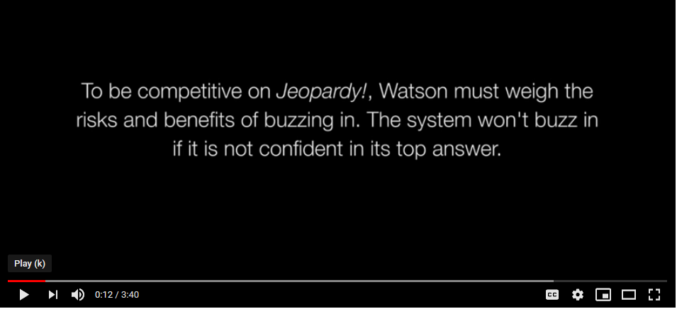
This. . . is Jeopardy!
For more, see : https://www.youtube.com/watch?v=7kOEmupSHB8

Slide 30
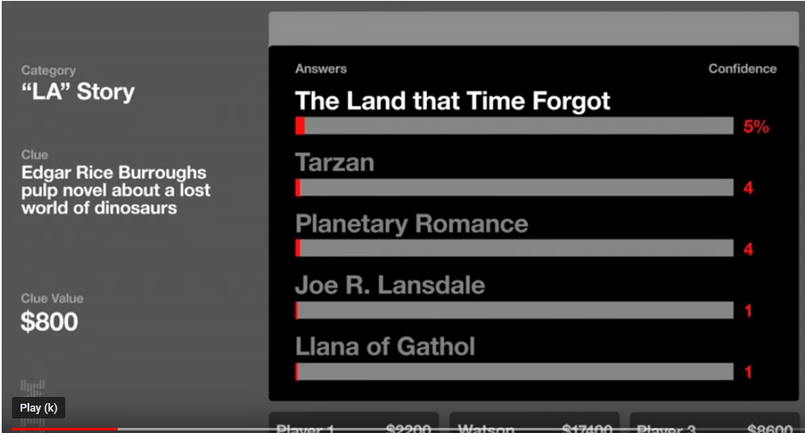
This. . . is Jeopardy!
For more, see : http://www.research.ibm.com/artificial-intelligence/

Slide 31
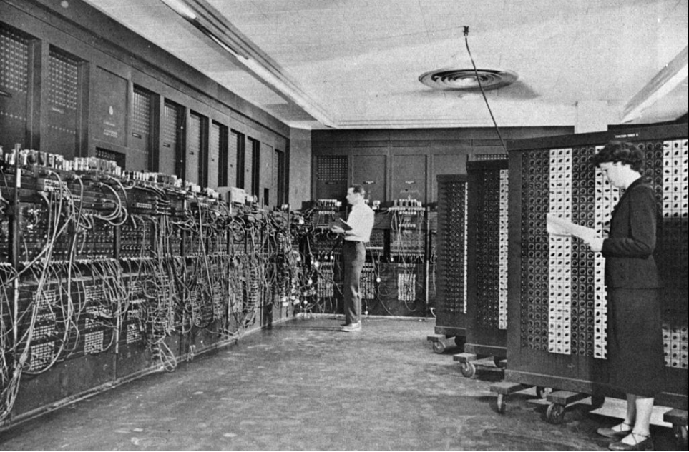
This. . . is Jeopardy!
Inside Watson… for more see: https://www.youtube.com/watch?v=P18EdAKuC1U

